Slide 1

Data Analysis Techniques in experimental physics
Tecniche di analisi dati in fisica sperimentale
Luciano RAMELLO – Dipartimento di Scienze e Innovazione Tecnologica

Slide 2
Course Program
Reminder of basic probability theory*
Monte Carlo methods (basic)*
Statistical methods for:
  Parameter estimation (confidence intervals)**
  Hypothesis testing (general, goodness-of-fit)***
Numerical exercises will be proposed throughout the course,
plus a special exercise provided by prof. A. Spagna
* this presentation; ** see Part II; *** see Part III
SEE ALSO: Hands-on Fitting and Statistical Tools for Data Analysis (M. Pelliccioni)
and Bayesan Statistics (S. Andreon)

Slide 3
Course materials
http://www.to.infn.it/~ramello/statis/teanda.htm
  Course slides
  Scripts to access the CERN subroutine library “CERNLIB” from FORTRAN, C
  FORTRAN code for MonteCarlo generation and MINUIT fits
  Exercises worked out in FORTRAN, C, C++
  Simple use of statistical functions in Mathematica 7
a very useful reference: http://www.nu.to.infn.it/Statistics/
by Carlo Giunti and Marco Laveder

Slide 4
Course bibliography
Probability theory & statistics:
  M. Loreti, Teoria degli Errori e Fondamenti di Statistica, 6ª ed., 2006 [GNU GPL, http://wwwcdf.pd.infn.it/labo/INDEX.html]
  F. James, Statistical Methods in Experimental Physics (2nd ed.) – World Scientific, 2006 (ISBN-13 978-981-270-527-3)
  G. Cowan, Statistical data analysis – Oxford University Press, 1998 (ISBN 0-19-850155-2) [www.pp.rhul.ac.uk/~cowan]
  Particle Data Group: Review of particle physics: reviews, tables, and plots - Mathematical tools [http://pdg.web.cern.ch/pdg/pdg.html]
Monte Carlo methods:
  F. James, MonteCarlo Theory and Practice, Rep. Prog. Phys. 43 (1980) 1145-1189
Bayesian statistics:
  G. D’Agostini, Bayesian reasoning in high-energy physics: principles and applications, CERN 99-03, 19 July 1999
Algorithms:
  W.H. Press et al., Numerical Recipes in FORTRAN / C, 2nd ed., Cambridge Univ. Press 1992 (ISBN 0-521-43108-5) [http://www.nr.com]

Slide 5
List of chapters from Cowan
“Statistical Data Analysis" by Glen COWAN (Clarendon Press, Oxford, 1998)
  chapter 1 (fundamental concepts): whole chapter
  chapter 2 (examples of probability functions): 2.1-2.5, 2.7
  chapter 3 (the Monte Carlo method): whole chapter
  chapter 4 (statistical tests): whole chapter except 4.4.1, 4.4.2, 4.4.3
  chapter 5 (general concepts of parameter estimation): whole chapter
  chapter 6 (the method of Max. Likelihood): whole chapter except 6.9
  chapter 7 (the method of least squares): 7.1-7.5
  chapter 9 (statistical errors, confidence intervals and limits): whole chapter

Slide 6
Introduction
E. Rutherford once said “If your experiment needs statistics, then you ought to do a better experiment” … but nowadays all experiments need statistics both in the design phase and, more important, in the data analysis phase
Statistics is, in some sense, the inverse of probability:
probability
Probabilistic laws (QM)
Probabilistic response of
experimental apparatus
Physical
Law
Observations
statistics

Slide 7
Poisson statistics example
Consider a situation where the number of events n follows a Poisson
distribution (without background) with unknown mean μ:
…
The probability to observe n = 3 events in a given time interval depends on the unknown parameter μ:
μ=1.0 → P(3)=0.0613
μ=2.0 → P(3)=0.1804
μ=3.0 → P(3)=0.2240
μ=4.0 → P(3)=0.1954
...... ..............
After having observed n=3 events what can we say about μ ?
Answer:
we can define a confidence interval.
More on this later ...

Slide 8
Another example
When tossing a “fair” coin, the probability to obtain H (heads) is P(H)=0.5; if the coin is unfair, for example it has two heads, then P(H) is obviously 1. We can imagine intermediate cases when, due to the tosser’s ability or a peculiar distribution of weights, one has P(H)≠P(T).
Let’s suppose that a coin is tossed 10 times. If we observe the sequence:
HHTHTHTTTH
What can we say about the coin ?
And what if we observe : TTTTTTTTTT ?
When tossing fair coins, both sequences listed above have the same probability of being observed (2⁻¹⁰), like any other sequence. We cannot draw a firm conclusion on the coin’s fairness after having observed just one (or a few) sequences. Statistical inference has always some degree of uncertainty.

Slide 9
Basic Probability Theory
A reminder

Slide 10

Probability (1)
Let’s start from Kolmogorov’s axioms (1933):
Let S be a set (S ↔ sample space) with subsets A,B,... (A ↔ event).
Probability is a real function P() satisfying the following axioms:
From these axioms many properties of probability can be derived,
such as ...

Slide 11
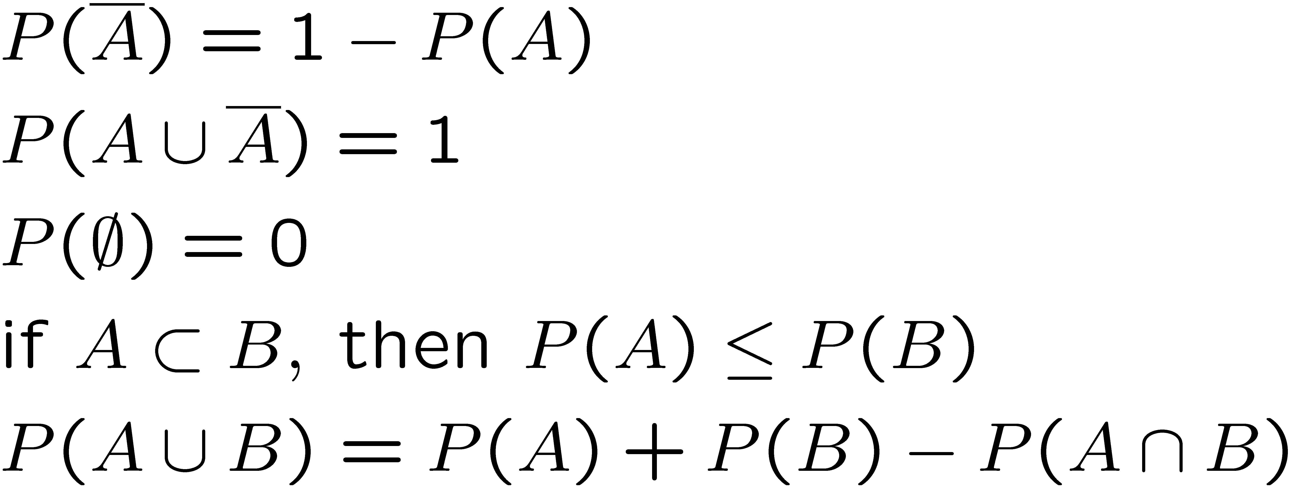
Probability (2)
Properties of the probability function ( “¯” denotes the complementary
subset, A=S-A):
¯
Let’s also define the conditional probability P(A|B), i.e. the
probability of observing A, knowing that B has been observed
(for example: the probability of obtaining 3 and 5 with two dice,
knowing that the sum is 8)

Slide 12
Probability (3)
S is the sample space, having unit probability, i.e. that of the union between an event B and its complement
This is the probability that
A and B occur simultaneously,
normalized to the whole sample space
To define conditional
probability, the
normalization in this
case is made
with respect to
event B
P(A) and P(B) must be ≠0

Slide 13
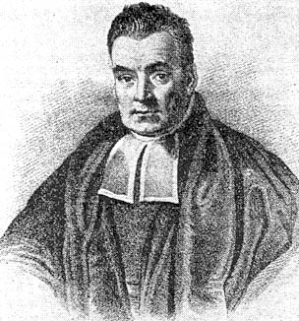
Bayes’ theorem
From previous definition:
Rev. Thomas Bayes (1702-1761), An essay towards solving a problem in the doctrine of chances, Philos. Trans. R. Soc. 53 (1763) 370; reprinted in Biometrika, 45 (1958) 293.
Events are independent when:
&

Slide 14
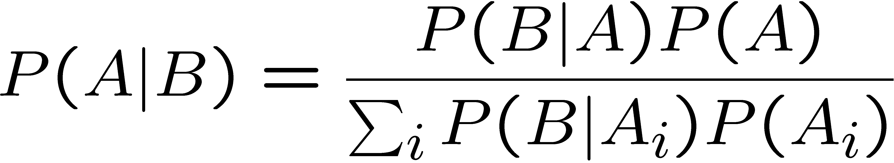
The law of total probability
disjoint subsets
If
The probability of B can be expressed as:
Then:
Law of total probability
Interpretation:
A: hypothesis to be evaluated
A_{i}: set of disjoint events
B: observed event
P(A|B): revised probability assigned to A
and Bayes’ theorem can be written as:

Slide 15
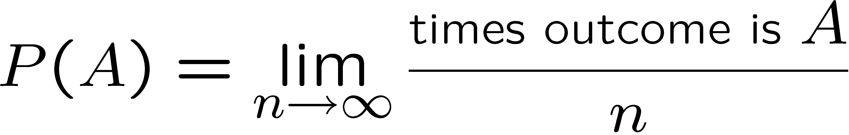
Interpretations of probability (1)
Frequentist (a.k.a. classic) probability:
A, B, … are possible outcomes of a repeatable experiment; the probability of A is the limit of the relative frequency as the number of repetitions goes to infinity:
Advantages of the frequentist interpretation:
it satisfies Kolmogorov’s axioms;
  it is appropriate whenever experiments are repeatable
  (quantum mechanics, radioactive decays, particle scattering).
Note that the convergence is not defined in the usual sense of calculus but in a weaker (stochastic) sense:
M, N are integer numbers; ε, δ are real numbers

Slide 16
An example: rolling two dice
When rolling 2 dice, what is the probability of obtaining a particular sum ? Green: expected frequency (a priori calculation), Red: frequency after N rolls (ROOT MonteCarlo simulation)

Slide 17
Comment on statistical inference
When small samples are involved statistical inference
can be problematic …
Values for a particular run
entries | Mean | RMS
50 | 7.46 | 2.594
1k | 7.058 | 2.416
100k | 7.006 | 2.413
∞ | 7.000 | 2.4152
Notes:
Variance of the prob. distr.: sigma^2 = (1/11)*Sum[Prob(i)*(xi-xaverage)^2] for i=1 to 11, xi=2 to 12, which gives 105/18, hence sigma = 2.4152

Slide 18
Interpretations of probability (2)
Subjective probability:
A, B, … are hypotheses, i.e. statements that could be either true or false;
the probability of A [P(A)] is the degree of belief that A
is true.
Advantages of the subjective interpretation:
it satisfies Kolmogorov’s axioms;
  it is appropriate in several circumstances where the frequentist definition may have problems:
  probability that a particle produced in a given collision
  is a K⁺ (rather than a pion or a proton or …)
  probability that it will rain in Torino in two days from now
  probability that it was raining in Rome on October 24,
  327 A.D.
  probability that it was raining in Madrid on October 14,
  1582 A.D.
  probability that Nature is supersymmetric

Slide 19
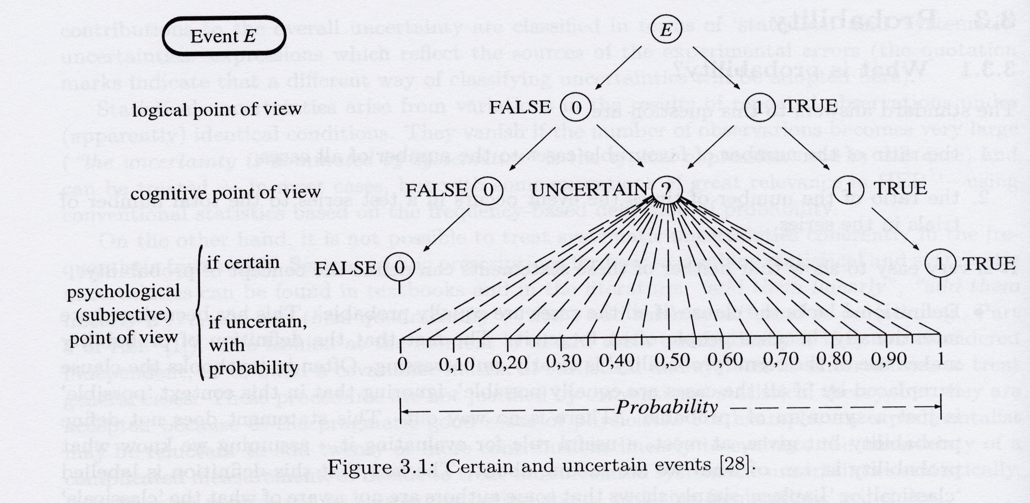
Interpretations of probability (3)
  G. D’Agostini, Bayesian reasoning in high-energy physics:
  principles and applications, CERN 99-03, 19 July 1999

Slide 20
Interpretations of probability (4)
The subjective probability definition is used by bayesian statisticians. Bayes’ law can be stated as:
Where:
  P(data | theory) is the probability of observing the measured data under the hypothesis that a given theory is valid (likelihood)
  P(theory) is the a-priori probability (prior) that theory is valid, reflecting the status of knowledge before the measurement. It is a subjective judgement made by the experimenter, which is carefully formed on the basis of all available information.
  P(theory | data) is the a posteriori probability that the given theory is valid, after having seen the new data
P(theory | data) ∝ P(data | theory) × P(theory)

Slide 21
Interpretations of probability (5)
Subsets in sample space may now be seen as hypotheses, i.e. statements which can be either true or false
The statement: “the W boson’s mass is between 80.3 and 80.5 GeV/c²” in the classical (frequentist) approach is either always true or always false: its probability is 0 or 1.
In the subjective (bayesian) approach instead it is possible to make the following statement:
P(80.3≤M_{W} ≤80.5 GeV/c²)=0.68
The sensitivity of the result (posterior probability) to the choice of the
prior is often criticized by frequentists… note that recently objective
bayesian analysis has emerged, and a combination of frequentist and
bayesian analyses is more and more common.

Slide 22
An example of Bayesian probability (1)
Let’s suppose that for a person randomly chosen from the population the a priori probability to have AIDS is (example from G. Cowan, values are fictitious):
P(AIDS)=0.001 and consequently P(NO AIDS)=0.999
Possible outcomes of the AIDS test are + or -:
P(+|AIDS)=0.98 (correct identification) P(-|AIDS)=0.02 (false negative)
P(+|NO AIDS)=0.03 (false positive) P(-|NO AIDS)=0.97 (correct identification)
If someone’ test result is +, how much need he/she worry?

Slide 23
An example of Bayesian probability (2)
The a posteriori probability is 0.032 (>> 0.001, but also <<1).
The person’s viewpoint: my degree of belief that I have AIDS is 3.2%
The doctor’s viewpoint: 3.2% of people like this will have AIDS
Moral ... a test which is 98% accurate and gives 3% of false positives must be used with caution: for mass screening one must use very high reliability tests (low false positive and false negative probabilities). If this is not the case, the test should be given only to people which have a different (higher) a priori probability with respect to the general population.

Slide 24
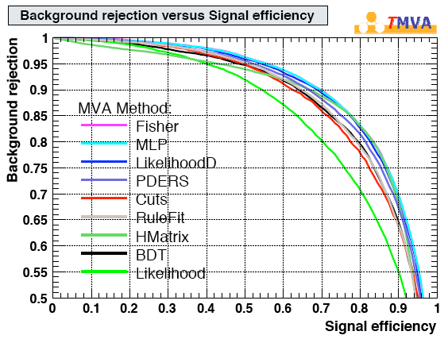
Another example (from Bob Cousins)
A b-tagging algorithm gives a curve like this:
One wants to decide where to cut,
optimizing analysis:
picking up a point on one of the curves one gets:
- P(btag|b-jet) signal efficiency
- P(btag|not a b-jet) BG efficiency*
Question: given a selection of jets
tagged as b-jets, what fraction of them
are b-jets, i.e. what is P(b-jet|btag)?
Answer: the information is not sufficient! one needs to know P(b-jet),
the fraction of all jets which are b-jets (in the given experiment); then:
P(b-jet|btag) ∝ P(btag|b-jet)×P(b-jet)
Note: this use of Bayes’ theorem is fine for frequentists
* The plot shows on the vert. axis BG rejection = (1- BG efficiency)

Slide 25
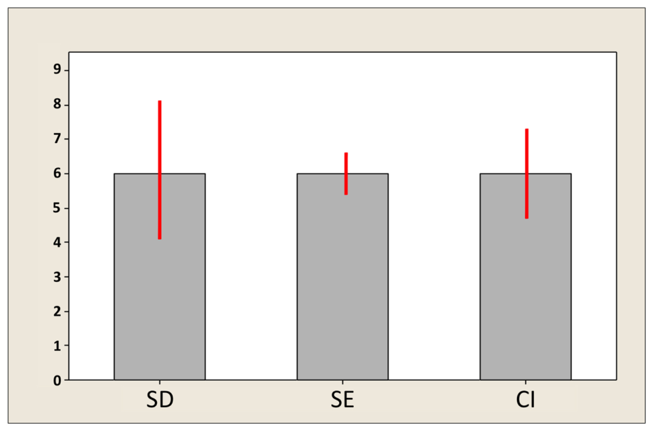
Reminder: basic indicators of variation
SD: standard deviation
SEM: standard error on
the mean
CI: confidence interval
(usually: 95%)
SEM
SD indicates how much variation there is in the sample (population)
SEM gives the smallest “error bar”
CI (95%) is approximately ± 2 SEM (if N ≥ 10) and is highly informative
on the accuracy of the mean, but its size depends on the C.L.
SD will be ≈ unaffected when increasing the sample size N,
while SEM and CI will shrink

Slide 26
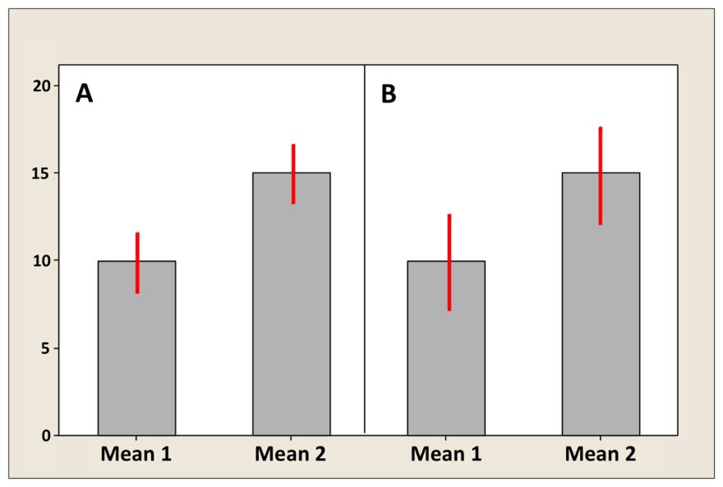
Comparison of two means
the correct measure for the comparison is
the SE on the difference between the means
in case of equal SEMs, the SE on
the difference is ∼1.4 SEM,
to be significantly different the two
means must differ (Δ) by ≥ 2.8 SEMs
Error bar type | Overlapping error bars (B) | Non-overlapping error bars (A)
SD | No inference | No inference
SEM | sample means are not significantly different | No inference
CI | sample means may or may not be significantly different | sample means are significantly different
Δ ≤ 2 SEMs
Δ ≥ 4 SEMs

Slide 27
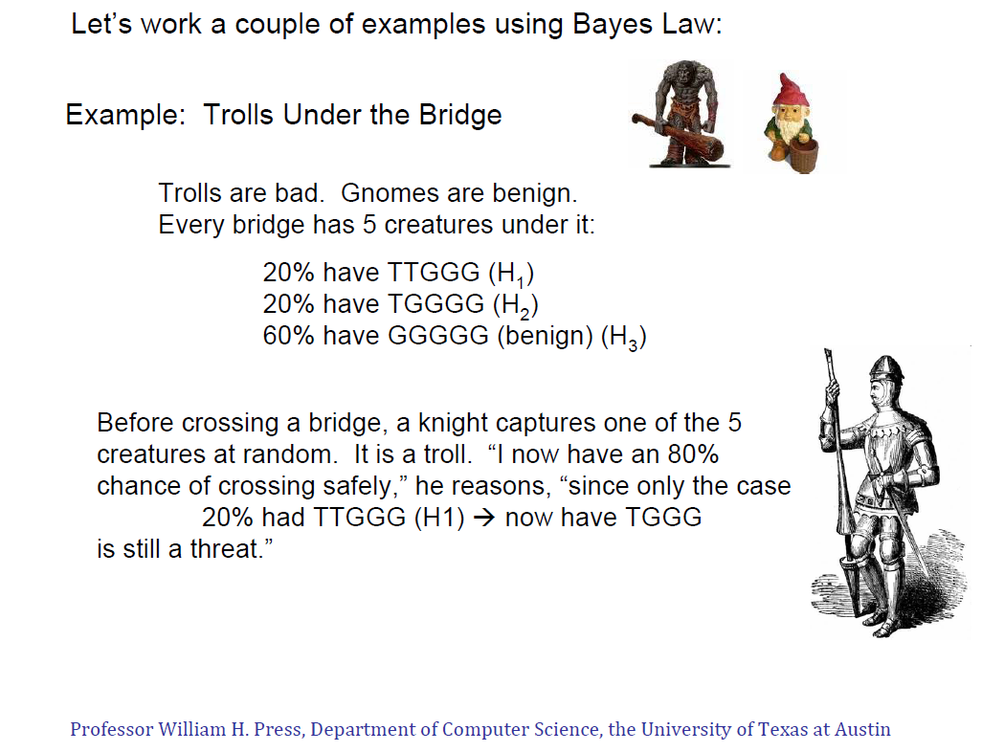
Bayesian example I

Slide 28
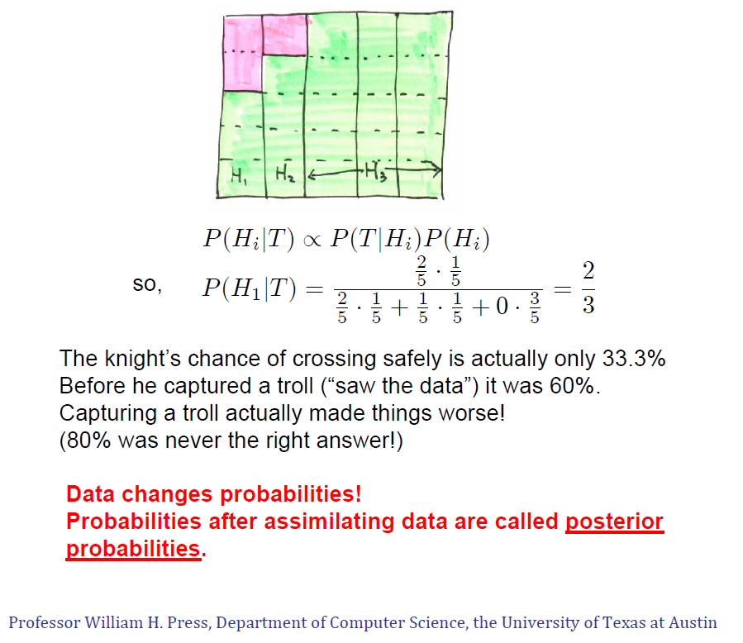
Trolls under the bridge, cont’d
Troll
Gnome
T : Troll captured

Slide 29
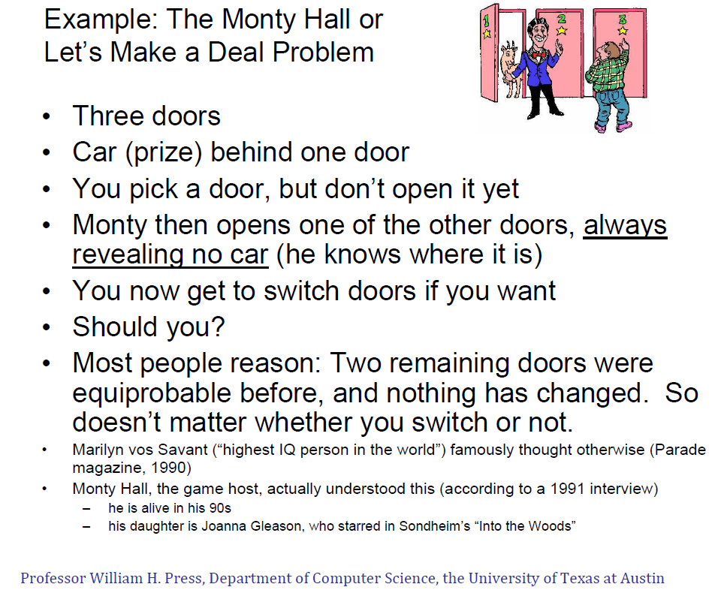
Bayesian example II: Monty Hall

Slide 30
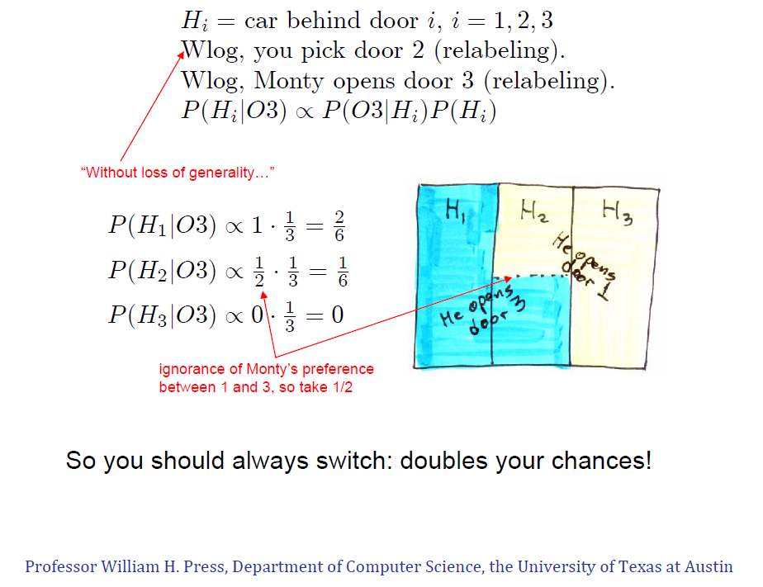
Monty Hall, cont’d

Slide 31
Using Bayes’ theorem
P(H_{i}) = 1/3 (i=1,2,3) is the “prior probability” or simply “prior”
P(H_{i}|O₃) is the “posterior probability” or simply “posterior”
P(O₃|H_{i}) are the “evidence factor” or simply “evidence”
Bayes says: posterior ∝ evidence × prior

Slide 32
Monte Carlo Methods
Random numbers
Exercise: simulation of radioactive decays
Exercise: repeated counting experiments
Transformation method
Acceptance-rejection method
Exercise: r.n. generation with both methods
Example: Compton scattering in GEANT

Slide 33
Random numbers (1)
MonteCarlo procedures which use (pseudo)random numbers are essential for:
  Simulation of natural phenomena
  Simulation of experimental apparatus
  Calculation of multi-dimensional integrals
  Determinaton of best stragegy in games
Random number generators are needed to produce a sequence of r.n. rather than a single r.n.
The basic form of random number generator produces a sequence of numbers with a uniform probability in [0,1]

Slide 34
Random numbers (2)
Truly random numbers can be obtained e.g. by:
  observing chaotic systems (lottery, dice throwing, coin tossing, etc.)
  observing random processes (radioactive decay, arrival of cosmic rays, white thermal noise, etc.)
  Published tables with a few million truly random numbers exist
Generators of pseudo-random numbers are more practical:
  sequences are reproducible (useful to validate a simulation after changing some part of the code)
  in any case it is desirable to have:
    a long repetition period
    quasi-statistical independence between successive numbers

Slide 35
Random number generators (1)
Middle Square (J. Von Neumann, 1946)
  I₀ = “seed” (m-digit number);
  I_{n+1} = m “central” digits of I_{n}²
Example (m=10):
5772156649² = 33317792380594909201
I_{n} I_{n+1}
Problems of the Middle Square generator:
small numbers tend to be near in the sequence
zero tends to repeat itself
particular values of the “seed” I₀ give rise to very short sequences:
6100² = 37210000
2100² = 04410000
4100² = 16810000
8100² = 65610000
Using 38-bit numbers (about 12
decimal digits) the maximum length
of a sequence is 7.5∙10⁵
Notes:
With 38 bits the largest (unsigned integer) number is 274,877,906,943

Slide 36
Random number generators (2)
Congruential methods (Lehmer, 1948)
  I₀ = “seed”;
  I_{n+1} = (aI_{n}+c)mod m
  with a,c ≥0; m > I₀, a, c
  When c=0 (faster algorithm) this is called
  multiplicative linear congruential generator (MLCG)
The modulus m must be as large as possible (sequence length cannot exceed m), on 32-bit machines m=2³¹ ≈2∙10⁹
Requirements for a sequence of period m (M. Greenberger, 1961):
  c and m must be relative primes
  a-1 must be a multiple of p, for every prime p which divides m
  a-1 must be a multiple of 4, if m is a multiple of 4
Good example: a = 40692, m = 2³¹-249 = 2147483399
Notes:
2147483399 e’ un numero primo a 10 cifre decimali. Valori suggeriti da L’Ecuyer, Commun. ACM 31 (1988) 742

Slide 37
Random number generators (3)
RANDU generator (IBM, 1960’s)
  I_{n+1} = (65539×I_{n})mod 2³¹
  distributed by IBM and widely used in the 1960’s
  (note: 65539 = 2¹⁶+3; the 3rd condition of Greenberger is not satisfied)
RANDU was later found to have problems: when using triplets of consecutive random numbers to generate points in 3D space, these points showed up to be concentrated on 15 planes …
Notes:
RANDU: 65539 = 2^16+3; 2^31 = 2147483648.

Slide 38
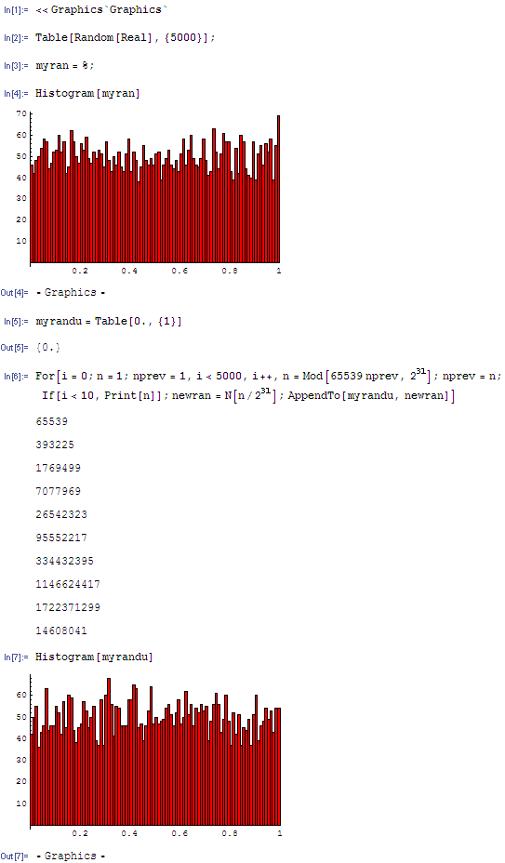
Randomness check (1)
The 1D distribution of random numbers from RANDU looks OK:
Notes:
2^31 = 2147483648.

Slide 39
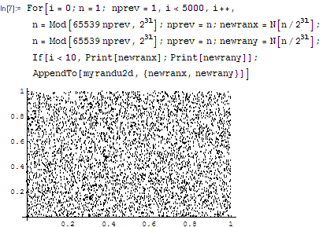
Randomness check (2)
RANDU in 2D looks still fine …

Slide 40
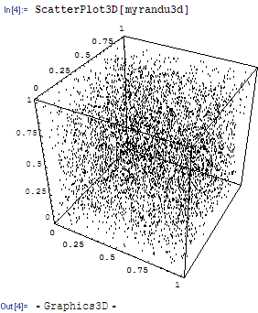
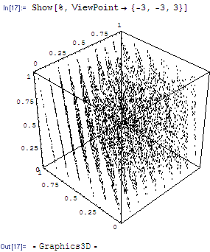
Randomness check (3)
The 3D distribution of points shows the problem:
Marsaglia (1968) showed that this is a general problem for all multipl.
congruential generators. Maximum n. of (hyper)planes is 2953 in 3D
but only 41 in 10D (for 32 bit numbers).
Practical solution for 3D: I_{n+1} = (69069×I_{n})mod 2³¹
Notes:
Improved RANDU: 69069 = 3 * 7 * 11 * 13 * 23; 69069-1 is divisible by 4.

Slide 41
More random number generators
RANMAR (CERNLIB V113) Marsaglia et al.: Towards a Universal Random Number Generator, report FSU-SCRI-87-80 (1987)
  103 seeds, which can be generated from a single integer 1 ≤ N ≤ 900,000,000
  every sequence has a period ≈10⁴³
Ran2 (Numerical Recipes) Press & Teukolsky: Portable Random Number Generators, Compt. Phys. 6 (1992) 521
RANLUX (CERNLIB V115) Lüscher & James Computer Phys. Comm. 79 (1994) 100-110; 111-114
  5 different sophistication levels
  period goes up to 10¹⁶⁵

Slide 42
RANLUX (V115)
RANLUX generates pseudorandom numbers uniformly distributed
in the interval (0,1), the end points excluded.
Each CALL RANLUX(RVEC,LEN) produces an array RVEC of single-precision
real numbers of which 24 bits of mantissa are random.
The user can choose a luxury level which guarantees the quality
required for his application. The lowest luxury level (zero) gives
a fast generator which will fail some sophisticated tests of randomness;
The highest level (four) is about five times slower but guarantees
complete randomness. In all cases the period is greater than 10¹⁶⁵.
Level | p | t
0 | 24 | 1 | Equivalent to RCARRY of Marsaglia and Zaman, very long period but fails many tests.
1 | 48 | 1.5 | Passes the gap test but fails spectral test.
2 | 97 | 2 | Passes all known tests, but still theor. defective.
3 | 223 | 3 | DEFAULT VALUE. Very small chance to observe correl.
4 | 389 | 5 | All 24 bits chaotic.

Slide 43
Random number gen. in ROOT
Implemented by class TRandom: fast generator with period 10⁸
TRandom1 (inherits from TRandom) is equiv. to RANLUX
TRandom2 (inherits from TRandom) has period 10¹⁴, but it’s slower than TRandom
TRandom3 (inherits from TRandom): implements the Mersenne-Twister generator, with period 2¹⁹⁹³⁷-1 (≈10⁶⁰⁰²). Passes the k-distribution test in 623 dimensions (see Numerical Recipes, chapter 7 for a description of the test) → the 623-tuples over the entire period are uniformly distributed on a hypercube with 623 dimensions (unlike RANDU!), see:
http://www.math.keio.ac.jp/∼matumoto/emt.html
Mersenne-Twister is a generator used by many present HEP experiments for their MonteCarlo simulations
Notes:
Use SetSeed method to change the default seed (for TRandom3 the default seed is 4357).

Slide 44
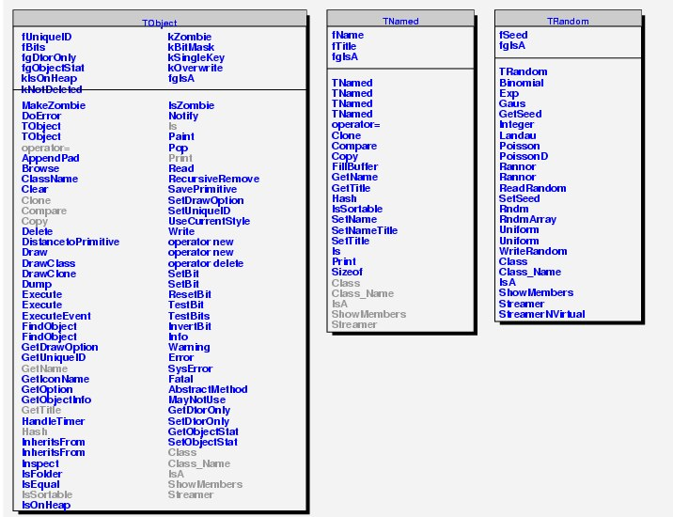
The TRandom class in ROOT
Use the SetSeed method to change the
initial seed (Trandom3 default seed: 4357)

Slide 45
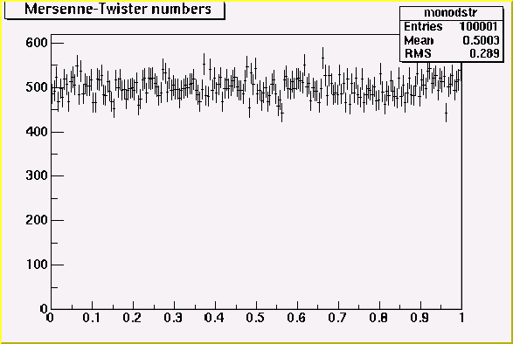
Mersenne-Twister (TRandom3)

Slide 46
Random numbers in Mathematica
Mathematica 6 (7) provides several random number generation methods:
Congruential: fast, not very accurate generator
ExtendedCA: Cellular automaton, high quality (default method)
Legacy: used in Mathematica versions <6.0
Mersenne Twister: by Matsumoto and Nishimura
MKL: only Intel platforms, several methods
Rule30CA: another cellular automaton method
Some methods use different techniques for integers and reals
use SeedRandom[n,Method->”method”] to set the seed and specify the
method; then RandomReal[{x_{min},x_{max}},n] gives a list of n random reals

Slide 47
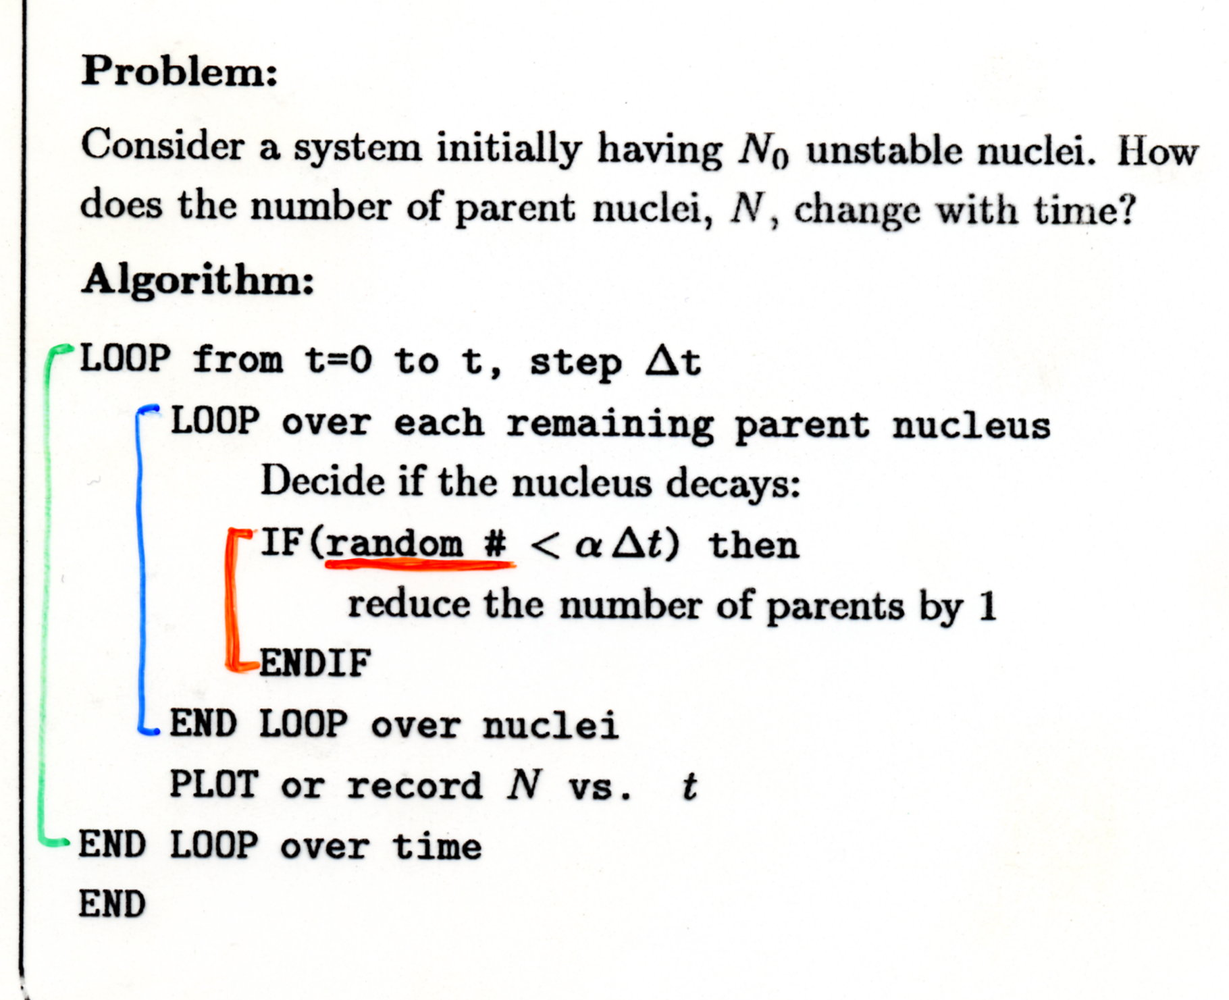
Simulation of radioactive decays
Radioactive decay is a truly random process,
with probability (per unit time and per nucleus) independent of the nucleus “age”:
in a time Δt the probability that a nucleus undergoes decay is p:
p = α Δt
(when α Δt << 1)
The MC technique requires one uniform
random number in [0,1] at each step

Slide 48
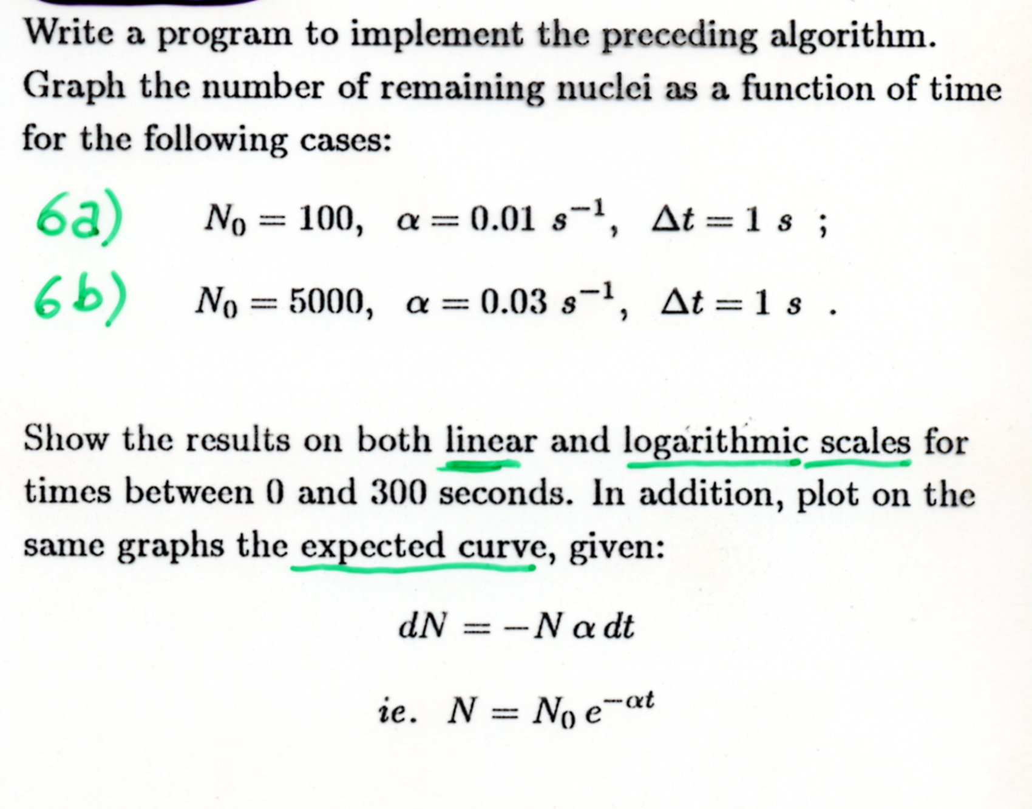
Exercise No. 1

Slide 49
Possible solutions to Exercise 1
C program (uses RANMAR from CERNLIB): decrad1.c
main()
{
int hid=1,istat=0,icycle=0;
int nvar=3;
char Title[3][8]={"Tempo","Nuclei","Num"};
float VecNtu[3];
int record_size=1024;
float vec[100];
int len=100;
int N0=100,count,t,i,N,j;
float alpha=0.01,delta_t=1.;
// Ntuple stuff
HLIMIT(PAWC_SIZE);
HROPEN(1,"decrad1","decrad1.hbook","N",record_size,istat);
HBOOKN(hid,"Decadimento Radioattivo",nvar," ",5000,Title);
continues..
Notes:
M. Obertino, S. Valchierotti, A. Stamerra (1999)

Slide 50
Ex. 1: C program (continued)
N=N0;
for (t=0;t<300;t++) { //--Loop sul tempo totale di osserv. (300 sec)
count=0;
RANMAR(vec[0],len); //--Genera sequenza numeri casuali
VecNtu[2]=vec[N-1]; //--Salva ultimo numero casuale utilizzato
for (i=0;i<N;i++) { //--Loop sui nuclei sopravvissuti
if(vec[i]<=(alpha*delta_t)) count=count+1;
}
N=N-count;
VecNtu[0]=t;
VecNtu[1]=N;
HFN(hid,VecNtu); //--Riempie t-esima riga della Ntupla
}
HROUT(0,icycle," ");
HREND("decrad1");
KUCLOS(1," ",1);
}

Slide 51
Possible solutions to Exercise 1
ROOT macro implementation (uses TRandom3):
  ROOT classes are used for random number generation, histograms and input-output
  the macro (decay.C) consists of 2 functions, decay and exponential
  it may be either compiled or executed with the ROOT interpreter (CINT)
  the code and sample results are shown in the following slides

Slide 52
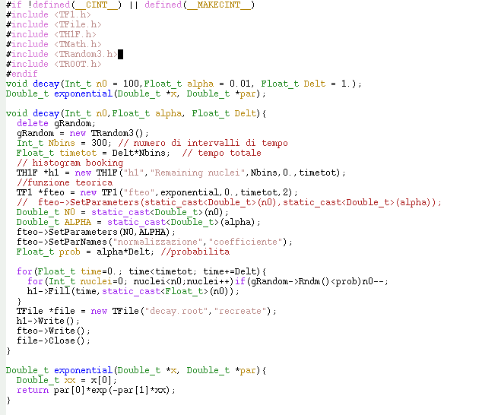
Header files, necessary for
macro compilation.
Compilation is not mandatory,
the ROOT C++ interpreter
may be used instead

Slide 53
The 2 functions are declared here,
with default values for arguments
Notes:
ATTENZIONE: possibile baco “n0 - -” puo’ far terminare in anticipo il for

Slide 54
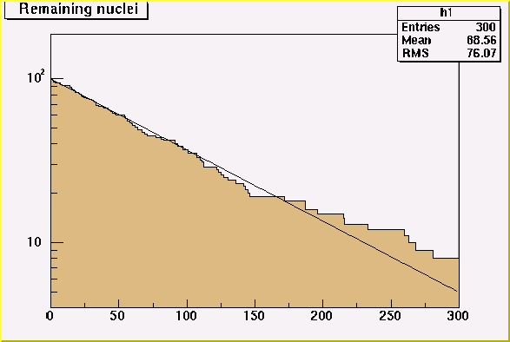
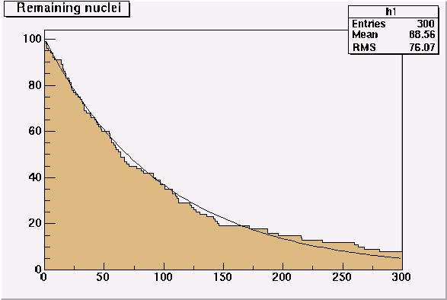
Line: expected exponential curve. Histogram: result of simulation.
Result for:
N₀=100,
α=1×10⁻² s⁻¹
Δt=1 s
Statistical fluctuations
are well visible

Slide 55
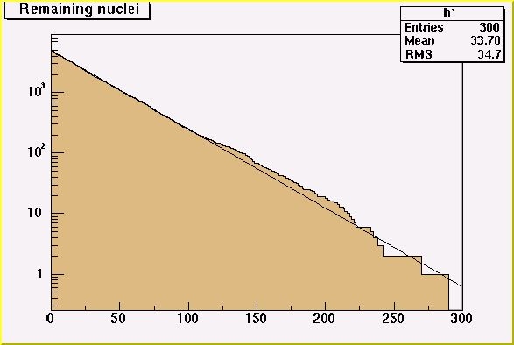
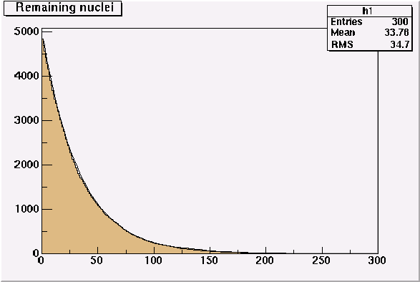
The relative impact of fluctuations depends on the number of surviving nuclei
Result for:
N₀=5000,
α=3×10⁻² s⁻¹
Δt=1 s

Slide 56
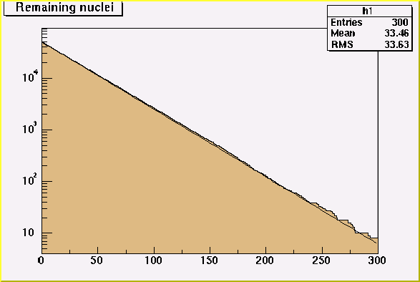
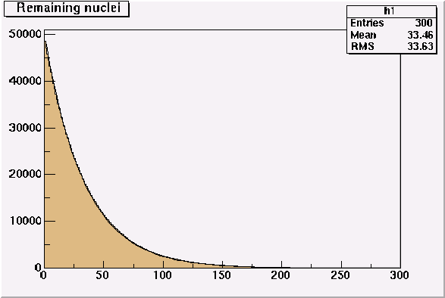
Result for:
N₀=50000,
α=3×10⁻² s⁻¹
Δt=1 s

Slide 57
Solutions to exercise No. 1
F. Poggio (2003)

Slide 58
Solutions to exercise No. 1
F. Poggio (2003)

Slide 59
How many decays in a fixed time?
Let’s consider a time T such that the number N of surviving nuclei does not decrease significantly: what is then the probability of observing n decays in time T ?
Let’s subdivide T in m intervals of duration Δt=T/m
  Probability of 1 decay in Δt → p = αNΔt ≡ βΔt
  If βΔt = βT/m << 1 then we may neglect the case of 2,3,... decays in Δt
  The probability of observing n decays in the time interval T is given by the binomial distribution ...

Slide 60
The binomial probability for n decays in m subintervals is:
In the limit m→∞, i.e. Δt→0 :
the binomial distribution approaches a poissonian distribution with parameter:

Slide 61
Exercise No. 2
Modify/rewrite the program of Exercise No. 1 in order to simulate an experiment where the number of decays n in a time interval of duration T is counted
Allow for experiment repetition (without restarting the random number sequence)
Generate 1000 experiments for the following two cases:
  N₀=500, α=4×10⁻⁵ s⁻¹, Δt=10 s, T=100 s
  N₀=500, α=2×10⁻⁴ s⁻¹, Δt=10 s, T=100 s
Compare the histogram of n for 1000 experiments with the expected poissonian (& possibly binomial) distribution

Slide 62
Solutions to exercise No. 2
F. Poggio (2003)

Slide 63
Solutions to exercise No. 2
F. Poggio (2003)

Slide 64
Non-uniform random numbers
To handle complex simulation problems it is useful to generate random numbers according to some specified distribution (Poisson, Gauss, ….)
Frequently used distributions are readily available in stat. libraries:
If a ready-made distribution is not available, two general methods can be used to generate random numbers:
  Transformation method
  Acceptance-rejection method
distribution | CERNLIB | Num. Recipes* | ROOT (TRandom methods)
Gauss | RNORML V120 | gasdev | Gaus
Poisson | RNPSSN V136 | poidev | Poisson, PoissonD
Binomial | RNBNML V137 | bnldev | Binomial
Multinomial | RNMNML V138
Gamma / χ² | RNGAMA V135 | gamdev
Exponential |  | expdev | Exp
* www.nr.com – Chapter 7 (Random Numbers)

Slide 65
The transformation method
This method can be used for relatively simple PDF’s (probability density functions) f(x) for which the corresponding cumulative function F(x) can be inverted:
is defined on the interval
The cumulative function is:
with
A uniform random number u in [0,1]
is transformed into
x = F⁻¹(u) which is
distributed according to f(x) in [x₁,x₂]
u
f(x) = 1/(4√x)
F(x)=½√x
in 0<x≤4
x = F⁻¹(u)

Slide 66



Transformation method: examples
We must therefore solve for x the following equation:
To generate according to the 1/√x PDF in [0,4]:
To generate according to an exponential PDF:
Fast approximate Gaussian generator: see F. James § 3.3.3

Slide 67
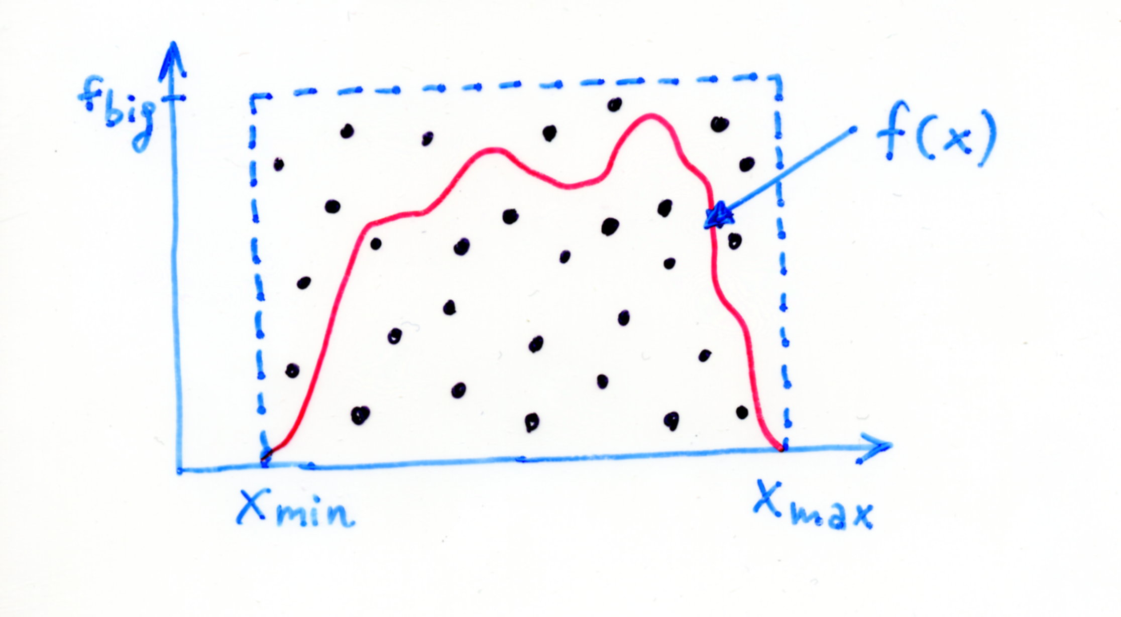
The acceptance-rejection method
Aim: extract random numbers according to a given f(x) positive and limited in [x_{min}, x_{max}]
Pairs of uniform random numbers u₁, u₂ are extracted and used to generate points x_{T}, y_{T}:
the x_{T} value is
accepted
if f(x_{T})>y_{T}
[x_{T},y_{T}]

Slide 68
Monte Carlo method for integrals
The acceptance-rejection method can be used to evaluate definite integrals:
where N_{A} is the number of accepted x-values and N_{P} the number of trials.
The accuracy of the result may be estimated from the error on N_{A}, which is given by the binomial distribution:
The error on I is therefore:
from which one finds:
The relative accuracy becomes (slowly) better with the number of trials: δI/I∝1/√N_{P}

Slide 69
Acceptance-rejection: drawbacks
It is generally not very efficient as far as CPU power is concerned (the transformation method, if available, is faster)
It is not very convenient with distribution functions having very narrow peaks (CPU time needed increases a lot) – see next exercise
It cannot be applied whenever the function has poles or the integration domain extends to infinity in either direction
On the other hand, it is often the only practical method for multi-dimensional integration

Slide 70
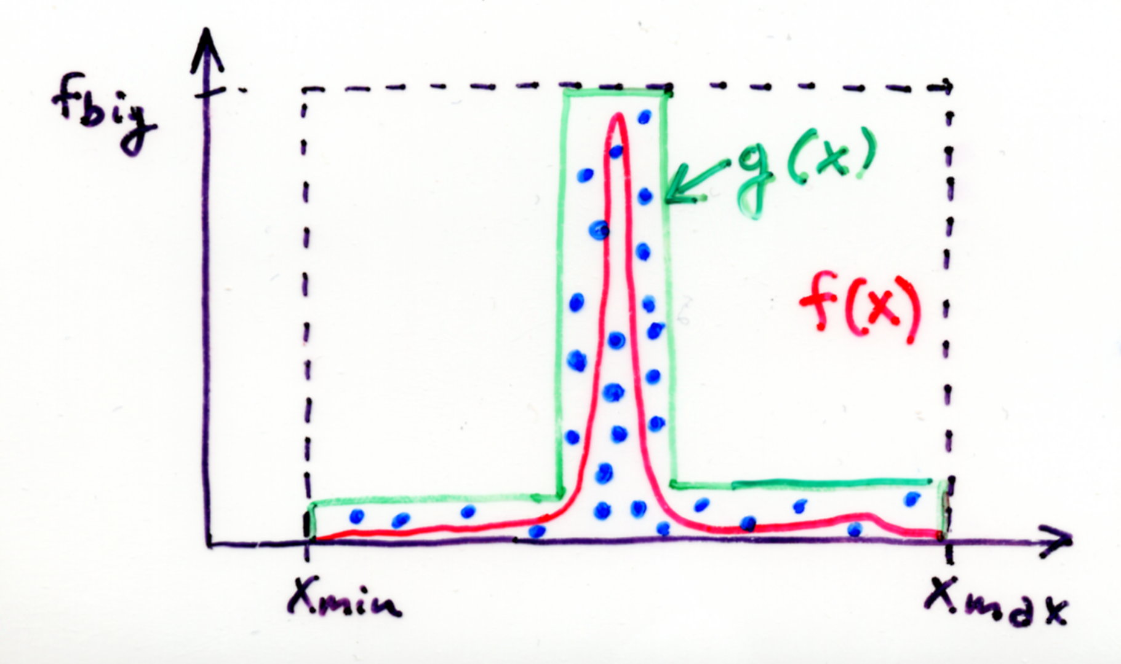
Importance sampling
The efficiency of the acceptance-rejection method can be increased by sampling not on a “rectangular” region but on a region defined by a function g(x) ≥ f(x)
If we are able to generate random numbers according to g(x), e.g. with the transformation method, the procedure is then the following:
Extract x according to g(x)
Extract u with a uniform distribution between 0 and g(x)
If u<f(x) then x is accepted

Slide 71

Exercise No. 3
Write a procedure to generate, with both the transformation and the acceptance-rejection methods, an angle Θ in [0, 2π] according to the PDF:
(be careful to consider the intervals in which the inverse trigonometric functions are defined in the library functions)
  Generate 10000 values of the angle Θ with both methods for two cases: a=0.5, a=0.001
  Compare the distribution of the generated angles to the input PDF, normalized to the number of trials
  If possible, compare CPU times between both methods [using CERNLIB: DATIME, TIMED; using ROOT: TBenchmark; using Mathematica: Timing]

Slide 72
Some hints for Exercise No. 3
The quoted function is periodic in [0,π]: to generate in [0,2π] one can add π to the generated Θ in 50% of the cases (taken at random)
the transformation method can also be implemented numerically rather than analytically: e.g. in ROOT using the method GetRandom() of the TH1 class

Slide 73
Solutions to exercise No. 3
F. Poggio (2003)

Slide 74
Solutions to exercise No. 3
F. Poggio (2003)

Slide 75
Physical example: Compton effect
K’
scattered photon
K
θ
incident photon
The differential cross-section is given by the Klein & Nishina formula (1929):
with the energy K’ of the scattered photon (using c=1, h/2π=1; m is the electron mass) given by:

Slide 76
The photon angular distribution
At a given incident energy K we want to sample the scattered photon angles θ and ϕ from:
The azimuthal angle ϕ can be generated uniformly in [0,2π];
generation of the polar angle θ is more complicated, we start from
the dominant term in K’/K:
Here the more convenient variable has been
introduced; dropping the ϕ dependence, the transformation
method can be used to generate v in the interval [0,2] …

Slide 77
Generating the photon polar angle
The transformation method gives the following “recipe”:
with
where u is a uniform random number.
Before dealing with the correction (still needed to recover the
full form of the differential cross section) it must be noted that:
for high incident energy K >> m the differential cross-section
is peaked at θ = 0: for this reason it is better to extract
v=1-cosθ rather than cosθ (to avoid rounding errors)
for low incident energy K << m on the contrary this procedure
is unsuitable because of rounding errors: (1+2K/m) ≈ 1
here we are interested in the high incident energy case

Slide 78
Early Monte Carlo shower simulation
The method to generate the full differential cross-section for the Compton effect (together with pair creation and bremsstrahlung) was implemented by Butcher and Messel in 1958:
In order to simulate fluctuations in the number of electrons in electromagnetic showers they were lead to consider in detail the three relevant processes mentioned above and …
This is the core of the simulation
method adopted in EGS4 and
also in GEANT3/GEANT4

Slide 79
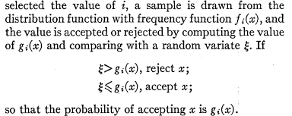
Composition + Rejection
The f_{i}(x) must be easily sampled
functions, the g_{i}(x) should be not much
smaller than unity in order to keep the
number of rejections low
This is the composition part …
… and this is the rejection part
(…)

Slide 80
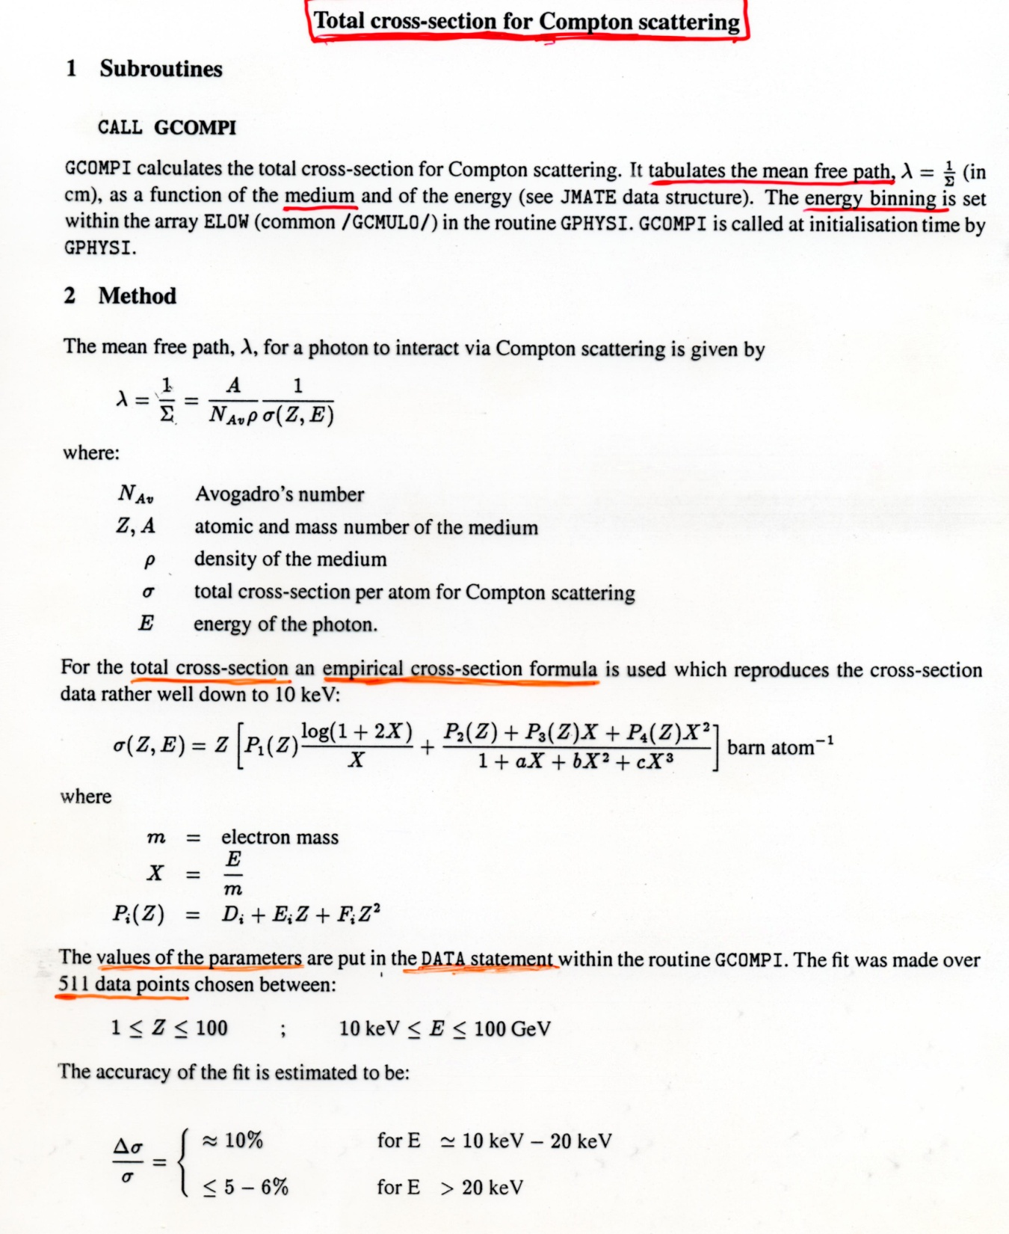
Implementation in the GEANT 3.21 code
(1 of 3)
This part refers to the
calculation of the total
Compton cross-section
for a certain number of
incident energies E and
atomic numbers Z;
it is done only once at
the beginning of the
simulation

Slide 81
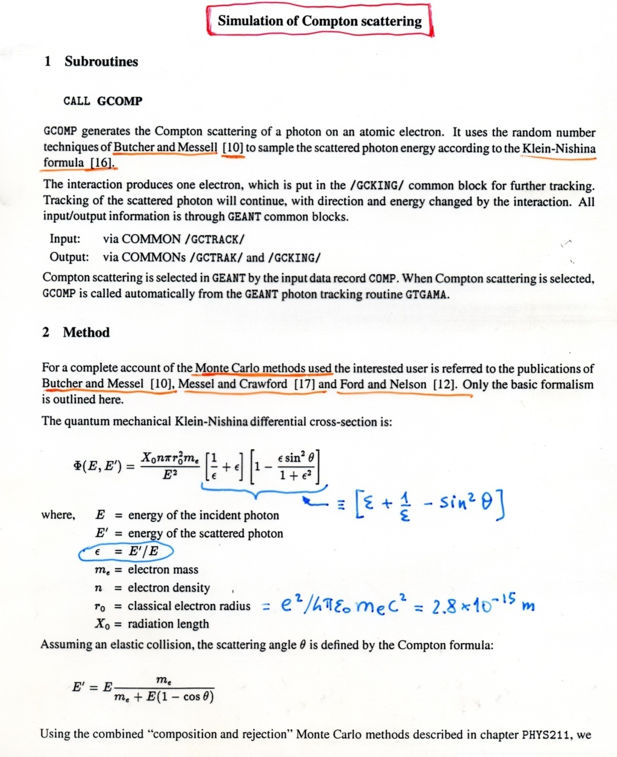
Implementation in the GEANT 3.21 code
(2 of 3)
ε is what we have called
K’/K before;
[1/ε+ε] is the “f_{i} part”,
i.e. the easily sampled one
(remember, θ is a function
of ε)

Slide 82
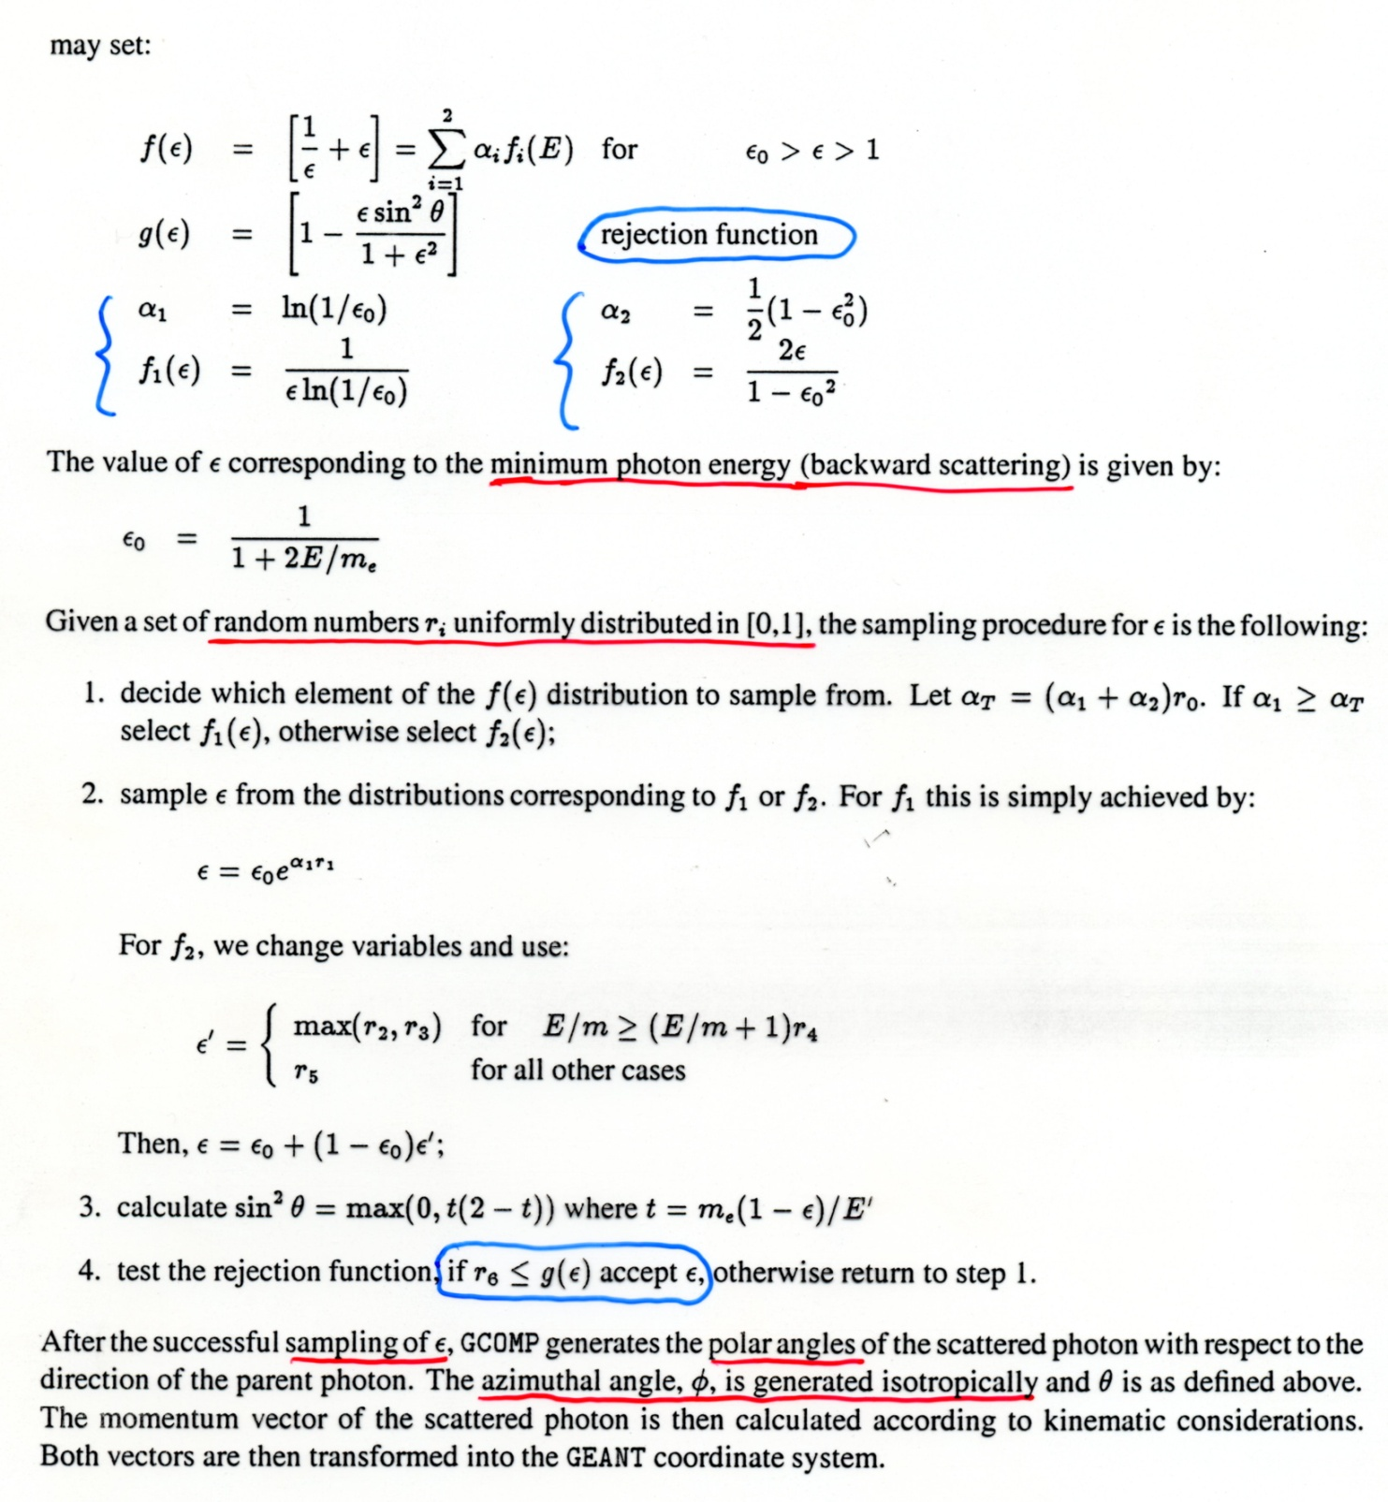
Implementation in the GEANT 3.21 code
(3 of 3)
here g₁ = g₂ is
the same function
for both components
f₁ and f₂;
ε₀ is the minimum
value of ε
The same method is used
in GEANT4 and EGS4 to track
photons and electrons

Slide 83
Photon (& electron) transport
The general scheme for transport of electrons and photons (& other particles) in a simulation program is the following:
  the path of each particle is subdivided in small steps
  at each step at most one of the competing processes is chosen, with probability according to the process cross-section
  the chosen process is simulated, the new momentum of the original particle and (possibly) the momenta of the other produced particles are stored in memory, and the next step is dealt with
The simulation ends when all particles have disappeared or have dropped below a certain minimum energy
EGS4: Electron-Gamma Shower (W.R. Nelson et al., SLAC-265, Stanford Linear Accel. Center, Dec. 1985 and later improvements); for software distribution see e.g.: http://www.irs.inms.nrc.ca/EGSnrc/EGSnrc.html
GEANT3/GEANT4: see http://wwwinfo.cern.ch/asd/geant
or http://cern.ch/geant4
FLUKA: see http://www.fluka.org
https://geant4.web.cern.ch/geant4/UserDocumentation/UsersGuides/ForApplicationDeveloper/html/
CLHEP / HEPRandom: section 3.2.2

Slide 84
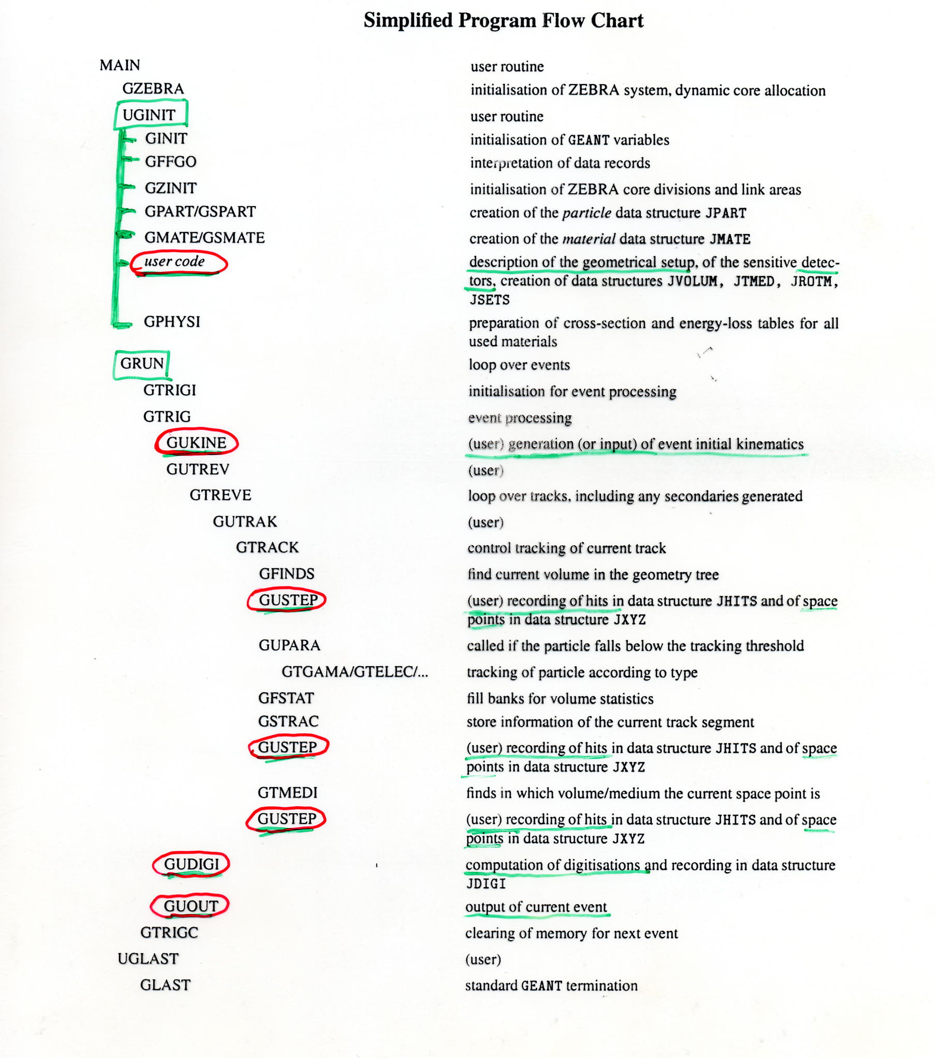
This is the GEANT3 flow
chart: the user must
provide (at least) the
subroutines circled in red
in order to specify the
geometry of the apparatus,
the detector sensitive
volumes, the initial
kinematics of each event.
Also, the storage of space
points (HITS) along tracks
and the simulation of the
data as recorded by the
detectors (DIGITS) must
be provided by the user.

Slide 85
Event generators
We have seen up to now how the transport of certain particles (in particular electrons and photons) is simulated in complex programs like GEANT or EGS
The initial kinematics can be very simple (one primary electron or photon of a given energy incident on a block of material) but more often we need to simulate in full detail lepton-lepton, lepton-hadron or hadron-hadron collisions (including ion-ion)
This task is accomplished by event generators like PYTHIA, HERWIG, HIJING which model the known physics (at the parton level) but which are outside the scope of this course
In any case even the transport code must include the most important electromagnetic and hadronic processes relevant for the interaction of produced long-lived or stable particles with matter

Slide 86
Simulation of detector response
The detailed simulation of a detector’s response is often based on laboratory + test beam results and is then incorporated in the general MC simulation of the experiment (e.g. GUDIGI in GEANT3)
The following main features are modeled:
  Geometrical acceptance
  Efficiency: e.g. detection efficiency vs. energy of the incoming particle
  Energy resolution: in the simplest case a gaussian “smearing” is enough to describe the energy resolution function
  Noise: it can be modeled either as a random amplitude which is added to the true signal before digitization, or as a noise count which occurs with a given probability (derived e.g. from the measured noise count rate per unit area)

Slide 87
MonteCarlo DEMONSTRATION
Demonstration of basic random number techniques with Mathematica
Demonstration of basic random number techniques with a FORTRAN/C program
  needs package ‘cernlib’ & gfortran compiler
Demonstration with ROOT

Slide 88
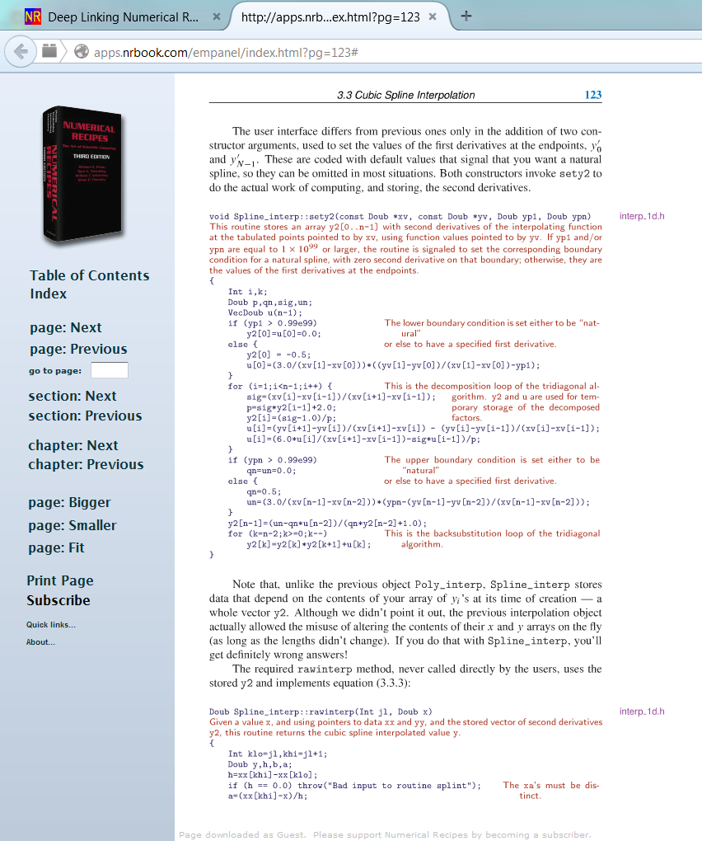
Numerical Recipes
numerical.recipes [was www.nr.com]
  Third edition in C++
  limited free access (30 pages per month)
  unlimited access with subscription
Go to Numerical Recipes Electronic now. (Guests may access a limited number of pages per month; subscribers have full access.)

Slide 89
Next:Part II
Statistical methods / parameter estimation

Slide 90
For those who want to learn more:
PHYSTAT 2005 conference, Oxford [http://www.physics.ox.ac.uk/phystat05/]:
  Cousins: Nuisance Parameters in HEP
  Cranmer: Statistical Challenges of the LHC
  Feldman: Event Classification & Nuisance Parameters
  Jaffe: Astrophysics
  Lauritzen: Goodness of Fit
G. D’Agostini, Telling the Truth with Statistics, CERN Academic Training, February 2005
T. Sjöstrand, Monte Carlo Generators for the LHC, CERN Academic Training, April 2005
YETI ’07, Durham, UK, January 2007 [http://http://www.ippp.dur.ac.uk/yeti07/]
  Cowan: Lectures on Statistical Data Analysis
continued on the following slide
see also PHYSTAT website (hosted by FNAL): phystat.org

Slide 91
…continued
PHYSTAT-LHC 2007 conference, CERN, June 2007 [http://phystat-lhc.web.cern.ch/phystat-lhc/]:
  Cranmer: Progress, Challenges, & Future of Statistics for the LHC
  Demortier: P Values and Nuisance Parameters
  Gross: Wish List of ATLAS & CMS
  Moneta: ROOT Statistical Software
  Verkerke: Statistics Software for the LHC
K. Cranmer, Statistics for Particle Physics, CERN Academic Training, February 2009
PHYSTAT 2011 workshop, CERN, January 2011 [http://indico.cern.ch/event/phystat2011]:
  Casadei: Statistical methods used in ATLAS
  van Dyk: Setting limits
  Lahav: Searches in Astrophysics and Cosmology

