Slide 1

Data Analysis Techniques in experimental physics
Part II: Statistical methods / parameter estimation
Luciano RAMELLO – Dipartimento di Scienze e Innovazione Tecnologica

Slide 2
Parameter estimation
Properties of estimators
Maximum Likelihood (M.L.) estimator
Confidence intervals by M.L. (with examples)
The frequentist approach to confidence intervals
Exercise: 1-parameter confidence intervals
Bayesian parameter estimation
Systematic “errors”
Exercise: 2-parameter confidence intervals

Slide 3
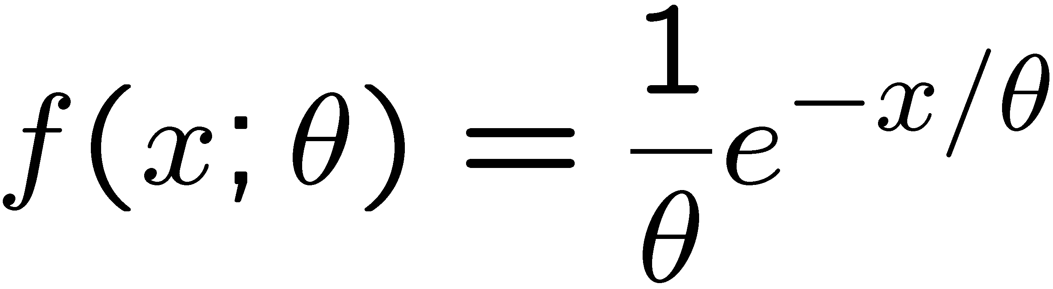
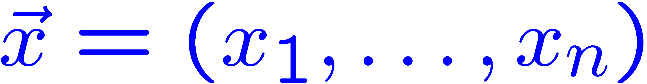
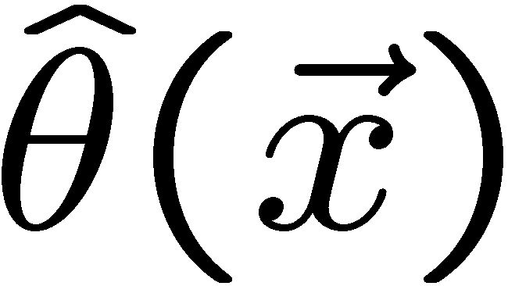
Parameter estimation
Let’s consider a random variable x which follows a PDF (probability density function) depending on some parameter(s), for example:
f(x) is normalized in [0,+∞]
After obtaining a sample of observed values:
we would like to estimate the value of the parameter, this can be achieved if we find a function of the observed values which is called an estimator:
An estimator is a function defined for any dimension n of the sample; sometimes the numerical value for a given n and a given set of observations is called an estimate of the parameter.
There can be many estimators: we need to understand their properties

Slide 4
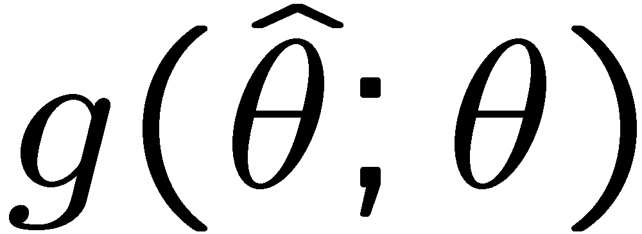
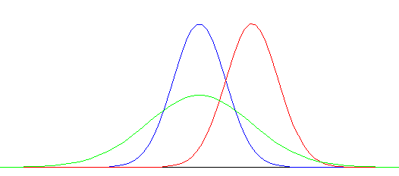


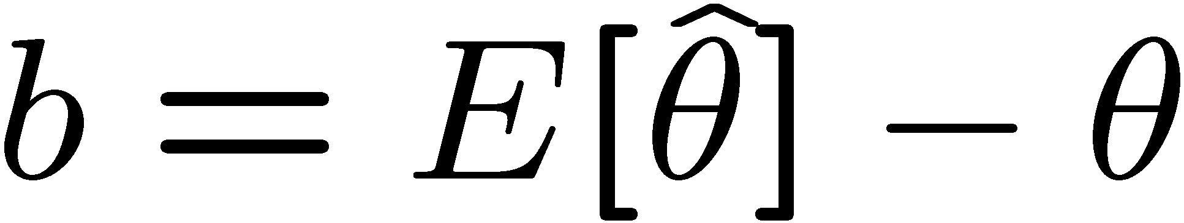

Comparing estimators
If we have three different estimators and we compute from each the estimate many times (from random samples of the same size) we will find that the estimates follow themselves a PDF:
best
large
variance
biased
We would like then that our chosen estimator has:
  low bias (ideally b=0)
  small variance
Unfortunately these properties are often in conflict …

Slide 5

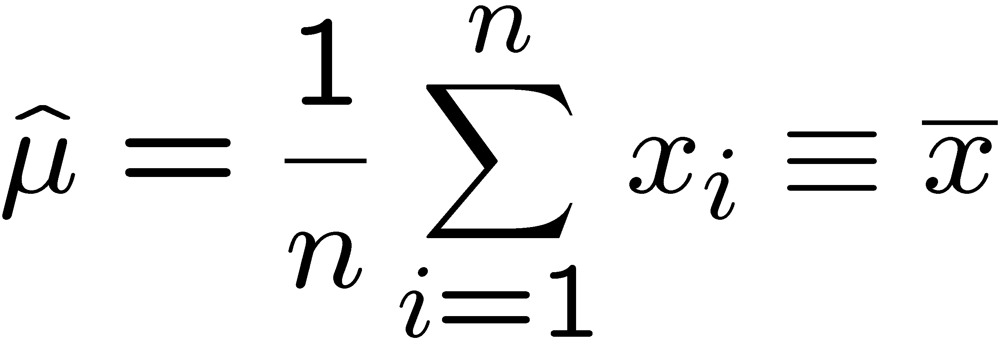

Estimator properties (1)
Consistency - the limit (in the statistical sense) of a consistent estimator, when the number of observed values n goes to ∞, must be the parameter value:
Bias – a good estimator should have zero bias, i.e. even for a finite number of observed values n it should happen that:
= 0
Let’s consider for example a well-known estimator for the mean
(expectation value) μ, which is the sample mean :

Slide 6
The Mean in historical perspective
It is well known to your Lordship, that the method practised by astronomers, in order to diminish the errors arising from the imperfections of instruments, and of the organs of sense, by taking the Mean of several observations, has not been so generally received, but that some persons, of considerable note, have been of opinion, and even publickly maintained, that one single observation, taken with due care, was as much to be relied on as the Mean of a great number.
And the more observations or experiments there are made, the less will the conclusion be liable to err, provided they admit of being repeated under the same circumstances.
Thomas Simpson, ‘A letter to the Right Honorable George Earl of Macclesfield, President of the Royal Society, on the advantage of taking the mean of a number of observations, in practical astronomy’,
Philosophical Transactions, 49 (1756), 93

Slide 7
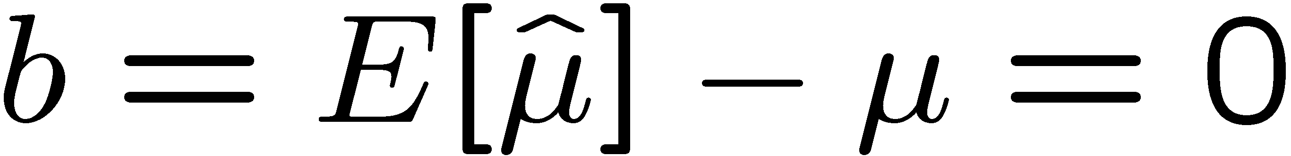
Consistency and bias (example 1)
The sample mean is a consistent estimator of the mean
  this can be shown using the Chebychev inequality, which is valid for any distribution f(x) whose variance is not infinite:
  when applying the inequality to the PDF of the sample mean we must use the fact that E[ ] = μ, V[ ] = σ²/N, then an appropriate k can be chosen (given ε and N) and consistency is demonstrated:
here σ is the square root
of the variance: σ² ≡ V[x]
‾
x
x
‾
x
‾
The sample mean is an unbiased estimator of the mean
  this can be shown easily since:
Bienaymé-Chebychev inequality: see e.g. Loreti § 5.6.1
Notes:
Disuguaglianza di Bienayme’ – Chebychev: vedi LORETI par. 5.6.1

Slide 8
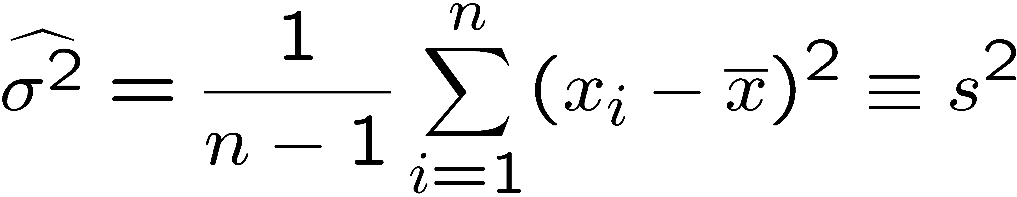
Consistency and bias (example 2)
The following estimator of the variance:
note instead of μ
n
n
is consistent BUT biased (its expectation values is always lower
than σ²) – the bias goes to zero as n goes to infinity.
The bias is due to the fact that the sample mean is constructed using
the n observed values, so it’s correlated with each of them.
The following estimator of the variance is both consistent and unbiased:
Estimators for the variance: see e.g. Loreti § 12.1
Notes:
Vedi LORETI par. 12.1

Slide 9
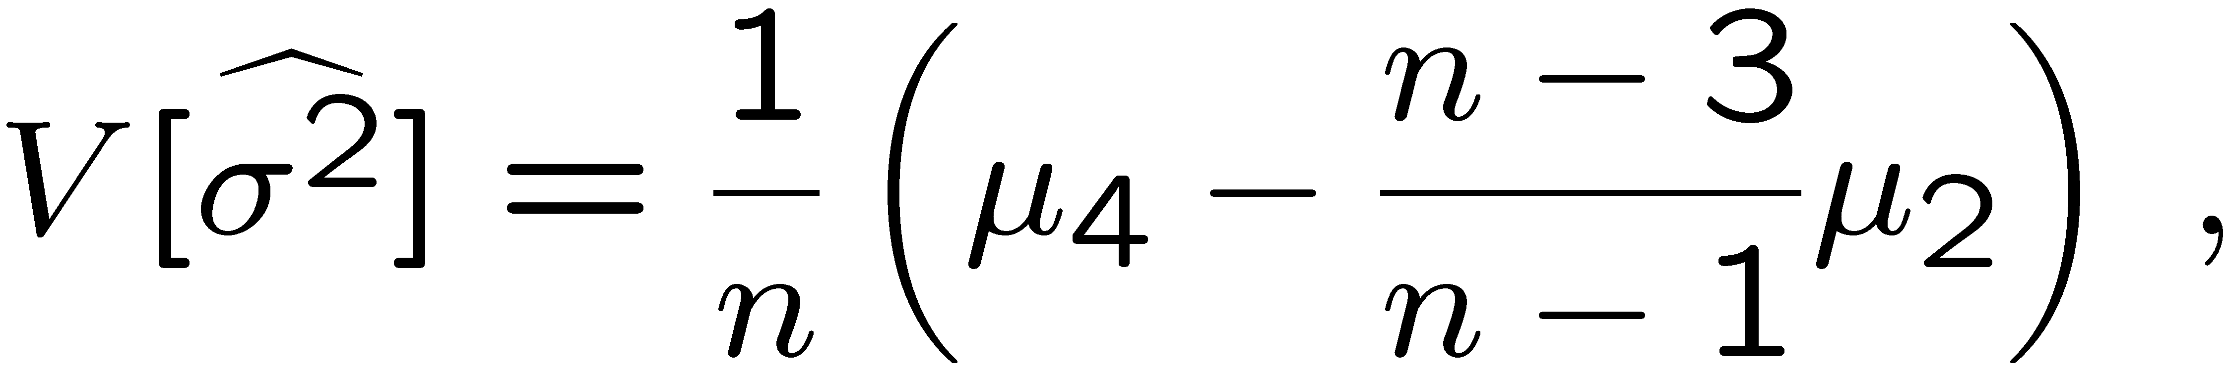
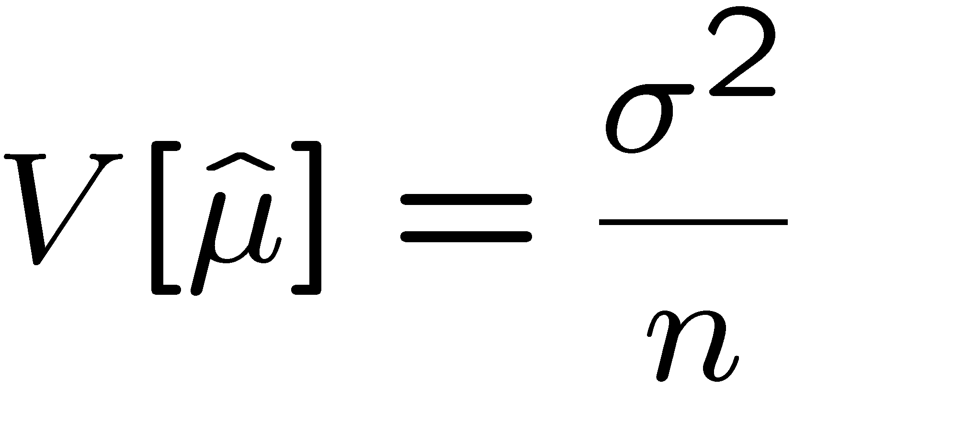
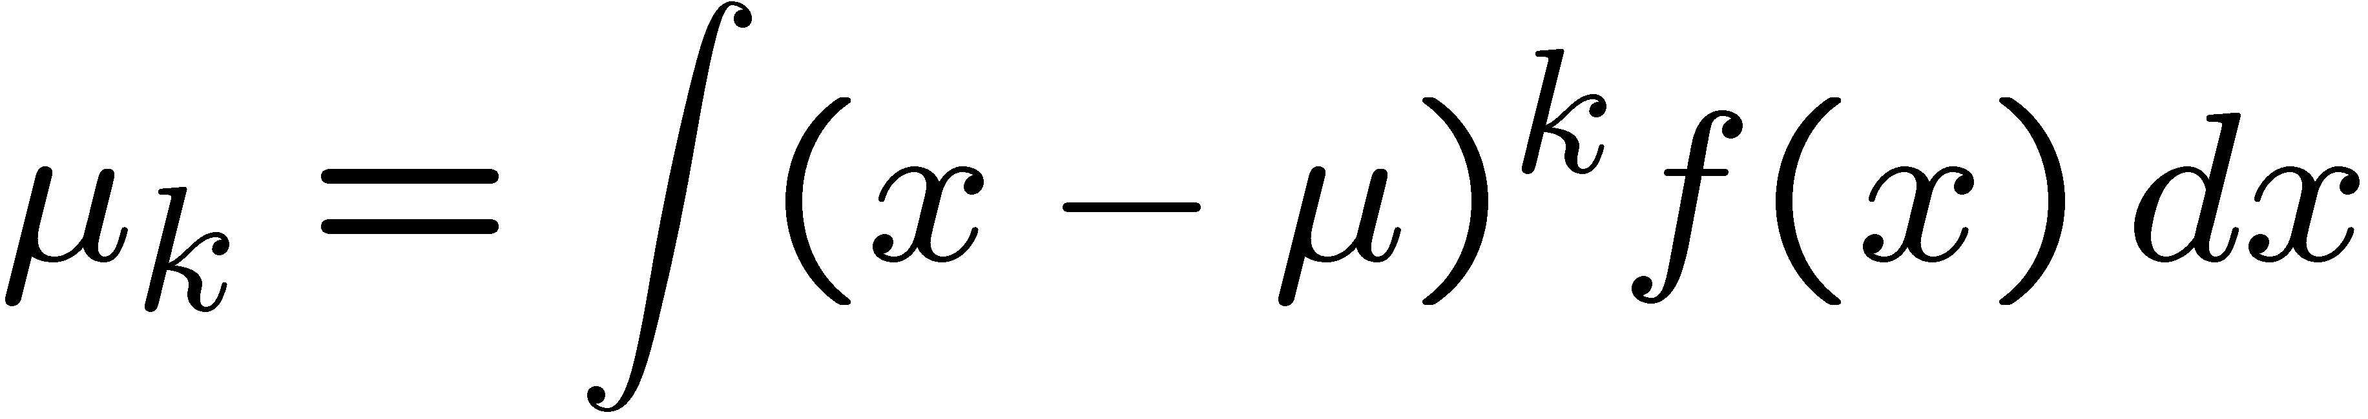
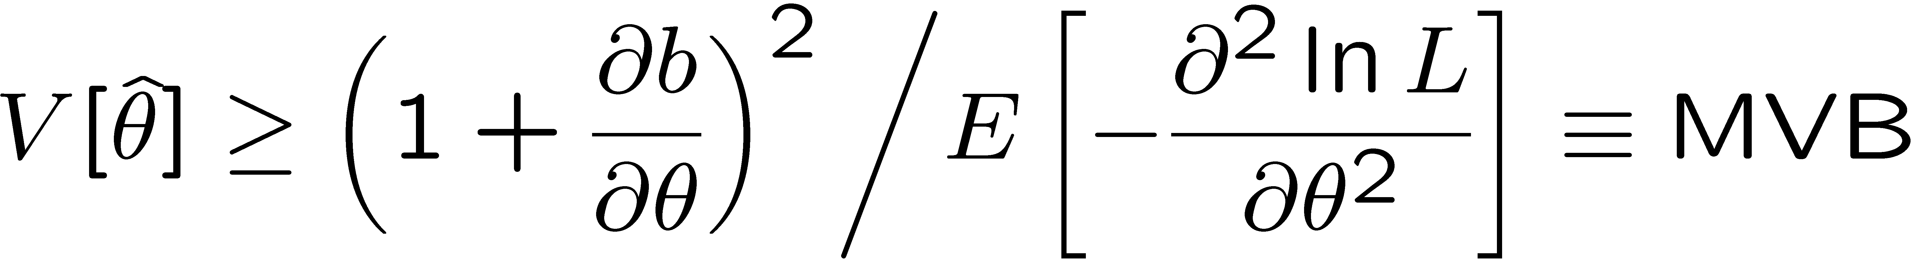
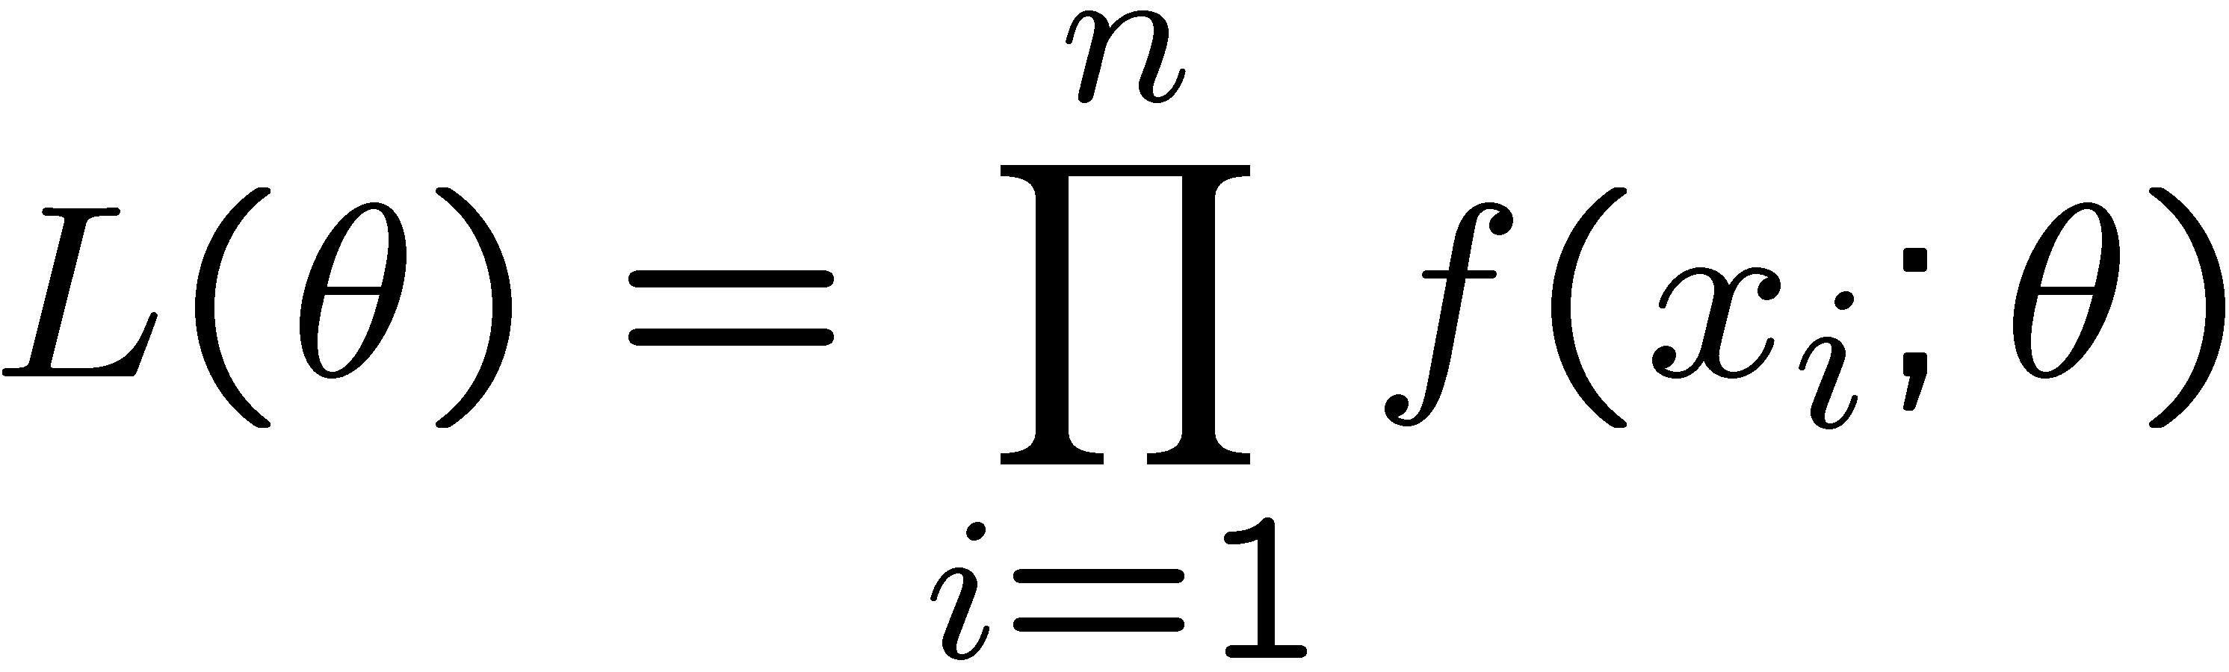
Estimator properties (2)
The variance of an estimator is another key property, for example the two unbiased estimators seen before have the following variances:
Under conditions which are not very restrictive the Rao-Cramer-Frechet theorem ensures that there is a Minimum Variance Bound:
where b is the bias and L is the likelihood function:
This leads to the definition of Efficiency:
Rao-Cramer theorem: see e.g. Loreti appendix E, or James § 7.4.1
Notes:
Errore sulla varianza: vedere LORETI appendice B.
Teorema di Rao-Cramer-Frechet: vedere LORETI appendice E.
V(theta) e’ la matrice di covarianza nel caso multidimensionale.

Slide 10
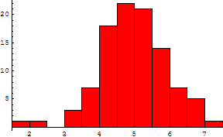
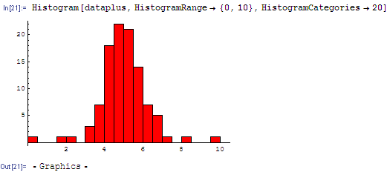
Estimator properties (3)
Robustness – loosely speaking, an estimator is robust if it is not too much sensitive to deviations of the PDF from the theoretical one - due for example to noise (outliers).
100 random values from Gaussian distribution:
mean = 4.95 (μ = 5.0)
std. dev. = 0.946 (σ = 1.0)
3 outliers added:
mean = 4.98
std. dev. = 1.19
The estimator of mean is robust, the
one of variance (std. dev.) is not …
_
Note: the sample mean x may not be the optimal estimator
if the parent distribution is not gaussian

Slide 11
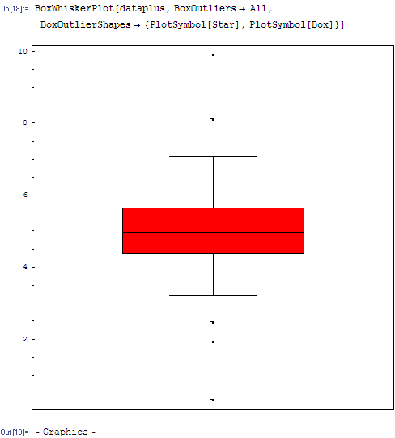
Visualizing outliers
A good way to detect outliers, other than the histogram itself, is the “Box and Wisker” plot (in the example from Mathematica):
(near) outliers
limit of “good” data
75% percentile (Q3)
median
25% percentile (Q1)
limit of “good” data
(near) outliers
By convention, near outliers are e.g. those between Q3 + 1.5*(Q3-Q1)
and Q3 + 3*(Q3-Q1), and far outliers (extreme values) those beyond that
Notes:
Near outliers (STAR): beyond 1.5 times the interquantile range (Q3-Q1, width of the box) from the edge of the (25%-75%) box;
Far outliers (BOX): beyond 3 times the interquantile range.

Slide 12
Estimator properties (4)
In most cases we should report not only the “best” value of the parameter(s) but also a confidence “interval” (a segment in 1D, a region of the plane in 2D, etc.) which reflects the statistical uncertainty on the parameter(s). The interval should have a given probability of containing the true value(s).
  Usually the 1D confidence interval is defined as ± the estimated standard deviation of the estimator
  However this may not be adequate in some cases (for example when we are close to a physical boundary for the parameter)
Coverage – for interval estimates of a parameter, a very important property is coverage, i.e. the fraction of a number of repeated evaluations in which the interval estimate will cover (contain) the true value of the parameter. Methods for interval estimation will be presented later, and coverage will be discussed there.

Slide 13
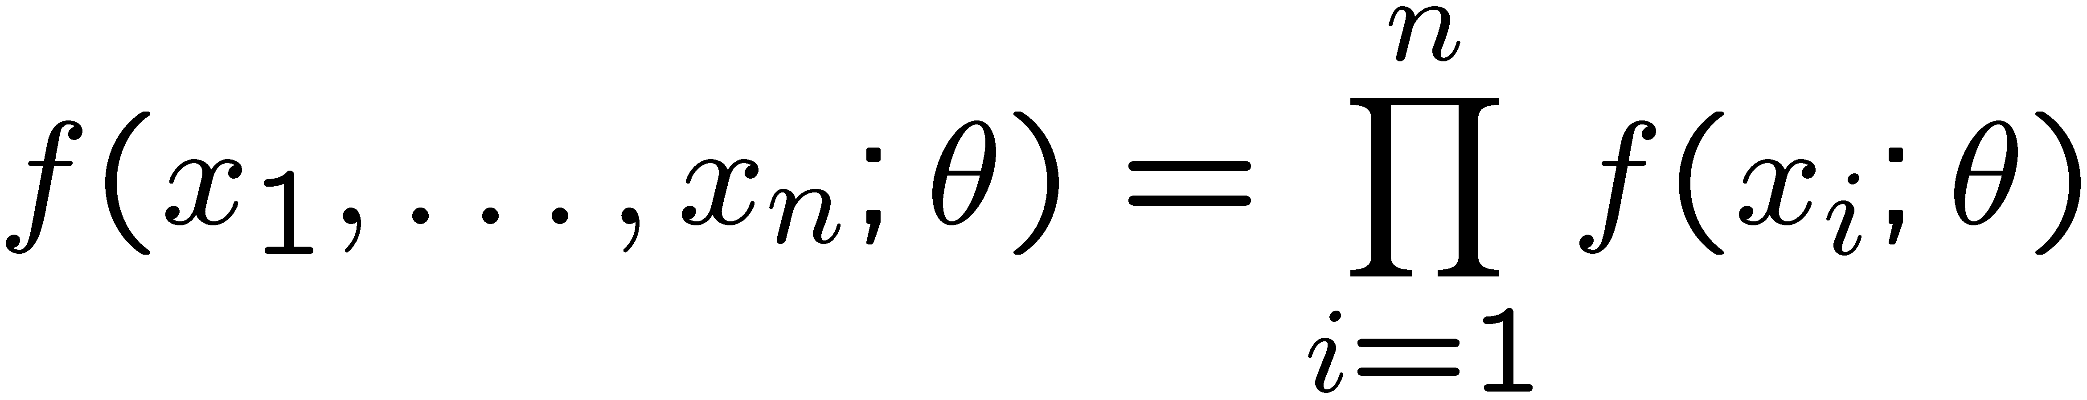
The Likelihood function
Let’s consider a set of n independent observations of x, and let f(x,θ) be the PDF followed by x; the joint PDF for the set of observations is then:
Here θ is the true value of the parameter(s); considering the x_{i}
as constants fixed by our measurement and θ as an independent
variable we obtain the Likelihood function:
Here L(θ) may be considered proportional to the probability density
associated to the random event “the true value of the parameter is θ”
We expect that L(θ) will be higher for θ values which are close to
the true one, so we look for the value which makes L(θ) maximum

Slide 14
The Maximum Likelihood estimator
The Maximum Likelihood (ML) estimator is simply defined as the value of the parameter which makes L(θ) maximum, and it can be obtained requiring:
&
Here we have already taken into account that, since L(θ) is defined as a product of positive terms, it is often more convenient to maximize the logarithm of L (log-likelihood):
The ML estimator is often the best choice, although it is not guaranteed to be ‘optimal’ (e.g. of minimum variance) except asymptotically, when the number of measurements N goes to ∞

Slide 15
Properties of the ML estimator
The ML estimator is asymptotically consistent
The ML estimator is asymptotically the most efficient one (i.e. the one with minimum variance)
The PDF of the ML estimator is asymptotically gaussian
However, with a finite number of data, there is no guarantee
that L(θ) has a unique maximum; and if there is more than one
maximum in principle there is no way to know which one is closest
to the true value of the parameter.
Under additional hypotheses on the PDF f(x;θ) it is possible to
show that already for finite N there exists a minimum variance
estimator, which then coincides with the ML one.
see e.g. Loreti, chapter 11; or F. James, chapter 7
Notes:
Vedi LORETI cap. 11

Slide 16


The ML method
Many results in statistics can be obtained as special cases of the ML method:
  The error propagation formulae
  The properties of the weighted average, which is the minimum variance estimator of the true value when data x_{i} are affected by gaussian errors σ_{i}
  The linear regression formulae, which can be obtained by maximizing the following likelihood function:
  it’s easy to show that maximizing L(a,b) is equivalent to minimizing the function:
  The previous point is an example of the equivalence between the ML method and the Least Squares (LS) method, which holds when the measurement errors follow a gaussian PDF (the Least Squares method will be discussed later)

Slide 17
The ML method in practice (1)
Often we can use the gaussian asymptotic behaviour of the likelihood function for large N:
which is equivalent for the log-likelihood to a parabolic behaviour:
to obtain simultaneously the ML estimate and its variance, from the shape of the log-likelihood function near its maximum:
the essence of the ML method is then: define & compute lnL
(either analytically or numerically), plot it, find its maximum

Slide 18
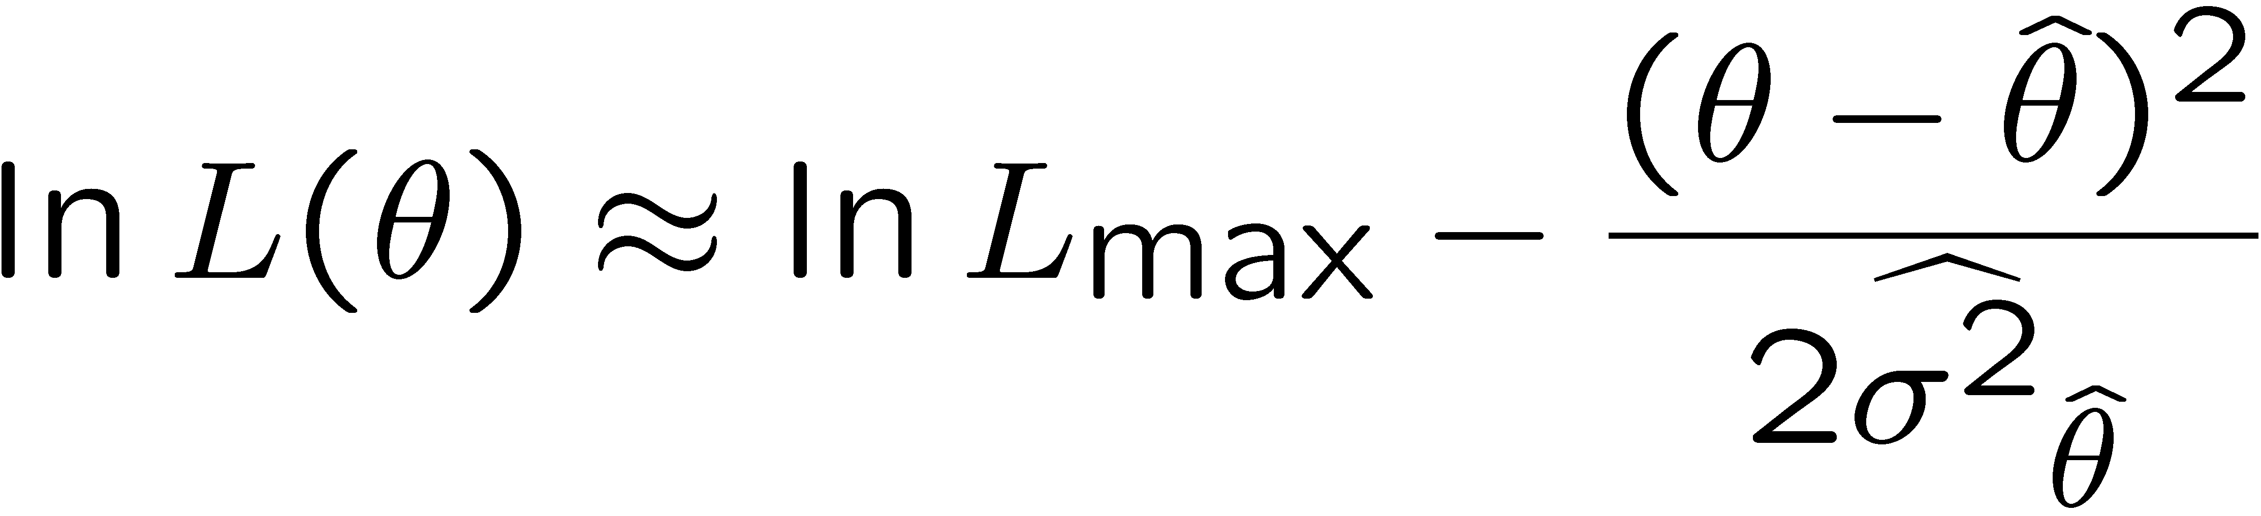
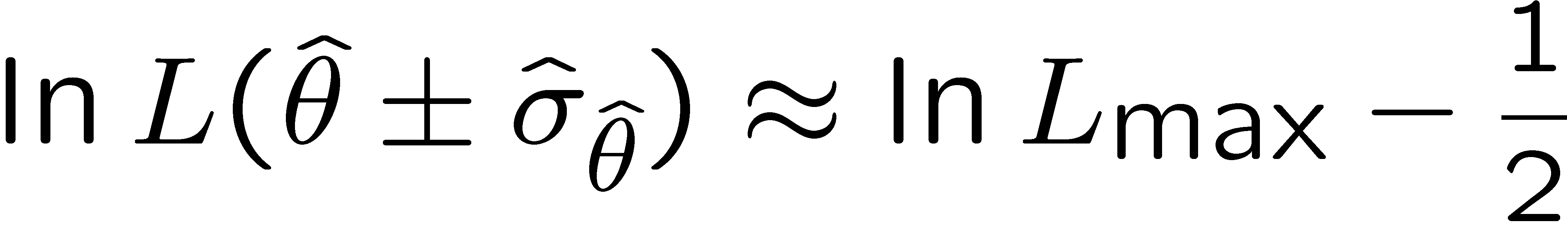


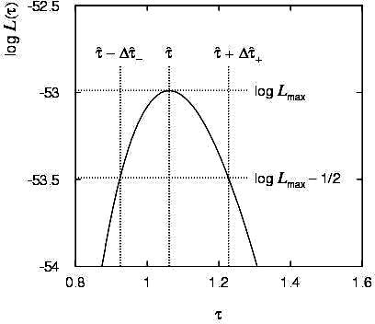
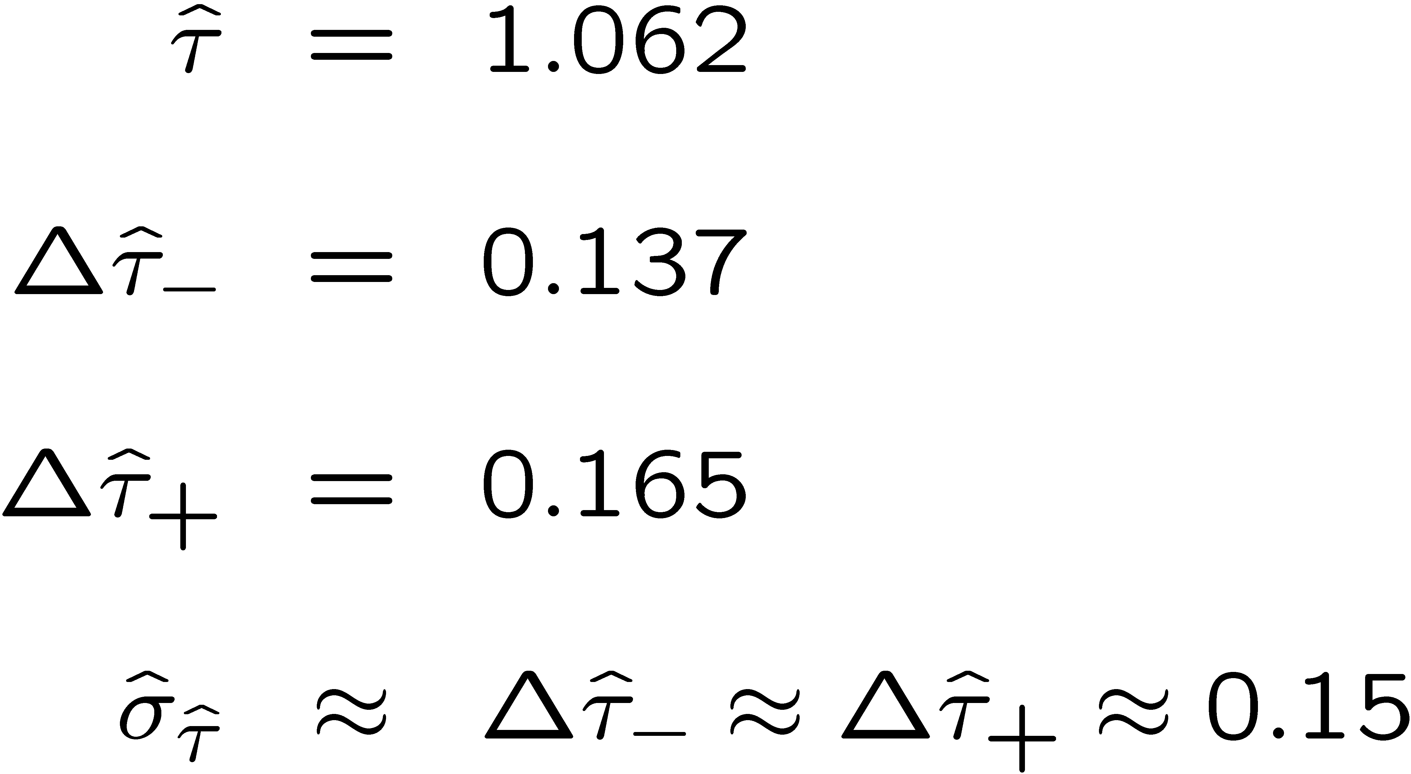
The ML method in practice (2)
By expanding the log-likelihood around its maximum:
we obtain the practical rule to get : change θ away from the estimated value until lnL(θ) decreases by ½.
This rule can be applied graphically also in case of a non-gaussian L(θ) due (for example) to a small number of measurements N(=50):
We obtain asymmetric errors
true value of parameter was: τ = 1.0

Slide 19
Meaning of the confidence interval
Let’s consider a random variable x which follows a gaussian PDF with mean μ and variance σ²; a single measurement x is already an estimator of μ, we know that the random variable z=(x-μ)/σ follows the normalized gaussian PDF so that for example:
Prob(-2<z<+2) = 0.954
(*)
We may be tempted to say that “the probability that the true value μ belongs to the interval [x-2σ,x+2σ] is 0.954” … in fact (according to the frequentist view):
  μ is not a random variable
  [x-2σ,x+2σ] is a random interval
  The probability that the true value is within that interval is …
    0 if μ < (x-2σ) or μ < (x-2σ)
    1 if (x-2σ) ≤ μ ≤ (x-2σ)
The actual meaning of statement (*) is that “if we repeat the measurement many times, the true value will be covered by the interval [x_{i}-2σ,x_{i}+2σ] in 95.4% of the cases, on average ”
Of course if we use the sample mean the variance will be reduced

Slide 20
Example 1 of ML method: m(top)
In their paper* on all-hadronic decays of tt pairs CDF retained 136 events with at least one b-tagged jet and plotted the 3-jet invariant mass (W⁺b → qqb → 3 jets).
The ML method was applied to extract the top quark mass: in the 11 HERWIG MC samples m_{top} was varied from 160 to 210 GeV, ln(likelihood) values were
plotted to extract m_{top} = 186 GeV
and a ±10 GeV statistical error
* F. Abe et al., Phys. Rev. Lett. 79 (1997) 1992

Slide 21
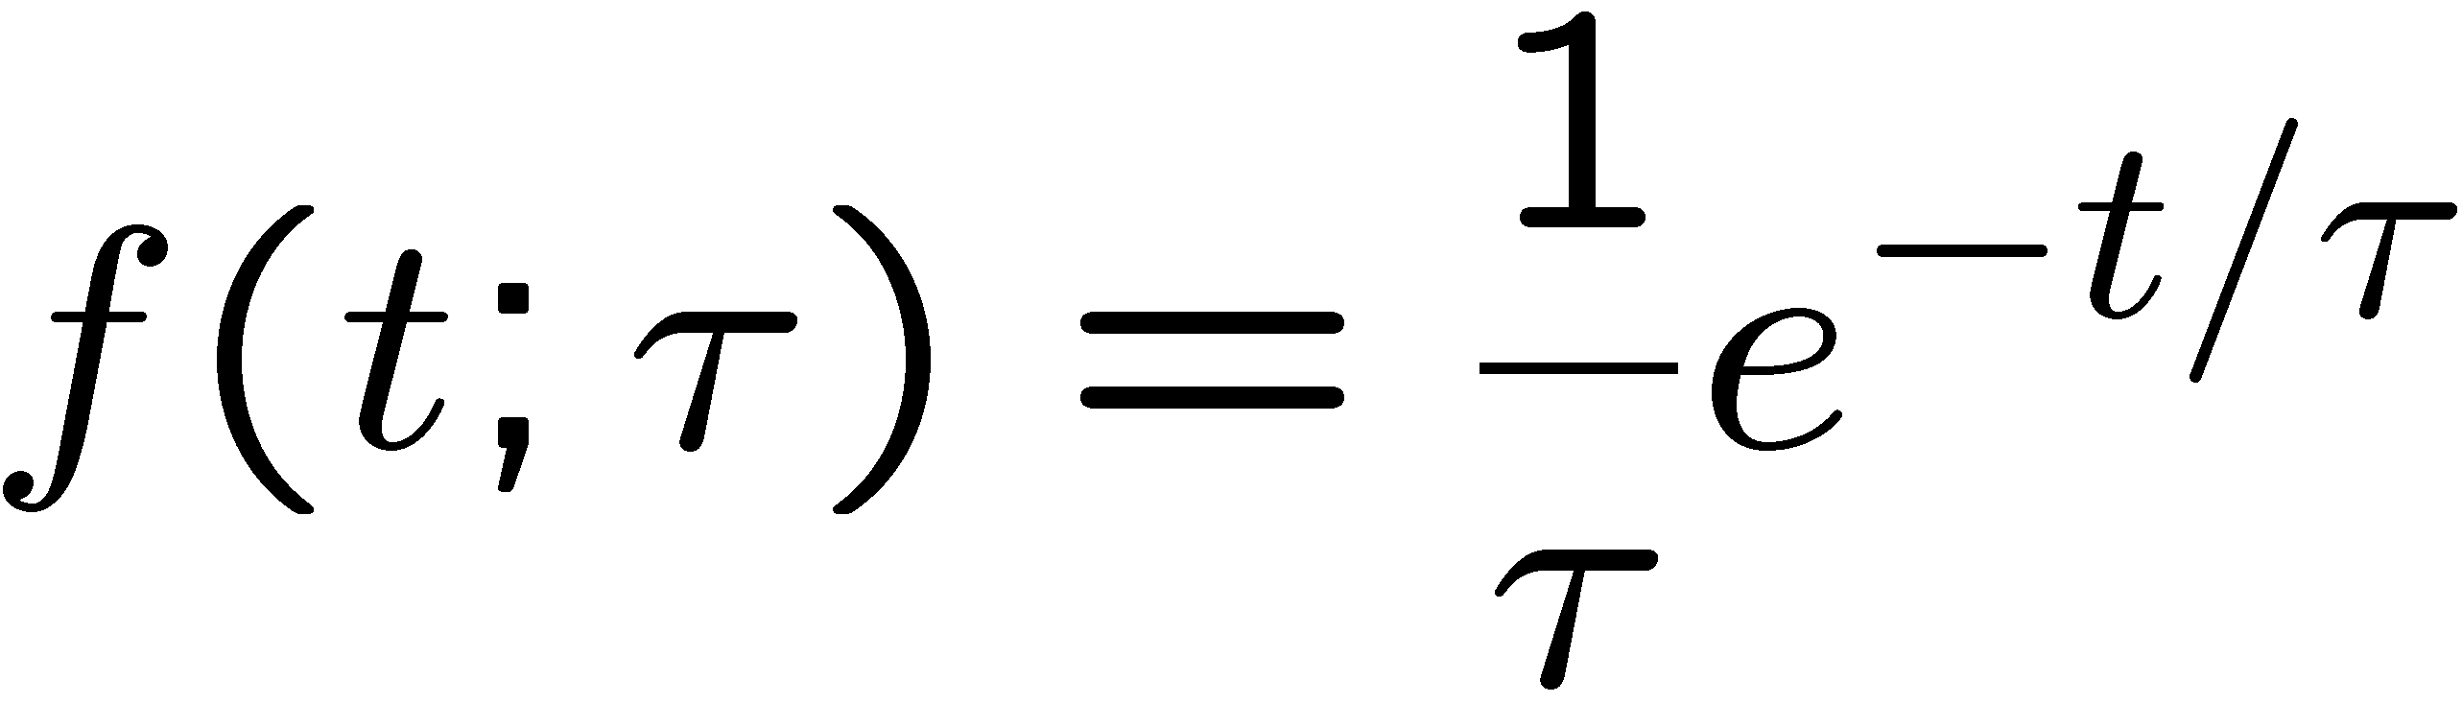
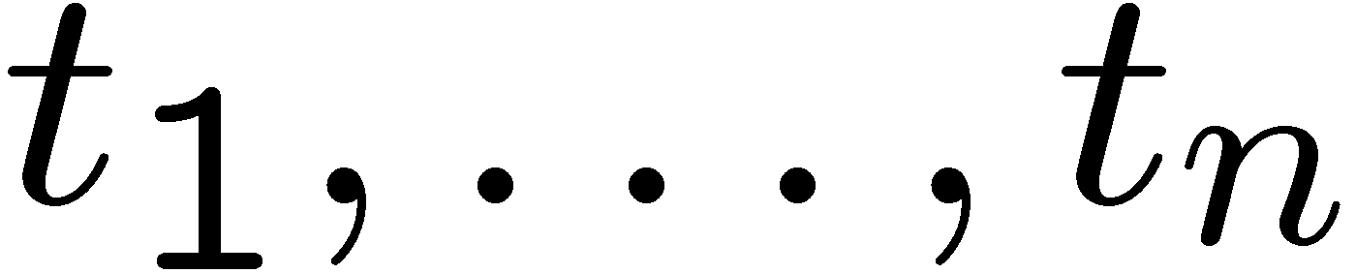
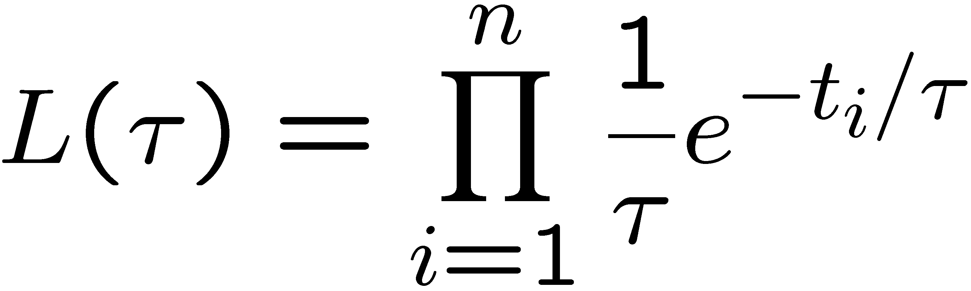
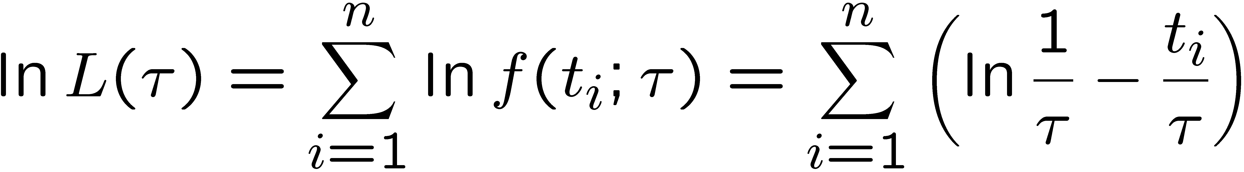
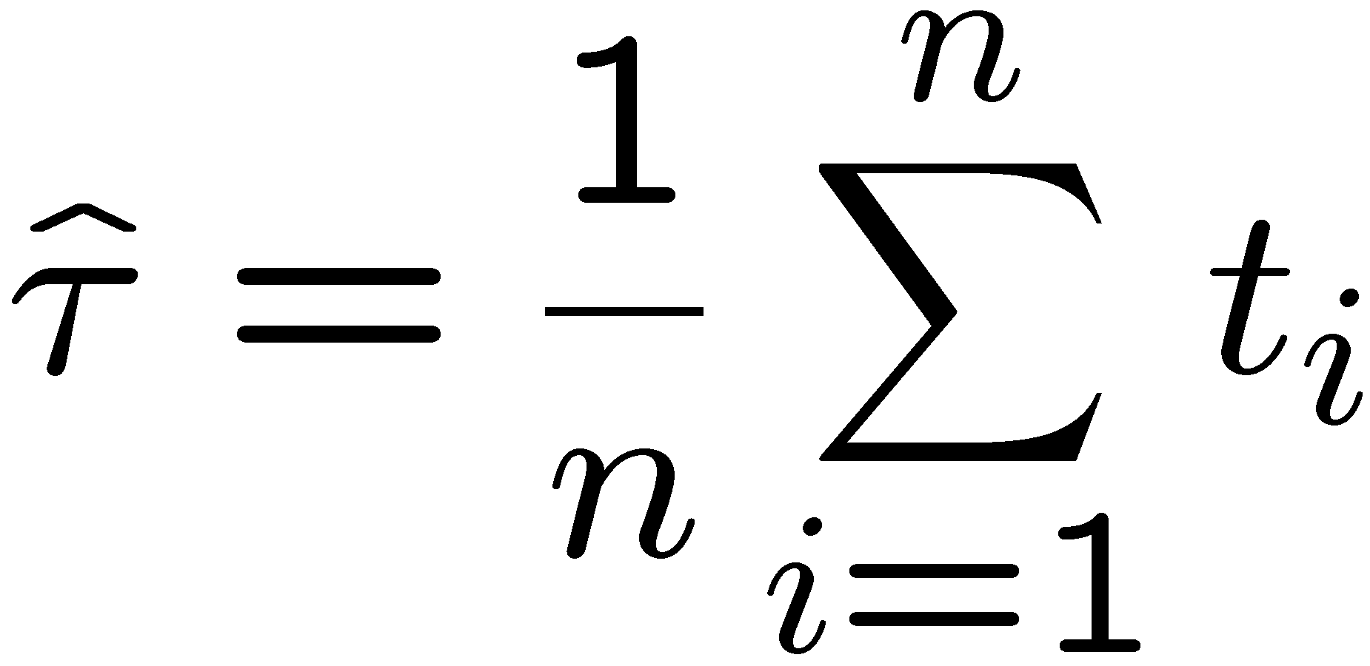
Parameter of exponential PDF (1)
Let’s consider an exponential PDF (defined for t ≥0) with a parameter τ:
and a set of measured values:
The likelihood function is:
We can determine the maximum of L(τ) by maximizing the log-likelihood:
The result is:

Slide 22
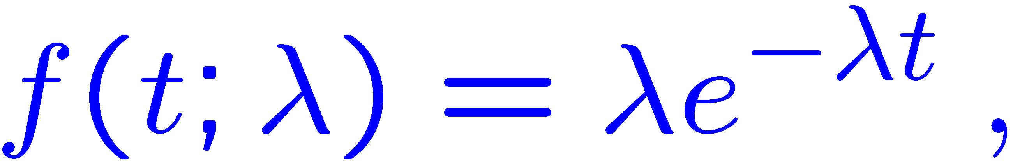
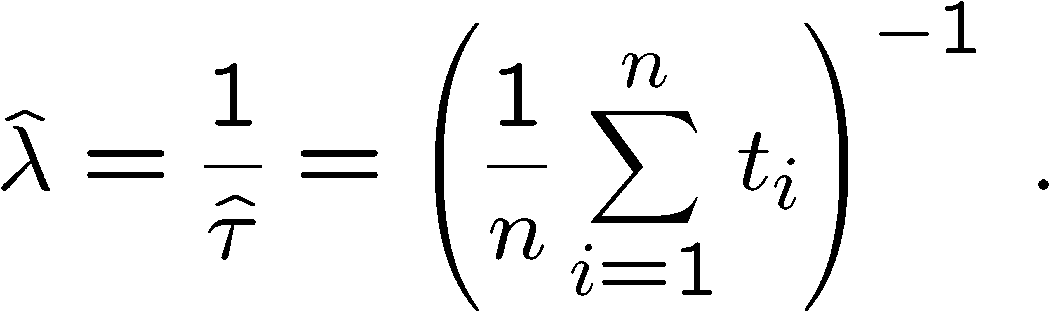
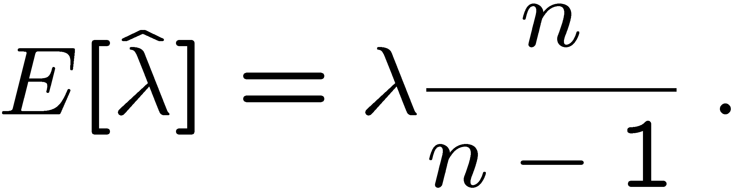
Parameter of exponential PDF (2)
The result is quite simple: the ML estimator is just the mean of the observed values (times)
It is possible to show that this ML estimator is unbiased
Changing representation
the ML estimate for λ is simply the inverse of the one for τ:
but now the ML estimate for λ is biased (although the bias vanishes as n goes to ∞):
Let’s now consider an example (the Λ baryon lifetime measurement)
where a modified Likelihood function takes into account some
experimental facts…

Slide 23
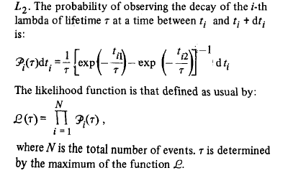
Example 2 of ML method: τ(Λ)
In bubble chamber experiments* the Λ particle can be easily identified by its decay Λ→pπ- and its lifetime τ can be estimated by observing the proper time t_{i} = x_{i}/(β_{i}γ_{i}c) for a number of decays (i=1,N)
There are however technical limitations: the projected length of the Λ particle must be above a minimum length L₁ (0.3 to 1.5 cm) and below a maximum which is the shortest of either the remaining length to the edge of the fiducial volume or a maximum length L₂ (15 to 30 cm)
These limitations define a minimum and a maximum proper time t_{i1} and t_{i2} for each observed decay – t_{i1} and t_{i2} depend on momentum and t_{i2} also on the position of the interaction vertex along the chamber
  They can be easily incorporated into the likelihood function by normalizing the exponential function in the interval [t_{i1},t_{i2}] instead of [0,+∞]
this factor is missing
from the article
see also James § 8.3.2
* G. Poulard et al., Phys. Lett. B 46 (1973) 135
Notes:
Vedere Zech [Zech-BOOK-2004.pdf] p. 141, Beispiel: Zeitverteilungen; F. James par. 8.3.2

Slide 24
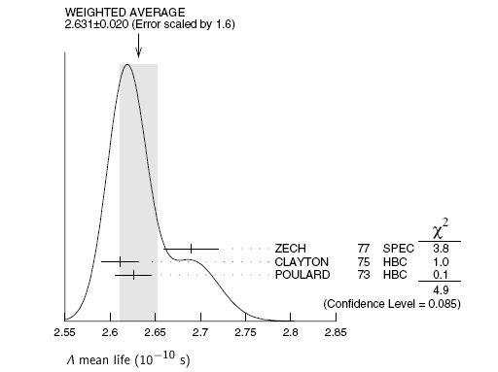
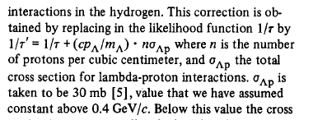
The measurement of τ(Λ)
Phys. Lett. B 46
(1973)
Particle Data Group (2006)
Further correction (Λp interactions):

Slide 25
The frequentist confidence interval
The frequentist theory of confidence intervals is largely due to J. Neyman*
  he considered a general probability law (PDF) of the type: p(x₁,x₂, … , x_{n};θ₁,θ₂, … , θ_{m}), where x_{i} is the result of the i-th measurement, θ₁, θ₂, … , θ_{m} are unknown parameters and an estimate for one parameter (e.g. θ₁) is desired
  he used a general space G with n+1 dimensions, the first n corresponding to the “sample space” spanned by {x₁,x₂, … , x_{n}} and the last to the parameter of interest (θ₁)
  Neyman’s construction of the confidence interval for θ₁, namely: δ(E)=[θ(E),θ(E)], corresponding to a generic point E of the sample space, is based on the definition of the “confidence coefficient” α (usually it will be something like 0.90-0.99) and on the request that:
  Prob{θ(E) ≤ θ₁ ≤ θ(E)}=α
  this equation defines implicitly two functions of E: θ(E) and θ(E), and so it defines all the possible confidence intervals
* in particular: Phil. Trans. Roy. Soc. London A 236 (1937) 333

Slide 26
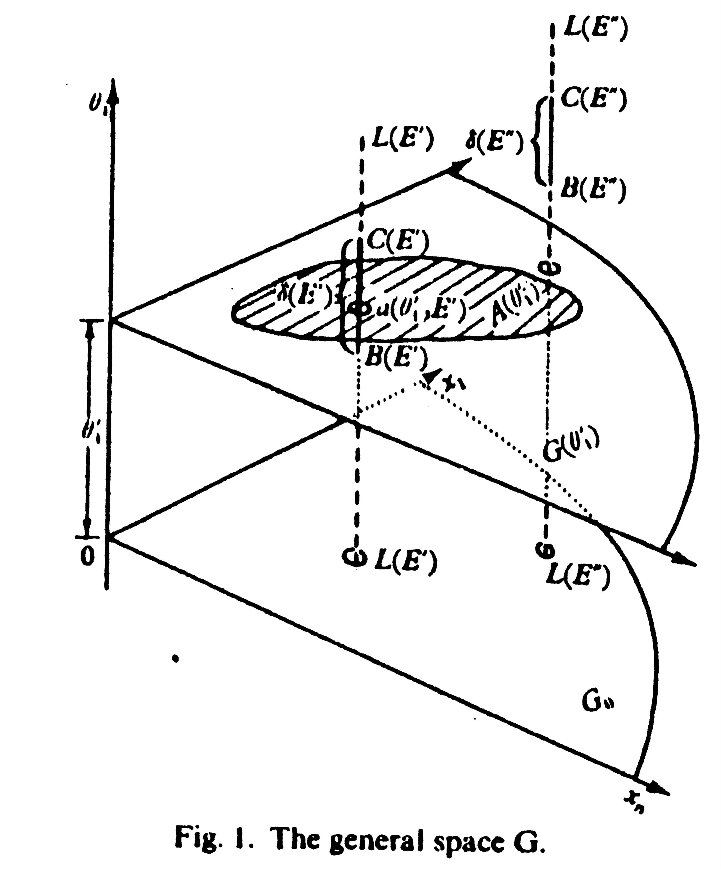
Neyman’s construction
  The shaded area is the “acceptance region” on a given hyperplane perpendicular to the θ₁ axis: it collects all points (like E’) of the sample space whose confidence interval, a segment δ(E’) parallel to the θ₁ axis, intersects the hyperplane, and excludes other points like E’’
  If we are able to construct all the “horizontal” acceptance regions on all hyperplanes, we will then be able to define all the “vertical” confidence intervals (segments) for any point E
  These confidence intervals will cover the true value of the parameter in a fraction α of the experiments

Slide 27
Neyman’s construction example/1
sample space here is represented
by just one variable, x
From K. Cranmer, CERN Academic Training, February 2009

Slide 28
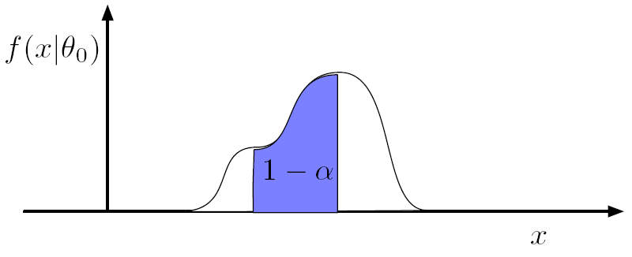
Neyman’s construction example/2
α
α

Slide 29
Neyman’s construction example/3

Slide 30
Neyman’s construction example/4
The regions of data (in this case, segments) in the confidence belt
can be considered as consistent with that value of θ

Slide 31
Neyman’s construction example/5
Now we make a measurement :
define

Slide 32
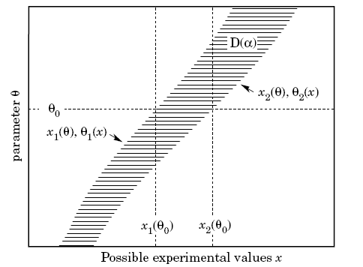
Constructing the confidence belt
The “confidence belt” D(α), defined for a specific confidence coefficient α, is delimited by the end points of the horizontal acceptance regions (here: segments)
A given value of x defines in the “belt” a vertical confidence interval for the parameter θ
Usually an additional rule is needed to specify the acceptance region, for example in this case it is sufficient to request that it is “central”, defining two excluded regions to the left and to the right with equal probability content (1-α)/2
in this example the sample space
is unidimensional, the acceptance
regions are segments like x₁(θ₀),x₂(θ₀)

Slide 33
Types of confidence intervals
Two possible auxiliary criteria are indicated, leading respectively
to an upper confidence limit or to a central confidence interval.
Feldman & Cousins, Phys. Rev. D57 (1998) 3873
Notes:
Text and figures from Feldman & Cousins, Phys. Rev. D57 (1998) 3873

Slide 34
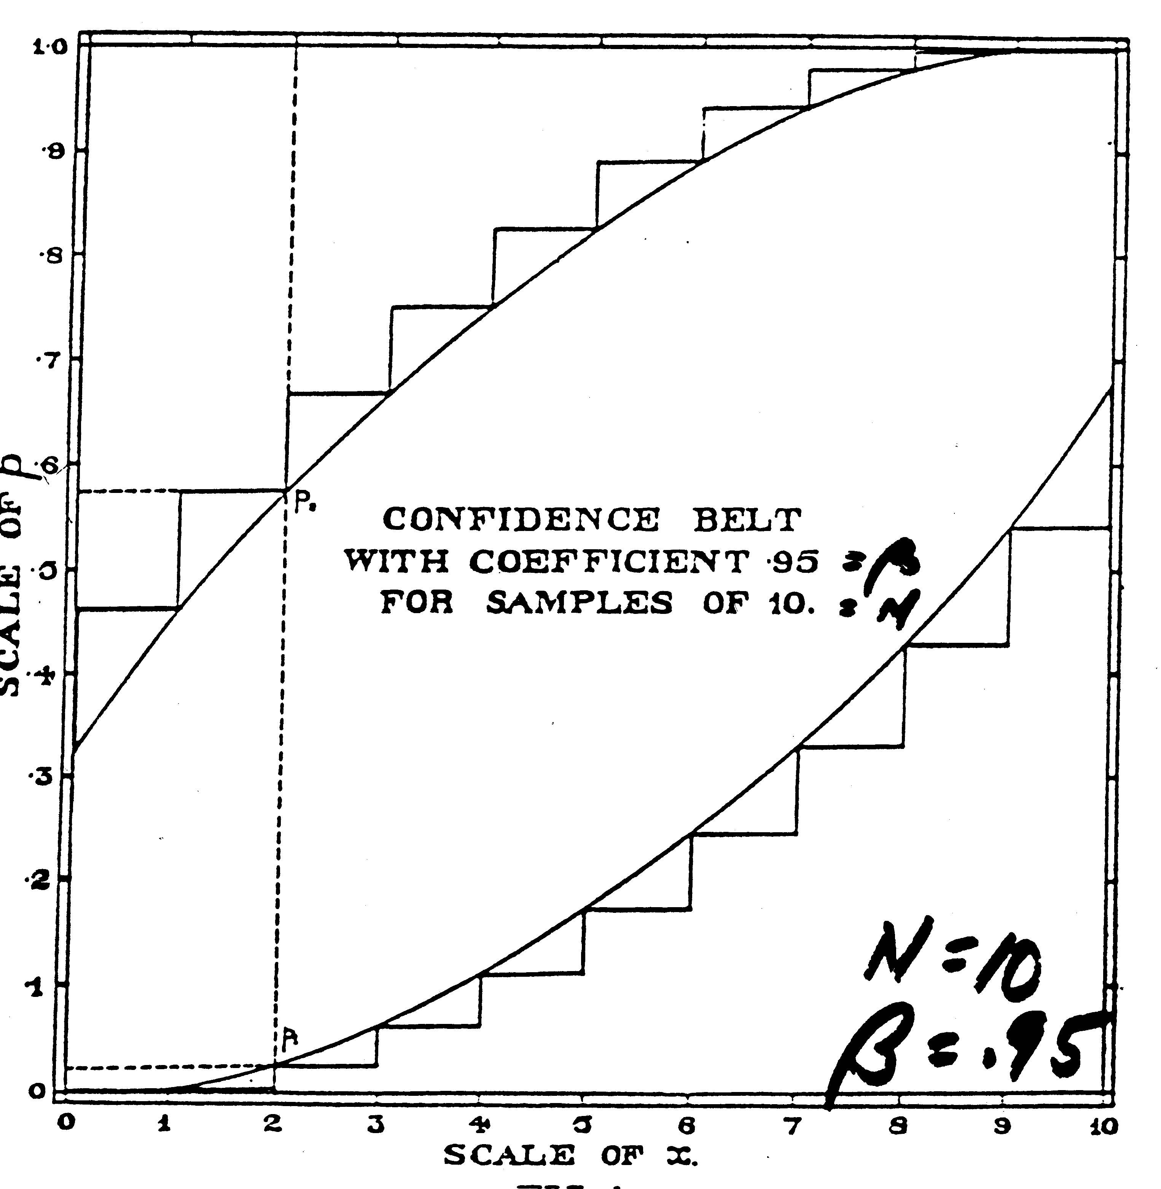
An example of confidence belt
Confidence intervals for the binomial parameter p, for samples of 10 trials, and a confidence coefficient of 0.95
for example: if we observe 2 successes in 10 trials (x=2) the 95% central confidence interval for p is: .03 < p < .57
with increasing number of trials the confidence belt will become narrower and narrower
Clopper & Pearson, Biometrika 26 (1934) 404

Slide 35
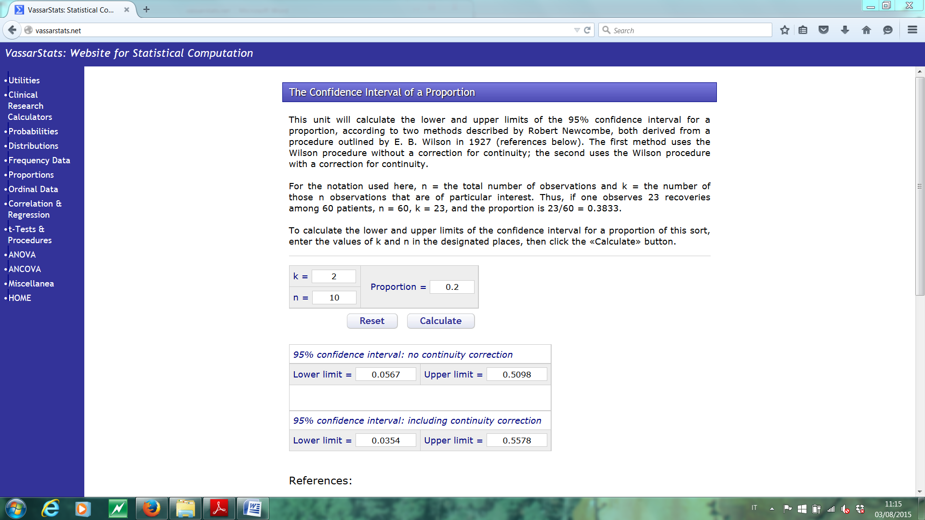
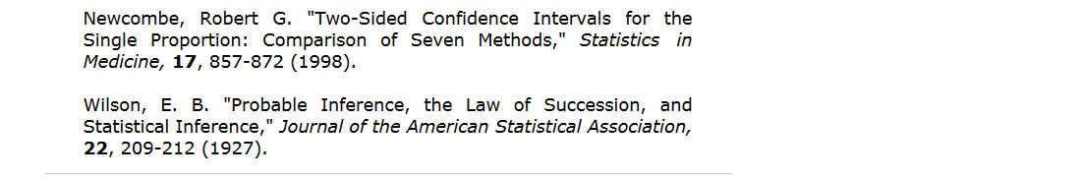
More on binomial C.I. (1)
example of online resource to compute (among other things)
the 95% binomial C.I.:
http://vassarstats.net/
Proportions
Notes:
Richard Lowry, PhD
Professor of Psychology Emeritus
Vassar College ~ Poughkeepsie, NY USA
Residential Address ~ Avon, Connecticut USA

Slide 36
More on binomial C.I. (2)
For large values of N the binomial distribution is well approximated by a Gaussian
Agresti and Coull (1998) have developed a modified normal approximation method that is recommended for CI calculation for proportions x/N between 1% and 99% even if N is small: given the z-value (e.g. 1.96 for 95% C.L.)
  add z² (rounded to nearest integer) to denominator N
  add half of that to numerator x
  compute the C.I. using the normal approximation
C.L. | z | z² ⇨ add to N | ½ z² ⇨ add to x
95% | 1.96 | 3.84 ⇨ 4 | 1.92 ⇨ 2
example: x/N = 2/10 ⇨ use x’/N’ = 4/14 and Gaussian
approximation for the 95% C.I. calculation

Slide 37

Gaussian confidence intervals (1)
Central confidence intervals and upper confidence limits for a gaussian PDF are easily obtained from the error function (integral of the gaussian), either from tables of from mathematical libraries:
  CERNLIB: GAUSIN
  double ROOT::Math::erf(double x)
  or in alternative gaussian_cdf:
NOTE: here the definitions of α & 1-α are interchanged wrt previous slides

Slide 38
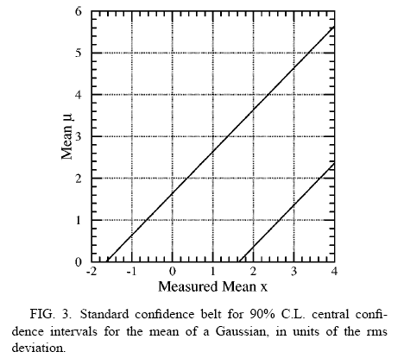
Gaussian confidence intervals (2)
The 90% C.L. confidence UPPER limits (left) or CENTRAL intervals (right) are shown for an observable “Measured Mean” (x) which follows a gaussian PDF with Mean μ and unit variance:
μ_{UL}=x+1.28
μ⁺=x+1.64
90% (U.L.)
confidence
region
90%
confid.
μ⁻=x-1.64
region
Suppose that μ is known to be non-negative. What happens if an
experiment measures x = -1.8? (the vertical confidence interval
turns out to be empty)

Slide 39


Poissonian confidence intervals (1)
n₀ = 3 was
observed

Slide 40

Poissonian confidence intervals (2)
Here are the standard confidence UPPER limits (left) or CENTRAL intervals (right) for an unknown Poisson signal mean μ in presence of a background of known mean b=3.0 at 90% C.L.:
for μ=0.5 the
acceptance
interval is [1,7]
(1 & 7 included)
since the observable n is integer, the
confidence intervals “overcover” if
needed (undercoverage is considered a
more serious flaw)
If we have observed n=0, again the confidence interval for μ is empty

Slide 41
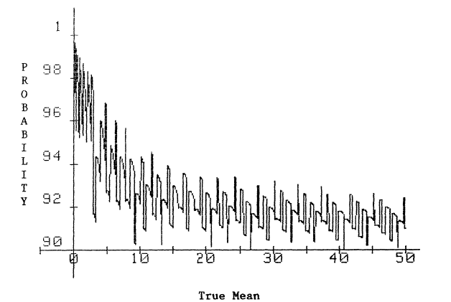
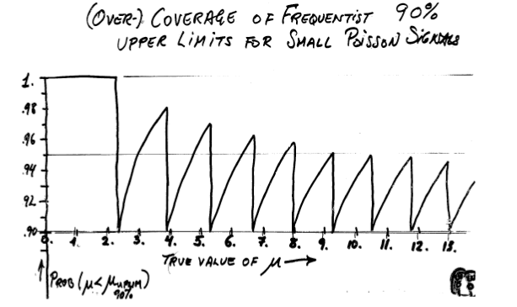
Poissonian confidence intervals (3)
since the observable n is integer, the
confidence intervals “overcover” if
needed (undercoverage is considered a
more serious flaw)
Garwood (1936): coverage
of 90% upper limit intervals
see also James § 9.2.5
Notes:
Vedere BU-903-M.Revised.pdf, Fig. 1.

Slide 42
Problems with frequentist intervals
Discrete PDF’s (Poisson, Binomial, …)
  If the exact coverage α cannot be obtained, overcoverage is necessary (see previous slide)
Arbitrary choice of confidence interval
  should be removed by auxiliary criteria
Physical limits on parameter values
  see later: Feldman+Cousins (FC) method
Coverage & how to quote result
  decision to quote upper limit rather than confidence interval should be taken before seeing data (or undercoverage may happen)
Nuisance parameters
  parameters linked to noise, background can disturb the determination of physical parameters

Slide 43
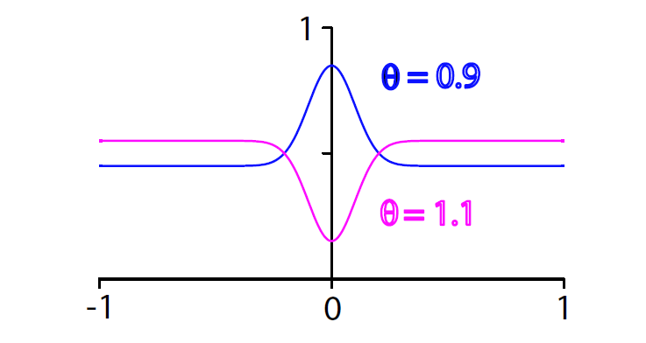
Physical and mathematical boundaries (1)
model: signal with Gaussian shape over a flat background (-1 ≤ x ≤ 1)
strength of the signal: 1- θ
physical boundary: 0 ≤ θ ≤ 1
mathematical boundary: the PDF must be ≥ 0 in [-1,1]
the magenta PDF (θ = 1.1) is outside the physical boundary but
inside the mathematical one
a fit to data (e.g. a Maximum Likelihood fit, binned or unbinned)
may produce a parameter value outside the physical boundary
or even outside the mathematical boundary
Notes:
Reference: F.C. Porter, SLAC-PUB-10243 (2003), arXiv:0311092v1 – par. 4.2.2

Slide 44
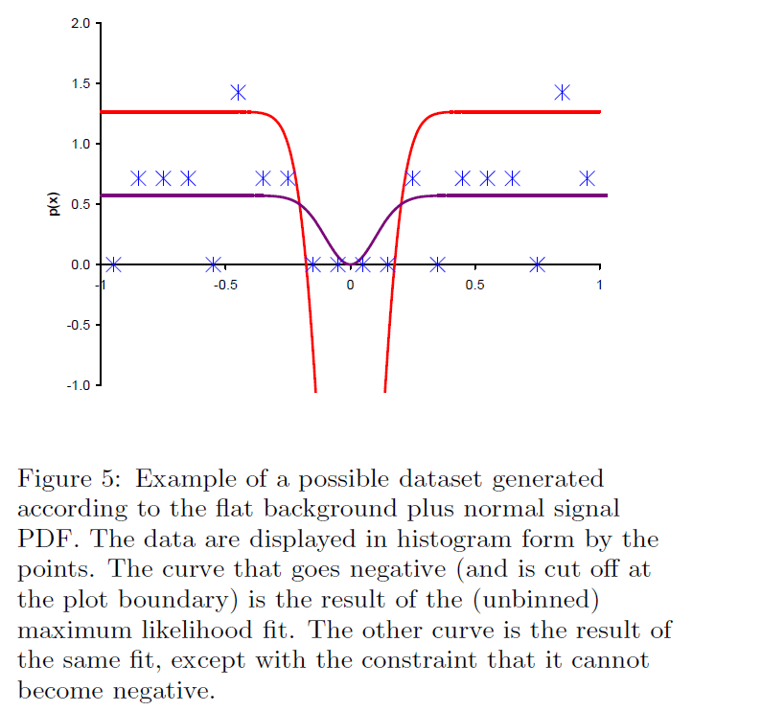
Physical and mathematical boundaries (2)
Red: result of unbinned ML fit
Violet: result of same fit with
additional constraint that curve
cannot become negative
the fit constrained to the
mathematical boundary
gives a reasonable
representation of the data,
even if the parameter
value is “unphysical”
F.C. Porter, SLAC-PUB-10243 (2003), arXiv:0311092v1
Notes:
Reference: F.C. Porter, SLAC-PUB-10243 (2003), arXiv:0311092v1 – par. 4.2.2

Slide 45

The Feldman+Cousins CI’s
Feldman and Cousins* have used the Neyman construction with an ordering principle to define the acceptance regions; let’s see their method in the specific case of the Poisson process with known background b=3.0
The horizontal acceptance interval n ∈ [n₁,n₂] for μ = 0.5 is built by ordering the values of n not simply according to the likelihood P(n|μ) but according to the likelihood ratio R:
where μ_{best} is the value of μ giving the highest likelihood for the observed n:
μ_{best} =max(0,n-b)
P(n=0|μ=0.5)=0.030 is low in
absolute terms but not so low when
compared to P(n=0|μ=0.0)=0.050
The horizontal acceptance region for
μ=0.5 contains values of n ordered
according to R until the probability
exceeds α=0.90: n ∈ [0,6] with a
total probability of 0.935 (overcoverage)
* Phys. Rev. D57 (1998) 3873

Slide 46
The FC poissonian CI’s (1)
F&C have computed the confidence belt on a grid of discrete values of μ in the interval [0,50] spaced by 0.005 and have obtained a unified confidence belt for the Poisson process with background:
  at large n the method gives two-sided confidence intervals [μ₁,μ₂] which approximately coincide with the standard central confidence intervals
  for n≤4 the method gives an upper limit, which is defined even in the case of n=0
very important consequence:
the experimenter has not (unlike
the standard case – slide 32)
anymore the choice between a
central value and an upper limit
(flip-flopping)*, but he/she can now
use this unified approach
* this flip-flopping leads to undercoverage in some cases

Slide 47
The FC poissonian CI’s (2)
For n=0,1, …, 10 and 0≤b≤20 the two ends μ₁ (left) and μ₂ (right) of the unified 90% C.L. interval for μ are shown here:
μ₁ is mostly 0
except for the
dotted portions
of the μ₂ curves
For n=0 the upper limit is decreasing with increasing background b (in contrast
the Bayesian calculation with uniform prior gives a constant μ₂ = 2.3)

Slide 48

The FC gaussian CI’s (1)
In the case of a Gaussian with the constraint that the mean μ is non-negative the F&C construction provides this unified confidence belt:
the unified confidence belt has the following features:
  at large x the method gives two-sided confidence intervals [μ₁,μ₂] which approximately coincide with the standard central confidence intervals
  below x=1.28 (when α=90%) the lower limit is zero, so there is an automatic transition to the upper limit

Slide 49
The FC gaussian CI’s (2)
This table can be used to compute the unified confidence interval for the mean μ of a gaussian (with σ=1),
constrained to be non-negative,
at four different C.L.’s,
for values of the measured mean x₀ from -3.0 to +3.1

Slide 50
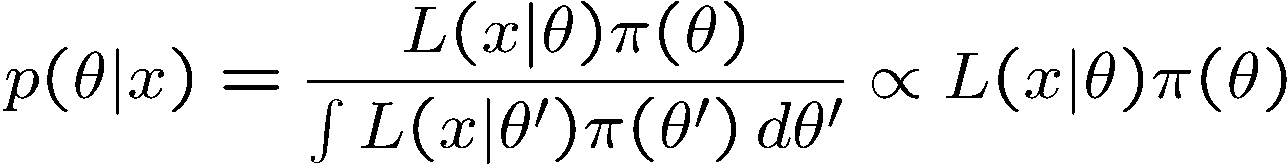
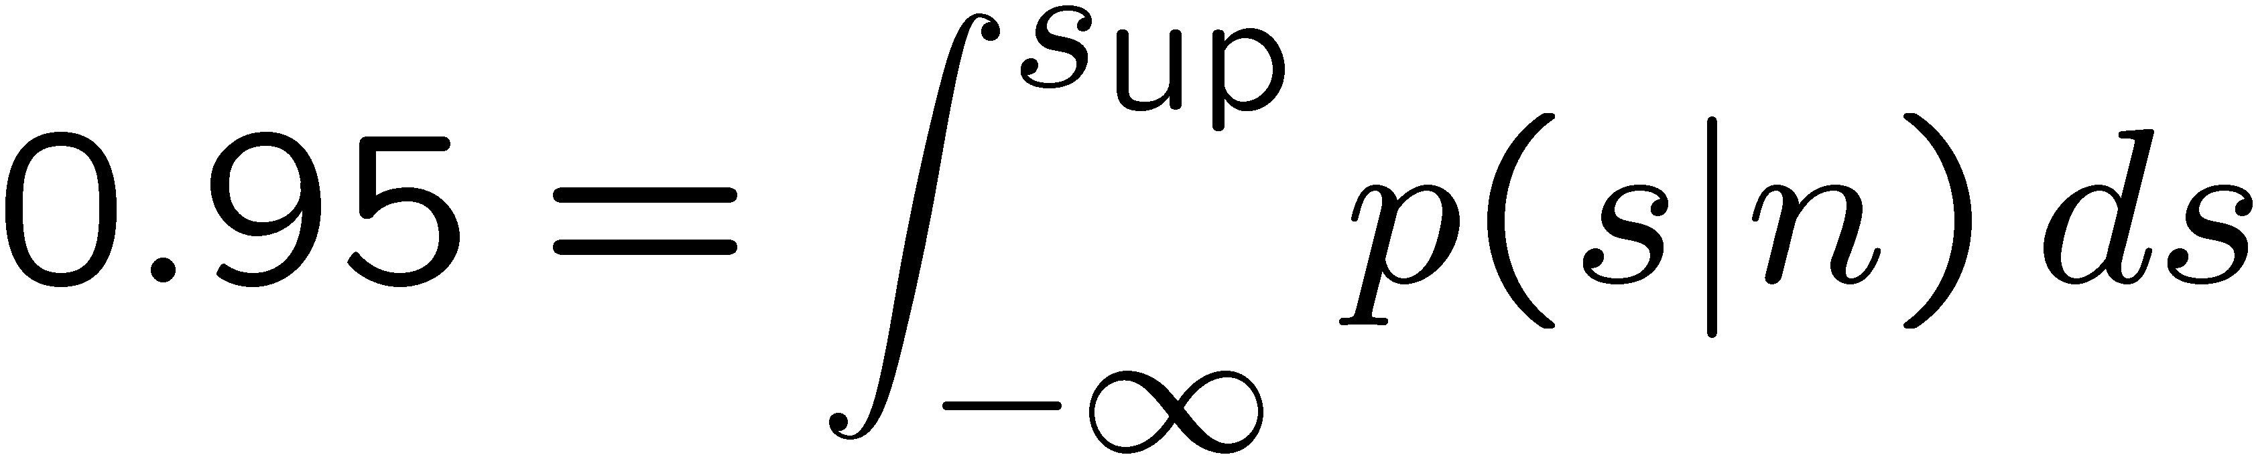
Bayesian confidence intervals
In Bayesian statistics we need to start our search for a confidence interval from a “prior PDF” π(θ) which reflects our “degree of belief” about the parameter θ before performing the experiment; then we update our knowledge of θ using the Bayes theorem:
Then by integrating the posterior PDF p(θ|x) we can obtain intervals
with the desired probability content.
For example the Poisson 95% C.L. upper limit for a signal s when
n events have been observed would be given by:
Let’s suppose again to have a Poisson process with background b and the signal s constrained to be non-negative…

Slide 51
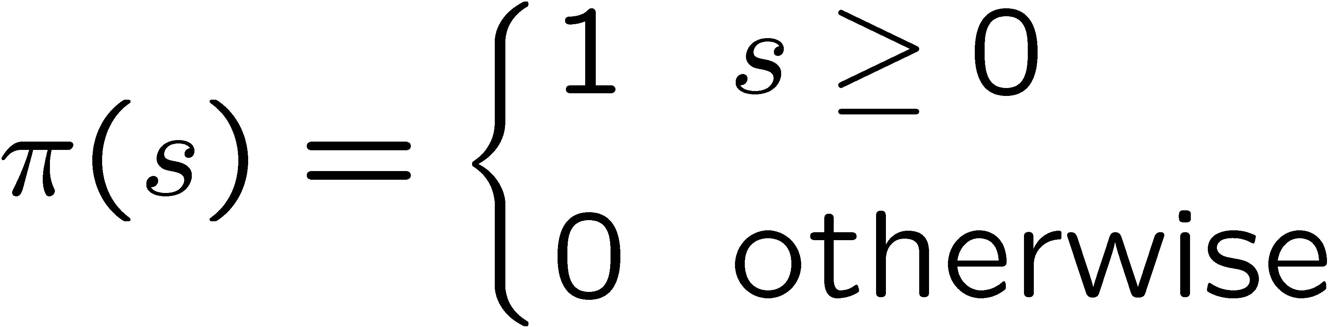
Setting the Bayesian prior
We must at the very least include the knowledge that the signal s is ≥0 by setting π(s) = 0 for s ≤ 0
Very often one tries to model “prior ignorance” with:
This particular prior is not normalized but it is OK in practice if the likelihood L goes off quickly for large s
The choice of prior is not invariant under change of parameter:
  Higgs mass or mass squared ?
  Mass or expected number of events ?
Although it does not really reflect a degree of belief, this uniform prior is often used as a reference to study the frequentist properties (like coverage) of the Bayesian intervals

Slide 52
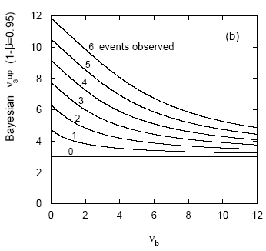
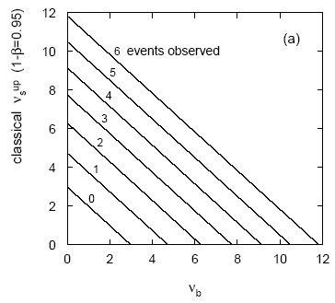
Bayesian upper limits (Poisson)
The Bayesian 95% upper limit for the signal in a Poisson process with background is shown here for n=0,1,2,3,4,5,6 observed events:
  in the special case b=0 the Bayesian upper limit (with flat prior) coincides with the classical one
  with n=0 observed events the Bayesian upper limit does not depend on the background b (compare FC* in slide 47)
  for b>0 the Bayesian upper limit is always greater than the classical one
  (it is more conservative)
* in slide 47 the 90% upper limit (rather than 95%) is shown
Notes:
Classical upper limits for Poisson + background: psu06_cowan.ppt slides 19-20;
see also Masera TANS_07.ppt slides 38-39 and Cousins HCP SS 2009, slide 54.

Slide 53
Exercise No. 4 – part A
Suppose that a quantity x follows a normal distribution with known variance σ²=9=3² but unknown mean μ.
After obtaining these 4 measured values, determine:
  the estimate of μ, its variance and its standard deviation
  the central confidence interval for μ at 95% confidence level (C.L.)
  the central confidence interval for μ at 90% C.L.
  the central confidence interval for μ at 68.27% C.L.
  the lower limit for μ at 95% C.L. and at 84.13% C.L.
  the upper limit for μ at 95% C.L. and at 84.13% C.L.
  the probability that taking a 5th measurement under the same conditions it will be < 0
  the probability that taking a series of 4 measurements under the same conditions their mean will be < 0
Tip: in ROOT you may use Math::gaussian_cdf (needs Math/ProbFunc.h);
in Mathematica you may use the package “HypothesisTesting”

Slide 54
Exercise No. 4 – part B
Use the same data of part A under the hypothesis that the nature of the problem requires µ to be positive (although individual x values may still be negative). Using Table X of Feldman and Cousins, Phys. Rev. D 57 (1998) 3873 compute:
  the central confidence interval for µ at 95% confidence level (C.L.)
  the central confidence interval for µ at 90% C.L.
  the central confidence interval for µ at 68.27% C.L.
then compare the results to those obtained in part A (points 2, 3, 4,)
Note: to compute confidence intervals in the Poisson case with ROOT
you may use TFeldmanCousins (see the example macro in
…/tutorials/math/FeldmanCousins.C)
or TRolke (which treats uncertainty about nuisance parameters
– see the example macro in …/tutorials/math/Rolke.C)

Slide 55
Exercise No. 4 – part C
Use the same data of Exercise No. 4, part A under the hypothesis that both µ and σ are unknown. Compute the 95% confidence interval for µ in two different ways:
  using for a gaussian distribution with variance equal to the sample variance;
  using the appropriate Student’s t-distribution.
note that the gaussian approximation underestimates the confidence interval
Tip: in ROOT you may use tdistribution

Slide 56
Nuisance parameters: an example
“Cut and count” experiment for a branching ratio (B) determination
  mean expected background:
  scaling factor* relating observed signal events to B:
the number of observed events n is sampled from a Poisson distribution with mean:
  with f, b sampled from Gaussian distributions
* efficiency, sample size
in this example we have one physics parameter (B)
and two nuisance parameters (b, f)
Notes:
arXiv:0311092v1 (SLAC-PUB-10243, 2003) presented at PHYSTAT 2003

Slide 57
Nuisance parameters (2)
How to quote a confidence interval for B?
  don’t give a CI, just quote n, ,
  integrate out the nuisance parameters (a partially Bayesian approach, where a uniform prior has been assumed for b and f)
  when quoting upper limits for B: do the Poisson statistical analysis for n, with b and f fixed at estimated values plus one SD (in the direction to make the limit higher than with central values): ad hoc
Another method proposed by F.C. Porter:
  find global maximum of likelihood function L with respect to B, f, b;
  search in B parameter space for the two points where lnL decreases by a specified amount (0.5 for a 68% CI), making sure that L is re-maximized with respect to f and b during the search:
B_{ℓ}, B_{u} give an estimated interval for B

Slide 58
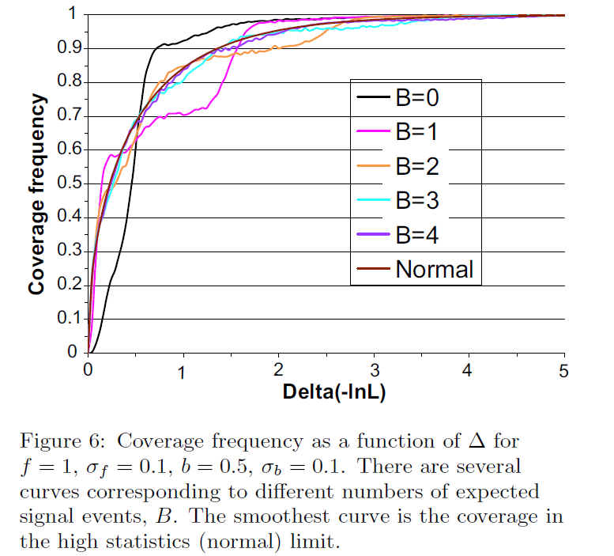
Nuisance parameters (3)
coverage vs. Δ for
several expected
numbers of signal
events B
(f is adjusted so that
B is equal to the number
of signal events)
at Δ = ½,
the coverage obtained
is reasonably close to
the nominal 68% for
number of expected
Signal events B ≥ 2

Slide 59

Nuisance parameters (4)
coverage vs. Δ
for B = 0 and
several (integer)
expected backgrounds
b’s
at Δ= ½
the coverage obtained
is reasonably close to
the nominal 68% for
exp. backgrounds b ≥ 2

Slide 60

Nuisance parameters (5)
coverage vs. b
for B=0 and
several values
of σ_{b}
uncertainties in
the background
help one to obtain
the desired
coverage
(they smooth out
the effect of the
discrete Poisson
sampling space)

Slide 61

Nuisance parameters (6)
coverage vs. f
for B=1, b=2 and
several values
of σ_{f}
uncertainties in
the scale factor
help to obtain
the desired
coverage
(they smooth out
the effect of the
discrete Poisson
sampling space)

Slide 62

Frequentist vs. Bayesian CI’s
a single observation x,
two models (θ₁ and θ₂)
intuitively: the likelihood is
larger for model θ₁ but…
… the observation x is less than 1σ from the central value predicted
by model θ₂
the classical (frequentist) approach will include θ₂ and exclude θ₁
from a 68% C.I.: “unfair” to θ₁?
the integral over the tail beyond the observed value x determines
whether θ is included or not in the CI
based on: Günter Zech, EPJ direct C4 (2002) 12 [arXiv:hep-ex/0106023v2]

Slide 63



Poisson process with background (1)
see also slide 52

Slide 64

Poisson process with background (2)
G. Zech’s proposal [EPJ direct C4 (2002) 12]*
i.e. a modified frequentist approach:
take into account that background has to be ≤ n (nb. obs. events)
probability to observe ≤ n events
(signal+background),
with signal mean μ and background
mean b, with the restriction that
the background does not exceed n
using this equation one can derive upper limits for the
signal mean μ for any C.L.
the upper limits coincide with the Bayesian ones with uniform prior
*) also available on http://arxiv.org/abs/hep-ex/0106023v2

Slide 65



Poisson process with background (3)
Feldman & Cousins reply to criticism [PRD 57 (1998) 3873, sect. VI]
Notes:
see slide 47

Slide 66

Poisson process with background (4)
Unified (F+C) approach vs. Bayesian approach (uniform prior)
Nominal coverage: 90%
for b=0 there is
maximal over-coverage
(average for 0≤μ≤2.2: 96%)

Slide 67

Poisson process with background (5)
Unified (F+C) approach vs. Bayesian approach (uniform prior)

Slide 68


Reporting Bayesian intervals
posterior probability density fn.
for the parameter θ;
when using a uniform prior π(θ),
it coincides with the likelihood L
usually called
Bayesian credible interval
reporting mean and r.m.s. ⇨ useful for error propagation
reporting equal prob. density interval ⇨ useful for hypothesis testing

Slide 69


Choice of Bayesian prior (1)
In principle there is a free choice for both the parameter and the prior
G. Zech suggests to use uniform prior selecting a parameter space in which one has no strong preference for specific parameter values
same probability for
and ?
Solution:
choose as parameter the decay constant γ with a flat prior

Slide 70

Choice of Bayesian prior (2)
mean life decay constant
observation of two decays
the choice of the decay constant
as a parameter (rather than the
mean life) is supported
by the likelihood function
being closer to a Gaussian

Slide 71

The likelihood principle
The information contained in an observation x with respect to
the parameter θ is summarized by the likelihood function L(θ|x)
inferences from two observations giving proportional L’s should be the same (provided the parameter space is the same)
warning: the LP is not accepted by all statisticians

Slide 72


The stopping rule paradox (1)
Poisson distr. with mean
value θt, for the obs. n=4
Gamma distr. with α=4
and rate θ,
for the obs. waiting time t
Gamma(t;α,θ) = (θ^{α}/Γ(α)) t^{α-1} e^{-θt}

Slide 73

The stopping rule paradox (2)
4 events
confidence intervals with n=4 (left figure):
Classical, fixed time | (2.08, 5.92) | violation of L.P.
Classical, 4 events | (2.08, 7.16)
Likelihood | (2.32, 6.36)

Slide 74

Pearson’s χ² and Student’s t
Let’s consider x and x₁,x₂, …, x_{n} as independent random variables with gaussian PDF of zero mean and unit variance, and define:
It can be shown that z follows a χ²(z;n) distribution with n degrees of freedom:
while t follows a “Student’s t” distribution f(t;n) with n degrees of freedom:
For n=1 the Student distribution is the Breit-Wigner (or Cauchy) one; for n→∞ it approaches the gaussian distribution.
It is useful to build the confidence interval for the mean when the number of measured values is small and the variance is not known …

Slide 75
CI for the Mean when n is small
Let’s consider again the sample mean and the sample variance for random variables x_{i} following a gaussian PDF with unknown parameters μ and σ:
The sample mean follows a gaussian PDF with mean μ and variance σ²/n, so the variable ( -μ)/√(σ²/n) follows a gaussian with zero mean and unit variance;
the variable (n-1)s²/σ² is independent of this and follows a χ² distribution with n-1 degrees of freedom.
Taking the appropriate ratio the unknown σ² cancels out and the variable:
will follow the Student distribution f(t,n-1) with n-1 degrees of
freedom; this can be used to compute e.g. the central confidence
interval for the mean when n is small

Slide 76

Percentiles of Student’s t-distribution
row index = number of degrees
of freedom N (1 to 40)
column index = probability P
table content = upper limit x

Slide 77
CDF & Quantiles of common PDF’s
We have seen how useful it is to have access to CDF’s and quantiles (percentiles) of popular PDF’s (Gaussian, Poisson, Student, …)
Here are some indications on where to find open-source statistical software which can be used in particular for the calculation of PDF’s, CDF’s and quantiles:
  CERNLIB (http://cernlib.web.cern.ch/cernlib/)
  Root (http://root.cern.ch)
  R (www.r-project.org)
  Numerical Recipes (www.nr.com)(numerical.recipes)
  GNU Scientific Library (http://www.gnu.org/software/gsl/)

Slide 78
Systematic errors
Before going to the issue of estimating 2 (or more) parameters simultaneously, let me stress a few point on systematic “errors”, extracted by this note by R. Barlow:
  Systematic Errors: Facts and Fictions, arXiv:hep-ex/0207026v1
Main points:
  Distinction between systematic effect, mistake and systematic uncertainty (a.k.a. systematic error)
  Systematic errors can be Bayesian
  Checks on analyses: what to do after running them?

Slide 79
Systematic effect or mistake?
Example (Bevington): Measuring lengths with a steel rule calibrated at 15 °C:
  If thermal expansion coefficient is known, as well as the actual temperature → correct for systematic effect, after which there will be zero systematic error
  If ignored → mistake (hopefully detected by consistency checks, with help from statistics*)
  If effect known but measurement temperature not measured and uncertain within few degrees → taken into account as systematic error
  * e.g. if measured value is an “outlier” or…

Slide 80
Systematic errors can be Bayesian
For example, a theory error: a calculation of a cross-section has been performed up to a certain order of perturbation theory and there is an “educated guess” as to the contribution of the next orders → the uncertainty associated is clearly Bayesian
Another example: let’s assume that the number of observed events n in an experiment can be written as
  n = SR
S being a sensitivity factor (including efficiency) and therefore affected by an associated uncertainty σ_{S} of Bayesian nature, R the quantity of interest (a rate e.g.); having observed n, how does one quote limits on R?
  the limit on R comes from a composition of a statistical (Poisson) variation on n with the variation in S

Slide 81
Systematic errors can be Bayesian, cont’d
A possible procedure (e.g. via toy MC) to compute the CL for a particular value of R as an upper limit:
  Take repeatedly that value of R:
    Multiply it each time by a random number drawn from Gauss(S,σ_{S})
    Use SR as a mean value (Poisson) to generate values of n
The CL will be the fraction of cases in which the generated value of n is less or equal to the observed n
But… we could equally well use the inverse of S, call it A: R = An
Considering the same relative error on S and A, one obtains different results!
Let’s consider R = 5, S = 1/A = 1 with 10% error on either S or A, n = 3 events observed:
  The first procedure (n = SR) gives a probability of observing 3 events of less of 27.2%
  The second procedure (R = An) gives a probability of 26.6%
  The two priors: gaussian in S, gaussian in A, are not equivalent!
Notes:
Solution: Jeffreys’ prior. In this case it means working in lnS or lnA and generating a gaussian in that -> it will give an intermediate result between the two previous ones.

Slide 82
Performing checks on your analysis
Typical checks that may be performed on an analysis:
  Analyze separate data subsets (more on this later…)
  Change cuts
  Change histogram bin sizes
  Change fit techniques
What to do with the discrepancy found between two analyses? Two possibilities…
  If the discrepancy is not significant (more on this later) the check is passed → do nothing
  If the discrepancy is significant → worry, look for mistakes, fix the error or … as a last resort, incorporate the discrepancy in systematic error

Slide 83
Performing checks on your analysis, cont’d
Suppose that the standard analysis gives a result a₁±σ₁ and another one gives a₂±σ₂; the difference and its variance are:
  Δ = a₁ – a₂; σ_{Δ}² = σ₁² + σ₂² -2ρσ₁σ₂
  where ρ is the correlation coefficient, i.e. the covariance bewteen a₁ and a₂ normalized by the product σ₁σ₂
Suppose that a₁ is obtained from the total data sample T and a₂ from a subset S; each a is estimated as the mean of some measured values x_{i} (following a Gaussian PDF with variance σ²), so that:
  a₁ = (Σ_{T}x_{i})/N_{T}, a₂ = (Σ_{S}x_{i})/N_{S} with N_{S} < N_{T}
  σ₁ = σ/√N_{T}, σ₂ = σ/√N_{S}
  Cov(a₁,a₂) = N_{S}(1/N_{T})(1/N_{S})σ²
So the correlation is ρ = Cov(a₁,a₂)/(σ₁σ₂) = σ₁/σ₂ and the error on the difference is given in this particular case by the subtraction in quadrature between the two separate errors:
σ_{Δ}² = σ₂² - σ₁² = σ² (1/N_{S} - 1/N_{T})
Notes:
Cov(a,b) = E[ab]-E[a]E[b] for simplicity assume that all xi’s follow a normal distribution with mean 0 and rms σ; then E[a] = E[b] = 0 and
one can prove that E[ab] = 1/(Nt.Ns) Ns σ²

Slide 84



The ML method with n parameters
Let’s suppose that we have estimated n parameters (shortly later we’ll focus on the case of just 2 parameters) and we want to express not only our best estimate of each θ_{i} but also the error on it
The inverse of the minimum variance bound (MVB, see slide 9) is given by the so called Fisher information matrix which depends on the second derivatives of the log-likelihood:
The information inequality states that the matrix V-I⁻¹ is a positive semi-definite matrix, and in particular for the diagonal elements we get a lower bound on the variance of our estimate of θ_{i} :
Quite often one uses I⁻¹ as an approximation for the covariance matrix (this is justified only for large number of observations and assumptions on the PDF), therefore one is lead to compute the Hessian matrix of the second derivatives of lnL at its maximum:

Slide 85



The ML method with 2 parameters (i)
The log-likelihood in the case of 2 parameters α, β (for large n) is approximately quadratic near its maximum:
(ρ is the correlation coefficient) so that the contour at the constant value lnL = lnL_{max} – 1/2 is an ellipse:
  The hor./vert. tangent lines to the ellipse identify std. deviations σ_{i}, σ_{j}
  the angle of the major axis of the ellipse is given by:
  and is related to the correlation coefficient ρ [here it’s negative]

Slide 86
The ML method with 2 parameters (ii)
^
^
The probability content of the horizontal band [θ_{i}-σ_{i},θ_{i}+σ_{i}] (where σ_{i} is obtained from the contour drawn at lnL_{max}-1/2) is 0.683, just as in the the case of 1 parameter
  The area inside the ellipse has a probability content of 0.393
  The area inside the rectangle which is tangent to the ellipse has a probability content of 0.50
Let’s suppose that the value of θ_{j} is known from previous experiments much better than our estimate [θ_{j}-σ_{j},θ_{j}+σ_{j}], so that we want to quote the more interesting parameter θ_{i} and its error taking into account its dependence on θ_{j}: we should then maximize lnL at fixed θ_{j}, and we will find that:
  the best value of θ_{i} lies along the dotted line (connecting the points where the tangent to the ellipse becomes vertical)
  the statistical error is σ_{inner} = (1-ρ²_{ij})^{1/2}σ_{i} (ρ_{ij} is the correl. coeff.)

Slide 87
Confidence regions and ΔlnL
The probability content of a contour at lnL = lnL_{max}-½k² (corresponding to k standard deviations) and of the related band is given by:
k | ½k² | 2ΔlnL | Prob. Ellipse | Prob. band
1 | 0.5 | 1.0 | 0.393 | 0.683
2 | 2.0 | 4.0 | 0.865 | 0.954
3 | 4.5 | 9.0 | 0.989 | 0.997
For m=1, 2 or 3 parameters the variation 2ΔlnL required to define a region (segment, ellipse or ellipsoid) with specified probability content is given in the following table:
As we will see later, a variation
of 0.5 units for the log-likelihood lnL is equivalent to a variation of 1 unit for the χ²

Slide 88




Lifetime of an unstable nucleus
Consider an experiment that is set up to measure the lifetime of an unstable nucleus N, using the chain reaction:
A→Neν, N→pX
The creation of the nucleus N is signalled by the electron, its decay by the proton. The lifetime of each decaying nucleus is measured from the time difference t between electron emission and proton emission, with a known experimental resolution σ_{t}.
The expected PDF for the measured times is the convolution of the exponential decay PDF:
with a gaussian resolution function:
The result of the convolution is:
Tip: transform the integrand into the exponential of
Notes:
Previously called Exercise 11;
See also gausexp-conv_v6.nb

Slide 89
Exercise No. 5
Generate 200 events with τ = 1 s and σ_{t} = 0.5 s (using the inversion technique followed by Gaussian smearing). Use the ML method to find the estimate and the uncertainty .
Plot the likelihood function, and the resulting PDF for measured times compared to a histogram containing the data.
Automate the ML procedure so as to be able to repeat this exercise 100 times, and plot the distribution of the “pull”:
for your 100 experiments; show that it follows a gaussian with zero mean and unit variance.
For one data sample, assume that σ_{t} is unknown and show a contour plot in the τ, σ_{t} plane with constant likelihood given by:
lnL = lnL_{max}-1/2
Add other contour plots corresponding to 2 and 3 standard deviations

Slide 90
Tip for exercise No. 5
Definition and sampling of the log-likelihood (e.g. in FORTRAN):
The value of τ is varied between 0.1 and 2.0 in steps of 0.01
a time value t is generated using
a uniform r.n. u(i) and a gaussian
r.n. n(i) prepared in advance
L(k) contains the log of the likelihood (summed over the 200 events) for τ = k/100.
since we use pre-stored random numbers u(i) and n(i), the 200 values of t
are the same throughout the scan over values of the parameter “tau”
Notes:
Taken from eserc11.f

Slide 91
Solutions to exercise No. 5
E. Bruna 2004
Notes:
From es11_a.ps (.pdf)

Slide 92
Solutions to exercise No. 5
E. Bruna 2004
Notes:
From neglogL.ps (.pdf) + neglogLzoom.ps (.pdf)

Slide 93
Solutions to exercise No. 5
E. Bruna 2004
Notes:
From residual.ps (.pdf)

Slide 94

Solutions to exercise No. 5
E. Bruna 2004
Notes:
From contour.ps (.pdf)

Slide 95
Minimization methods
Numerical Recipes in FORTRAN / C, chapter 10:
  brent (1-dimensional, parabolic interp.)
  amoeba (N-dim., simplex method)
  powell (N-dim., Direction Set method)
  dfpmin (N-dim., variable metric Davidon-Fletcher-Powell method)
CERNLIB: MINUIT (D506) (also available in ROOT), different algorithms are available:
  MIGRAD – uses variable metric method and computes first derivatives, produces an estimate of the error matrix
  SIMPLEX – uses the simplex method, which is slower but more robust (does not use derivatives)
  SEEK – M.C. method with Metropolis algorithm, considered unreliable
  SCAN – allows us to scan one parameter at a time

Slide 96
Error calculation in MINUIT
Two additional commands in MINUIT allow a more accurate calculation of the error matrix:
  HESSE – computes (by finite differences) the matrix of second derivatives and inverts it, in principle errors are more accurate than those provided by MIGRAD
  MINOS – an even more accurate calculation of errors, which takes into account non linearities and correlations between parameters
A very important remark: the SET ERRordef k command must be used to set the number of standard deviations which is used by MINUIT to report errors, and the parametric value k depends on the method used for minimization, according to this table:
Function to be minimized | k for 1σ error | k for 2σ error
-lnL | 0.5 | 2.0
χ² | 1.0 | 4.0

Slide 97
Contours from MINUIT (1)
PAW macro (minuicon.kumac) to demonstrate log-likelihood contour extraction after a MINUIT fit
A 3-parameter gaussian
fit wil be performed on
a 10-bin histgram
These MINUIT instructions
are executed in sequence when
Hi/Fit is called with option M
The Mnc instruction fills vectors
XFIT, YFIT with the contour in
the plane of parameters 1 and 2

Slide 98
Contours from MINUIT (2)
The contours at 2σ and 3σ
are obtained in a similar way

Slide 99
PAW/MINUIT DEMONSTRATION
Demonstration of the interactive fit with PAW / MINUIT
Demonstration of the log-likelihhod contour plot with PAW/ MINUIT
Demonstration of the batch fit with MINUIT called by a FORTRAN program
  the demonstration is made first with a single exponential and then with a double exponential fit to experimental data for the muon lifetime
Notes:
1) vitamu.kumac
2) minuicon.kumac
3) …

Slide 100
Using MINUIT in a C++ program
Example from Cowan (2006): exponential PDF, 1-parameter fit
  Program: expFit.cc
  Data: mltest.dat
Procedure (need Root libraries i.e. $ROOTSYS must be defined):
  source rootSetup1.sh
  make
  ./expFit

Slide 101
ROOT/MINUIT DEMONSTRATION
Demonstration of some fitting tutorials with ROOT / MINUIT (mostly in the “fit” directory):
  fitLinear.C – three simple examples of linear fit
  fitMultiGraph.C – fitting a 2nd order polynomial to three partially overlapping graphs
  multifit.C – fitting histogram sub-ranges, then performing combined fit
  fitLinear2.C – multilinear regression, hyperplane “hyp5” fitting function (see also Mathematica: regress1.nb)
  fitLinearRobust.C – Least Trimmed Squares regression (see P.J. Rousseeuw & A.M. LeRoy, Robust Regression and Outlier Detection, Wiley-Interscience, 2003) uses option “robust” in TLinearFitter*
  solveLinear.C – Least Squares fit to a straight line (2 parameters) with 5 different methods (“matrix” directory)
* source code in $ROOTSYS/math/minuit/src/

Slide 102
RooFit DEMONSTRATION
RooFit was developed by Kirby and Verkerke for the BaBar experiment, see e.g. the tutorial by A. Bevan given at YETI ’07
Demonstration of some tutorials* with RooFit:
  rf101_basics.C
  rf102_dataimport.C
  rf103_interprfuncs.C
  rf105_funcbinding.C
  rf109_chi2residpull.C
  rf201_composite.C
  rf601_intminuit.C
* source code in $ROOTSYS/tutorials/roofit/
Notes:
See slides 29-40 in file access3.pdf

Slide 103
Next: Part III
Statistical methods / hypothesis testing

