Slide 1
Linear and Nonlinear Waves
A. Mignone
Physics Department
Turin University

Slide 2
I. The scalar advection equation

Slide 3
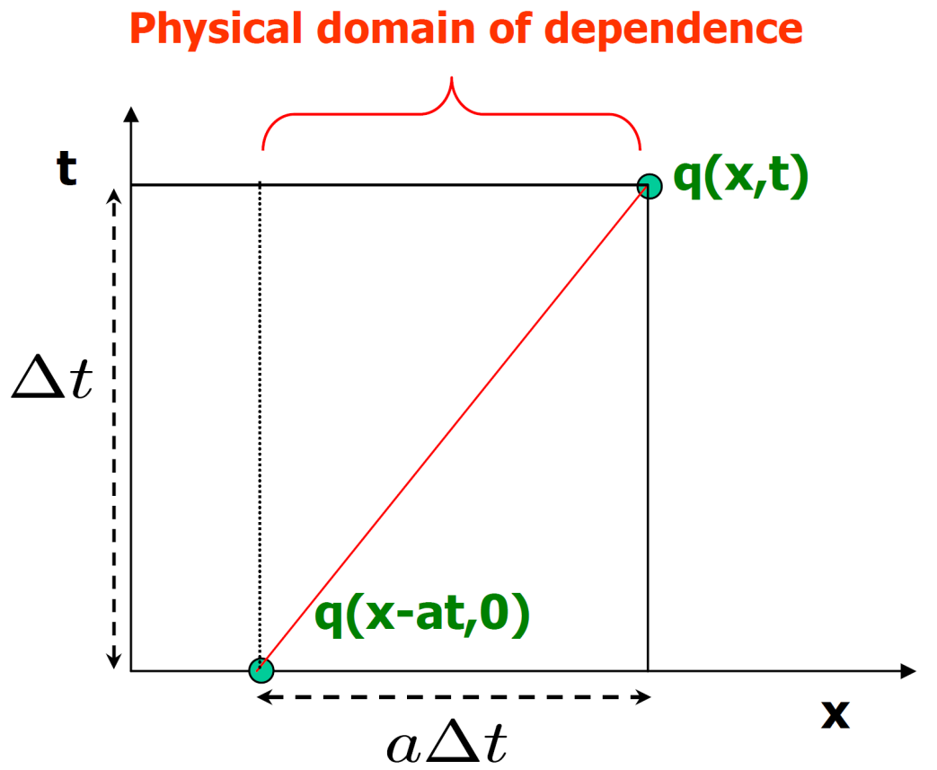
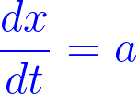
The Advection Equation: Theory
First order partial differential equation (PDE) in (x,t):
Hyperbolic PDE: information propagates across domain at finite speed → method of characteristics
Characteristic curves satisfy:
Along each characteristics:
→ The solution is constant along characteristic curves.
U(x,t)
U(x-at,0)
Notes:
→ Use Latin modern, 10pt, 300 , transparent
\color{blue}
\frac{\partial U(x,t)}{\partial t} + a\frac{\partial U(x,t)}{\partial x} = 0
\frac{dx}{dt} = a
\frac{dU}{dt} = \frac{\partial U}{\partial t} + \frac{dx}{dt}\frac{\partial U}{\partial x} = 0

Slide 4
The Advection Equation: Theory
for constant a: the characteristics are straight parallel lines and the solution to the PDE is a uniform shift of the initial profile:
The solution shifts to the right (for a > 0) or to the left (a < 0):
Notes:
\color{blue}
U(x,t) = U(x-at,0)

Slide 5
II. Linear systemS of Hyperbolic conservation laws

Slide 6
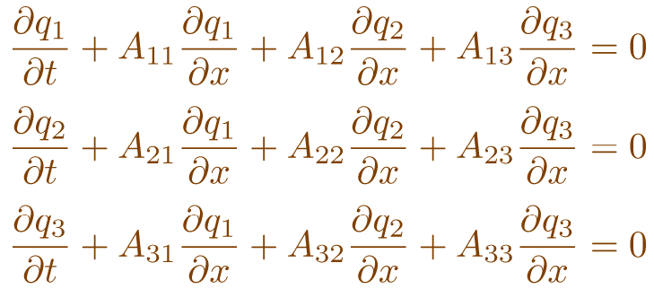
System of Equations: Theory
We turn our attention to the system of equations (PDE)
where is the vector of unknowns. A is a m × m constant matrix.
For example, for m=3, one has

Slide 7
System of Equations: Theory
The system is hyperbolic if A has real eigenvalues, λ¹ ≤ … ≤ λ^{m} and a complete set of linearly independent right and left eigenvectors r^{k} and l^{k} (r^{j} ⋅l^{k} =δ_{jk}) such that
For convenience we define the matrices Λ = diag(λ^{k}), and
So that A⋅R = R⋅Λ, L⋅A = Λ⋅L , L⋅R = R⋅L = I, L⋅A⋅R = Λ.
Notes:
\color{DarkRed}
R = (r^1 | r^2 | ... | r^m) \,,\qquad
L = R^{-1} = \left(\begin{array}{c}
(l^1)^{\intercal} \\
\\
(l^2)^{\intercal} \\
... \\
(l^m)^{\intercal} \\
\end{array}\right)

Slide 8
System of Equations: Theory
The linear system can be reduced to a set of decoupled linear advection equations.
Multiply the original system of PDE’s by L on the left:
Define the characteristic variables w=L⋅ q so that
Since Λ is diagonal, these equations are not coupled anymore.

Slide 9
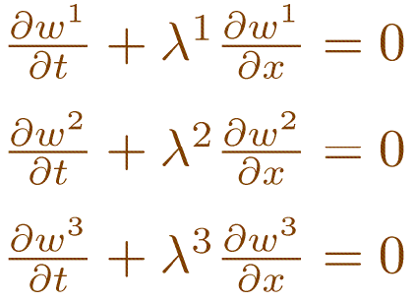
System of Equations: Theory
In this form, the system decouples into m independent advection equations for the characteristic variables:
where (k=1,2,…,m) is a characteristic variable.
When m=3 one has, for instance:

Slide 10
System of Equations: Theory
The m advection equations can be solved independently by applying the standard solution techniques developed for the scalar equation.
In particular, one can write the exact analytical solution for the k-th characteristic field as
i.e., the initial profile of w^{k} shifts with uniform velocity λ^{k} , and
is the initial profile.
The characteristics are thus constant along the curves dx/dt = λ^{k}

Slide 11
System of Equations: Exact Solution
Once the solution in characteristic space is known, we can solve the original system via the inverse transformation
The characteristic variables are thus the coefficients of the right eigenvector expansion of q.
The solution to the linear system reduces to a linear combination of m linear waves traveling with velocities λ^{k} .
Expressing everything in terms of the original variables q,

Slide 12
III. Nonlinear Scalar hyperbolic PDE: Burger’s equation

Slide 13
Nonlinear Advection Equation
We turn our attention to the scalar conservation law
Where f(u) is, in general, a nonlinear function of u.
To gain some insights on the role played by nonlinear effects, we start by considering the inviscid Burger’s equation:

Slide 14
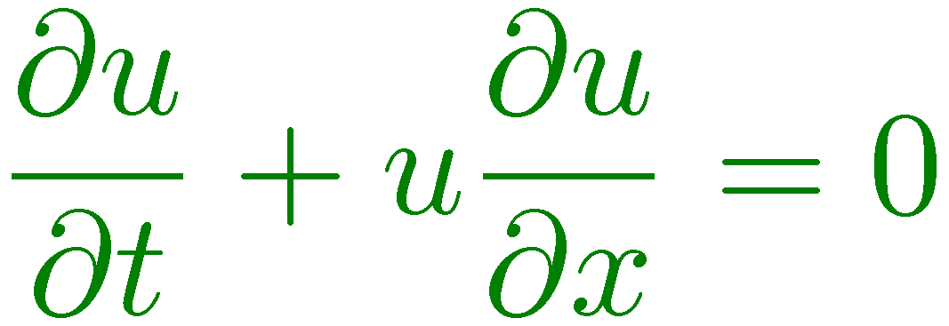
Nonlinear Advection Equation
We can write Burger’s equation also as
In this form, Burger’s equation resembles the linear advection equation, except that the velocity is no longer constant but it is equal to the solution itself.
The characteristic curve for this equation is
→ u is constant along the curve dx/dt=u(x,t) → characteristics are again straight lines: values of u associated with some fluid element do not change as that element moves.

Slide 15
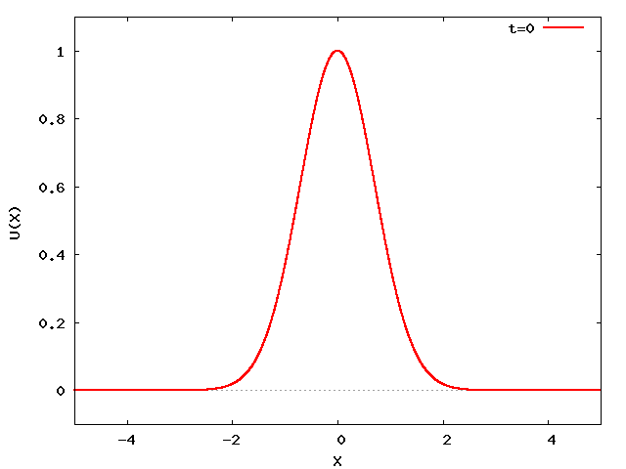
Nonlinear Advection Equation
From
one can predict that, higher values of u will propagate faster than lower values: this leads to a wave steepening, since upstream values will advances faster than downstream values.

Slide 16
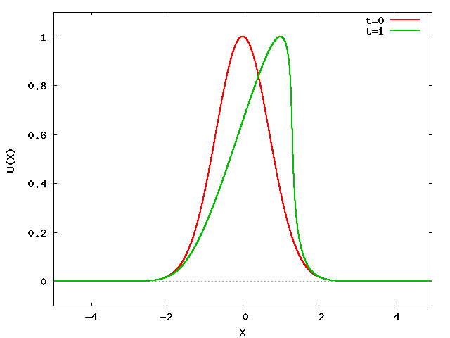
Nonlinear Advection Equation
Indeed, at t=1 the wave profile will look like:
the wave steepens…

Slide 17
Nonlinear Advection Equation
If we wait more, we should get something like this:
A multi-value functions ?! → Clearly NOT physical !
? ? ?

Slide 18
Burger Equation: Shock Waves
The correct physical solution is to place a discontinuity there:
a shock wave.
Since the solution is no longer smooth, the differential form is not valid anymore and we need to consider the integral form.
Shock position

Slide 19
Burger Equation: Shock Waves
This is how the solution should look like:
Such solutions to the PDE are called weak solutions.

Slide 20
Burger Equation: Shock Waves
Let’s try to understand what happens by looking at the characteristics.
Consider two states initially separated by a jump at an interface:
Here, the characteristic velocities on the left are greater than those on the right.
u_{L}
u(x)
u_{R}
x

Slide 21
Burger Equation: Shock Waves
The characteristic will intersect, creating a shock wave:
The shock speed is such that λ(u_{L}) > S > λ(u_{R}). This is called the entropy condition.
t
t
x
x

Slide 22
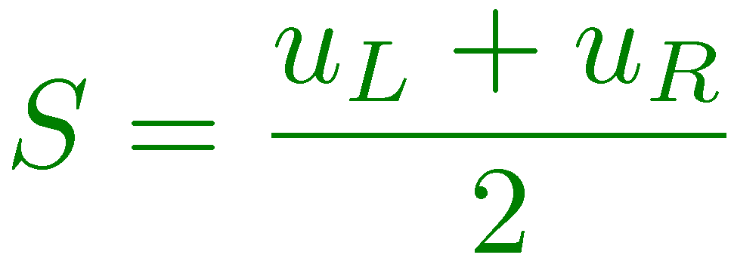
Nonlinear Advection Equation
The shock speed S can be found using the Rankine-Hugoniot jump conditions, obtained from the integral form of the equation:
For Burger’s equation f(u) = u²/2, one finds the shock speed as

Slide 23
Burger Equation: Rarefaction Waves
Let’s consider the opposite situation:
Here, the characteristic velocities on the left are smaller than those on the right.
u(x)
u_{R}
u_{L}
x

Slide 24
Burger Equation: Rarefaction Waves
Now the characteristics will diverge:
Putting a shock wave between the two states would be incorrect, since it would violate the entropy condition. Instead, the proper solution is a rarefaction wave.
t
t
tail
head
x
x

Slide 25
Burger Equation: Rarefaction Waves
A rarefaction wave is a nonlinear wave that smoothly connects the left and the right state. It is an expansion wave.
The solution can only be self-similar and takes on the range of values between u_{L} and u_{R}.
The head of the rarefaction moves at the speed λ(u_{R}), whereas the tail moves at the speed λ(u_{L}).
The general condition for a rarefaction wave is λ(u_{L})<λ(u_{R})
Both rarefactions and shocks are present in the solutions to the Euler equation. Both waves are nonlinear.

Slide 26
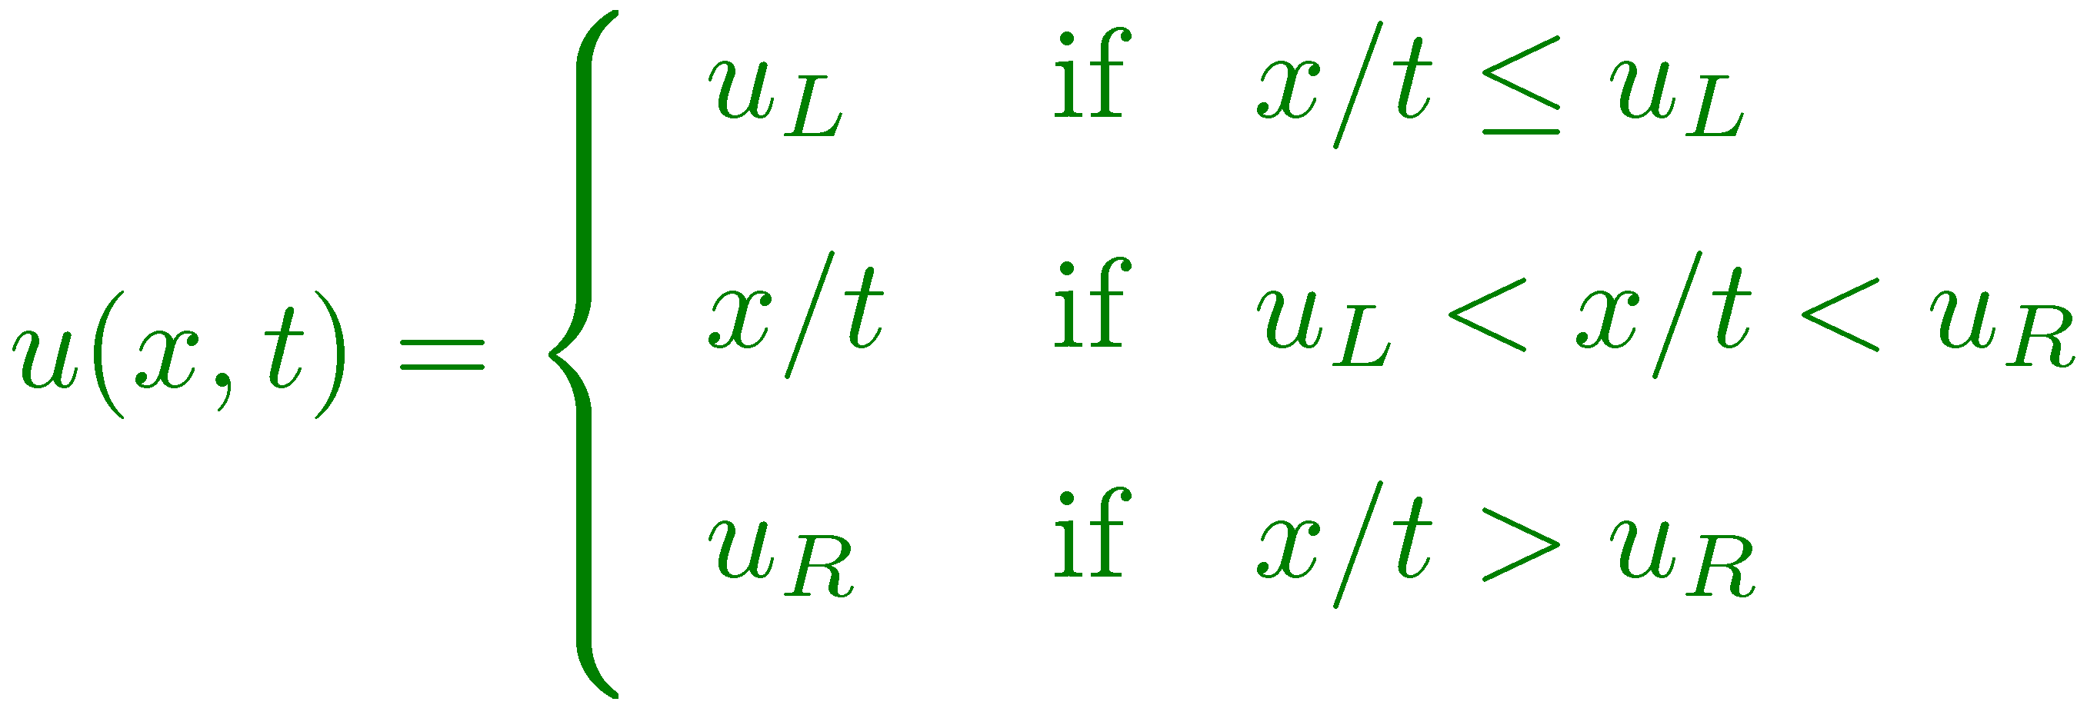
Burger Equation: Riemann Solver
These results can be used to write the general solution to the Riemann problem for Burger’s equation:
If u_{L} > u_{R} the solution is a discontinuity (shock wave). In this case
If u_{L} < u_{R} the solution is a rarefaction wave. In this case

Slide 27
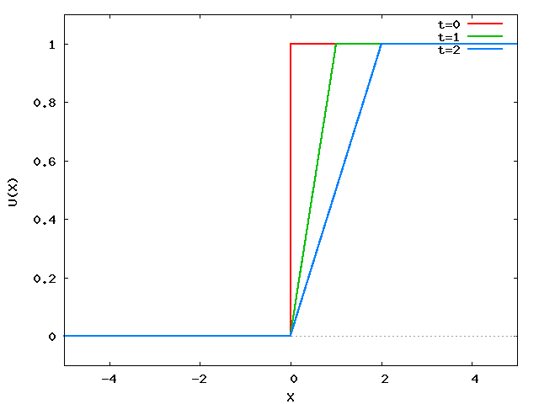
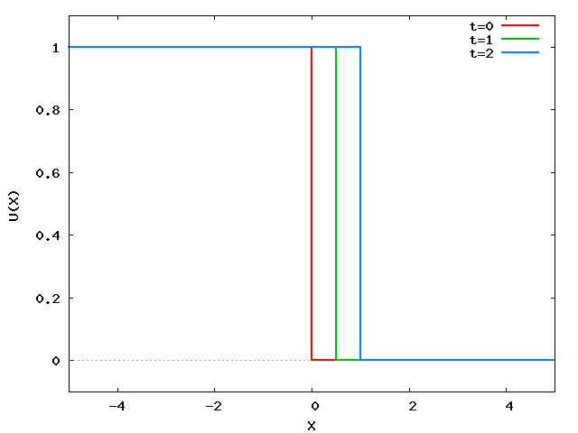
Nonlinear Advection Equation
Solutions look like
for a rarefaction and a shock, respectively.

Slide 28
IV. Nonlinear systems of Conservation law

Slide 29
Nonlinear Systems
Much of what is known about the numerical solution of hyperbolic systems of nonlinear equations comes from the results obtained in the linear case or simple nonlinear scalar equations.
The key idea is to exploit the conservative form and assume the system can be locally “frozen” at each grid interface.
However, this still requires the solution of the Riemann problem, which becomes increasingly difficult for complicated set of hyperbolic P.D.E.

Slide 30
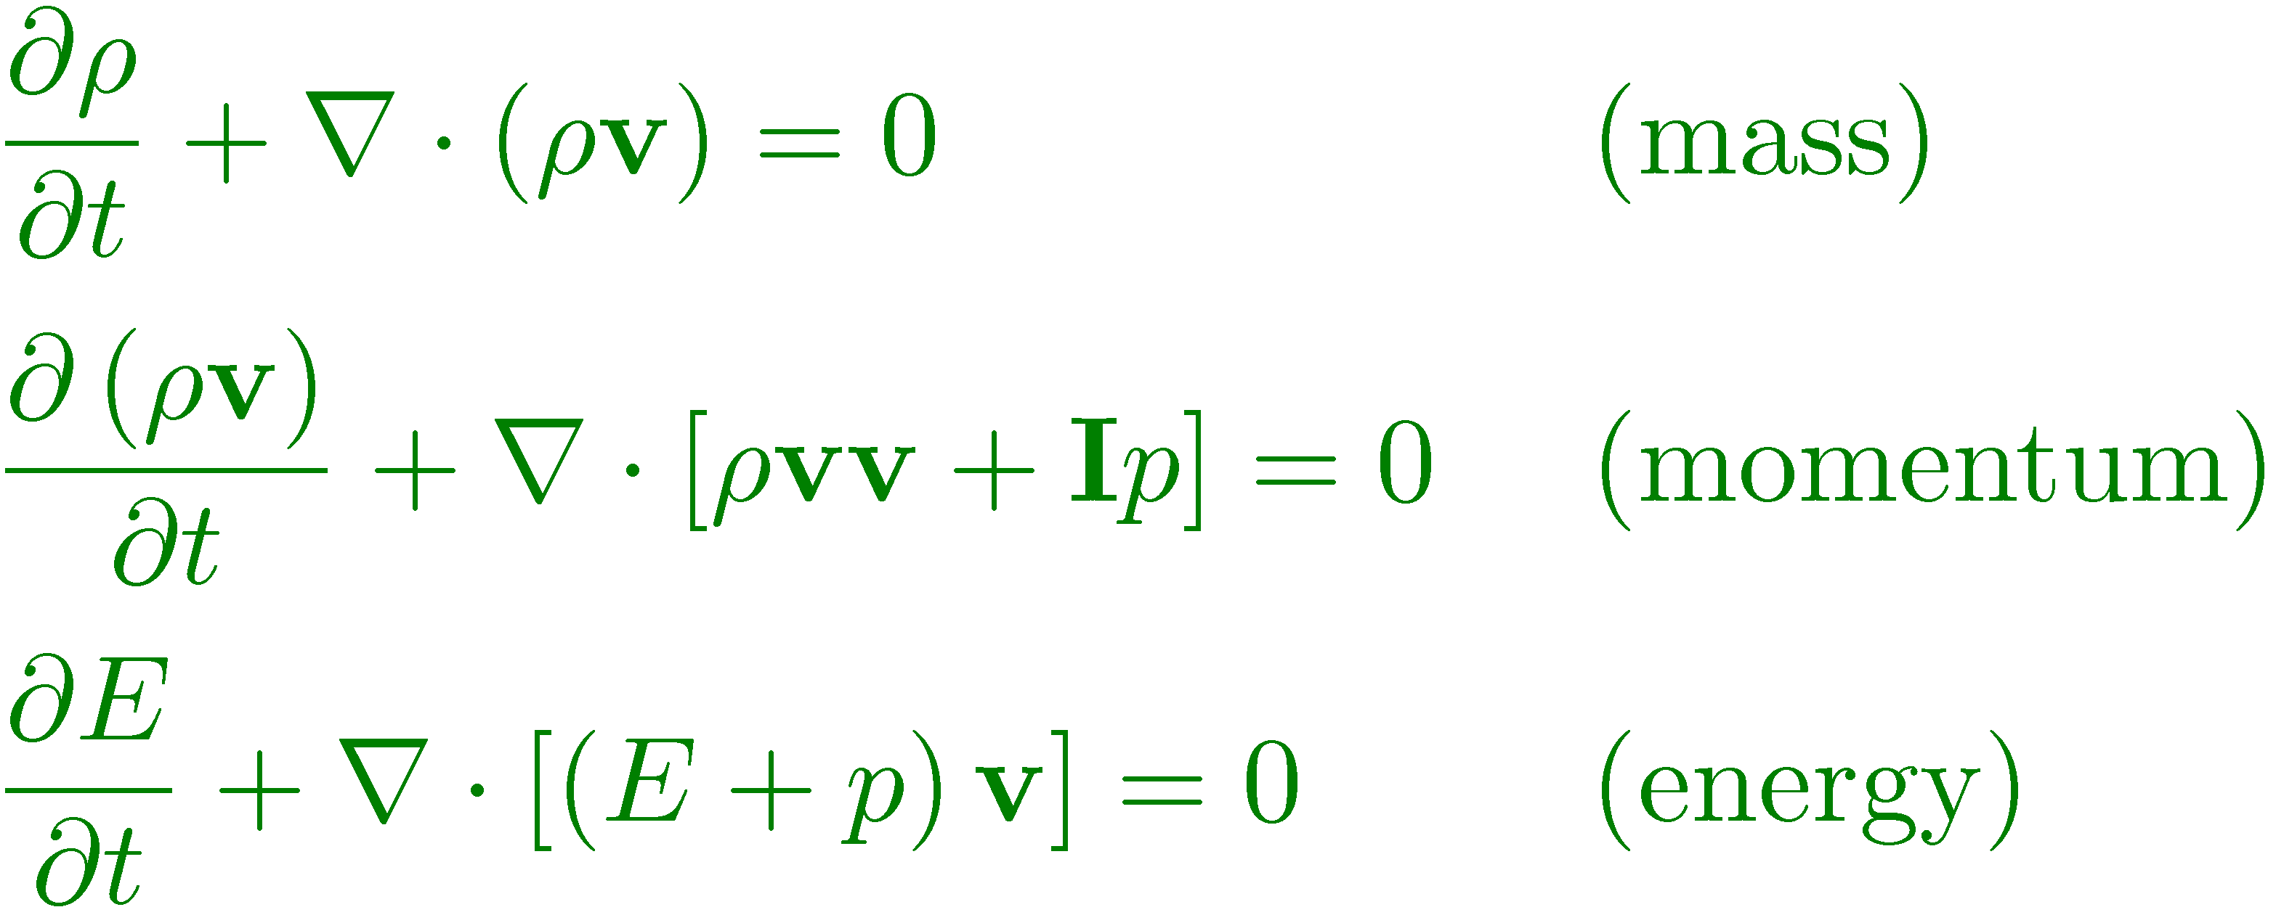
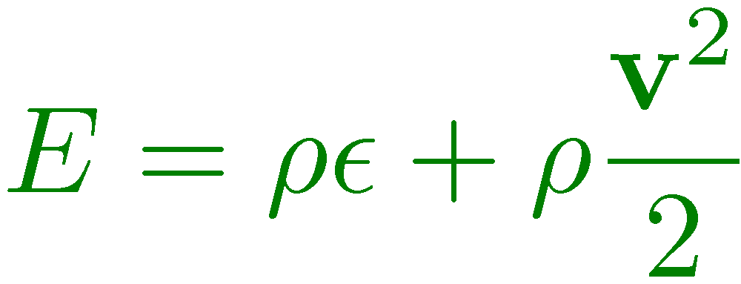
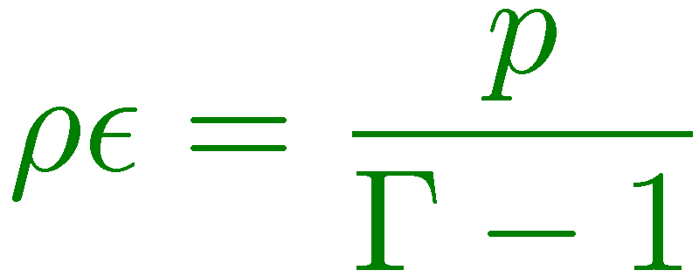
Euler Equations
System of conservation laws describing conservation of mass, momentum and energy:
Total energy density E is the sum of
thermal + Kinetic terms:
Closure requires an Equation of State (EoS).
For an ideal gas one has

Slide 31
Euler Equations: Characteristic Structure
The equations of gasdynamics can also be written in “quasi-linear” or primitive form. In 1D:
where V = [ρ,v_{x},p] is a vector of primitive variable, c_{s} = (γp/ρ)^{1/2} is the adiabatic speed of sound.
It is called “quasi-linear” since, differently from the linear case where we had A=const , here A = A(V).

Slide 32
Euler Equations: Characteristic Structure
The quasi-linear form can be used to find the eigenvector decomposition of the matrix A:
Associated to the eigenvalues:
These are the characteristic speeds of the system, i.e., the speeds at which information propagates. They tell us a lot about the structure of the solution.

Slide 33
Euler Equations: Riemann Problem
By looking at the expressions for the right eigenvectors,
we see that across waves 1 and 3, all variables jump. These are nonlinear waves, either shocks or rarefactions waves.
Across wave 2, only density jumps. Velocity and pressure are constant. This defines the contact discontinuity.
The characteristic curve associated with this linear wave is dx/dt = u, and it is a straight line. Since v_{x} is constant across this wave, the flow is neither converging or diverging.

Slide 34
Euler Equations: Riemann Problem
The solution to the Riemann problem looks like
The outer waves can be either shocks or rarefactions.
The middle wave is always a contact discontinuity.
In total one has 4 unknowns: , since only density jumps across the contact discontinuity.
t
(contact)
(shock or rarefaction)
(shock or rarefaction)
x

Slide 35
Euler Equations: Riemann Problem
Depending on the initial discontinuity, a total of 4 patterns can emerge from the solution:
t
R
C
S
t
S
C
R
x
x
C
R
C
S
t
R
t
S
x
x

