Slide 1
Quantum mechanical simulation of crystaline systems
Roberto Dovesi
Gruppo di Chimica Teorica
Dip. Di Chimica IFM
Università degli Studi di Torino

Slide 2
Why simulation?
Is simulation useful?
Does it produce reasonable numbers?
Or can only try to reproduce the experiments?
Connected question:
Is simulation expensive?

Slide 3
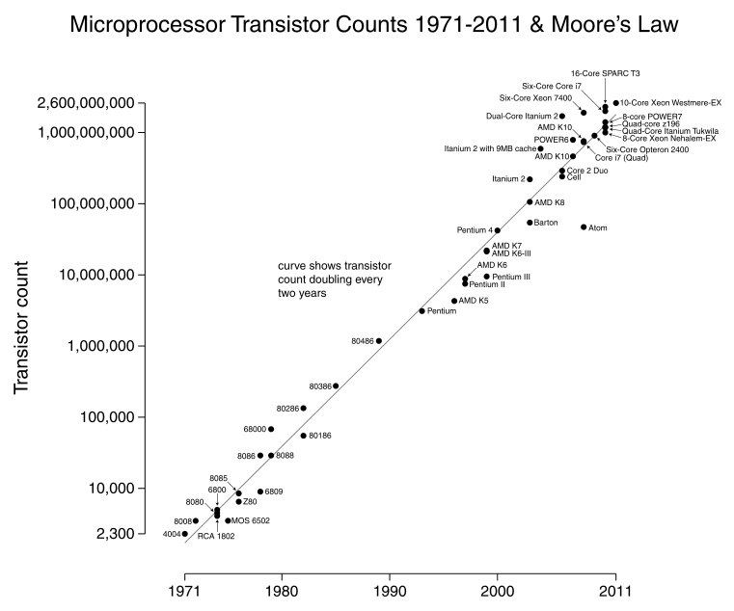
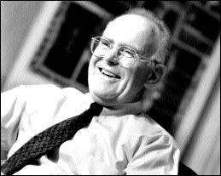
How many transistors on a chip?
Gordon Moore
The number of transistors per chip doubles every 18 months
Notes:
3

Slide 4
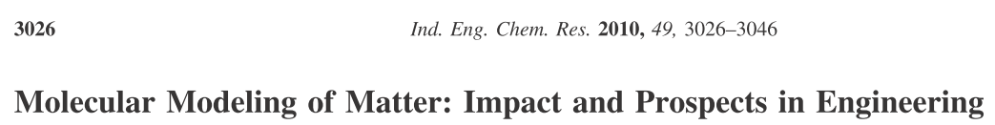
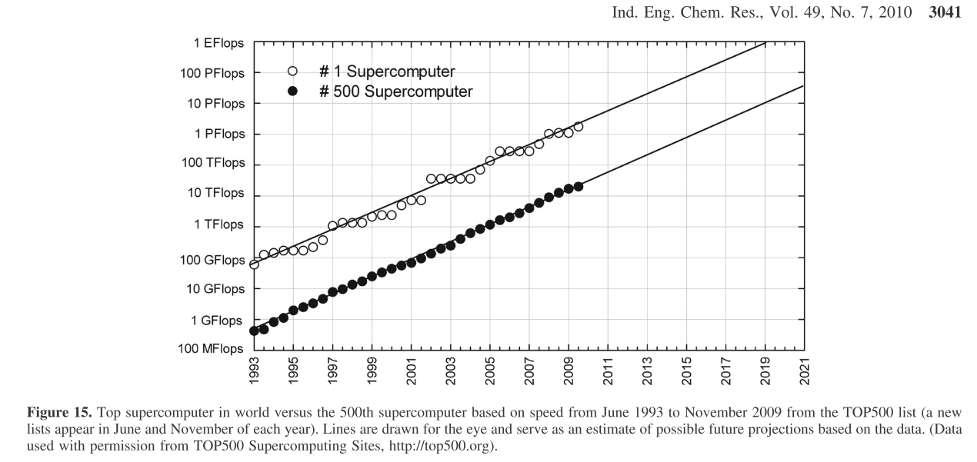
Performance of HPC
Notes:
4

Slide 5
But…..
The evolution of the hardware is always much faster than that of the software.
Parallel computing….
How to fill supercomputers?

Slide 6
Is simulation expensive?
The last computer we bought….
Server Supermicro 64 CORE OPTERON euros 6.490 ,00
1 x Chassis 2U - 6 x SATA/SAS - 1400W
4 x CPU AMD Opteron 16-Core 6272 2,1Ghz 115W
8 x RAM 8 GB DDR3-1333 ECC Reg. (1GB/core)
1 x Backplane SAS/SATA 6 disks
1 x HDD SATAII 500 GB 7.200 RPM hot-swap
1 x SVGA Matrox G200eW 16MB
2 x LAN interface 1 Gbit
1 x Management IPMI 2.0
Cheap… but 64 cores-→ Parallel computing
Much less than most of the experimental equipments
64 cores enough for large calculation……..
Notes:
6

Slide 7
At the other extreme: SUPERCOMPUTERS
Available, but:
They are fragile
Not so much standard (compiler, libreries)
c) The software (that is always late with respect to hardware) MUST BE ABLE TO EXPLOIT this huge power
Notes:
7

Slide 8
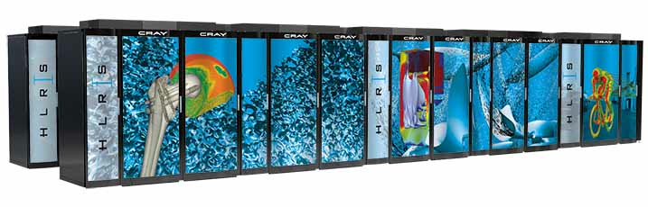
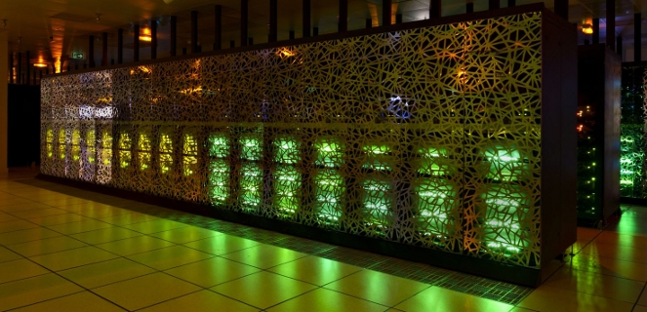

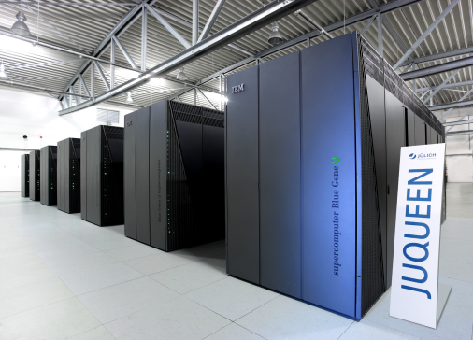

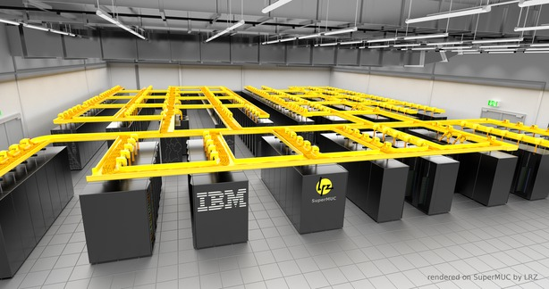
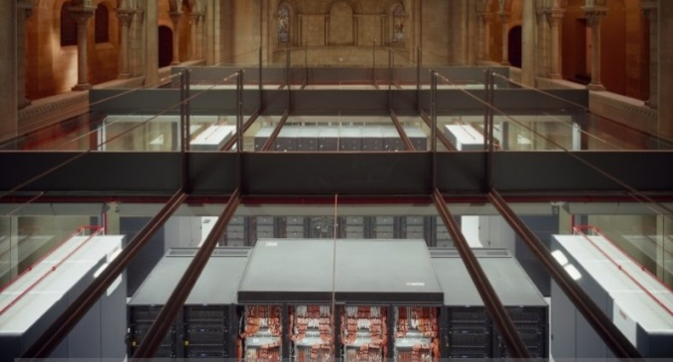
The PRACE Tier-0 Resources
HORNET (HLRS, DE)
Cray XC30 system - 94,656 cores
CURIE (GENCI, FR)
BULL x86 system – 80,640 cores (thin nodes)
FERMI (CINECA, IT)
BlueGene Q system – 163,840 cores
JUQUEEN (JÜLICH, DE)
BlueGene Q system – 458,752 cores
SUPERMUC (LRZ, DE)
IBM System x iDataPlex system– 155,656 cores
MARENOSTRUM (BSC, SP)
IBM System x iDataPlex system– 48,448 cores

Slide 9
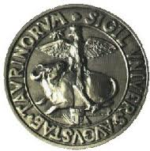
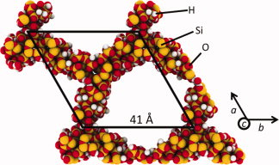
MPPCRYSTAL: strong scaling
Scaling of computational time required for an SCF cycle with the number of processors for two supercells of mesoporous silica MCM-41, with a 6-31G** basis set and PBE functional. The X16 cell contains 9264 atoms and 124096 atomic orbitals, the X24 one 13896 atoms and 186144 atomic orbitals.

Slide 10
Various approaches can be
used for the simulation of solids:
Notes:
10

Slide 11
-classical or semi-classical energy expressions
(force-field, electrostatic + repulsion terms); structural, elastic, dielectric properties of ionic and semi-ionic compounds such as Al₂O₃ (corundum) or SiO₂ (quartz); the only available in the 1960-1980 period; still used for large systems or for a first quick determination. Parametric (then boring parametrization, usually valid for interpolation, much less for extrapolation……).
-MD (molecular dynamics) based on classical mechanics (then on force fields). The only available for, say, more than 30.000 atoms (for example proteins). Temperature effect
Obviously no electronic wavefunction → nothing about the related properties

Slide 12
Quantum mechanical
(based then on the solution of the Schroedinger equation at some level of approximation) a) ab initio
(no parameters, also indicated as first-principle) b) semi-empirical in the quantum-mechanical frame many of the interactions (then of expensive integrals) are approximated with reference to some physical or chemical property. Cheaper than a)

Slide 13
Quantum mechanical, ab initio
I) wavefunction based (Hartree-Fock, Configuration interaction, Coupled Cluster, Moeller Plesset…..).
In short:
The multielectronic problem MUST be tackled through ONE electron wavefunctions: Hartree-Product >Slater Determinant >variational principle > double infinite expansion (basis set and determinants).
Historically, the Molecular or Chemistry approach.
Standard codes since 1960-70 (IBMOL- means IBM first explicit set of atomic wave-functions,
1974, Clementi and Roetti.
Gaussian (Pople) code (1975), and others in the following years.

Slide 14
Quantum mechanical, ab initio
II) Electronic Density based
(a 3 variables problem instead of 3N variables)
The Hohenberg-Kohn Theorems (1964) originates the DFT (Density Functional Theory):
LDA, GGA, meta-GGA, «hybrids», range separated…… a sort of medioeval «bestiarium» because: the theorems say that the TOTAL ENERGY (a number) only depends on the density (a function); however the link between the two is unknown (or known only in limiting cases as for the electron gas). In practice solves an equation very close to the one for the wavefunction.

Slide 15
Here we consider the
QUANTUM MECHANICAL ab initio approach to the properties of crystalline compounds only crystalline (means: periodic in 1, 2 3 directions)?
NO!
The same scheme applies to: a) local defects (say vacancies in silicon) b) desordered systems (say solid solutions)

Slide 16
The level of the theory: non relativistic
Schroedinger equation
Born-Hoppeneimer approximation single particle approximation single determinant (Hartree-Fock or ….DFT) variational principle local basis set (LCAO)

Slide 17
An obvious statement: also the simplest crystalline system is much more complicated than the simplest molecular system:
Accurate studies for the latter in the ’60
(H₂, methane,benzene)
The first ab initio calculations for solids appear in
1979-1980 (diamond)

Slide 18
Hystorically, two separated development lines:
Molecules (or finite systems):
HF based, a local basis set, all electron
Solids (infinite in three directions)
DFT, plane-waves, pseudopotential.
In the last say 10 years…..intersections…

Slide 19
The simulation at the theoretical chemistry group in Torino
The CRYSTAL code

Slide 20
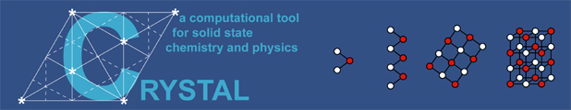
The CRYSTAL PROJECT:
was formulated in the 1972-76 years by
Cesare Pisani, Carla Roetti and Roberto Dovesi,
starting from the periodic Hartree Fock schemes proposed
in these years by various authors
(André, Del Re, Harris, Ladik, Euwema);
first “exercices” with periodic EHT, CNDO, MNDO
Then many other contributions (local and from abroad)
Notes:
20

Slide 21

Cesare Pisani
1938-2011
Cesare Pisani died on July 17, 2011,
in a mountains accident

Slide 22

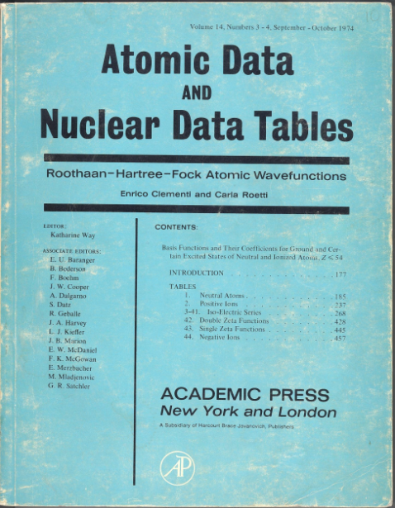
Carla Roetti
Carla Roetti graduated in chemistry (1967) from the University of Torino, where she became Associate Professor in Physical Chemistry in 1980.
Throughout her scientific career, she has been one of the leaders of the Theoretical Chemistry Group of the Torino University. For almost forty years (1974-2010) she has been involved with her colleagues in the quantum mechanical ab-initio study of the electronic properties of solids and in the implementation of related algorithms and computer codes, in particular of CRYSTAL.
Her contribution in this respect has been invaluable. Since the release of the first public version of CRYSTAL (1988) and throughout all the subsequent ones, she has played a leading rôle in the maintenance, portability, documentation and testing of the new features of the code, and the support of the users.
Carla Roetti has died on September 7th 2010,
all those who have worked and interacted with her deeply miss her.

Slide 23
The CRYSTAL code for the investigation of systems periodic in 1D (polymers, nanotubes), 2D (monolayers, slabs), 3D (bulk)
Born in Torino in 1976, public releases in
1988 (QCPE),
1992, 1995, 1998, 2002, 2006, 2009,
2014
Contributions from many researchers from many countries

Slide 24
CRYSTAL88, was the first ab initio code publicly available to the scientific community, last release: 2014.

Slide 25
The basis set
The basis set consists of Bloch Functions (BF) defined in terms of local functions, the atomic orbitals (AO), χ_{μ} (r), throughout the entire lattice (g = lattice vector):
The local functions are, in turn, a linear combination of n_{G} individually normalized Gaussian type functions (GTF) with constant coefficients d_{j} and exponents α_{j}

Slide 26
Matrix elements of Fock matrix in direct space
Fock matrix
kinetic contribution
electron-nuclei
Coulomb el-el
exchange el-el
Integration in k space to compute the value of ε_{Fermi}

Slide 27
Hartree-Fock total energy per unit cell
The evaluation of HF total energy of a periodic system requires
the evaluation of 3 infinite summations (h, g, n) that extend to all direct lattice vectors

Slide 28
μ^{g} ν^{g}
μ^{g} ν^{g}
μ^{h+n} ν^{h+n}
μ^{h+n} ν^{h+n}
g
g
μ⁰ ν⁰
μ⁰ ν⁰
n
n
μ^{h} ν^{h}
μ^{h} ν^{h}
h
h
Coulomb integral
Exchange integral

Slide 29
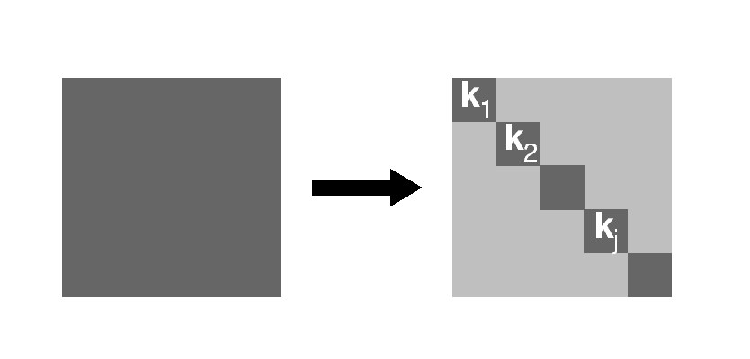
Schrödinger equation in the BF basis
In the basis of Bloch functions the Hamiltonian matrix is factorized into diagonal blocks of finite size (the number of BFs in the unit cell), each corresponding to a point in reciprocal space.
Schrödinger equation can be solved independently at each k point.
H(k) C(k) = S(k) C(k) E(k)

Slide 30
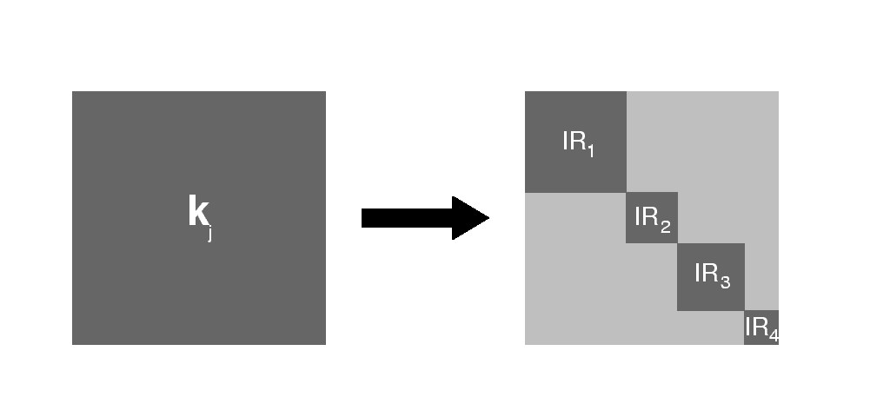
Symmetry Adapted Crystalline Orbitals
Some k points are invariant to some point symmetry operations: this property is used to generate Symmetry Adapted Bloch Functions from a set of local functions (AO).
The method, based on the diagonalization of Dirac characters, permits to factor out H(k) into smaller diagonal blocks:

Slide 31
The periodic model
Consistent treatment of Periodicity
  3D - Crystalline solids (230 space groups)
  2D - Films and surfaces (80 layer groups)
  1D – Polymers
  (75 rod groups)
  1D – Helical symmetry
  (up to order 48)
  0D – Molecules
  (32 point groups)
Infinite sums of particle interactions
  Ewald's method
  Specific formulæ for 1D, 2D, 3D
Full exploitation of symmetry
  in direct space
  in reciprocal space

Slide 32
Hamiltonians
Restricted and Unrestricted Hartree-Fock Theory
Total and Spin Density Functional Theory
  Local functionals [L] and gradient-corrected [G]
  exchange-correlation functionals
    Correlation functionals
    Vosko-Willk-Nusair (VWN5 parameterization) [L]
    Perdew-Wang [L]
    Perdew-Zunger '81 [L]
    von Barth-Hedin [L]
    Lee-Yang-Parr [G]
    Perdew '86 [G]
    Perdew-Wang '91 [G]
    Perdew-Burke-Ernzerhof [G]
    Revised PBE for solids [G]
    Wilson-Levy '90 [G]
    Exchange functionals
    Slater [L]
    von Barth-Hedin [L]
    Becke '88 [G]
    Perdew-Wang '91 [G]
    Perdew-Burke-Ernzerhof [G]
    Revised PBE for solids [G]
    Second-order GGA expansion for solids [G]
    Wu-Cohen '06 [G]

Slide 33
Types of calculations
Single-point energy calculation
Automated geometry optimization
  Full geometry optimization (cell parameters and atom coordinates)
  Freezes atoms during optimization
  Constant volume or pressure constrained geometry optimization
  Transition state search
Harmonic vibrational frequencies
  Frequencies at Γ point
  Phonon dispersion with an efficient supercell approach
  IR intensities through either localized Wannier functions or Berry phase scheme
  Reflectance spectrum
  Exploration of the energy and geometry along selected normal modes
Anharmonic frequencies for X-H bonds

Slide 34
A few applications…….
Total energy calculation….
Geometry optimization….

Slide 35
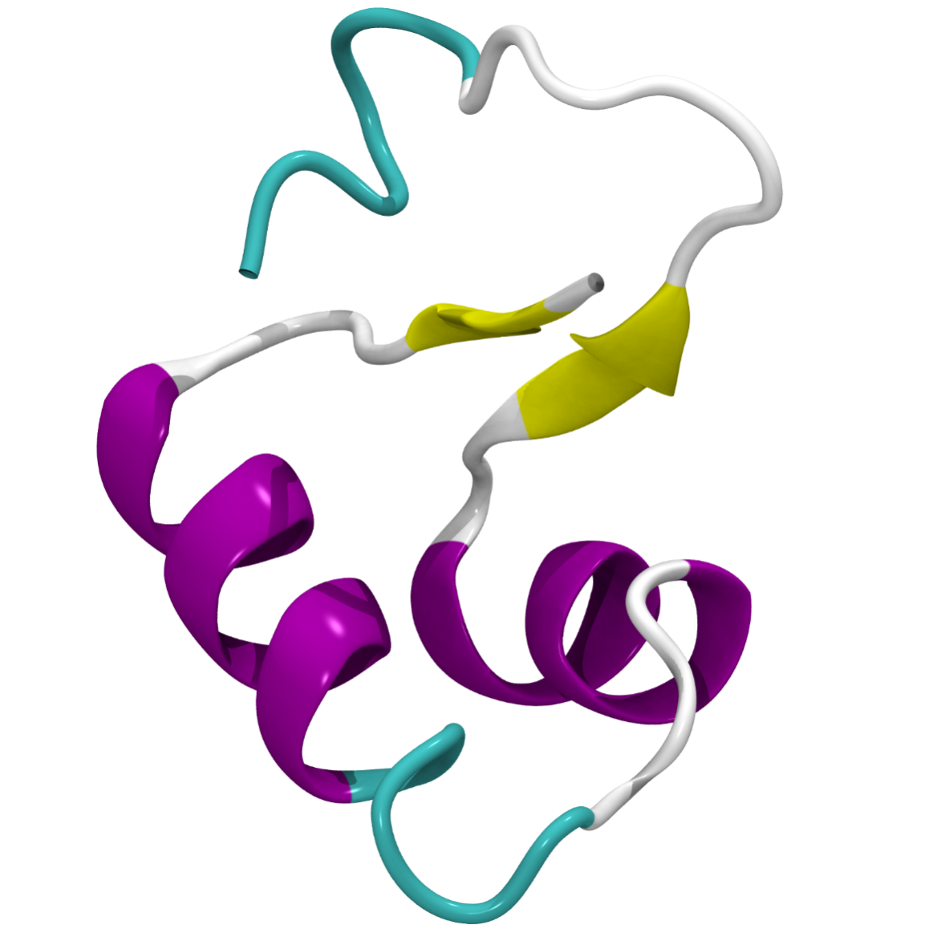
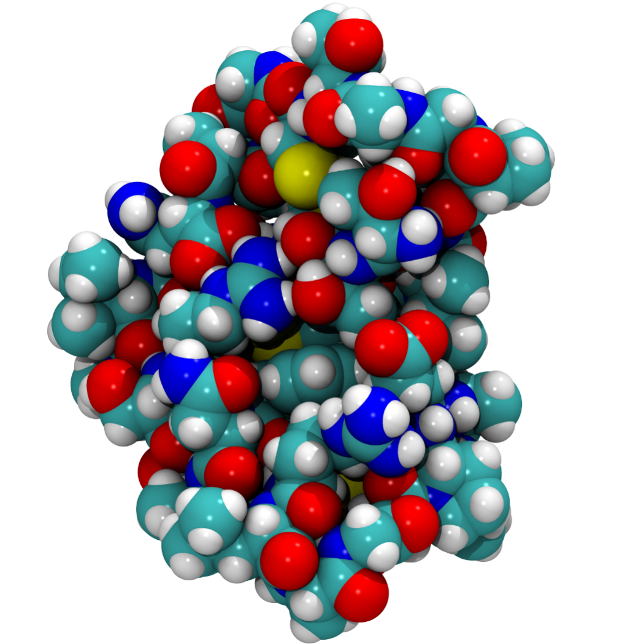
CRAMBIN
Crambin is a small seed storage protein from the Abyssinian cabbage. It belongs to thionins. It has 46 aminoacids (642 atoms).
Primary structure:
Secondary structure:
RANDOM COIL
N-term
C-term
β-SHEET
α-HELIX B
α-HELIX A

Slide 36
Tensorial Properties of Crystals
Second order
Third order
Fourth order
Dielectric
Polarizability
Piezoelectric
First hyperpolarizability
Elastic
Photoelastic
Second hyperpolarizability
Maximum number of independent elements according to crystal symmetry:
6 18 21
Minimum number of independent elements according to crystal symmetry:
1 1 3
Notes:
36

Slide 37
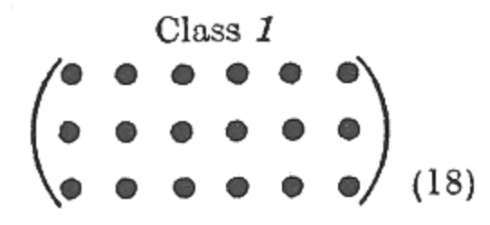
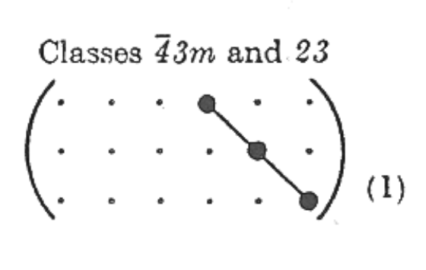
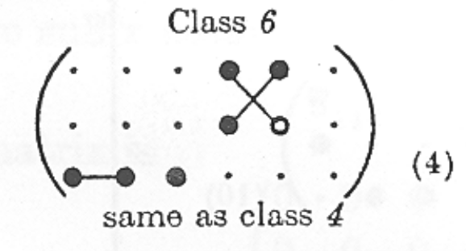
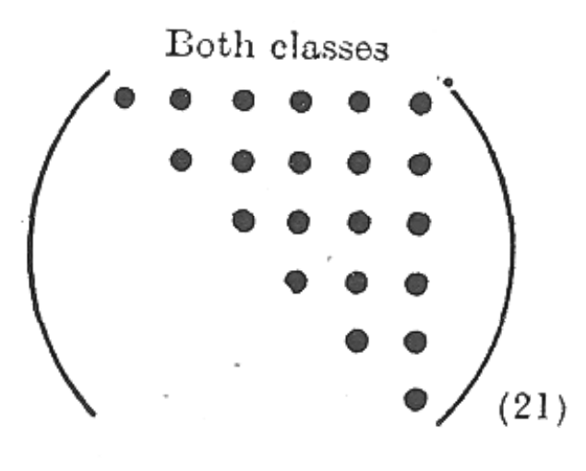
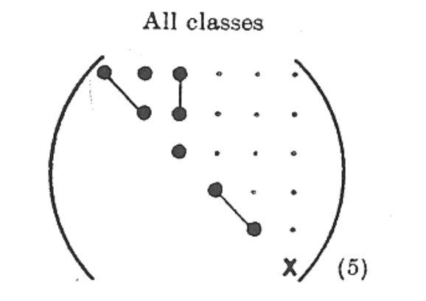
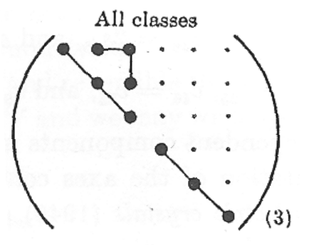
Effect of the Crystal Symmetry on Tensors
Third Order Tensors:
Triclinic
Hexagonal
Cubic
Fourth Order Tensors:
Triclinic
Hexagonal
Cubic
J. F. Nye, Oxford University Press, (1985)
Notes:
37

Slide 38
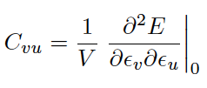
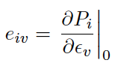
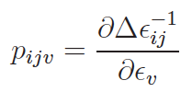
Tensorial Properties Related to Crystal Strain
Elastic Tensor
Piezoelectric Tensor
Photoelastic Tensor
4 3 4
Order of the Tensors
Second derivatives of the total energy E with respect to a pair of strains,
for a 3D crystal
First derivative of the polarization P (computed through the Berry phase approach) with respect to the strain
First derivative of the inverse dielectric tensor (difference with respect to the
unstrained configuration)
with respect to strain
Voigt’s notation is used according to v, u = 1, . . . 6 (1 = xx, 2 = yy, 3 = zz, 4 = yz, 5 =xz, 6 = xy) and i,j =1, 2, 3 (1 = x , 2 = y, 3 = z).
Notes:
38

Slide 39
Tensorial Properties Related to Crystal Strain
Elastic Tensor
Piezoelectric Tensor
Photoelastic Tensor
Geometry definition
ELASTCON
[Optional keywords]
END
END
Basis set definition
END
Comput. Parameters
END
Geometry definition
PHOTOELA
[Optional keywords]
END
END
Basis set definition
END
Comput. Parameters
END
Geometry definition
PIEZOCON
[Optional keywords]
END
END
Basis set definition
END
Comput. Parameters
END

Slide 40
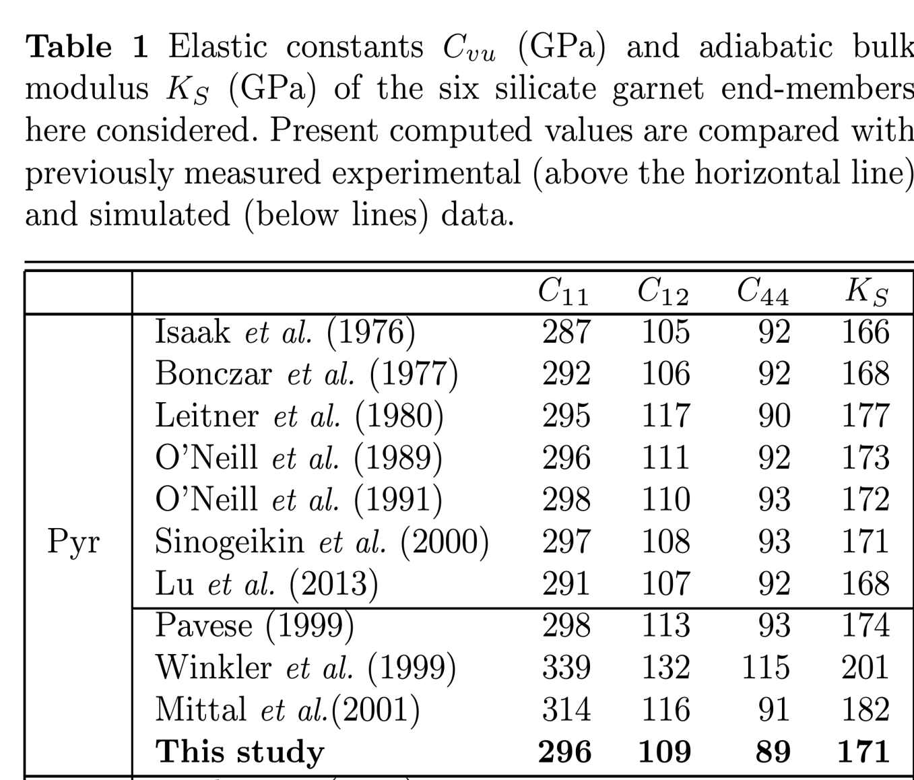
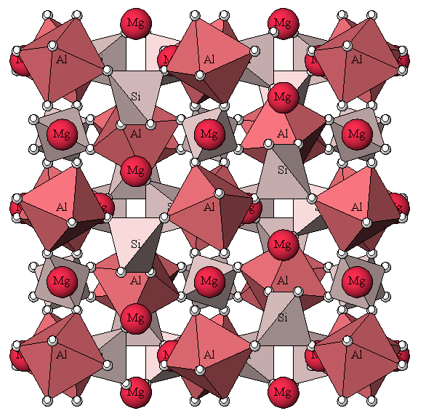
CRYSTAL14: Elastic Properties
Pyrope-Mg₃Al₂(SiO₄)₃
A. Erba, A. Mahmoud, R. Orlando and R. Dovesi, Phys. Chem. Minerals (2013)
DOI 10.1007/s00269-013-0630-4
Notes:
40

Slide 41
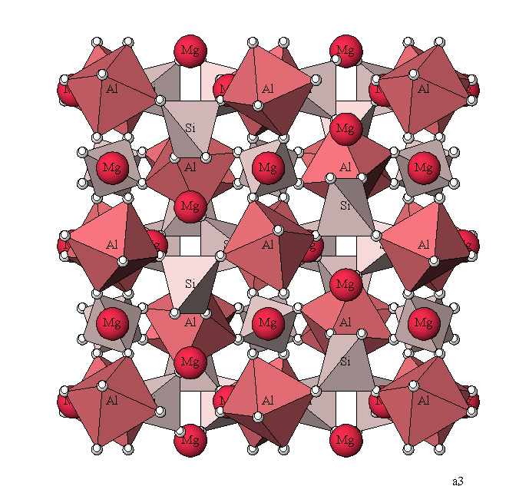
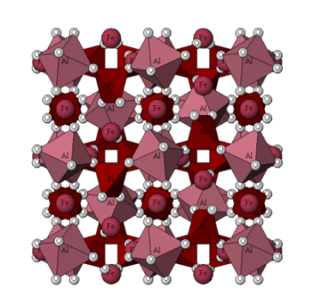
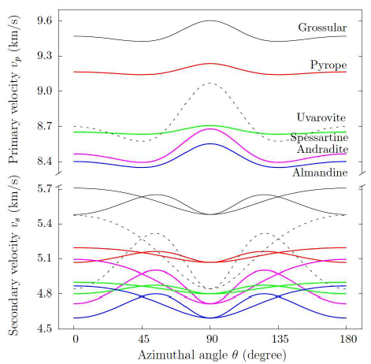
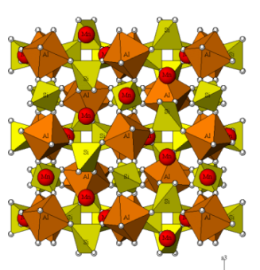
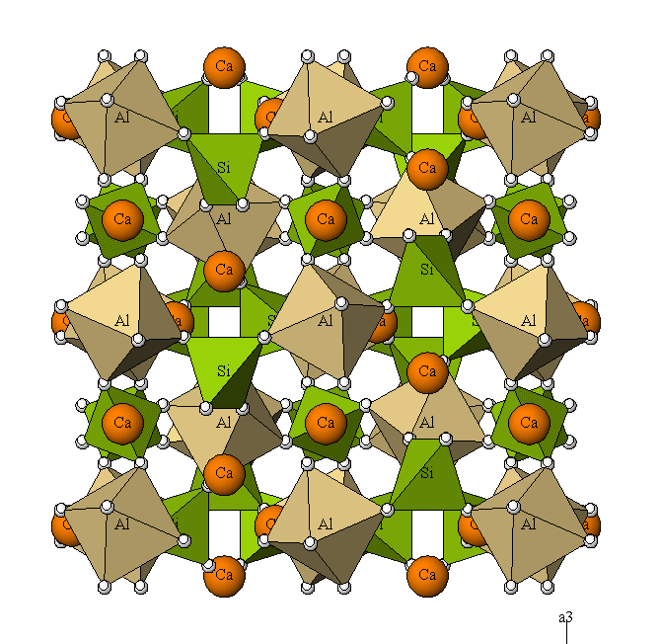
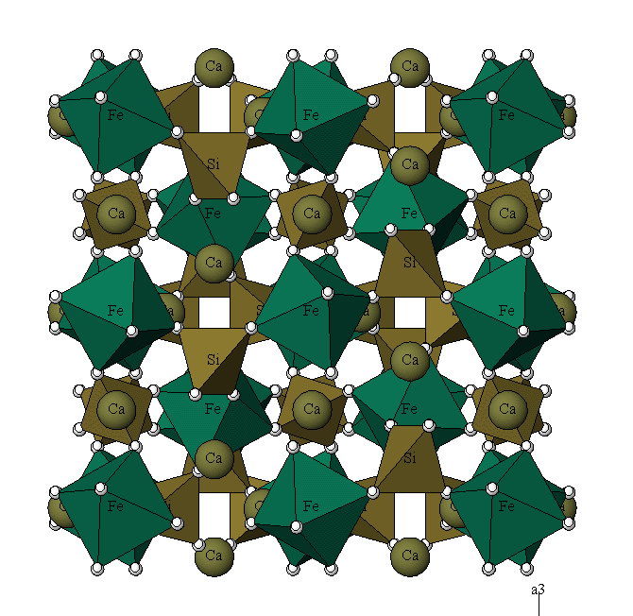
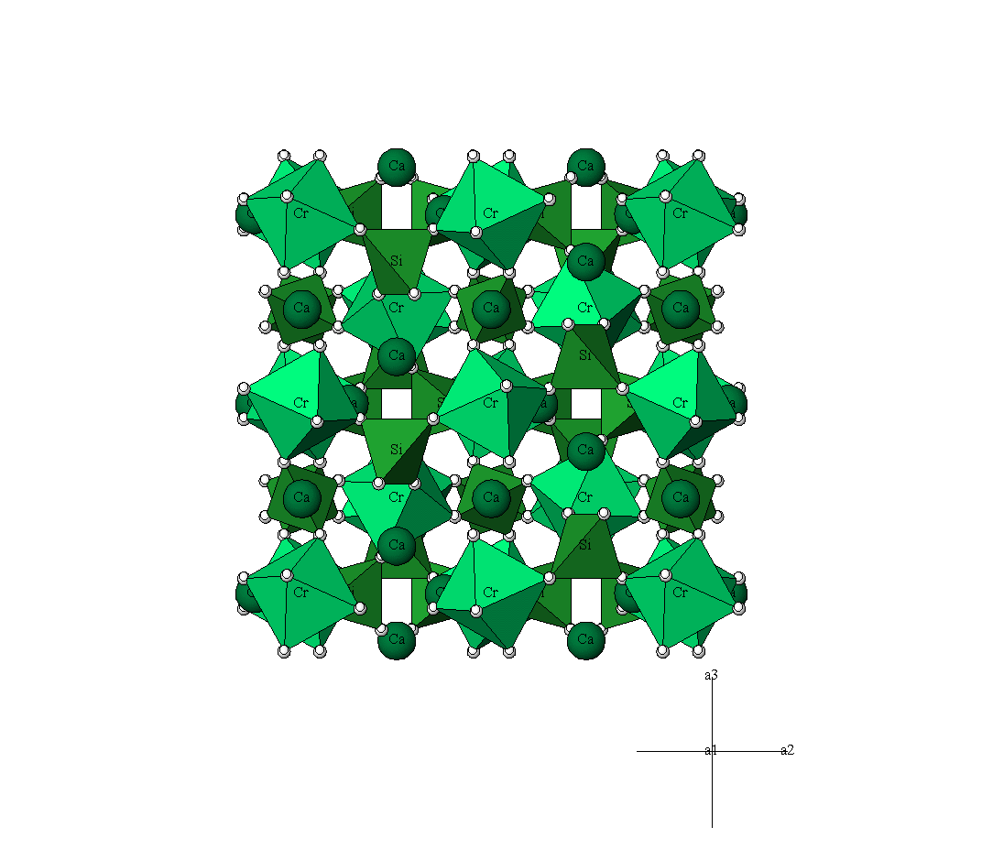
CRYSTAL14: Elastic Properties
Pyrope
Almandine
Elastic Anisotropy
Spessartine
Grossular
Seismic wave velocity
Andradite
Uvarovite
A. Erba, A. Mahmoud, R. Orlando and R. Dovesi, Phys. Chem. Minerals (2013)
DOI 10.1007/s00269-013-0630-4
Notes:
41

Slide 42
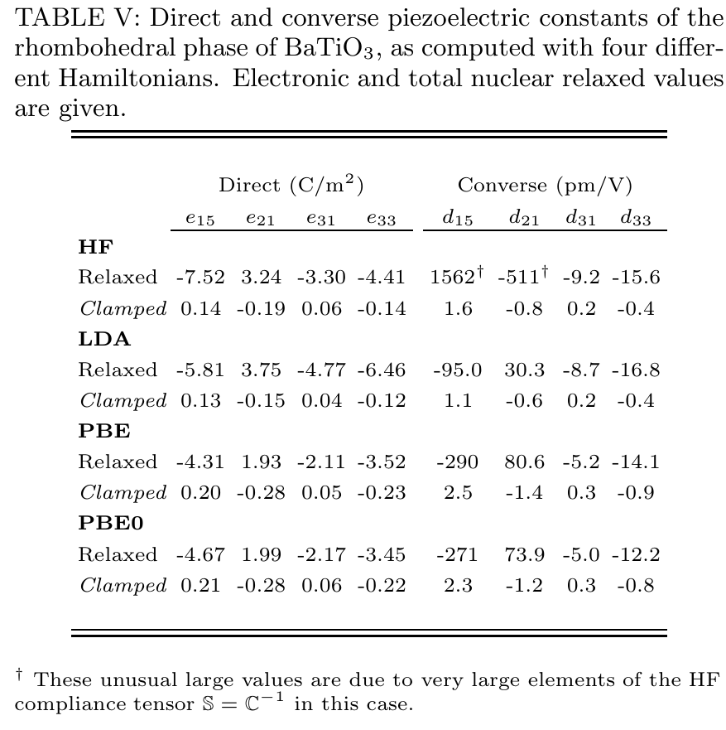
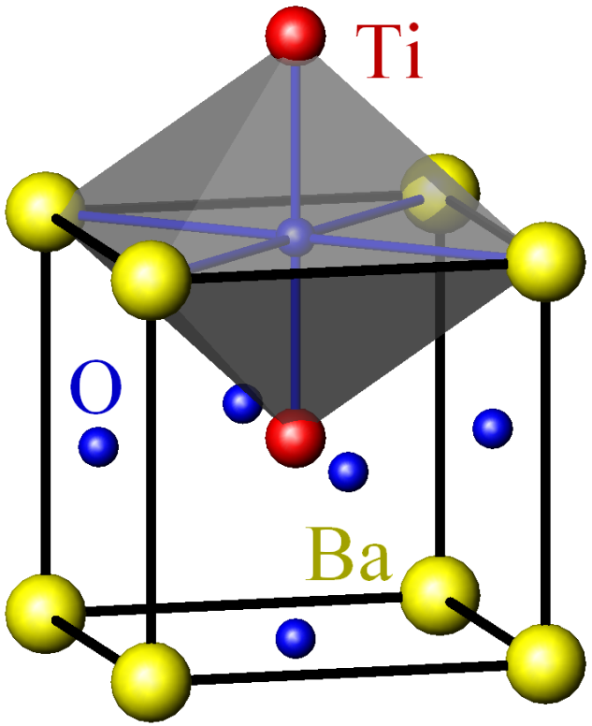
CRYSTAL14: Piezoelectric and Dielectric Properties
A. Mahmoud, A. Erba, Kh. E. El-Kelany, M. Rérat and R. Orlando, Phys. Rev. B (2013)
Notes:
42

Slide 43
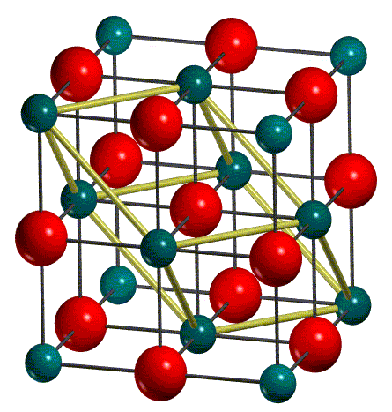
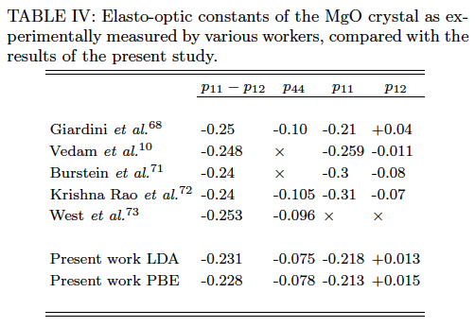
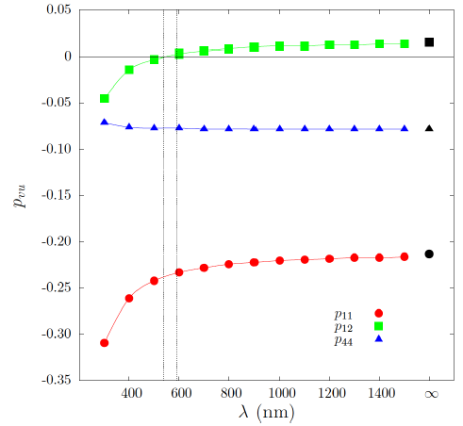
CRYSTAL14: Photoelastic Properties
The three independent elasto-optic constants of MgO, computed at PBE level, as a function of the electric field wavelength λ
p44 is almost wavelength independent
p11 and p12 show a clear dependence from λ
Dashed vertical lines in the figure identify the experimental range of
adopted electric field wavelengths
A. Erba and R. Dovesi, Phys. Rev. B 88, 045121 (2013)
Notes:
43

Slide 44
Vibrational properties
IR and Raman spectra……
Notes:
44

Slide 45
Garnets: X₃Y₂(SiO₄)₃
X | Y | Name
Mg | Al | Pyrope
Ca | Al | Grossular
Fe | Al | Almandine
Mn | Al | Spessartine
Ca | Fe | Andradite
Ca | Cr | Uvarovite
Space Group: Ia-3d
80 atoms in the primitive cell (240 modes)
Γ^{rid} = 3A_{1g} + 5A_{2g} + 8E_{g} + 14 F_{1g} + 14 F_{2g} + 5A_{1u} + 5 A_{2u}+ 10E_{u} + 18F_{1u} + 16F_{2u}
17 IR (F_{1u}) and 25 RAMAN (A_{1g}, E_{g}, F_{2g}) active modes
Notes:
To illustrate vib freq calc we will use examples from garnet familly.
The generic chemical formula is X₃Y₂(SiO₄)_{3.}
X is a 2+ cations and Y is a 3+cation. Most of our examples are pyrope and grossluar
The eighty atoms in the primitive cell lead to 240 modes but only 17 modes are infrared active (F1u modes)
And 25 Raman modes; 3 modes are translation modes

Slide 46
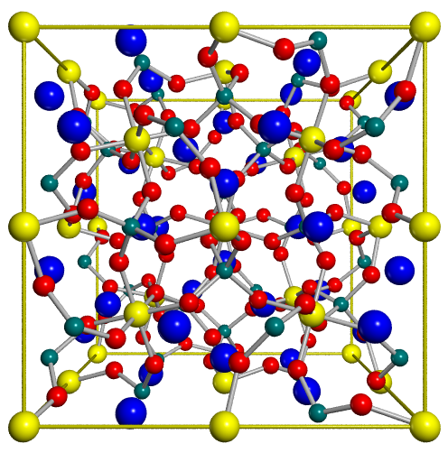
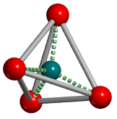
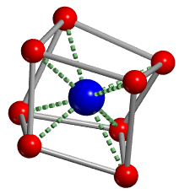
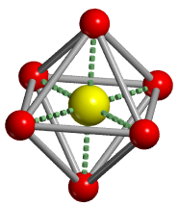
Silicate garnet spessartine structure: Mn₃Al₂(SiO₄)₃
O
Si
O
Mn
tetrahedra
O
distorted
dodecahedra
Al
Cubic Ia-3d
160 atoms in the UC (80 in the primitive)
O general position (48 equivalent)
Mn (24e) Al (16a) Si (24d) site positions
octahedra
Notes:
The Garnets structure is cubic.3 types of cations sites are present
As in all silicate, silicon atoms are tetrahedraly bonded to oxygen. Tetrahedra are isolated.
Y³⁺ cations (as Aluminium in the grossular example) are in a octahedral environement.
X²⁺ cations (as Calcium in this example) is located in a distorded dodecahedra

Slide 47
Harmonic frequency in solids with CRYSTAL
Building the Hessian matrix
analytical first derivative
numerical second derivative
Harmonic frequencies at the central zone are obtained by diagonalising the mass weighted Hessian matrix, W
Isotopic shift can be
calculated at no cost!
Notes:
In order to calculate the hamonic frequency we need to build the Hessian matrix.
In a first step, the first derivative is calculated analyticaly and then derivided a second time numerical to obtain the hessian matrix
Harmonic frequencies at the central zone are obtained by diagonalising the mass weighted Hessian matrix, W.
The heavy step of these calculations is the building of the Hessian mat.
You can notice that isotopic substitution can simalated by changing the mass of atoms and rediagonalising W. This is very fast.

Slide 48
Spessartine raman modes : Calc vs Exp
Calculated Modes BSB |  |  | Observed Modes
 |  |  | Exp. a) | Exp. b)
 | υ | Δυ a) | υ | υ
F_{2g} | 1033 | -4 | 1029 | 1027
E_{2g} | 914 | -1 | 913 | 913
A_{2g} | 910 | -5 | 905 | 905
F_{2g} | 877 | 2 | 879 | 878
E_{2g} | 852 | - | - | 892
F_{2g} | 845 | 4 | 849 | 849
F_{2g} | 640 | -10 | 630 | 628
E_{2g} | 596 | -4 | 592 | 5920
F_{2g} | 588 | -15 | 573 | 573
A_{2g} | 561 | -9 | 552 | 550
E_{2g} | 531 | -9 | 522 | 521
F_{2g} | 505 | -5 | 500 | 499
F_{2g} | 476 | -1 | 475 | 472
Frequency differences (Δυ) are evaluated with respect to experimental data. υ and Δυ in cm⁻¹.
a) Hofmeister &Chopelas, Phys. Chem Min. 1991
b) Kolesov &Geiger, Phys. Chem. Min.1998
Notes:
C

Slide 49
Spessartine raman modes : Calc vs Exp
Calculated Modes BSB |  |  | Observed Modes
 |  |  | Exp. a) | Exp. b)
 | υ | Δυ a) | υ | υ
E_{2g} | 376 | -4 | 372 | 372
F_{2g} | 366 | - | - | -
F_{2g} | 348 | 2 | 350 | 350
A_{2g} | 342 | 8 | 350 | 347
E_{2g} | 320 | 1 | 321 | 318
F_{2g} | 315 | 13 | 302 | 314
E_{2g} | 299 | -30 | 269 | -
F_{2g} | 221 | 0 | 221 | 229
F_{2g} | 195 | 1 | 196 | 194
F_{2g} | 165 | 10 | 175 | 163
E_{2g} | 163 | -1 | 162 | 162
F_{2g} | 105 | - | - | -
Frequency differences (Δυ) are evaluated with respect to experimental data. υ and Δυ in cm⁻¹.

Slide 50
Oscillator strengths of spessartine
TO freq. | Calc. f | Δf | Exp. f
106.6 | 2.28 | 1.58 | 0.7
137.8 | 1.84 | 0.34 | 1.5
170.0 | 0.11 | 0.02 | 0.09
205.4 | 0.85 | 0.45 | 0.4
251.6 | 0.22 | 0.14 | 0.08
322.7 | 0.39 | 0.21 | 0.18
356.1 | 0.23 | 0.11 | 0.12
380.7 | 0.84 | -0.06 | 0.9
417.5 | 0.08 | 0.06 | 0.02
447.8 | 1.59 | 0.29 | 1.3
470.8 | 0.16 | -0.44 | 0.6
520.2 | 0.01 | -0.02 | 0.03
564.0 | 0.12 | 0.04 | 0.08
639.9 | 0.03 | 0.01 | 0.02
852.2 | 0.44 | 0.11 | 0.33
877.5 | 0.13 | 0.01 | 0.12
942.8 | 0.17 | -0.03 | 0.2
Oscillator strengths corresponding to the IR-TO modes (F_{1u}) of spessartine.
Differences (Δf) are evaluated with respect to experimental data.
f and Δf dimensionless.
EXP Hofmeister and Chopelas, “Vibrational spectoscopy of end-member silicate garnets”, Phys. Chem. Min., 17, 503-526 (1991).
|Δf|
0
0.25
0.5
2

Slide 51
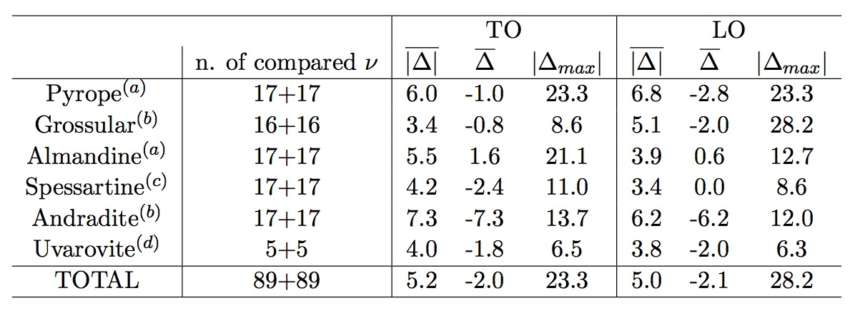
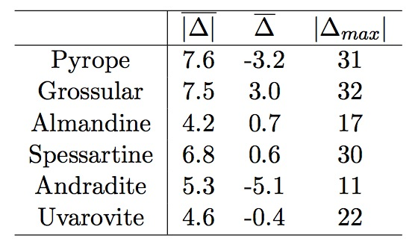
Garnets : Statistics
IR frequencies
Raman frequencies^{(e)}
a) Hofmeister et al., Phys. Chem. Min. 1996. 81, 418
b) McAloon et. al., Phys. Chem. Min. 1995. 80, 1145
c) Hofmeister et. al., Phys. Chem. Min. 1991. 17, 503
d) Hofmeister, private comm.
e) Kolesov et. al., Phys. Chem. Min. 1998. 25, 142
Statistical analysis of calculated IR and Raman modes of garnets compared to experimental data.
Notes:
To illustrate vib freq calc we will use examples from garnet familly.
The generic chemical formula is X₃Y₂(SiO₄)_{3.}
X is a 2+ cations and Y is a 3+cation. Most of our examples are pyrope and grossluar
The eighty atoms in the primitive cell lead to 240 modes but only 17 modes are infrared active (F1u modes)
And 25 Raman modes; 3 modes are translation modes

Slide 52
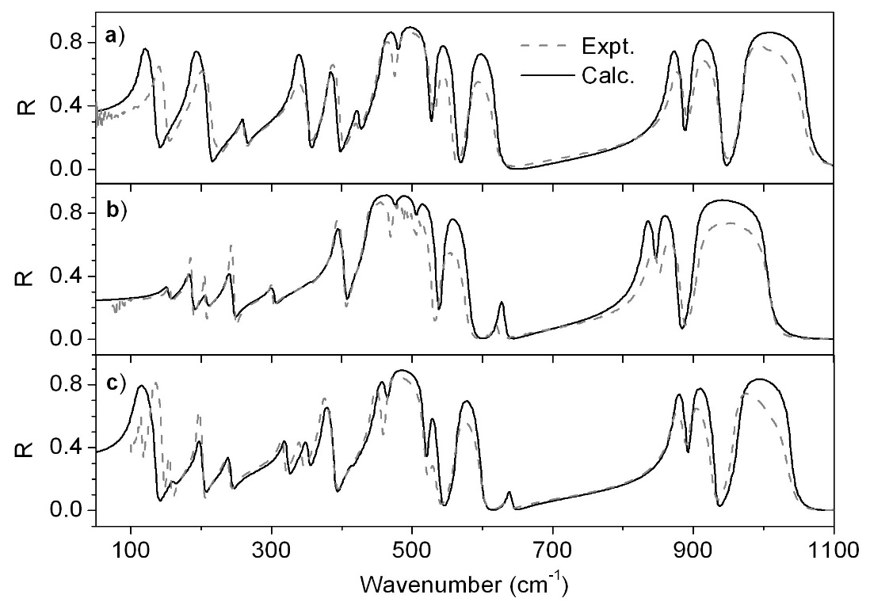
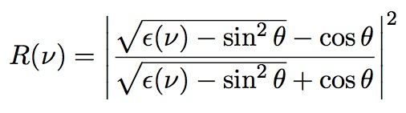
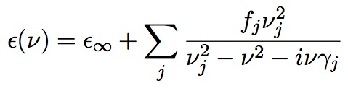
IR reflectance spectrum
Reflectivity is calculated from dielectric constant by means of:
(θ is the beam incident angle)
The dielectric function is obtained with the classical dispersion relation:
Comparison of computed and experimental IR reflectance spectra for garnets: a) pyrope b) grossular c) almandine .
Notes:
To illustrate vib freq calc we will use examples from garnet familly.
The generic chemical formula is X₃Y₂(SiO₄)_{3.}
X is a 2+ cations and Y is a 3+cation. Most of our examples are pyrope and grossluar
The eighty atoms in the primitive cell lead to 240 modes but only 17 modes are infrared active (F1u modes)
And 25 Raman modes; 3 modes are translation modes

Slide 53
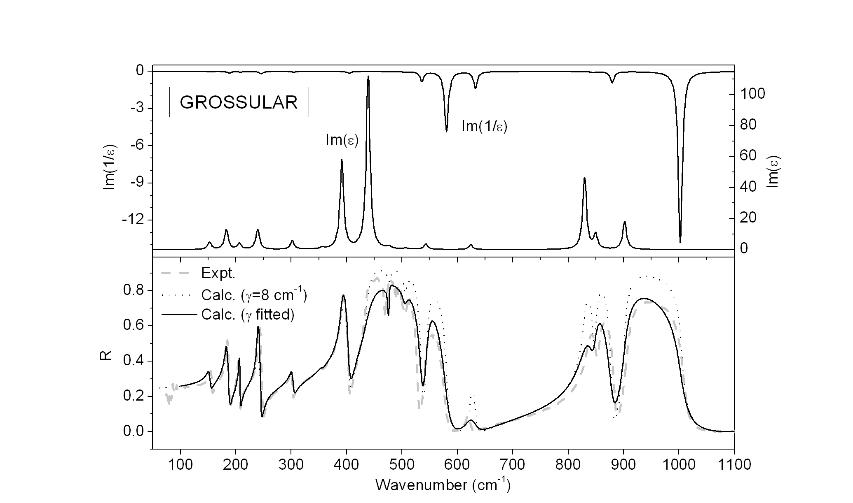
IR reflectance spectrum of grossular
Computed and experimental IR reflectance spectra of grossular garnet, plus imaginary parts of ε and 1/ε.
Notes:
To illustrate vib freq calc we will use examples from garnet familly.
The generic chemical formula is X₃Y₂(SiO₄)_{3.}
X is a 2+ cations and Y is a 3+cation. Most of our examples are pyrope and grossluar
The eighty atoms in the primitive cell lead to 240 modes but only 17 modes are infrared active (F1u modes)
And 25 Raman modes; 3 modes are translation modes

Slide 54

IR reflectance spectrum: required quantities
Optical dielectric constant ε∞
  Computed through a Coupled Perturbed HF(KS) scheme
Transverse Optical vibrational frequencies ν
  Eigenvalues of the Hessian matrix, constructed in the harmonic approximation
Damping factors γ
  A constant value 8 cm⁻¹ is adopted
Optical dielectric constants of garnets
(expt. from Medenbach et al., J. Opt. Soc.Am. B, 1997, 14, 3299-3318)
Notes:
To illustrate vib freq calc we will use examples from garnet familly.
The generic chemical formula is X₃Y₂(SiO₄)_{3.}
X is a 2+ cations and Y is a 3+cation. Most of our examples are pyrope and grossluar
The eighty atoms in the primitive cell lead to 240 modes but only 17 modes are infrared active (F1u modes)
And 25 Raman modes; 3 modes are translation modes

Slide 55
The RAMAN spectrum of Pyrope:
25 modes

Slide 56
From A_{1g}+E_{g} wavenumbers...
 |  | Ours | Hofmeister |  | Chopelas |  | Kolesov
Sym | M | υ (cm⁻¹) | υ (cm⁻¹) | Δυ (cm⁻¹) | υ (cm⁻¹) | Δυ (cm⁻¹) | υ (cm⁻¹) | Δυ (cm⁻¹)
 | 1 | 352.5 | 362 | -10 | 362 | -10 | 364 | -12
A_{1g} | 2 | 564.8 | 562 | 3 | 562 | 3 | 563 | 2
 | 3 | 926.0 | 925 | 1 | 925 | 1 | 928 | -2
 | 4 | 209.2 | 203 | 6 | 203 | 6 | 211 | -2
 | 5 | 308.5 |  |  | 309 | -1 | 284 | 25
 | 6 | 336.5 | 342 | -6 |  |  | 344 | -8
 | 7 | 376.9 | 365 | 12 | 379 | -2 | 375 | 2
E_{g} | A |  | 439 |  | 439
 | 8 | 526.6 | 524 | 3 | 524 | 3 | 525 | 2
 | 9 | 636.0 | 626 | 10 | 626 | 10 | 626 | 10
 | 10 | 864.4 |  |  | 867 | -3
 | B |  | 911
 | 11 | 937.4 | 938 | -1 | 938 | -1 | 945 | -8
Frequency differences are evaluated with respect to calculated data.
Hofmeister: Hofmeister & Chopelas, Phys. Chem. Min., 1991
Chopelas: Chaplin & Price & Ross, Am. Mineral., 1998
Kolesov: Kolesov & Geiger, Phys. Chem. Min., 1998

Slide 57
... to RAMAN spectra!

Slide 58
And now F_{2g} wavenumbers...
 |  | Ours | Hofmeister |  | Chopelas |  | Kolesov
Sym. | M | υ (cm-1) | υ (cm-1) | Δυ (cm-1) | υ (cm-1) | Δυ (cm-1) | υ (cm-1) | Δυ (cm-1)
 | 12 | 97.9 | - | - | - | - | 135 | -37
 | 13 | 170.1 | - | - | - | - | - | -
 | 14 | 203.7 | 208 | -4 | 208 | -4 | 212 | -8
 | C |  | 230 |  | 230
 | 15 | 266.9 | 272 | -5 | 272 | -5 | - | -
 | D |  | 285
 | 16 | 319 | 318 | 1 | 318 | 1 | 322 | -3
F_{2g} | E |  |  |  | 342
 | 17 | 350.6 | 350 | 1 | 350 | 1 | 353 | -2
 | 18 | 381.9 | 379 | 3 | 379 | 3 | 383 | -1
 | 19 | 492.6 | 490 | 3 | 490 | 3 | 492 | 1
 | 20 | 513.5 | 510 | 4 | 510 | 4 | 512 | 2
 | 21 | 605.9 | 598 | 8 | 598 | 8 | 598 | 8
 | 22 | 655.3 | 648 | 7 | 648 | 7 | 650 | 5
 | 23 | 861 | 866 | -5 | 866 | -5 | 871 | -10
 | 24 | 896.7 | 899 | -2 | 899 | -2 | 902 | -5
 | 25 | 1068.4 | 1062 | 6 | 1062 | 6 | 1066 | 2
B3LYP overstimates the lattice parameter!
Frequency differences are evaluated with respect to calculated data.
Hofmeister: Hofmeister & Chopelas, Phys. Chem. Min., 1991
Chopelas: Chaplin & Price & Ross, Am. Mineral., 1998
Kolesov: Kolesov & Geiger, Phys. Chem. Min., 1998

Slide 59
... and the RAMAN spectra!
A_{1g} peaks also in F_{2g} spectrum caused by the presence of different crystal orientations and/or rotation of the polarized light.

Slide 60
High-order dielectric
properties of solids

Slide 61
The total energy of a crystal in an electric field
The total energy (E_{tot}) of a crystal (or a molecule) in a “weak” electric field (ε) can be expressed as a perturbative series of the field components plus the total energy of the field-free system (E⁰_{tot}):
dipole moment
polarizability
first-order hyperpolarizability
second-order hyperpolarizability
The effect of a low-intensity high-frequency electric field (ε) applied to a crystal within the periodic boundary conditions can be represented by the following perturbative term in the Hamiltonian operator:
Ω depends on k, any point in the reciprocal space
position operator
gradient in k space

Slide 62
Static polarizability and hyperpolarizabilities
substitute for U^{[2]}
n+1 formulation
2n+1 formulation
2n+1 formulation

Slide 63
Dielectric properties
Polarizability (α) and hyperpolarizability (β and γ ) tensors are related to other tensors:
first-order electric susceptibility
V = unit cell volume
dielectric tensor
δ = Kronecker delta
second-order electric susceptibility
second-harmonic generation (SHG) electric susceptibility
third-order electric susceptibility

Slide 64
Dependence of α, β, γ on series truncation (I)
Cubic 3C-SiC at the experimental lattice parameter
HF approximation
T_{I} |  | d
6 | 4.8391 | - 6.3452 | 7.2035 | 2.9887
7 | 4.8446 | - 6.3746 | 7.2796 | 3.0221
8 | 4.8420 | - 6.4141 | 7.2435 | 3.0180
10 | 4.8544 | - 6.5059 | 7.4565 | 3.1180
12 | 4.8596 | - 6.5626 | 7.5326 | 3.1548
14 | 4.8655 | - 6.6116 | 7.6932 | 3.2351
16 | 4.8669 | - 6.6225 | 7.7307 | 3.2529
18 | 4.8680 | - 6.6245 | 7.7668 | 3.2691
T_{I}: tolerances for the truncation of the Coulomb and exchange series
T₁=T₂=T₃=T₄=T_{I}
T₅= 2 T_{I}
overlap < 10^{-TI}
d in pm/V
χ⁽³⁾ in 10⁻¹⁴ esu

Slide 65
Static optical properties of cubic 3C-SiC
d
gap
LDA
6.85
15.0
6.32
PBE
6.85
14.8
6.26
CRYSTAL09 calculations
B3LYP
6.10
10.5
8.05
PBE0
6.19
10.4
8.32
HF
5.05
5.54
15.3
PW-LDA
12.4
+ scissors
8.00
PW-LDA
8.83
d in pm/V
PW-LDA-GW
7.45
gap in eV
+ scissors
5.71
Experiment
7.18
6.2-8.7
6.52

Slide 66



Potassium Di-hydrogen Phosphate KDP
Chemical formula: KH₂PO₄
NonLinear Optic Properties (NLO):
the electric polarization (P) shows a NON LINEAR optic
response to the applied electric field (F).
Ferroelectric Phase Transition (PARA->FERRO) at 123° K
Fdd2
ferro
Fdd2
ferro
I-4d2
para

Slide 67
Potassium Di-hydrogen Phosphate KDP
Tetragonal (I-4d2)
Orthorhombic (Fdd2)
Symmetric H-bonds
Above T_{c}: DISORDER, protons move along the H-bond (PE)‏
Transition state as documented by negative frequencies.
  Protonic Trasfer
  Below T_{c}: ORDER, protons fixed in ferroelectric domains (FE)
  Real minimum: all frequencies are positive

Slide 68




Potassium Di-hydrogen Phosphate KDP
K
I-4d2 (Exp) Fdd2 (Exp.)
a 7.44 (7.44) 10.56 (10.53)
b 7.44 (7.44) 10.67 (10.44)
c 6.95 (6.97) 6.98 ( 6.90 )
H-O₁ 1.19 (1.25) 1.03 ( 1.05 )
H-O₂ 1.19 (1.25) 1.48 ( 1.44 )
P-O₁ 1.54 (1.54) 1.58 ( 1.59 )
P-O₂ 1.54 (1.54) 1.51 ( 1.50 )
I-4d2 Fdd2
P
OPTGEOM: PBE0 [1]
V. Lacivita, M. Rérat, B. Kirtman, M. Ferrero, R. Orlando and R. Dovesi, J. Chem. Phys. 2009.

Slide 69
Potassium Di-hydrogen Phosphate KDP
CPHF: B3LYP, Exp. geom.
V. Lacivita, M. Rérat, B. Kirtman, M. Ferrero, R. Orlando and R. Dovesi, J. Chem. Phys. 2009.

Slide 70


Potassium Di-hydrogen Phosphate KDP
Dielectric Tensor and Optical Indicatrix
DIAGONALIZATION ->
PRINCIPAL REFRACTIVE INDICES
(α <= β <= γ)
BIREFRINGENCE: B = γ − α (≠ 0)
OPTICAL CLASSES:
1) MONOAXIAL = one monorefringence direction (one optical axis)
2) BIAXIAL = two monorefringence directions (two optical axes)

Slide 71


Potassium Di-hydrogen Phosphate KDP
Tetragonal (I-4d2)
Orthorhombic (Fdd2)
Monoaxial
Oblate optical indicatrix
  Biaxial
α = 1.436
β = 1.476
γ = 1.484
ε = 1.43
ω = 1.49
optic axis
ω
CPHF: B3LYP, Exp. geom.

Slide 72
Nanotubes

Slide 73
Nanotubes
What’s new in the implemented method?
The exploitation of the high point symmetry
in helical 1D systems allows to
dramatically reduce the computational cost
and automatically build nanotubes
from 2D and 3D structures.
Y. Noël, P. D’Arco, R. Demichelis, C. M. Zicovich-Wilson, R.Dovesi; J. Comput. Chem., 2010, 31, 855-862
Why?
Nanotube ab initio simulation is, in general, expensive:
the unit cell can contain hundreds or thousands of atoms.
QM ab initio calculation of nanotubes with large basis sets and
hybrid functionals: POSSIBLE AND NOT EXPENSIVE

Slide 74

Nanotubes
Automatic Construction of a Nanotube from 2D Structures
(CRYSTAL can authomatically cut 2D layers from 3D structures)
We start from 2D graphene, a simple case ---> C nanotube (CNT).
Shortest lattice vector perpendicular to R:
L=l₁a₁+l₂a₂
R=n₁a₁+n₂a₂
Rolling direction
|R|:nanotube circumference
(n₁,n₂) defines the nanotube
a₂
a₁
* Noël, D’Arco, Demichelis, Zicovich-Wilson, Dovesi; J. Comput. Chem., 2010, 31, 855-862

Slide 75
Nanotubes
Exploitation of the High Point Symmetry of Nanotubes
A CNT unit cell can contain hundreds of atoms
BUT
ONLY 2 IRREDUCIBLE ATOMS WITH HELICAL SYMMETRY EXPLOITATION
EXAMPLE: frequency calculation of the (24,0) SWCNT
(96 atoms in the unit cell)
FREQUENCY CALCULATION:
- equilibrium geometry
- displacement of each atom along the 3 Cartesian directions
96x3+1=289 SCF calculations
If the calculation is performed on 2 irreducible atoms:
2x3+1=7 SCF calculations (helical symmetry exploitation)
* Noël, D’Arco, Demichelis, Zicovich-Wilson, Dovesi; J. Comput. Chem., 2010, 31, 855-862

Slide 76
Nanotubes
Exploitation of the High Point Symmetry of Nanotubes
The helical symmetry of nanotubes is then exploited at three levels:
1 - Automatic generation of the nanotube starting from a 2D structure
Build the (4,2) SWCNT
CRYSTAL
0 0 0
186
2.47 6.70
2
6 0.000000 0.000000 0.000000
6 0.333333 0.666667 0.000000
SLAB
0 0 1
1 1
SWCNT
4 2
Easy to use
Thick slabs can be treated
Geometry guess for nanotubes
3D geometry
Cut a slab
Build nanotube
* Noël, D’Arco, Demichelis, Zicovich-Wilson, Dovesi; J. Comput. Chem., 2010, 31, 855-862

Slide 77

Nanotubes
Time Scaling
B3LYP, 6-1111G*
single processor Intel Xeon
1.86GHz, RAM 8Gb
* Noël, D’Arco, Demichelis, Zicovich-Wilson, Dovesi; J. Comput. Chem., 2010, 31, 855-862

Slide 78

Nanotubes
Time Scaling
NANORE (SWCNTRE): build a (n₁,n₂) nanotube from the structure of another one
''old'' nanotube unrolled and re-rolled according to a new R vector, with minor modifications to the structure.
EXAMPLE: geometry optimisation of imogolite
Al₂(OH)₃SiO₃OH, tubular hydrated aluminosilicate
(thick slabs, large systems, tube and slab geometries very different)
starting structure for the optimisation
(the optimised slab or a previously optimised tube)
ATOMS Beginning Number of SCF+gradient
ΔE
δE
(8,0)
(9,0)
(10,0)
(11,0)
(12,0)
224
252
280
308
336
(9,0)
(10,0)
slab
(10,0)
(11,0)
22
20
46
19
16
-47.8
-52.1
-52.6
-51.8
-50.8
-8.0
-4.2
-236.6
-2.4
-1.5
ΔE: Energy difference with respect to slab, kJ/mol per fu
δE: Energy relaxation after rigid unrolling and re-rolling , kJ/mol per fu
* Demichelis, Noël, D’Arco, Maschio, Orlando, Dovesi; submitted for publication

Slide 79



Nanotubes
Inorganic Nanotubes: the Case of Chrysotile
FIRST AB INITIO SIMULATION OF SINGLE LAYER CHRYSOTILE
(smallest fibre in the nature ~1000 atoms in the unit cell)
“White” asbestos:
wrapping of lizardite - phyllosilicate, Mg₃Si₂O₅(OH)₄
brucite-type octahedral sheet (MgO₆ octahedra sharing edges)
tetrahedral sheet (vertices-sharing SiO₄ tetrahedra forming hexagonal motif)
Brucite-like slab : lattice parameter 5.43 Å
SiO₃(OH)₂ slab : lattice parameter 5.32 Å
Lizardite slab : lattice parameter 5.37 Å
The misfit might be one of the main responsible for chrysotile curling. Octahedral external wall is allowed to expand and tetrahedral wall to contract.
* D’Arco, Noël, Demichelis, Dovesi; J. Chem. Phys., 2009, 131, 204701

Slide 80
FULLERENES
Notes:
80

Slide 81

Input again: general!!

Slide 82

Some (in pink) hexagons (or pentagons in orange) cannot change their orientation; it is fixed by symmetry
C1500 fullerene

Slide 83



Slide 85

Comparison of optimized structures
C240
C540
Each fullerene is compared to the C1500. The center of pentagons have been taken as reference.
C960

Slide 86


Slide 87
FULLERENES: size of the matrices
(n,n) | n_{at} | N_{at} | N_{AO} | S_{FIRR} | S_{FRED} | R₁ | R₂ | R₄
(1,1) | 1 | 60 | 840 | 1759 | 169'980 | 97 | 401 | 22
(2,2) | 3 | 240 | 3360 | 6707 | 716'130 | 107 | 1683 | 23
(3,3) | 6 | 540 | 7560 | 14570 | 1'609'020 | 110 | 3923 | 23
(4,4) | 10 | 960 | 13440 | 25377 | 2'847'690 | 112 | 7118 | 23
(6,6) | 21 | 2160 | 30240 | 55661 | 6'362'370 | 114 | 16429 | 24
(8,8) | 36 | 3840 | 53760 | 97559 | 11’260’170 | 115 | 29625 | 24
(10,10) | 55 | 6000 | 84000 | 151071 | 17’541’090 | 116 | 46707 | 24
n_{at} = number of irreducible atoms, N_{at} = number of atoms, N_{AO} = number of AO
S_{FIR} (S_{FRED} ) = size of the irreducible (reducible) compact Fock matrix.
R₁, R₂ and R₄ = S_{FRED}/S_{FIRR} , N_{AO}²/S_{FIRR} and N_{AO}/MAX_{IR}.
N_{op} = 120
N_{IR} = 10

Slide 88
 | t | (1,1) | (4,4) | (6,6) | (8,8)* | (10,10)*
A. | init | 26.36 | 64.92 | 184.54 | 418.64 | 825.41
“ | over | 81.40 | 8.11 | 22.36 | 56.73 | 135.85
B. | pole | 326.15 | 6.64 | 14.76 | 26.51 | 40.77
“ | biel | 8.34 | 154.46 | 578.06 | 1141.61 | 1885.74
“ | mono | 0.02 | 4.45 | 21.98 | 68.70 | 166.01
C. | fock | 0.16 | 7.71 | 18.91 | 36.27 | 56.31
D. | diag | 0.1 | 2.51 | 26.20 | 183.42 | 729.50
E. | dens | 1.23 | 93.02 | 233.02 | 441.63 | 740.14
F. | dft | 5.50 | 55.16 | 126.18 | 437.99 | 702.36
 | TOT_{cyc} | 15.67 | 323.97 | 1019.14 | 2336.16 | 4320.87
 | TOT_{SCF} | 1265.23 | 6552.43 | 20589.74 | 47198.57 | 87378.66
 | grad | 83.99 | 1253.55 | 3191.33 | 10088.28 | 16170.70
Time (in seconds): ONE CORE
construction of symmetry group and transformation matrices (init), construction of the overlap matrix (over), calculation of multipole (pole), bi- (biel) and mono- (mono) electronic integrals, transformation of f into F (fock), Fock matrix diagonalization (diag), construction and back transformation of the density matrix (dens), calculation of the electron density over the DFT grid (dft), a single SCF cycle (TOT_{cyc}, from B. to F.), the entire SCF procedure (TOT_{SCF} , 20 SCF cycles considered), calculation of the gradient for geometry optimization (grad). Calculations from (7,7) on (marked with an asterisk) were performed using the “low memory" option.

