Slide 1
Sensitivity of WRF meteorological model in retrieving Cloud Top Height and application to the EUSO-SPB1 experiment
Università degli Studi di Torino
Dipartimento di Fisica
Supervisor: Ferrarese Silvia
Co-supervisor: Bertaina Mario
Candidate: Monte Silvia
Academic Year 2017/2018

Slide 2
Summary
JEM-EUSO program
Meteorological models
GCM outputs
WRF structure
CTH retrieval
CTH from cloud fraction
CTH from optical depth
EUSO-SPB1: an application
Sensitivity of WRF meteorological model in retrieving CTH and application to EUSO-SPB1 experiment
2

Slide 3
Summary
JEM-EUSO program
Meteorological models
GCM outputs
WRF structure
CTH retrieval
CTH from cloud fraction
CTH from optical depth
EUSO-SPB1: an application
Sensitivity of WRF meteorological model in retrieving CTH and application to EUSO-SPB1 experiment
3

Slide 4
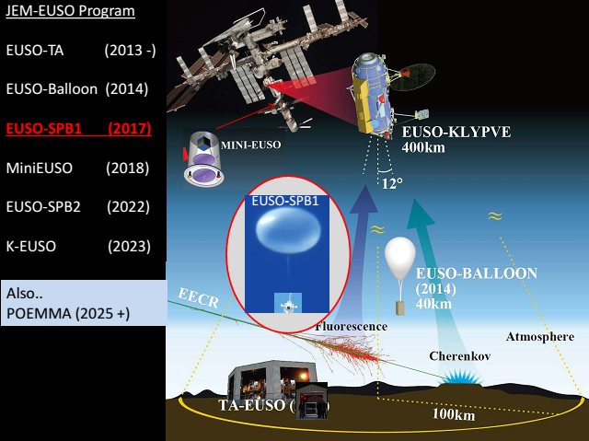
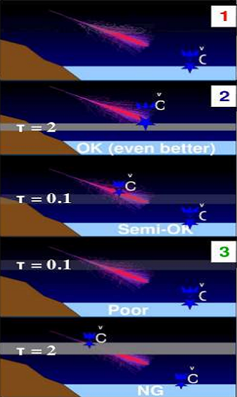
JEM-EUSO program
16 countries and 77 institutes involved, with support of International and National Space Agencies.
Designed to increase the number of observed Extreme Energy Cosmic Rays by an order of magnitude.
CTH and thickness needed for a correct detection

Slide 5
JEM-EUSO program
Meteorological models
GCM outputs
WRF structure
CTH retrieval
CTH from cloud fraction
CTH from optical depth
EUSO-SPB1: an application
Sensitivity of WRF meteorological model in retrieving CTH and application to EUSO-SPB1 experiment
5

Slide 6
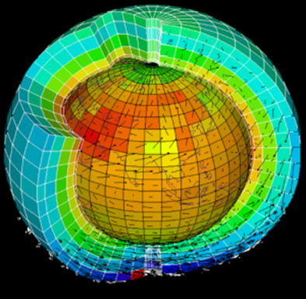
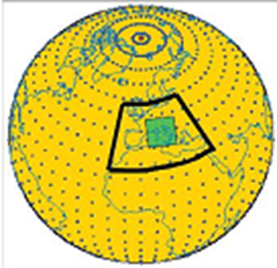
Meteorological Models
Global Circulation Models (GCM): IFS
Forecasts: meteorological variables typically every 6 hours
Input: in situ and remote sensing observations
Model: prognostic equations solved at every grid point
Analysis
input for
Limited Area Models (LAM): WRF
Output: case-study
(meteorological variables at a fixed time step)
Model: prognostic equations solved at every grid point

Slide 7
Meteorological Models
Global Circulation Models (GCM): IFS
Forecasts: meteorological variables typically every 6 hours
Max horizontal
resolution: 0.125°
(14 km at the Equator)
Variable: cloud cover
over 3 layers
Input: in situ and remote sensing observations
Model: prognostic equations solved at every grid point
Analysis
input for
Limited Area Models (LAM): WRF
Max horizontal resolution:
order of km
Variable: cloud fraction
over model layers
Output: case-study
(meteorological variables at a fixed time step)
Model: prognostic equations solved at every grid point

Slide 8
JEM-EUSO program
Meteorological models
GCM outputs
WRF structure
CTH retrieval
CTH from cloud fraction
CTH from optical depth
EUSO-SPB1: an application
Sensitivity of WRF meteorological model in retrieving CTH and application to EUSO-SPB1 experiment
8

Slide 9
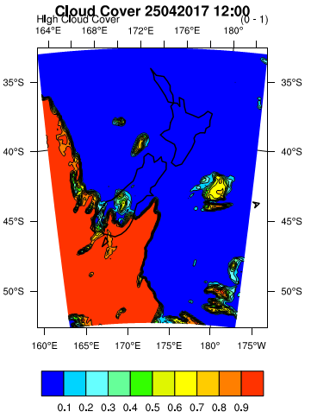
GCM Outputs
ECMWF (Reading, UK) provides:
10 m U and V wind components
2 m T and dewpoint T
Albedo
Geopotential
Land-sea mask
Mean sea level pressure
Sea-ice cover
Sea surface temperature
Skin temperature
Snow depth
Soil temperature level (4)
Surface pressure
Total, Low, Medium and High cloud cover
Total column water and water vapor
Volumetric soil water layer (4)
 | H (km)
L | ≤ 2
M | 2 ÷ 6
H | 6 ÷ 12

Slide 10
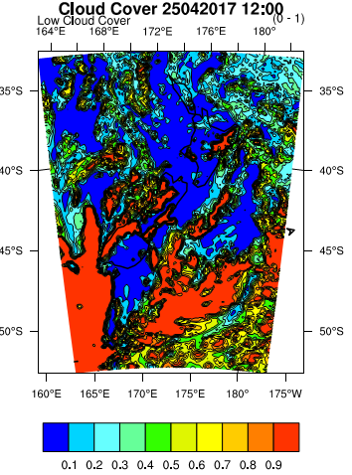
GCM Outputs
ECMWF (Reading, UK) provides:
10 m U and V wind components
2 m T and dewpoint T
Albedo
Geopotential
Land-sea mask
Mean sea level pressure
Sea-ice cover
Sea surface temperature
Skin temperature
Snow depth
Soil temperature level (4)
Surface pressure
Total, Low, Medium and High cloud cover
Total column water and water vapor
Volumetric soil water layer (4)
 | H (km)
L | ≤ 2
M | 2 ÷ 6
H | 6 ÷ 12

Slide 11
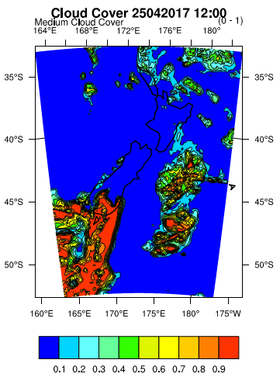
GCM Outputs
ECMWF (Reading, UK) provides:
10 m U and V wind components
2 m T and dewpoint T
Albedo
Geopotential
Land-sea mask
Mean sea level pressure
Sea-ice cover
Sea surface temperature
Skin temperature
Snow depth
Soil temperature level (4)
Surface pressure
Total, Low, Medium and High cloud cover
Total column water and water vapor
Volumetric soil water layer (4)
 | H (km)
L | ≤ 2
M | 2 ÷ 6
H | 6 ÷ 12

Slide 12
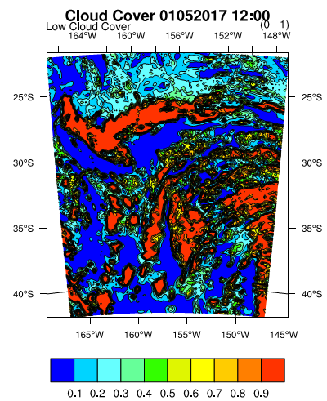
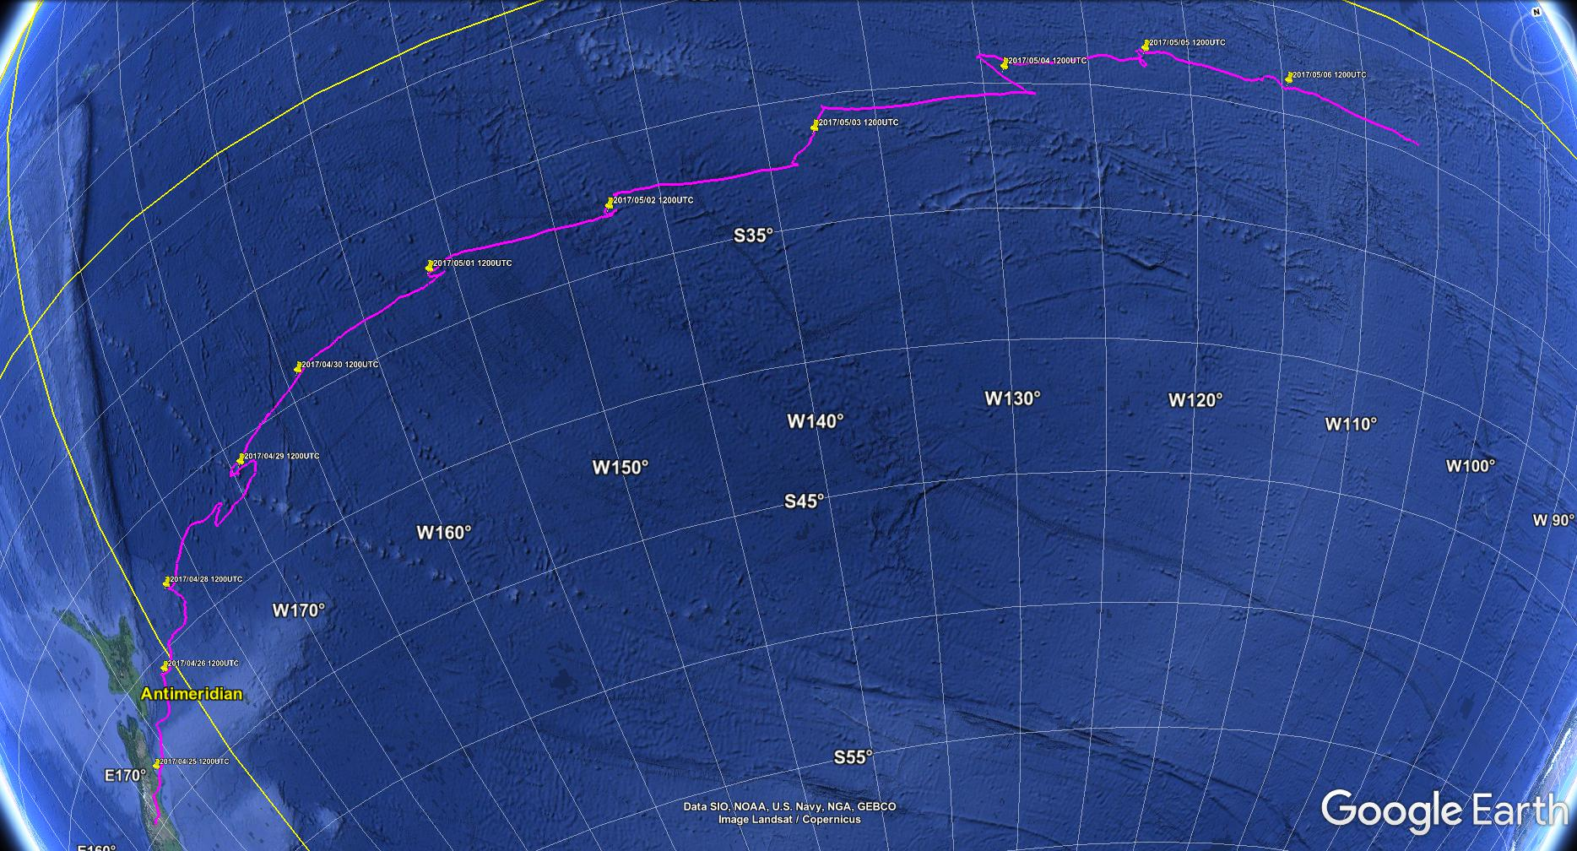
GCM Outputs: EUSO-SPB1
Start: 25th April 2017 (Wanaka, NZ) Height fly: almost 33 km
End: 6th May 2017 (South Pacific Ocean)
Looking down from orbital space: first observations of UHECR Air Showers
A first idea of the cloud field

Slide 13
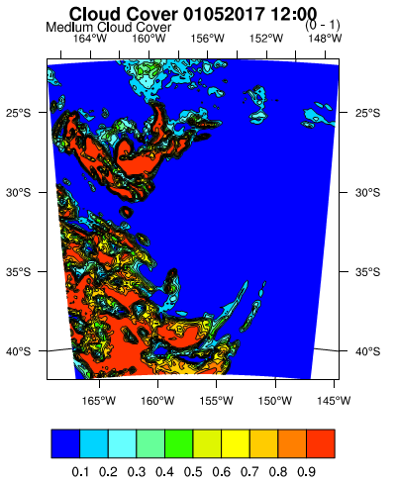
GCM Outputs: EUSO-SPB1
Start: 25th April 2017 (Wanaka, NZ) Height fly: almost 33 km
End: 6th May 2017 (South Pacific Ocean)
Looking down from orbital space: first observations of UHECR Air Showers
A first idea of the cloud field

Slide 14
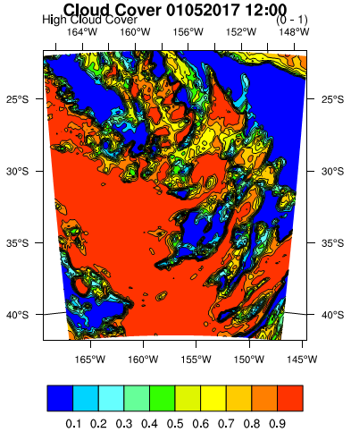
GCM Outputs: EUSO-SPB1
Start: 25th April 2017 (Wanaka, NZ) Height fly: almost 33 km
End: 6th May 2017 (South Pacific Ocean)
Looking down from orbital space: first observations of UHECR Air Showers
A first idea of the cloud field

Slide 15
JEM-EUSO program
Meteorological models
GCM outputs
WRF structure
CTH retrieval
CTH from cloud fraction
CTH from optical depth
EUSO-SPB1: an application
Sensitivity of WRF meteorological model in retrieving CTH and application to EUSO-SPB1 experiment
15

Slide 16
WRF structure
WPS
Mesoscale Numerical Weather Prediction system
Maximum resolution: 1 km
Eta vertical coordinates: $η=\frac{p−p_{t}}{p_{s}−p_{t}}$
Horizontal nesting
Parametrisation for sub-grid processes: microphysics, radiation, planetary boundary layer
Geogrid
(model domains and geographical data interpolation)
Ungrib
(meteorological fields from GCM)
Metgrid
(horizontal interpolation to the model grid)
ARW
Real
(initial and boundary conditions)
WRF
(solver)

Slide 17
Parametrisation schemes
Microphysics
(vapor, cloud and precipitation processes)
Radiation
(heat balance at surface, effects of radiative flux)
PBL
(vortex generation for heat, humidity, momentum transfer)
LW
Morrison 2-moment (Morr): cloud resolving
Rapide Radiative Transfer Model (RRTM): common use
Fu Liou Gu (FLG): high clouds
Dudhia: common use
New Goddard (Godd):
Fu Liou Gu (FLG): high clouds
Yonsei University (YSU):
common use
Mellor-Yamada-Janjic (MYJ):
Mellor-Yamada-Nakanishi and Niino level 2.5 (MYNN2.5):
Shin-Hong:
SW

Slide 18
JEM-EUSO program
Meteorological models
GCM outputs
WRF structure
CTH retrieval
CTH from cloud fraction
CTH from optical depth
EUSO-SPB1: an application
Sensitivity of WRF meteorological model in retrieving CTH and application to EUSO-SPB1 experiment
18

Slide 19
CTH retrieval
N+1 level
Cloud Top Pressure (CTP) and Cloud Top Height (CTH) obtained for each grid point using:
Cloud Fraction > 20%
(“A Semiempirical Cloudiness Parameterization for Use in Climate Models”, Xu and Randall,1996)
Optical Depth > 0.002 m
from$Optd=\left(0.145∗Q_{cloud}+0,272∗Q_{ice}\right)∗\frac{∆P}{g}$
Qcloud : water mixing ratio , Qice : ice mixing ratio
(“Verification and Sensitivity Experiments for the WISP94 MM5 Forecasts”, Manning and Davis, 1997)
N level
N-1 level
CTP / CTH

Slide 20
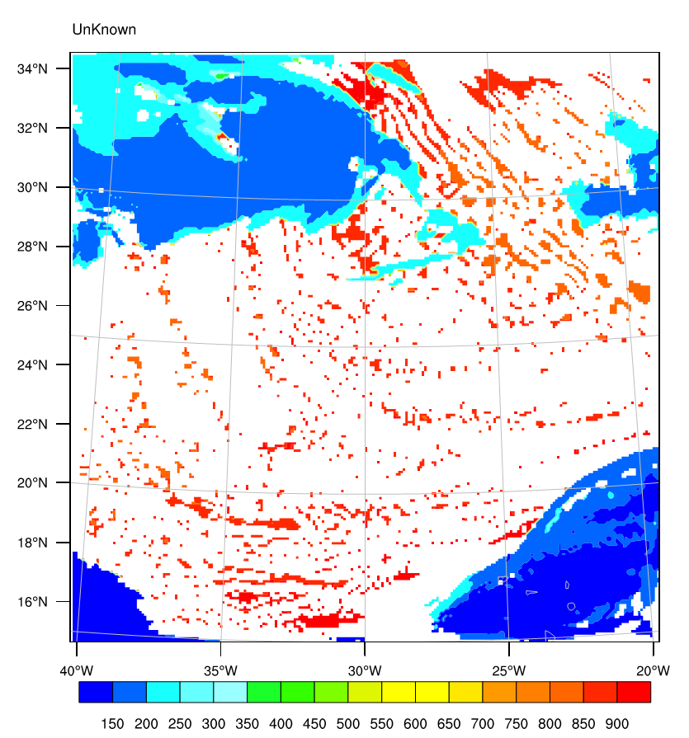
comparison
Cloud Top Pressure (hPa)
Study case selection:
A. Anzalone et al., «Methods to retrieve the Cloud Top Height in the frame of the Jem-EUSO mission », 2018 (in press),
heterogeneous situation
Jem-EUSO observation condition (over the Atlantic Ocean)
near Equator (maximum resolution)
WRF
Spatial resolution:
9 km
Grid point:
250 x 250

Slide 21
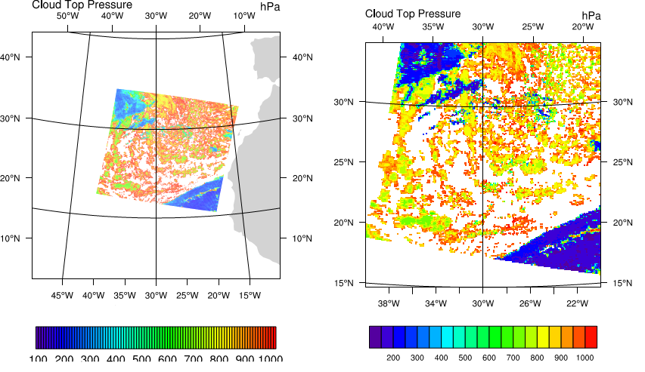
comparison
Cloud Top Pressure (hPa)
Study case selection:
A. Anzalone et al., «Methods to retrieve the Cloud Top Height in the frame of the Jem-EUSO mission », 2018 (in press),
heterogeneous situation
Jem-EUSO observation condition (over the Atlantic Ocean)
near Equator (maximum resolution)
MODIS images used for comparison:
CTP and CTH measured
Real resolution:
5 km
Grid point:
406 x 269
Gridded resolution:
9 km
Grid point:
250 x 250
MODIS
WRF
Spatial resolution:
9 km
Grid point:
250 x 250

Slide 22
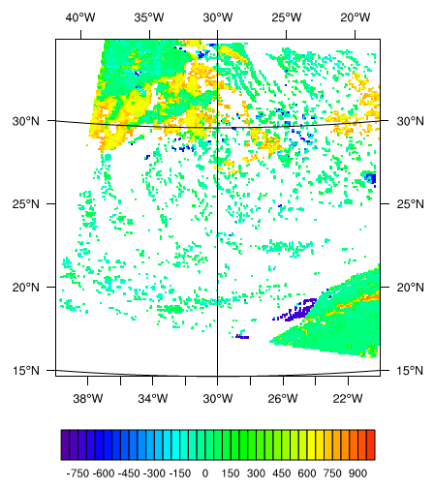
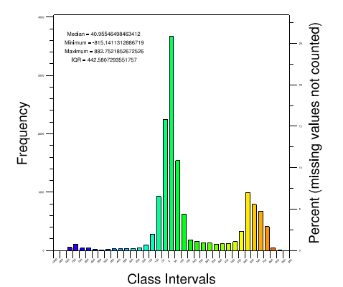
comparison
MODIS-WRF
MODIS data regridded onto WRF horizontal grid and subtracted (where not missing)
Statistical quantities for estimating the goodness of simulation:
Median
InterQuartile Range $IQR=Q_{3}−Q_{1}$
measure of the statistical dispersion
Spatial resolution:
9 km
Grid point:
250 x 250
Median = 40.96
Minimum = -815.14
Maximum = 882.75
IQR = 442.58
-850 0 850

Slide 23
JEM-EUSO program
Meteorological models
GCM outputs
WRF structure
CTH retrieval
CTH from cloud fraction
CTH from optical depth
EUSO-SPB1: an application
Sensitivity of WRF meteorological model in retrieving CTH and application to EUSO-SPB1 experiment
23

Slide 24
Simulations
# Simulation | # Point | Vertical levels | Radiation param | PBL param | Microphysic param
DK1 | 250 x 250 | 40 | Dudhia | YSU | Morr
DK2 | 250 x 250 | 60 | Dudhia | YSU | Morr
DK3 | 250 x 250 | 90 | Dudhia | YSU | Morr
DK4 | 250 x 250 | 50 | Dudhia | YSU | Morr
DK5 | 250 x 250 | 40 | Godd | YSU | Morr
DK6 | 100 x 100 | 28 | FLG | YSU | Morr
DK13 | 250 x 250 | 60 | Godd | YSU | Morr
DK14 | 250 x 250 | 40 | Dudhia | Shin-Hong | Morr
DK15 | 250 x 250 | 40 | Dudhia | MYJ | Morr
DK16 | 250 x 250 | 40 | Dudhia | MYNN2.5 | Morr
# Simulation | # Point | Vertical levels | Radiation param | PBL param | Microphysic param
DK7 | 100 x 90 | 28 | FLG | YSU | Morr
DK8 | 100 x 90 | 28 | Dudhia | YSU | Morr
DK9 | 100 x 90 | 28 | Godd | YSU | Morr
DK10 | 100 x 90 | 40 | FLG | YSU | Morr
DK11 | 100 x 90 | 40 | Dudhia | YSU | Morr
DK12 | 100 x 90 | 40 | Godd | YSU | Morr
Only high clouds

Slide 25
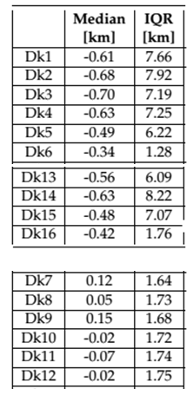
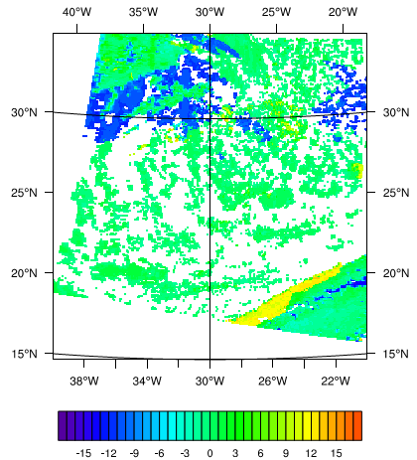
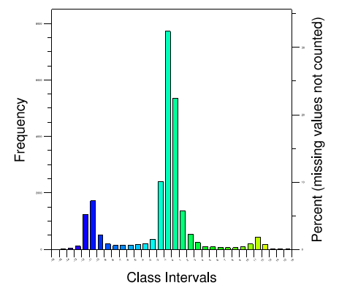
CTH from Cloud fraction
 | # Point | Vertical levels | Radiation param | PBL param | Microphysic param |  | Median [km] | IQR [km]
DK17 | 250x250 | 50 | Godd | MYNN | Morr |  | -0.43 | 1.72
-16 0 16

Slide 26
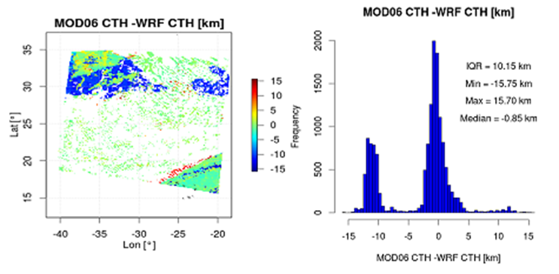
CTH from Cloud fraction
 | # Point | Vertical levels | Radiation param | PBL param | Microphysic param |  | Median [km] | IQR [km]
DK17 | 250x250 | 50 | Godd | MYNN | Morr |  | -0.43 | 1.72
Previous work | 250x250 | 40 | Dudhia | YSU | Morr |  | -0.85 | 10.15

Slide 27
JEM-EUSO program
Meteorological models
GCM outputs
WRF structure
CTH retrieval
CTH from cloud fraction
CTH from optical depth
EUSO-SPB1: an application
Sensitivity of WRF meteorological model in retrieving CTH and application to EUSO-SPB1 experiment
27

Slide 28
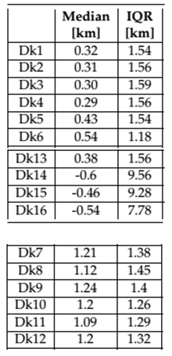
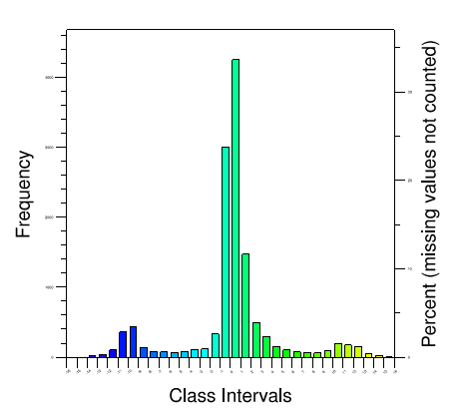
CTH from optical depth
 | # Point | Vertical levels | Radiation param | PBL param | Microphysic param |  | Median [km] | IQR [km]
DK4 | 250x250 | 50 | Dudhia | YSU | Morr |  | 0.29 | 1.56

Slide 29
JEM-EUSO program
Meteorological models
GCM outputs
WRF structure
CTH retrieval
CTH from cloud fraction
CTH from optical depth
EUSO-SPB1: an application
Sensitivity of WRF meteorological model in retrieving CTH and application to EUSO-SPB1 experiment
29

Slide 30
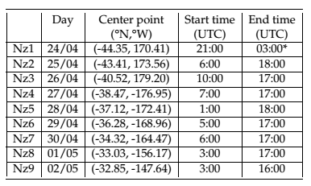
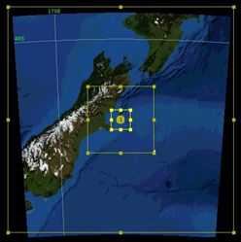
EUSO-spb1: settings
No satellite comparison
50 vertical levels, Morrison 2-mom, New Goddard, MYNN2.5 (cloud fraction)
3 nested domains: 9 km, 3 km, 1 km
Input for ESAF program to predict the number of possible air showers

Slide 31
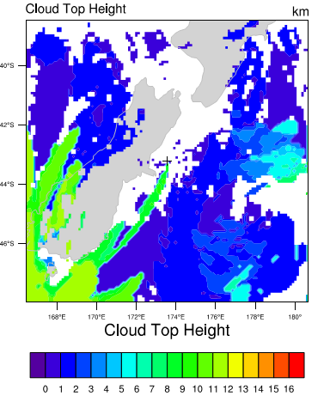
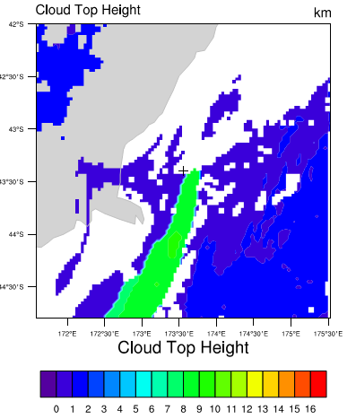
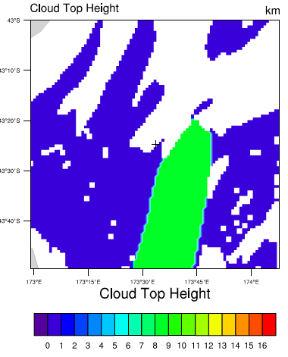
CTH retrieval
9 km
3 km
1 km

Slide 32
Conclusions
Improvement of the previous work:
Median: -0.43 km
IQR: 1.72 km
Inhomogeneous cloud case:
1. cloud fraction 50 levels, New Goddard radiation scheme, MYNN2.5 PBL scheme
2. optical depth 50 levels, Dudhia radiation scheme, YSU PBL scheme

Slide 33
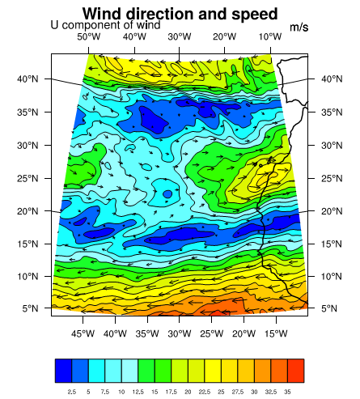
Appendix a: GCM Outputs
02/04/2014 12:00 UTC,
Atlantic Ocean
ECMWF (Reading, UK) provides:
10 m U and V wind components
2 m T and dewpoint T
Albedo
Geopotential
Land-sea mask
Mean sea level pressure
Sea-ice cover
Sea surface temperature
Skin temperature
Snow depth
Soil temperature level (4)
Surface pressure
Total, Low, Medium and High cloud cover
Total column water and water vapor
Volumetric soil water layer (4)

Slide 34
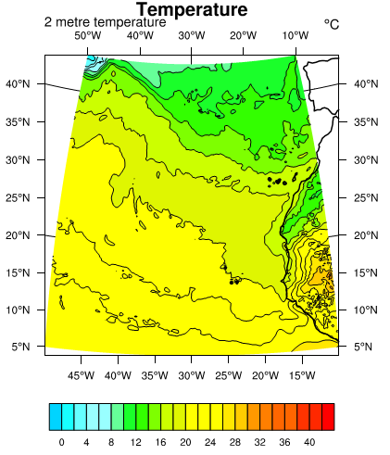
GCM Outputs
02/04/2014 12:00 UTC,
Atlantic Ocean
ECMWF (Reading, UK) provides:
10 m U and V wind components
2 m T and dewpoint T
Albedo
Geopotential
Land-sea mask
Mean sea level pressure
Sea-ice cover
Sea surface temperature
Skin temperature
Snow depth
Soil temperature level (4)
Surface pressure
Total, Low, Medium and High cloud cover
Total column water and water vapor
Volumetric soil water layer (4)

Slide 35
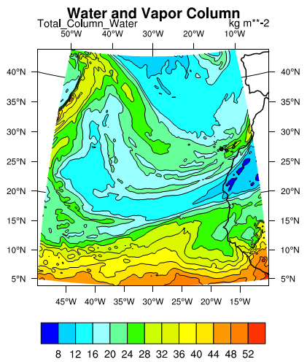
GCM Outputs
02/04/2014 12:00 UTC,
Atlantic Ocean
ECMWF (Reading, UK) provides:
10 m U and V wind components
2 m T and dewpoint T
Albedo
Geopotential
Land-sea mask
Mean sea level pressure
Sea-ice cover
Sea surface temperature
Skin temperature
Snow depth
Soil temperature level (4)
Surface pressure
Total, Low, Medium and High cloud cover
Total column water and water vapor
Volumetric soil water layer (4)

Slide 36
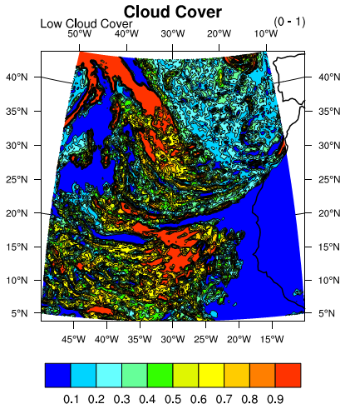
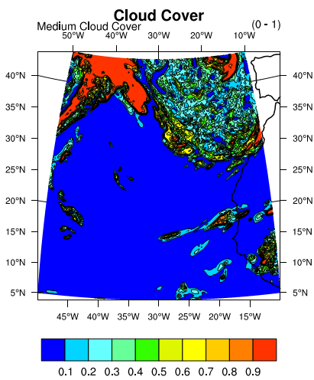
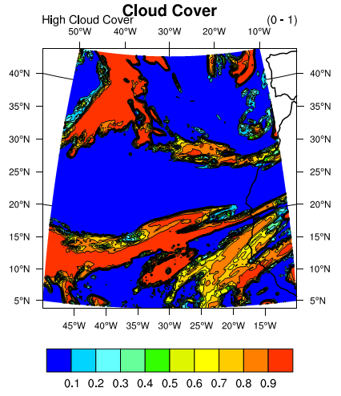
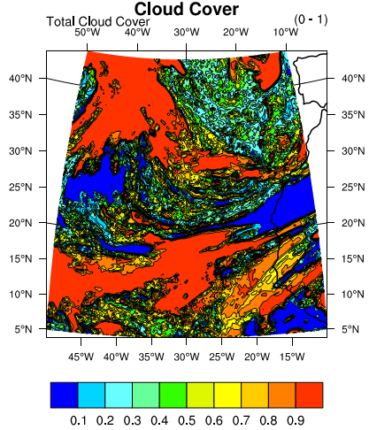
GCM Outputs
02/04/2014 12:00 UTC,
Atlantic Ocean
ECMWF (Reading, UK) provides:
10 m U and V wind components
2 m T and dewpoint T
Albedo
Geopotential
Land-sea mask
Mean sea level pressure
Sea-ice cover
Sea surface temperature
Skin temperature
Snow depth
Soil temperature level (4)
Surface pressure
Total, Low, Medium and High cloud cover
Total column water and water vapor
Volumetric soil water layer (4)
 | σ | H (km)
L | 0.8 ÷ 1 | ≤ 2
M | 0.45 ÷ 0.8 | 2 ÷ 6
H | ≤ 0.45 | 6 ÷ 12

Slide 37
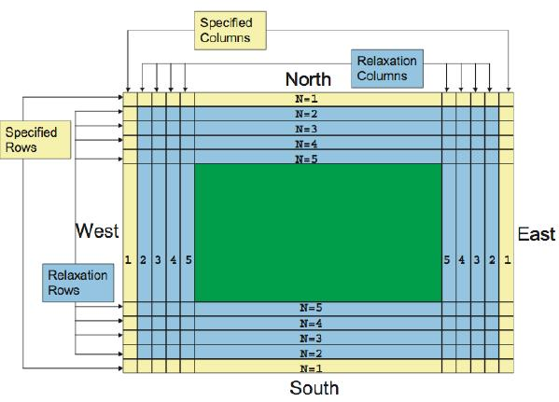
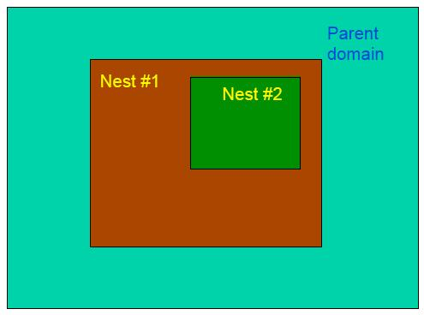
Appendix b: wrf structure
NESTING
The bigger domain gives the initial and boundary conditions for the inner domain.
ETA COORD
Coordinates are terrain-following

Slide 38
Appendix c: Accuracy

Slide 39
Appendix d: From the previous work
40 vertical levels
Morrison 2-moment microphysics
Dudhia radiation
YSU planetary boundary layer
Median (km) | IQR (km)
-0.85 | 10.15

Slide 40
Meteorological Models
Global Circulation Models (GCM): IFS
Input: in situ and remote sensing observations
Analysis: meteorological variables retrieved for every grid points
Model: prognostic equations solved at every grid point
Forecasts: meteorological variables typically every 6 hours
Max resolution: 0.125°
(14 km at the Equator)
Variable: cloud cover
over 3 layers
input for
Limited Area Models (LAM):WRF
Model: prognostic equations solved at every grid point
Output: case-study
(meteorological variables at a fixed time step)
Max resolution: 1 km
Variables: cloud fraction
over model layers

Slide 41
Meteorological Models
Global Circulation Models (GCM): IFS
Input: in situ and remote sensing observations
Model: prognostic equations solved at every grid point
Forecasts: meteorological variables typically every 6 hours
Max resolution: 0.125°
(14 km at the Equator)
Variable: cloud cover
over 3 layers
input for
Limited Area Models (LAM): WRF
Max resolution: order of
km
Variable: cloud fraction
over model layers
Output: case-study
(meteorological variables at a fixed time step)
Model: prognostic equations solved at every grid point

