Slide 1
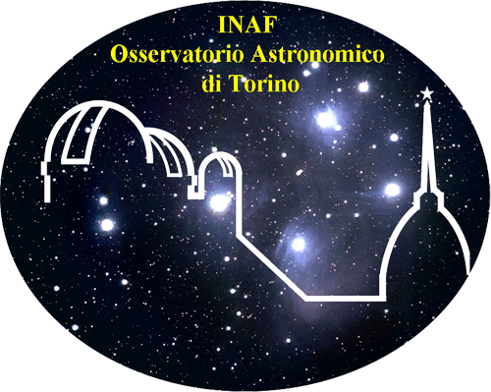
SIMULATIONS AND SEARCH of NUclearites WITH TUS EXPeRIMENT
Università degli studi di Torino
Facoltà di scienze matematiche,fisiche e naturali
Corso di Laurea Triennale
Candidato : Antonio Montanaro
Primo Relatore:Prof. Mario Bertaina
Secondo Relatore: Prof. Alberto Cellino
Correlatore: Dott.Kenji Shinozaki
Anno Accademico 2017-2018

Slide 2
INTRODUCTION

Slide 3
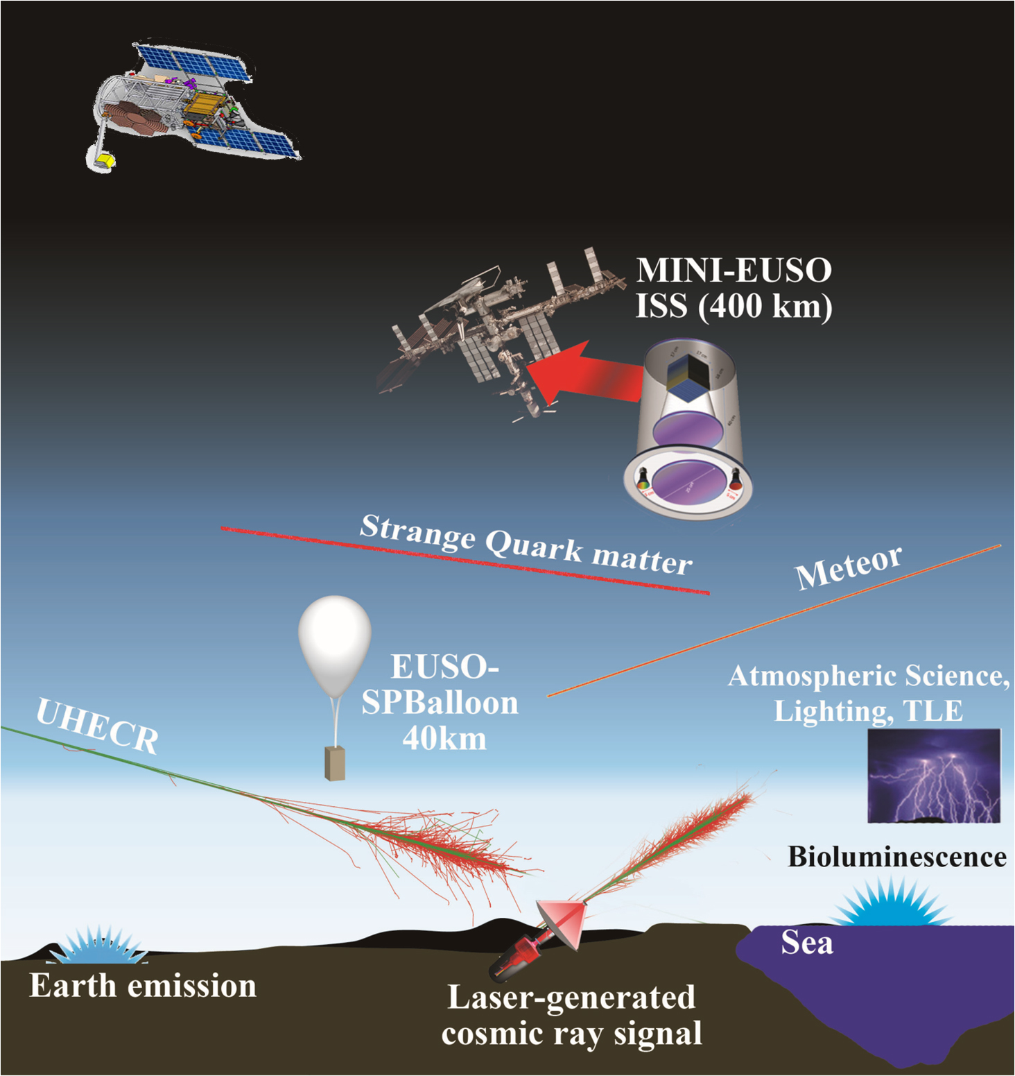
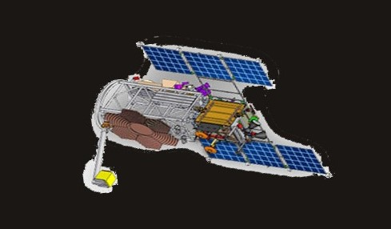
TUS
LOMONOSOV (500km)
JEM-EUSO
COLLABORATION

Slide 4
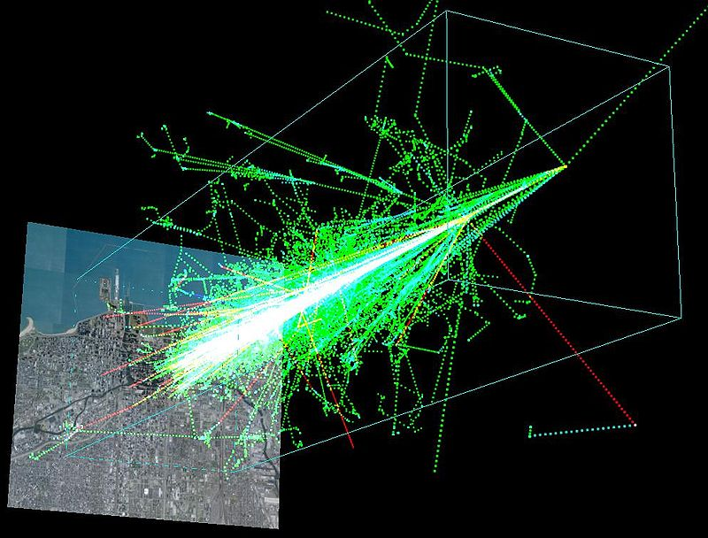
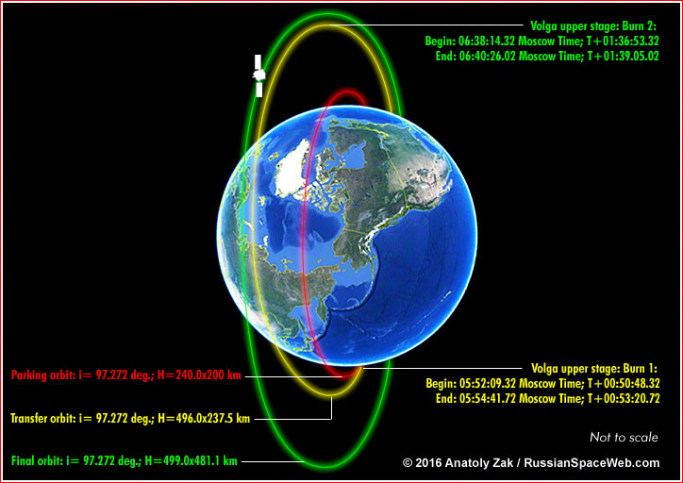
Tracking Ultraviolet Setup
TUS is a detector in near UV band on board of Lomonosov satellite. It was launched on April 28 2016 and it has a sun-synchronous orbit. TUS is intended to study the most energetic cosmic-ray particles, providing larger, uniform exposure than ground-based detectors. It tests the fluorescent method of measuring EECRs and it is expected to detect EECRs with energies above 100 EeV.
It is also able to record slower atmospheric transient events : atmospheric fluorescence in electrical discharges of various types and the radiation of meteors and nuclearites that pass through the atmosphere.

Slide 5
TUS DESIGN
-Fresnel mirror: 2 m²
-focal distance 1.5 m
-Reflectivity @350 nm: 85%
-Field of view: 9°
- 80 km x 80 km at sea level from orbit height h ≈ 500 km

Slide 6
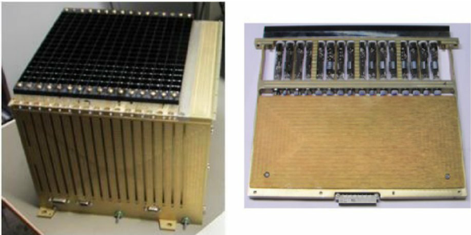
TUS ELECTRONICS
Photodetector: 256 Hamamatsu R1463 PMTs
16 x 16 pixels (15mm x 15mm), each of them is a square of 5 km on Earth
The data are recorded only in the moon-less night each 6.6 ms (in METEOR mode), in 256 timeticks for a total acquisition time of 1.68 seconds
Photons that arrive are converted in photoelectrons and finally in ADC counts
ADC counts
timeticks (6.6 ms)
On left : TUS photodetector. On right : a typical light-curve recorded by TUS.

Slide 7
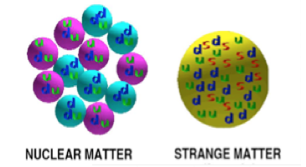
NUCLEARITES (strange quark matter)
• Aggregates of u, d, s quarks + electrons of equal
number, density: 3.5 x 10¹⁴ g cm⁻³.
• Ground state of nuclear matter (E/A < 930 MeV).
• Stable for any baryon number A
Nuclearites : core + electrons , neutral, A > 10⁶
Strangelets : positively charged, A < 10⁶
References:
E. Witten Phys Rev D30(1984) 272A
De Rujula & Glashow Nature 312 (1984) 734

Slide 8
NUCLEARITES (strange quark matter)
Speed: of the order of 250 km/sec. No ablation.
Absolute magnitude at 100 km
Expression of the magnitude derived from predicted luminosity expressed as a function of mass.
Apparent Visual magnitude : 20 g nuclearite at 400 km distance from observer → M = 6
Absolute magnitude : 20 g nuclearite → M = 3.6
Models expect a Maximum possible height for light emission
Nuclearites are expected to be essentially a low atmosphere phenomenon.
10⁻⁴ g nuclearite → h_{max} ~ 6 km 10⁴ g nuclearite → h_{max} ~ 60 km
Nuclearites with masses > 0.1 g can cross the whole Earth and move upward!
E. Witten Phys Rev D30(1984) 272
De Rujula Glashow Nature 312 (1984) 734

Slide 9
SIMULATIONS

Slide 10
HOW SIMULATOR WORKS
The simulaor was made for the JEM-EUSO Collaboration by INAF at the Astronomical observatory of Pino Torinese.
For every timesticks ( 6.6 ms) the detector checks if a light source (city, meteor, nuclearite…) is in its FOV, then according to the distance of each other the magnitude (that dipends on the object ) is calculated and the corresponding photoelectrons that arrives at the focal surface (FS).
EARTH
There is also a ground-based detector that can be simulated .

Slide 11
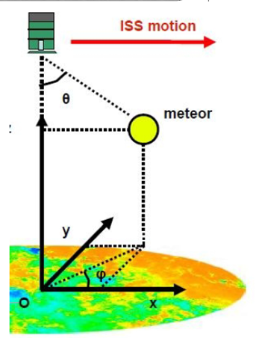
Simulation’s Parameters(for nuclearites)
INPUT
- Mass (Range: 10 ⁻⁴ g --> 10⁴ g )
Horizontal speed of TUS
Initial coordinates of TUS
Beginning height of the event
Duration of the event
-Velocity of nuclearite
-Maximum height of
nuclearite light
emission
OUTPUT (From TUS)
-Timestep
-Position on the focal plane (pix)
-Number of photoelectrons
-Theta and Phi angle
--Position (x,y,z) from TUS
TUS motion
We have simulated :
-1000 meteors
-1000 nuclearites
Nuclearite

Slide 12
References:
JEM-EUSO: Meteor and nuclearite observations…M. Bertaina·A. Cellino·F. Ronga

Slide 13
Injecting nuclearite on a sphere of a given radius omni-directionally at a constant flux
Light emission in atmosphere calculated along the track
Taking into account TUS motion, event seen on the TUS focal detectors simulated
Range masses 0.1 g -> 100 g
Trigger algorithm and selection cuts to be applied
1000 simulated events
TUS motion
_{Earth}
R = 200 km

Slide 14
Initial Position projected
on ground
Initial Position on space
(km)
km
km
(km)
km
km
Theta Distribution (0° -> 180°)
Phi Distribution (-180° ->+180°)

Slide 15
From a previous analysis we can yet understand what is the main difference between nuclearites (speed ca. 250 km/s) and meteors (range of speed 12km/s → 70 km/s ) just seeing the histograms of horizontal speed on focal surface (supposed that all signals are in the centre of the pixel):
There are few events with velocity comparable to that of meteors!
FOV
Meteor
-Total nuclearites tracks seen by TUS 4%
Nuclearite
Horizontal speed [px/s]

Slide 16
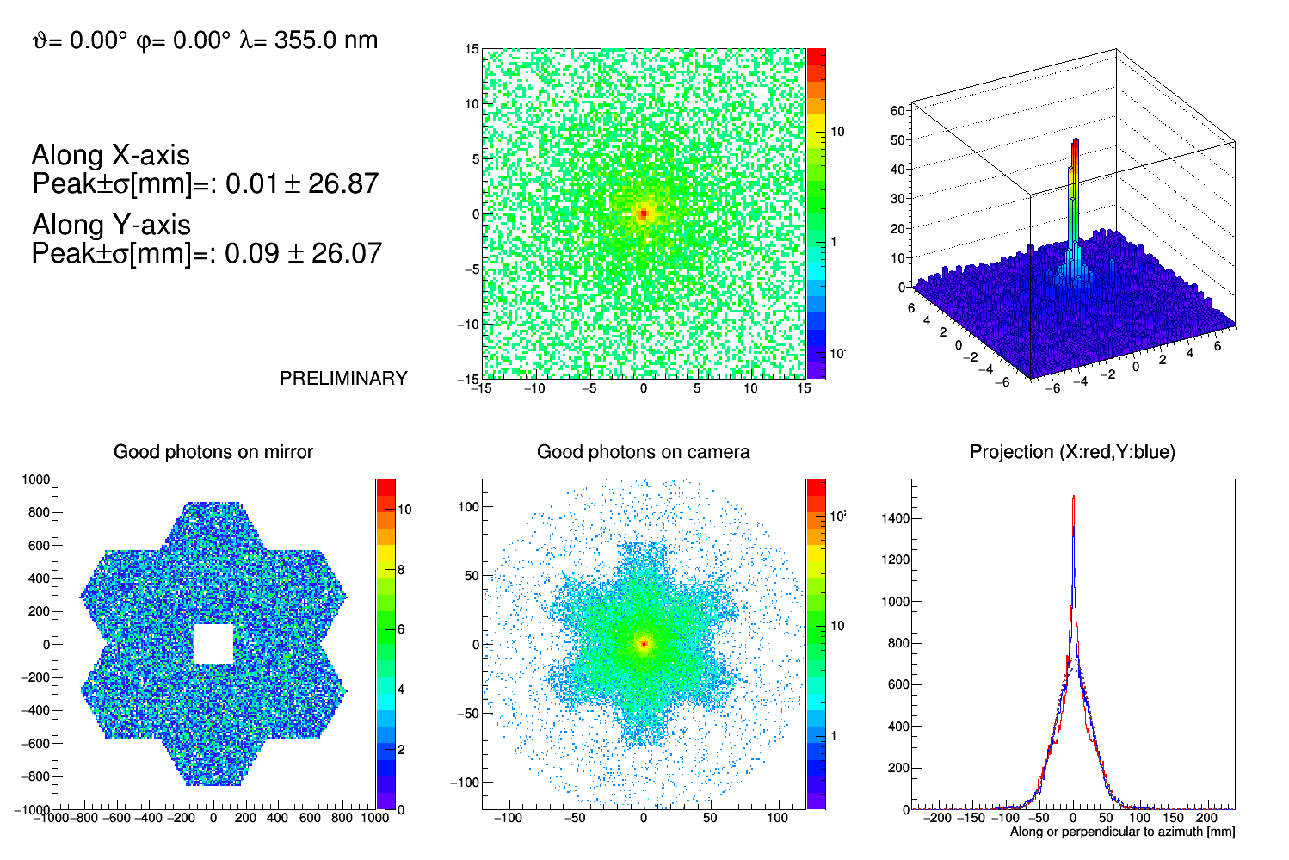
After these simulations we have improved the response of the optic and we have tried to determine the horizontal speed on focal surface and we have compared this with the real horizontal speed given by the input parameters.
This test is done for a nuclearite of 5 grams, a real meteor (according to A. Cellino’s simulator ) and a meteor like a pseudonuclearite.
At the first order of approximation, we have selected ten pixels brigthest to try to determine the horizontal speed for these three events!

Slide 17
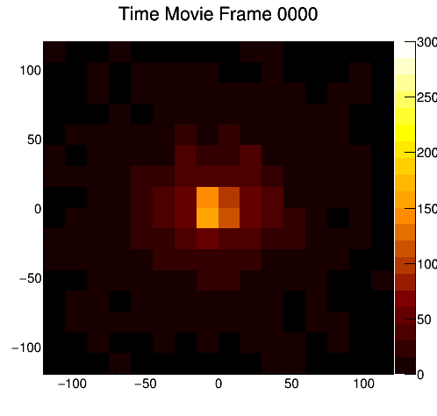
Nuclearite
counts
-Nuclearite mass : 5.00g
-hmax = 34.9 km
-beginning height = 0.0 km
-final height = 175.0 km
-Magnitude at 10 km of distance: -0.58
-duration = 0.165 s
-vx =226.27 km/s vy = 80.00 km/s
vz = 70.00 km/s
from the two fit V = 62 ± 6 px/s
Instead the input horizontal speed is Vi = 52 px/s

Slide 18
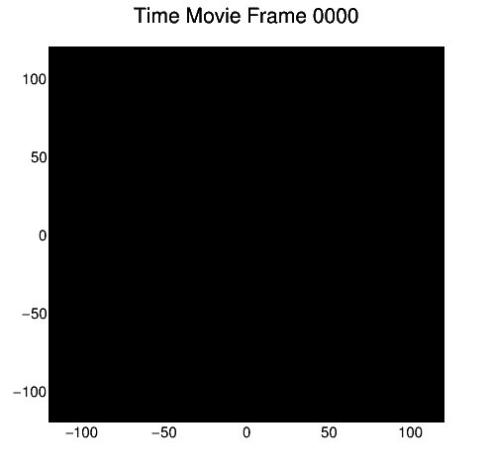
METEOR
Counts*
-beginning height = 108.5 km
-final height = 48.7 km
-duration = 1.252 seconds
-Absolute mag at 100 km =-3.35
-vx = 20.87 km/s vy = 50.00 km/s
vz = -47.76 km/s
*The counts are scaled by a factor of 50!!!
from the two fit V = 21 ± 3 px/s
Instead the input horizontal speed is Vi = 12 px/s

Slide 19
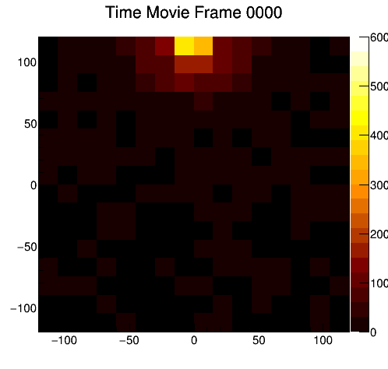
METEOR PSEUDONUCLEARITE
counts
-Pseudonuclearite mass (g): 6.50
-hbegin = 119.7 km
-hend = 62.7 km
-Magnitude at 10 km of distance: -0.58
-vx = -69.0 km/s vy = 12.0 km/s
vz = -8.5 km/s
It seems that there is an offset and so the speed is overstimated .
Point Spread Function…
from the two fit V = 35 ± 8 px/s
Instead the input horizontal speed is Vi = 21 px/s

Slide 20
ANALYSIS OF DATA

Slide 21
ANALYSIS OF DATA
There are 9825 events recorded in moon-less 38 nights by TUS in METEOR-MODE in different days of these months: December 2016, January, February, March and November 2017.
I have done an histogram with all time durations to understand which is the death time and the total ammount of time in METEOR-MODE.
(s)
The death time estimated is ca. 50 seconds and subtracting this value for all bins and summing the new values I have achieved a total acquisition time of 5.32 days.

Slide 22
ANALYSIS OF DATA
In total there are 9825 events recorded in moon-less nights by TUS in METEOR-MODE.
For selecting which of them are good candidates we have chosen different cuts in different steps:
The signal taken into the account has to be a certain threshold bigger than noise
2. These events have been separated in three groups according to the time duration (in timeticks, that is 6.6 ms) that the signal persists in the same pixel, calculated assuming a travelled distance of 5 km (dimension of 1 pixel):
-City : Apparent speed of 7.6 km/s → 5 km / 7.6km/s = 658 ms ̴ 100 timeticks
-Meteor : Range of speed 12 km/s -> 70 km/s → 71ms ->417ms ̴ 25 -> 80 timeticks
-Nuclerite : Range of speed 250 km/s -> 500 km/s → smaller than 71ms ̴25 timeticks
This first cuts select 1210 candidates!!!

Slide 23
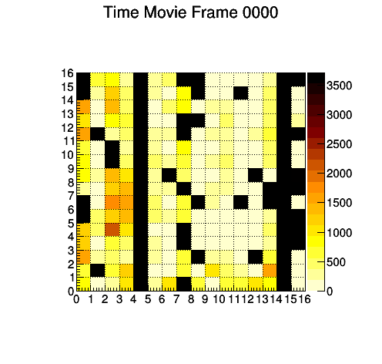
EXAMPLE OF CITIES
ADC counts
Stimated speed : 7.48 km/s
ADC counts
timeticks (6.6 ms)
ADC counts
Stimated speed : 7.95 km/s
VERONA
timeticks (6.6 ms)
ADC counts
Stimated speed : 8.77 km/s
timeticks (6.6 ms)
Speeds compared to that of TUS (7.6 km/s ), so these are stationary objects like cities !!!

Slide 24
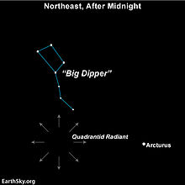
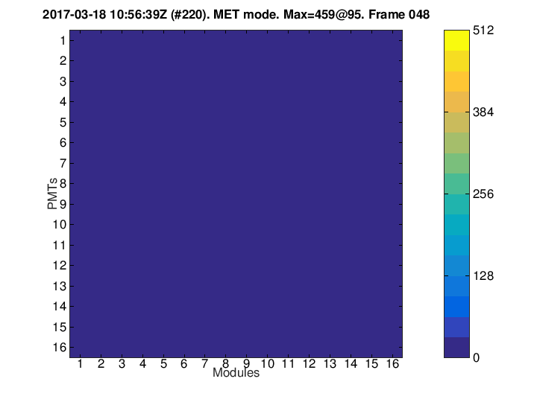
EXAMPLE OF A METEOR
ADC counts
ADC counts
Radiant point of Quadrantid meteor
shower, active each year in early January
256 timeticks (6.6 ms)
This is a good candidate to be a meteor. It is very fast, the horizontal speed stimated is 88 km/s ± 19 km/s, bigger than the upper limit of meteors’ speed. But if we take into account the offset this one should have a speed smaller.
This event is in the Pacific ocean (no stationary light source ).
This meteor most probably comes from the bright meteor shower Quadrantis which have an estimated speed of 41km/s.
They had the peak on 3 January 2017, same as the time that TUS has recorded this one.

Slide 25
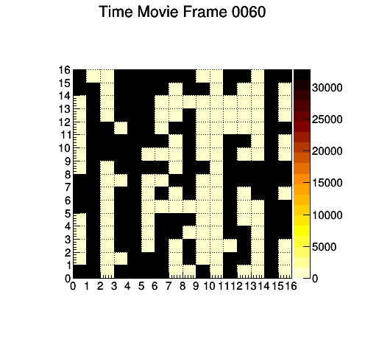
THE THIRD CUT -LIGHTNING CANDIDATE
The two cuts take into the account also other types of events that have to be rejected. So the next cut has been the exclusion of signals that cross many pixels at the same time.
ADC counts
The time duration of this event is ca. 347 ms that is comparable to that of some TLE events.
Then an other factor is that this signal brights many pixels at the same time, this means that the dimensions of the event could be bigger than 80 km (along x-axis).
This because this kind of light-source could propagate in the clouds and appear as a huge signal in TUS FOV.
timeticks (6.6 ms)

Slide 26
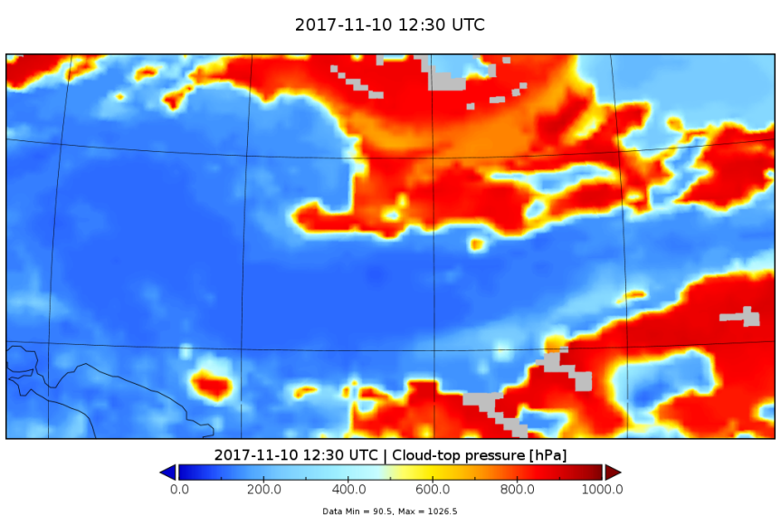
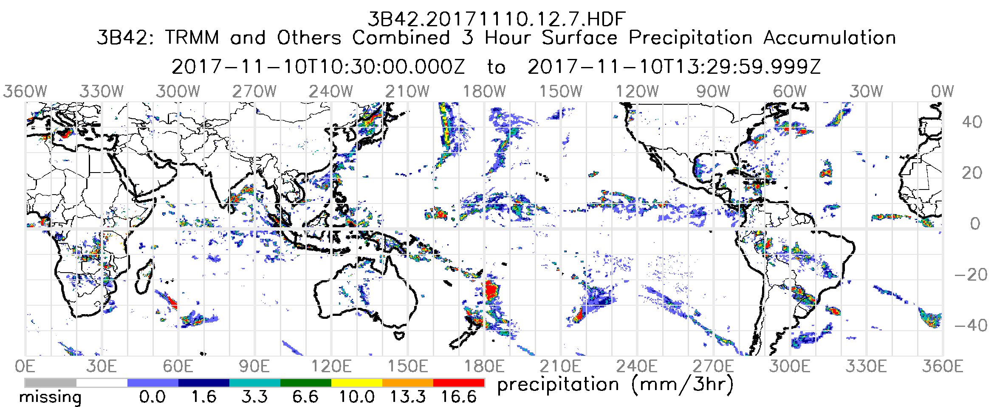
LIGHTNING CANDIDATE
The weather’s conditions of such event, very cloudy, justifies possible electrical-discharged.
The blue zone showes an intense concentration of clouds.
An high activity (on 3 hours avarage) of rains recorded in this zone!

Slide 27
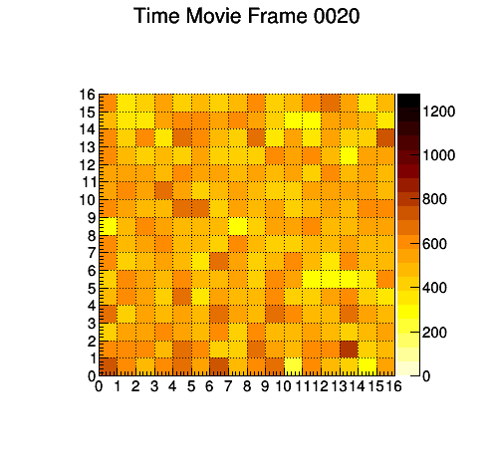
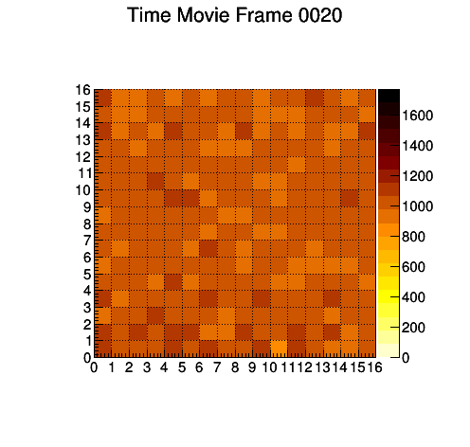
THE LAST CUT
Thanks to this cuts we remain with only 226 candidates, this means that other conditions are necessary.
So the apparent speed is considered just for the brightest pixel and an other surrounding, and the events with a speed’s range between 13 px/s and 150 px/s are selected.
The last candidates are only 76 and for these I have applied a visible check.
To check if the cuts select really nuclearites’ events I have applied these on a nuclearite downward simulated event and I have seen if it is selected and how the signal appears with different levels of noise. Parameters simulated:
-Speed: 250 km/s -Zenith angle : 60° → horizontal speed : 216.5 km/s
-Absolute Magnitude : 12 ← faintest event detectable !!! -Azimuth angle : 0°
-Beginning hight : 50 km
ADC counts
ADC counts
Reconstracted horizontal speed:
234 km/s
NOISE: Mean: 100 Sigma:30 Mean: 500 Sigma:100
In this way I have excluded all possible candidates, by the way there could be some events that are lost so we need to check better all different candidates (also meteors and cities) and apply these cuts in many simulated events.

Slide 28
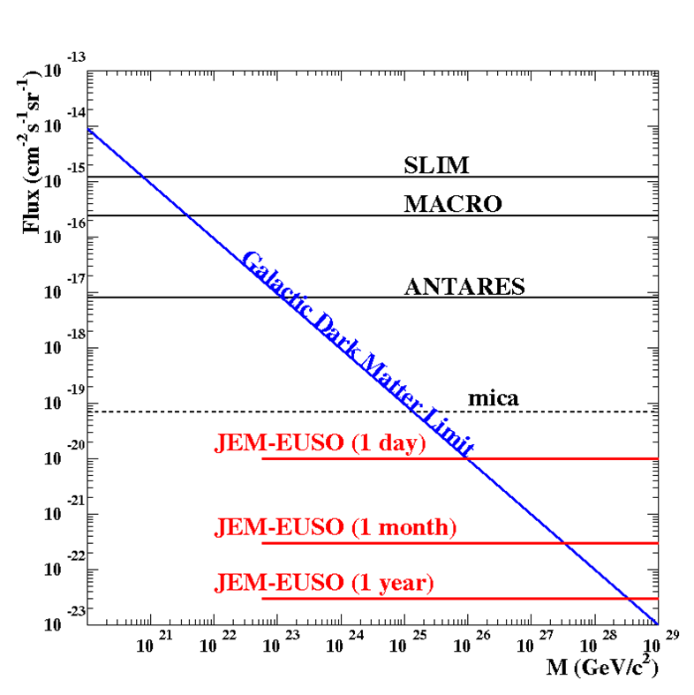
ESTIMATION OF MINIMUM MASS AND MAXIMUM FLUX
At the first order of approximation, considering all our estimations and cuts try to fix these two conditions
The lowest magnitude detectable is Mag = 12 so from this we can calculate the minimum mass :
M = 10^{(10.8-Mag)/1.67} μg = 1.89 x 10⁻⁷ kg ̴ 1.0 x 10²⁰ GeV/c²
To estimate the flux I use the same assumptions of JEM-EUSO flux, that is a range of zenith angle from 60° up to 120° just to make sure that no nuclearite has an horizontal speed comprable to that of fast meteors.
= 5.3 x 10⁻²⁰ cm⁻² s⁻¹ sr⁻¹
THIS SHOWS THAT TUS UPPER LIMIT IS BETTER THAN GROUND EXPIRIMENTS YET DONE AND THESE NEW TYPES OF EXPIRIMENTS CAN REALLY DETECT NUCLEARITES !!!
TUS(5 days)
MINI-EUSO(1 month)

Slide 29
MINIMUM SPEED
Chosing a zenith angle of 60° the horizontal speed for a nuclearite with a speed of 250 km/s becomes 217 km/s that means (assuming a preliminary conversion from pixel to km) 31 px/s
Meteor
Nuclearite
31 px/s
Horizontal speed [px/s]

Slide 30
SUMMARY AND NEXT GOAL
-Simulations of nuclearites and meteors in different coditions and analysis of these signals
-Researching in TUS events of signals appear as “very fast objects” and accurated study of these one.
-Classification of signals according to their light-curve, speed, location on Earth,time duration in one pixel.
-Preliminary understanding of the lowest magnitude recorded by TUS and fixing the minimum mass and the exposure of nuclearites.
-Riview the different candidates and check if there are other signals not taken into the account
-Apply these cuts for many events to have more statistic and verify the correctness of cuts
-Consider other factors (for determining the flux and mass) that could move this threshold in the graph (clouds, noise, other angle of exposure…)
Thanks for your attention !

Slide 31
SUMMARY
-Simulations of nuclearites and meteors in different coditions and analysis of these signals
-Researching in TUS events of signals appear as “very fast objects” and accurated study of these one.
-Classification of signals according to their light-curve, speed, location on Earth,time duration in one pixel.
-Understanding the lowest magnitude recorded by TUS and fixing the minimum mass and the maximum flux for nuclearites.

Slide 32
METEOR *
At the first order of approximation, we have selected ten pixels brigthest to try to determine the horizontal speed:
counts
from the two fit V = 100 ± 38 km/s
Instead the input horizontal speed is Vi = 54 km/s
NUCLEARITE
counts
from the two fit V = 307 ± 60 km/s
Instead the input horizontal speed is Vi = 260 km/s
METEOR PSEUDONUCLEARITE
counts
from the two fit V = 140 ± 60 km/s
Instead the input horizontal speed is Vi = 78 km/s
It seems that there is a systematic factor
∆v = +50 km/s for each speed.
Point Spread Function…
*The counts are scaled by a factor of 50!!!

Slide 33
-If some nuclearite hits TUS’ field of view then its track in a total sampling time of 256*0.0065536s = 1.68s passes through all FOV and so many pixels records it
3. Also the apparent speed calculated just to two pixels is considered and select the event with a speed’s range between 13 px/s and 150 px/s.
Flux = (8000000 cm x 8000000 cm x π/2 sr x 5 x 24 x 3600 s ) ⁻¹ x (–ln(1-0.9)) =
= 5.3 x 10⁻²⁰ cm⁻² s⁻¹ sr⁻¹ at 90% C.L.
The fraction of energy dissipated as light in possible collisions is ~ 4%. It does not depend upon radius or velocity.

Slide 34
nell’ ultima slide devo considera il fattore 0.72 DEI RAGGI COSMICI E ANCHE LE NUVOLE e devo mettere un altro limite superiore?
Devo specificare che nel calcolo di qualsiasi velocitò ho sempre assunto che il segnale fosse nel centro del pixel?
Quelli di Alberto sono fotoni o fotoel come fanno ad essere quest ultimi senza PSF???

Slide 35
THE LAST CUT
Thanks to this cuts we remain with only 226 candidates, this means that other conditions are necessary.
So the apparent speed is considered just for the brightest pixel and an other surrounding, and the events with a speed’s range between 13 px/s and 150 px/s are selected.
The last candidates are only 76 and for these I have applied a visible check.
In this way I have excluded all possible candidates, by the way there could be some events that are lost so we need to check better all different candidates (also meteors and cities) and apply these cuts in many simulated events.

Slide 36
TUS ELETRONICS
Photodetector: 256 Hamamatsu R1463 PMTs
I Light guides with square entrance apertures (15 mm x 15 mm) and circular output
16 x 16 pixels , each of them is a square of 5 km on Earth
The data are recorded only in the night each 6.6 ms (in METEOR mode), in 256 timeticks for a total acquisition time of 1.68 seconds
Photons that arrive are converted in photoelectrons and finally in ADC counts
ADC
counts
256 timeticks (6.6 ms)
On left : TUS photodetector. On right : a typical light-curve recorded by TUS.

Slide 37
TUS
LOMONOSOV (500km)
JEM-EUSO
COLLABORATION

Slide 38
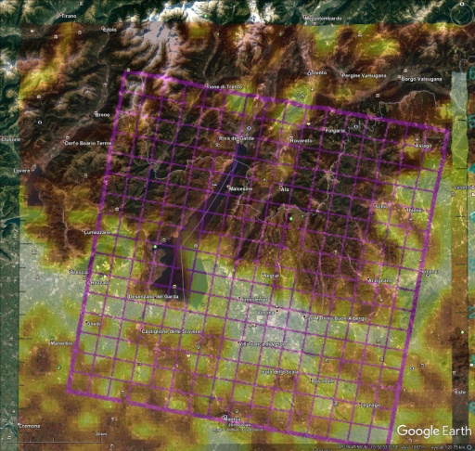

Slide 39
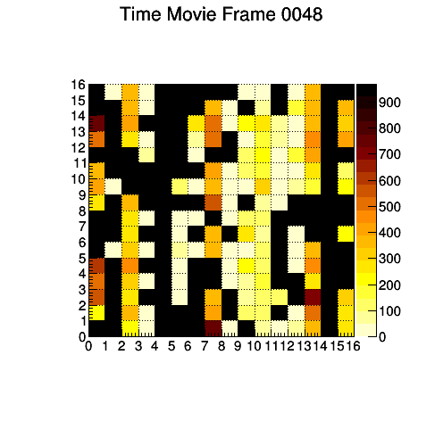
EXAMPLE OF A METEOR
ADC counts
ADC counts
Radiant point of Quadrantid meteor
shower, active each year in early January
256 timeticks (6.6 ms)
This is a good candidate to be a meteor. It is very fast, the horizontal speed stimated is 88 km/s ± 19 km/s, bigger than the upper limit of meteors’ speed. But if we take into account the offset this one should have a speed smaller.
This event is in the Pacific ocean (no stationary light source ).
This meteor most probably comes from the bright meteor shower Quadrantis which have an estimated speed of 41km/s.
They had the peak on 3 January 2017, same as the time that TUS has recorded this one.

Slide 40
Initial Position projected
on ground
Initial Position
FOV
(km)
km
km
(km)
km
-Total nuclearites tracks seen by TUS 4%
Theta Distribution (0° -> 180°)
Phi Distribution (-180° ->+180°)
Speed histograms
-Range of horizontal speed :
13 px/s -> 150 px/s

