Slide 1
CubeSat mission: detection of space debris on LEO
Fantine Blanquez-Nadal
June 8th – September 8th

Slide 2
Summary
Introduction
Tools used
Modeling work
Study of the orbit
Sizing of the thermal control system

Slide 3
I. Introduction
Background of the project
The issue:
Space debris
How much ?
M_{space debris} = 3000 t
Where ?
GEO (Geostationary Orbit), GTO (Geostationary Transfer Orbit), LEO (Low Earth Orbit)

Slide 4
II. Tools used
FreeCAD
Ansys STK

Slide 5
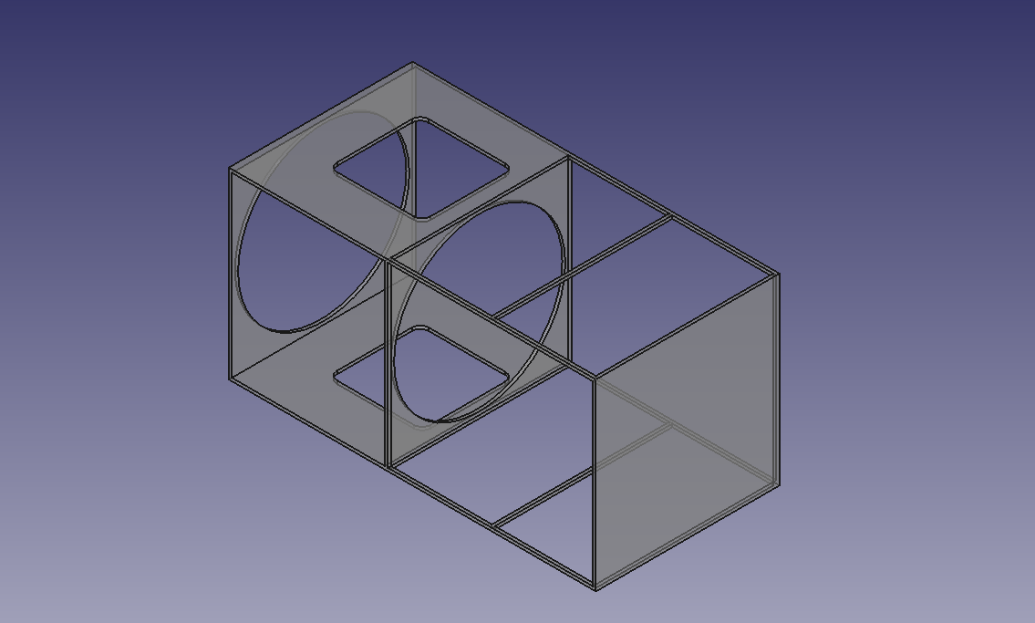
III. Modeling work
3D view of an experiment

Slide 6
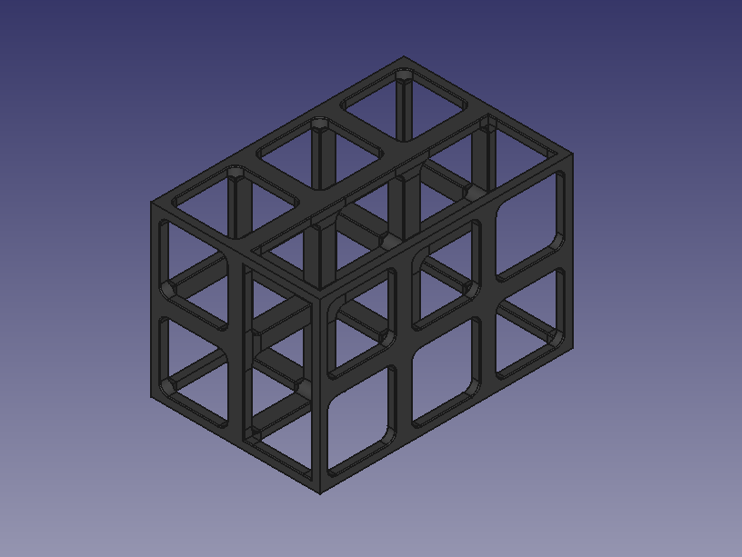
III. Modeling work
1st version: too much detailed → too heavy for STK
Not machinable
1st version of the external structure of the cubesat

Slide 7
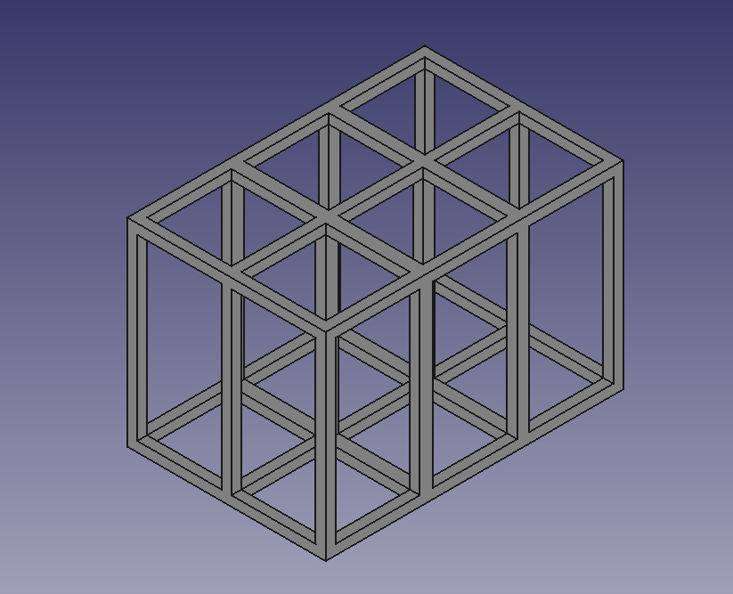
III. Modeling work
2nd draft: less detailed –> STK
2nd version of the external structure of the cubesat

Slide 8
III. Modeling work
Visualization of the satellite on its orbit, STK

Slide 9
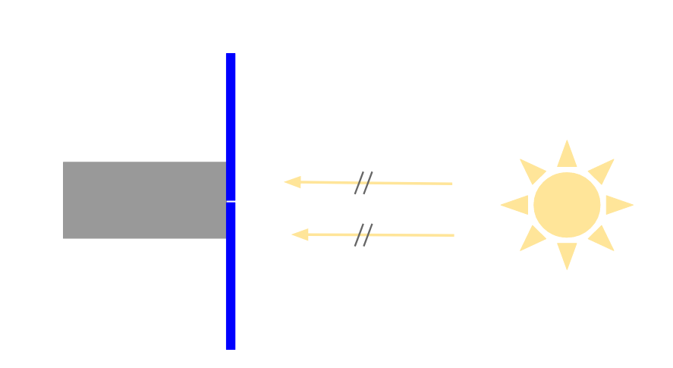
IV. Study of the orbit
Criteria:
Sun-synchronous, 700 km < altitude < 900 km
Goal:
To have a trajectory where the satellite receives as much light as possible
Orientation of the satellite toward the sun

Slide 10
IV. Study of the orbit
Inclination for a sun-synchronous orbit at 800 km
Formula:
$$∆Ω_{1__orbit}=−3π×J_{2}×(\frac{R_{T}}{p})×\cos{i}$$
p: the semi latus rectum: $p=a(1−e^{2})$, e: eccentricity=0 and $a=R_{E }+z_{sat}$ → $p=a$
$J_{2}$ = ${1.0826.10}^{−3}$: factor of Earth non-sphericity
$∆Ω_{1__orbit}$: the variation of $Ω$ in 1 orbit; $ΔΩ_{1__ortbit}= \dot{Ω}×T_{sat}$
i: the inclination
$\frac{ΔΩ_{1_orbit}}{ΔΩ_{1_day}}=\frac{t_{1_orbit}}{t_{1_day }}$
- $ΔΩ_{1_{day}}=0.9856°=0.0172 rad$: rotation of the Earth on itself
$t_{1_day}=86400 s$
$t_{1_orbit}=2π×\sqrt{\frac{a^{3}}{μ_{T}}}$ and $μ_{T}=398600 km.s^{−2}$
→ $i=98.59 °$

Slide 11
IV. Study of the orbit
Inclination for a sun-synchronous orbit at 800 km
STK
Create a new scenario: sun-synchronous orbit + altitude of 800 km → $i=98.608°$
$relative spread=0.01\%$

Slide 12
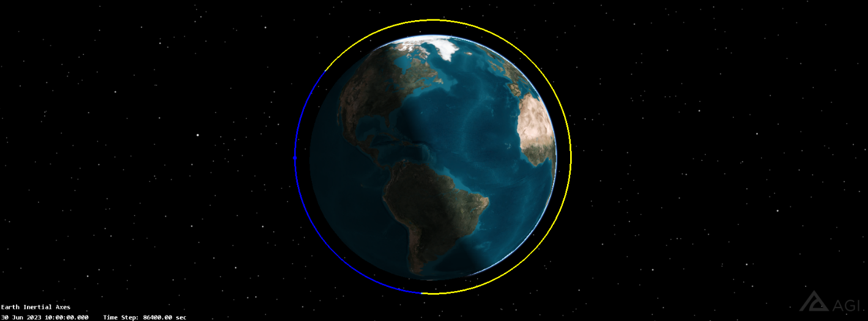
IV. Study of the orbit
Local Time of Descending Node
Sun-synchronous orbit, 800 km, LTDN = 12 a.m.
LTDN = 12 a.m. → insufficient illumination
Figure explaining the descending node

Slide 13
IV. Study of the orbit
Local Time of Descending Node
Orbit: in the plane separating day and light (sunset) → LTDN = 6 p.m.
Sun-synchronous orbit, 800 km, LTDN = 6 p.m.
Local Time of Descending Node | Time of total darkness (s)
12 a.m | 10901950,948
6 p.m | 741687,026

Slide 14
IV. Study of the orbit
Local Time of Descending Node
Best LTDN = 6 p.m.

Slide 15
IV. Study of the orbit
Parametric study
For all altitudes varying between 700 km and 900 km, LTDN = 6 p.m. is the best.

Slide 16
IV. Study of the orbit
Parametric study
The higher the altitude, the smaller the time spent in the shadow.
~ 1300 km = no more time spent in darkness, but it’s too high.
Between 700 km and 900 km, only 2.75 % and 1.75% of the year is spent in darkness.
An altitude of 800 km is great.

Slide 17
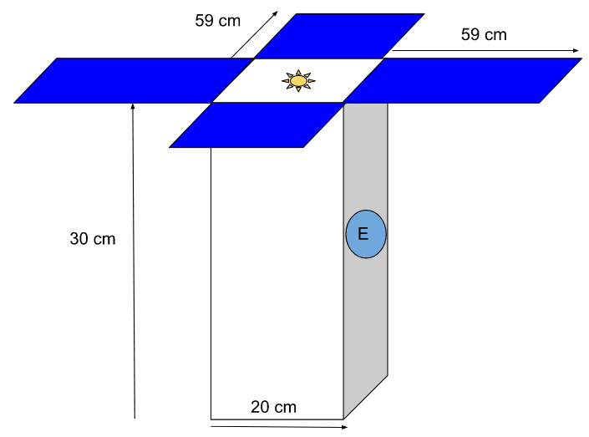
V. Sizing of the thermal control system
Thermal environment of the satellite
Harsh environment but:
$$T_{satellite}∈[0°C;20°C]$$
Orbital parameters:
Sun-synchronous orbit
Altitude of 800 km → inclination of 98,608°
LTDN = 6 p.m.
Fluxes to take into account
Pointing of the satellite

Slide 18
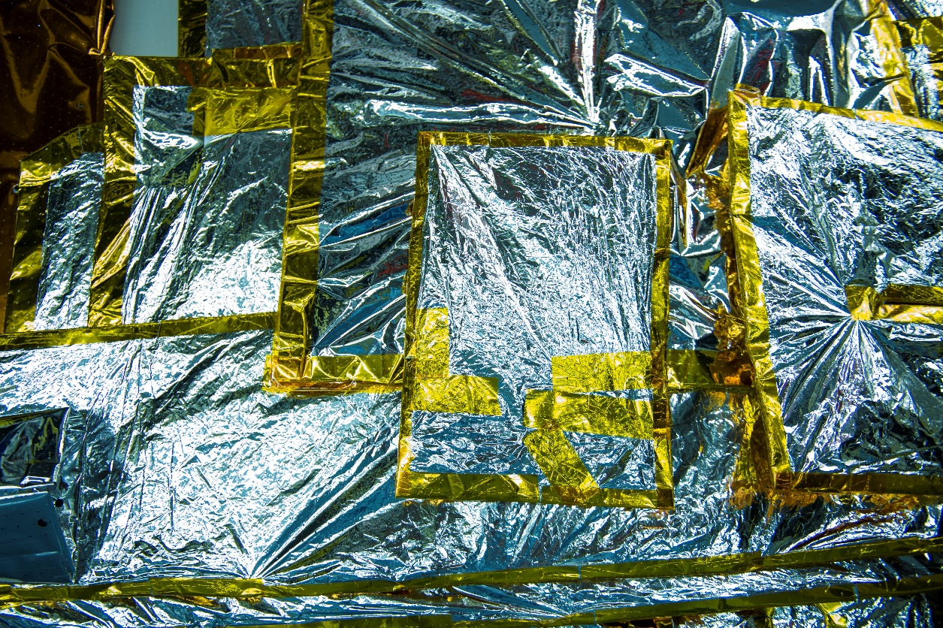
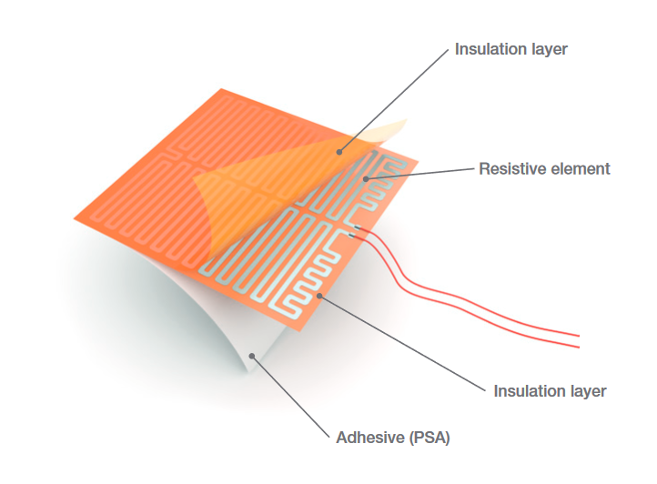
V. Sizing of the thermal control system
The most common thermal control systems
Surface finishes
MLI
Patch heater
Passive or active systems: surface finishes, MLI, heat pipes, louvers, radiators…

Slide 19
V. Sizing of the thermal control system
1st method
Methods described in 11.5 Thermal, section Radiator requirements, p. 453-456 (Space Mission Analysis and Design, J.R Wertz) + Spacecraft Systems Engineering, p.363
We determine equilibrium temperatures, in the hot and the cold case and for different surface finishes:
${(A}_{solar}G_{s}+A_{albedo}J_{a})α+A_{planetary}J_{p}ε+Q=A_{surface}σT^{4}ε$ (1)
$A_{solar}=20∗20 cm^{2}$, $A_{albedo}=30∗20 cm^{2}$, $A_{planetary}=30∗20 cm^{2}$, $A_{surface}=4∗\left(30∗20\right)+2∗\left(20∗20\right) cm^{2}$
$G_{s}$is the solar radiation intensity
$J_{a}$ is the intensity of the incident albedo radiation.
$J_{p}$ is the intensity of the Earth IR radiation.
$Q$ is the internal dissipated heat.
α, ε and σ respectively are the absorptance, the emissivity and the constant of Boltzmann.

Slide 20
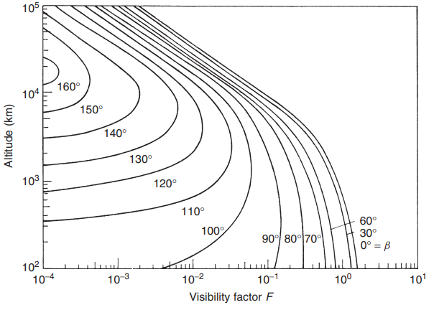
V. Sizing of the thermal control system
1st method
$$J_{p}=237×{\left(\frac{R_{E}}{R_{orbit}}\right)}^{2}$$
$R_{E}$: radius of the Earth’s surface
$R_{orbit}$: orbit radius
$J_{a}=G_{s}×a×F$
$a:$Earth albedo. $a_{hot case }=0.3$; $a_{cold case}=0.23$
${G_{s}}_{cold case }=1360 W.m^{−2}$; ${G_{s}}_{hot case}=1420 W.m^{−2}$
F: visibility factor → F=0.1
$$Q_{hot case}=40 W$$
$$Q_{cold case}=10W$$
 | α | ε
Black paint | 0.9 | 0.9
White paint | 0.15 | 0.9
Electroplated gold | 0.25 | 0.04
MLI | 0.45 | 0.71
values of ε and α for different surface finishes

Slide 21
V. Sizing of the thermal control system
1st method
 | $$T_{hot case}$$ | $$T_{cold case}$$
Black paint | 9.2°C | -18°C
White paint | - 28°C | -69°C
Electroplated gold | 252°C | 153°C
MLI | 12°C | -44°C
Temperatures for different surface finishes in the cold case and in the hot case
The best surface finish: black paint.
Needs a heating system (-18°C <<< 0°C)

Slide 22
V. Sizing of the thermal control system
1st method
Area of radiators:
$$Q_{int}+A_{radiators}\left(J_{a}+J_{p}\right)=εσT^{4}A_{radiators}$$
$T=20°C$: maximum temperature of internal components.
$Q_{int}=40W$
$J_{a}$and $J_{p}$ were calculated previously. In the hot case, $J_{p}=187 W.m^{−2}$ and $J_{a}=42.6 W.m^{−2}$
$ε=0.9$(black paint)
→ $A_{radiators}=0.04 m^{2}$
Very uncertain method

Slide 23
V. Sizing of the thermal control system
1st method
$$Q+A_{radiators}\left(J_{a}+J_{p}\right)=εσAT^{4}$$
→ $Q_{heater}=33W$
We can’t really draw conclusions from this result. The model we used is too much simplified.
Very uncertain method

Slide 24
V. Sizing of the thermal control system
2nd method
Solving the heat transfer budget equation using explicit Euler:
$C_{i}\frac{∂T_{i}}{∂t}=QS_{i}+QA_{i}+QE_{i}+QI_{i}+QR_{i}+σ\sum_{j}{GR_{ij}\left(T_{j}^{4}−T_{i}^{4}\right)+\sum_{k}{GL_{ik}\left(T_{k}+T_{i}\right)}}$
$C_{i}$: capacitance, $C_{i}=m_{\max{sat }}×C_{p}$
$QS_{i}$: solar flux, $QS_{i}=αφ_{s}$
$QA_{i}$: albedo flux, $QA_{i}= αφ_{A}$
$QE_{i}$: IR Earth flux, $QE_{i}= εφ_{E}$
$QI_{i}$: internal heat dissipation flux
$QR_{i}$: external heating source flux
$\sum_{k}{GL_{ik}\left(T_{k}+T_{i}\right)}$: conductive flux established between nodes i and k;
$σ\sum_{j}{GR_{ij}\left(T_{j}^{4}−T_{i}^{4}\right)}$ : radiative flux established between nodes i and j;
$GR_{ij}=A_{i}F_{ij}ε_{ij}$ where $F_{ij}$ is the view factor of surface j as seen from surface I and $ε_{ij}$ is the effective emittance.

Slide 25
V. Sizing of the thermal control system
2nd method
Simple model: 1 node
$QA_{i}$ and $QE_{i}$ can’t be neglected because the orbit is low, near the surface of the Earth.
In a CubeSat, the density of internal components is big: we will neglect radiative coupling → $σ\sum_{j}{GR_{ij}\left(T_{j}^{4}−T_{i}^{4}\right)}=σεS_{échange}(T_{espace}^{4}−T_{i}^{4})$.
$\sum_{k}{GL_{ik}\left(T_{k}+T_{i}\right)}$: not considered (1 node)
$QR_{i}=0W$
Encoding on python
Need values for $QA_{i}$, $QE_{i}$, $QS_{i}$ → I wasn’t able to go further

Slide 26
Conclusion

