Slide 1
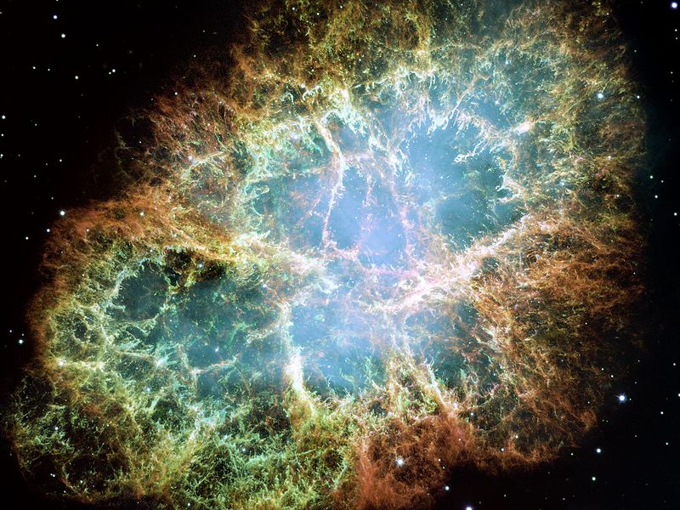
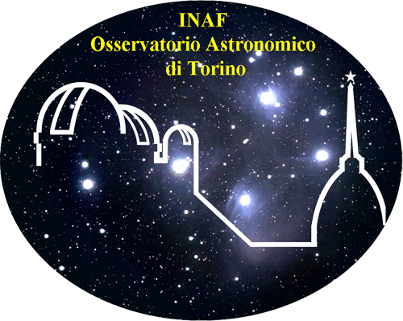
SIMULATIONS OF NUCLEARITES SIGNALS FOR THE Mini-EUSO SPACE EXPERIMENT
Università degli studi di Torino
Facoltà di scienze matematiche, fisiche e naturali
Tesi di laurea triennale in Fisica
a.a. 2018-2019
Candidato: Riccardo Corno
Primo relatore: Prof. Mario E. Bertaina
Secondo relatore: Prof. Alberto Cellino
Correlatore: Dott. Kenji Shinozaki

Slide 2
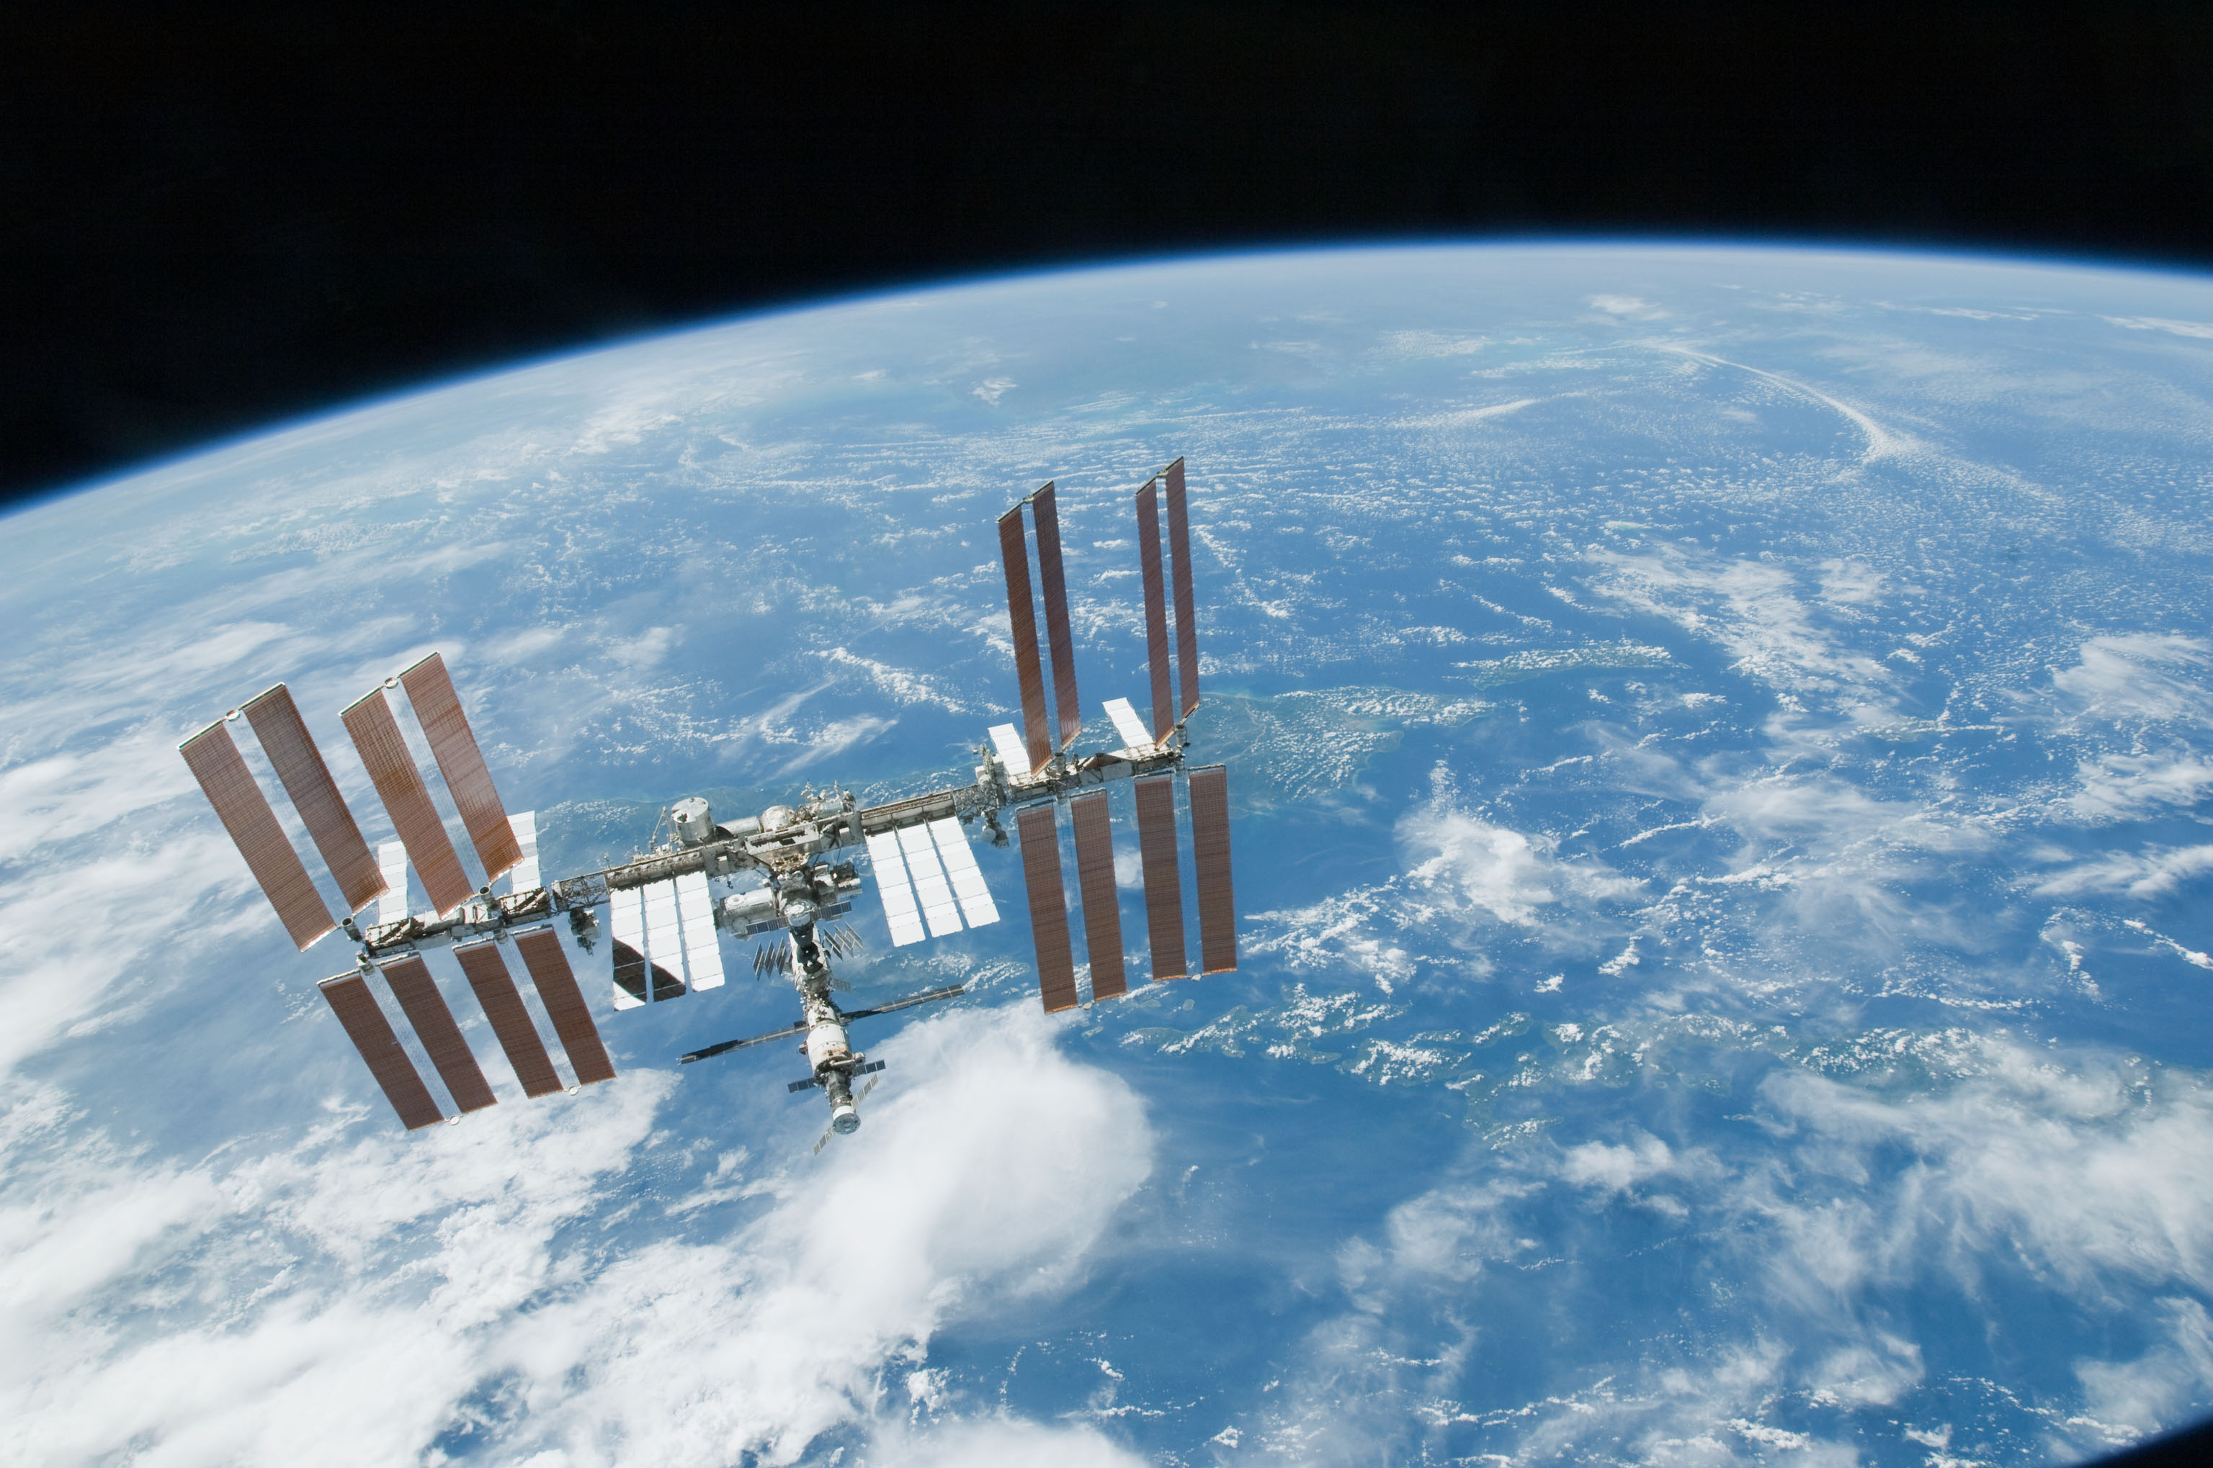
AIM OF THE STUDY
Simulation of nuclearites in the Field of View (FOV) of the Mini-EUSO
Verification of such a simulation by modelled events
Determination of the Mini-EUSO’s nuclearites’ upper limit flux for null detection

Slide 3
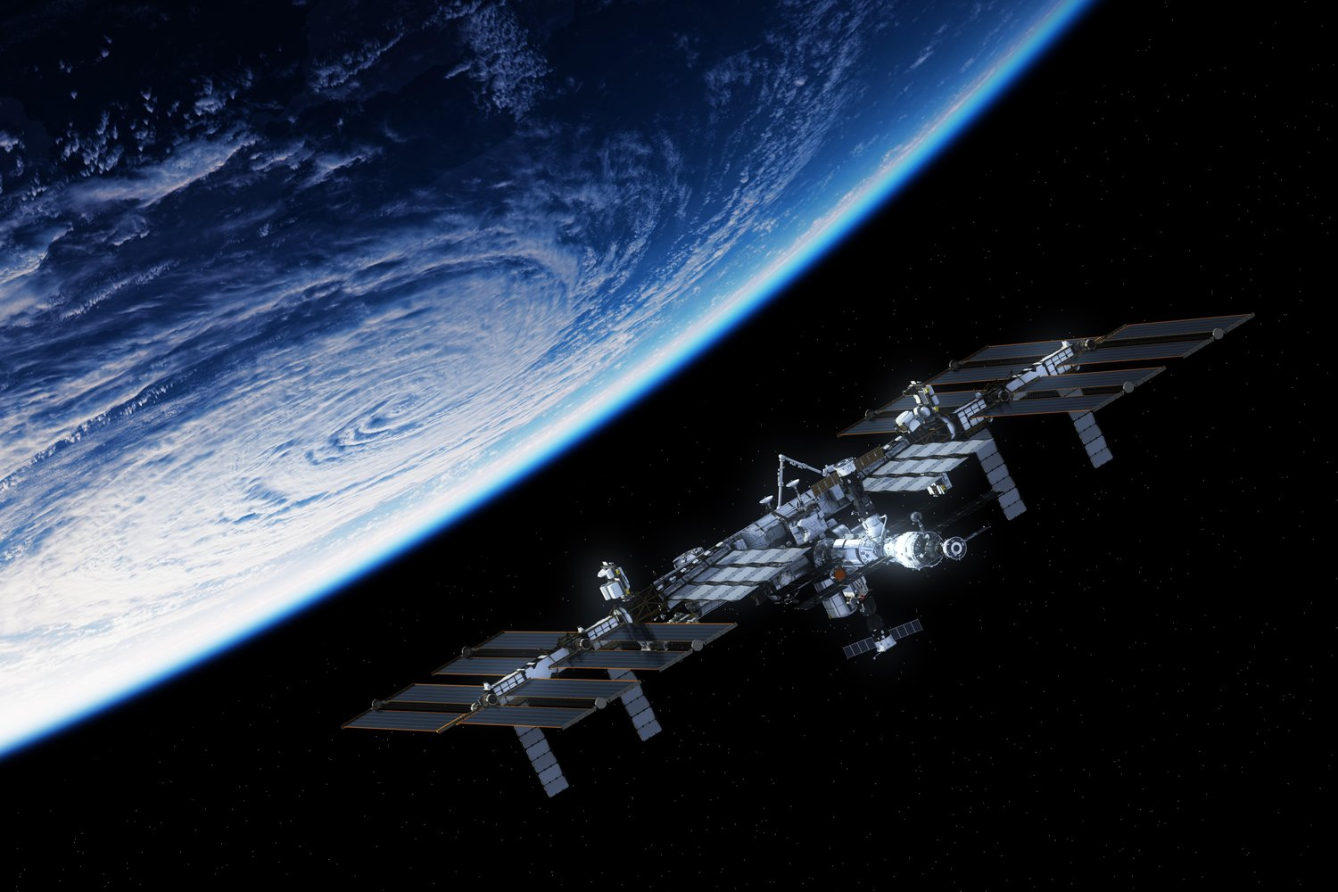
INTRODUCTION

Slide 4
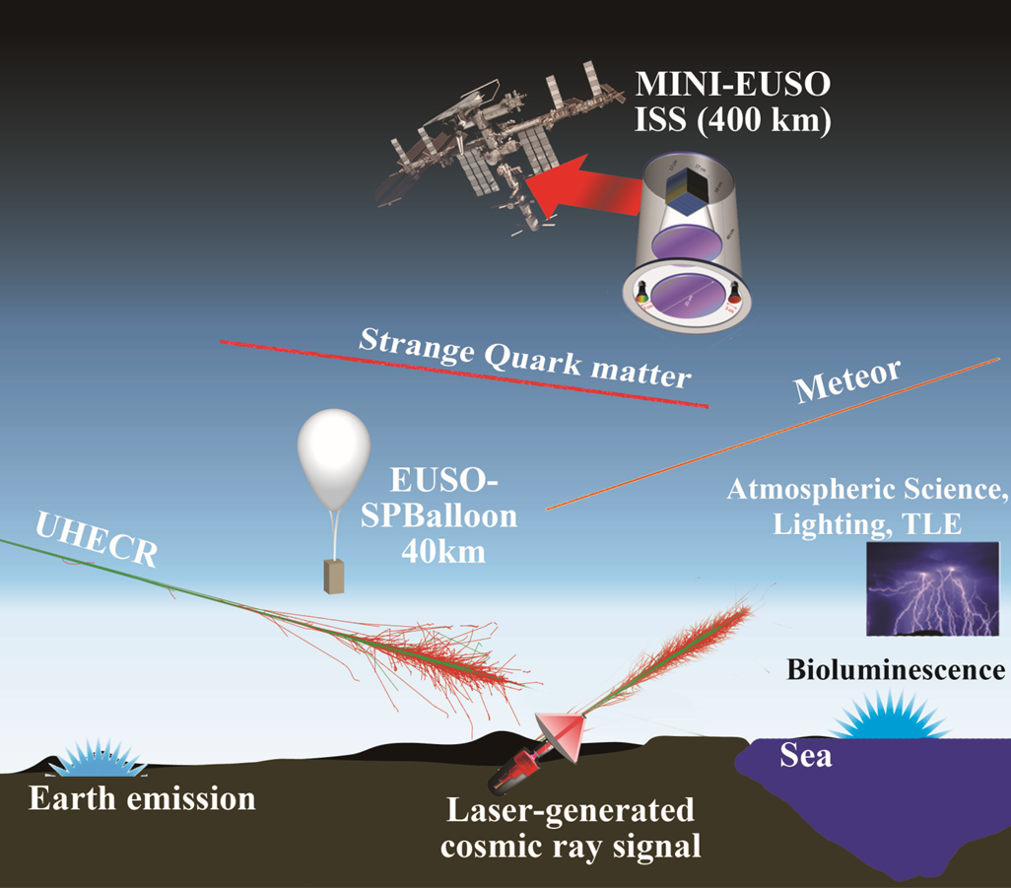
Mini-EUSO
Mini-EUSO is an UV telescope installed in the Russian Zvezda Module of the ISS.
It’s part of the mission Beyond begun on the 20th of July 2019.
Mini-EUSO has been installed on the ISS since the 27th of August 2019.
Its main goal is the measurement of the UV emissions of interacting particles in Earth atmosphere.
Interaction emissions differ in light profile, depending upon the particle causing them, its velocity and mass.
Particles can be meteors, space debris or Strange Quark Matter (SQM, Nuclearites).
All measurement will be made by night.

Slide 5
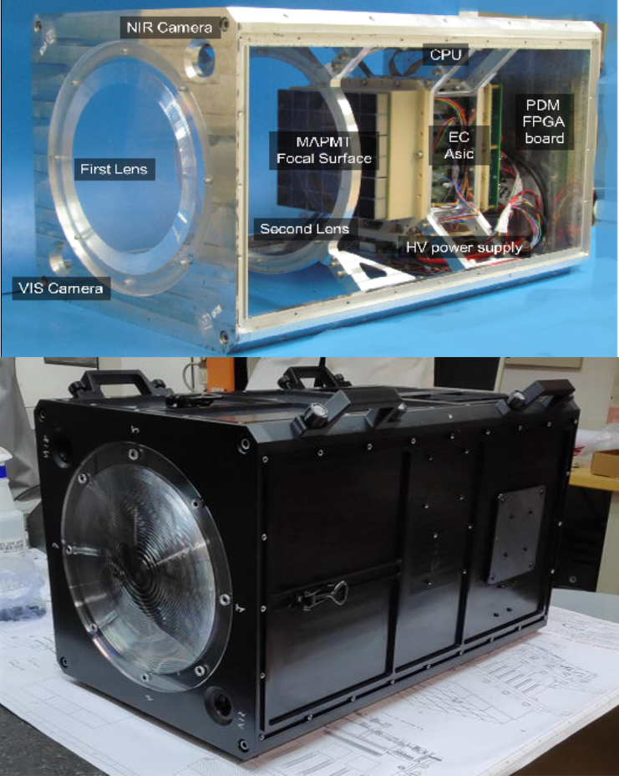
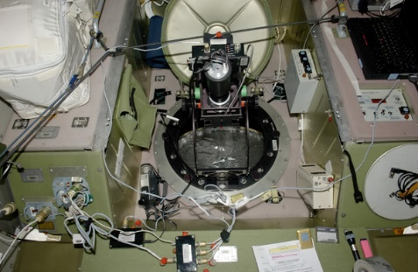
INSTRUMENT: OVERVIEW
Mini-EUSO is situated inside the ISS behind an UV-transparent window from which it observe the Earth in a fixed position facing the nadir direction.
The full Mini-EUSO telescope
is made up of 3 main systems, the Optical System,
the Focal Plane (PDM) and the Data Acquisition System.
Instrument dimensions:
37 x 37 x 62 cm³

Slide 6
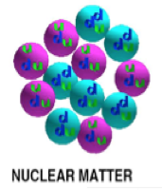
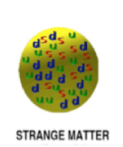
NUCLEARITES: STRUCTURE
Nuggets of Strange Quark Matter (SQM): clumps of Stranglets, made of about same number of up, down and strange quarks, captured electrons to reach neutrality.
Baryonic Number greater than 10⁶ . Stable for any value:
Nuclearites: A > 10⁶, core + electrons, neutral.
Stranglets: A < 10⁶, positive charged.
Size from 10⁻⁸ cm through any value for example dimensions of neutron stars.

Slide 7
NUCLEARITES: ORIGIN
Possible origin:
Primordial nuclearites: Residuals from the transition period from the quasi-free quark plasma to the cooler state where quarks are confined.
According to theory of Quantum Chromodynamics (QDC) they are vestiges of the Big Bang.
Recent nuclearites: products of the collision of neutron stars or supernovae bursts.
Strange Quark Matter is non-luminous and it may constitute the dark matter.
De Rujula & Glashow, Nature 312 (1984) 734

Slide 8
NUCLEARITES: SPEED and MASS
Speed ranges from about 250 to 500 km/s. They are not subject to ablation phenomena.
Mass determines Magnitude and Maximum Altitude:
Magnitude
If Absolute Magnitude (calculated at standard height h = 100 km):
Maximum Altitude:
Nuclearites are expected to be a low atmosphere phenomenon:
10⁻⁴ g nuclearite → h_{max} ~ 6 km
10⁴ g nuclearite → h_{max} ~ 60 km

Slide 9
NUCLEARITES vs METEORS
Nuclearites are faster than Meteors:
The light emitted by nuclearite is constant at h ≤ h_{max}.
Meteors move only downwards while Nuclearite can move also upward (mass greater than 0.1 g).

Slide 10
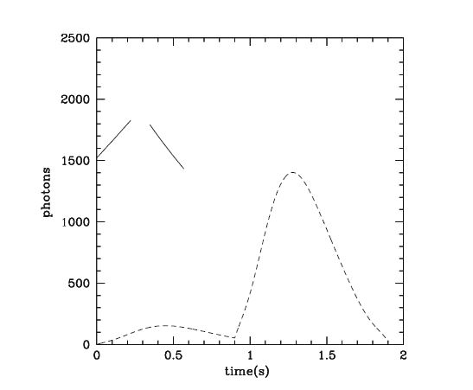
NUCLEARITES vs METEORS
Light curve of:
two nuclearites, one up- and one downwards moving
a meteor
Model parameters
Nuclearites:
mass: m = 20 g
velocity: 250 km/s
θ = 45° inclination from the
vertical.
Meteor:
magnitude: M = −1
velocity: 70 km/s
θ = 45°
Nuclearites
Meteor

Slide 11
FIELD OF VIEW (FOV)

Slide 12
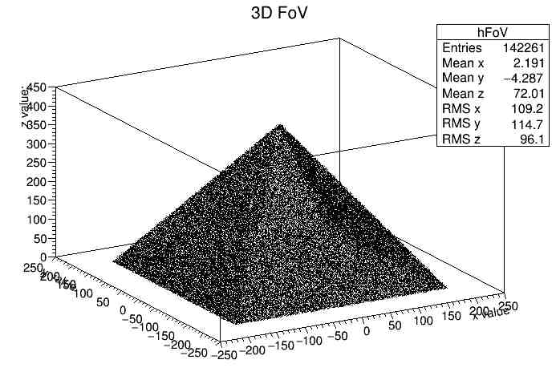
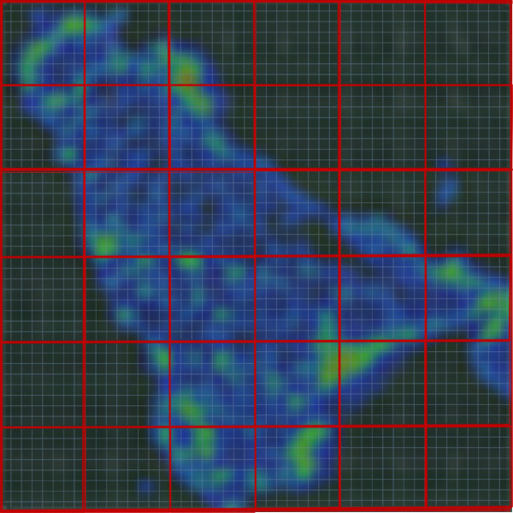
FOV: PROPERTIES
Pyramidal shape.
Vertices: ISS, 400 km from Earth’s ground.
Angle at vertices: 50°. Mini-EUSO FOV is 44° wide: 50° prevents data loss.
Space isotropy and constant flux of particles.
Nuclearites have a constant light emission and a constant mass.

Slide 13
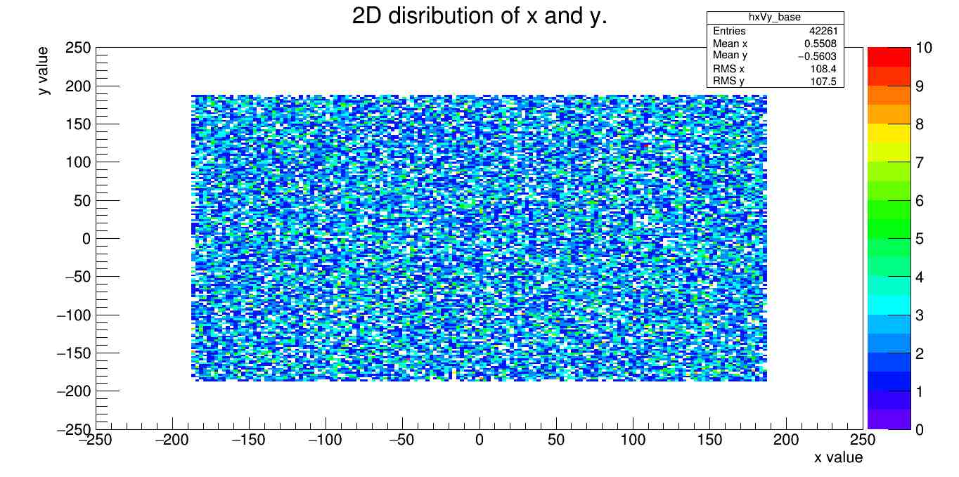
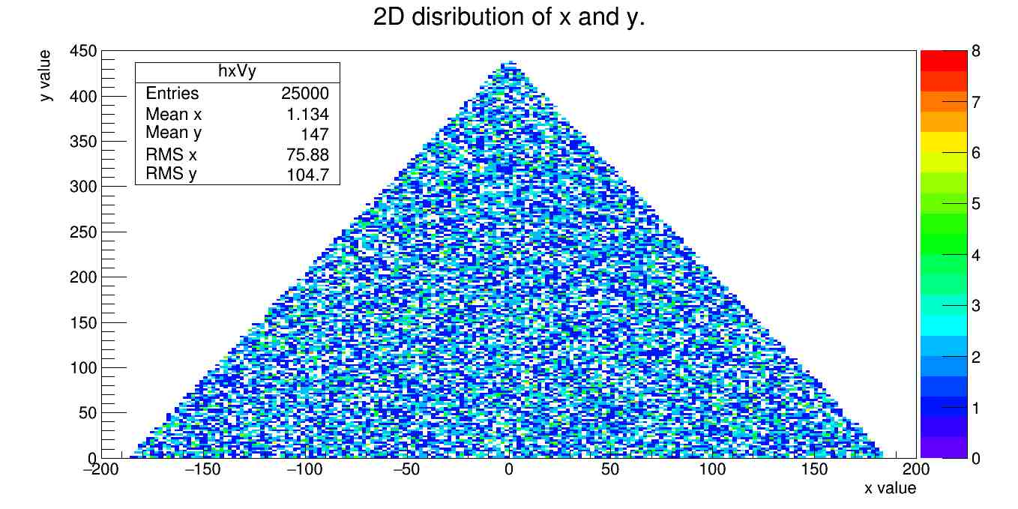
FOV: DISTRIBUTION ON EACH FACE AND ON BASE
Total number of events on the faces (N_{Faces} ):
100 000
Total number of events on the base (N_{Base} ):
42 261
(proportional to base to faces area ratio)

Slide 14
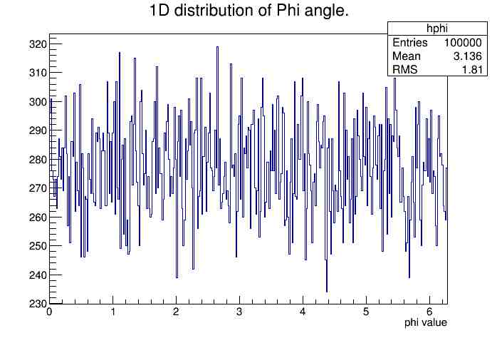
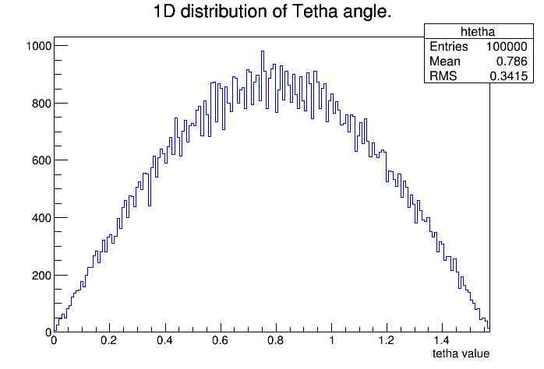
FOV SPACE ISOTROPY: ϕ_{Face}, θ_{Face}
ϕ: azimuth angle
θ: zenithal angle
For a given event, both ϕ_{Face} and θ_{Face} are randomly generated.
ϕ varies from 0 to 2π.
The distribution of events vs ϕ is constant.
θ varies form 0 to ^{π}/₂.
The distribution of events vs θ is proportional to
sen θ cos θ
[rad]
[rad]

Slide 15
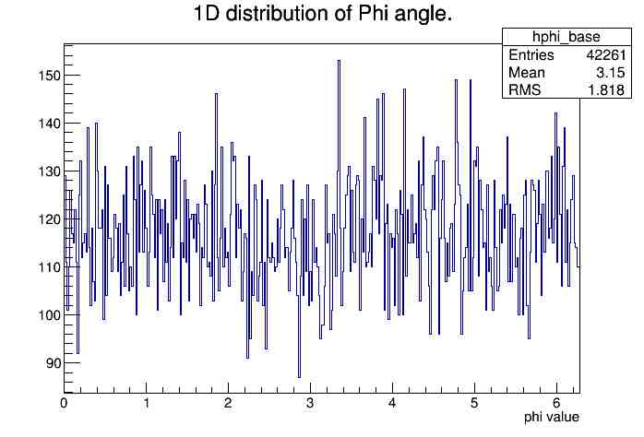
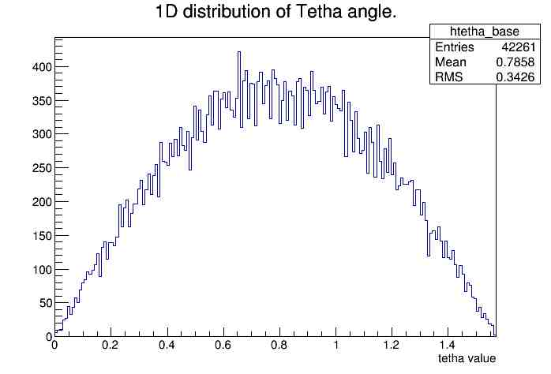
FOV SPACE ISOTROPY: ϕ_{Base}, θ_{Base}
ϕ: azimuth angle
θ: zenithal angle
For a given event, both ϕ_{Base} and θ_{Base} are randomly generated.
ϕ varies from 0 to 2π.
The distribution of events vs ϕ is constant.
θ varies form 0 to ^{π}/₂.
The distribution of events vs θ is proportional to
sen θ cos θ
[rad]
[rad]

Slide 16
FOV: ASSUMPTIONS
Each event in the FOV receives a random mass and velocity, hence a maximum altitude:
Speed range: 250-500 km/s
Mass range: 5-100 g
Maximum altitude as expected from the assigned mass
Analyzing for each event the coordinates (x, y, z ) at any time, the SW checks following the nuclearite as it reaches the h_{max} or it leaves the FOV.

Slide 17
SIMULATIONS

Slide 18
NUCLEARITE SIMULATIONS
The simulator can operate in two RS one ground based and the other ISS based, the latter only was considered.
It simulates the path of the nuclearite and associated light curve with a time tick of 1 ms, accounting also for the boundary conditions of:
FOV
h_{max}
z
y
Mini-EUSO
7.8 km/s
x
z
FOV
400 km
y
Ground Simulator
x
EARTH

Slide 19
SIMULATION I/O
INPUT
Mass (Range: 5 - 100 g)
Horizontal speed of Mini-EUSO
Initial coordinates of Mini-EUSO
Duration of the event
Velocity of nuclearite
Maximum height of nuclearite
light emission that can be
registered by Mini-EUSO
Simulation run on 10 000 nuclearites
OUTPUT
Event duration
Path on the focal plane
Number of photons registered vs time (light curve)
θ and ϕ angles
Position (x, y, z) in respect to Mini-EUSO

Slide 20
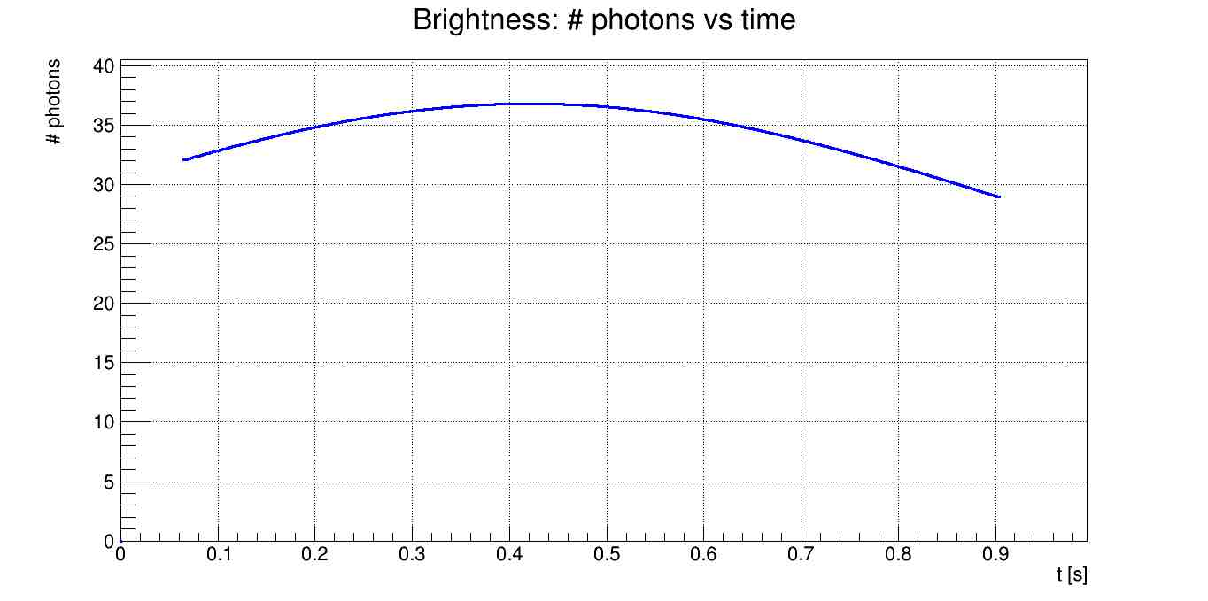
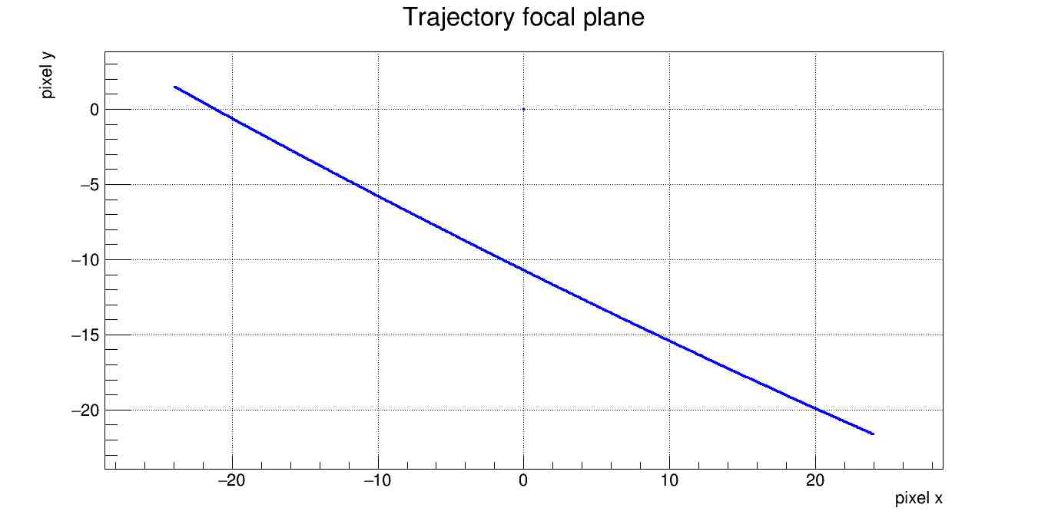
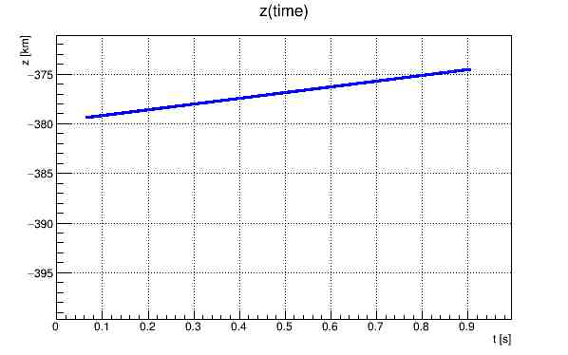
FROM FACES
# photonenlectrons / 1 ms
Nuclearite 1:
mass = 65.30 g
h_{max} = 41.9 km
v_{minieuso} = v_{ISS} = 7.8 km/s , along x
Duration of the event: 0.839 s
Light curve, Nuclearite 1
Mini-EUSO
Nuclearite motion: upward
Earth

Slide 21
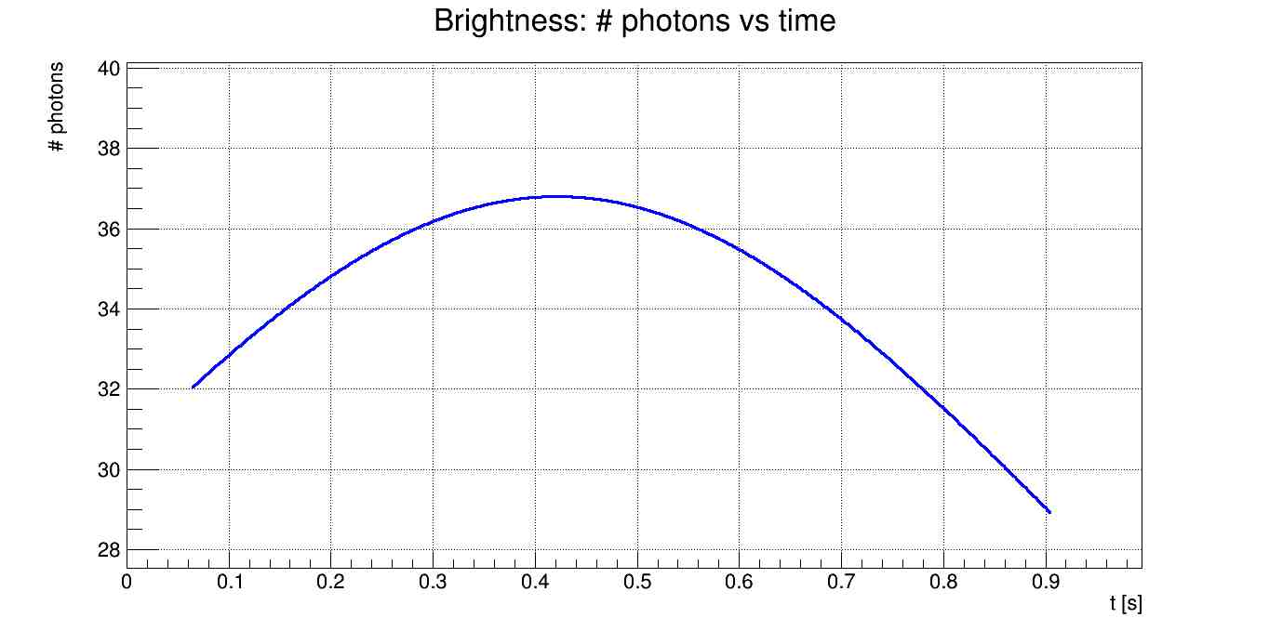
READING THE LIGHT CURVE
The maximum of the Light Curve represent the nearest point of the nuclearite’s trajectory to the ISS. We observe this kind of bell shape because after the maximum the ISS moves in the opposite direction of the nuclearite and by consequence Mini-EUSO can detect less photons.
Light curve Nuclearite 1, Zoom
# photonenlectrons / 1 ms
Note: This interpretation is similar for all the examples of nuclearites reported in this presentation.
Approaching the ISS
Moving away from the ISS

Slide 22
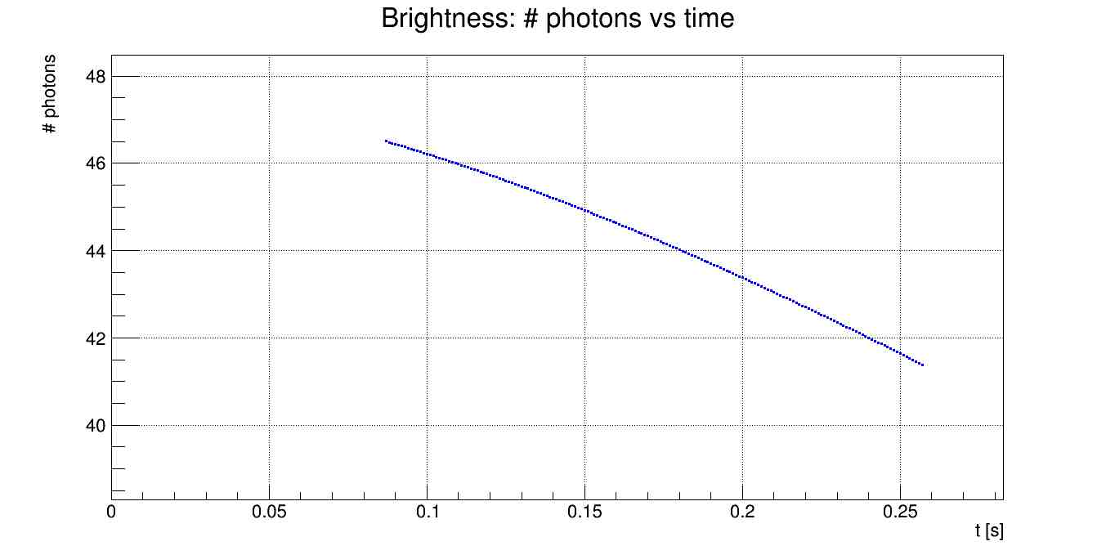
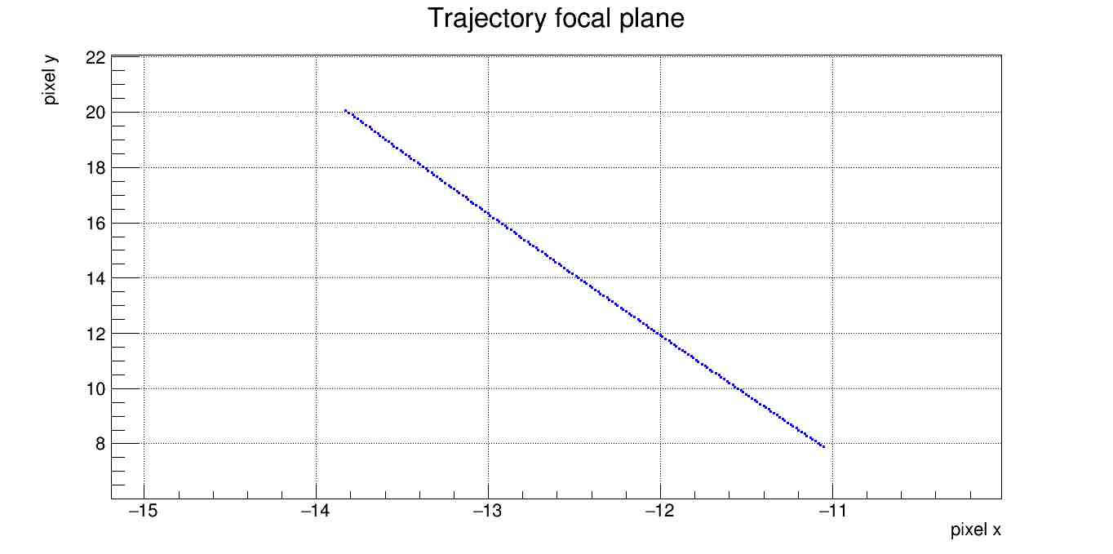
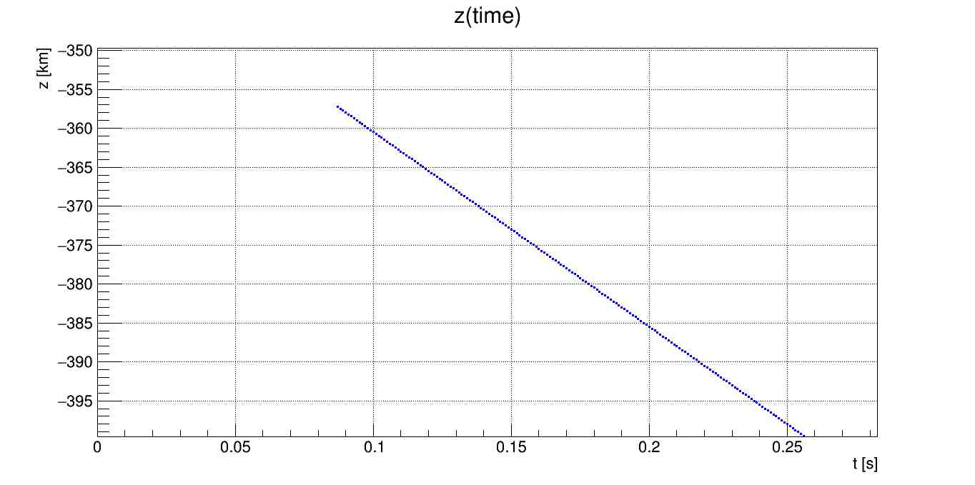
FROM FACES
Light curve, Nuclearite 2
# photonenlectrons / 1 ms
Nuclearite 2:
mass = 95.88 g
hmax = 42.9 km
v_{minieuso} = v_{ISS} = 7.8 km/s , along x
Duration of the event: 0.170 s
Mini-EUSO
Nuclearite motion: downward
Earth

Slide 23
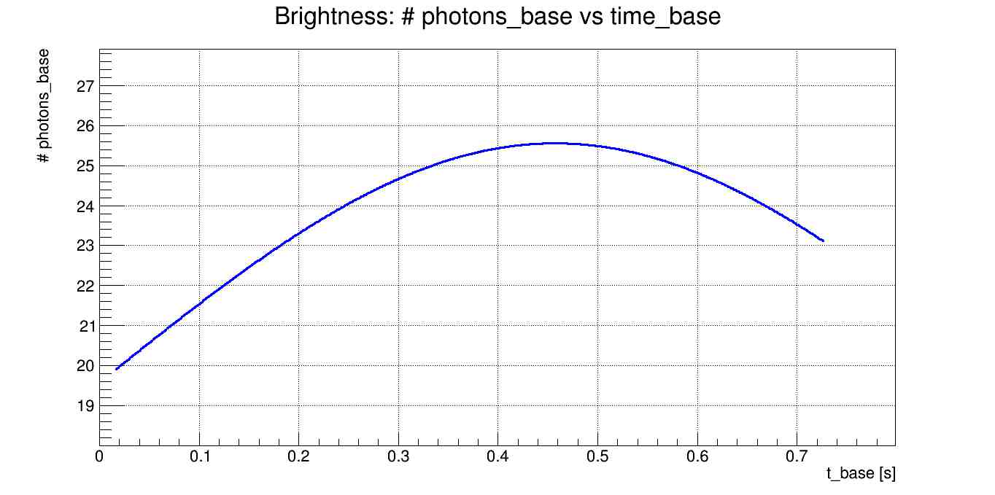
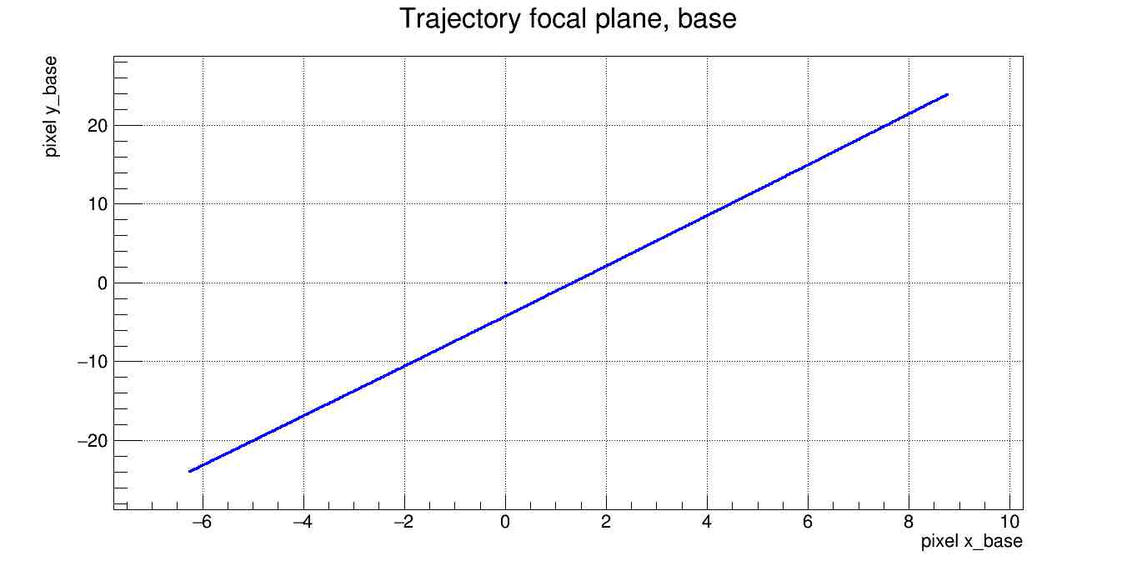
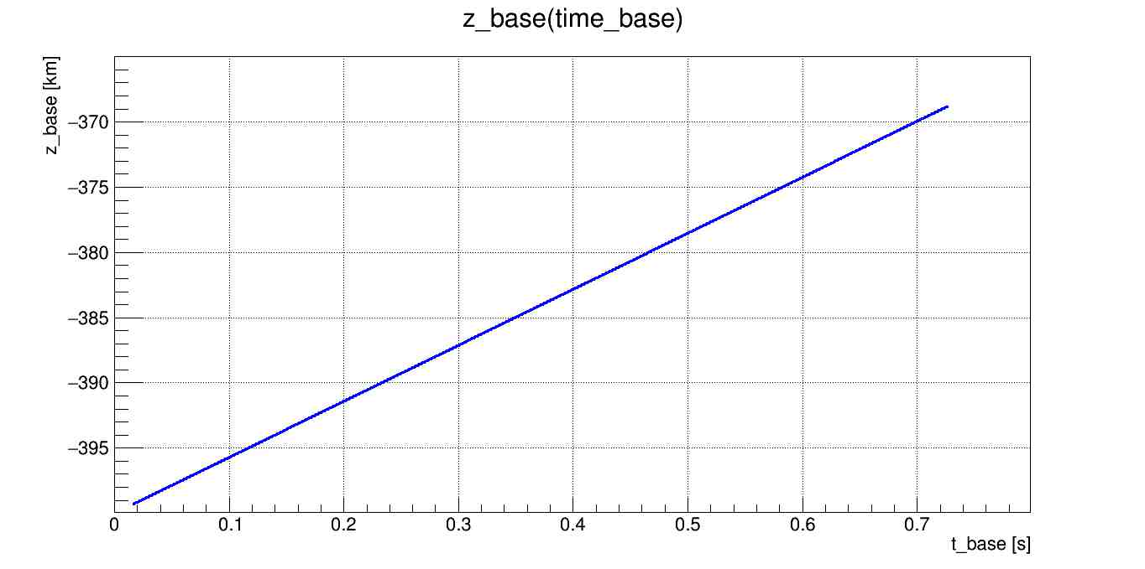
FROM BASE
# photonenlectrons / 1 ms
Nuclearite 3:
mass = 37.89 g
hmax = 40.4 km
v_{minieuso} = v_{ISS} = 7.8 km/s, along x
Duration of the event: 0.709 s
Light curve, Nuclearite 3
Mini-EUSO
Nuclearite motion: upward
Earth

Slide 24
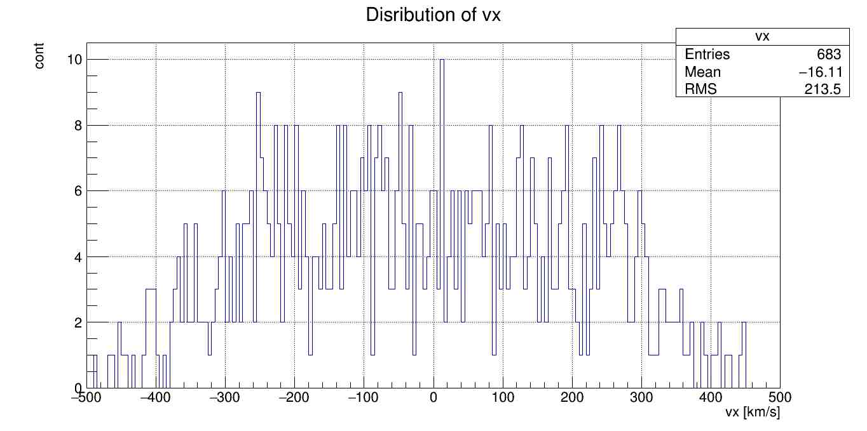
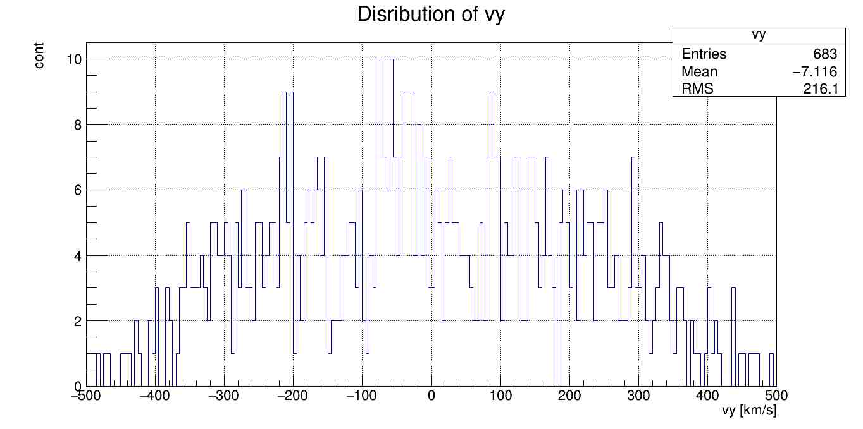
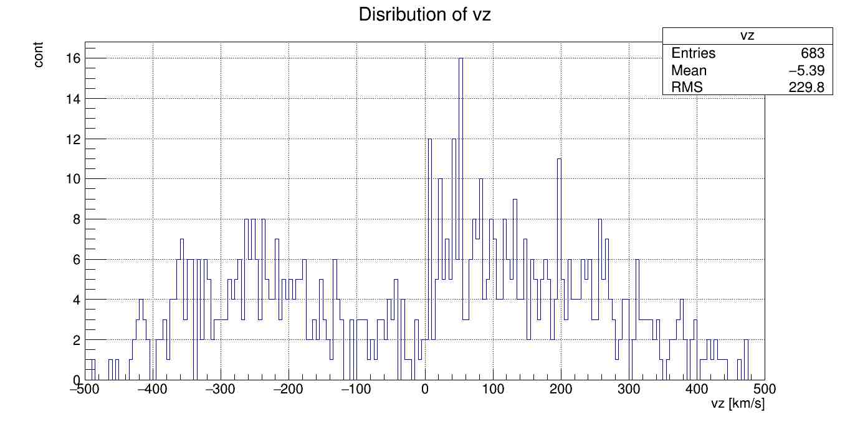
VELOCITY VECTORIAL COMPONENTS
V_{X}
V_{Y}
Origin of the coordinate system is in Mini-EUSO:
Velocity components along x or y can be both positive and negative
Velocity component along z can be both positive or negative because nuclearties can pass through the Earth
V_{Z}
Downward motion
Upward motion

Slide 25
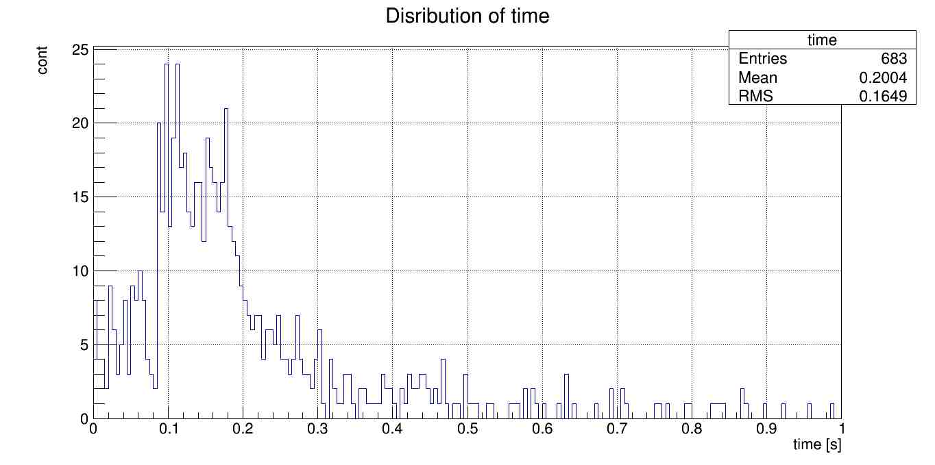
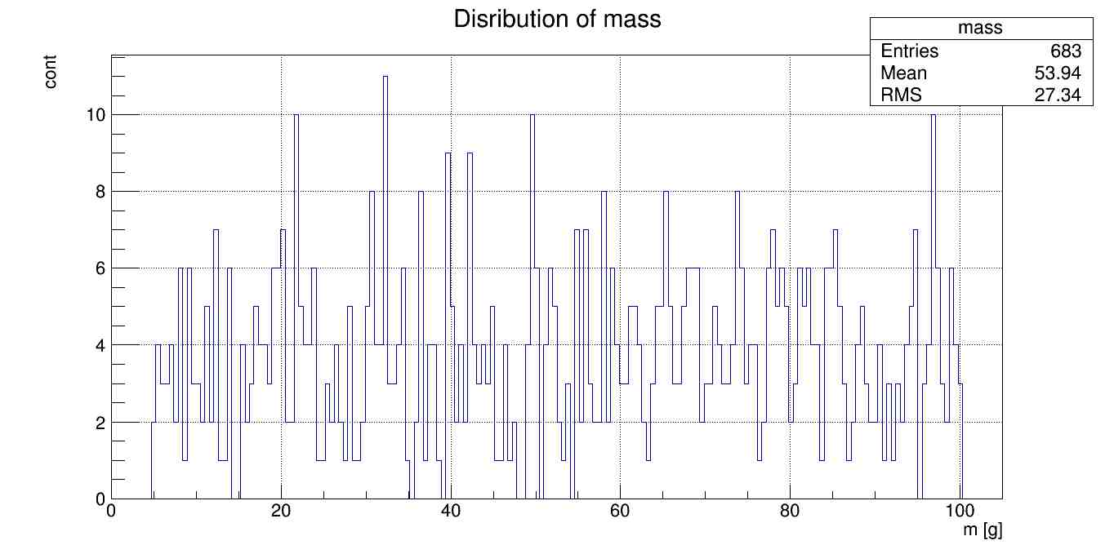
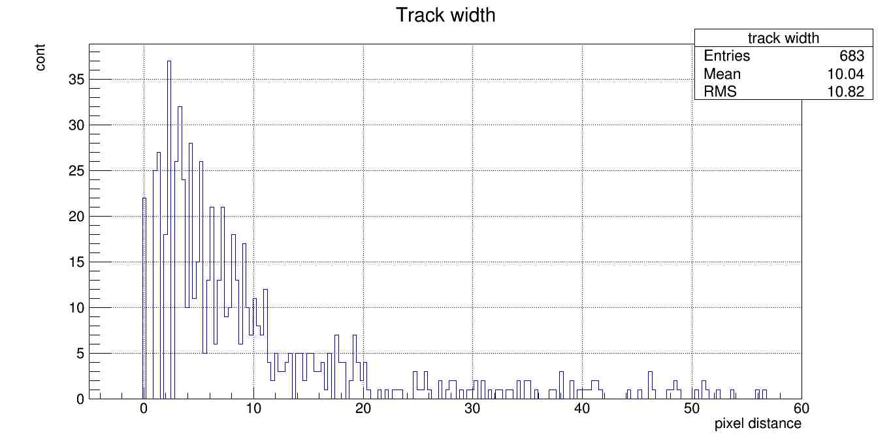
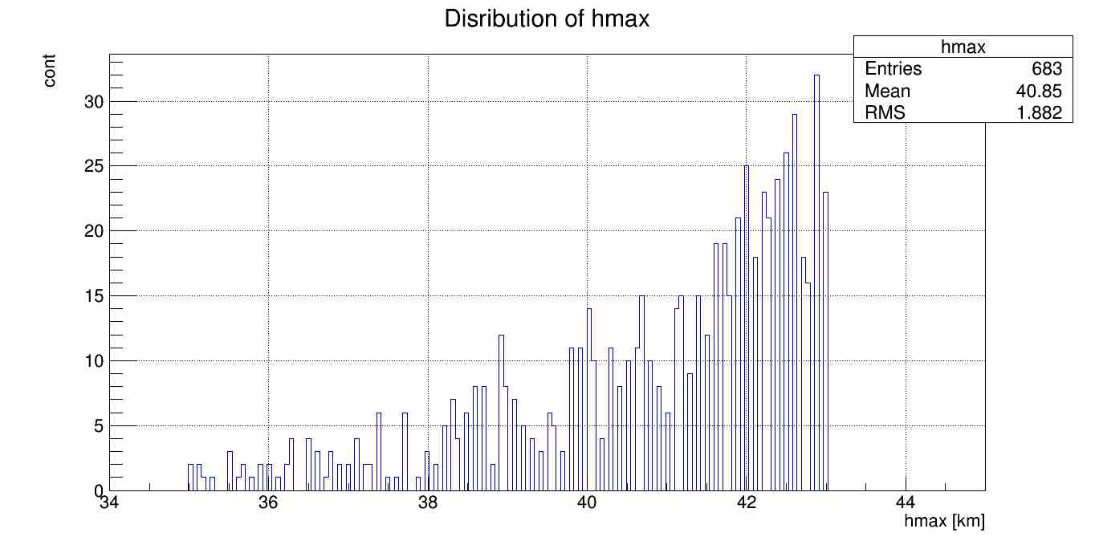
DISTRIBUTIONS: t, m, h_{max}, TRACK WIDTH
More fast events than slow.

Slide 26
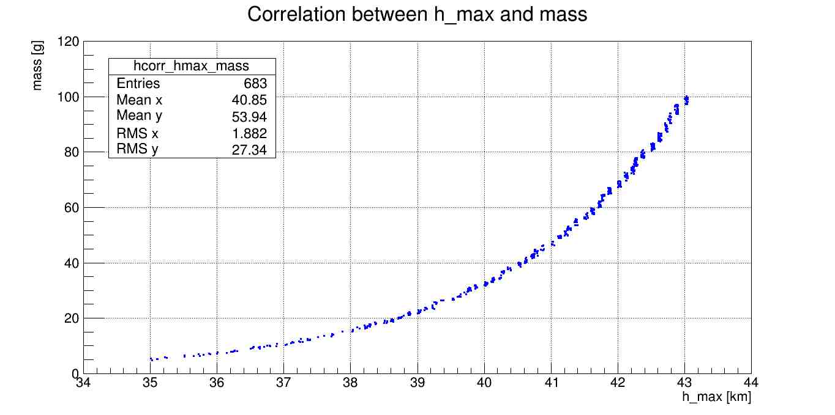
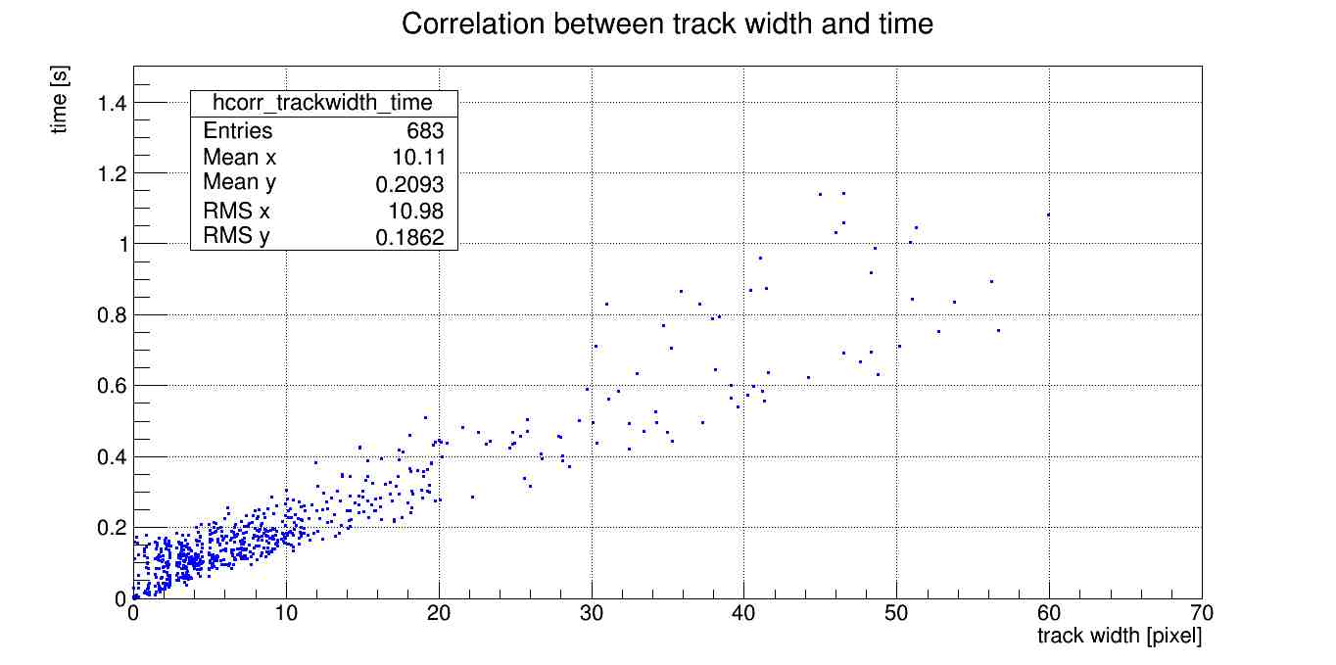
This graph shows that the distribution of h_{max} and mass is correlated by an exponential. This is the result of the relation between the two.
Correlation between
track width and time.
Events with durations shorter than 0.1 s are not considered as too fast for a significant analysis.
This will be verified adding data from a meteors simulation.

Slide 27
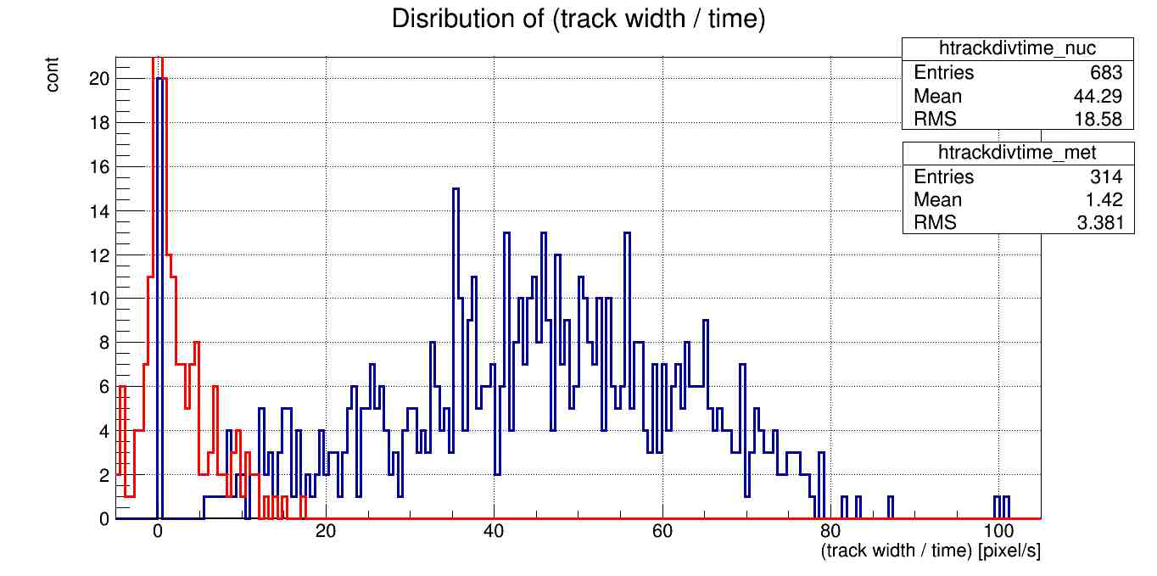
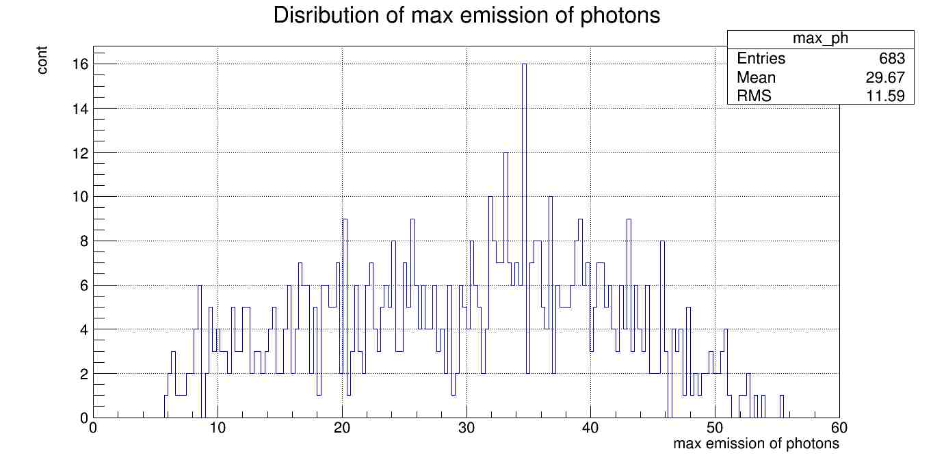
HORIZONTAL SPEED FOR NUCLEARTES AND METEORS
Nuclearites
Meteors
Distribution, for nuclearites and meteors, of the ratio of track width and the duration of the single event.
The meteor distribution of track width and time ratio helps to understand where the cut is to be made.
The cut conditions will be imposed considering limitations on the duration of the events, the
(track width/time) value and the maximum emissions of photons.
Photons / GTU

Slide 28
UPPER LIMIT OF NUCLEARITES’ FLUX, THEORY
The following relations report the value of the constant K and the upper limit of nuclearites’ flux for a null detection that can be observed with Mini-EUSO (Φ_{Ph, 0}).
Φ_{Ph, 0} expression derives from the result of the integral that give the probability to obtain Φ_{Ph, 0} with a Confidence Level (CL) of 90%.
Hypothesis:
T = 30 days = 2 592 000 s
A_{FOV} = 4.68 * 10¹⁵ cm²
ε = N / 1 000
CL = 90 %

Slide 29
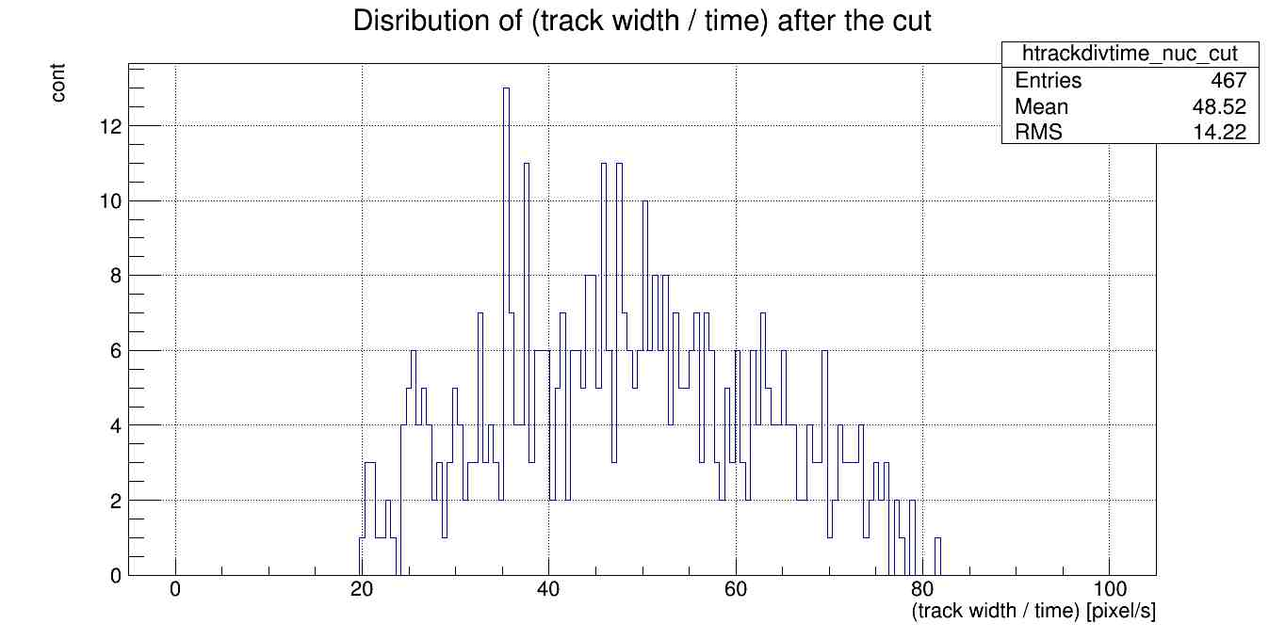
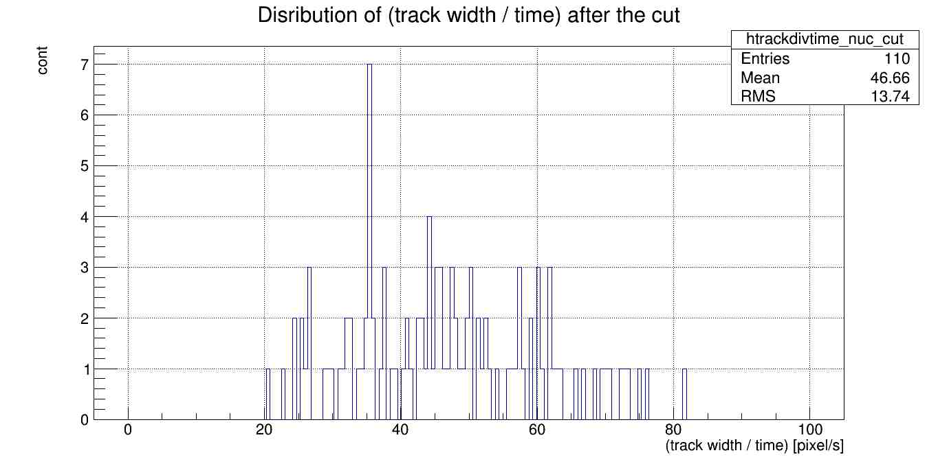
CUT CONDITIONS
Distribution of (track width/time) after the cut
Data acquisition > 0.1 s
(track width / time) > 20 pixels/s
Max emission > 40 photons / GTU
N = 110 events
Φ_{Ph, 0} = 5.5 * 10⁻²² cm⁻² sr⁻¹ s⁻¹
8 ph / GTU
Distribution of (track width/time) after the cut
40 ph / GTU

Slide 30
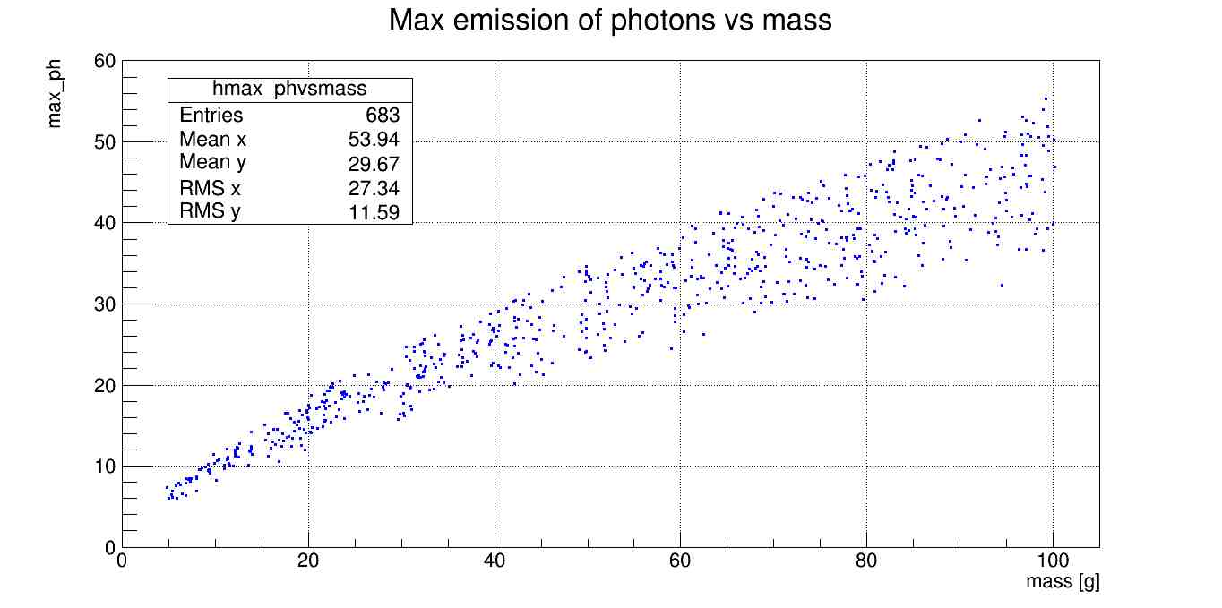
INTERVAL OF MASS
Photonselectrons/ GTU
CUT 3
CUT 2
CUT 1

Slide 31
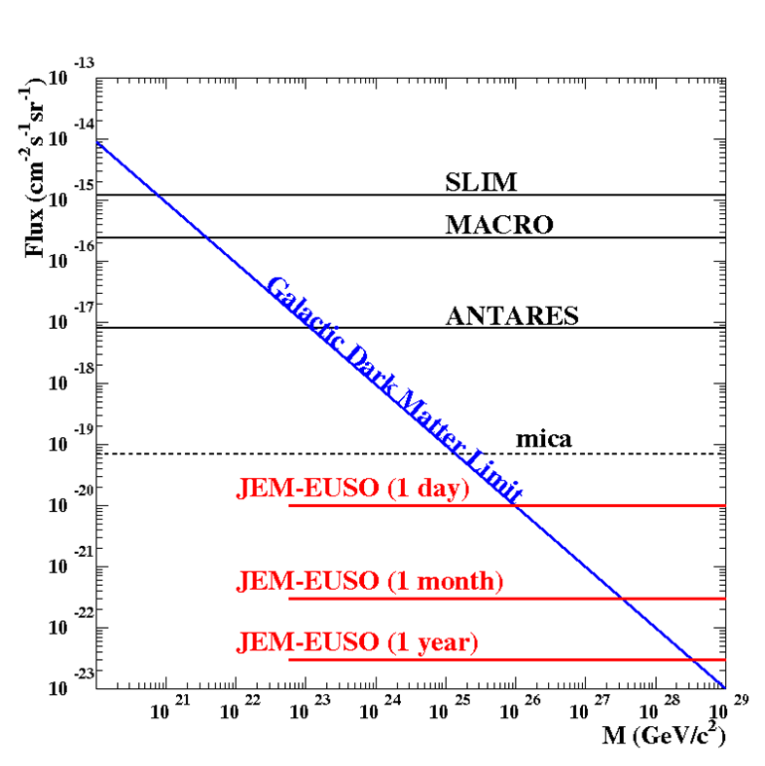
ESTIMATED UPPER LIMIT OF NUCLEARITES’ FLUX
Preliminary
With the most conservative cut condition we obtain that the sensitivity of Mini-EUSO at 90% of CL is:
The 30 days indicated as acquisition time are to be understood as effective acquisition time: the total acquisition time in which observations were made in the best conditions, for example above the Oceans and clear sky.
Φ_{Ph, 0} = 5.5 * 10⁻²² cm⁻² sr⁻¹ s⁻¹
Φ_{Ph, 0} Mini-EUSO (30 days)

Slide 32
SUMMARY
Generation of the FOV of Mini-EUSO
Simulated and analyzed nuclearites’ signals
Estimated the nuclearites’ flux upper limit for a null
detection for 30 days of Mini-EUSO work

Slide 33
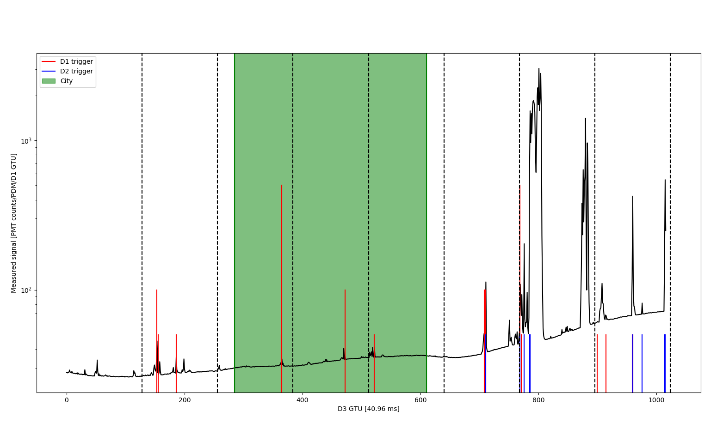
FIRST SET OF DATA FROM Mini-EUSO
Between the night of 7th and 8th of October there was the first observation of Mini-EUSO lasted about 40 s.
At that moment the ISS was flying between Ethiopia and Sudan.
Probably the photons registered came from Thunderstorm or Lightnings.

Slide 35
MORE DETAILS…
THANK YOU!

Slide 36
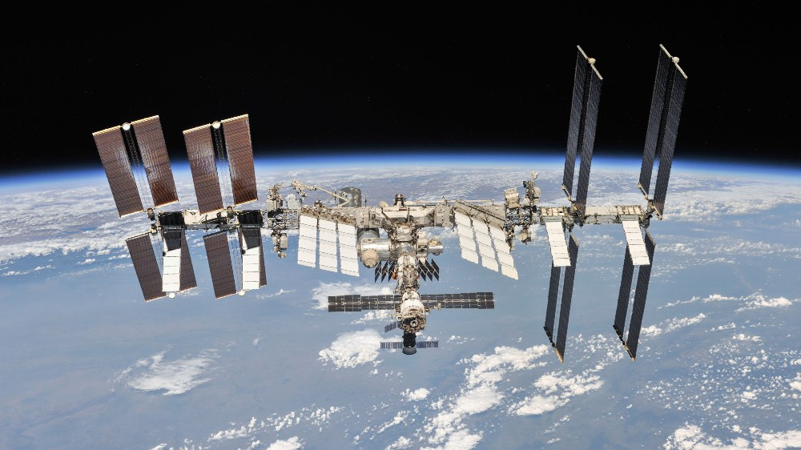
A DEEPER VIEW

Slide 37
INSTRUMENT

Slide 38
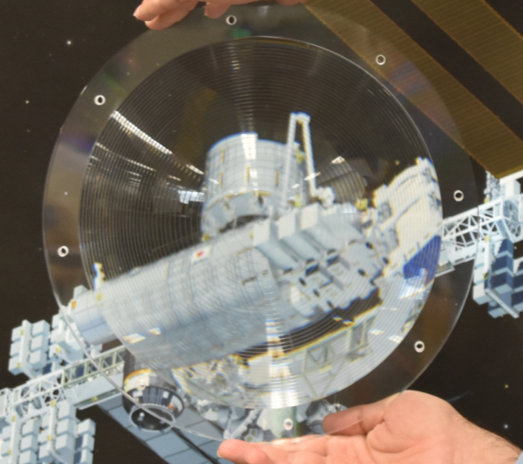
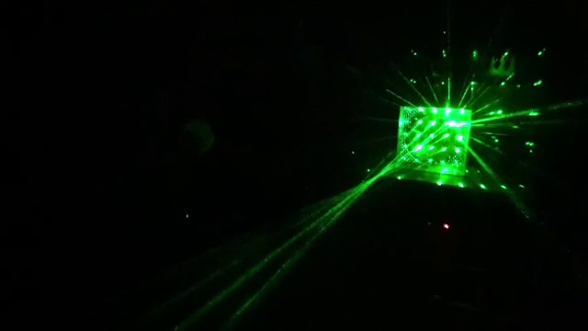
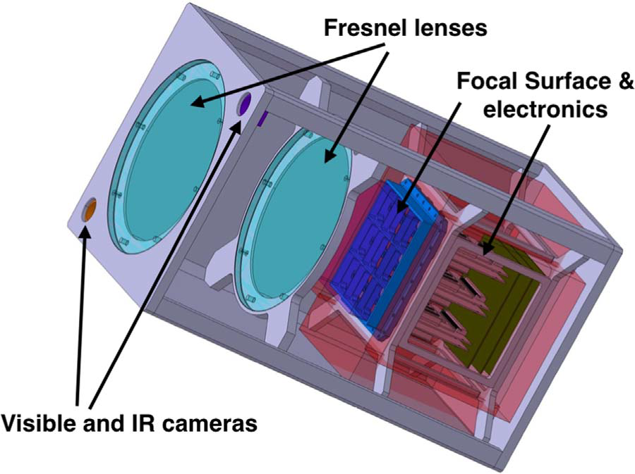
INSTRUMENT: OPTICAL SYSTEM
Operation of the two Fresnel lenses
Two double sided Fresnel lenses.
Diameter: 25 cm
Thickness: 11 mm
Weight: 0.8 kg
Wavelength accepted:
300-400 nm, UV band
Each lens is made of PMMA. The effective focal lens is 300 mm and the FOV is 44°.

Slide 39
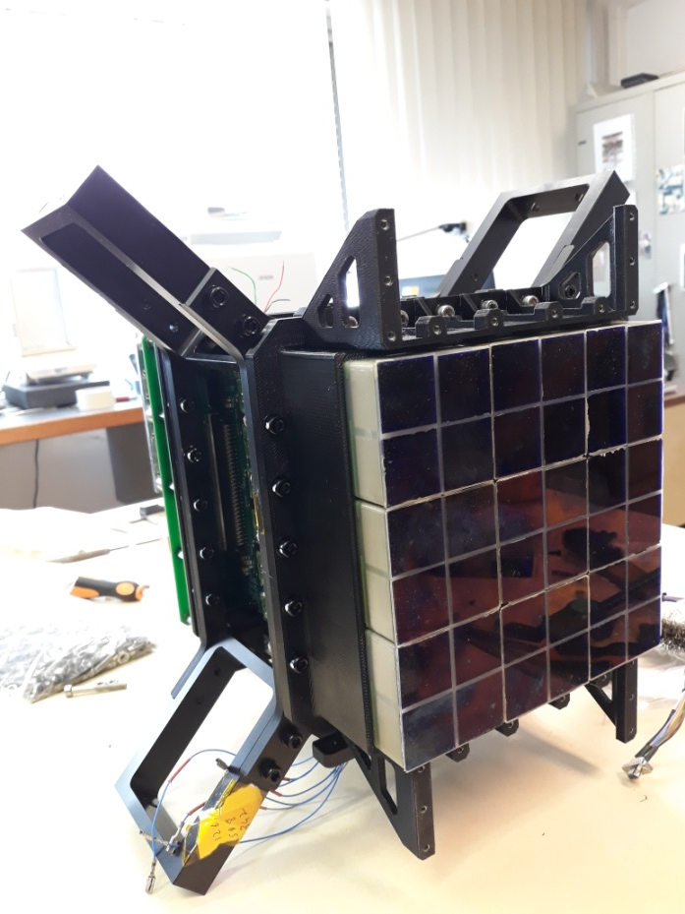
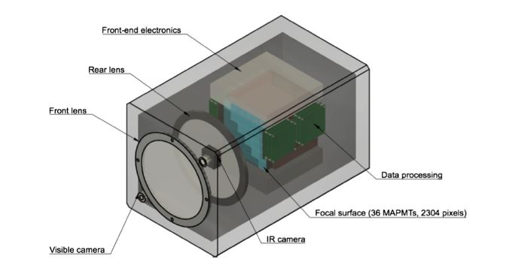
INSTRUMENT: PDM
The two lenses focuses the light on to a focal surface consisting of a single PDM, made up of 36 MAPMTs and 2304 pixels.
The two acronyms stands for:
PDM: Photo Detector Module
MAPMT: Multi-Anode Photomultiplier Tubes

Slide 40
INSTRUMENT: VISIBLE and IR CAMERAS
There are also two IR cameras for complementary measurement in the NIR (Near IR , range from 1500 to 1600 nm) and in the visible (VIS from 400 to 780 nm).
The main task of the cameras is to provide an atmospheric monitoring in order to better understand the UV luminosity measurement.
The NIR and VIS cameras will operate with a trigger passed from the Mini-EUSO PDM in order to provide multi-wavelength measurements of slower atmospheric events, such as meteors and nuclearites. When not triggered, the cameras will operate continuously to provide complementary measurements on the atmospheric status at the time of measurement, matching the third level of data from the Mini-EUSO trigger.

Slide 41
INSTRUMENT: DATA ACQUISITION SYSTEM
Consists of the front-end electronics, the PDM-DP (PDM data processing) subsystem based on a Xilinx Zynq XC7Z030 system on chip and a PCIe/104 form factor CPU.
Incoming photon pulses are preamplified and digitized at intervals of 2.5 μs, referred to as the Gate Timing Unit or GTU.
The signal is then triggered and time-stamped in the Zynq FPGA, before being passed to the CPU for data management and storage.
The Zynq chip is responsible for of the majority of the data handling including data buffering, triggering, synchronization and interfacing with the separate CPU system.
The CPU performs the control of the instrument sub-systems as well as the data management and storage, housekeeping, switching between operational modes and collecting data from the NIR and VIS cameras.
Data is stored on board in SSDs which are periodically returned to Earth from the ISS.

Slide 42
NUCLEARITE PROPERTIES

Slide 43
ADDITIONAL NUCLEARITES PROPERTIES
Ground state of nuclear matter (E/A < 930 MeV).
Density is 3.6 x 10¹⁴ g cm⁻³.
The principle energy-loss mechanism for a nuclearite passing through matter is by atomic collision and is expressed in this relation:
Cross-Section area A
Emitted energy follows a blackbody relation, ensuring fluxes in the interval of wavelength covered by Mini-EUSO.
A = Effective Cross-sectional area, ρ = Density of the medium, v = Speed.

Slide 44
DARK MATTER

Slide 45
DARK MATTER (1)
Dark matter is a form of matter thought to account for approximately 85% of the matter in the universe and about a quarter of its total energy density. Its presence is implied in a variety of astrophysical observations, including gravitational effects which cannot be explained by accepted theories of gravity unless more matter is present than can be seen. Dark matter is abundant in the universe and have had a strong influence on its structure and evolution.
Dark matter is called dark because it does not appear to interact with observable electromagnetic radiation, such as light, and is thus invisible to the entire electromagnetic spectrum, making it undetectable using existing astronomical instruments.
3D map of the large-scale distribution of dark matter, reconstructed from measurements of weak gravitational lensing with the Hubble Space Telescope.

Slide 46
DARK MATTER (2)
Primary evidence for dark matter comes from calculations showing many galaxies would fly apart instead of rotating, or would not have formed or move as they do, if they did not contain a large amount of unseen matter. Other lines of evidence include observations in gravitational lensing, from the cosmic microwave background, also astronomical observations of the observable universe's current structure, the formation and evolution of galaxies, mass location during galactic collisions, and the motion of galaxies within galaxy clusters. In the standard Lambda-CDM model of cosmology, the total mass-energy of the universe contains 5% ordinary matter and energy, 27% dark matter and 68% of an unknown form of energy known as dark energy. Thus, dark matter constitutes 85% of total mass, while dark energy plus dark matter constitute 95% of total mass–energy content.
Because dark matter has not yet been observed directly, if it exists, it must barely interact with ordinary baryonic matter and radiation, except through gravity.
The primary candidate of constituent for dark matter is the nuclearites.
Dark matter is classified as "cold", "warm", or "hot" according to its velocity (more precisely, its free streaming length). Current models favor a cold dark matter scenario, in which structures emerge by gradual accumulation of particles.

Slide 47
CUT CONDITIONS

Slide 48
CUT CONDITIONS 1
Duration of the data acquisition > 0.1 s
(track width / time) > 20 pixels/s
Max emission of photons > 8 photons / GTU
N = 467 events
Φ_{Ph, 0} = 1.3 * 10⁻²² cm⁻² sr⁻¹ s⁻¹
Note: 1 GTU = 2.5 μs

Slide 49
CUT CONDITIONS 2
Duration of the data acquisition > 0.1 s
(track width / time) > 20 pixels/s
Max emission of photons > 20 photons / GTU
N = 372 events
Φ_{Ph, 0} = 1.6 * 10⁻²² cm⁻² sr⁻¹ s⁻¹

Slide 50
CUT CONDITIONS 3
Duration of the data acquisition > 0.1 s
(track width / time) > 20 pixels/s
Max emission of photons > 40 photons / GTU
N = 110 events
Φ_{Ph, 0} = 5.5 * 10⁻²² cm⁻² sr⁻¹ s⁻¹

Slide 51
REFERENCES
Francesca Capel, Alexander Belov , Marco Casolino, Pavel Klimov, for the JEM-EUSO Collaboration ScienceDirect Advances in Space Research 62 (2018) 2954–2965
JEM-EUSO: Meteor and nuclearite observations
M. Bertaina · A. Cellino · F. Ronga · The JEM-EUSO Collaboration,
Exp Astron DOI 10.1007/s10686-014-9375-4
E. Witten Phys Rev D30(1984) 272A
De Rujula & Glashow, Nature 312 (1984) 734
Thesis of Giulia Bruno and Antonio Montanaro
Francesca Bisconti, Presentazione notte dei ricercatori Mini-EUSO, 27/09/2019
https://ned.ipac.caltech.edu/level5/Leo/Stats5_4.html

