Slide 1
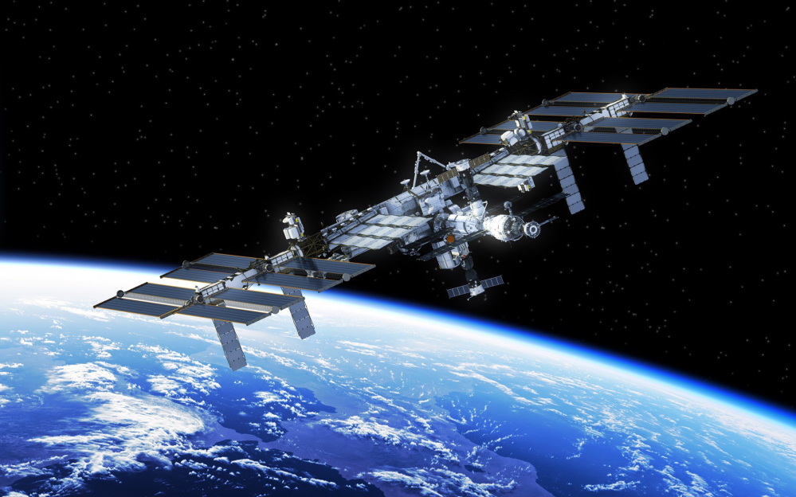
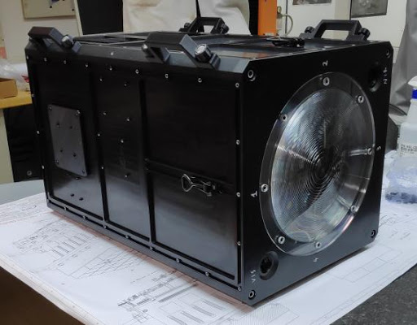
Ground based observations of meteors and simulations of space debris environment
Mini-EUSO, a JEM EUSO program
Supervisors : Mario Bertaina & Hiroko Miyamoto Mauca 2019/2020
ref : jem-euso.infn.it
ref : leganerd.com

Slide 2
Contents
Introduction
JEM EUSO program
The Mini-EUSO telescope
How Mini-EUSO works?
My project : Meteors detection
The principle
Meteors detection / Etos tool
Area calcul covered per pixel
My project : Space Debris (SD) simulations
The principle
MASTER tool
Simulations
Data comparison
Is Mini-EUSO detected SD?
Conclusion

Slide 3
Introduction

Slide 4
Introduction
JEM EUSO program
Joint Experiment Missions for Extreme Universe Space Observatory
A concept of a new generation space telescopes
Realization of a space mission devoted to scientific research for Extreme Energy Cosmic Ray (EECR) detection
Observation of meteors and exotic matter (space debris)
ref : jem-euso.infn.it

Slide 5
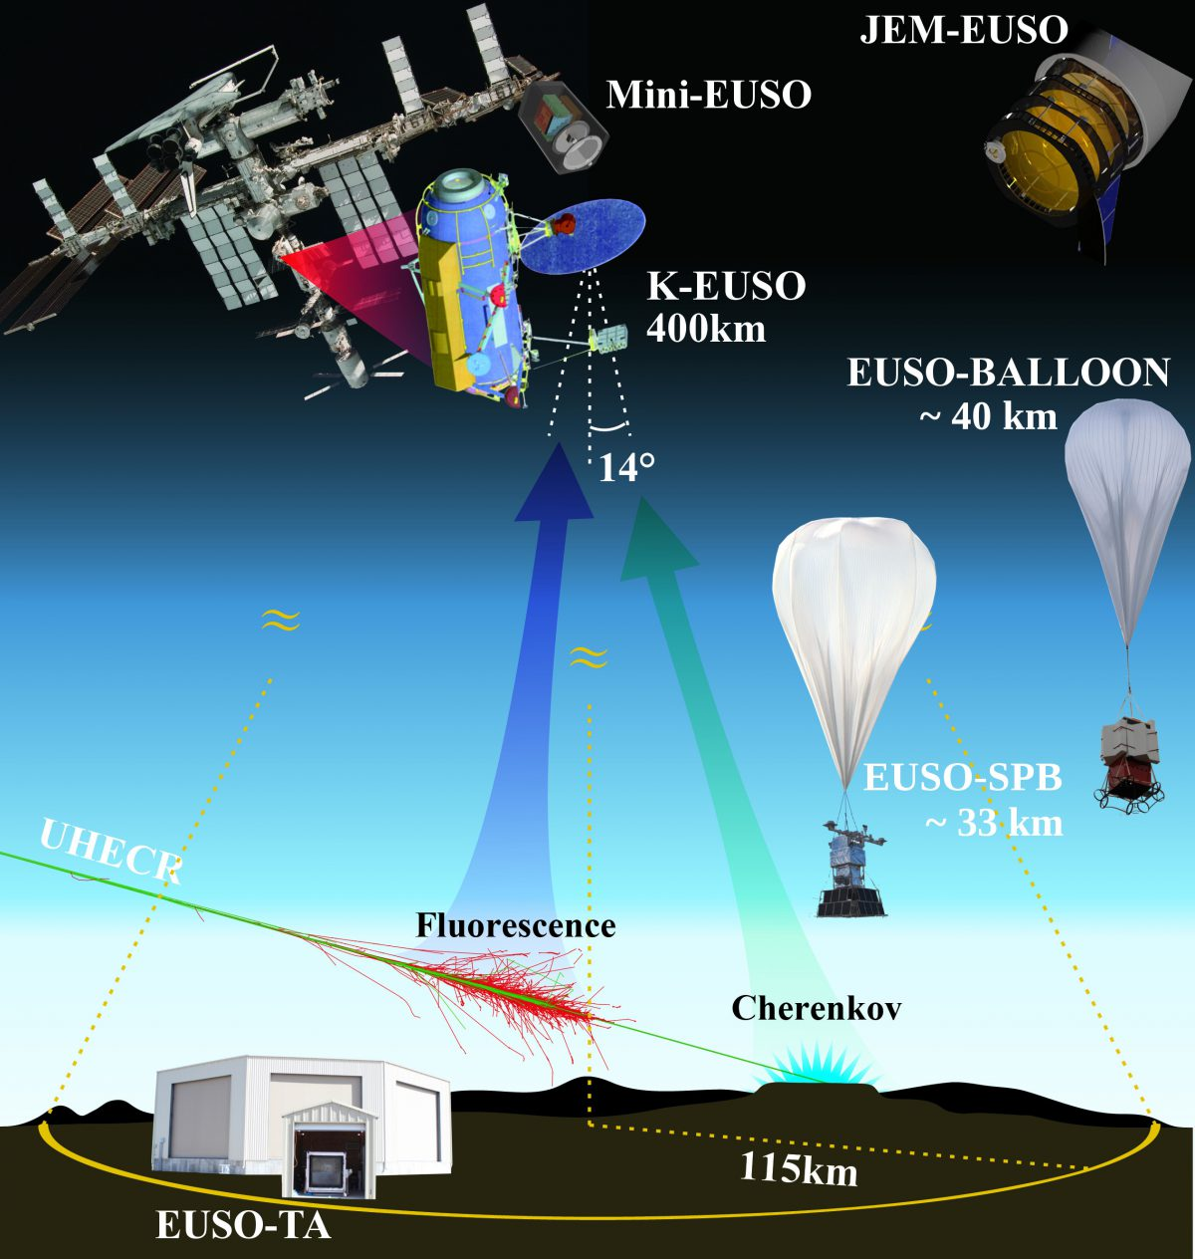
Introduction
JEM EUSO program
Joint Experiment Missions for Extreme Universe Space Observatory
8 different missions
EUSO-TA / 2013
EUSO-Balloon / 2014
TUS / 2016
EUSO-SPB / 2017
Mini-EUSO / 2019
EUSO-SPB2 / 2022
K-EUSO / 2022
POEMMA / in the future
POEMMA
ref : jem-euso.infn.it

Slide 6
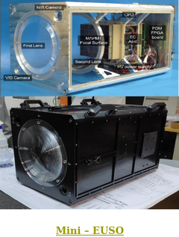
Introduction
JEM EUSO program
Joint Experiment Missions for Extreme Universe Space Observatory
8 different missions
EUSO-TA / 2013
EUSO-Balloon / 2014
TUS / 2016
EUSO-SPB / 2017
Mini-EUSO / 2019
EUSO-SPB2 / 2022
K-EUSO / 2022
POEMMA / in the future
POEMMA
ref : jem-euso.infn.it

Slide 7
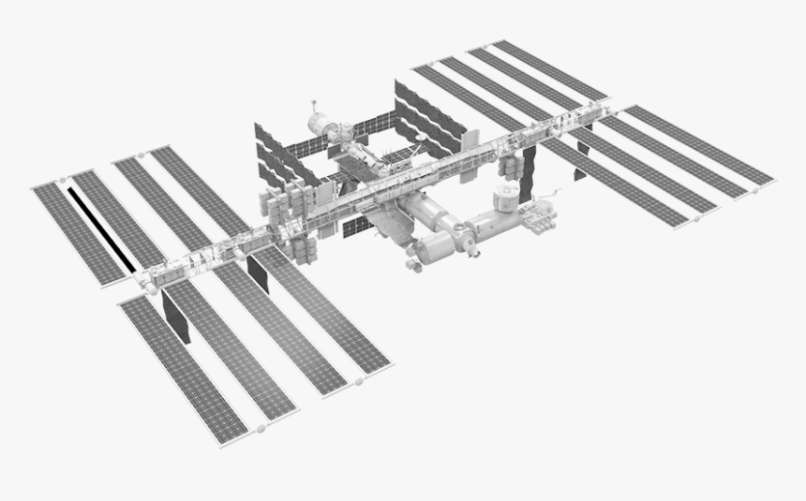
Introduction
The Mini-EUSO telescope
Concept of the telescope
Present on board the ISS
ref : ESA

Slide 8
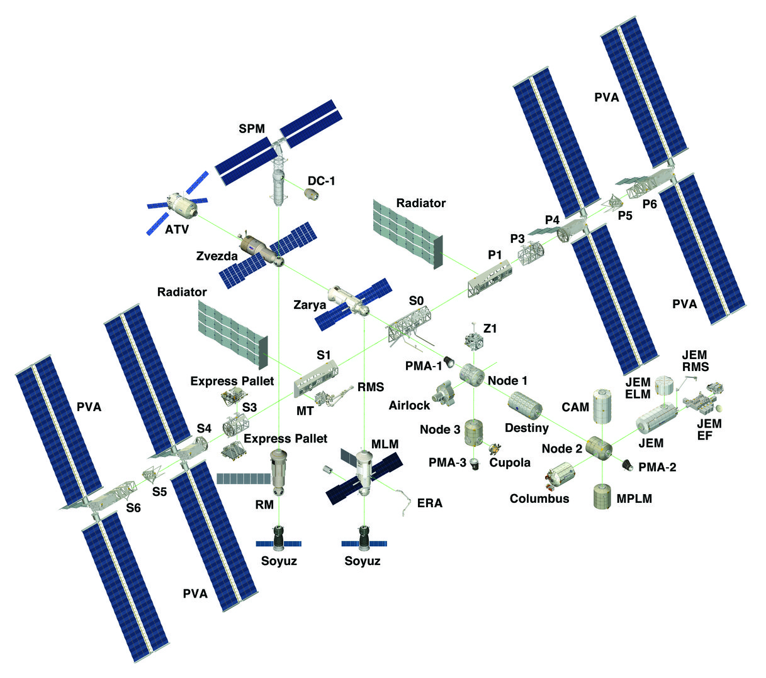
Introduction
The Mini-EUSO telescope
Concept of the telescope
Present on board the ISS
On the russian Zvezda module
ref : ESA

Slide 9
Introduction
The Mini-EUSO telescope
External shape of the telescope
Little box of 37 * 37 * 62 cm³
ref : jem-euso.infn.it

Slide 10
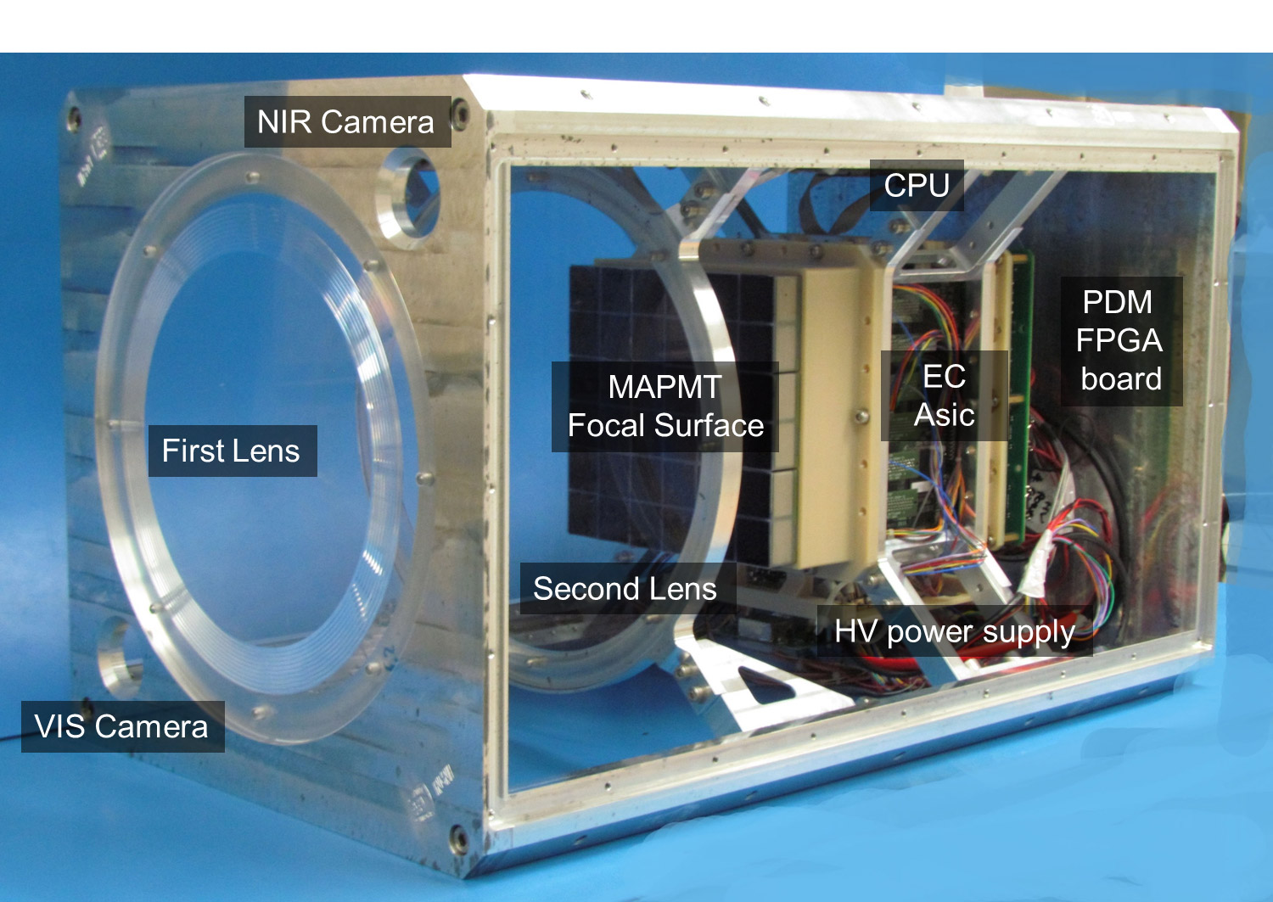
Introduction
The Mini-EUSO telescope
Internal shape of the telescope
Little box of 37 * 37 * 62 cm³
An optical system employing two Fresnel lenses
Mini-EUSO observe the Earth in the UV range (300 - 400 nm)
A large field of view (44°)
ref : jem-euso.infn.it

Slide 11
Introduction
The Mini-EUSO telescope
Internal shape of the telescope
Little box of 37 * 37 * 62 cm³
An optical system employing two Fresnel lenses
Mini-EUSO observe the Earth in the UV range (300 - 400 nm)
A large field of view (44°)
ref : jem-euso.infn.it

Slide 12
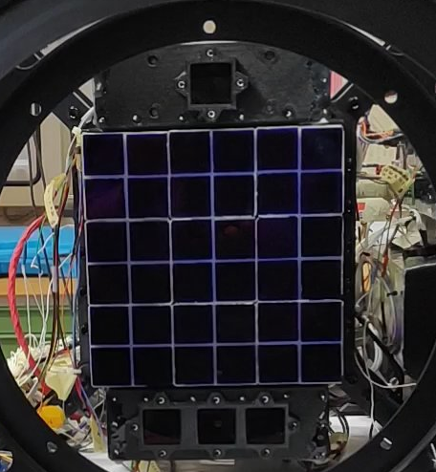
Introduction
How Mini-EUSO works?
Measuring during night time
The light is focused onto an array of 36 multi-anode photomultiplier tubes (MAPMT) among 9 Elementary cells
ref : jem-euso.infn.it
Notes:
9 elementary cells. Trigger is a concept of the futur. A mean to study the data from Mini Euso. Explain 25 is our mean from the trigger point of view. 25 elementary cells virtual in the sense to have to translate this square in one direction

Slide 13
Introduction
How Mini-EUSO works?
Measuring during night time
The light is focused onto an array of 36 multi-anode photomultiplier tubes (MAPMT) among 9 Elementary cells
A total of 2304 pixels
ref : jem-euso.infn.it

Slide 14
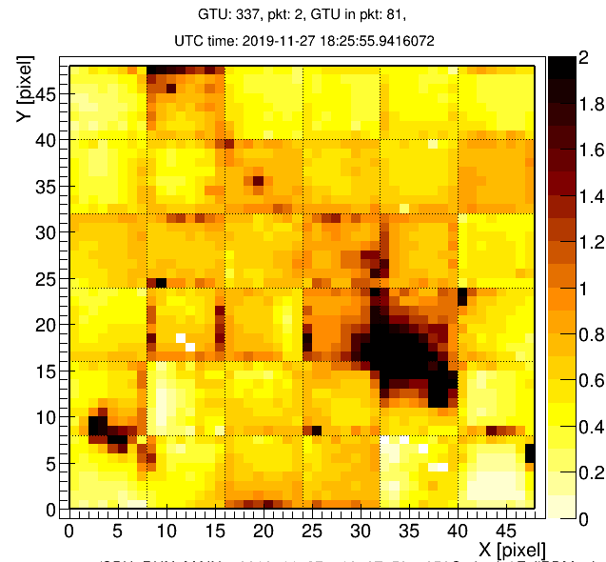
Introduction
How Mini-EUSO works?
Measuring during night time
The light is focused onto an array of 36 multi-anode photomultiplier tubes (MAPMT) among 9 Elementary cells
A total of 2304 pixels
ref : jem-euso.infn.it
Got with the Etos software
A tool to visualize environment
Providing light curves

Slide 15
My project : Meteors detection

Slide 16
My project : Meteors detection
The principle
Mini-EUSO on ISS
The principle
Using Mini-EUSO, a space-borne fluorescence telescope deployed on the ISS, to track :
EECR
Meteors
Space Debris
Meteors detection altitude 100 km
ISS altitude 400 km
Earth

Slide 17
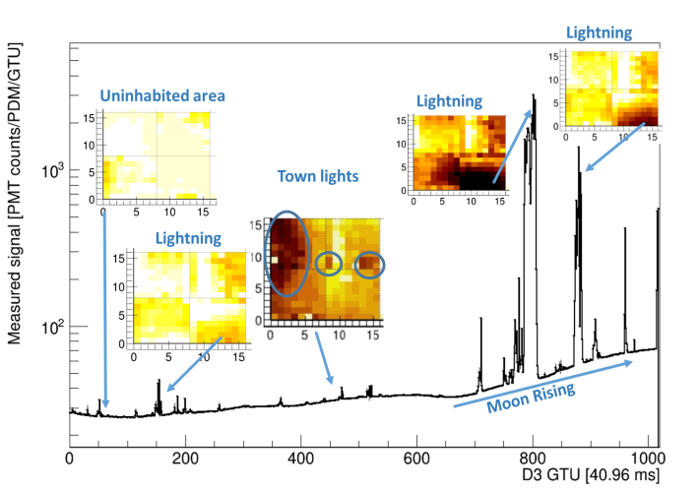
My project : Meteors detection
Meteors detection / Etos tool
Etos : a software tool to analyze data
Light curve of the MAPMT
Notes:
Possible to visualize the environment and to have light curves. I learn how to use it. Expliqué les 3 diff seuils. Standard background level

Slide 18
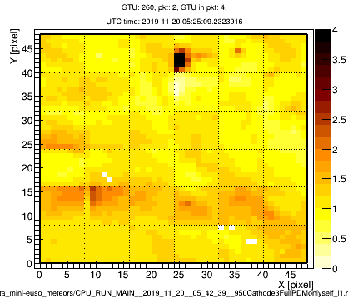
My project : Meteors detection
Meteors detection / Etos tool
Etos : a software tool to analyze data
Light curve of the MAPMT
Different events could be detected
Town
Town
Events example got from different observations
Notes:
Possible to visualize the environment and to have light curves. I learn how to use it. Expliqué les 3 diff seuils. Standard background level

Slide 19
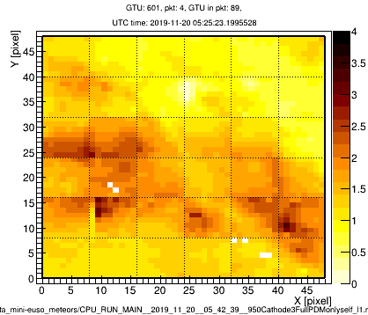
My project : Meteors detection
Meteors detection / Etos tool
Etos : a software tool to analyze data
Light curve of the MAPMT
Different events could be detected
Town
Cloud
Town
Cloud
Events example got from different observations
Notes:
Possible to visualize the environment and to have light curves. I learn how to use it. Expliqué les 3 diff seuils. Standard background level

Slide 20
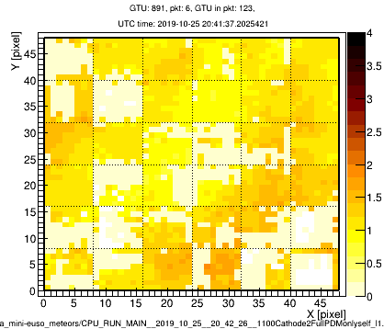
My project : Meteors detection
Meteors detection / Etos tool
Etos : a software tool to analyze data
Light curve of the MAPMT
Different events could be detected
Lightning
Town
Cloud
Town
Cloud
Lightning
Events example got from different observations
Notes:
Possible to visualize the environment and to have light curves. I learn how to use it. Expliqué les 3 diff seuils. Standard background level

Slide 21
My project : Meteors detection
Meteors detection / Etos tool
Etos : a software tool to analyze data
Light curve of the MAPMT
Different events could be detected
Lightning
Town
Cloud
Town
Cloud
Lightning
Events example got from different observations
Moon rising
Notes:
Possible to visualize the environment and to have light curves. I learn how to use it. Expliqué les 3 diff seuils. Standard background level

Slide 22
My project : Meteors detection
Meteors detection / Etos tool
Etos : a software tool to analyze data
Light curve of the MAPMT
Different events could be detected
Particular event

Slide 23
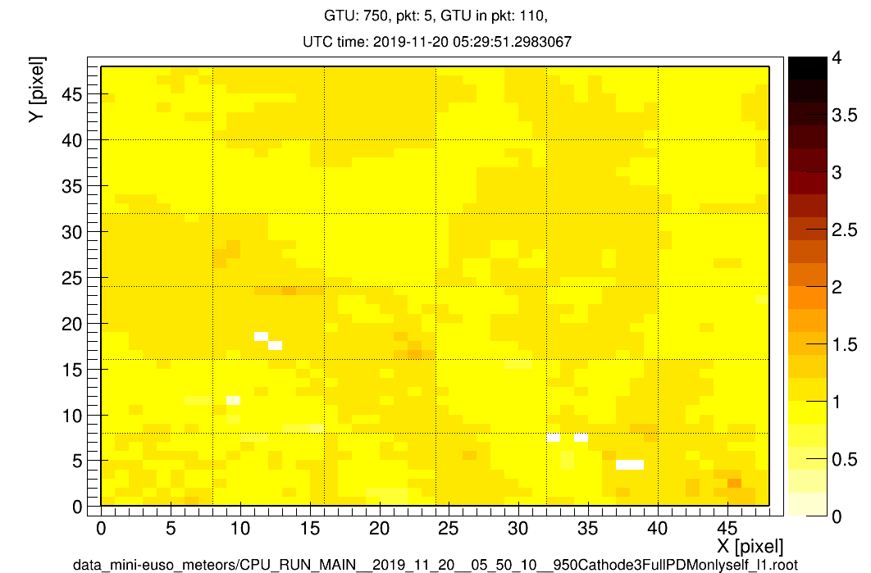
My project : Meteors detection
Meteors detection / Etos tool
Etos : a software tool to analyze data
Light curve of the MAPMT
Different events could be detected
Particular event
Notes:
meteors = point light source. Light curve of this one and show what is the signal related to the meteor. GTU is the time using for cosmic rays.

Slide 24
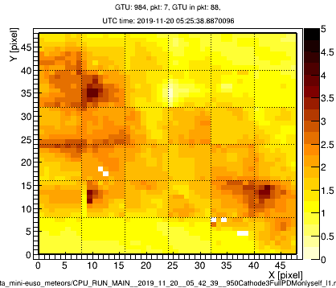
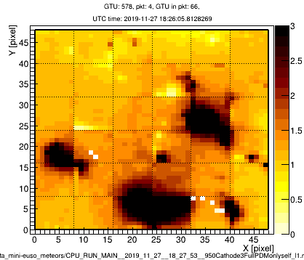
My project : Meteors detection
Meteors detection / Etos tool
Etos : a software tool to analyze data
Light curve of the MAPMT
Different events could be detected => Meteors

Slide 25
My project : Meteors detection
Area covered per pixel
Area calcul
To improve the meteors and space debris speed estimation
The goal : to be able to know what is the area covered by each pixel

Slide 26
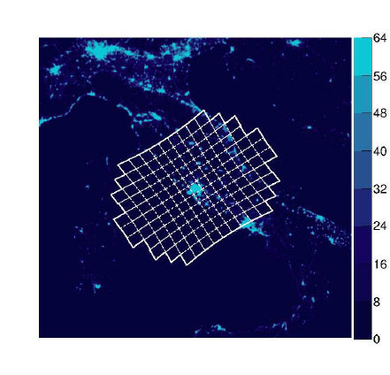
My project : Meteors detection
Area covered per pixel
Area calcul
To improve the meteors and space debris speed estimation
The goal : to be able to know what is the area covered by each pixel
2 different assumptions
The area covered is a plane
The area covered is curved
ref : researchgate.net

Slide 27
My project : Meteors detection
Area covered per pixel
Area calcul
To improve the meteors and space debris speed estimation
The goal : to be able to know what is the area covered by each pixel
2 different assumptions
The area covered is a plane
The area covered is curved
Knowing Mini-EUSO parameters
Altitude
FoV
Pixel size
And the position of the detection plane
Earth
ref : researchgate.net

Slide 28
My project : Meteors detection
Area covered per pixel
Results
Notes:
square kilometers.Changer l’unité de l’échelle.

Slide 29
My project : Meteors detection
Area covered per pixel
Results
elementary cells / MAPMT / pixel

Slide 30
My project : Meteors detection
Area covered per pixel
Results
Meteor projected speed estimation in a nadir position V_{Meteor} = 53.6 km/s

Slide 31
My project : Space Debris (SD) simulations

Slide 32
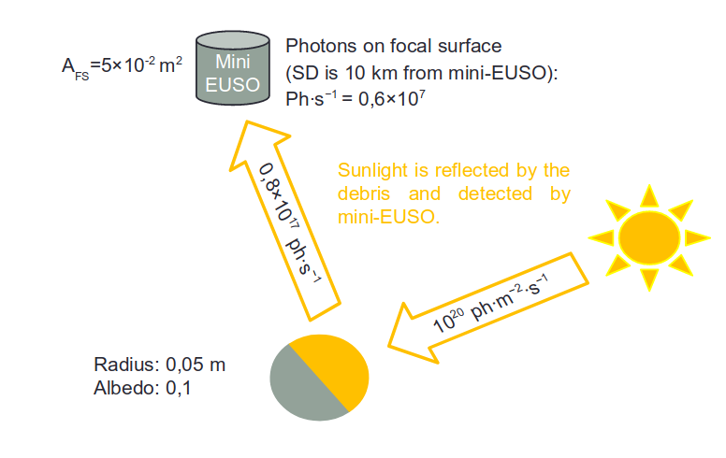
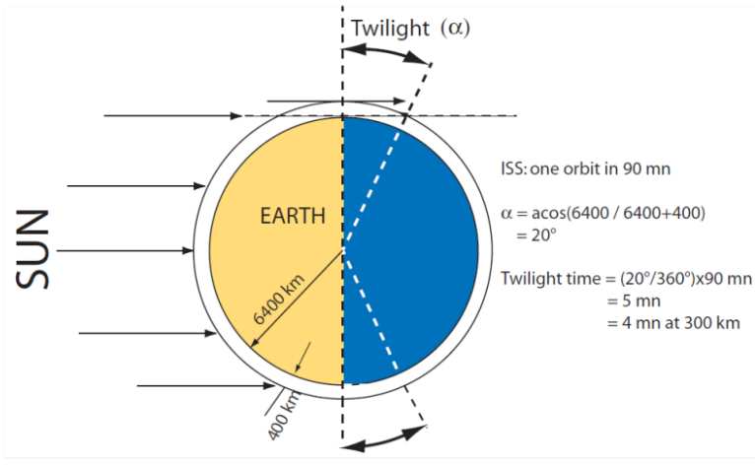
My project : SD simulations
The principle
Is it possible for Mini-EUSO to track SD?
SD don’t emit light but can be illuminated and so detected !
Detection interest
In the twilight zone
SD size between 1-10 cm
Related to a maximum detection distance

Slide 33
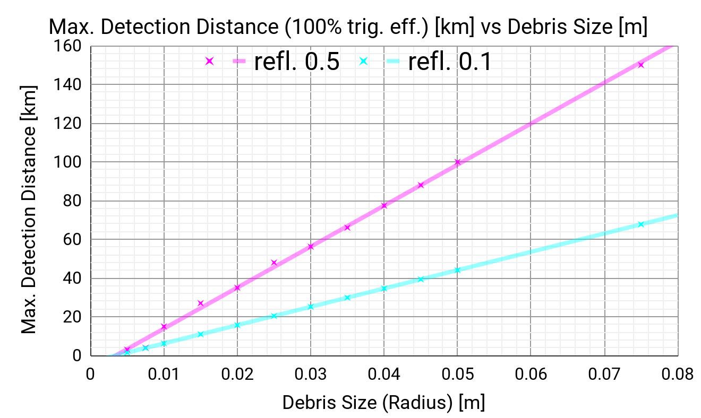
My project : SD simulations
The principle
According to ESAF results yes but under conditions
SD don’t emit light but can be illuminated and so detected !
Detection interest
In the twilight zone
SD size between 1-10 cm
Related to a maximum detection distance
Results from EUSO Simulation and Analysis Framework data (ESAF)

Slide 34
My project : SD simulations
MASTER tool
Are there SD in the Mini-EUSO environment?
MASTER (Meteoroid and Space Debris Terrestrial Environment Reference)
Reference model for the SD and meteoroid environment
SD evolution predictions

Slide 35
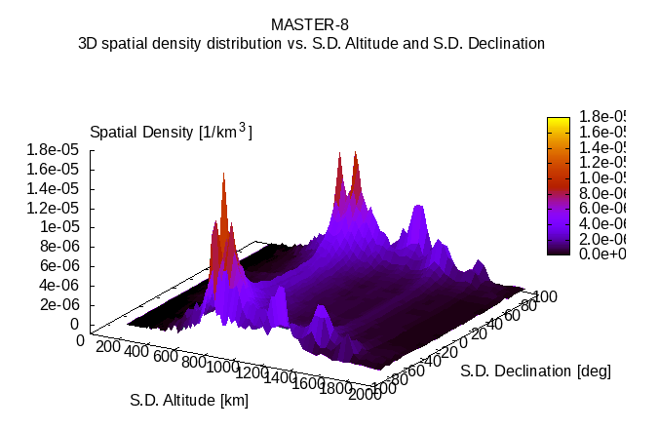
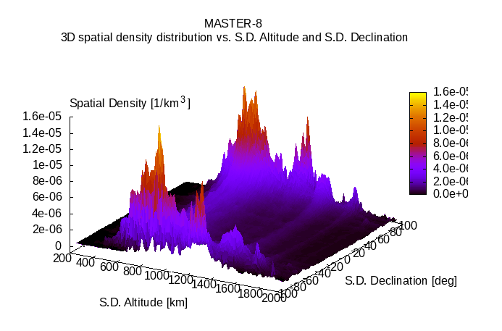
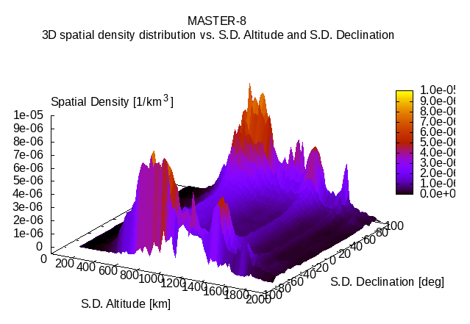
My project : SD simulations
MASTER tool
Grip of the ESA’s tool MASTER
MASTER (Meteoroid and Space Debris Terrestrial Environment Reference)
Reference model for the SD and meteoroid environment
SD evolution predictions
2009
2020
2035
Notes:
Version 2019

Slide 36
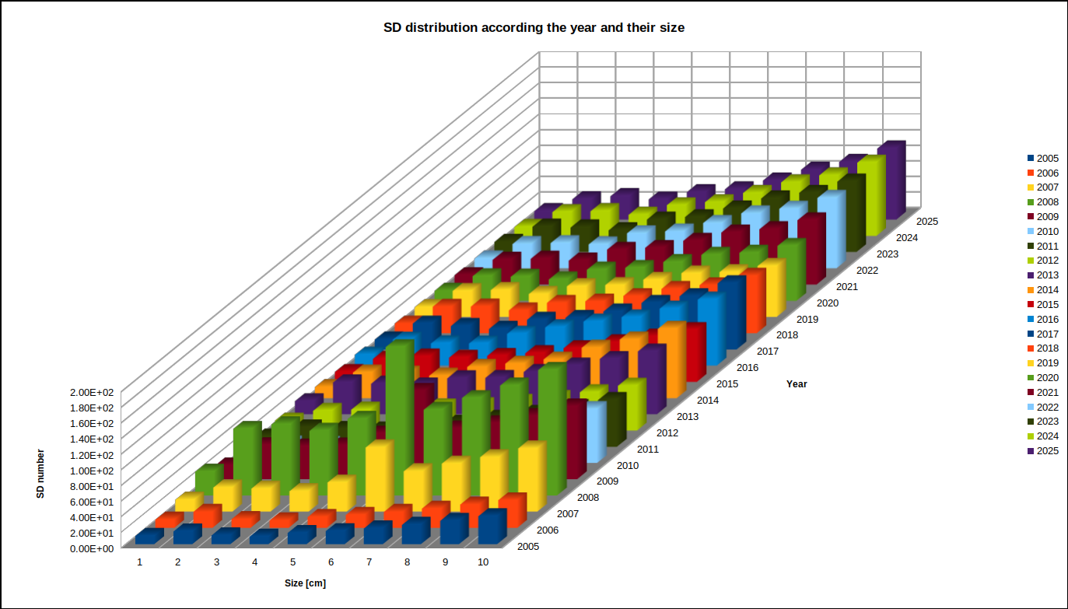
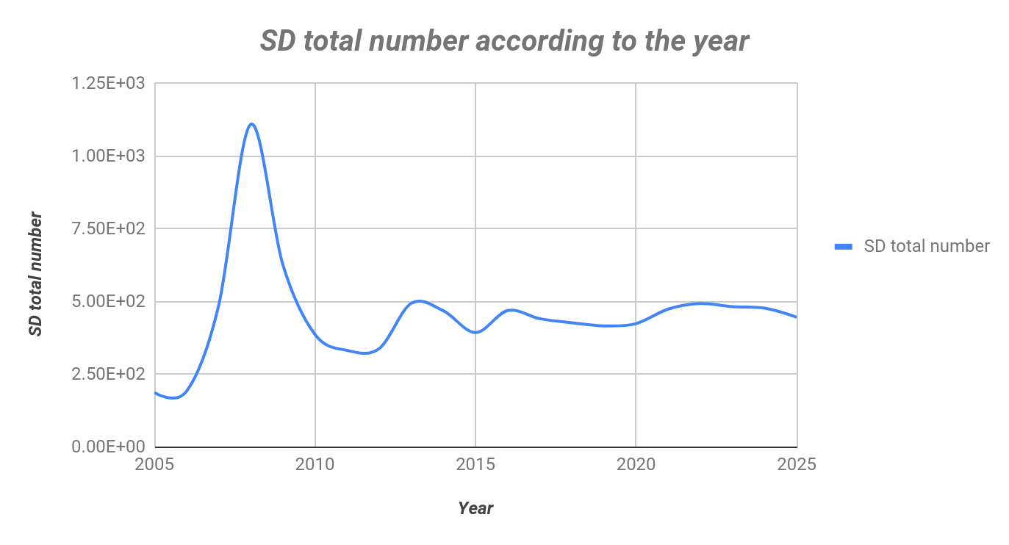
My project : SD simulations
Simulations
SD simulation through a few years and for different size
Simulation taking into account orbital parameters related to the ISS
Generating a SD distribution diagram

Slide 37
My project : SD simulations
Data comparison
Comparison with data got from the MASTER 2009 and MASTER 2019 version (V8)
Previous study did with MASTER 2009
Average spatial density distribution for each sizes ([1 cm-10 cm] ± 1 cm)
at the height 400 km ± maximum detection distance derived by ESAF (EUSO Simulation and Analysis Framework)
at the ISS declination (±51.64°)
Version 8
Notes:
Maybe explain the sensitivity of Mini Euso. SD size related to the distance.

Slide 38
My project : SD simulations
Data comparison
Comparison with data got from the MASTER 2009 and MASTER 2019 version (V8)
Previous study did with MASTER 2009
Average spatial density distribution for each sizes ([1 cm-10 cm] ± 1 cm)
at the height 400 km ± maximum detection distance derived by ESAF (EUSO Simulation and Analysis Framework)
at the ISS declination (±51.64°)
Version 8
2009 Version

Slide 39
My project : SD simulations
Data comparison
Comparison with data got from the MASTER 2009 and MASTER 2019 version (V8)
Previous study did with MASTER 2009
Average spatial density distribution for each sizes ([1 cm-10 cm] ± 1 cm)
at the height 400 km ± maximum detection distance derived by ESAF (EUSO Simulation and Analysis Framework)
at the ISS declination (±51.64°)
Version 8
2009 Version
2019 Version

Slide 40
My project : SD simulations
Data comparison
Comparison with data got from the MASTER 2009 and MASTER 2019 version (V8)
Debris radius [±0.25 cm] | altitude [km] | dist from Mini-EUSO [km] | average nSD MASTER 2009 | nDetect° / day | average nSD MASTER V8 | nDetect° / day
5.0 | 300 | 100 | 1.91E-09 | 1.57E-01 | 3.11E-09 | 2.55E-01
4.5 | 312 | 88 | 5.68E-13 | 3.61E-05 | 3.49E-09 | 2.21E-01
4.0 | 323 | 77 | 6.33E-13 | 3.08E-05 | 4.04E-09 | 1.96E-01
3.5 | 334 | 66 | 7.17E-13 | 2.56E-05 | 4.99E-09 | 1.78E-01
3.0 | 344 | 56 | 3.28E-11 | 8.42E-04 | 1.21E-08 | 3.10E-01
2.5 | 352 | 48 | 5.02E-10 | 9.47E-03 | 8.48E-09 | 1.60E-01
2.0 | 365 | 35 | 8.93E-10 | 8.96E-03 | 1.18E-08 | 1.18E-01
1.5 | 373 | 27 | 1.41E-08 | 8.42E-02 | 1.92E-08 | 1.15E-01
1.0 | 385 | 15 | 1.53E-08 | 2.81E-03 | 6.46E-08 | 1.19E-01
0.5 | 396 | 4 | 3.42E-07 | 4.48E-02 | 3.66E-07 | 4.80E-02
Total | - | - | - | 3.08E-01 | - | 1.72E00

Slide 41
My project : SD simulations
Data comparison
Comparison with data got from the MASTER 2009 and MASTER 2019 version (V8)
Debris radius [±0.25 cm] | altitude [km] | dist from Mini-EUSO [km] | average nSD MASTER 2009 | nDetect° / day | average nSD MASTER V8 | nDetect° / day
5.0 | 300 | 100 | 1.91E-09 | 1.57E-01 | 3.11E-09 | 2.55E-01
4.5 | 312 | 88 | 5.68E-13 | 3.61E-05 | 3.49E-09 | 2.21E-01
4.0 | 323 | 77 | 6.33E-13 | 3.08E-05 | 4.04E-09 | 1.96E-01
3.5 | 334 | 66 | 7.17E-13 | 2.56E-05 | 4.99E-09 | 1.78E-01
3.0 | 344 | 56 | 3.28E-11 | 8.42E-04 | 1.21E-08 | 3.10E-01
2.5 | 352 | 48 | 5.02E-10 | 9.47E-03 | 8.48E-09 | 1.60E-01
2.0 | 365 | 35 | 8.93E-10 | 8.96E-03 | 1.18E-08 | 1.18E-01
1.5 | 373 | 27 | 1.41E-08 | 8.42E-02 | 1.92E-08 | 1.15E-01
1.0 | 385 | 15 | 1.53E-08 | 2.81E-03 | 6.46E-08 | 1.19E-01
0.5 | 396 | 4 | 3.42E-07 | 4.48E-02 | 3.66E-07 | 4.80E-02
Total | - | - | - | 3.08E-01 | - | 1.72E00

Slide 42
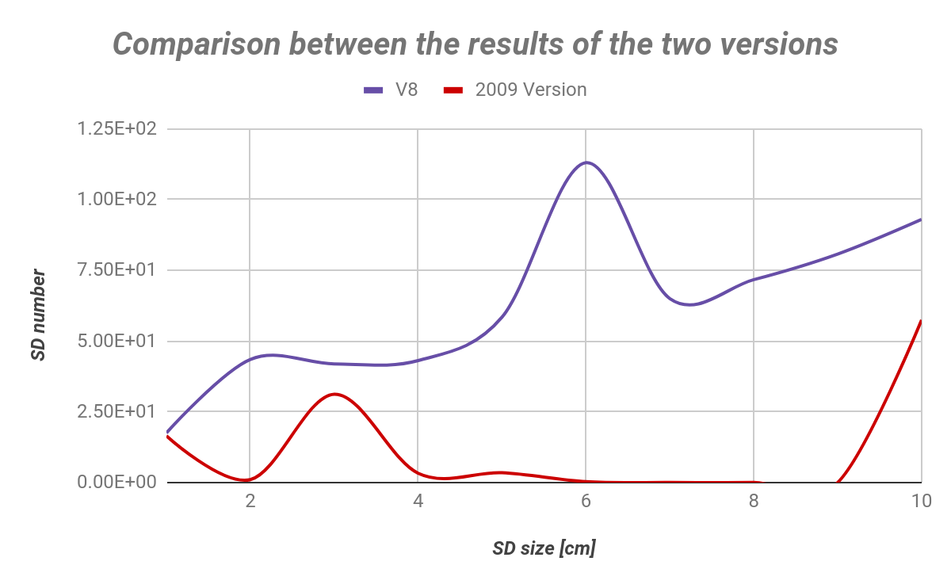
My project : SD simulations
Data comparison
Comparison with data got from the MASTER 2009 and MASTER 2019 version (V8)

Slide 43
My project : SD simulations
Data comparison
Comparison with data got from the MASTER 2009 and MASTER 2019 version (V8)

Slide 44
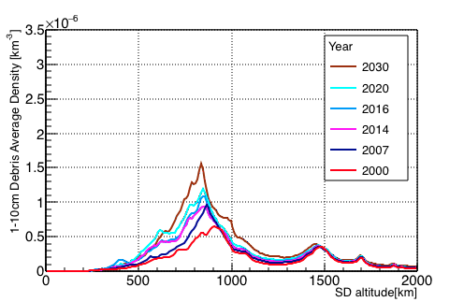
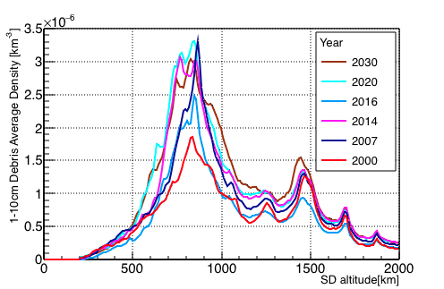
My project : SD simulations
Data comparison
Comparison with data got from the MASTER 2009 and MASTER 2019 version (V8)
SD distribution with 2009 MASTER version
SD distribution with MASTER V8 version
Ref : Space Debris detection and track prediction by MiniEUSO-like telescope

Slide 45
My project : SD simulations
Data comparison
Comparison with data got from the MASTER 2009 and MASTER 2019 version (V8)
SD distribution with 2009 MASTER version
SD distribution with MASTER V8 version
Ref : Space Debris detection and track prediction by MiniEUSO-like telescope

Slide 46
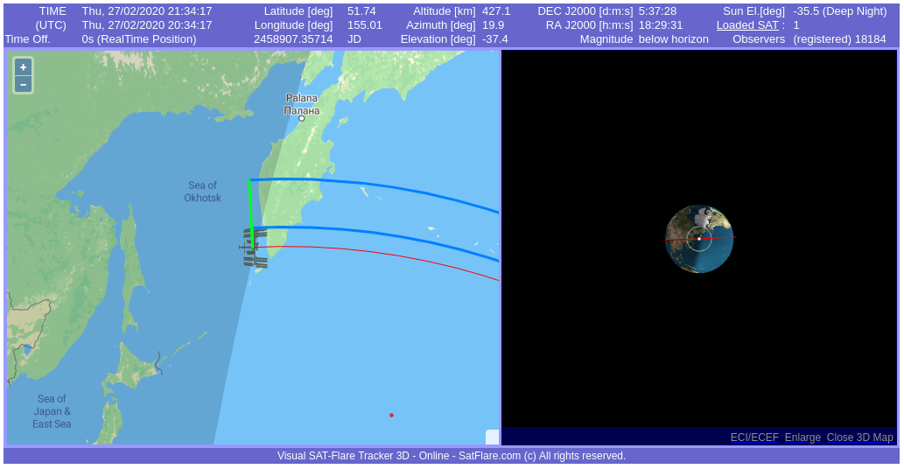
My project : SD simulations
Is Mini-EUSO detected SD through observations?
1st approach : Developing a method to know the position of the ISS
Knowing the date and the time when Mini-EUSO took data
Knowing the actual position of the ISS
Knowing the Sunset and Sunrise moment
Possibility to calculate where was the ISS
Estimating number of time passing through the Twilight zone
 | 1st session | 2nd session | 3rd session | 1st session | 2nd session | 3rd session
 | Data duration [s] |  |  | Number of time passing through the Twilight zone
07/10/2019 | 748 | - | - | 1 | - | -
19/10/2019 | 655 | 639 | - | 0 | 1 | -
25/10/2019 | 1002 | 6789 | 25200 | 0 | 2 | 9
06/11/2019 | 1310 | 1355 | - | 0 | 0 | -
19/11/2019 | 1315 | 1180 | - | 0 | 0 | -
27/11/2019 | 1331 | 1258 | - | 1 | 0 | -
05/12/2019 | 1189 | 1290 | - | 0 | 1 | -
30/12/2019 | 1316 | 5198 | - | 1 | 2 | -
08/01/2020 | 1320 | 4815 | - | 0 | 2 | -
14/01/2020 | 53 | - | - | 1 | - | -
21/02/2020 | 39,638 | - | - | 14 | - | -

Slide 47
My project : SD simulations
Is Mini-EUSO detected SD ?
1st approach : Developing a method to know the position of the ISS
Knowing the date and the time when Mini-EUSO took data
Knowing the actual position of the ISS
Knowing the Sunset and Sunrise moment
Possibility to calculate where was the ISS
Estimating number of time passing through the Twilight zone
Need to fix some parameters
ISS altitude
ISS Orbital period
In consequence, results could not be enough accurate
How to know if these results were reliable ?

Slide 48
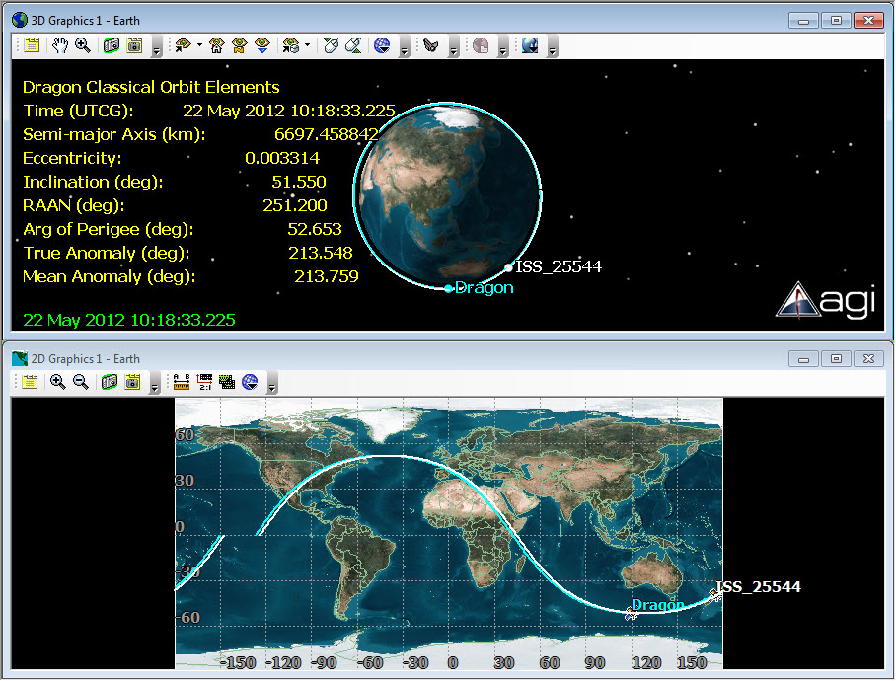
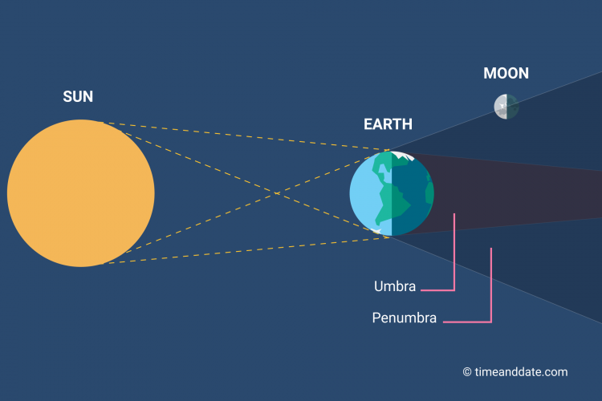
My project : SD simulations
Is Mini-EUSO detected SD ?
2nd approach : Using System Tool Kit (STK) software
A mean to plot the ISS orbit according to its “Two Lines Elements” (TLE)
ISS position in function of the UTC time
Night/Light delimitation
Penumbra/Umbra position
ref : AGI

Slide 49
My project : SD simulations
Is Mini-EUSO detected SD ?
2nd approach : Using System Tool Kit (STK) software
A mean to plot the ISS orbit according to its “Two Lines Elements” (TLE)
ISS position in function of the UTC time
Night/Light delimitation
Penumbra/Umbra position
Results comparison :
Globally my method follows the same
tendency than STK
However there’s a uncertainty of +/- 1
which is directly related to the
fact that I need to fix some parameters
 | 1st session | 2nd session | 3rd session | 1st session | 2nd session | 3rd session
 | Number of time passing through the Twilight zone with my method |  |  | Number of time passing through the Twilight zone with STK
07/10/2019 | 0 | - | - | 0 | - | -
19/10/2019 | 0 | 1 | - | 0 | 1 | -
25/10/2019 | 0 | 3 | 9 | 0 | 2 | 8
06/11/2019 | 1 | 1 | - | 0 | 0 | -
19/11/2019 | 1 | 0 | - | 0 | 0 | -
27/11/2019 | 1 | 1 | - | 0 | 1 | -
05/12/2019 | 0 | 1 | - | 0 | 0 | -
30/12/2019 | 1 | 2 | - | 0 | 1 | -
08/01/2020 | 0 | 1 | - | 0 | 2 | -
14/01/2020 | 0 | - | - | 0 | - | -
21/02/2020 | 15 | - | - | 14 | - | -
ref : AGI

Slide 50
My project : SD simulations
Is Mini-EUSO detected SD ?
2nd approach : Using System Tool Kit (STK) software
A mean to plot the ISS orbit according to its “Two Lines Elements” (TLE)
Access to the ISS position in function of the UTC time
Access to the Night/Light delimitation
Access to the Penumbra/Umbra position
Results comparison :
 | 1st session | 2nd session | 3rd session | 1st session | 2nd session | 3rd session
 | Number of time passing through the Twilight zone with my method |  |  | Number of time passing through the Twilight zone with STK
07/10/2019 | 0 | - | - | 0 | - | -
19/10/2019 | 0 | 1 | - | 0 | 1 | -
25/10/2019 | 0 | 3 | 9 | 0 | 2 | 8
06/11/2019 | 1 | 1 | - | 0 | 0 | -
19/11/2019 | 1 | 0 | - | 0 | 0 | -
27/11/2019 | 1 | 1 | - | 0 | 1 | -
05/12/2019 | 0 | 1 | - | 0 | 0 | -
30/12/2019 | 1 | 2 | - | 0 | 1 | -
08/01/2020 | 0 | 1 | - | 0 | 2 | -
14/01/2020 | 0 | - | - | 0 | - | -
21/02/2020 | 15 | - | - | 14 | - | -
ref : AGI
! Mini-EUSO takes data in a commisionnaly phase !

Slide 51
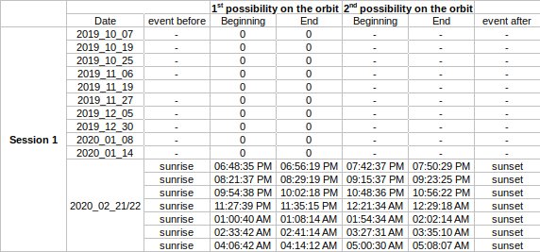
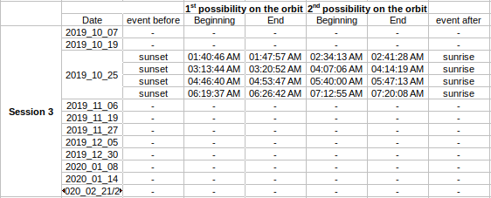
My project : SD simulations
Is Mini-EUSO detected SD ?
Final results
Cross checking with Etos it appeared that Mini-EUSO was never in a Twilight zone for the different possible periods presented below
ref : AGI

Slide 52
Conclusion

Slide 53
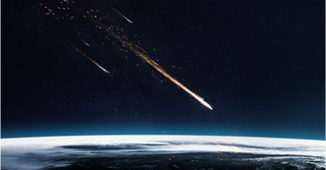
Summary & Conclusion
Etos tool
Tracking meteors and extracting informations to analyze them
Providing a tool to estimate the meteor speed
SD simulation
Updating the simulation using MASTER
New estimation of the expected number of SD detection by Mini-EUSO
Data analysis
Providing a method to estimate the number of time passing through the Twilight zone
Unlucky no available data to validate the possibility to observe SD with Mini-EUSO
Nevertheless, always possible in the future observations
ref : interestingengineering.com
Notes:
Mini Euso is operating only sporadicaly time. Mini Euso operates during the transition ?

Slide 54
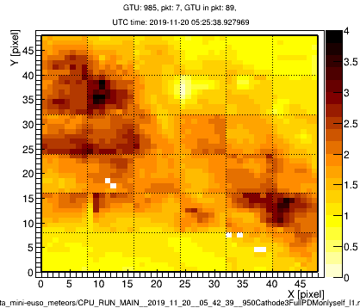
Mini-EUSO , a JEM-EUSO program
Thank you for your attention
Marco Nari
Mauca 2019/2020
Supervisors : Mario Bertaina & Hiroko Miyamoto

Slide 55
Annex

Slide 56
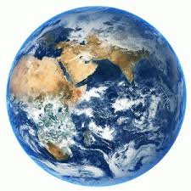
Considering a surface plane
B
𝜽₁
A
R₂
44°
Using right angled triangle
A = R₂.tan(𝜽₁/2) distance on the plane according to the angle
B = R₂/cos(𝜽₁/2) distance max from MinEuso to the plane surface

Slide 57
Considering a curved plane
B
𝜽₂
𝜽₁
R₂
R₁
Using right angled triangle
B = A.tan(𝜽₁)
𝜽₂ = 180-90-𝜽₁

Slide 58
Considering a curved plane
B
C
𝜽₃
44°
Using right angled triangle
𝜽₃= 180 - 90 - 𝜽₂
C = B.cos(𝜽₃)

Slide 59
Considering a curved plane
𝜽₄
C
44°
Using right angled triangle
𝜽₃= 180 - 90 - 𝜽₂
C = B.cos(𝜽₃)
𝜽₄= cos⁻¹(C/R₁)

Slide 60
Considering a curved plane
𝜽₅
44°
Using right angled triangle
𝜽₅= 180 - 𝜽₃ - 𝜽₄

Slide 61
Considering a curved plane
Area / Pixel
44°
𝜽₅
Knowing the 𝜽₅ angle
P_{Earth}= 2.𝝿.R₁= 40,030 km
=> 40,030/360 = 111.19 km/angle
=> 111.19 * 𝜽₅ = km covered by the angle related to the number of pixel
To get the km / pixel we subtract the 2 consecutive angle value (so for 2 consecutive pixels)
To get the km² / pixel we multiply the 2 value got according to the corresponding angle on the X axis and Y axis

Slide 62
Considering a curved plane
Area / Pixel
44°
𝜽₅
Same approach
R_{Shere}= R_{Earth} + 100 = 6,471 km
=> 40,658/360 = 112.94 km/angle
=> 112.94 * 𝜽₅ = km covered by the angle related to the number of pixel
To get the km / pixel we subtract the 2 consecutive angle value (so for 2 consecutive pixels)
To get the km² / pixel we multiply the 2 value got according to the corresponding angle on the X axis and Y axis

Slide 63
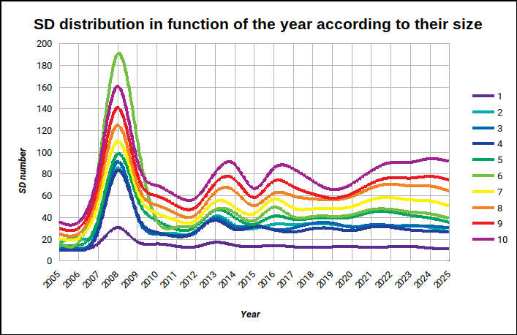
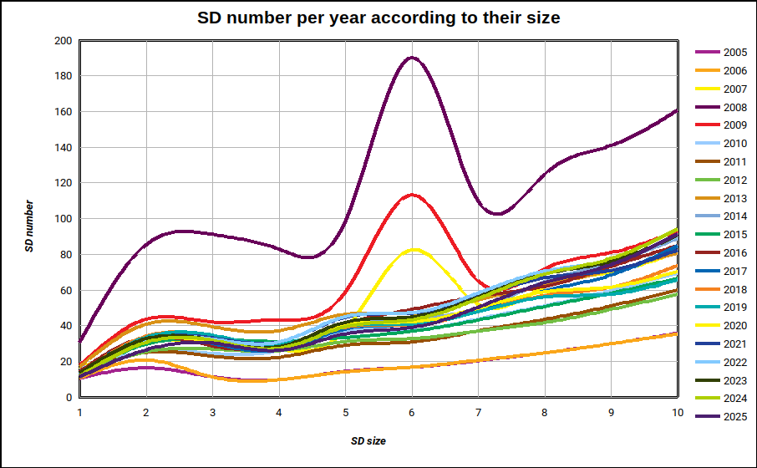
My project : SD simulations
Simulations
SD simulation through a few years and for different size
Simulation taking into account orbital parameters related to the ISS
Altitude 400 km
Inclination 51.64°
SD size from 1cm to 10 cm
Years studied from 2005 to 2025
Notes:
Space debris, smaller than 10 cm, can be sufficiently decelerated by laser impulses resulting in its re-entry to the Earth's atmosphere

Slide 64
My project : SD simulations
Simulations
SD simulation through a few years and for different size
Simulation taking into account orbital parameters related to the ISS
A peak linked to an event generating SD in large number
2007 : Russian Briz-M booster stage exploded. Before explosion :
Elliptical orbit : perigee at 165 miles (265 km), and apogee at 3,100 miles (5,000 km)
An inclination of 49.9 degrees

Slide 65
My project : SD simulations
Simulations
SD simulation through a few years and for different size
Simulation taking into account orbital parameters related to the ISS
A peak linked to an event generating SD in large number
2007 : Russian Briz-M booster stage exploded. Before explosion :
Elliptical orbit : perigee at 165 miles (265 km), and apogee at 3,100 miles (5,000 km)
An inclination of 49.9 degrees

Slide 66
My project : SD simulations
Data comparison
Comparison with data got from the MASTER 2009 and V8 version
Debris radius [±0.25 cm] | average nSD MASTER 2009 | nDetect° / day | average nSD MASTER V8 | nDetect° / day | nDetect° / year difference
5.0 | 1.91E-09 | 1.57E-01 | 3.11E-09 | 2.55E-01 | 3.56E+01
4.5 | 5.68E-13 | 3.61E-05 | 3.49E-09 | 2.21E-01 | 8.07E+01
4.0 | 6.33E-13 | 3.08E-05 | 4.04E-09 | 1.96E-01 | 7.17E+01
3.5 | 7.17E-13 | 2.56E-05 | 4.99E-09 | 1.78E-01 | 6.50E+01
3.0 | 3.28E-11 | 8.42E-04 | 1.21E-08 | 3.10E-01 | 1.13E+02
2.5 | 5.02E-10 | 9.47E-03 | 8.48E-09 | 1.60E-01 | 5.50E+01
2.0 | 8.93E-10 | 8.96E-03 | 1.18E-08 | 1.18E-01 | 3.98E+01
1.5 | 1.41E-08 | 8.42E-02 | 1.92E-08 | 1.15E-01 | 1.07E+01
1.0 | 1.53E-08 | 2.81E-03 | 6.46E-08 | 1.19E-01 | 4.25E+01
0.5 | 3.42E-07 | 4.48E-02 | 3.66E-07 | 4.80E-02 | 1.03E-00
Total | - | 3.08E-01 | - | 1.72E00 | 5.15E+02

Slide 67
My project : SD simulations
Data comparison
Comparison with data got from the MASTER 2009 and V8 version
Debris radius [±0.25 cm] | average nSD MASTER 2009 | nDetect° / day | average nSD MASTER V8 | nDetect° / day | nDetect° / year difference
5.0 | 1.91E-09 | 1.57E-01 | 3.11E-09 | 2.55E-01 | 3.56E+01
4.5 | 5.68E-13 | 3.61E-05 | 3.49E-09 | 2.21E-01 | 8.07E+01
4.0 | 6.33E-13 | 3.08E-05 | 4.04E-09 | 1.96E-01 | 7.17E+01
3.5 | 7.17E-13 | 2.56E-05 | 4.99E-09 | 1.78E-01 | 6.50E+01
3.0 | 3.28E-11 | 8.42E-04 | 1.21E-08 | 3.10E-01 | 1.13E+02
2.5 | 5.02E-10 | 9.47E-03 | 8.48E-09 | 1.60E-01 | 5.50E+01
2.0 | 8.93E-10 | 8.96E-03 | 1.18E-08 | 1.18E-01 | 3.98E+01
1.5 | 1.41E-08 | 8.42E-02 | 1.92E-08 | 1.15E-01 | 1.07E+01
1.0 | 1.53E-08 | 2.81E-03 | 6.46E-08 | 1.19E-01 | 4.25E+01
0.5 | 3.42E-07 | 4.48E-02 | 3.66E-07 | 4.80E-02 | 1.03E-00
Total | - | 3.08E-01 | - | 1.72E00 | 5.15E+02

Slide 68
The Twilight zone
The method followed
To set the context
I Estimated this for all the different data duration per date and per session
Defining :
1st session
2nd session
3rd session
07/10/2019 | 19/10/2019 | 25/10/2019 | 06/11/2019 | 19/11/2019 | 27/11/2019 | 05/12/2019 | 30/12/2019 | 08/01/2020 | 14/01/2020 | 21/02/2020
06:47:31 PM | 07:03:23 PM | 08:41:00 PM | 07:02:02 PM | 06:21:46 PM | 06:25:43 PM | 06:23:45 PM | 06:08:26 PM | 06:56:53 PM | 05:27:52 PM | 06:28:51 PM
06:59:59 PM | 07:14:18 PM | 08:57:41 PM | 07:23:51 PM | 06:43:41 PM | 06:47:53 PM | 06:43:33 PM | 06:30:22 PM | 07:18:53 PM | 05:28:45 PM | 05:28:29 AM
- | 07:33:23 AM | 10:05:38 PM | 05:46:49 AM | 05:16:15 AM | 05:23:37 AM | 05:15:16 AM | 03:50:04 AM | 04:36:40 AM | - | -
- | 07:44:02 AM | 11:58:47 PM | 06:08:24 AM | 05:35:55 AM | 05:44:35 AM | 05:36:46 AM | 05:16:42 AM | 05:56:55 AM | - | -
- | - | 01:11:07 AM | - | - | - | - | - | - | - | -
- | - | 07:35:43 AM | - | - | - | - | - | - | - | -

Slide 69
The Twilight zone
The method followed
To set the context
Knowing the duration time separating each events and the orbital period of the ISS, I calculated the number of orbit to join the data acquisition point.
Then, I was able to determine where was the ISS in function of the night and day duration
At an instant t
-𝚫t
2 twilight periods
At an instant t-𝚫t
1 light period duration
1 night period duration
1 orbital period duration

