Slide 1
Candidato: Isabella Arcieri
Relatore: Mario Edoardo Bertaina
Co-relatore: Dario Barghini
A.A 2022-2023
FIRST ESTIMATION OF THE FLUX OF INTERSTELLAR METEORS WITH
MINI-EUSO SPACE EXPERIMENT

Slide 2
$$Summery$$
$Meteoroids$
$Interstellar meteoroids?$
$First interstellar objects$
$Local Interstellar Cloud$
$Effect of measurement errors on the resulting orbit$
$JEM$-$EUSO and Mini$-$EUSO$
$Interstellar meteors candidates$
$Estimation of mass and flux$
$Conclusions$

Slide 3
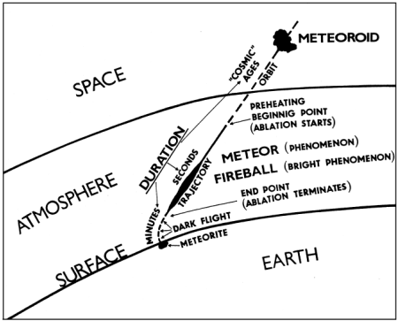
$$Meteroids$$
Meteor is a phenomena caused by transit of some objects into a planetary atmosphere.
Meteoroids are rocky and/or metallic bodies that orbit around the Sun with a diameter range of ∼30 µm to ∼1 m.
$$Phenomelogy of a meteoroid:$$
Impact speed in the range of 11 and 72 km/s
Preheating and ablation
Ionization and evaporation at T$\sim 2500K$
Emission of light
Impact speed on the ground between 10-100 m/s

Slide 4
$$How to distinguish an intestellar meteroid ?$$
Solar System origin
Measured parameters of a meteoroid (position and speed) are used to determine its origin
Interstellar origin
The hyperbolic excess of meteoroid’s heliocentric velocity $v_{H}$ above the escape velocity ($\sim 42km/s$) indicates a possible interstellar origin:
$$v_{H}=\sqrt{v_{a}^{2}+v_{p}^{2}}$$
$$v_{a}=arrival speed of meteoroid\sim 25km/s$$
$v_{p}=$ $escape velocity from the Sun near Earth\sim 42km/s$

Slide 5
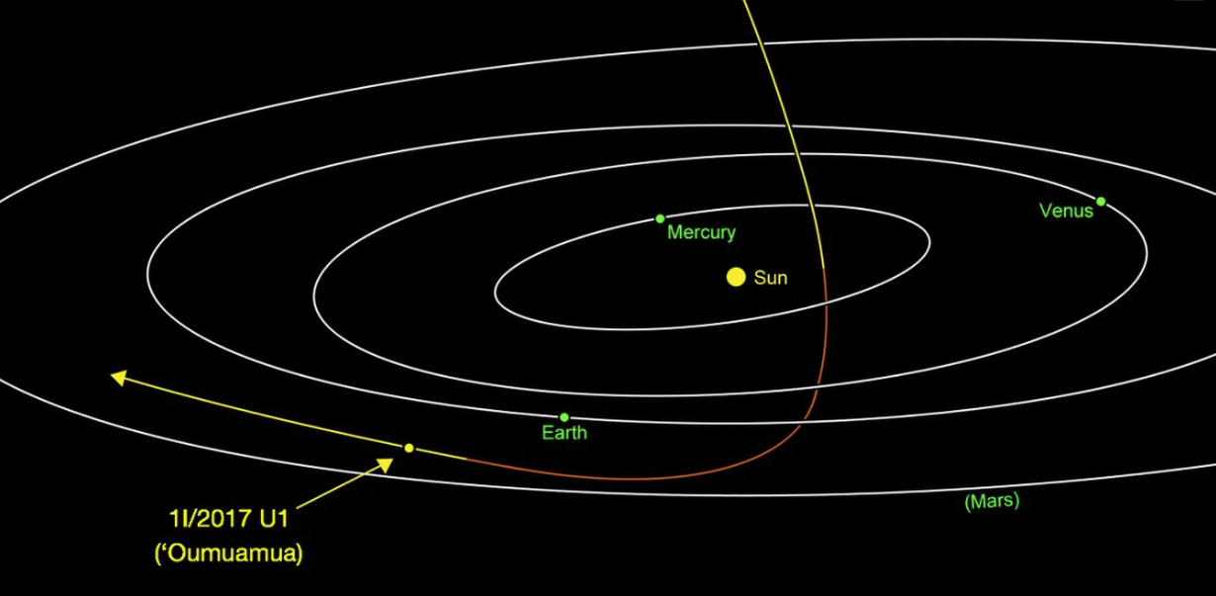
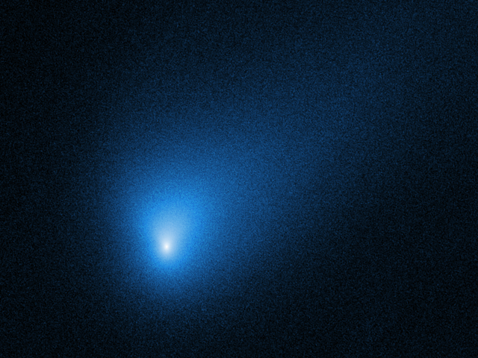
$$Interstellar objects$$
ʻ1I/Oumuamua’ is the first interstellar object detected passing through the Solar System. It was discovered by Robert Weryk using the Pan-STARRS telescope at Haleakala Observatory, Hawaii, on 19 October 2017.
‘2I/Borisov’ is the second observed interstellar object after ʻOumuamua. It was discovered by the Crimean amateur astronomer and telescope maker Gennadiy Borisov on 30 August 2019.
100 m < d < 1 km
1.4 km < d < 16 km

Slide 6
ISD
$$<10μm$$
Micrometeroids
10µm-2mm wide
Meteoroids
2mm-1m wide
?
?
?
ʻ1I/Oumuamua’
“Visualisation: ETH Zürich/D-PHYS, Veerle Sterken, Mia Hajdukova, Sara Hartmann”

Slide 7
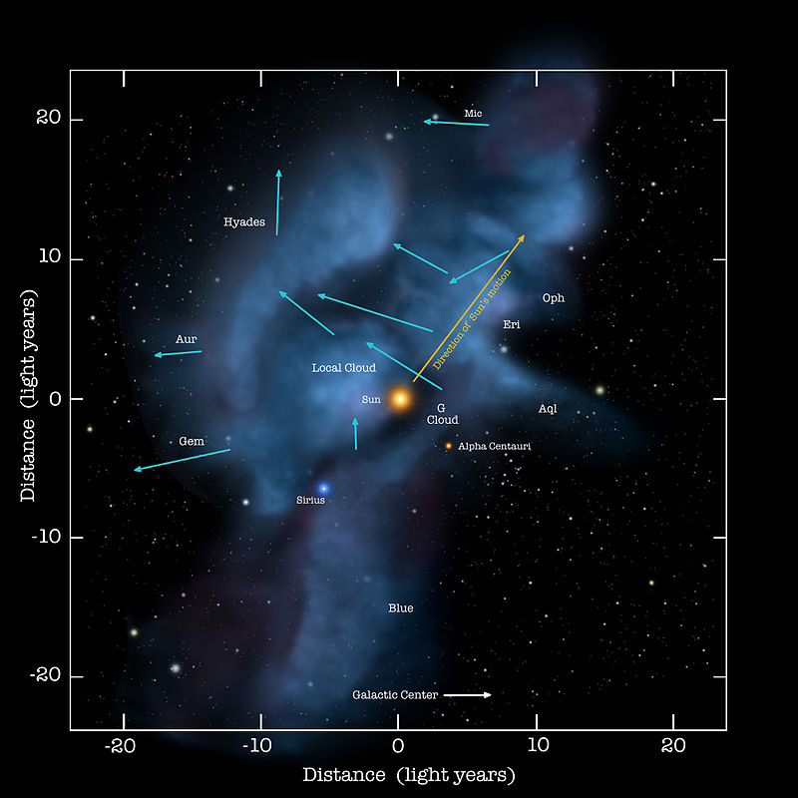
$$Local Interstellar Cloud$$
One confirmed source of the smaller interstellar particles, ISD, is the Local Interstellar Cloud through which the Sun travels at a relative speed of ∼26 km/s.
gas of H and He and a small amount of dust up to about 1 % by mass
warm, dense, partially ionized cloud
embedded in a low density region of space called the Local Bubble that was likely excavated by a few supernovae

Slide 8
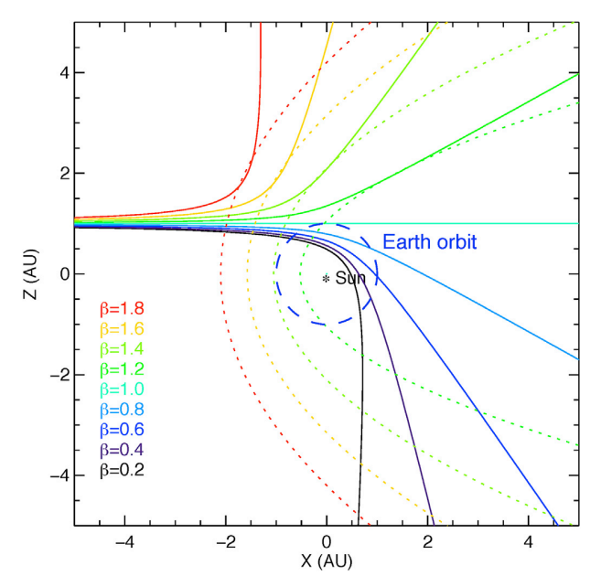
$Dynamics of Extra$-$Solar System Particles$
The dust particles from the LIC experience the solar gravity, solar radiation pressure and the Lorentz force. The strength of these forces is given by $β$ parameter and by the particle’s charge-to-mass ratio $Q/M$.
$$β=\frac{F_{SRP}}{F_{grav}}$$
$β>1 particles cannot reach the close vicinity of the Sun$
$β<1$ $particles are pulled in the direction of the Sun by$
$gravity (>1μ\text{m}\text{)}$

Slide 9
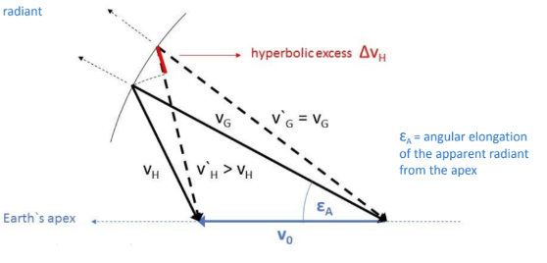
$$Effect of measurement errors on the resulting Orbit$$
The semi-major axis $a$ which defines the type of orbit strongly depends on module of the heliocentric speed vector $v_{H}:$
$${v^{2}}_{H}={GM}_{s}\left(\frac{2}{R}−\frac{1}{a}\right)$$
$$G=gravitational constant$$
$$M_{s}=Solar mass$$
$$R=heliocentric distance\sim 1AU$$
$$ε_{A }=elongation from the Earth^{′}s apex$$
$$v_{G}=geocentric velocity$$
$v_{0}=\text{m}\text{ean} \text{heliocentric} \text{velocity}$ of Earth
${v^{2}}_{H}={v^{2}}_{G}+{v^{2}}_{0}−2v_{G}v_{0}\cos{ε_{A}}$
The heliocentric velocity is burdened by various errors that can transfer near-parabolic orbits over the parabolic limit and create an artificial population of hyperbolic meteors.

Slide 10
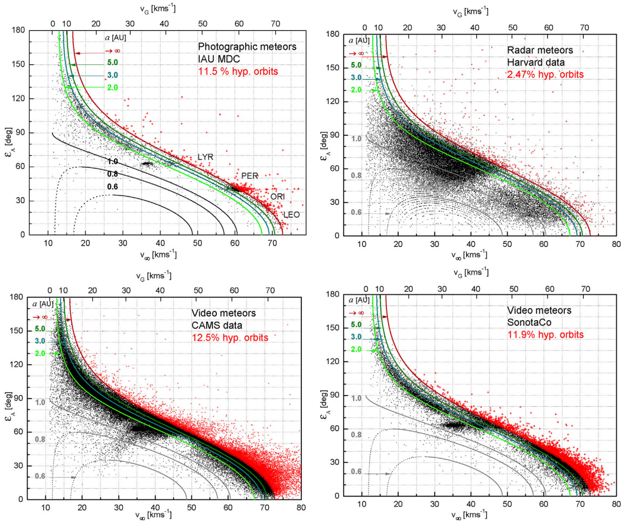
$$Kresak^{′}s diagram$$
The best way to understand if an event is an interstellar meteor candidate is to use the plots of the geocentric (or pre-atmospheric) velocity of the meteor as a function of the radiant elongation.
The red curve , in all graphs, represents the parabolic limit. Solar System’s orbits are confined on the portion of graphs on the left of the red curve.
It is observed that the distribution of interstellar meteors depends on the accuracy of the data and on the observation technique used.

Slide 11
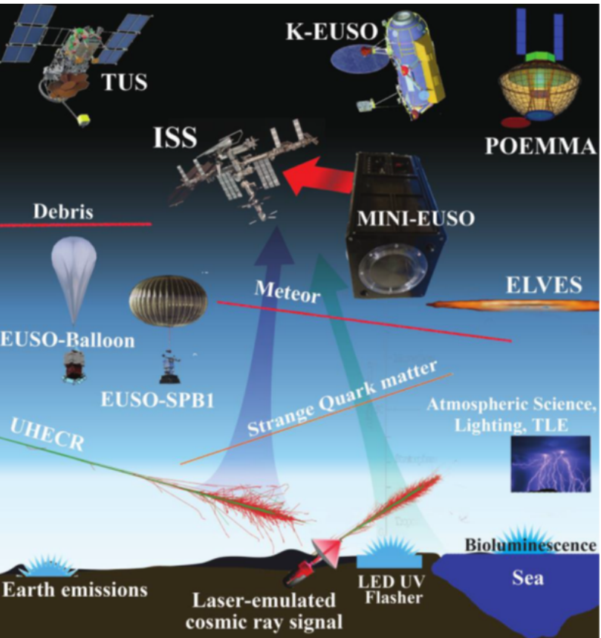
$JEM$-$EUSO$
Joint Experiment Missions for
Extreme Universe Space Observatory
Is a scientific program dedicated to the Ultra High Energy Cosmic Rays (UHECR).
Other goals:
systematic monitoring of the Earth’s atmosphere in the UV range
Observation of meteors
Space debris, SQM , TLEs
$$Main advantages:$$
Not dependent on sky and weather conditions
Can monitor a huge volume of atmosphere
$$Main disvantages:$$
In general not capable to reconstruct the three-dimensional trajectory of the event
Spatial resolution limited

Slide 12
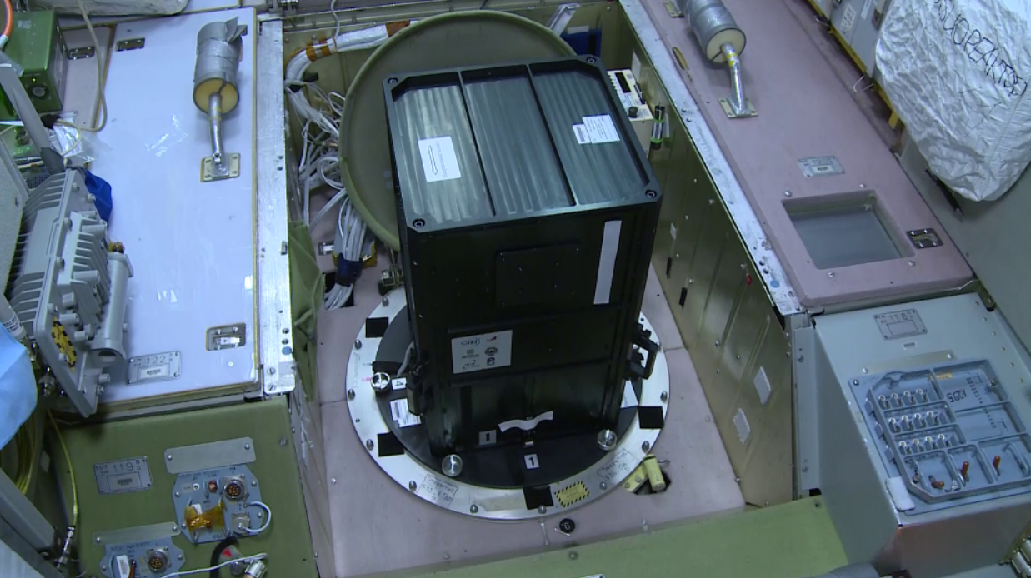
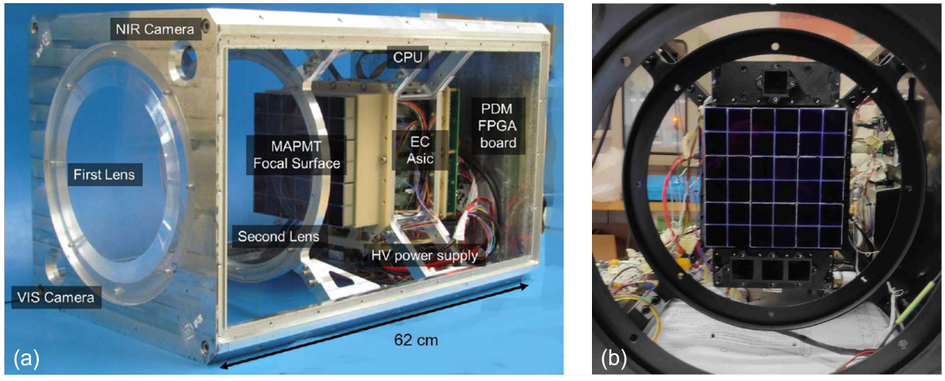
$Mini$-$EUSO$ is an UV telescope installed in the Russian Zvezda Module of the ISS and is the second space-based experiment of the Jem-Euso that operates on the ISS. The telescope is made up of 3 main systems, the Optical System, the Focal Plane (PDM) and the Data Acquisition System.
$$MAIN CHARACTERISTICS:$$
Launched on $22/08/2019$
Spatial resolution: $4.7∙4.7 {km}^{2}$ at $100km$
Temporal resolution: $2.5 μs$
Size: $37∙37∙62$ ${cm}^{3}$
Weight: $35 kg$
Fov: $44°$
Aperture shape: Circular
Aperture area: $490 {cm}^{2}$
N$°$pixels: $2304$
Only operates during night time (4-6 hours of effective data acquisition)

Slide 13
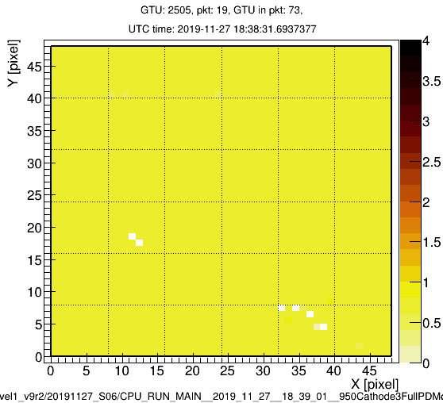
$Example of a meteor detected by Mini$-$EUSO$
14°53'N 92°08'E Bay of Bengal
Magnitude: $(0.8±0.1$)
Speed: ($29±1$) km/s
Counts/2.5µs
Notes:
Conteggi per pixel per frame temporale da 2.5 us.

Slide 14
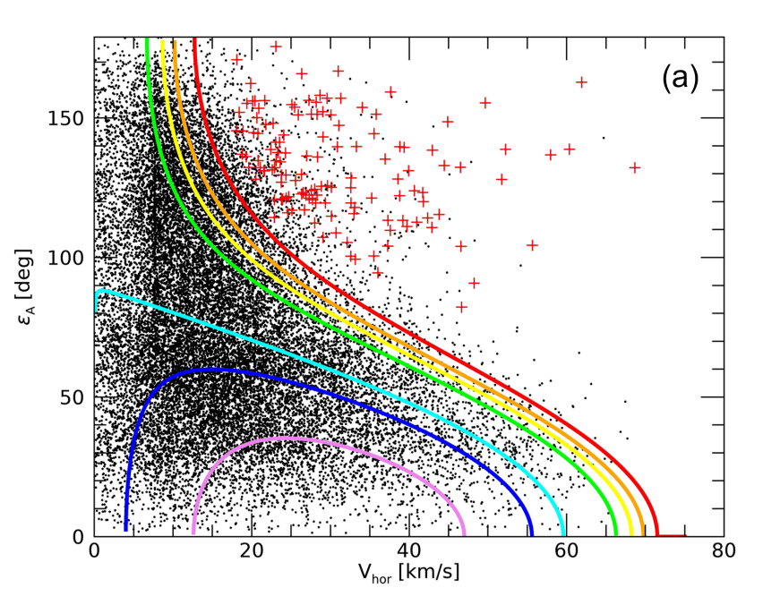
$Meteors in the Mini$-$EUSO database$
Mini-EUSO observed a ∼24k in ∼5.7 days of effective data taking in ∼ 30 sessions of 12 hours each .
A weakness of Mini-Euso is that instrument is not capable to reconstruct the three-dimensional trajectory of the event. If we assume that $V_{g}=V_{hor} (γ=0, γ∈\left[0,90\right]°)$ this leads to an underestimation of the geocentric speed $V_{g}$, but this approximation doesn’t generate artificial interstellar meteors.

Slide 15
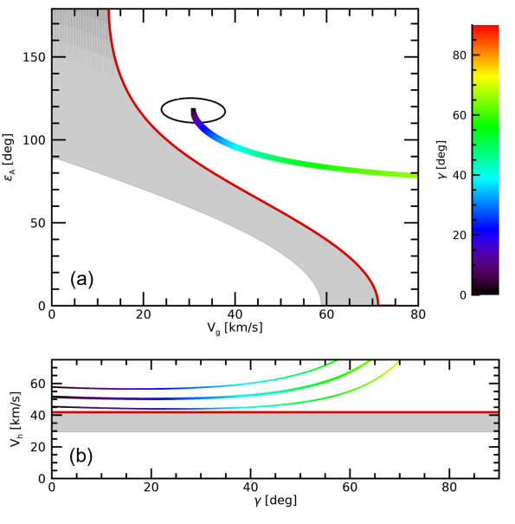
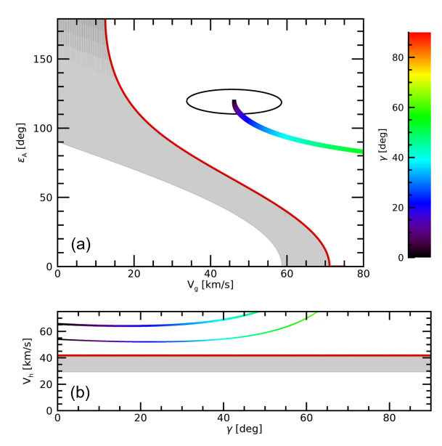
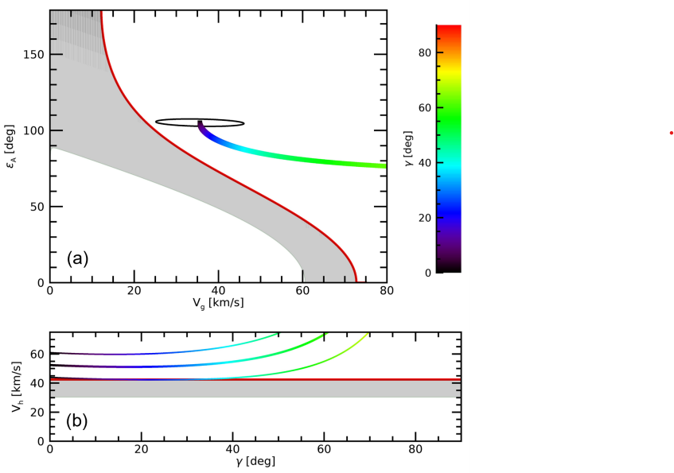
$Selection criteria$:
$Hyperblic orbit$→ 5.83% (1397 events)
$3σ selection$→ 0.56% (135)
$Trajectory simulation \left(inclination between \left[0,90\right]°\right)$ → 9 events
$Meteor candidate \left(M?\right)\text{→} 3 events$

Slide 16
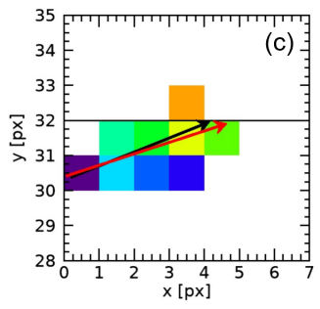
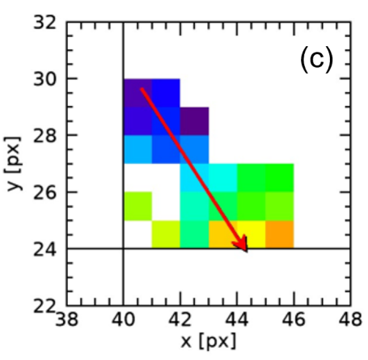
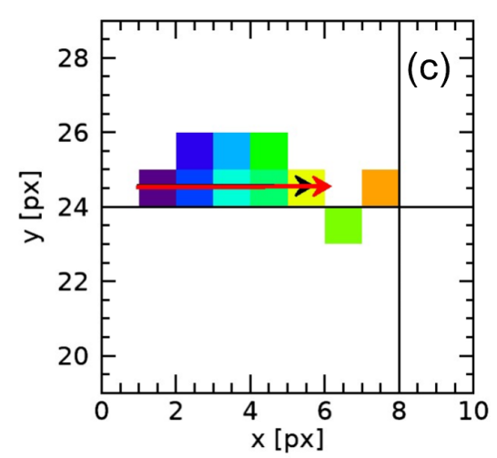
$The three interstellar candidates detected by Mini$-$Euso$
Counts/2.5µs
Counts/2.5µs
Counts/2.5µs
06°33’N 31°45’E
Sudan del Sud
25°47’S 80°30’W
South Pacific Ocean
38°40’N 69°11’W
North Atlantic Ocean
Notes:
Scala intensità varia per risaltare meteora.
Aggiungere Mettere Primo evento: Baidit, Sudan del Sud 06°33’N 31°45’E

Slide 17
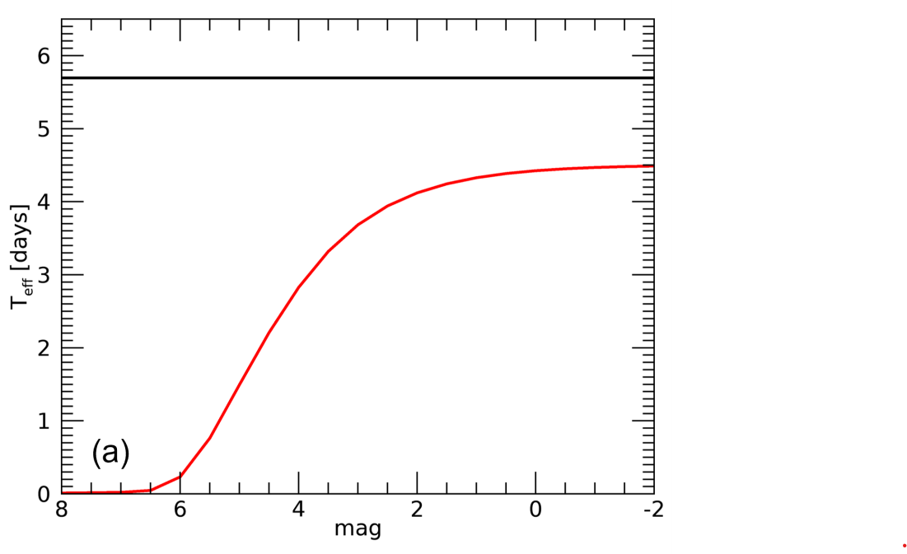
$$Meteors^{′} flux estimation$$
Meteors’ flux is defined as:
$φ=\frac{N}{A_{obs}∙ε∙T}$
$N=number of observed events=3$
$A_{obs}=observed area$ $at 100km altitude=250∙250{ km}^{2}$
$T_{eff}=T∙ε=observing time\sim 5.7 days ε=trigger efficiency$
The measure of flux is usually given as a function of the meteoroid’s preatmospheric mass (Robertson and Ayers, 1968):
$$\log_{10}M_{∞}=−2.985−0.4ℳ$$
$M_{∞}= preatmospheric mass$
$ℳ=absolute magnitude=3$
For the three candidates, detected by Mini-EUSO, it has been estimated a mass of $\left(65±18\right)mg$and a flux of$\left(0.5±0.3\right)m^{−2}h^{−1}.$

Slide 18
$$Upper limit flux of interstellar meteors$$
For magnitudes that do not show events is possible to estimate the upper limit flux of interstellar meteors $φ_{Ph,0}$.
The integral that gives the probability to obtain $φ_{Ph,0}$ with a Confidence Level (CL) of 90% is:
$$P\left(φ_{Ph}≤φ_{Ph,0}\right)=\int_{0}^{φ_{Ph,0}}{e^{−(φ_{Ph}∙K)}dK}=1−e^{−(φ_{Ph,0}∙K)}$$
$$φ_{Ph,0}=−\frac{1}{K}∙\ln\left(1−CL\right)=−\frac{1}{K}∙ln⁡(1−0.9)$$
$K=A_{obs}∙T_{eff}$
$A_{obs}=250∙250{ km}^{2}$
$T_{eff} \sim 5.7 days$
$CL=90\%$

Slide 19
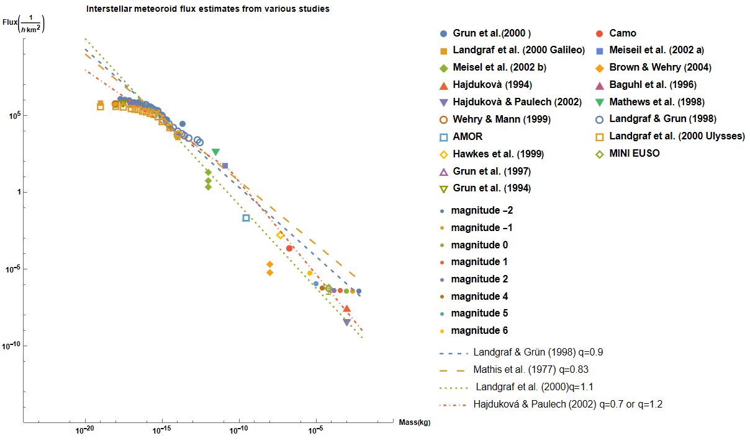
Interstellar meteoroid fluxes from the literature
$$N\left(m\right)\text{∝}{ m}^{−q}$$
If we combine our result, for the three events detected by Mini-EUSO, with others ISPs fluxes estimate in scientific literature and examine a possible power-law fit, $q=1.2 \left(\text{Hajdukov}\text{á }\text{and} \text{Paulech}\text{ (2002)}\right)$ seems to be the most promising representation.
Figure 1.

Slide 20
$$Conclusions$$
Mini-EUSO during its operation detected $\sim$24k meteors
3 possible events are candidates to be interstellar meteors
My contribution was to estimate mass and flux of the three events and compare them with others scientific results
Despite operating in an effective time of only about 15 days Mini-EUSO managed to provide interesting scientific results

Slide 21
$$Future works$$
Without any improvements to the velocity measurements, which are crucial for orbit determination, the problem of distinguishing interstellar meteors from interplanetary ones remains
An important step would be to be able to bridge the gap between particle sizes observed by in-situ instruments and those observable by radar and optical technologies

Slide 22
$$Thank you for your attention!!$$

Slide 23
$$SLIDE DI BACKUP$$

Slide 24
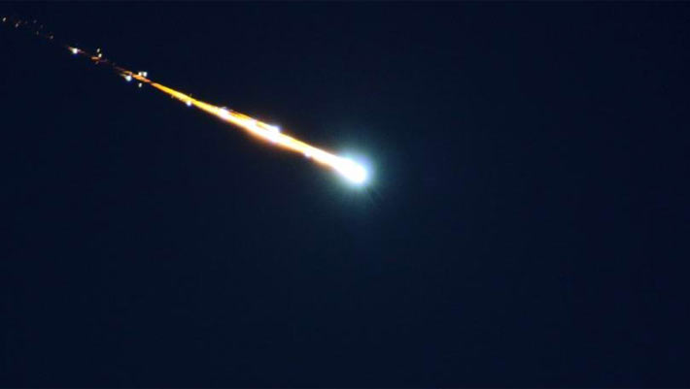
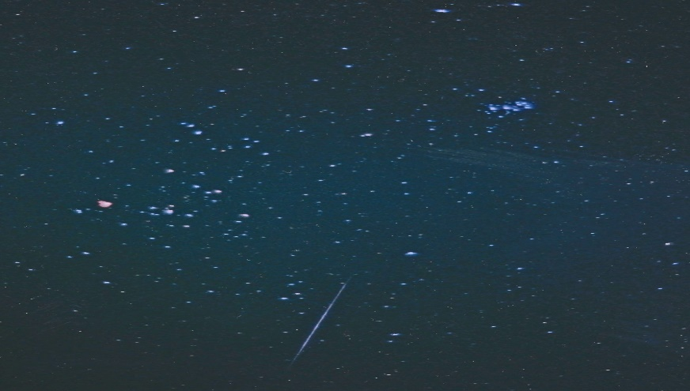
$$Meteors^{′}origin:$$
$Meteoroids$
$Asteroids$
$Cometary fragments$
First meteor photography taken on 27th November 1885

Slide 25
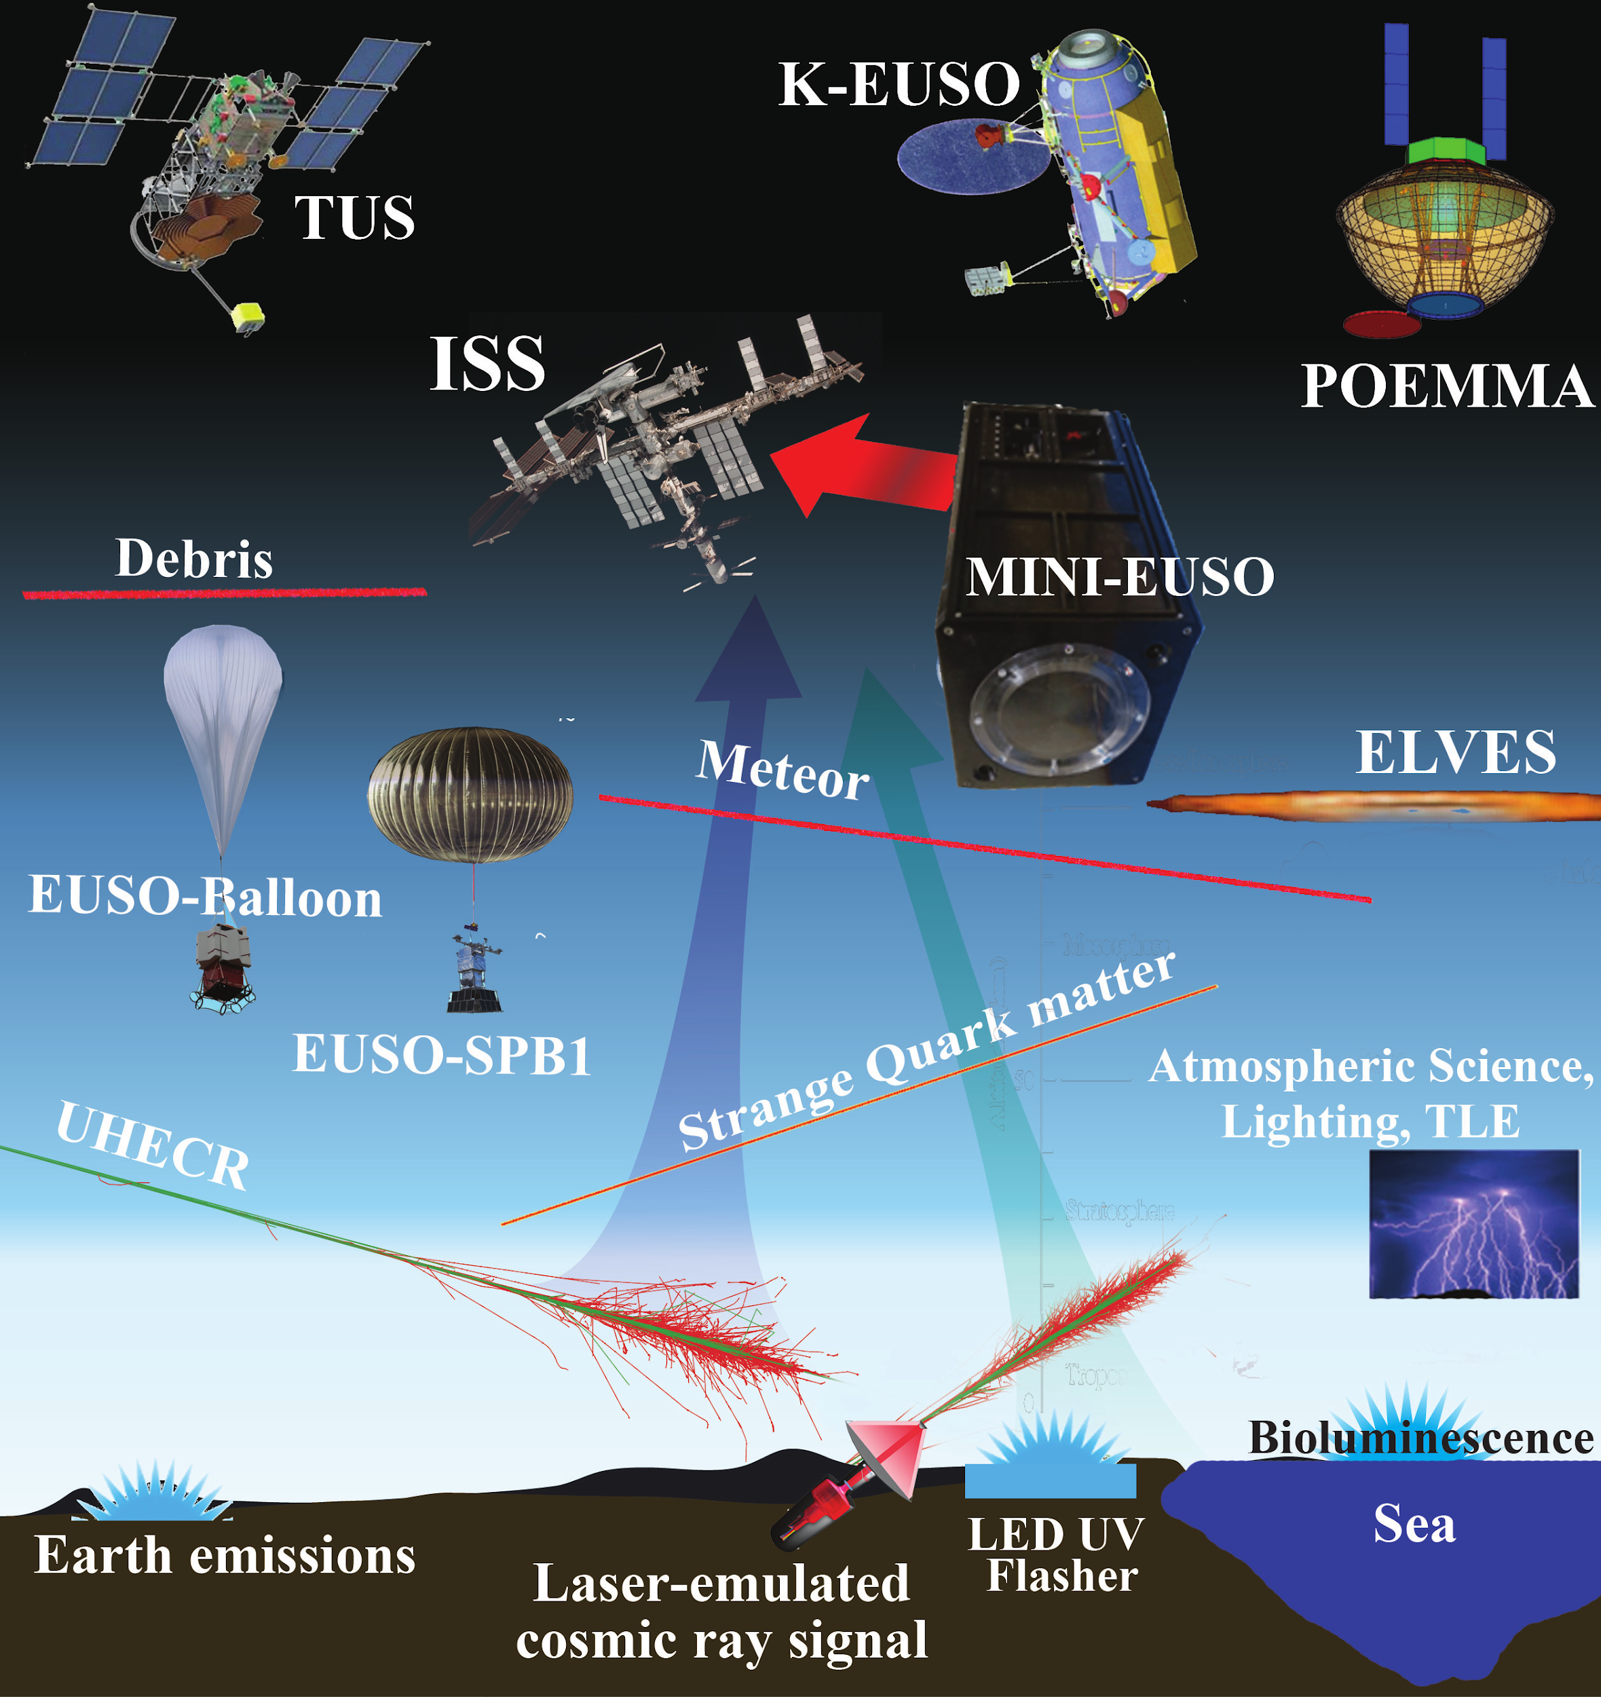
$Missions of JEM$-$EUSO$
EUSO-TA
EUSO Balloon
EUSO-SPB1
TUS
Mini-EUSO
EUSO-SPB2
K-EUSO
POEMMA

Slide 26
$$Magnitude$$
Astronomers measure the brightness of a star in the sky using a magnitude scale. The apparent magnitude is defined as:
$$m=−2.5\log_{10}\left(F\right)$$
Absolute magnitude is defined to be the apparent magnitude an object would have if it were located at a distance
of 10 parsecs:
$$M=−2.5\log_{10}\left(\frac{F}{F_{0}}\right)=−2.5\log_{10}\left(F\right)+m_{0}$$

Slide 27
$The three Interstellar meteors candidates detected by Mini$-$EUSO$
$$DATE$$ | $$TIME UT$$ | $$Lat. [deg]$$ | $$Long. [deg]$$ | $$M [mag]$$ | $$V_{h} [km⁄s]$$
$$25/05/20$$ | $$23:49:24.83$$ | 06°33’N | $$\text{31}\text{°}\text{45’}\text{E}$$ | $$2.7±0.1$$ | $$50±2$$
$$28/07/20$$ | $$08:04:48.02$$ | 25°47’S | $$\text{80}\text{°}\text{30’}\text{W}$$ | $$3.3±0.1$$ | $$64±4$$
$$16/01/21$$ | $$07:12:43.96$$ | 38°40’N | $$\text{69}\text{°}\text{11’}\text{W}$$ | $$2.9±0.1$$ | $$51±3$$

Slide 28
$$Identification of points in figure 1$$
$$Dust Instrument (Ulysses and Galileo)$$
Landgraf and Grun (1998)
Landgraf and Grun (2000)
Grun et al. (1997)
Grun et al. (1994)
Wehry and Mann (1999)
Baghul et al. (1996)
$$Radar$$
Meisel et al. (2002a) Arecibo UHF
Meseil et al.(2002b) Arecibo UHF
AMOR (1993)
Weryk and Brown (2004) CMOR
Mathews et al. (1998) Arecibo UHF
$$Optical$$
CAMO (2012)
Hajdukova (1994) IAU MDC
Hajdukova and Paulech (2002) IAU MDC
Hawkes et al. (1999) NASA

Slide 29
REFERENCES
Grun, E., Landgraf, M., Horanyi, M., et al. 2000, J. Geophys. Res., 105, 10403
Landgraf, M., Baggaley, W. J., Grun, E., Kruger, H., & Linkert, G. 2000, J. Geo-phys. Res., 105, 10343
Meisel, D. D., Janches, D., & Mathews, J. D. 2002a, ApJ, 567, 323
Meisel, D. D., Janches, D., & Mathews, J. D. 2002b, ApJ, 579, 895
Hajdukova, M., Jr. 1994, A&A, 288, 330
Hajdukova, M., Jr., & Paulech, T. 2002, in Asteroids, Comets, and Meteors: ACM 2002, ed. B. Warmbein (ESA SP-500; Noordwijk: ESA), 173
Wehry, A., & Mann, I. 1999, A&A, 341, 296
Hawkes, L. R., Close, T., & Woodworth, S. 1999, in Proc. Int. Conf., Meteoroids 1998, ed. W. J. Baggaley & V. Porubcan (Bratislava: Astronomical Institute of the Slovak Academy of Sciences), 257
Grun, E., Gustafson, B., Mann, I., et al. 1994, A&A, 286, 915
Weryk, R. J., & Brown, P. 2004, Earth Moon and Planets, 95, 221
Mathews, D. J., Meisel, D. D., Janches, D., Getman, S. V., & Zhou, Q.-H. 1999, in Proc. Int. Conf., Meteoroids 1998, ed. W. J. Baggaley & V. Porubcan (Bratislava: Astronomical Institute of the Slovak Academy of Sciences), 79
Baguhl, M., Grun, E., & Landgraf, M. 1996, Space Sci. Rev., 78, 165
Landgraf, M., & Grun, E. 1998, in IAU Colloq. 166, The Local Bubble and ¨ Beyond, ed. D. Breitschwerdt, M. J. Freyberg, & J. Truempe (Lecture Notes in Physics, Vol. 506; Berlin: Springer), 381
Landgraf, M., Baggaley, W. J., Grun, E., Kruger, H., & Linkert, G. 2000, J. Geophys. Res., 105, 10343
CAMO, Musci, R., Weryk, R. J., Brown, P., Campbell-Brown, M. D., and Wiegert, P. A. 2012. An optical survey for millimeter-sized interstellar meteoroids. The Astrophysical Journal, 745, 161
Grun, E., Landgraf, M., Horanyi, M., et al. 2000, J. Geophys. Res., 105, 10403
Baggaley, J. W., Taylor, D. A., & Steel, I. D. 1993, in Proc. Int. Astron. Symp., Meteoroids and their Parent Bodies, ed. J. Stohl & I. P. Williams (Bratislava: Astronomical Institute of the Slovak Academy of Sciences), 53
Maria Hajdukova , Veerle Sterken, Paul Wiegert, Leonard Korno, Planetary and space science, volume 192

