Slide 1
“SEARCH FOR HIGH-SPEED EVENTS SEEN BY MINI-EUSO: NUCLEARITES AND INTERSTELLAR METEORS CANDIDATES”
Università degli studi di Torino
Facoltà di scienze matematiche, fisiche e naturali
Tesi di Laurea Triennale in Fisica
A.A. 2019-2020
26 Novembre 2020
Candidato: Federico Reynaud
Primo relatore: Mario E. Bertaina
Primo correlatore: Dario Barghini
Secondo correlatore: Hiroko Miyamoto

Slide 2
Summary
Jem-euso
Mini-euso
Dark matter
Nuclearites
Meteor classification
Meteors and nuclearites
Data analysis
Metor event
Interstellar meteors candidates
Nuclearites candidates
Results
conclusions

Slide 3
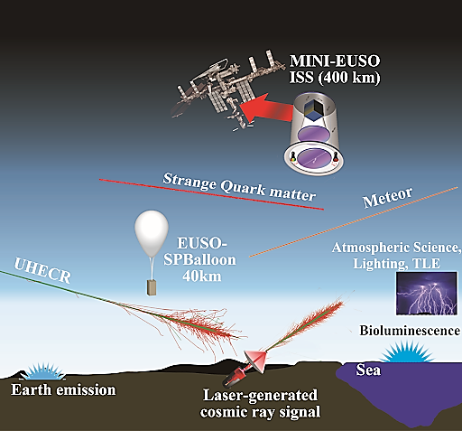
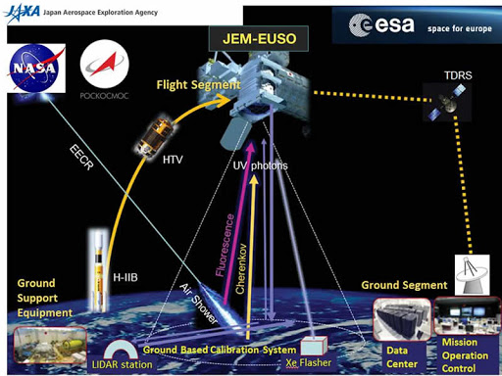
Jem-Euso
Extreme Universe Space Observatory onboard Japanese Experiment Module
E > 5×${10}^{19}$eV
-Mini-EUSO

Slide 4
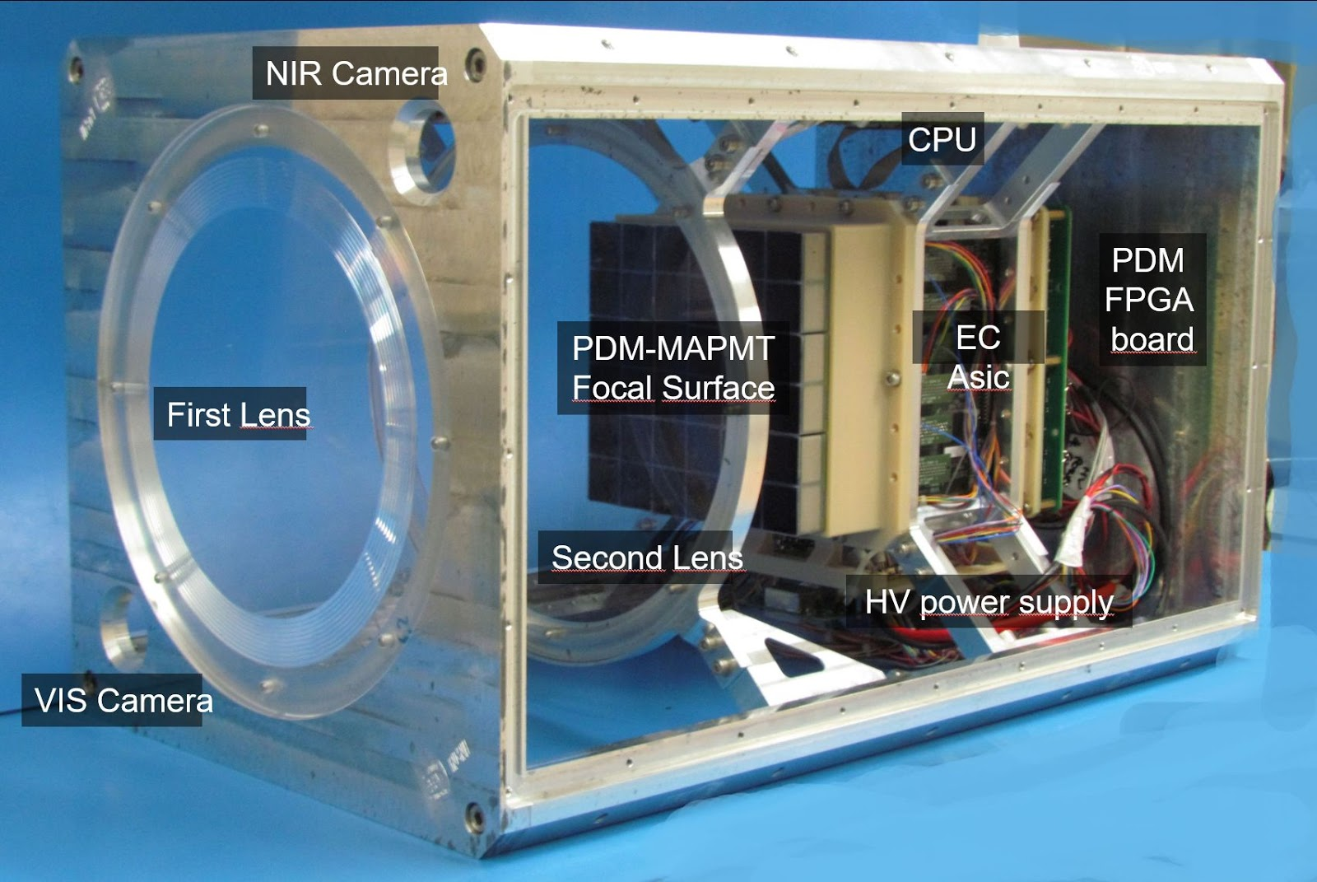
Mini-EUSO
Located in front of the UV transparent window in the Zvezda Russian module in the ISS, looking at Earth in nadir position.
Properties:
-FoV: ±21 degrees
-Two Fresnel lenses (25 cm of diameter)
Mini-EUSO objectives are:
-the detection of some cosmic ray showers
-the study of atmospheric phenomena, like Transient Luminous Events (TLEs)
-meteors
-the search for Strange Quark Matter (SQM)

Slide 5
Dark matter
In the standard model of the fundamental interactions there isn’t a specific particle which is able to describe dark matter; we only know the properties it should have :
-Neutral
-Not baryonic
-Massive
- Stable on cosmological time scales

Slide 6
Possible dark matter candidates
PHYSIC BSM (beyond standard model)
Neutrino with mass
WIMPs (weakly interactive massive particles)
PHYSIC SM (standard model)
Macros -> massive and cross-section interaction
Nuclearites

Slide 7
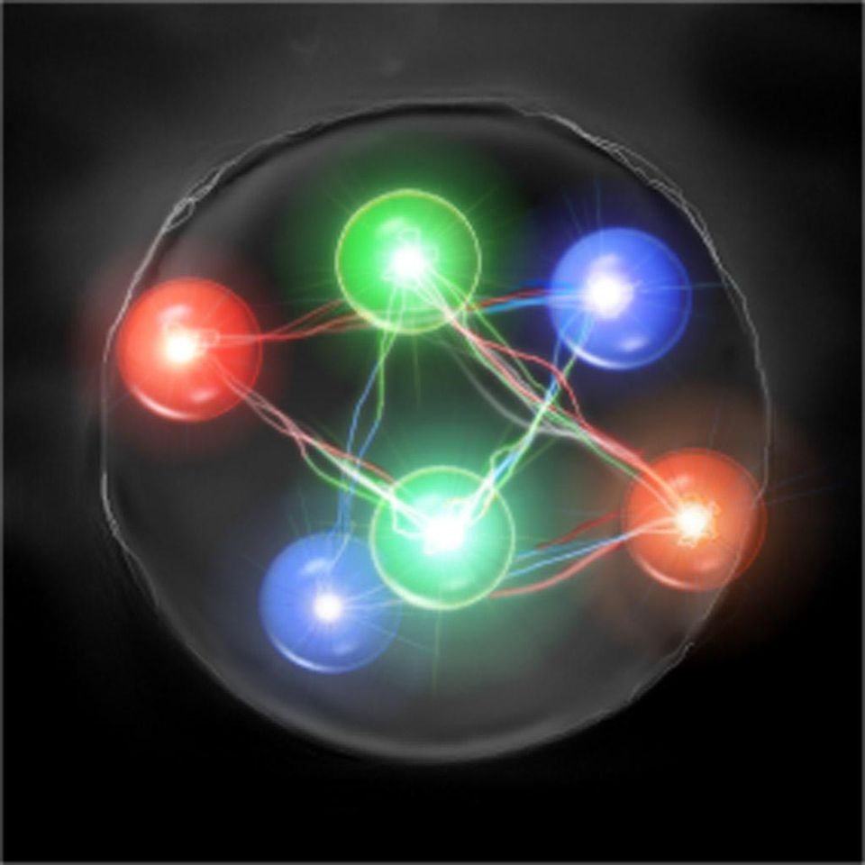
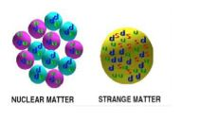
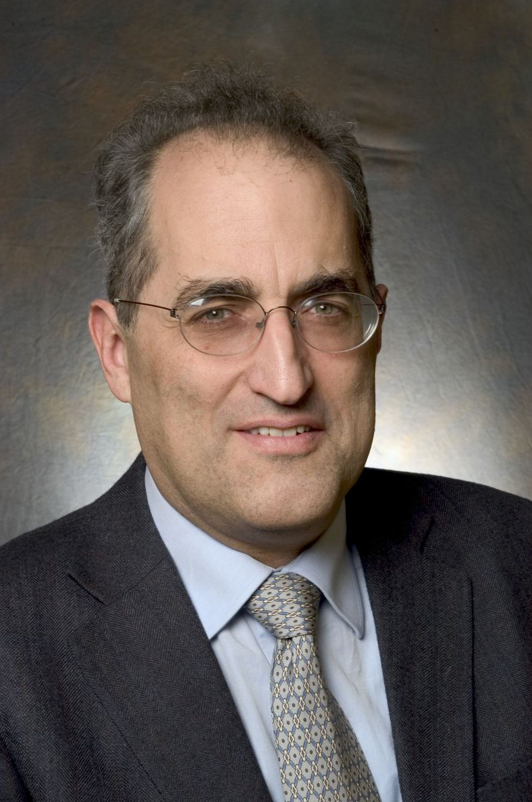
NUCLEARITES
We assume the existence of a hypothetical state of matter consisting of quark up, down and gluons in which the latter are free and not limited into nucleons
UP
STRANGE
DOWN
U
D
Edward Witten ( 1951) Physicist and mathematician
S

Slide 8
NUCLEARITES
Main Hypothesis:
Reference speed: ~250 Km/s
Srtarting height: $h_{max}=2,7∗ln\left(\frac{M}{1,2∗{10}^{−5}}\right)km\sim 10km$
Magnitude: $M=10,8−1,67∗\log_{10}\left(\frac{m}{1μg}\right)+5\log_{10}\left(\frac{h}{10km}\right)$
Energy loss: $\frac{dE}{dx}=−AρV^{2}$
with:
A is the effective cross-sectional area of the nuclearite,
V is its velocity
$ρ$ is the density of the medium.
UP
STRANGE
DOWN
D
U
S
From : Nuclearites: a novel form of cosmic radiation (pages 10-11)
By: De Rùjula and Glashow

Slide 9
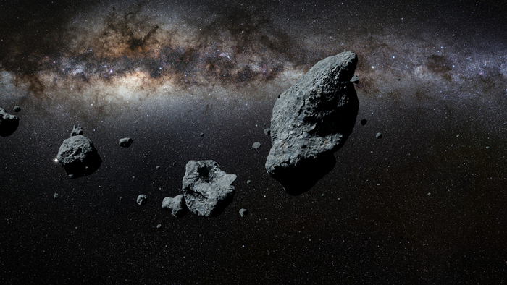
4. Meteorite
(fragment of an asteroid or a meteoroid that arrives on the ground)
3. Meteor
(the light emitted by meteoroir or asteroid as it enters the atmosphere)
1. Asteroid
Meteors classification
2. Meteoroid
(small asteroid)

Slide 10
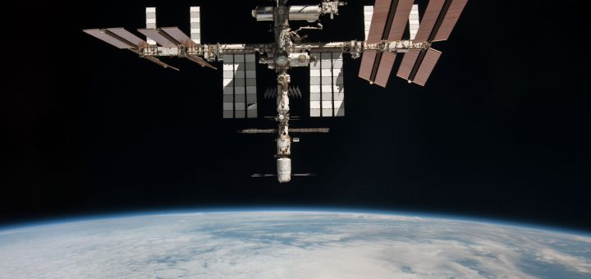
Meteors and nuclearites
Meteors properties :
Solar system meteor’s speed : ~11-72 Km/s
Interstellar meteor’s speed: >72 km/s
Nuclearites properties:
Positively charged, compensated by electronic cloud
${10}^{−4}g≤m≤{10}^{4}g$
Speed: ~250 Km/s
Properties of both events :
Rate of energy loss: $\frac{dE}{dx}=−AρV^{2}$
(a nuclearite of mass $>{10}^{23}\frac{Gev}{c^{2}}\sim 0,2g$ crosses the entire Earth)

Slide 11
Data analysis
S12: 2020/03/02
M = meteor | 134 | 30%
M? = maybe meteors | 87 | 19%
U = unidentified event | 67 | 15%
N = nothing (noise) | 162 | 36%
TOTAL | 450 | 100%
Three Mini-EUSO sessions:
S08: 2019/12/30
M = meteor | 287 | 38%
M? = maybe meteors | 161 | 21%
U = unidentified event | 150 | 20%
N = nothing (noise) | 162 | 21%
TOTAL | 760 | 100%
S14: 2020/03/31
M = meteor | 158 | 32%
M? = maybe meteors | 96 | 19%
U = unidentified event | 75 | 15%
N = nothing (noise) | 170 | 34%
TOTAL | 499 | 100%

Slide 12
Data analysis
These are the distribution for each type of events of S08: 2019/12/30
M = meteor | 287 | 38%
M? = maybe meteors | 161 | 21%
U = unidentified event | 150 | 20%
N = nothing (noise) | 162 | 21%
TOTAL | 760 | 100%

Slide 13
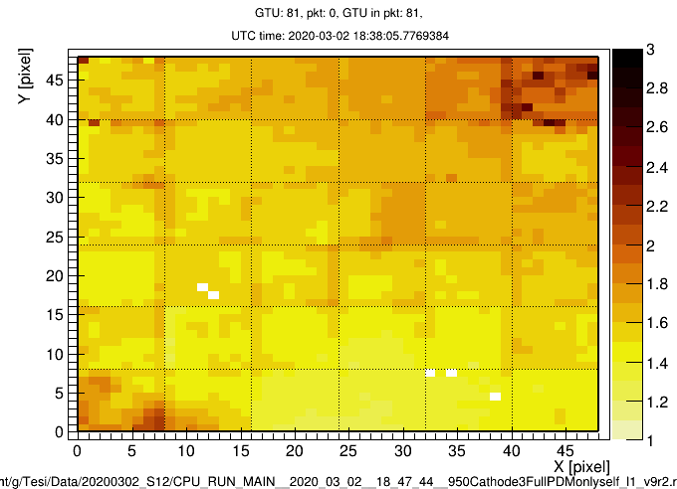
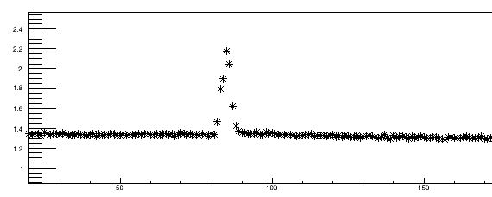
Meteor Event example
Description
-Time of each frame: 41 ms
-Luminosty scale (dark more intense, bright less intense)
2020-03-02 18:47:44
This is an example of meteor event with its light curve

Slide 14
Fast events (interstellar meteors candidates)
Main properties:
Srtarting height: $h_{max}\sim 100km$
Reference horizontal speed: $>72 km/s$
Follow the only 7 possible candidates:
TYPE | Horizontal Speed at h=100km (km/s) | Magnitude at 100km
M | 81 | 9
M | 69 | 4
M | 91 | 7
M | 88 | 6
M | 86 | 6
M | 68 | 6
M | 97 | 6

Slide 15
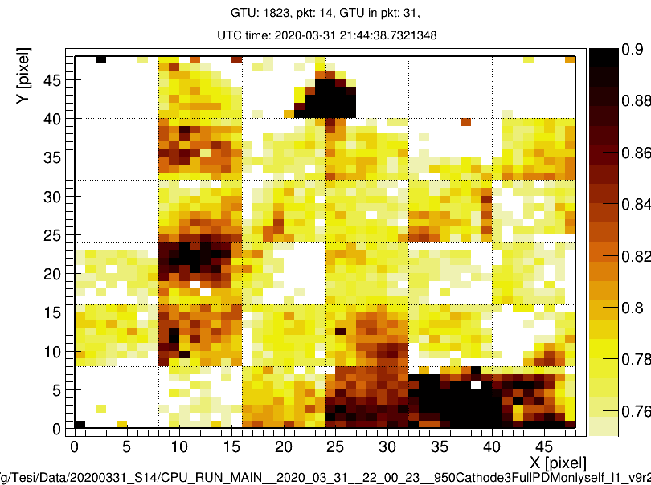
Interstellar Meteor Event example
Description
-Time of each frame: 41 ms
-Luminosty scale (dark more intense, bright less intense)
2020-03-31 22:00:23
This is an example of meteor event with its light curve

Slide 16
Fast events (nuclearites candidates)
Knowing that:
Nuclearites produce visible light as they traverse the atmosphere;
There is an upper limit to the altitude at which nuclearites effectively generate light: $h_{max}=2,7∗ln\left(\frac{M}{1,2∗{10}^{−5}}\right)km\sim 10km$;
The apparent magnitudes of hypothetical cosmic nuclearites range from M=+6 for nuclearites near ${10}^{−4}g$;
The horizontal speed is calculated from the pixel paths in the time unit, I found the vertical speed assuming 250 km/s as total speed;
From the two speed components it’s possible to find the inclination, supposing that the light of the nuclearite is extinguished on the ground;
The magnitude formula is: $M=10,8−1,67∗\log_{10}\left(\frac{m}{1μg}\right)+5\log_{10}\left(\frac{h}{10km}\right)$ and assuming 10km as starting height, as I said before, it’s possible to find nuclearite candidate mass.

Slide 17
Results
There is only one possible candidate to nuclearite:
TYPE | Horizontal Speed at h=10km (km/s) | Vertical Speed at h=10km (km/s) | Inclination (°) | Starting height at 10km (km) | Magnitude at 10km | Mass at 10km
M | 71 | 240 | 16,03 | 29 | +6,08 | $$6,7∗{10}^{−4}g$$
Nuclearites properties:
h~10 km
M~+6
m~${10}^{−4}g$
V ~250 km/s

Slide 18
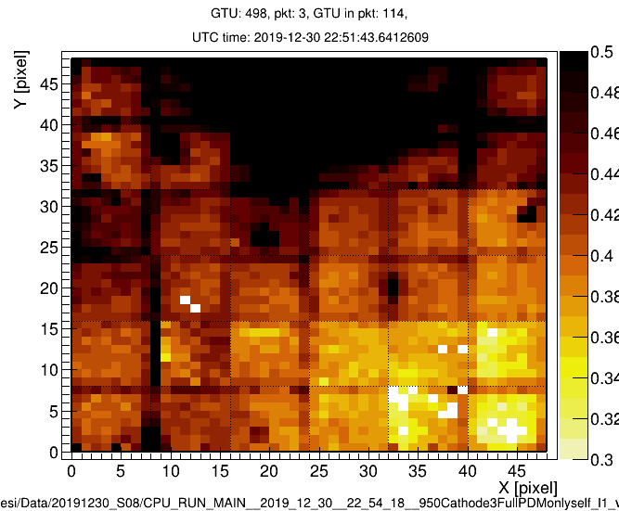
Possible Nuclearite event
Description
-Time of each frame: 41 ms
-Luminosty scale (dark more intense, bright less intense)
2019-12-30 22:54:18
This is an example of the possible nuclearite event with its light curve

Slide 19
Conclusions
Three session analysis of Mini-EUSO data for a total of 1715 events;
Distinguish meteors(M), meteor candidates(M?), unidentified events(U),noise events(N);
Focus on fast events to analyse interstellar meteor candidate at 100km for a total of 7 possible candidates;
Study nuclearites properties;
Apply these properties to the compatible events;
Find two events that, at a first not too thorough analysis, may be nuclearites.
Thanks to Prof. Bertaina, Dr. Miyamoto, Dario Barghini and Simone Valenti for their support in this work!

Slide 20
Thank you all for your attention!

