Slide 1
Search for interstellar meteor candidates and nuclearites with the Mini-EUSO space experiment
Università degli studi di Torino
Facoltà di scienze matematiche, fisiche e naturali
Tesi di Laurea Magistrale in Fisica
A.A. 2021-2022
14 Giugno 2023
Candidato: Federico Reynaud
Primo relatore: Mario E. Bertaina
Primo correlatore: Dario Barghini
Controrelatore: Carla Taricco

Slide 2
SUMMARY
MINI-EUSO
METEORS & INTERSTELLAR METEORS
NUCLEARITES
DATA ANALYSIS
INTERSTELLAR METEORS CANDIDATES
NUCLEARITES’ SIMULATION
CONCLUSIONS

Slide 3
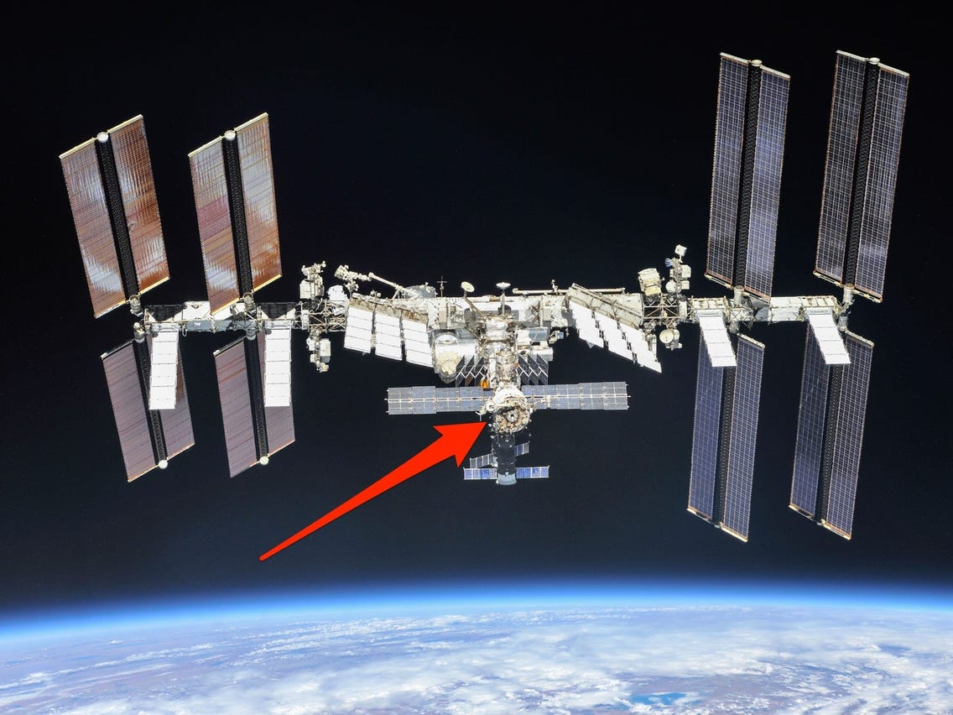
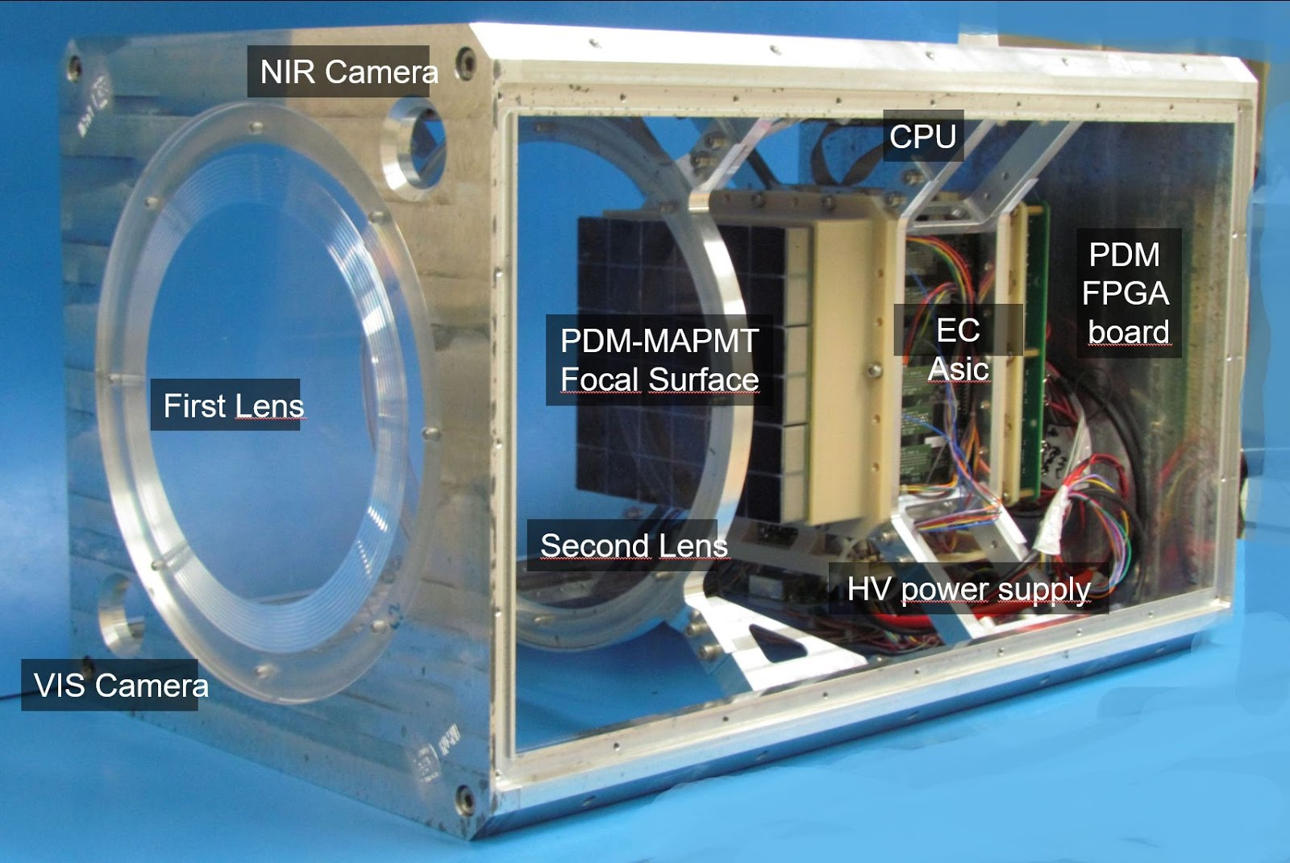
MINI-EUSO
Located in front of the UV transparent window in the Zvezda Russian module in the ISS, looking at Earth in nadir position.
(Launch on 22 August 2019)
The optical system consists of two Fresnel lenses of 25 cm diameter each with a wide field of view of 44°x44°.
Night UV emission from the Earth (290–430 nm)
Time resolutions:
• 2.5 μs time resolution → D1 GTU (Gate Time Unit).
• 320 μs time resolution → D2 GTU.
• 40.96 ms time resolution → D3 GTU

Slide 4
Scientific objectives

Slide 5
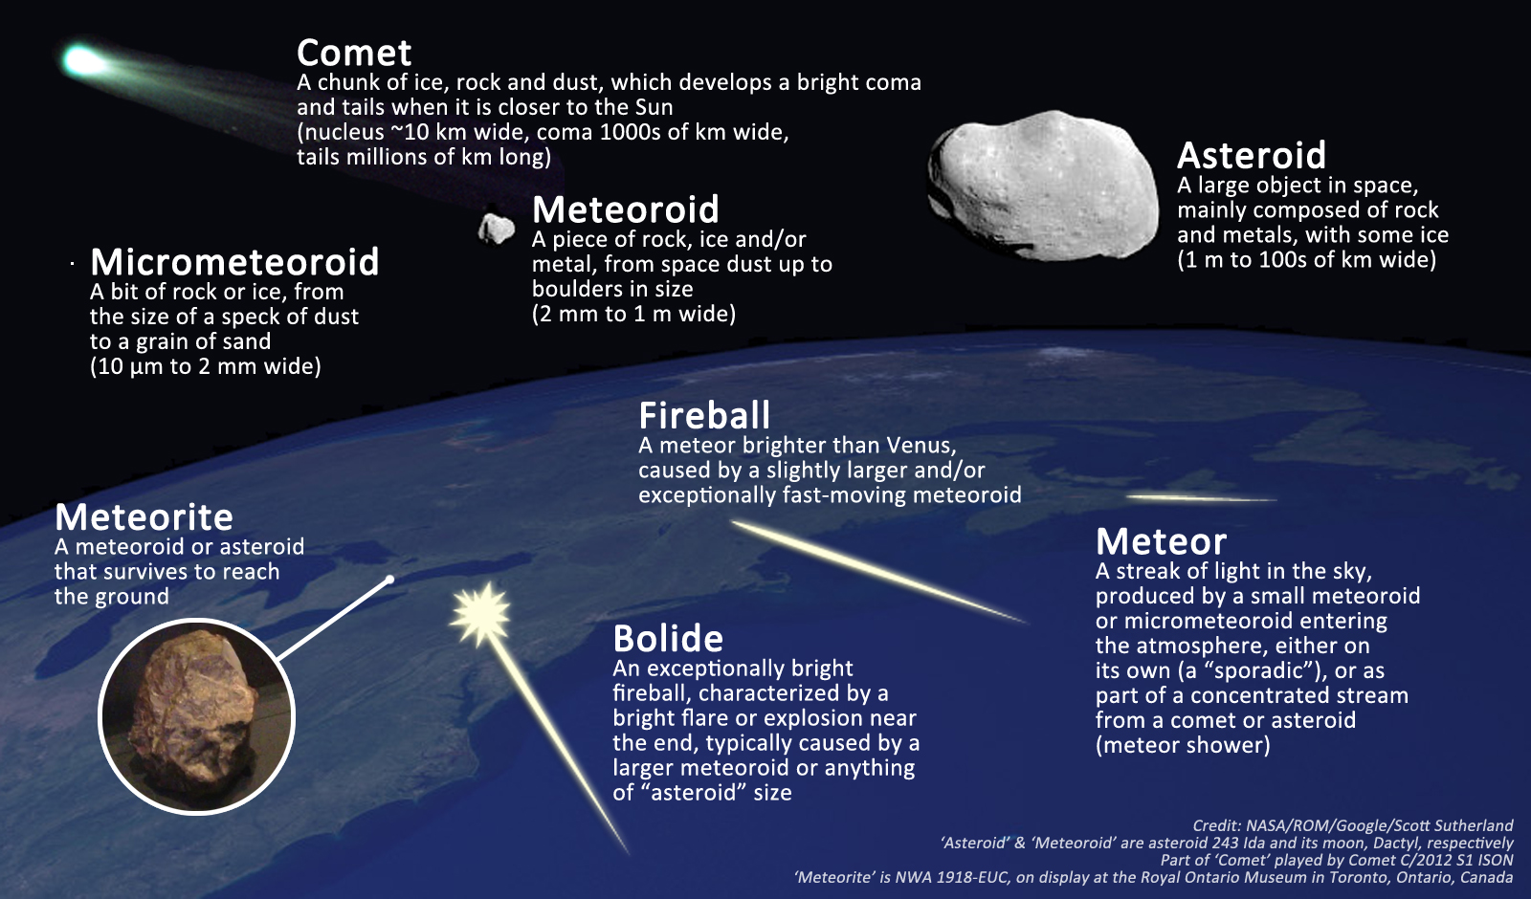
Meteors terminology

Slide 6
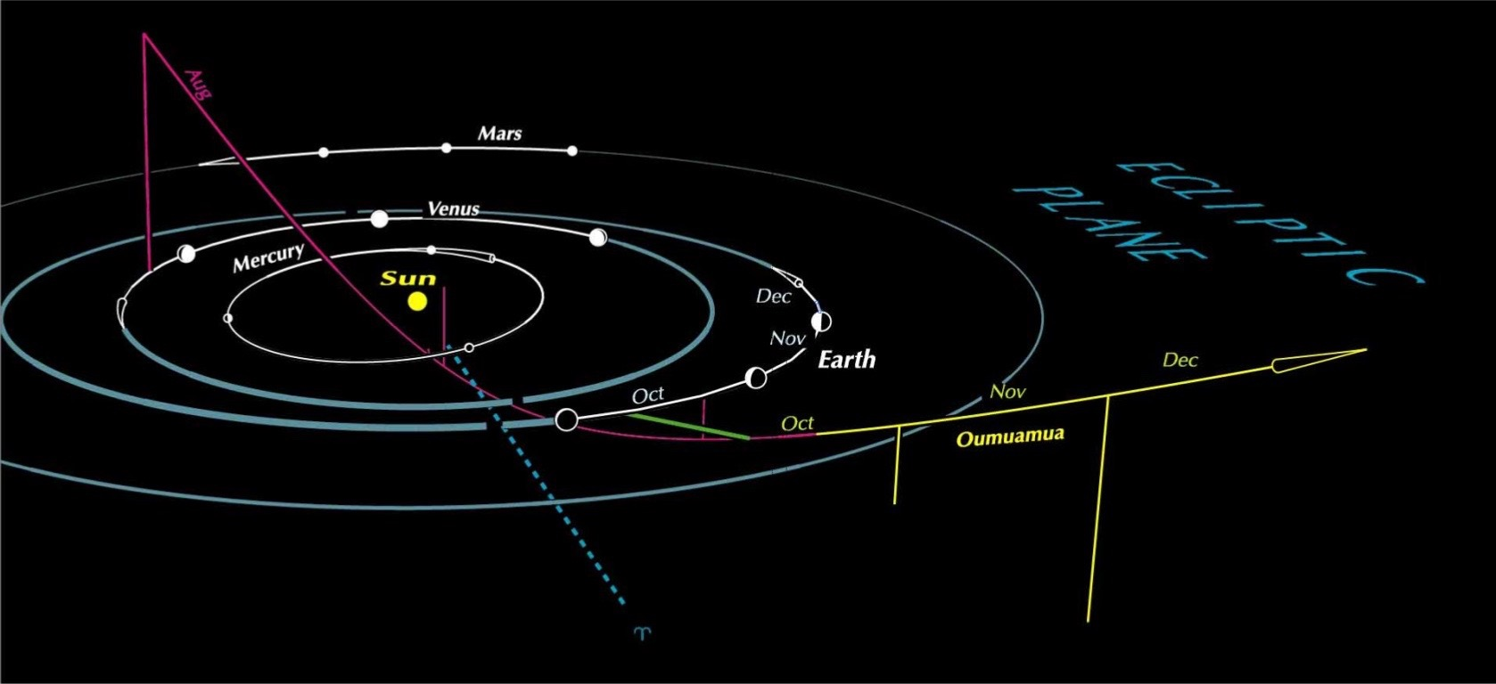
Objects of Apparent Interstellar Origin
ʻ1I/Oumuamua’ is the first interstellar object detected passing through the Solar System. It was discovered by Robert Weryk using the Pan-STARRS telescope at Haleakala Observatory, Hawaii, on 19 October 2017.
100 m < d < 1.000 m
‘2I/Borisov’ is the first observed rogue comet and the second observed interstellar interloper after ʻOumuamua. It was discovered by the Crimean amateur astronomer and telescope maker Gennadiy Borisov on 30 August 2019.
1.4 km < d < 16 km

Slide 7
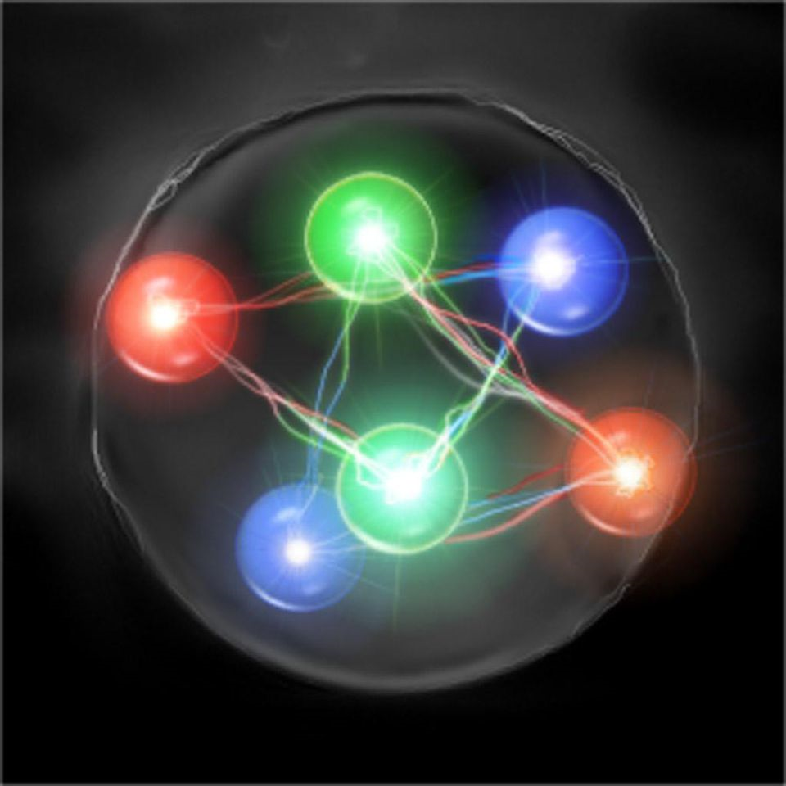
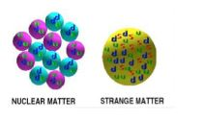
Nuclearites
Nuclearites are strange quark matter conglomerates that are hypothesized as possible candidates of macroscopic dark matter.
The original idea was proposed by Witten in 1984 who suggested that strange quark matter (SQM), in the form of macroscopic aggregates of up, down and strange quarks, might be more stable than ordinary matter. Later, De Rujula and Glashow developed a theoretical description of the interaction with the Earth’s atmosphere of such compact objects, that were named nuclearites.
UP
STRANGE
DOWN
U
D
S

Slide 8
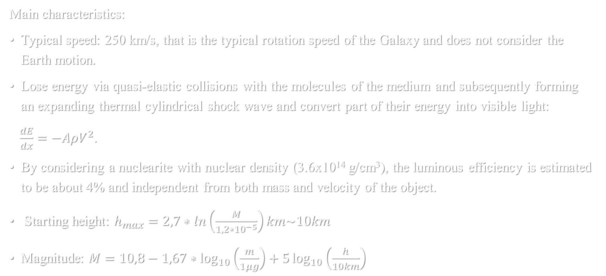
NUCLEArites properties
Main characteristics:
Typical speed: 250 km/s, that is the typical rotation speed of the Galaxy and does not consider the Earth motion.
Lose energy via quasi-elastic collisions with the molecules of the medium and subsequently forming an expanding thermal cylindrical shock wave and convert part of their energy into visible light:
$\frac{dE}{dx}=−AρV^{2}$.
By considering a nuclearite with nuclear density (3.6x10¹⁴ g/cm³), the luminous efficiency is estimated to be about 4% and independent from both mass and velocity of the object.
Starting height: $h_{max}=2,7∗ln\left(\frac{M}{1,2∗{10}^{−5}}\right)km\sim 10km$
Magnitude: $M=10,8−1,67∗\log_{10}\left(\frac{m}{1μg}\right)+5\log_{10}\left(\frac{h}{10km}\right)$

Slide 9
DATA ANALYSIS

Slide 10
Mini-euso data
For METEORS analysis:
Mini-EUSO is on ISS and takes data 2/month;
Mini-EUSO stores the data on the SSD in a binary format, producing one file every 131 s;
D3 GTU → 40.96 ms;
Trigger offline;
Division in session.
Classification

Slide 11
Barghini’s data sets
Session Analysis
S05-S44
(19/11/2019 to 11/08/2021)
Meteor | M
Maybe meteor | M?
Unidentified | U
Noise | N
Piotrowsky’s data sets
The two datasets were analysed by the Meteor Tracking Algorithm (MTA), written by Dr. Barghini.

Slide 12
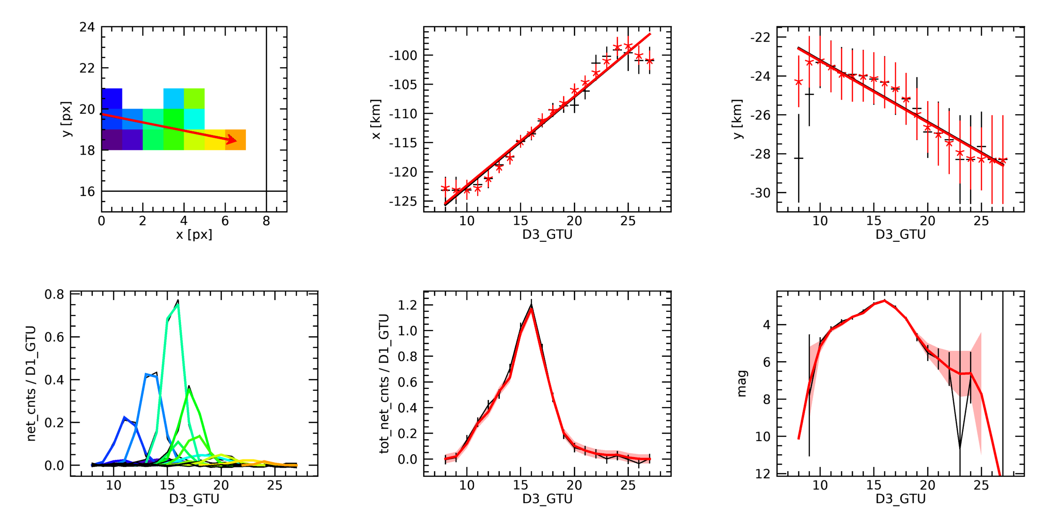
Meteor Event (M)

Slide 13
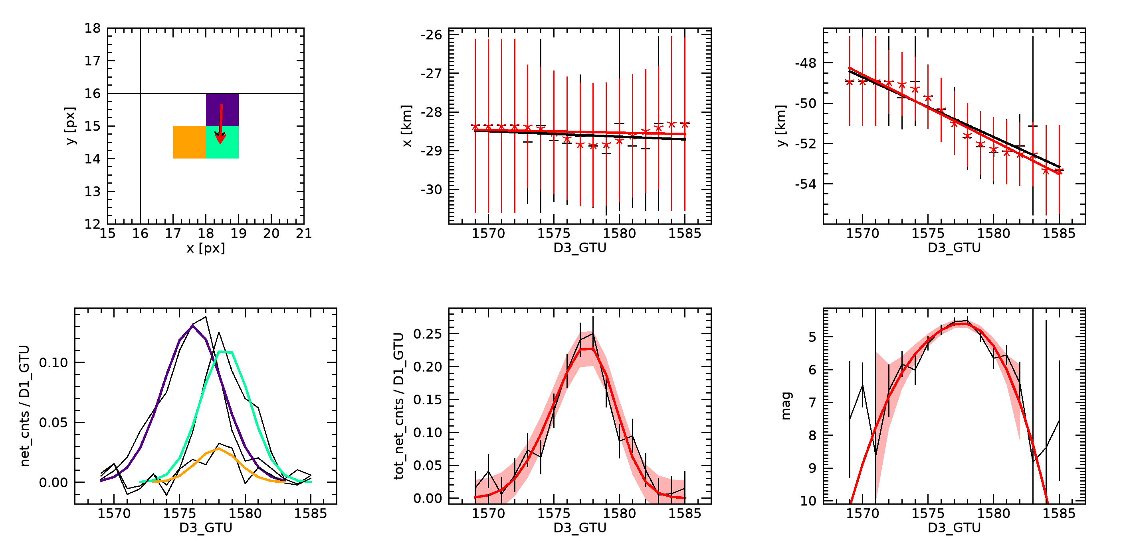
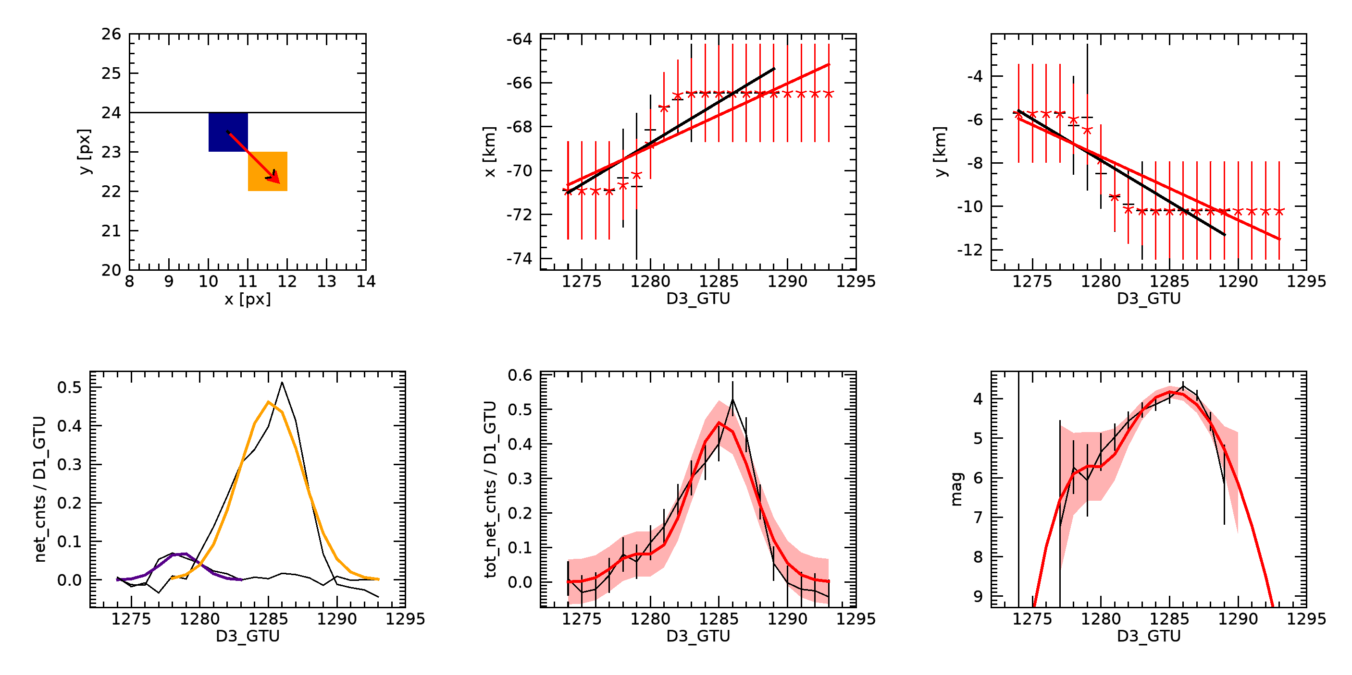
Maybe meteor event (M?)

Slide 14
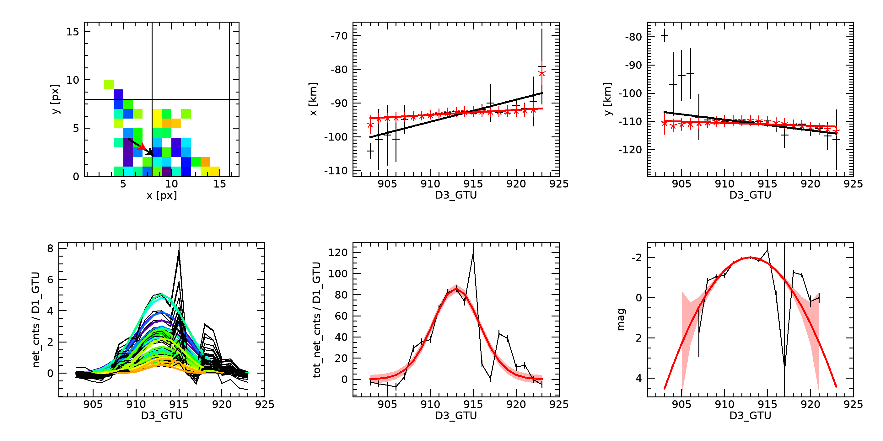
Unidentified event (U)

Slide 15
data
Barghini’s data analysis
piotrowsky’s data analysis
Total M+M?: 14.405 (58%)
Total events: 24.757
Total M+M?: 18.251 (88%)
Total events: 20.661

Slide 16
Method and Purpose of the comparison
The results are divided in two classes:
Common data results that are found with a Python code in which I compared GTU, X and Y with a range of 10 GTUs in time and 8 pixels in space in each direction
Events recognized only by one of the two algorithms
The purpose was to understand the main differences and peculiarities!

Slide 17
Common data results
Piotrowsky’s & Barghini’s dataset: 8800 M + M?
Total Common Events : 9053 (including U and N)

Slide 18
Different data results
Piotrowsky’s dataset: 9448 M + M?
Barghini’s dataset: 5607 M+ M?

Slide 19
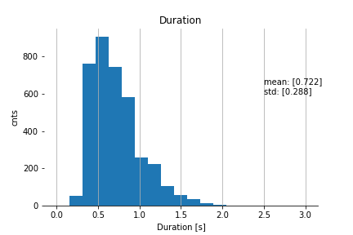
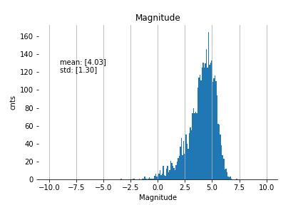
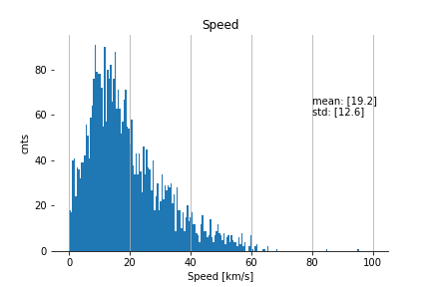
Histogram Results
Duration
Magnitude
Speed

Slide 20
INTERSTELLAR METEORS CANDIDATES

Slide 21
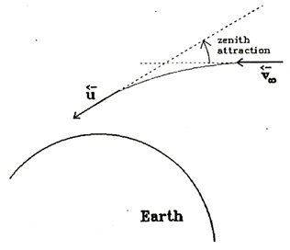
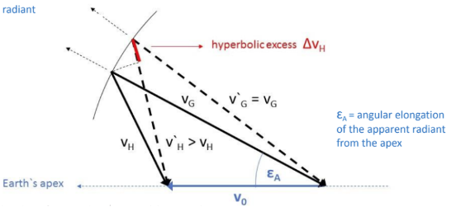

Apparent → Geocentric →Heliocentric
Observation: $\left(v_{∞}, α, δ\right)$
(Correction for Earth’s rotation)
Correcting for Earth’s gravitational attraction: $\left(v_{g}, α_{g}, δ_{g}\right)$
$\left(v_{∞}, α, δ\right) →(v_{∞}, a, z)$ equatorial to horizontal
$\left(v_{g},a_{g},z_{g}\right)→\left(v_{g}, α_{g}, δ_{g}\right)$ horizontal to equatorial
Correcting for Earth’s revolution speed: $\left(v_{h}, α_{h}, δ_{h}\right)$
$\left(v_{g}, α_{g}, δ_{g}\right)→\vec{V_{h}}=\left(v_{xh},v_{yh},v_{zh}\right)$ equatorial to rectangular (ECI)

Slide 22

Interstellar meteors dynamic model
Measured parameters of a meteor (position and speed) are used to determine the orbit of the meteoroid around the Sun. The orbital derived elements indicate the particles’ origin. However, the semi-major axis a, which defines the type of the orbit, strongly depends upon the derived heliocentric velocity V_{H} :
$V_{H}^{2}(r,a)=GM_{S}\left(\frac{2}{r}−\frac{1}{a}\right)$
Orbit elements:
$a>0$ → close orbit → $V_{H}^{2}<$2 $GM_{S}$
$a<0$ → open orbit → $V_{H}^{2}>$ 2 $GM_{S}$
$ε=1$ → parabolic orbit → $V_{H}^{2}=$ 2 $GM_{S}$~ 42 km/s

Slide 23
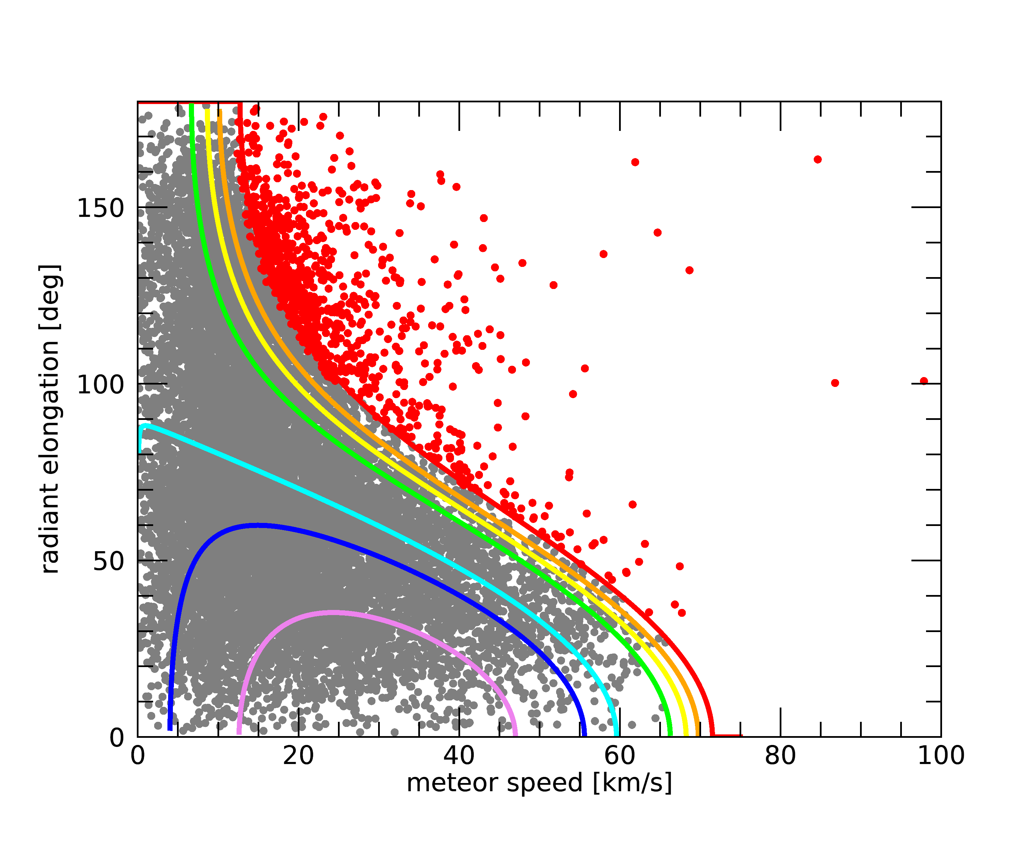
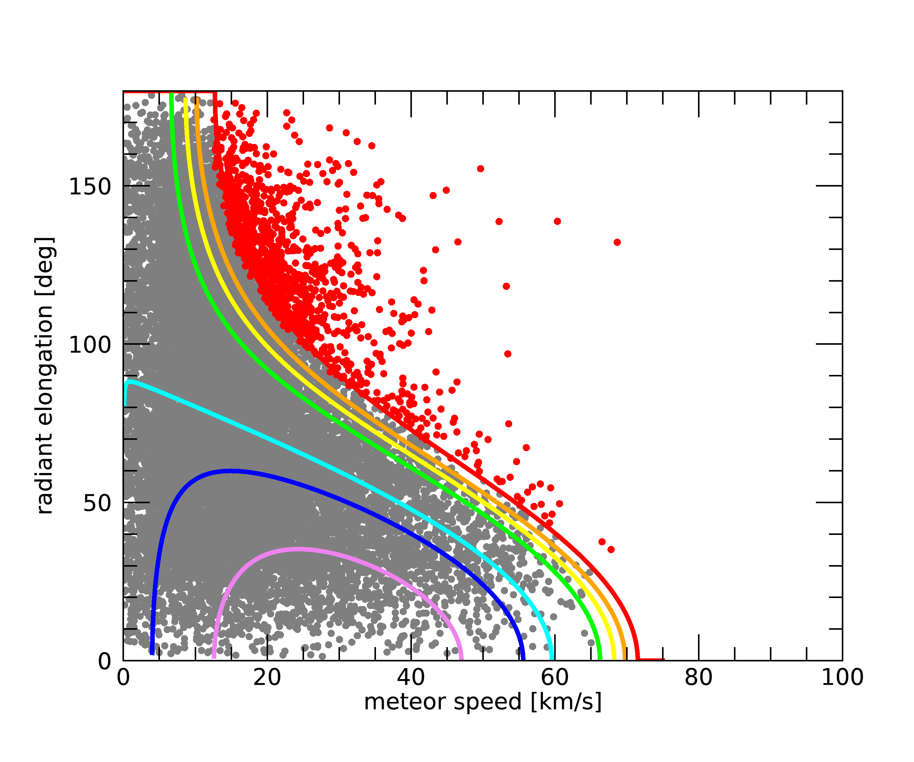

INTERSTELLAR METEORS DYNAMIC MODEL
The best way to understand if an event is an interstellar meteor candidate is to use the plots of the velocity of the meteor as a function of the radiant elongation according to: $\overset{⃑}{V_{H}}=\overset{⃑}{V_{g}}+\overset{⃑}{V_{0}}$
BARGHINI
PIOTROWSKY
263 EVENTS!

Slide 24
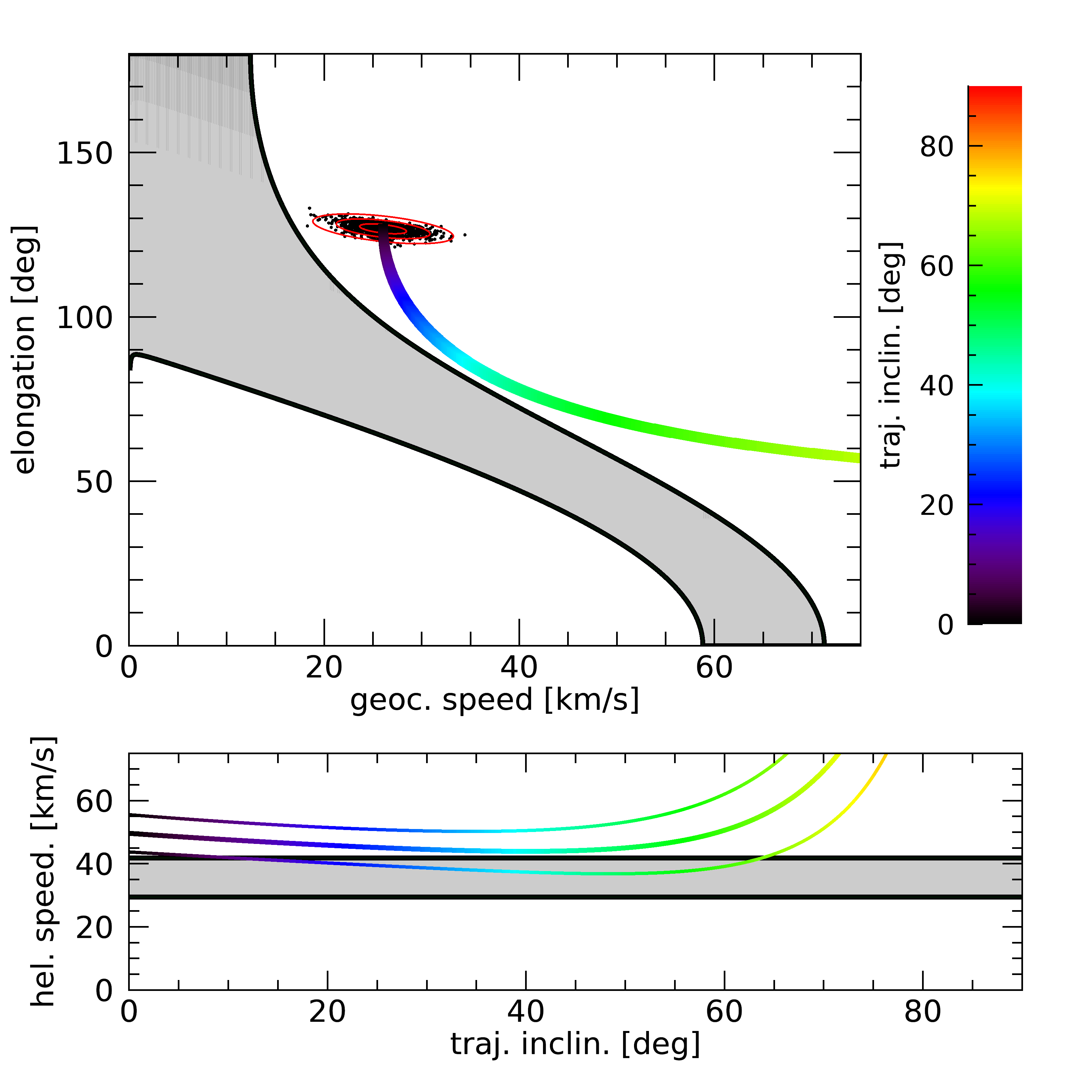
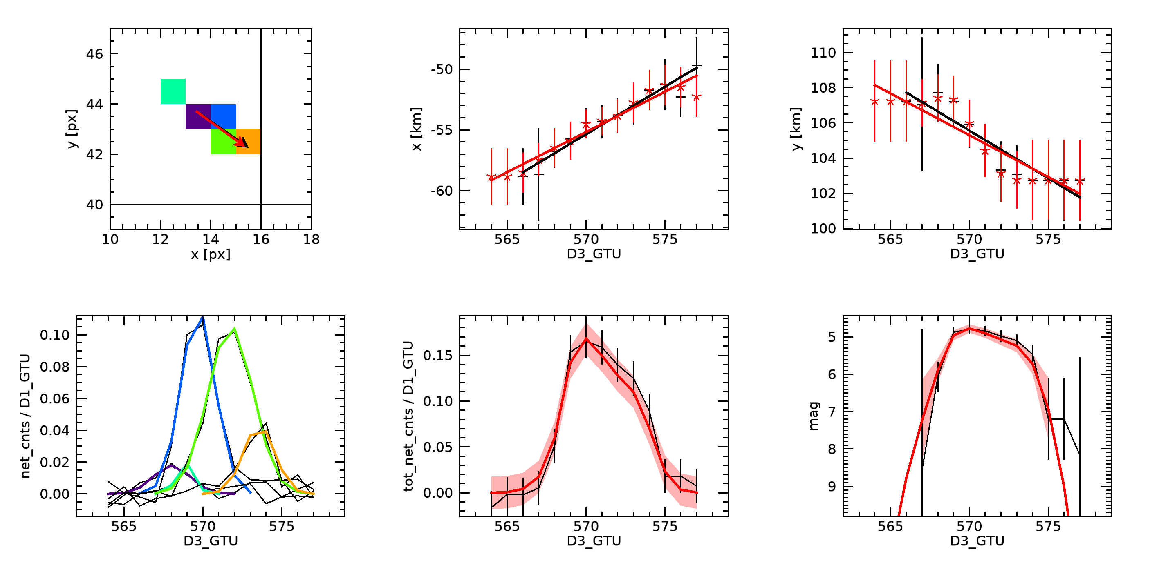
Example Candidates
Research in two databases:
V_{H} > 42 km/s selection and 3σ;
Trajectory simulation (inclination between [0,90]°) ;
3σ acceptance
2020_07_28__08_09_57_gtu3186_x15_y08

Slide 25
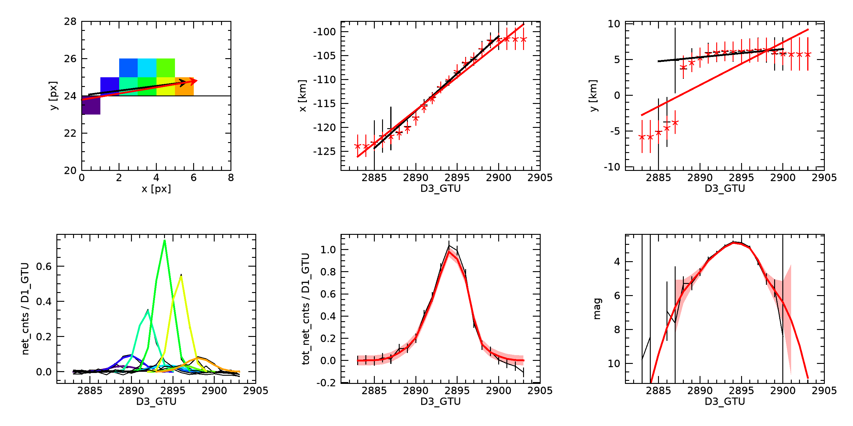
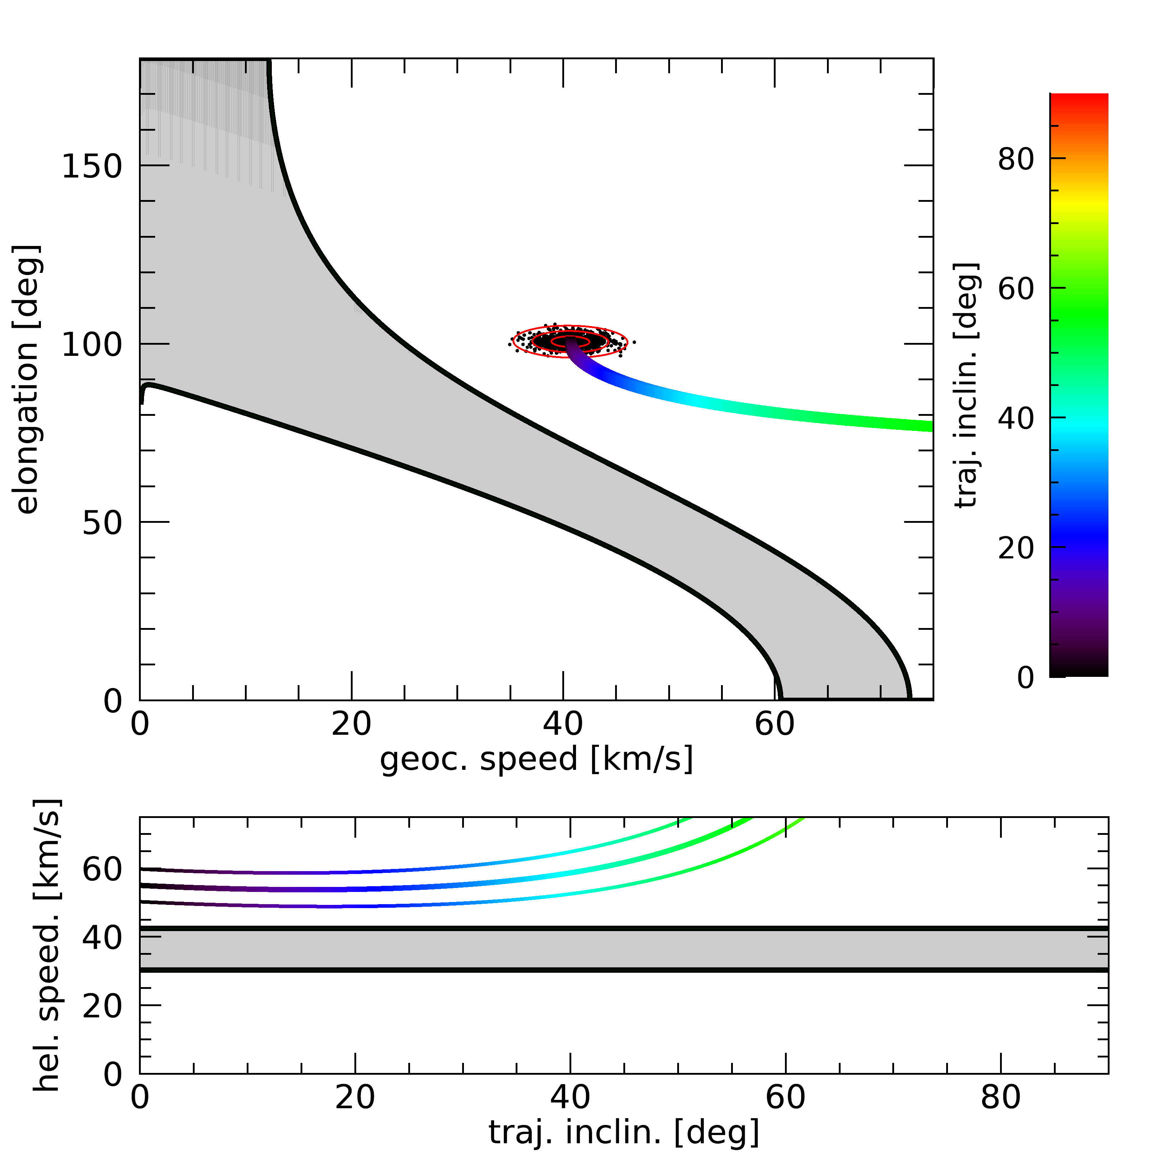
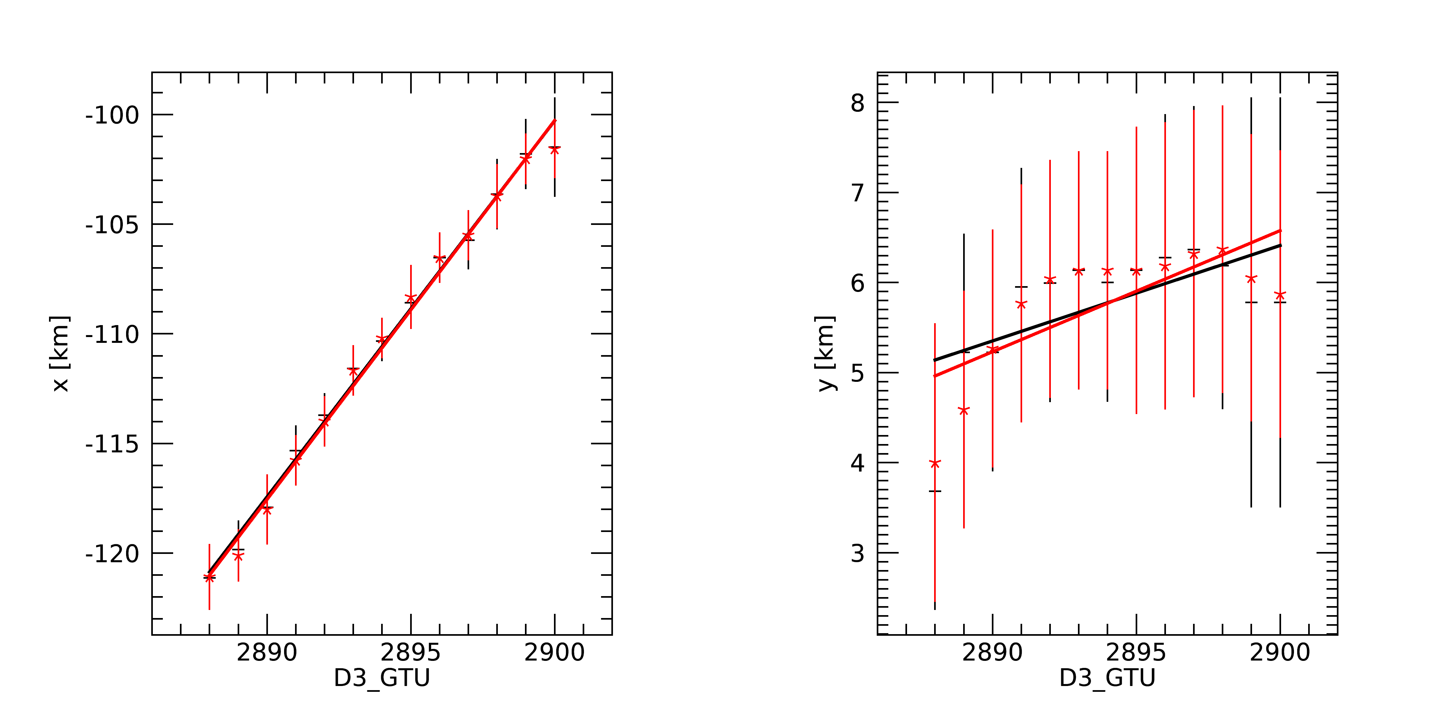
Possible candidates
2021_01_16__07_21_05_gtu2889_x1_y24

Slide 26
RESULTS
The result from the analysis of two different datasets is that we found 9 possible interstellar meteors candidates.

Slide 27
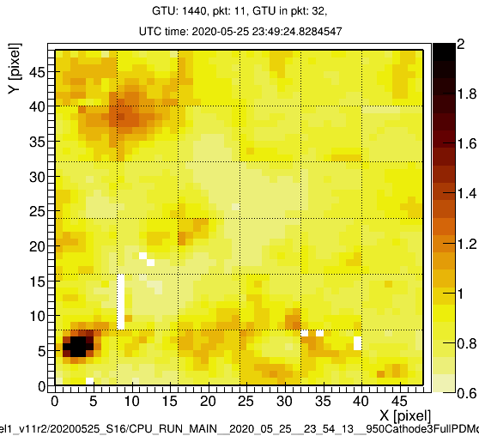
Common: 2021_01_16__07_21_05_gtu2888_x01_y24

Slide 28
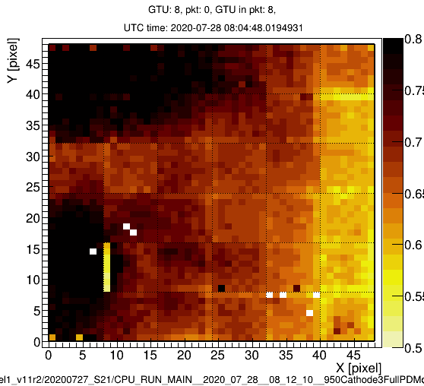
Common: 2020_07_28__08_12_10_gtu0016_x42_y27

Slide 29
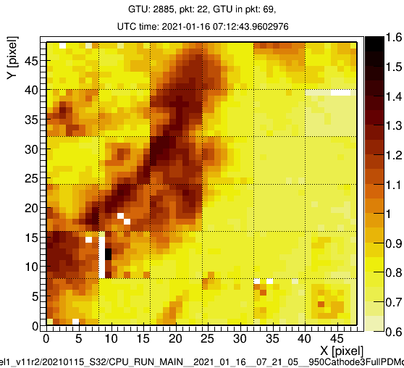
Piotrowsky: 2020_05_25__23_54_13_gtu1442_x00_y30

Slide 30
Nuclearites’ simulation

Slide 31

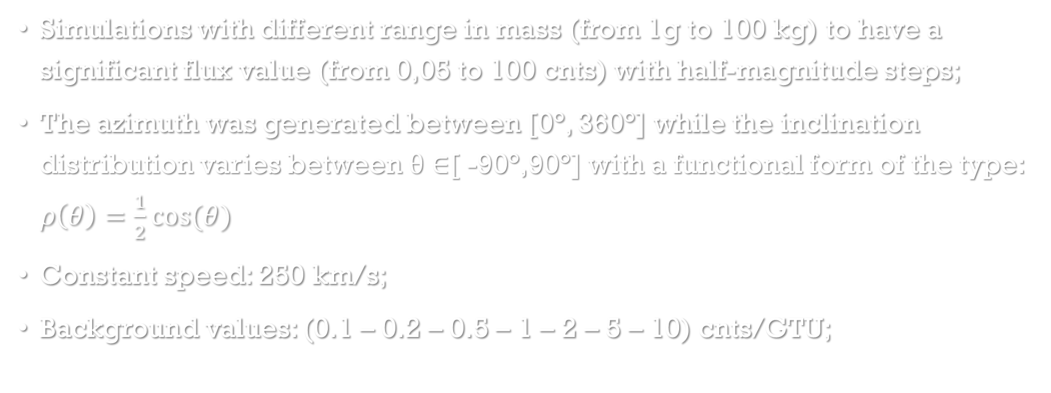
Nuclearites
Simulations with different range in mass (from 1g to 100 kg) to have a significant flux value (from 0,05 to 100 cnts) with half-magnitude steps;
The azimuth was generated between [0°, 360°] while the inclination distribution varies between θ ∈[ -90°,90°] with a functional form of the type: $ρ\left(θ\right)=\frac{1}{2}cos⁡(θ)$
Constant speed: 250 km/s;
Background values: (0.1 – 0.2 – 0.5 – 1 – 2 – 5 – 10) cnts/GTU;
PURPOSE: Mini-EUSO’s efficiency!
$$ε=\frac{Total trigger events}{Total events}$$

Slide 32
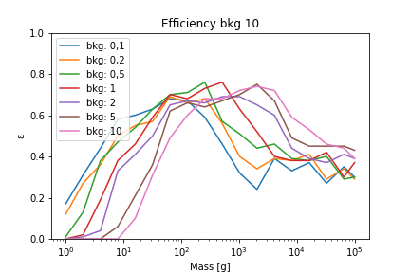
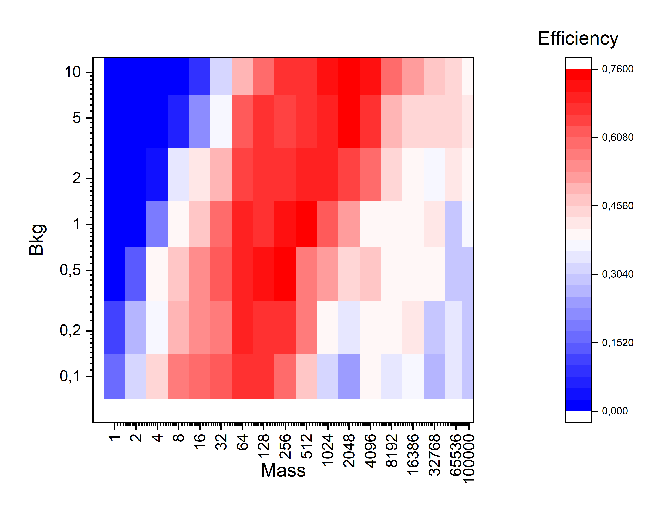
First results
The efficiency does not stabilise as mass increases, but on the contrary tends first to peak
looking at the maximum efficiency values, one realises that they are around 60% for background value 1;
as the background increases, the efficiency increases.

Slide 33
conclusions
In conclusion, it is possible to summarise the results in three macro topics:
Comparison results: Barghini’s and Piotrowsky’s data sets show similar numbers of detective meteors in particular 27% in common and 73% not in common.
Interstellar meteor candidates: 3 possible events seen by Mini-EUSO are candidates to be interstellar meteor.
Mini-EUSO’s efficiency for nuclearites: preliminary results indicate a relatively low efficiency (max 70%) and a peculiar decrease of the efficiency for masses greater than 1 kg, maybe related to a not full suitability of the trigger for these fast events.

Slide 34
Thank you for your attention!
F. Reynaud

Slide 35
Slide di backup

Slide 36
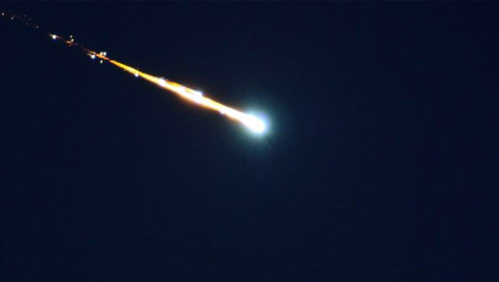
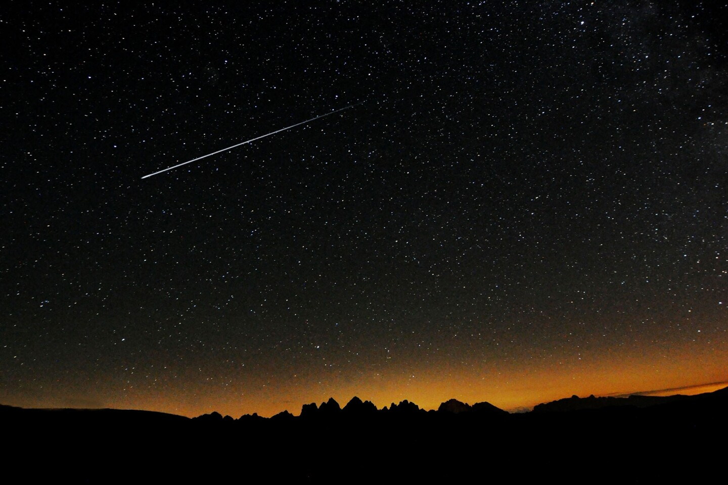
Meteors’ origin
Asteroid: typically have prograde orbits, «low» velocity < 40 km/s
Comet: typically have retrograde orbits, «high» velocity > 40 km/s

Slide 37
Dynamics of Extra-Solar System Particles
The dust particles from the Local Interstellar Cloud (LIC) which move inside the heliosphere experience the solar gravity, solar radiation pressure and the Lorentz force.
The strength of these forces is given by the ratio F_{SRP}/F_{grav} (β parameter).
d < 1 μm → β > 1
d > 1 μm → β < 1

Slide 38
OFFLINE TRIGGER
Barghini
piotrowsky
The principles of the off-line trigger:
Divides data into cathode 3 and cathode 2 for each EC;
Find pixel’s signal rise over threshold, after background subtraction (TSpectrum for now);
Leave consecutive events (at least 2 in 4 frames);
Group those single-pixel events together in space-time using KD-tree;
Apply a lot of cuts and categorisations (meteors, flashes, lightnings, etc.) in two steps
Perform basic measurements and image preparation (lightcurve, track, animation, etc.) for meteors;
Stores information in a database.
Track of over-threshold pixels over 4 consecutives GTUs (D3)
The threshold is set at pixel level: μpix+ 3σpix computed over the last 16 GTUs
The trigger is discarded if more than 64 pixels are triggered at the same time on the same EC (Cathode2 → Cathode3)

Slide 39
Meteor tracking algorithm
Starting from the trigger results(first triggered pixel and GTU), we scan neighbouring pixels to reconstruct the entire meteor track
For each pixel, we perform an automatic gaussian fit + polynomial background on the lightcurve within ± 30 GTUs
If several criteria are matched(e.g., is the gaussian height significant?) the pixel is added to the track and its first neighbourhood is added to the process. This procedure is iteratively repeated until no more pixels are found to be significant.

Slide 40
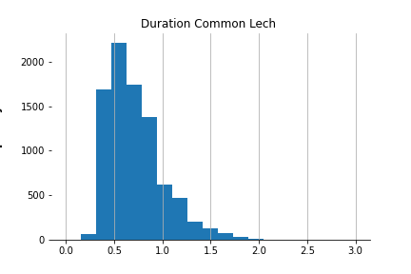
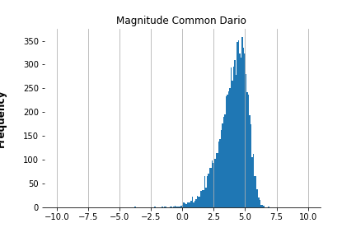
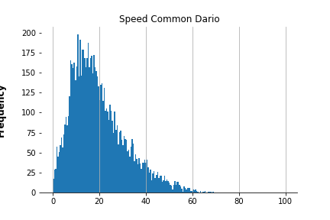

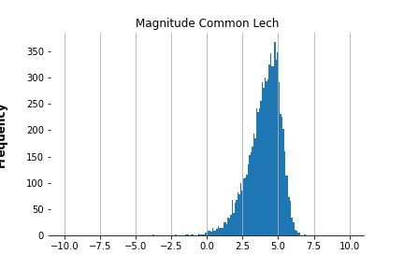

Histogram Plot Results (common data)
Magnitude
Speed [km/s]
Duration [s]

Slide 41
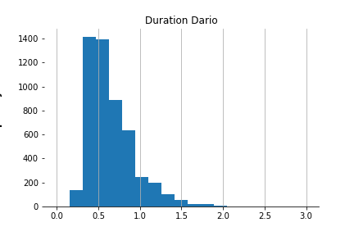
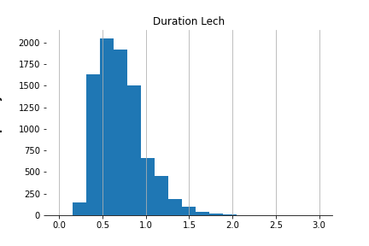
Duration distribution
[s]
[s]

Slide 42
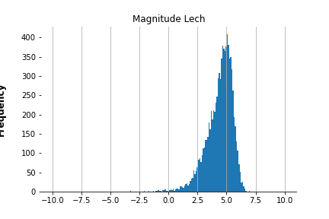
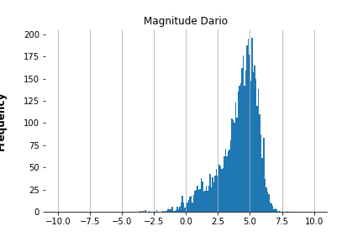
Magnitude distribution

Slide 43
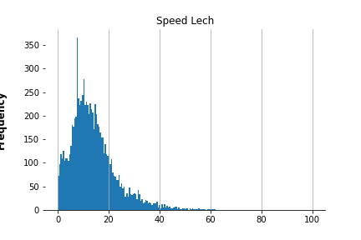
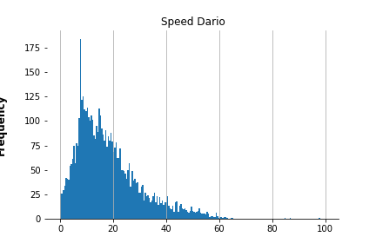
Speed distribution
km/s
km/s

Slide 44
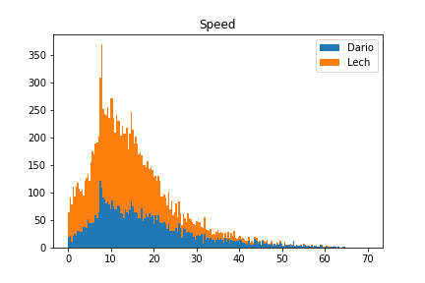
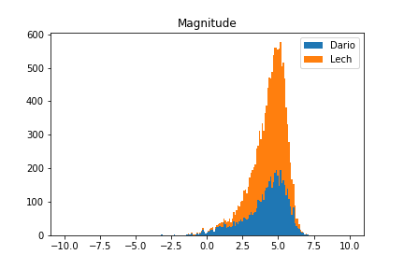
Different Data Distribution
km/s

Slide 45
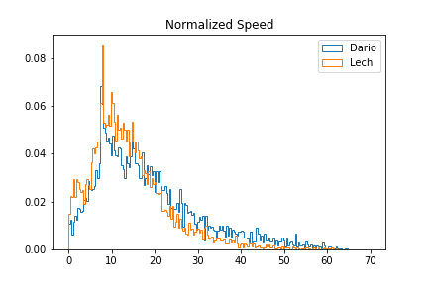
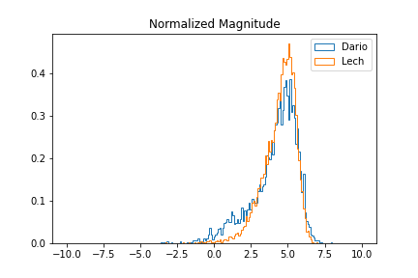
Different Data Distribution
km/s

Slide 46
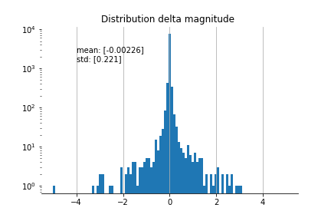
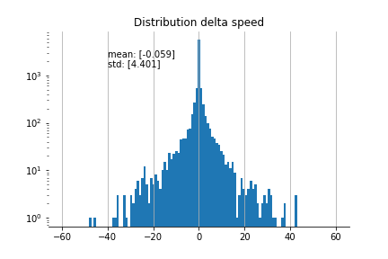
Delta distribution
km/s
The queues represent different events that are still in analysis to understand why they are being processed by the two triggers.

Slide 47
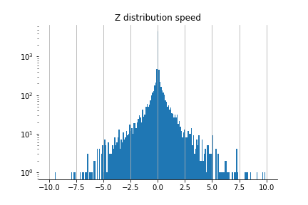
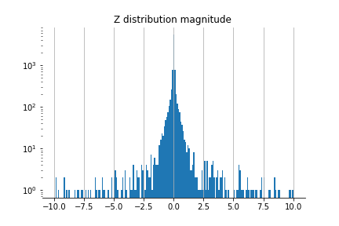
Z Distribution Test

Slide 48
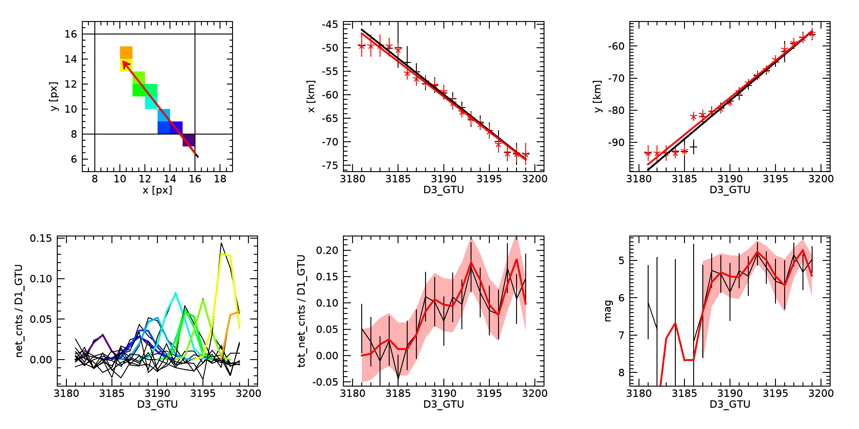

Not possible candidate
2020_05_25__17_53_58_gtu0568_x14_y43

Slide 49




First Common Possible candidate
2020_07_28__08_12_10_gtu0016_x42_y27

Slide 50


Second Common Possible candidate
2021_01_16__07_21_05_gtu2888_x01_y24
BEFORE AFTER

Slide 51




THIRD Possible candidate
PIOTROWSKY: 2020_05_25__23_54_13_gtu1442_x00_y30
BEFORE AFTER

Slide 52


RESULTS
BARGHINI
PIOTROWSKY
3 EVENTS!

Slide 53
Possible candidates
Common
Common
Piotrowsky
2020_07_28__08_12_10_gtu0016_x42_y27
2021_01_16__07_21_05_gtu2888_x01_y24
2020_05_25__23_54_13_gtu1442_x00_y30

Slide 54


First Common Possible candidate
Second Common Possible candidate
2020_07_28__08_12_10_gtu0016_x42_y27
2021_01_16__07_21_05_gtu2888_x01_y24

