Slide 1




Suriano Alessio
Erasmus Traineeship
A.Y. 2018/2019
Data processing of Airglow MOnitor – Extended Station (AMON-ES)
Coordinator: Prof. Mario Bertaina
Advisor: Dr. Šimon Mackovjak
Department of Space Physics, Institute of Experimental Physics, Slovak Academy of Sciences, Košice, Slovak Republic
Dipartimento di Fisica, Università degli Studi di Torino

Slide 2
Index
Physics overview
  Ionosphere
  Radiative emission processes
  Airglow
AMON-ES
  The instruments
  Sun and MOON influence in AMON measurements
  First data plotted
Conclusions and next steps

Slide 3
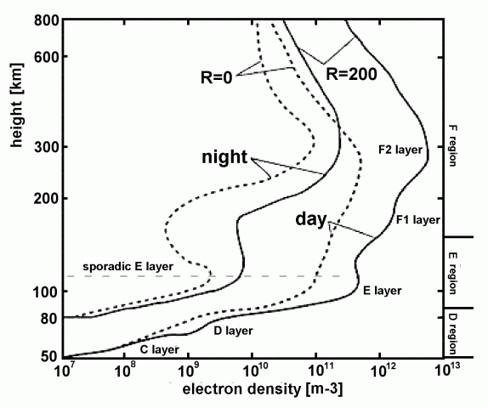
Concentration of ions changes basing on solar activity and altitude
F1 and F2 regions merges during the night forming a single F region, there are important in HF communications
F region is dynamically active in fact reactions occurs there:
  O + hν → O⁺ + e⁻
  O⁺ + O₂ → O₂⁺ + O
Fig. 2. Typical day and night profiles of electron density in the ionosphere. [3]

Slide 4
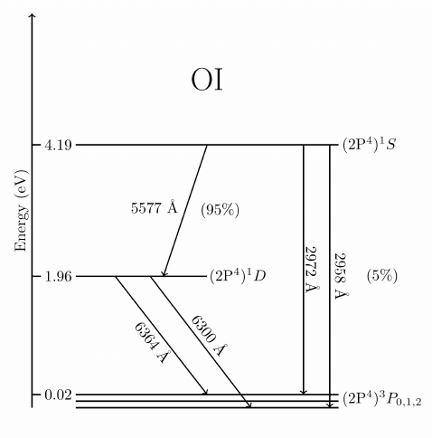
Exited atoms are produced through dissociative recombination
O₂⁺ + e⁻ → O* + O* + 7eV
Thanks to atomic transitions the metastable state decays in the ground state:
  557.7 nm (green), lifetime 0.74s
  630.0 nm (red), lifetime 110s
In the E region red line is missing because the lifetime of the intermediate state is larger than the flew time associated at the free mean path, so energy is removed through collisions with other molecules²
Fig. 3. Energy level diagram of atomic oxygen showing different spectroscopic transitions related to 1S and 1D states. [4]

Slide 5
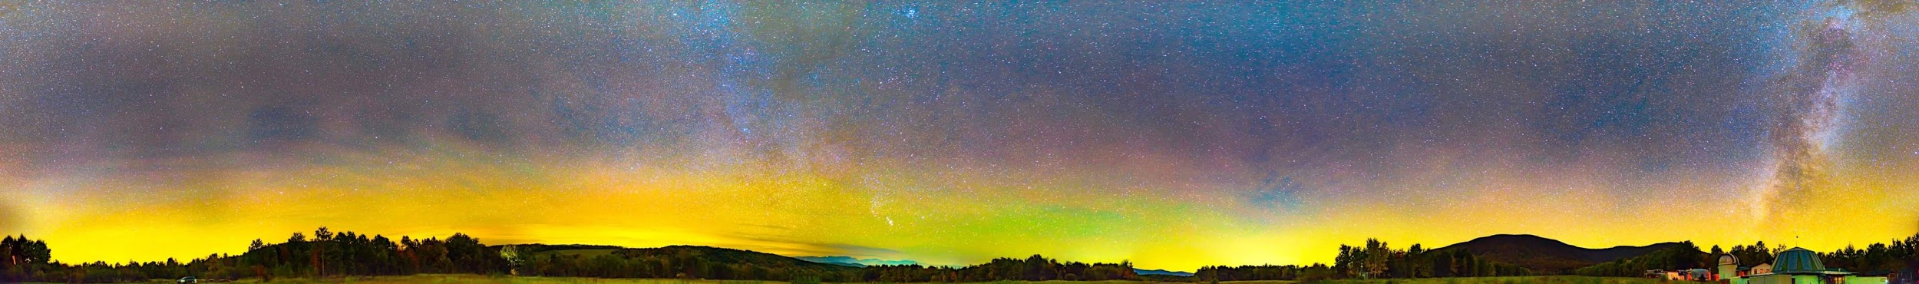
Airglow
Fig. 4. Airglow in Kolonica, Slovakia. Photo by Šimon Mackovjak.
Atmospheric phenomenon formed due to emission of photons from the atmospheric constituents, which are exited directly or indirectly by the electromagnetic radiation of the sun.⁵

Slide 6
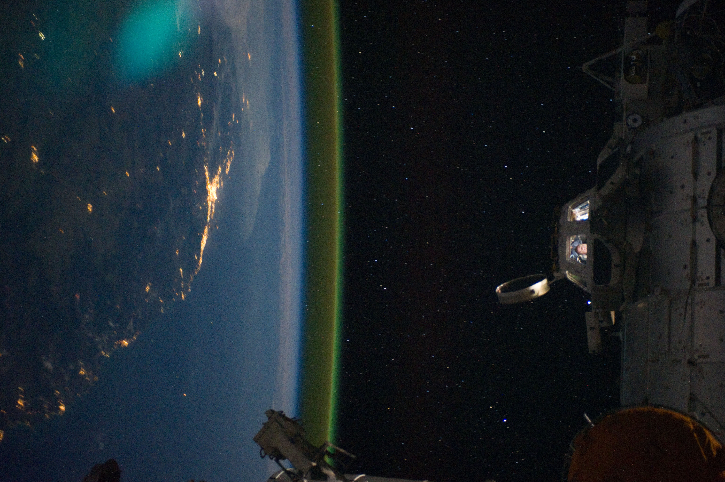
557.7 nm at
90-100 km
Fig. 5. The airglow above the horizon, captured from the ISS. [6]

Slide 7
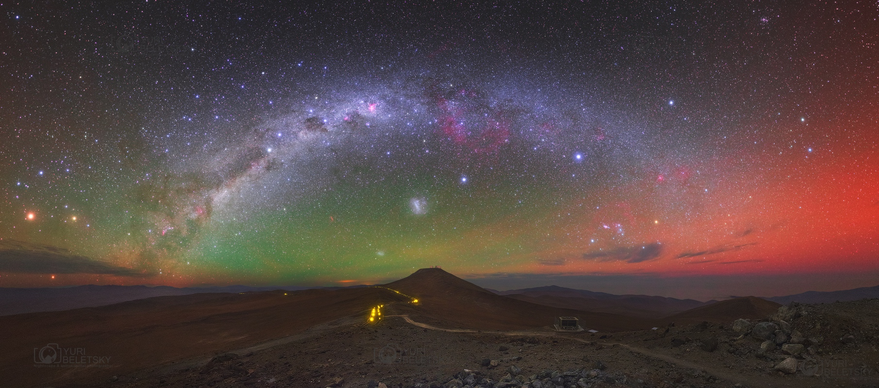
630.0 nm at 150-300 km
Fig. 6. Milky Way vs Airglow Australis in Atacama Desert. [7]

Slide 8
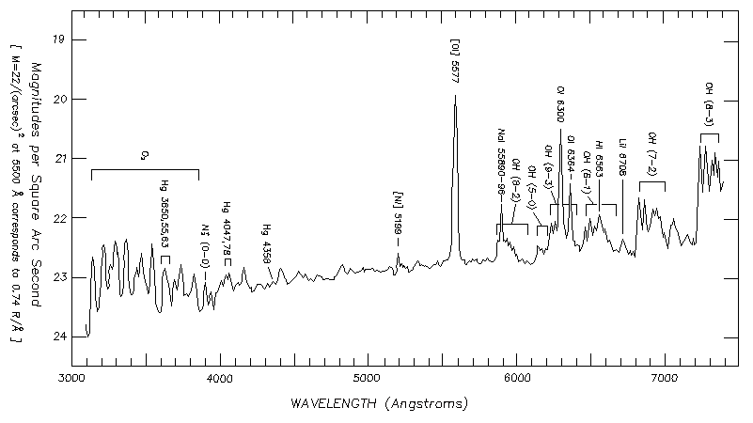
Oxygen airglow is the main part of visible and UV sky background
Airglow 557.7nm
Airglow UV band
Airglow 630nm
Fig. 7. Typical spectrum of visible night sky emission at Mauna Kea. [8]
Airglow infrared

Slide 9
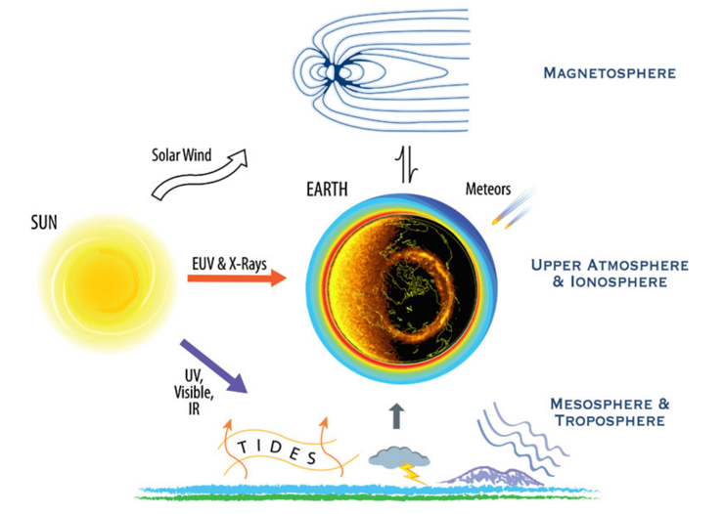
Upper atmosphere is a dynamic system
Thermosphere-ionosphere environment is influenced by space and Earth weather conditions tides, planetary waves and atmospheric gravity waves
Seasonal, geographical and daily variations are possible
Airglow variations could be associated with upper atmosphere composition
Fig. 8. The various path of solar energy to the Earth’s upper atmosphere and ionosphere as well as its coupling to the magnetosphere above and the mesosphere and troposphere below. [9]

Slide 10
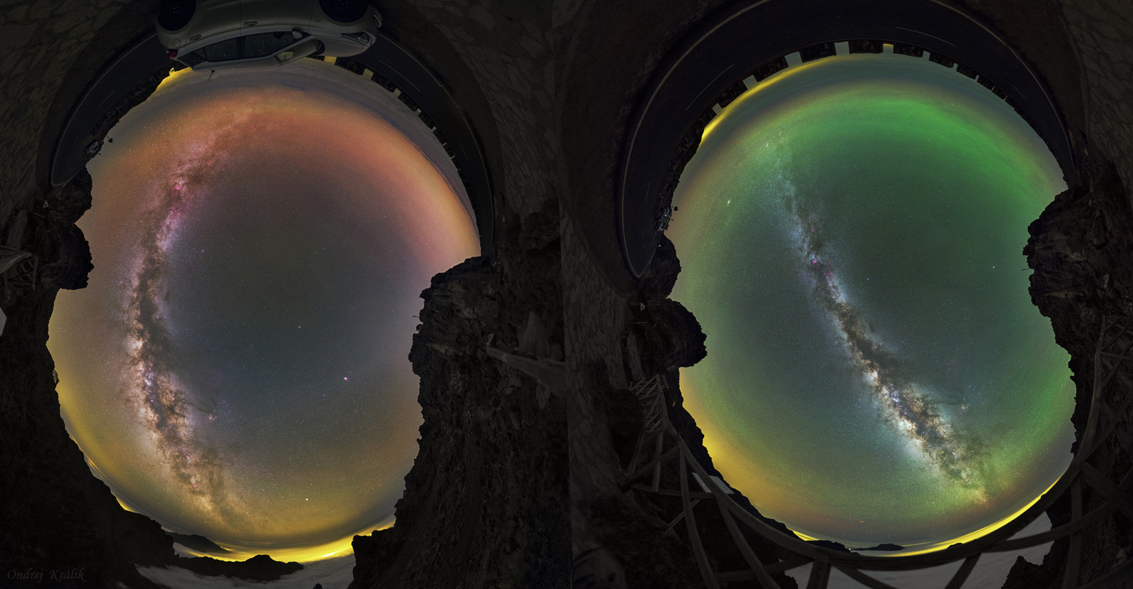
Airglow emission is not constant!
18 June 2017
21 June 2017
Fig. 9. Airglow, La Palma. [10]

Slide 11
Could we monitor the ionosphere disturbances by a network of simple airglow photometers?

Slide 12
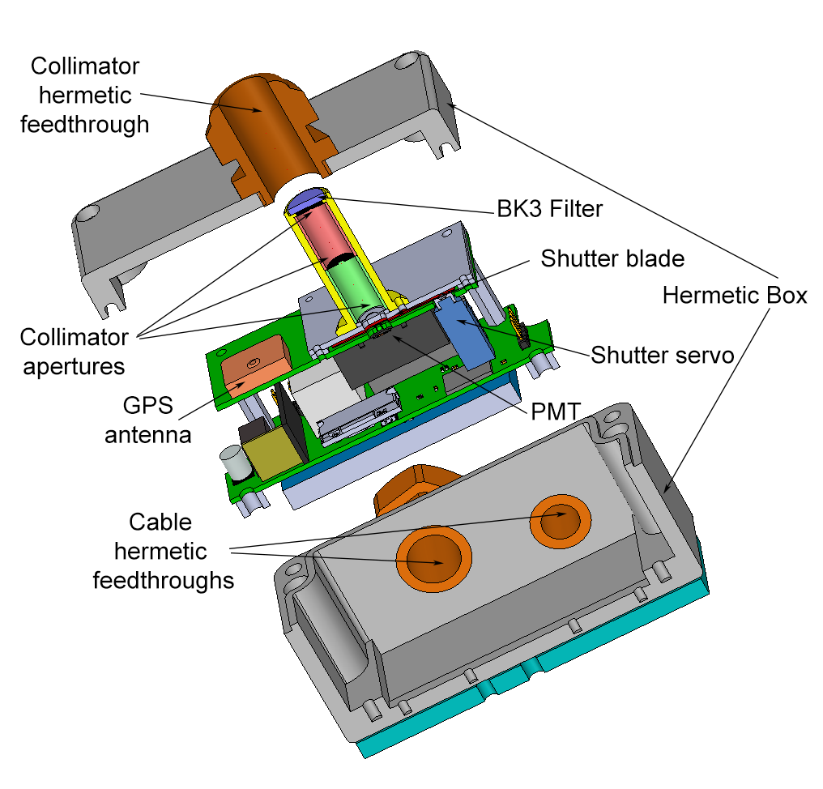
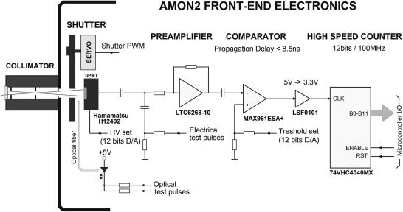
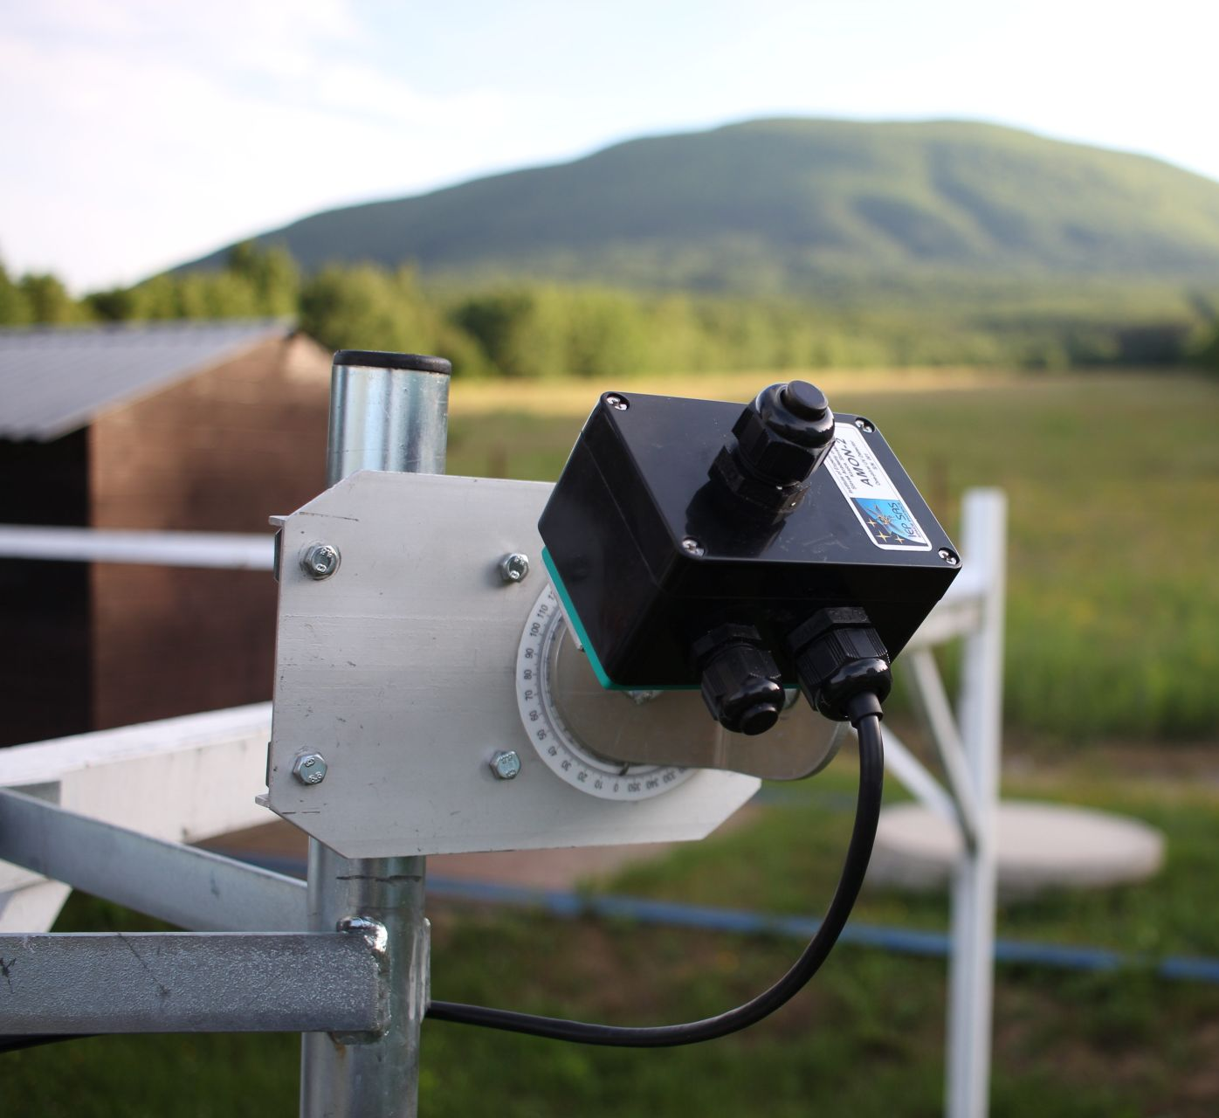
AMON – Airglow MONitor¹²
Single pixel detector based on a μPMT
Spectral response 300-650nm
Weight: 575g
Dimension: 110 x 75 x 95 mm
Lux-meter, thermometer, barometer, humidity-meter, GPS receiver, 3D accelerometer integrated
Power consumption: 1W
Bandwidth: 100 B/s
BG3 .
Fig. 10. The exploded view of instrument with the indication of the main components. [11]
Fig. 11. The schematic view of the instrument front-end electronics. The main components are indicated with exact denotations. [11]
Fig. 12. AMON

Slide 13
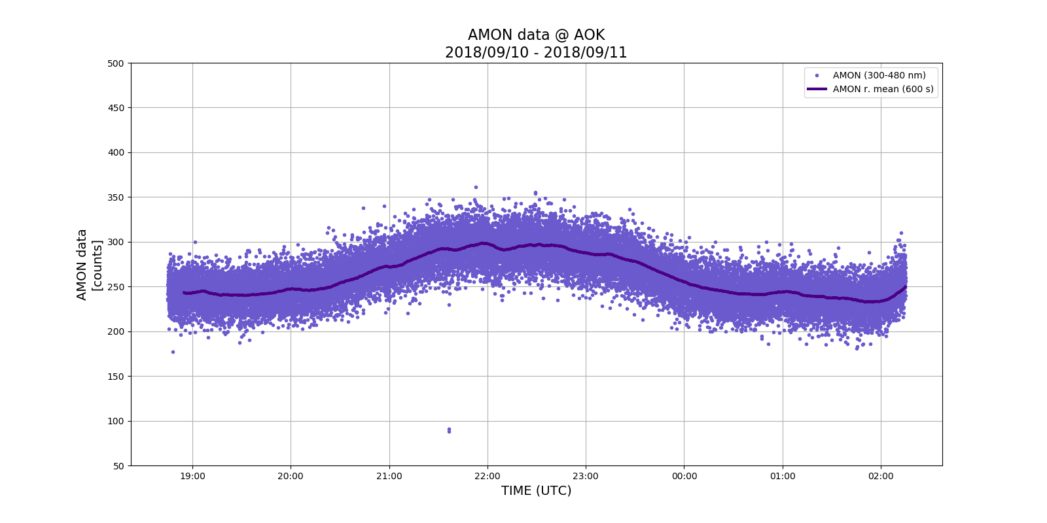
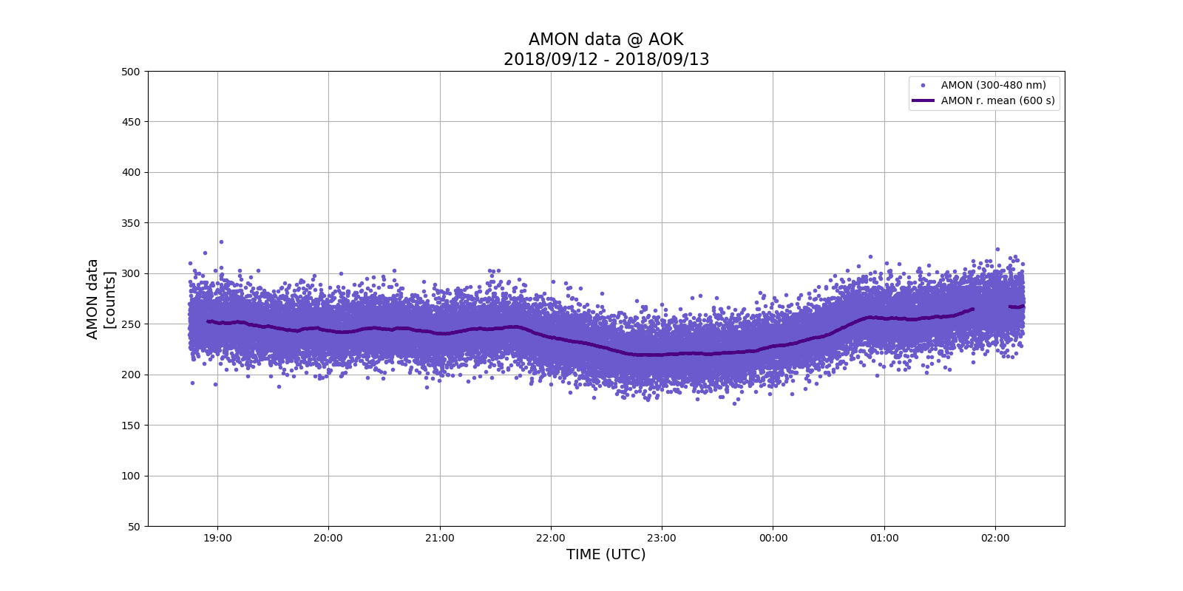
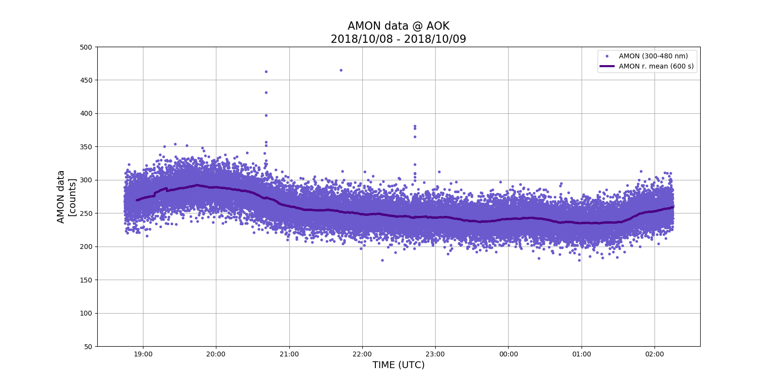
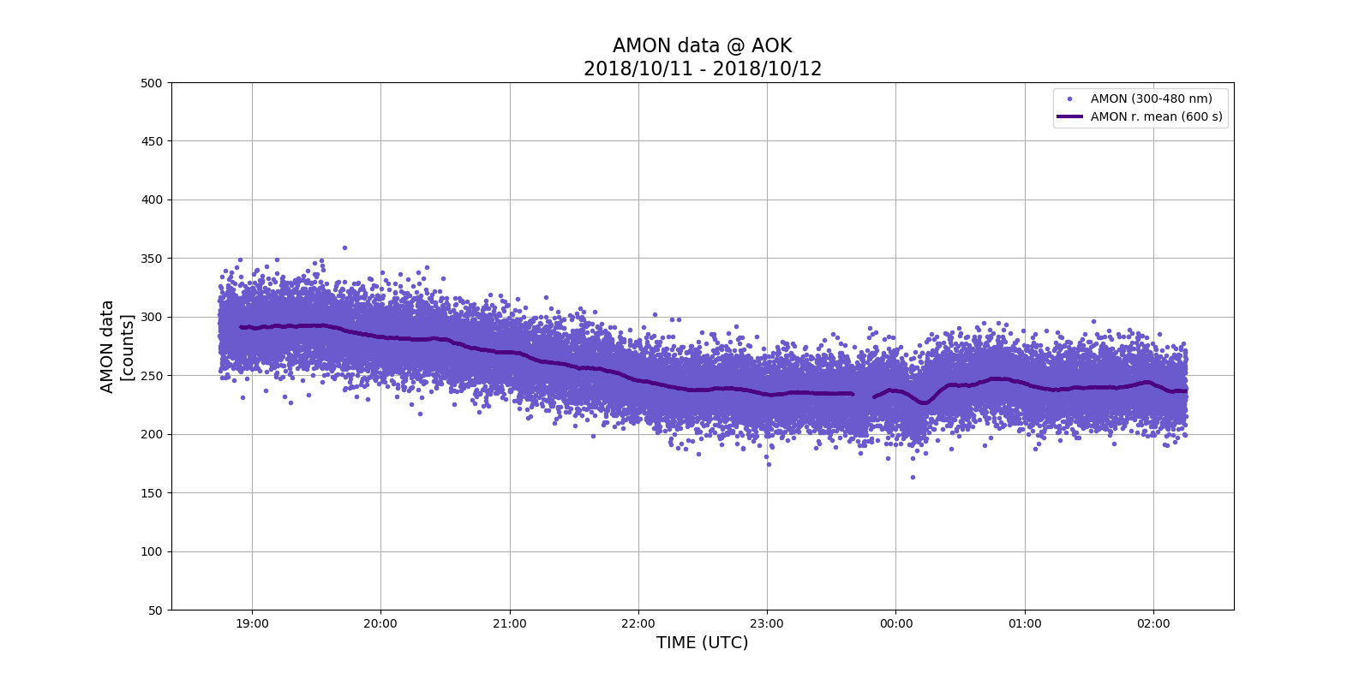
Evolution of measured intensity in different nights
Fig. 13. Airglow intensity in different nights

Slide 14
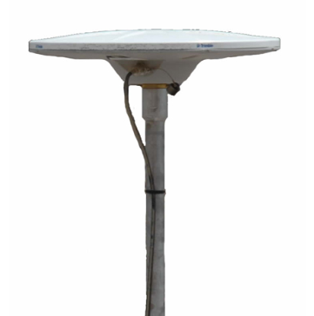
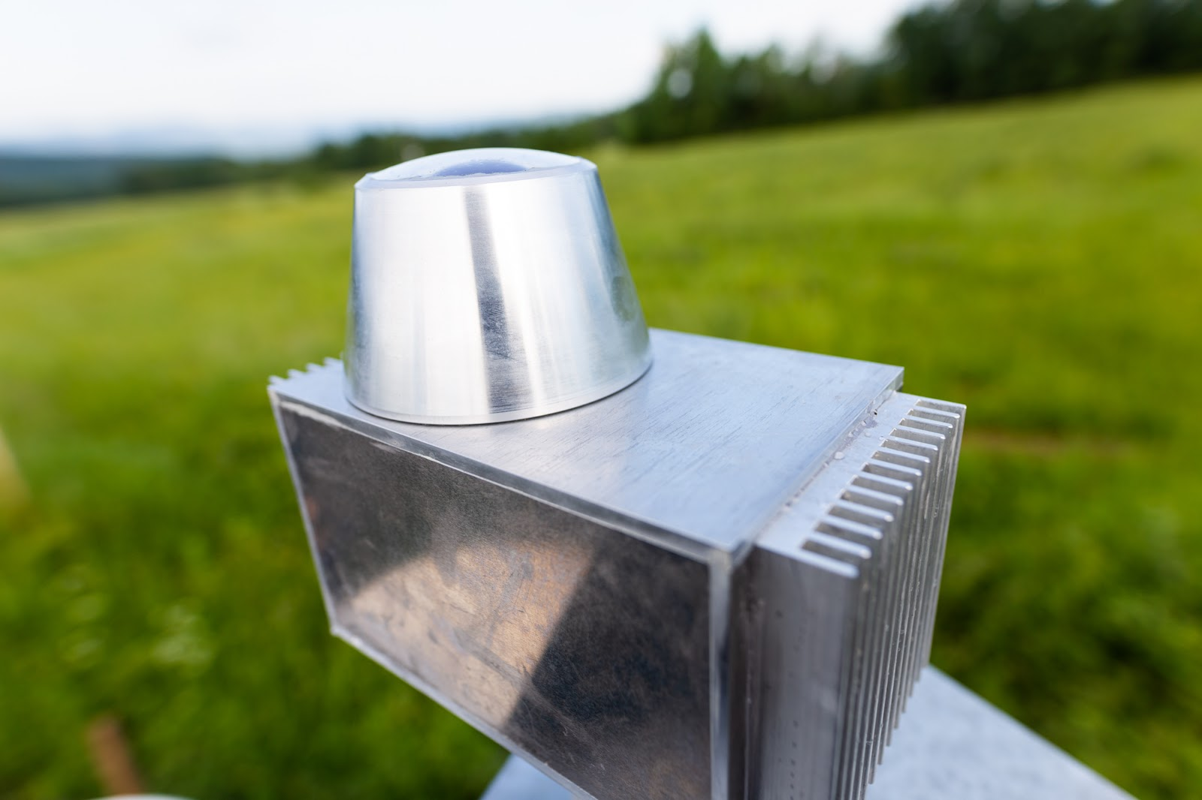
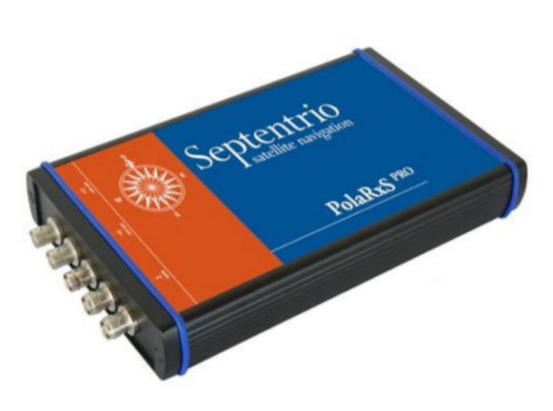
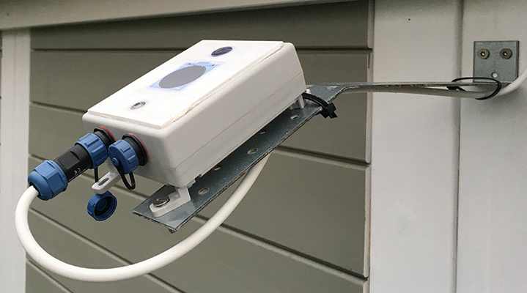
AMON-Extended Station
The aim is to investigate if a network of cheap and easily operated one-pixel detectors could detect the variation in airglow intensities and so contribute to the monitoring system of the ionospheric disturbance.
Weather monitoring system
AAG CloudWatcher¹² through IR sensor, thermometer, humidity meter, pression meter and rain sensor detects weather condition switching off AMON-ES during cloudy and extremely freezing conditions.
All sky camera
Moravian Instruments G2-4000 is a fishy camera equipped with a filter wheel to select different wavelength (558, 630, 300 - 500, 700 - 930, 572 nm). Will provide information about airglow evolution all over the sky
Ionosphere monitoring system
Septentrio PloaRxS¹³ is a GNSS receiver for ionospheric scintillation monitoring that provides TEC index. These data will be used for comparison with airglow data.

Slide 15
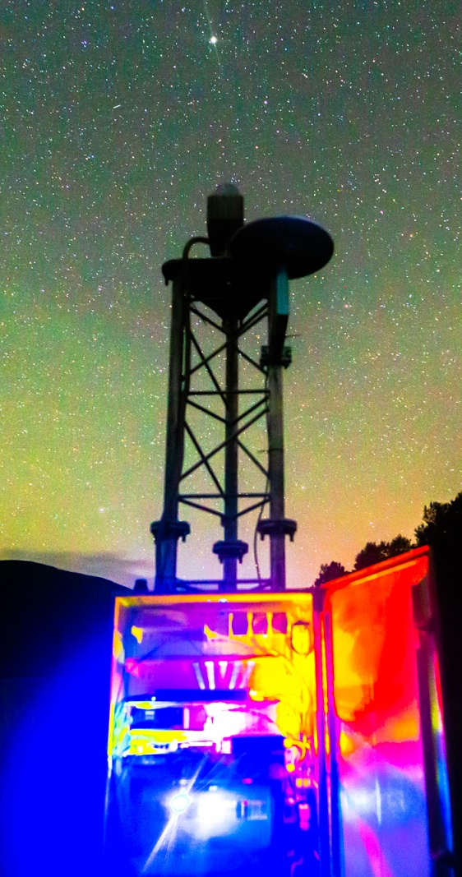
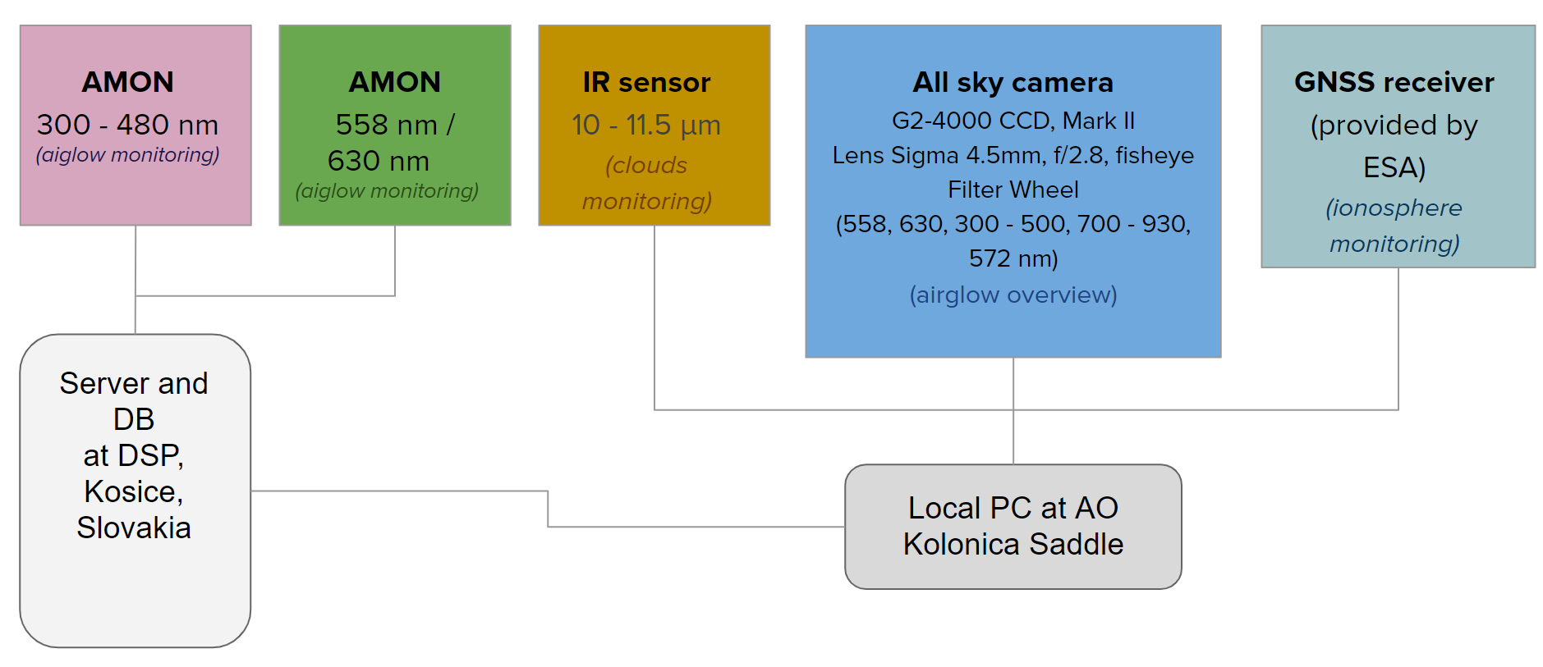
AMON-Extended Station
Devices integration
Fig. 14. Scheme of AMON Extended Station facility. Created by Šimon Mackovjak.

Slide 16
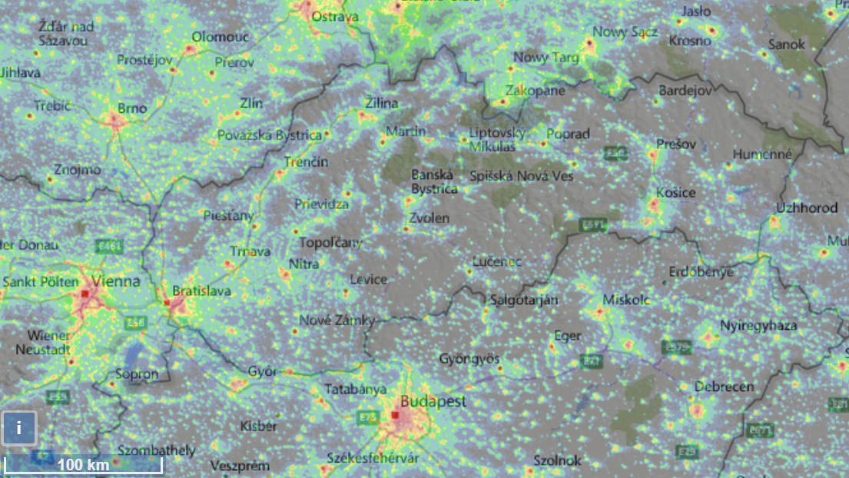
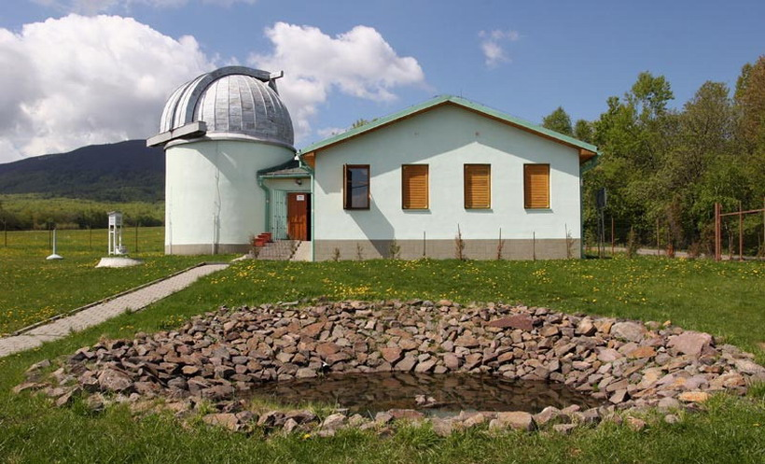
AMON-ES location
Astronomical Observatory at Kolonica Saddle
Lat: 48.9349° N
Long: 22.2737° E
Alt: 450 m asl
www.lightpollutionmap.info

Slide 17
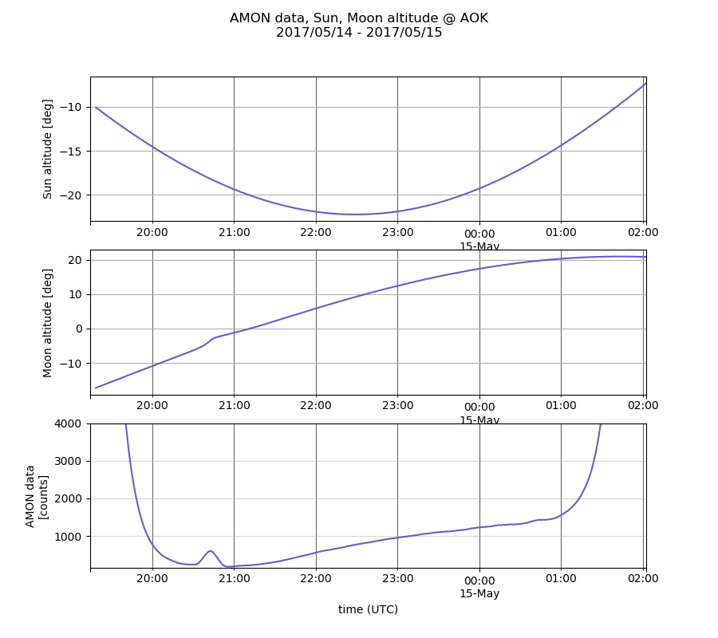
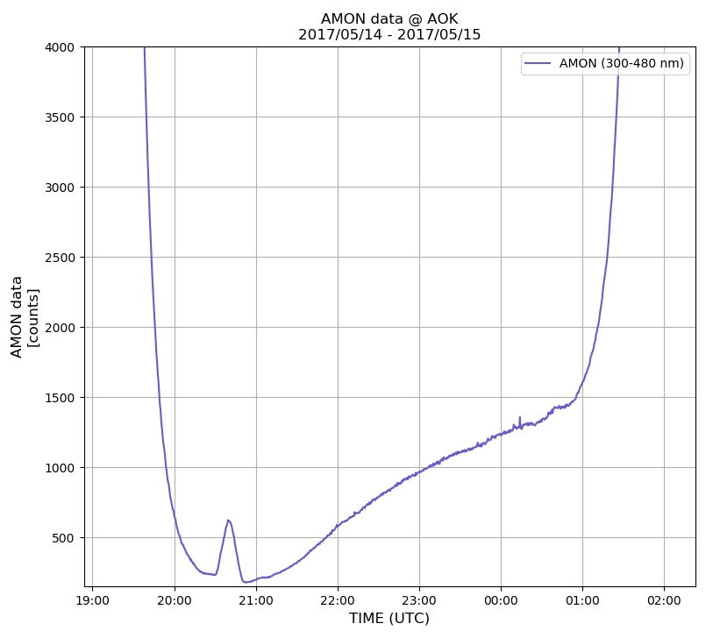
Sun and moon affect AMON measurements
AMON revealed intensity compare with sun and moon altitude
AMON revealed intensity
Fig. 15. First AMON data plot and an evaluation’s example of Sun and Moon’s position

Slide 18
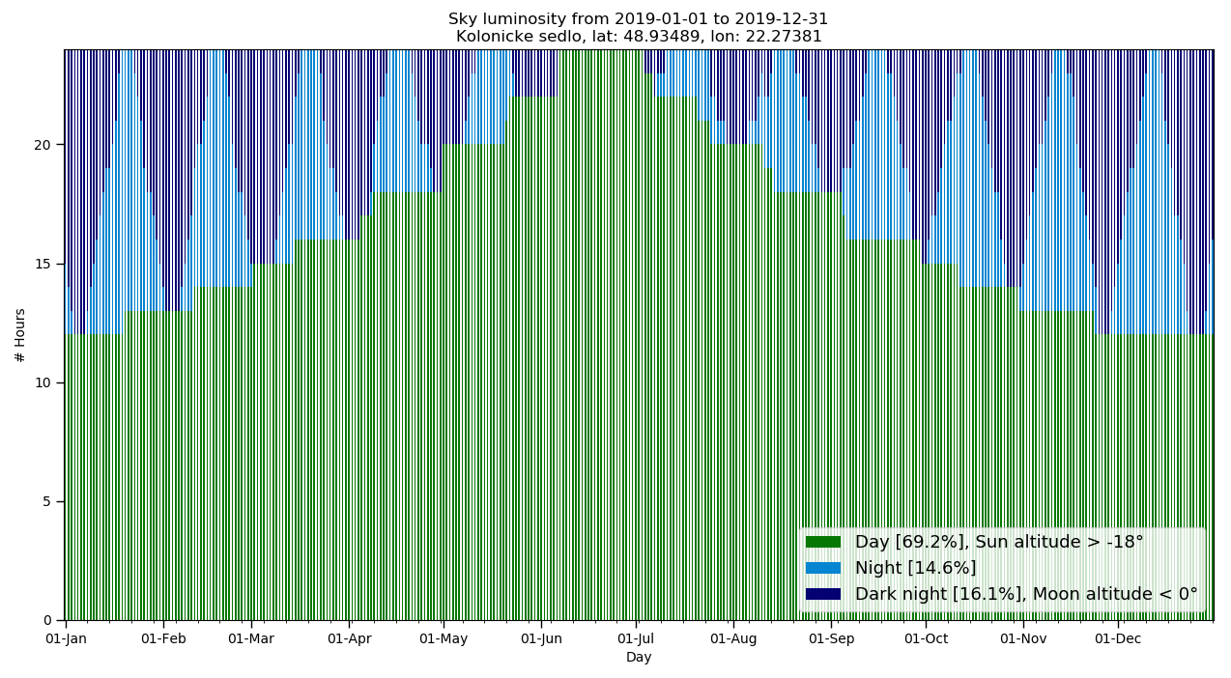
Dark nights for AMON-ES
We can measure airglow only in very dark conditions
Fig. 16. The number of hours for day, night and dark night conditions at AOK for the year 2019.

Slide 19
Non suitable weather conditions
Fig. 17. The example of not clear sky conditions at AOK. The presence of cloud is blocking the light from stars and Milky way.

Slide 20
AMON All-sky Camera (AAC) – available filters
R
G
N
IR
UV
Fig. 21. The typical airglow spectrum by [9]. The five spectral filters that are used in AAC are indicated with the width and the designation.

Slide 21
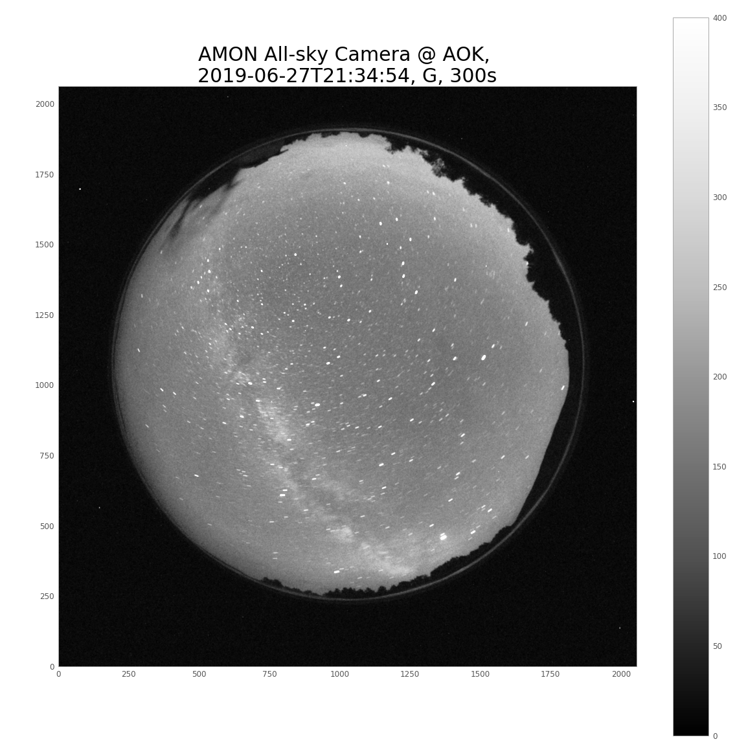
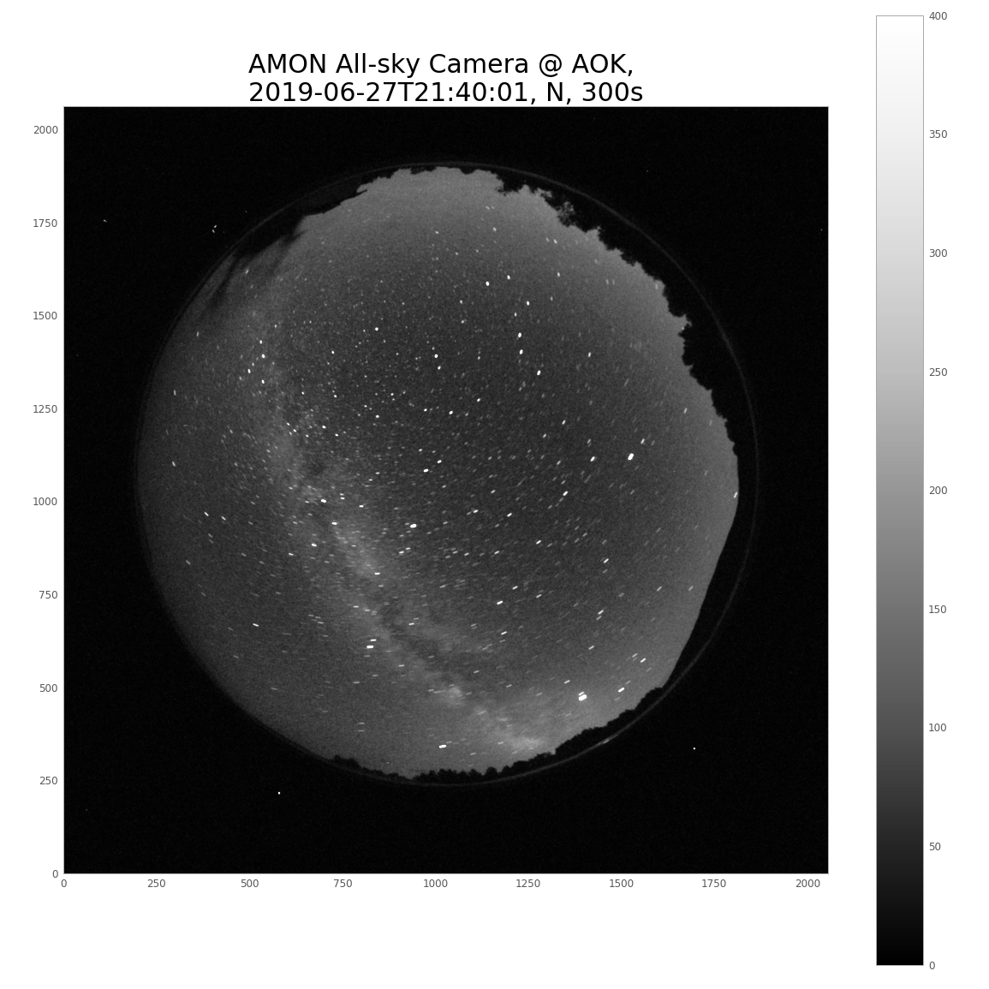
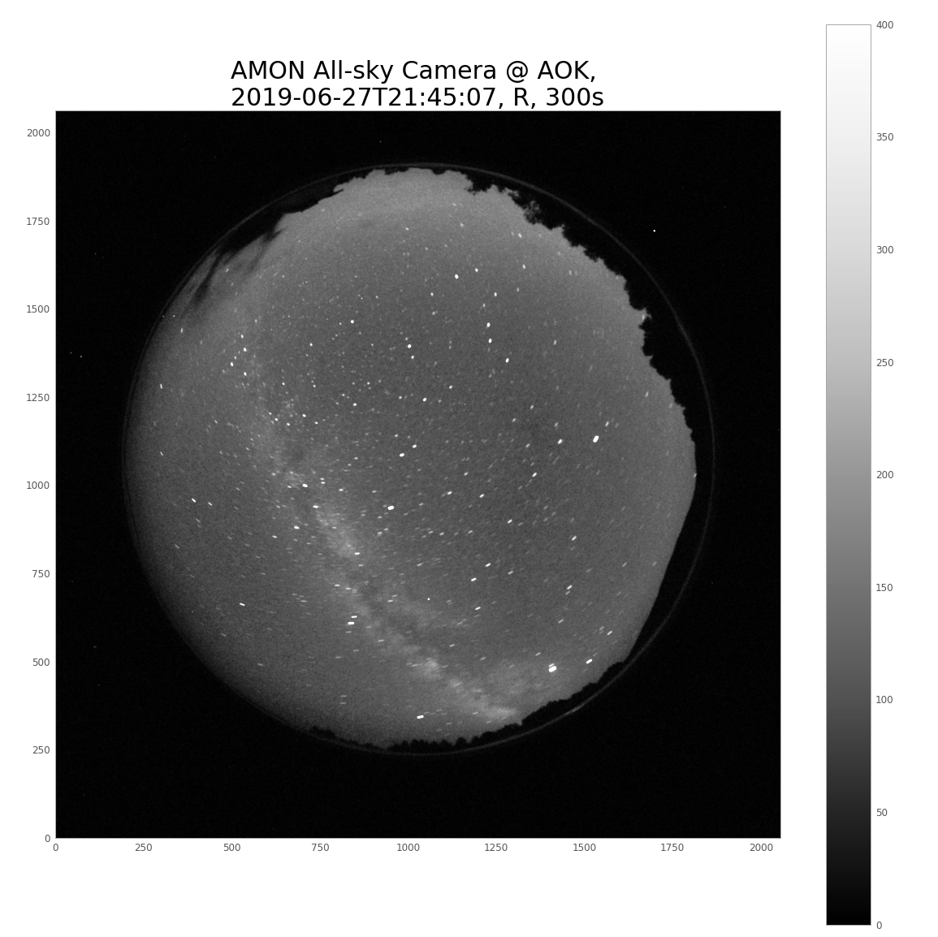
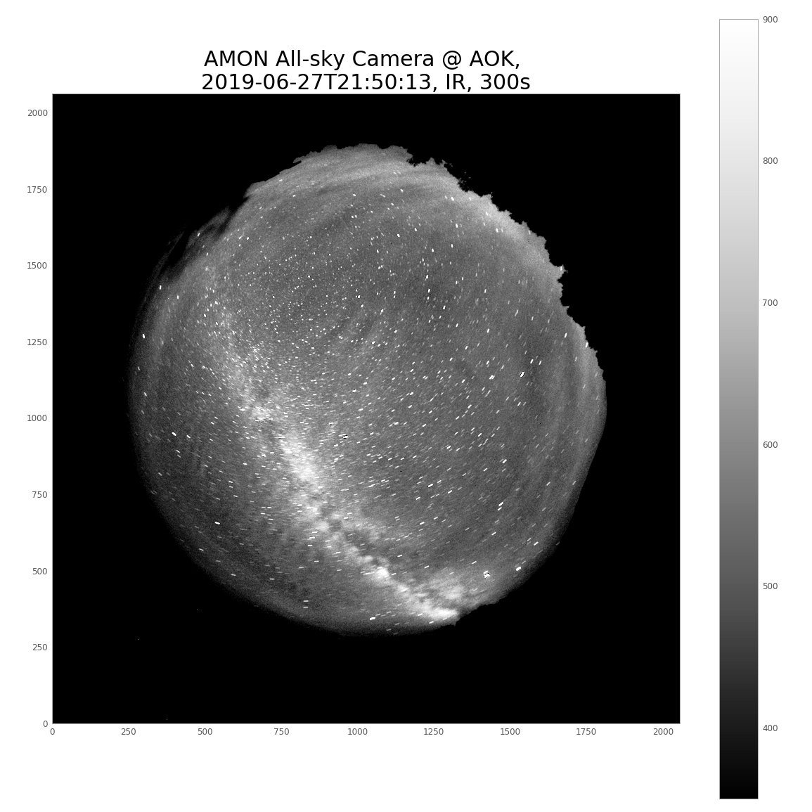
AMON All-sky Camera (AAC)
We can detect great changes basing on the wavelength filter we choose
Fig. 22. The all sky images in filters G, N, R, IR obtained by AAC on 27 July 2019.

Slide 22
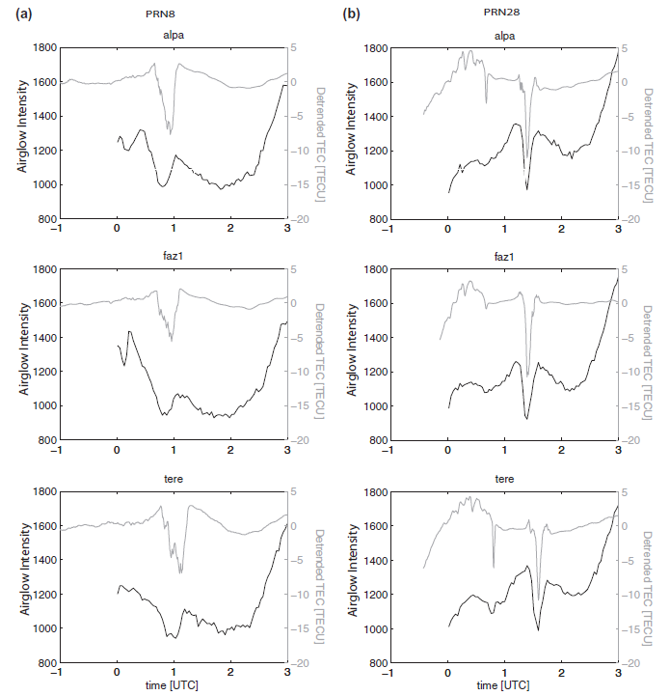
Airglow and ionosphere composition
Total Electron Content.
Fig. 23. An example of multiple plasma depletions imaged in the IR airglow emission.
Fig. 17. Detrended GPS (grey) and airglow intensity extracted from the 630.0 nm airglow images (black). [14]

Slide 23
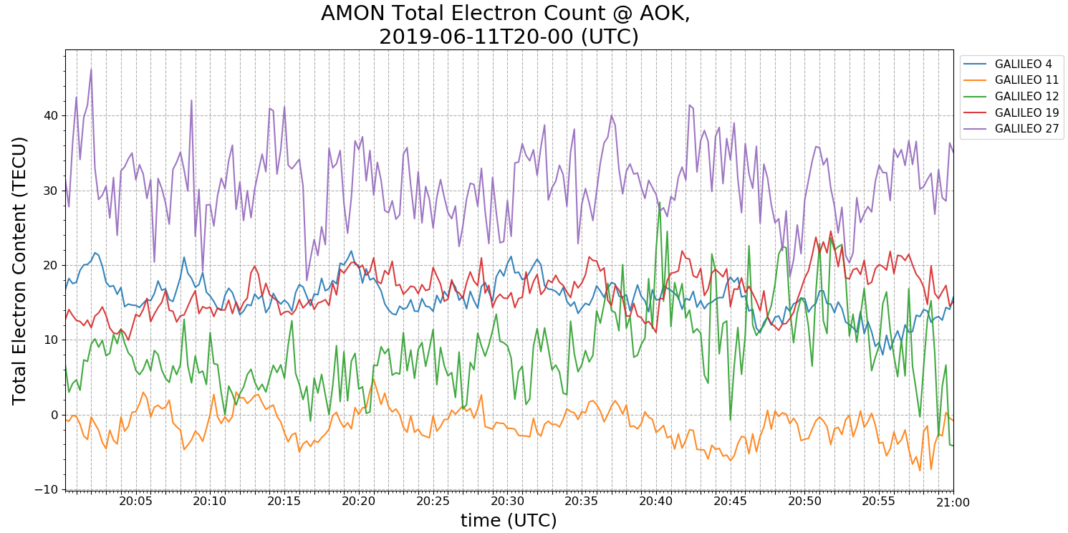
GNSS receiver - TEC by Galileo satellites
Fig. 24. TEC over time by Galileo Satellites

Slide 24
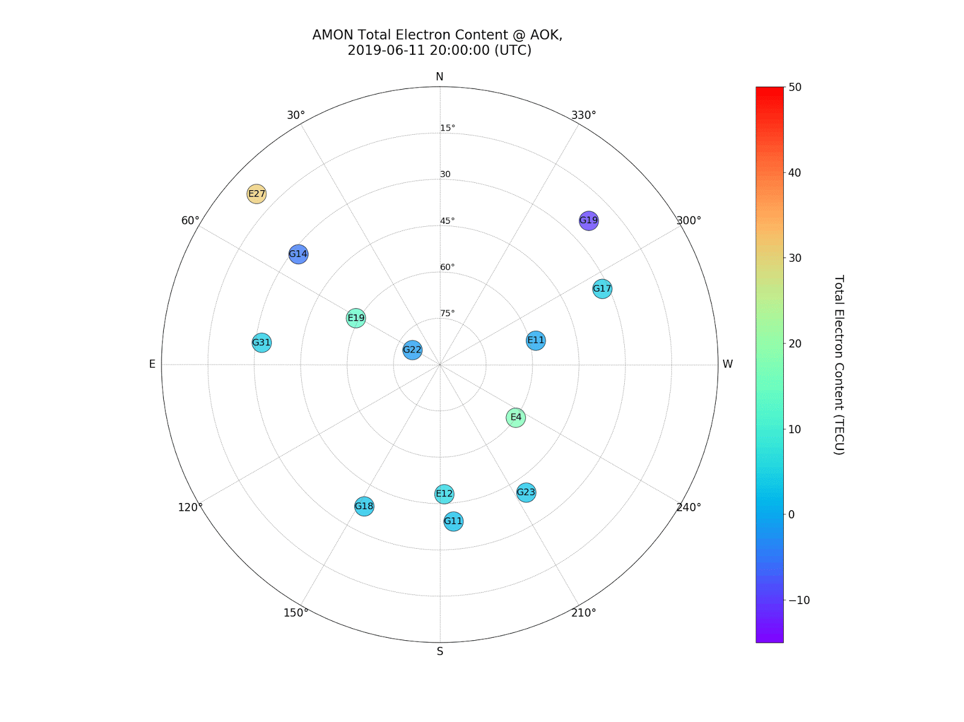
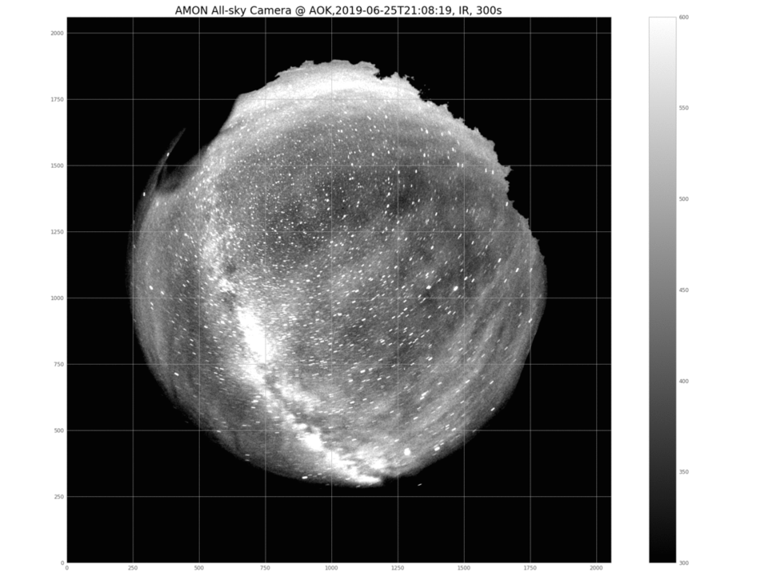
TEC measurements in space and time
Consistency of the satellites position demonstrates the correctness of the scripts
that we are using.
Fig. 25. An example of how to compare Airglow emission (left) and the polar plot of GNSS satellites position and value of TEC generated by script in Python (right).

Slide 25
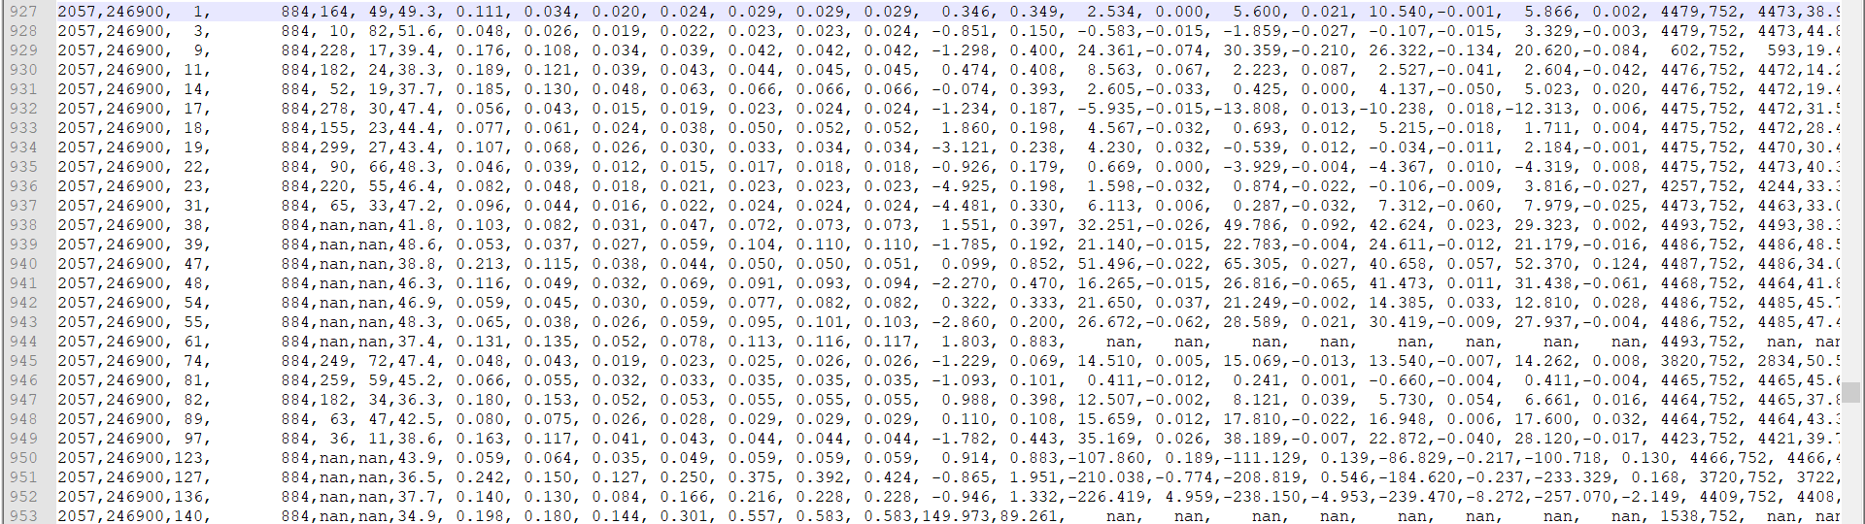

Slide 26

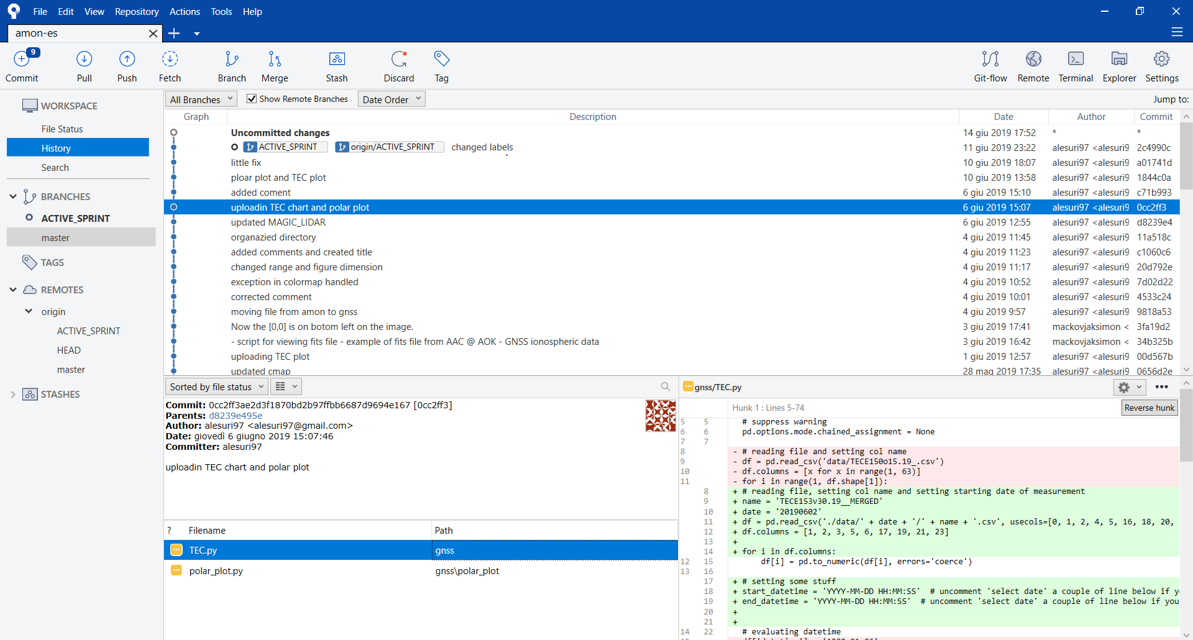
Team work in creating scripts
Lot of the graphs shown were created whit python and shared on bitbucket for team collaboration and future usage
Fig. 26. Screenshot by bitbucket: an example of the script’s sharing process.

Slide 27
Concluding
Upper atmosphere is a dynamic system in which airglow is produced
AMON was developed in order to study the behaviour of the phenomena
AMON-ES is built and will monitor the relation between airglow emission and ionospheric composition
I’ve attended at the facility’s construction learning that lots of problems have to be overcome before first observational campaign
I’ve learned that a lot of ‘behind the scene’ work is required to understand what the instruments are telling us.

Slide 28
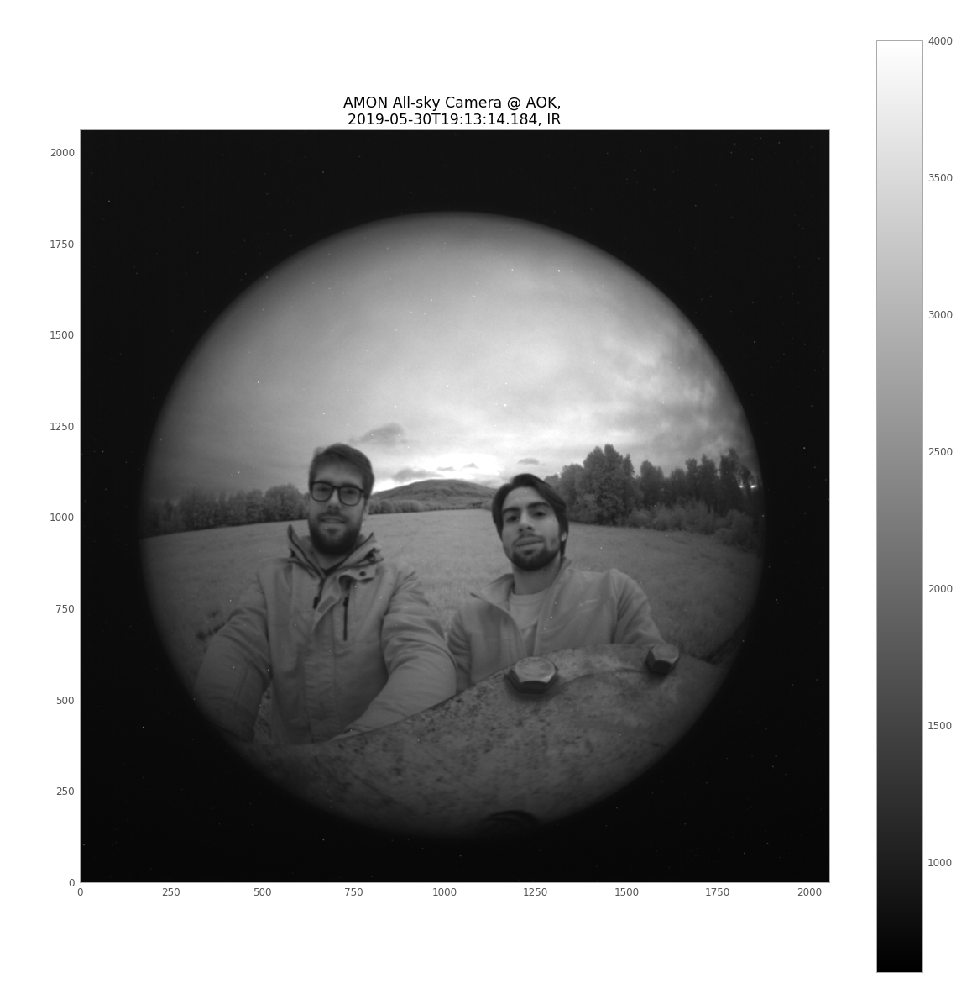
Thanks
A special thank to Šimon Mackovjak for all the kindness demonstrated and for the fantastic possibility he gave me to join this research.
A thank also to Pavol Bobík and to all the team of the Space Physics Department.
A mention also to my coordinator Mario Bertaina for the help and the support he gave me during my staying abroad and after my return in Italy.

Slide 29
References
Bhamer, Earth's atmosphere and ionosphere. English Wikipedia, 2007.
Pidwirny, M., Atmospheric Composition. Date Viewed, 2006, available at. http://www.physicalgeography.net/fundamentals/7a.html [accessed 2 May, 2019]
Zucchetti, E. Schiacca, U., Ionosphere, 2014, available at. http://roma2.rm.ingv.it/en/research_areas/4/ionosphere [accessed 2 May, 2019]
Hyakutake, Emissions in Comet, 1996, Scientific Figure on ResearchGate, available at. https://www.researchgate.net/figure/Energy-level-diagram-of-atomic-oxygen-showing-different-spectroscopic-transitions_fig1_221668544 [accessed 3 May, 2019]
Rupesh Ghodpag, Upper atmosphere study using night airglow, LAP LAMBERT Academic Publishing, Saarbrucken ,2010.
JSC PAO Web Team , Milky Way with airglow australis, NASA, ISS028-E-050185, 2011, available at. spaceflight.nasa.gov/gallery/images/station/crew-28/html/iss028e050185.html [accessed 9 May, 2019].
Beletsky, Yuri, International Space Station Imagery, available at. esplaobs.blogspot.com/2017/02/milky-way-with-airglow-australis-image.html [accessed 9 May, 2019].
CFHT Observatory Manua, 2003, available at. http://www.cfht.hawaii.edu/Instruments/ObservatoryManual/CFHT_ObservatoryManual_(Sec_2).html
F., Pfaff. R., ”The Near-Earth Plasma Environment”, Space Science Reviews, 2012, vol. 168, pages 23-112.
Ondrej Kralik, Airglow, La Palma, ASTROBOOK, 2017, available at. http://astrobook.sk/2017/06/26/airglow-la-palma/ [accessed 13 May, 2019]
Š. Mackovjak, P. Bobík, J. Baláž, I. Strhárský, M. Putiš, P. Gorodetzky, Airglow monitoring by one-pixel detector, Nuclear Instruments and Methods in Physics Research Section A: Accelerators, Spectrometers, Detectors and Associated Equipment, 2019, 922, Pages 150-156.
Lunatic astronomical. AAG CloudWatcher cloud detector, available at. https://www.lunaticastronomical.com/AAG-CloudWatcher-cloud-detector-1 [accessed 13 May, 2019]
Septentrio. Septentrio PloaRxS GNSS receiver available at. https://www.septentrio.com [accessed 13 May, 2019]
J.S. Haase, T. Dautermann, M.J. Taylor, N. Chapagain, E. Calais, D. Pautet, Propagation of plasma bubbles observed in Brazil from GPS and airglow data, Advances in Space Research, 2011, 47, pages 1758–1776.

