Slide 1
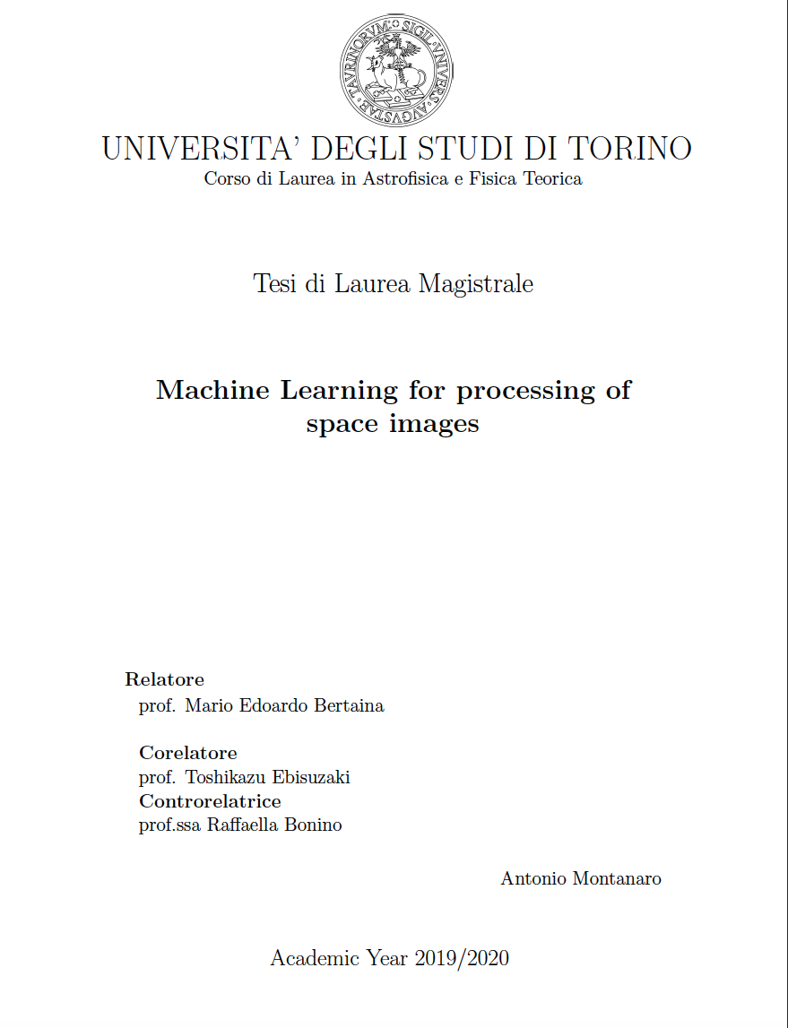
Machine Learning for processing
of space images
ANTONIO MONTANARO
Ottobre 2020

Slide 2
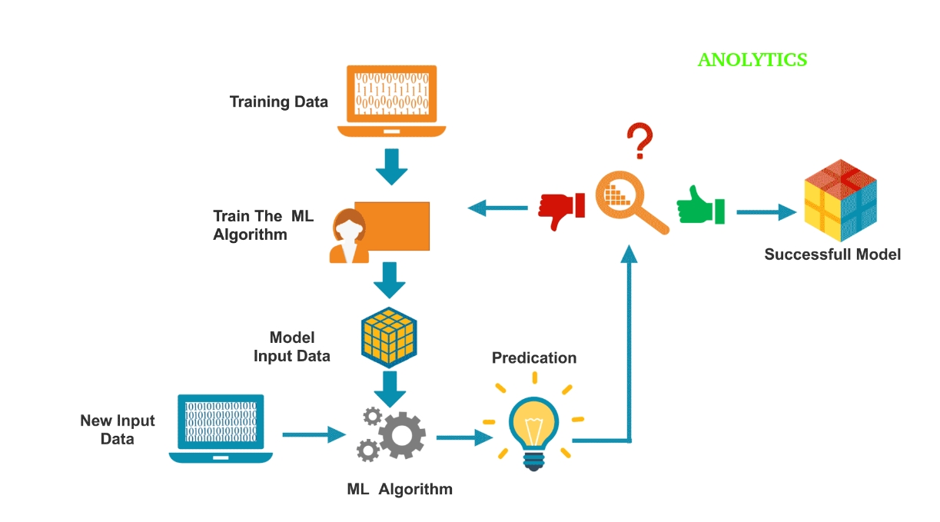
Machine Learning
Brunch of Artificial Intelligence
Attempt of an algorithm to generalize a task
Different approaches ( (un)supervised, reinforcement learning)
Many applications with the highest performances
Open source platforms with hardware accellerators
Strategy
Different Tasks:
- Classification
Outlier detection
Prediction
Image Denoising
Prediction

Slide 3
Machine Learning techniques
Old standard techniques (Support Vector Machine,Least-Square Regression, Logistic Regression, …)
- different statistical concepts
- specific applications
New techniques: Deep Neural Networks
- Biology inspired
- Perform standard techniques
- Fast implementation thanks to hardware accellerators (GPU..)
- Huge amount of applications in many fields ( physics, biology, chemistry …)
- Most performing in image analysis
Can detectors benefit from these techniques?

Slide 4
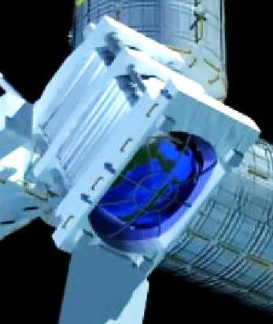
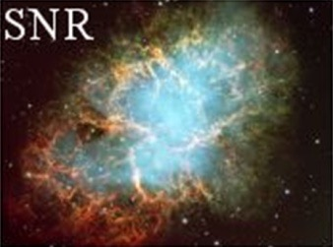
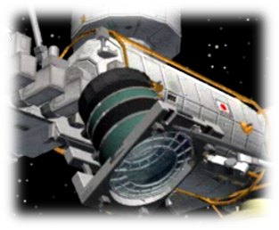
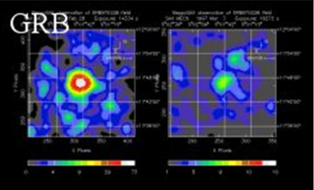
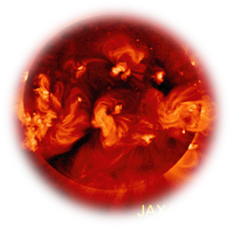
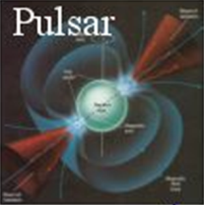
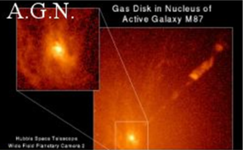
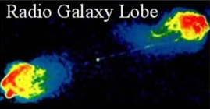
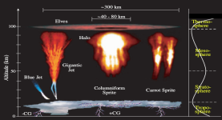
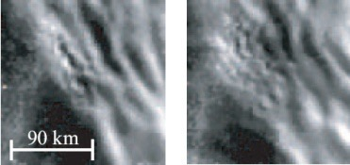
Charged
Particles
EECRｓ
Dust and Meteors, Space Debris,
Nuclearites
Ultraviolet photons
Atmosphere
Solar wind
Air shower
Air shower
Night glow
The Earth
Plasma Discahrge
Atmosphere in JEM-EUSO FoV
O(10³ km³ H2O equivalent)
EHE Neutrinos
27
Notes:
JEM-EUSO è un nuovo tipo di osservatorio astronomico alloggiato sul modulo giapponese della Stazione Spaziale Internazionale che utilizzerà l'atmosfera terrestre come gigantesco rivelatore dei raggi cosmici delle più alte energie, le particelle più energetiche che provengano dall'Universo.
Guardando verso Terra dallo Spazio, JEM-EUSO rivelerà queste particelle osservando il segnale di fluorescenza da esse prodotto durante il loro passaggio in atmosfera e, in più, potrà osservare neutrini di energia estremamente alta, aprendo il campo dell'astronomia dei neutrini di alta energia.
Inoltre contribuirà all'indagine dei fenomeni intrinsechi all'atmosfera terrestre o indotti dal flusso di meteoroidi provenienti dallo Spazio.

Slide 5
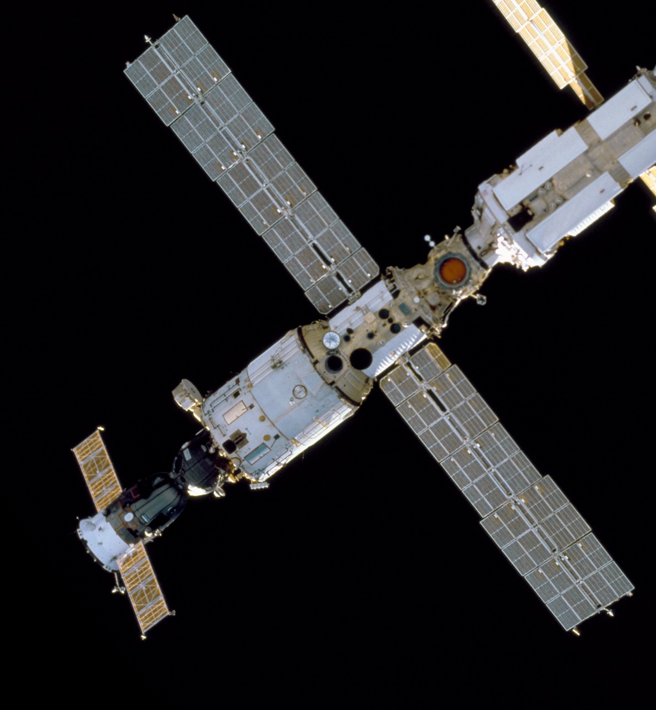
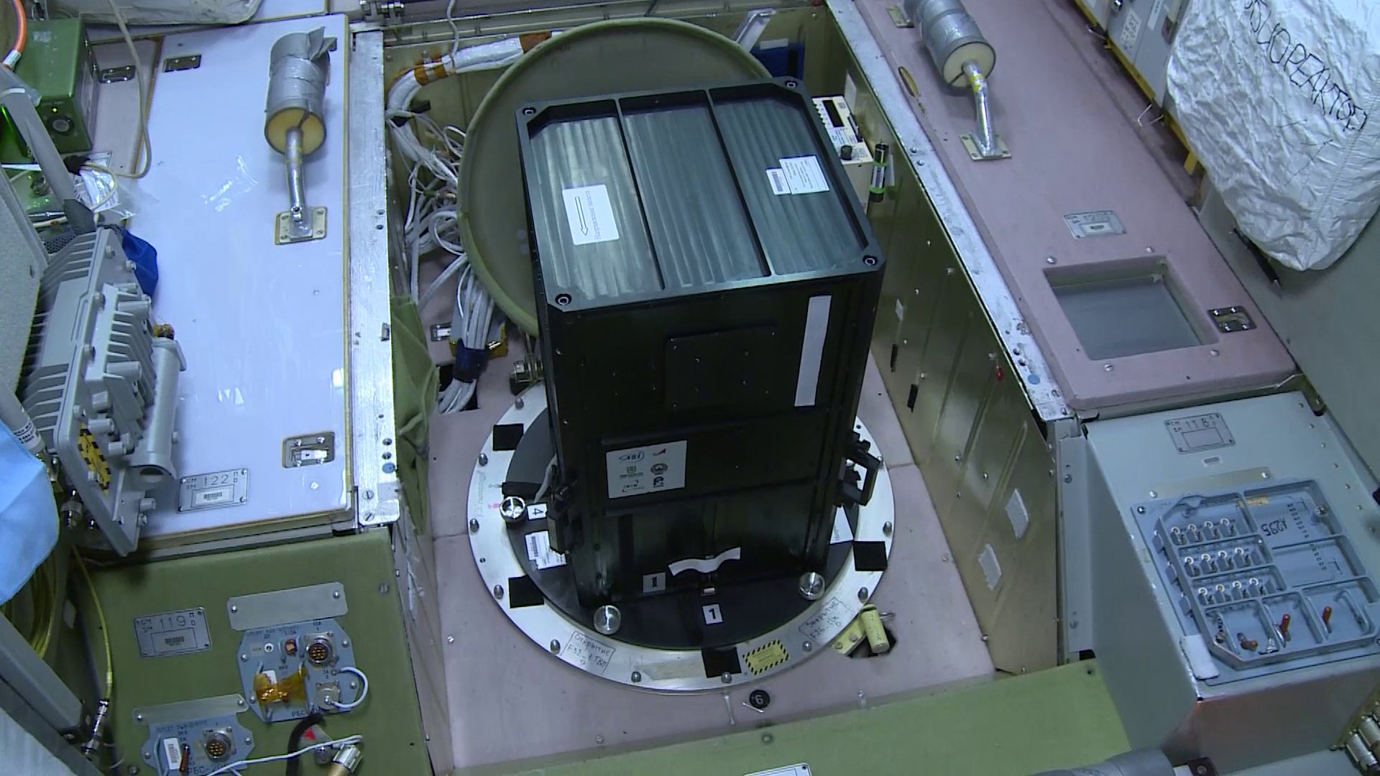
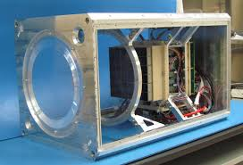
MINI-EUSO - Design to record UV emission from the Earth - Launched on August 2019 on the ISS - Data available

Slide 6
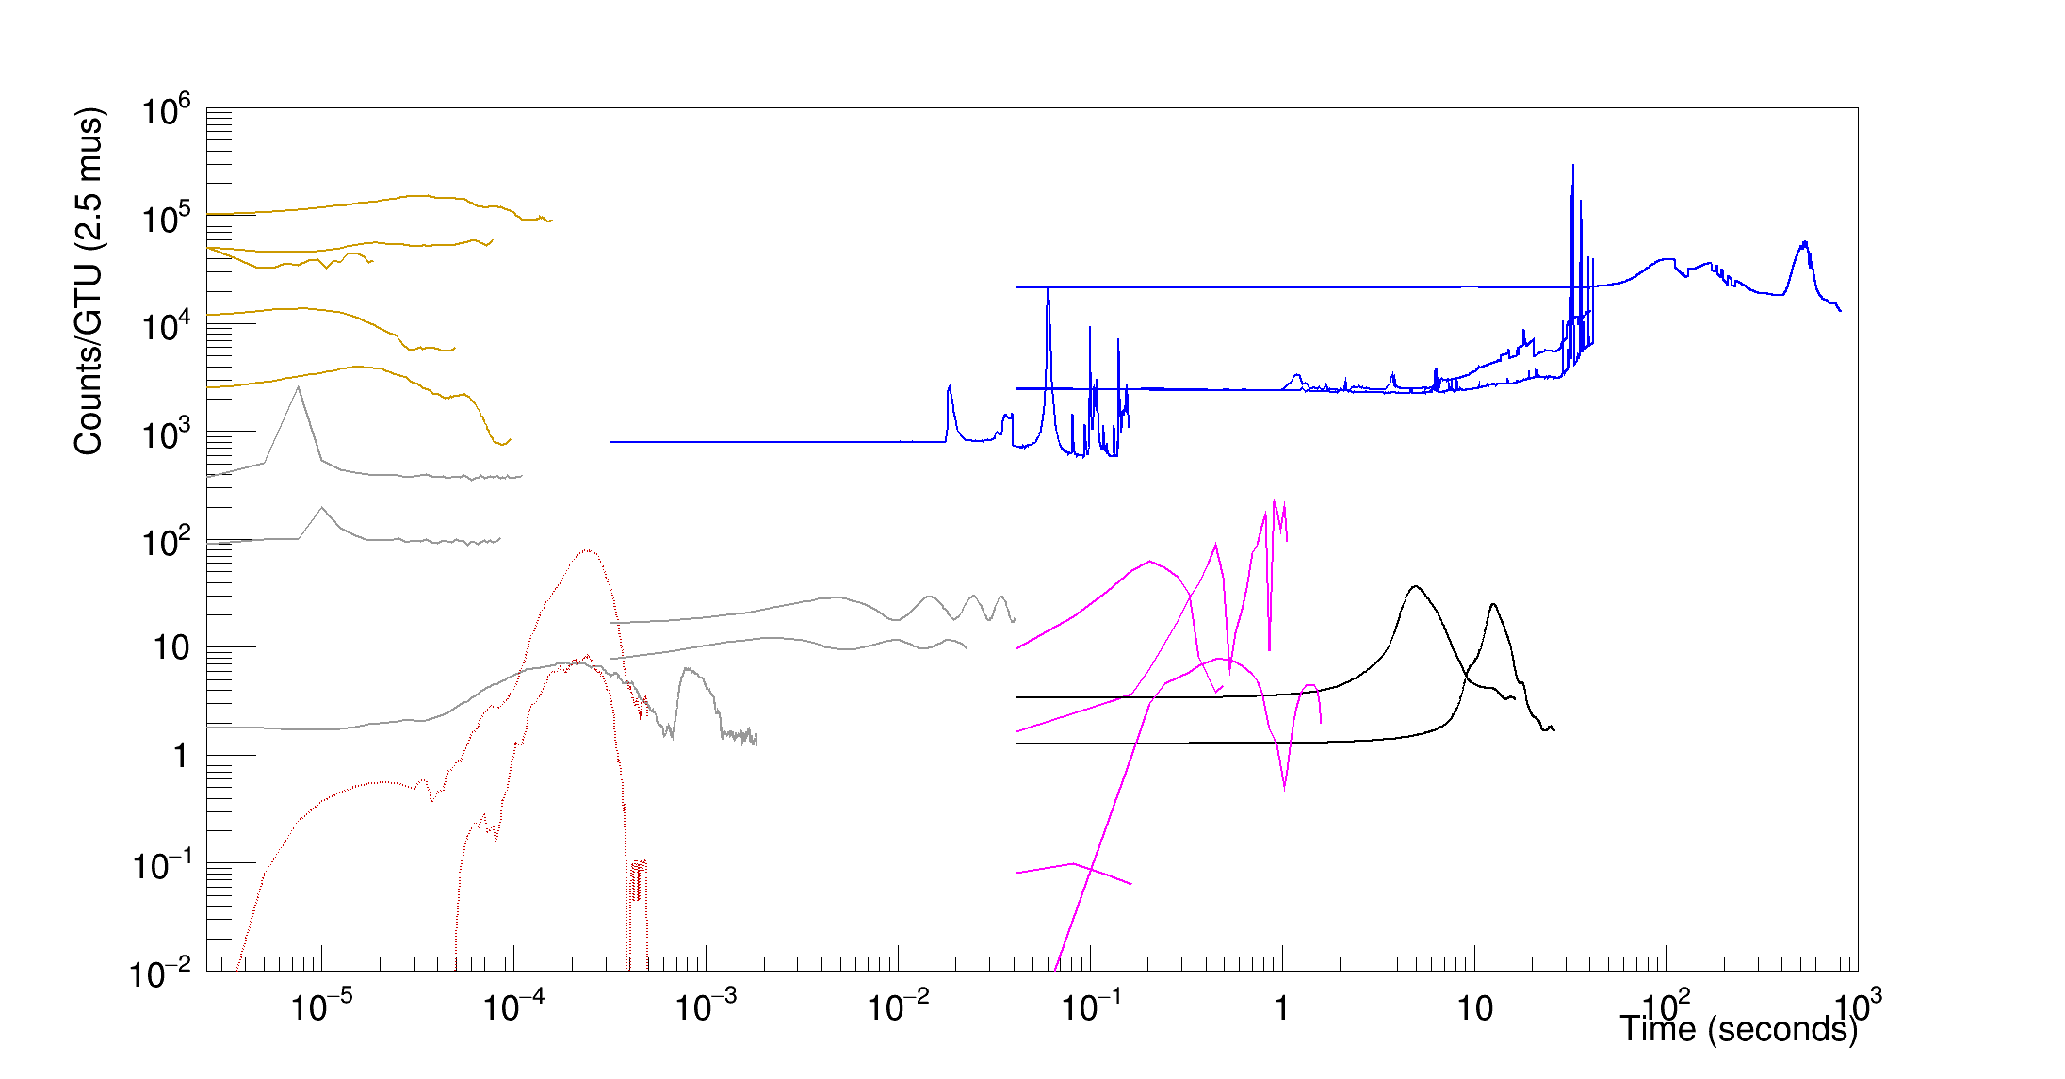
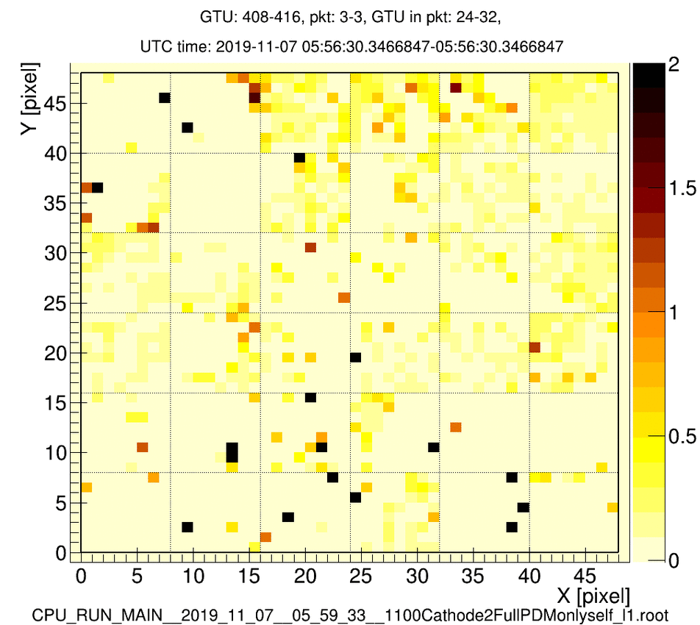
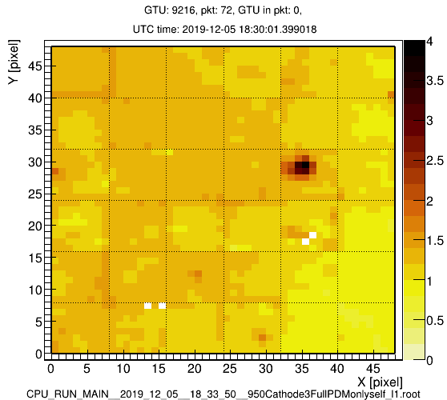
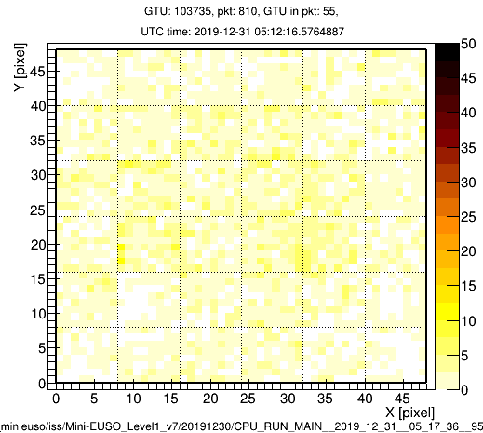
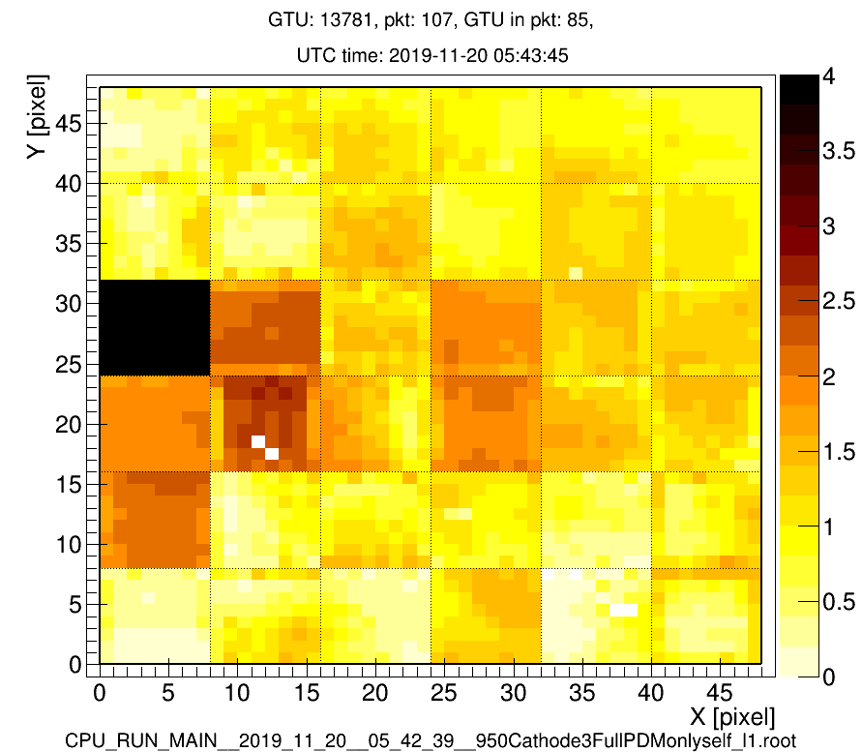
Time profile of various events (selected from 10% of data)
2.5 µs sampling
(triggered)
320µs averages
(triggered)
41ms averages
(full time acquisition)
lightning
ELVES
Earth emissions
lighting
clouds
Direct cr hits
50Hz city light
Town lights
Xe ground
flashers
Simulated
1E21
1e22
events
Meteors
ISS data 2019-2020 except simulated events
+imaging capabilities
Time (seconds)

Slide 7
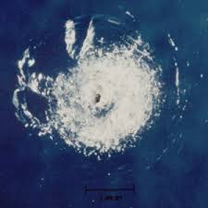
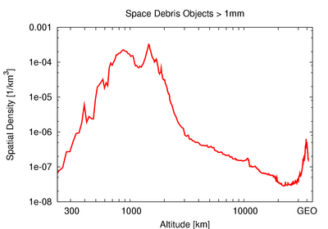
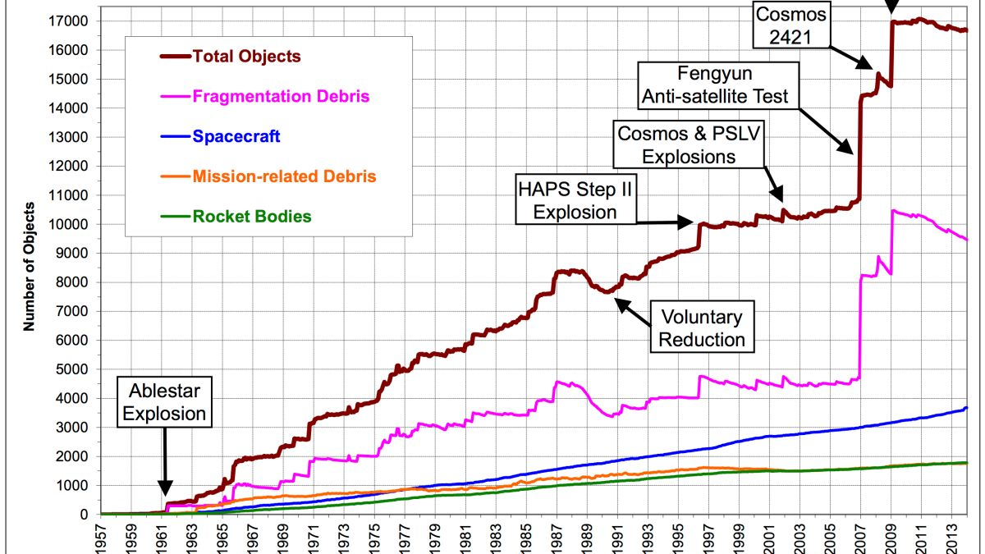
Space Debris Problem
Space Debris (SD) are fragments of various size and material orbiting around the Earth at high speed
During the last years these are increased so much to worry many space agencies about the safety of future space missions
No official strategy was found to defenitely track and remove such fragments
Damage caused by a paint fleck only 0.2 mm in size. NASA credit.

Slide 8
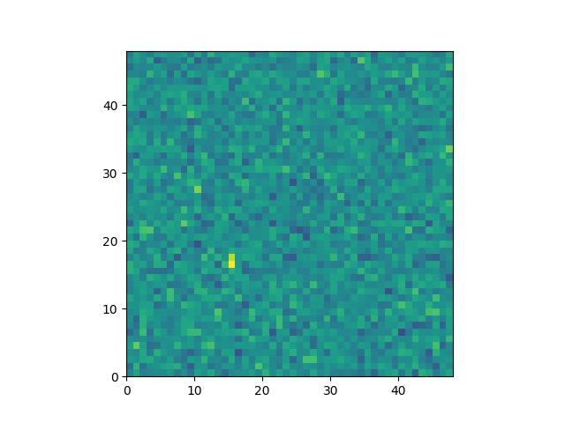
Detection Strategy for SD
Albedo Phenomenon
No SD detected by Mini-EUSO (so far)
- ESAF – Euso Simulation and Analysis Framework

Slide 9
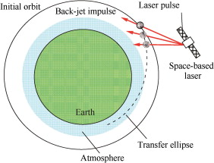
JEM-EUSO project for SD removal
1) Passive detection with a super-wide FOV camera (like JEM-EUSO)
2) Active tracking by a narrow FOV telescope
3) Velocity modification by laser ablation
This kind of technology needs autonomous system to track and detect quickly and efficiently as much as possible SD !
ML techniques are developed for this purpose
In the framework of Mini-EUSO
(Jem-EUSO smaller prototype)

Slide 10
Machine Learning Applications
Convolutional Long-Short Term Memory (Conv-LSTM) Network
For predicting space debris motion

Slide 11
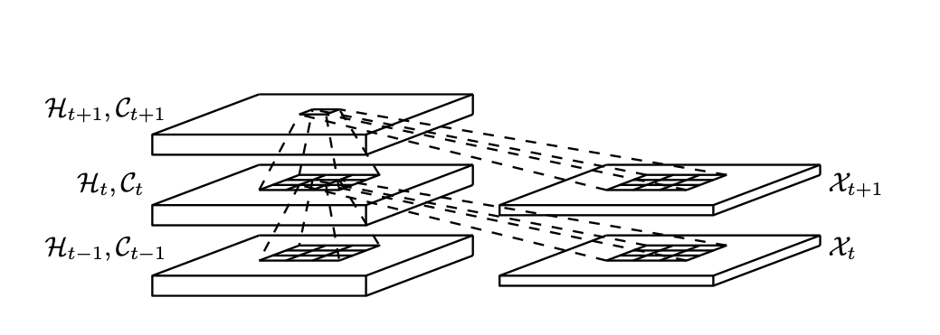
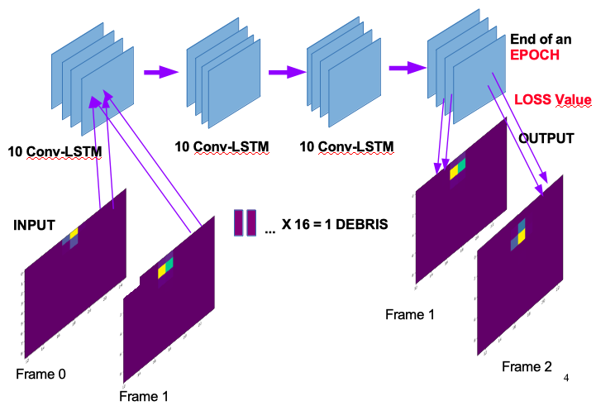
Conv-LSTM Network
Recently proposed for precipitation nowcasting
Make use of LSTM cell with a convolutional structure
Very sensible to store temporal and spatial informations
Is this network able to predict space debris
moving in the FOV of Mini-EUSO ?

Slide 12
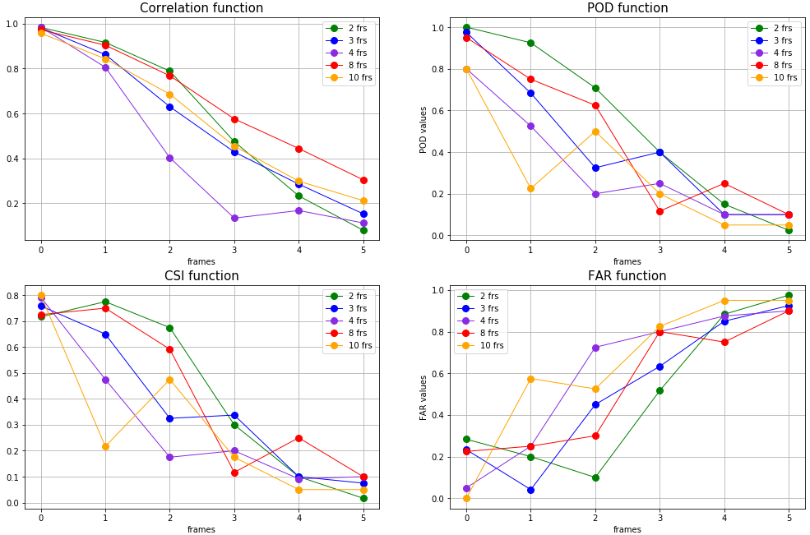
Conv-LSTM Network: Ideal Case
Dataset: 200 SD moving in 16 frames:
5-12 km/s, different directions, 4 initial positions
The best architecture and configuration ( best number of input frames) is chosen evaluating 4 functions.
Total Frames correctly predicted → 3

Slide 13
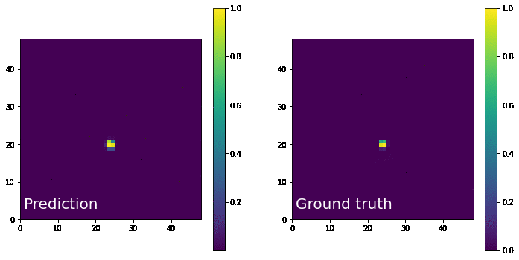
Conv-LSTM Network: Real Case
Dataset: 200 SD + Real Mini-EUSO Background
Preprocess: Binarization
Pix < 3σ → 0
Pix > 3σ → 1
2 frames correctly predicted !

Slide 14
Conv-LSTM Network
Autonomous prediction system only for 3 frames with bright SD
Train requires GPU accelerator
Deep Network
(90000 parameters)
Difficult to mount on FPGA
We would like to have a system that performs the standard trigger algorithms:
Fast
Suitable for faint signals
Able to capture motion parameters
Possible impementation on FPGA

Slide 15
Machine Learning Applications
Recurrent Neural Network (RNN)
For correlated background forecasting

Slide 16
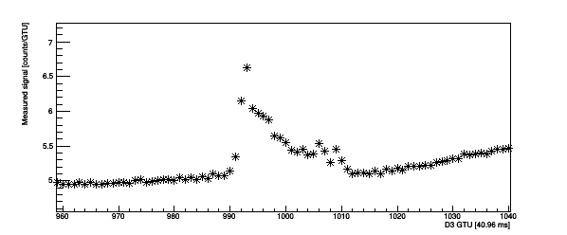
RNN for background forecasting
Correlated Background is not simple to handle
Mean and Median subtraction can cut the signal
The considered number of frames for calculation is event-dependent
A new possible solution comes from RNN:
Time series problem
Regression from a time-sequence

Slide 17
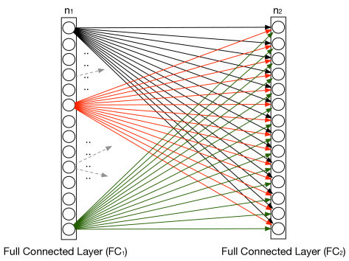
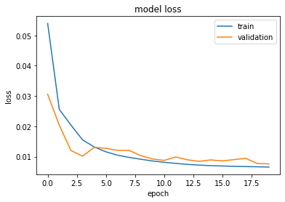
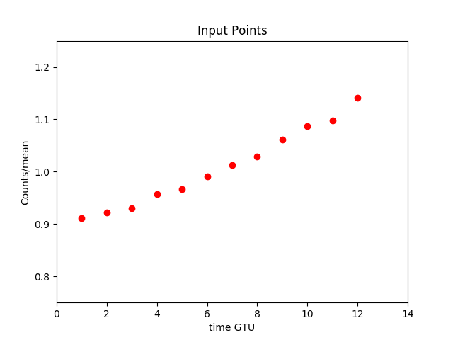
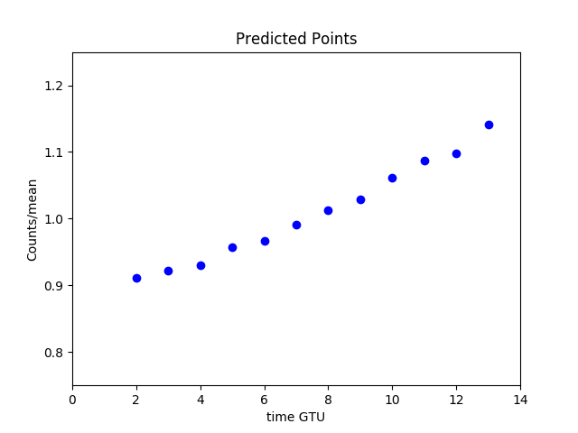
RNN: ARCHITECTURE
13 LSTM Cell
3 FC layers x 12 units
2 304 parameters
Train on 19906 samples
Validate on 830 samples
13 LSTM Cell
…...
…………..

Slide 18
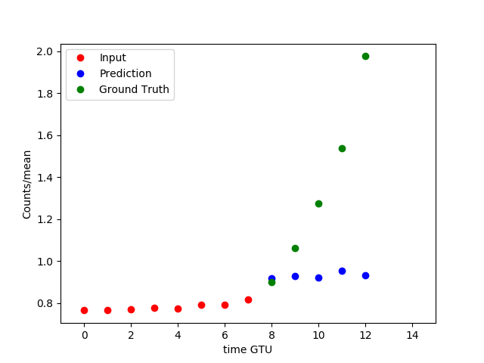
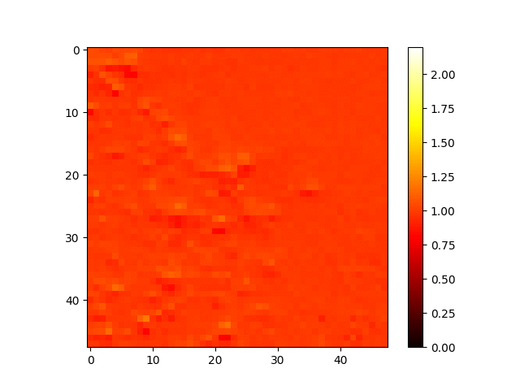
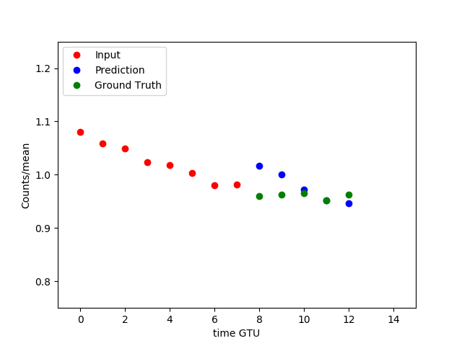
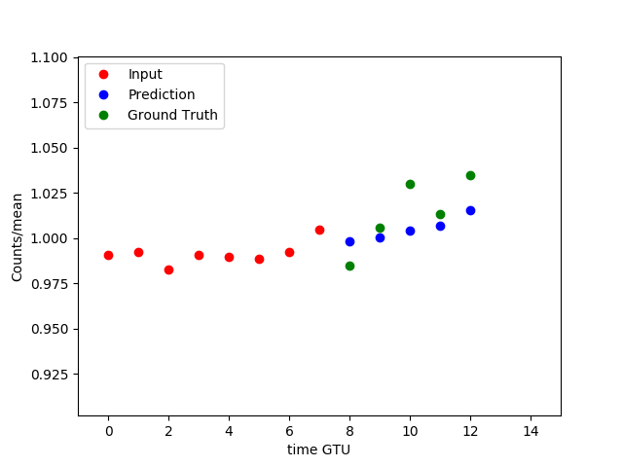
RNN: Outliers Detection
Meteor
Ground Truth / Predicted values
Moving Background (City)
Stationary Background

Slide 19
Machine Learning Applications
K-means Clustering
For unsupervised classification of sea areas with and without clouds

Slide 20
Unsupervised Classification
Bio-Luminescence phenomena
Best Conditions for detection:
Mini-EUSO is over ocean
Sky without clouds
First Step
Finding (sub)images
with such conditions !

Slide 21
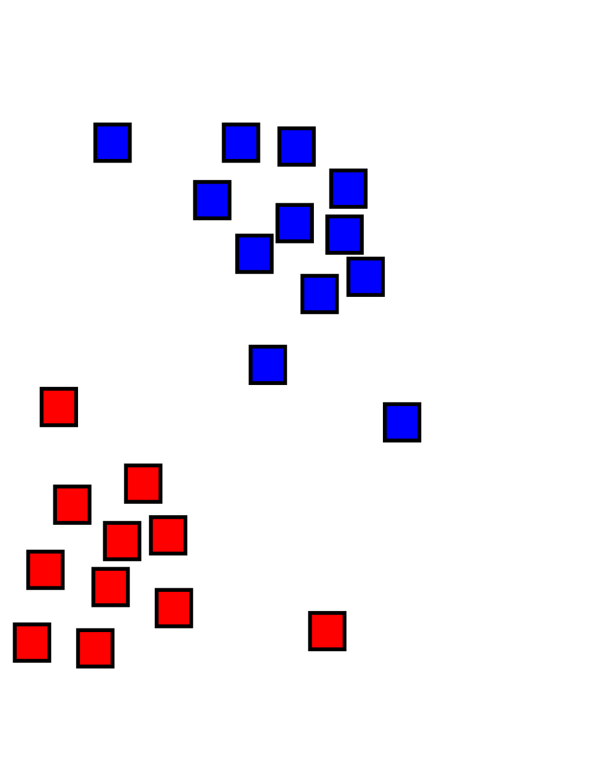
First Step: ML approach
Unsupervised Clustering for finding areas without clouds:
Autoencoder (CNN): Images → Feature d-dimensional Vectors
K-means : Clustering vectors as cluster of points in d-space
PRE-PROCESS
ENCODER
K-MEANS

Slide 22
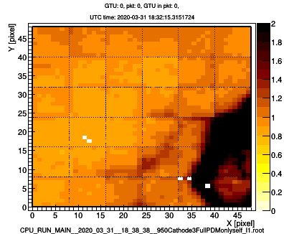
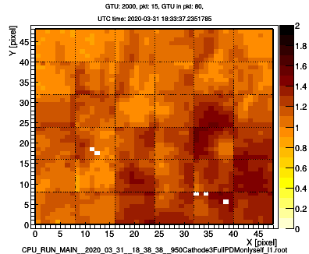
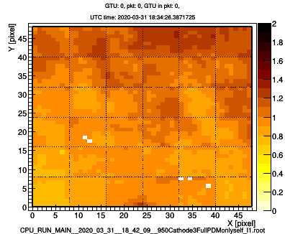
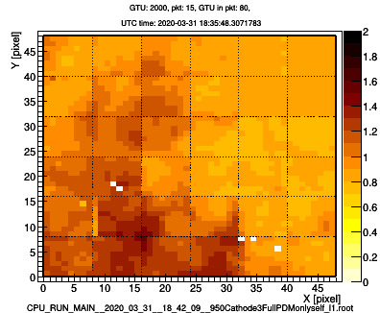
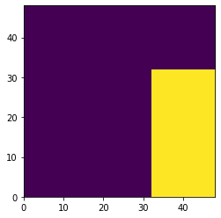
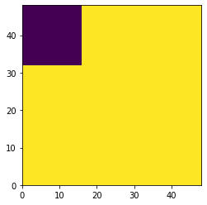
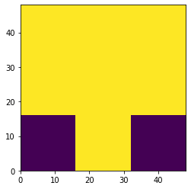
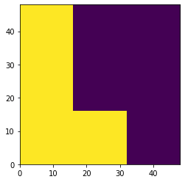
Unsupervised Classification
GTU = 0 GTU = 2000 GTU = 0 GTU = 2000

Slide 23
Conclusions
Machine Learning Techniques suitable for data analysis of Mini-EUSO:
Conv-LSTM for predicting SD trajectory
RNN for background nowcasting
K-means for Unsupervised classification for sea areas without clouds
THANKS FOR YOUR ATTENTION !

