Slide 1
Methods for tsunami detection in Mini-EUSO measurements
Virtual Traineeship Mobility
Institute of Experimental Physics
Slovak Academy of Sciences
Košice
Student: Filippo Faita
839441
A.Y.: 2019/2020
Thesis Advisor: Mario Edoardo Bertaina
Thesis Co-Advisor: Pavol Bobik
1

Slide 2
Index
Physics overview
Airglow
Tsunami-atmosphere coupling (internal gravity waves)
Building the method:
Tsunami modelling with EasyWave software
Mini-EUSO data analysis tool
Checking correlation between tsunami events and airglow fluctuations
Conclusions
2

Slide 3
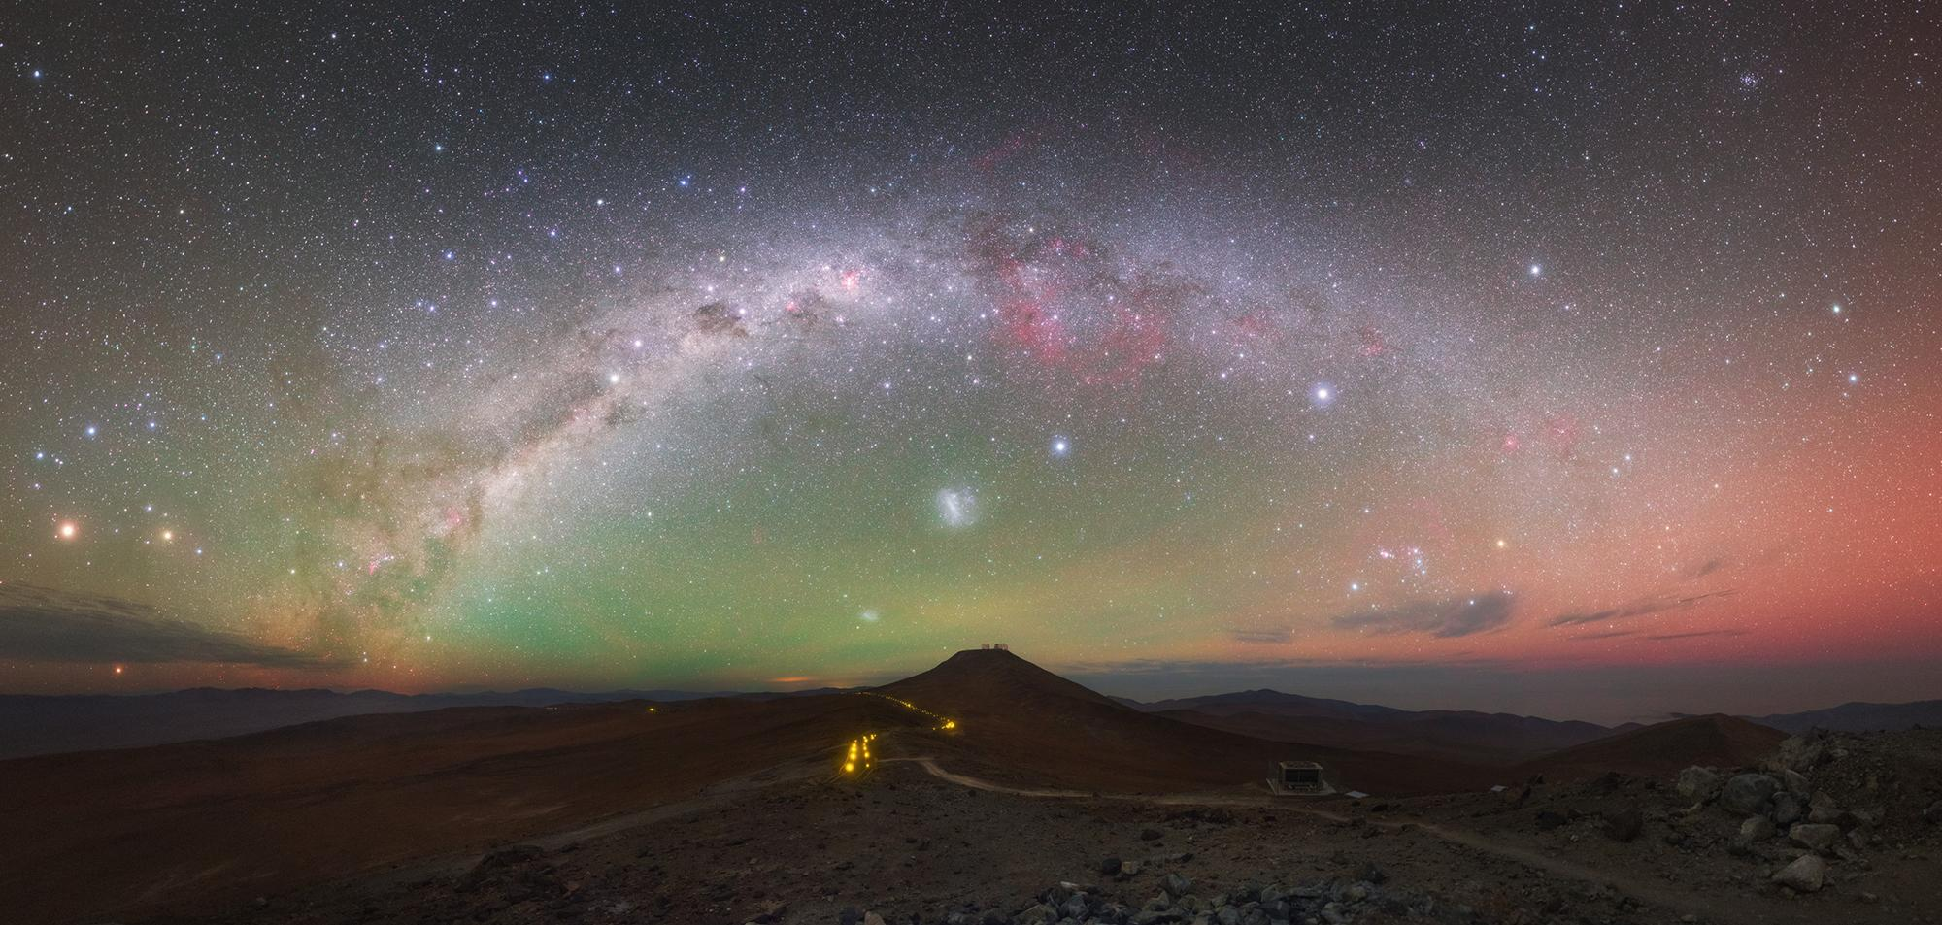
O + hν → O⁺ + e⁻
O⁺ + O₂ → O₂⁺ + O
O₂⁺ + e⁻ → O* + O* + 7eV
λ = 557.7 nm (green) at 90-100 km
λ = 630.0 nm (red) at 150-300 km
The green and red light in the sky around the Paranal Observatory is airglow. (Y. Beletsky (LCO)/ESO)
Airglow is an atmospheric chemiluminescence phenomenon which consists in the emission of photons from the atmospheric constituents (atoms or molecules) excited directly or indirectly by the electromagnetic radiation of the Sun
3

Slide 4
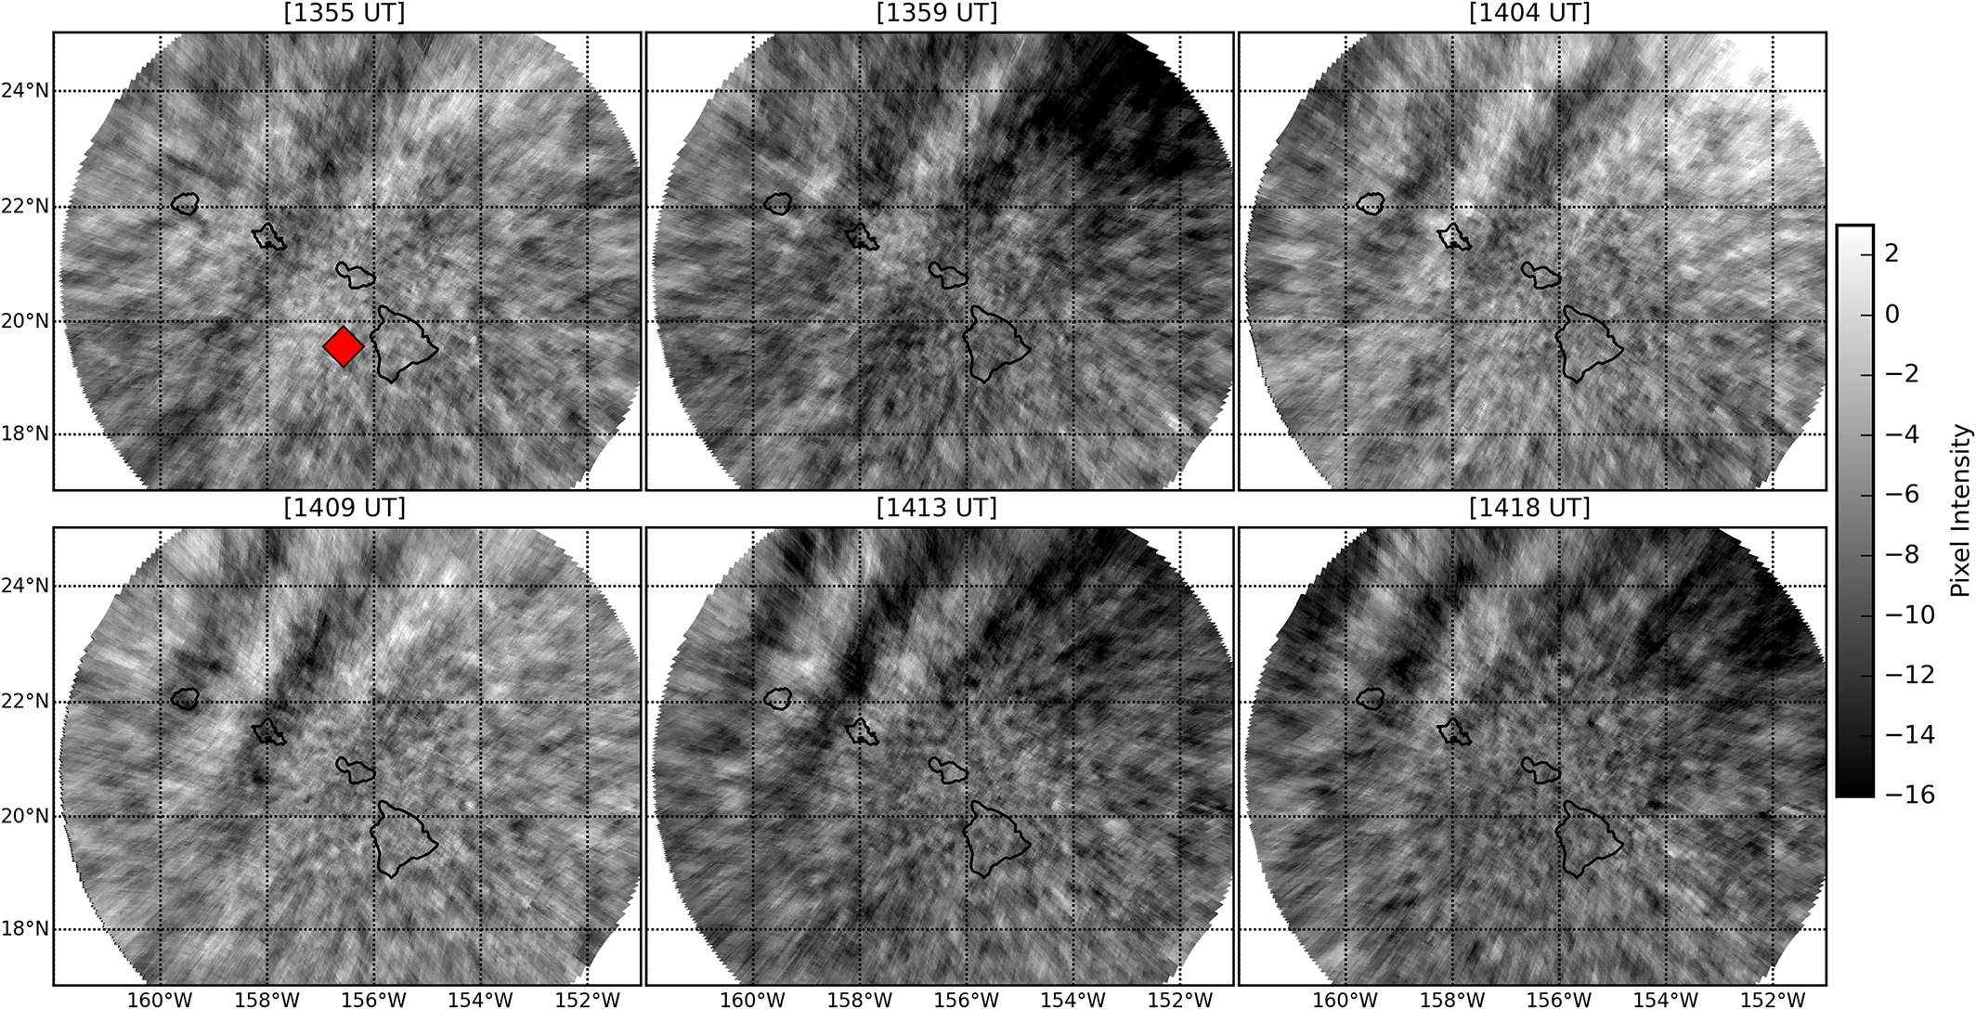
MAKELA, J.J., LOGNONNÉ, P. et al. Imaging and modeling the ionospheric airglow response over Hawaii to the tsunami generated by the Tohoku earthquake of 11 March 2011. In Geophysical Research Letters. 2011, vol. 38.
maximum water height at shore = 39 m
GRAWE, A.M., MAKELA, J.J. The ionospheric responses to the 2011 Tohoku, 2012 Haida Gwaii, and 2010 Chile tsunamis: Effects of tsunami orientation and observation geometry. In Earth and Space Science. 2015, vol. 2.
maximum water height at shore = 29 m
Observation of tsunami-generated ionospheric signatures over Hawaii caused by the 16 September 2015 Illapel earthquake (off the Chilean coast).
GRAWE, A.M., MAKELA, J.J. The ionospheric responses to the 2011 Tohoku, 2012 Haida Gwaii, and 2010 Chile tsunamis: Effects of tsunami orientation and observation geometry. In Earth and Space Science. 2015, vol. 2.
maximum water height at shore= 14 m
The tsunami reaches the DART Buoy (red dot) at 13:20 and its signal in airglow reaches the same spot at around 13:55. Thus, the pressure wave speed is roughly 200 km/h, less than sound speed in air, yet in phase with the tsunami propagation.
4

Slide 5
Tsunami simulation with EasyWave software
EasyWave is a quick tool written in C++ to simulate tsunami generation and propagation in application to the early warning.
2D shallow water equations are solved on a staggered finite-difference grid in spherical coordinates implying explicit time-stepping.
Its right owner is Andrey Babeyko (GFZ German Research Center for Geosciences, Potsdam, babeyko@gfz-potsdam.de)
https://gitext.gfz-potsdam.de/geoperil/easyWave/-/tree/master
5

Slide 6
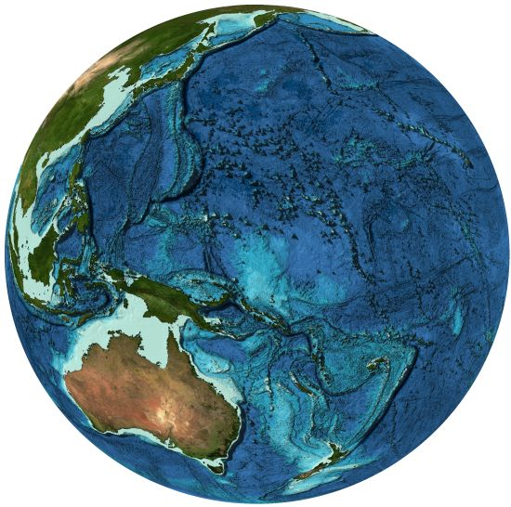
Ocean grid
A grid file is saved in Golden Software grid format, which is used to generate maps (not open source)
Contains two-dimensional uniform lattices (regularly spaced, rectangular array) of XYZ data (longitude, latitude, and depth);
Grids are equidistant: grid spacing is fixed (∆x, ∆y are constants)
Header section contains all information
Stored as binary files and written in netCDF for full portability
Can also be saved in text format, heavy files
grid files of ocean depth are retrievable at
GEBCO, which provides publicly available bathymetry data sets for the world’s oceans
https://www.gebco.net/
6

Slide 7
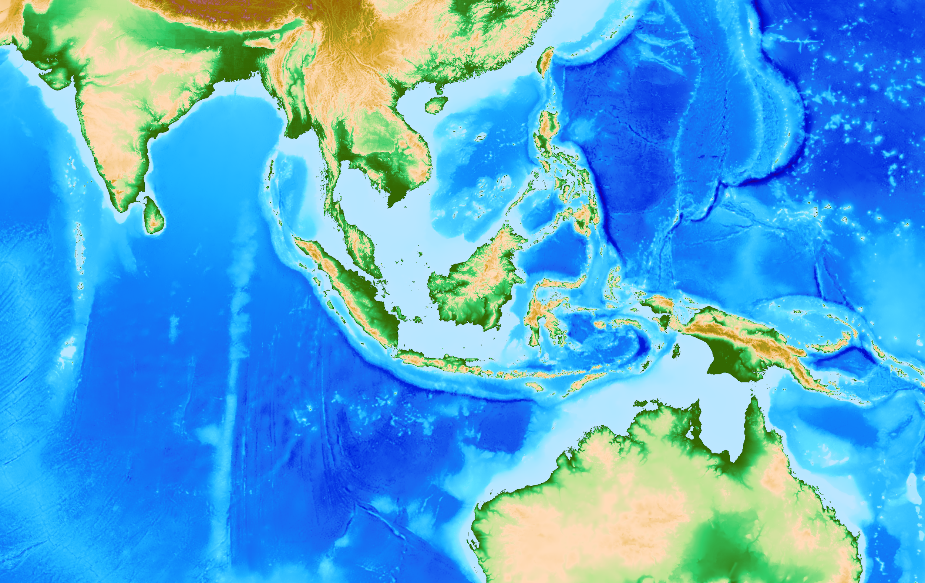
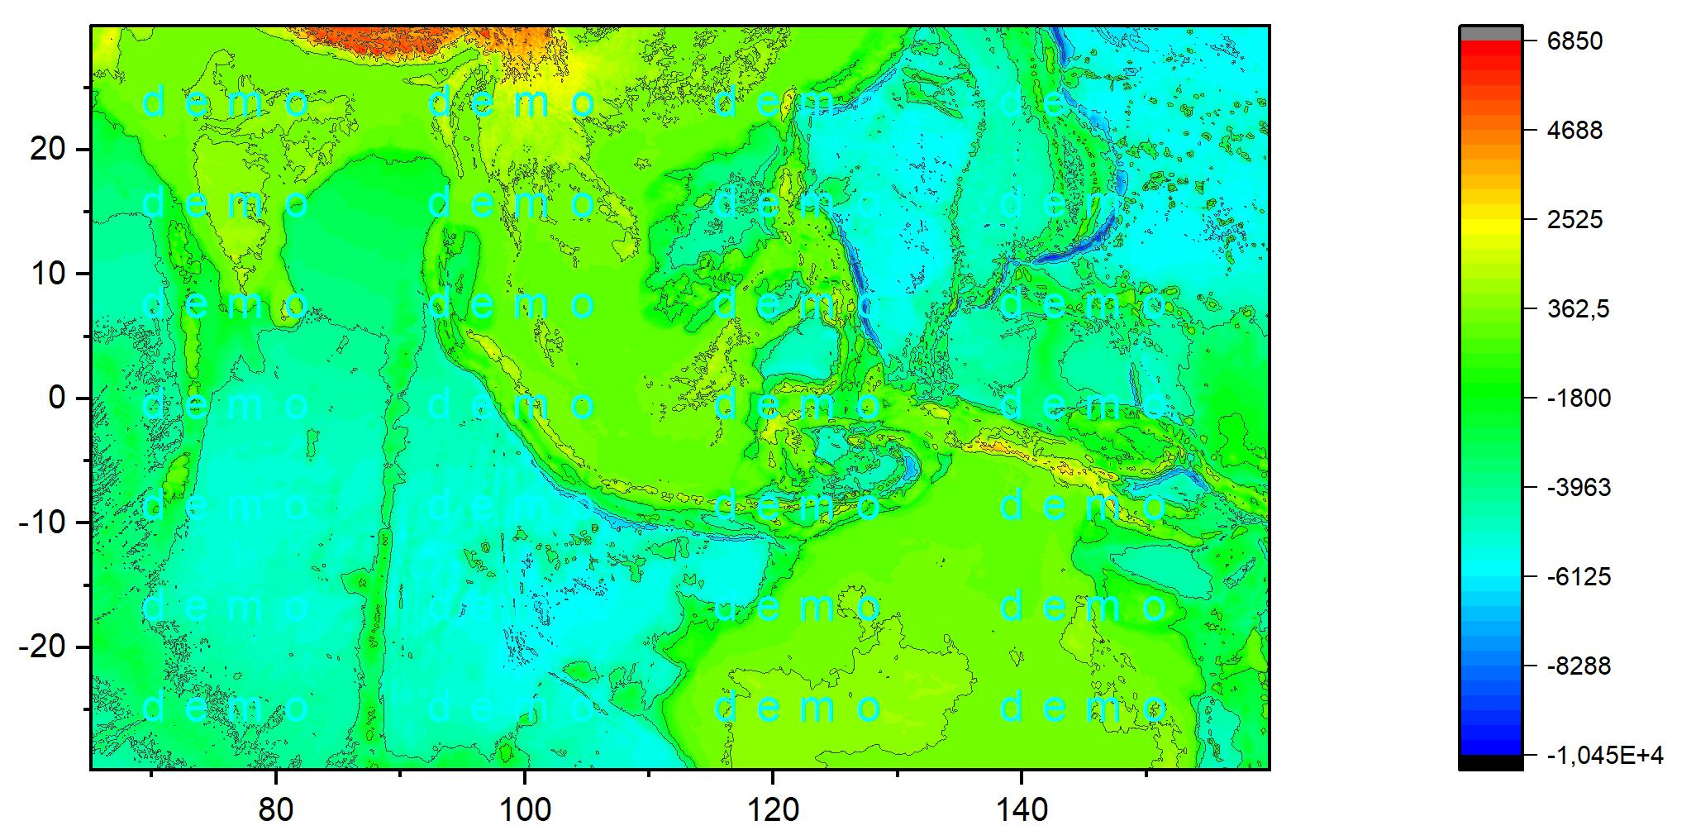
We elaborated an algorithm to reduce grids to save up cpu usage
grid files used by easywave are heavy so it turns out to be useful to write a
code to reduce grids/matrixes to 2x2, 3x3, 4x4 squares e.g. 25% , 11.1%, 6.25%
6.25% reduction
non-reduced and reduced grid visualization: approximately reduction conserves geometry
7

Slide 8
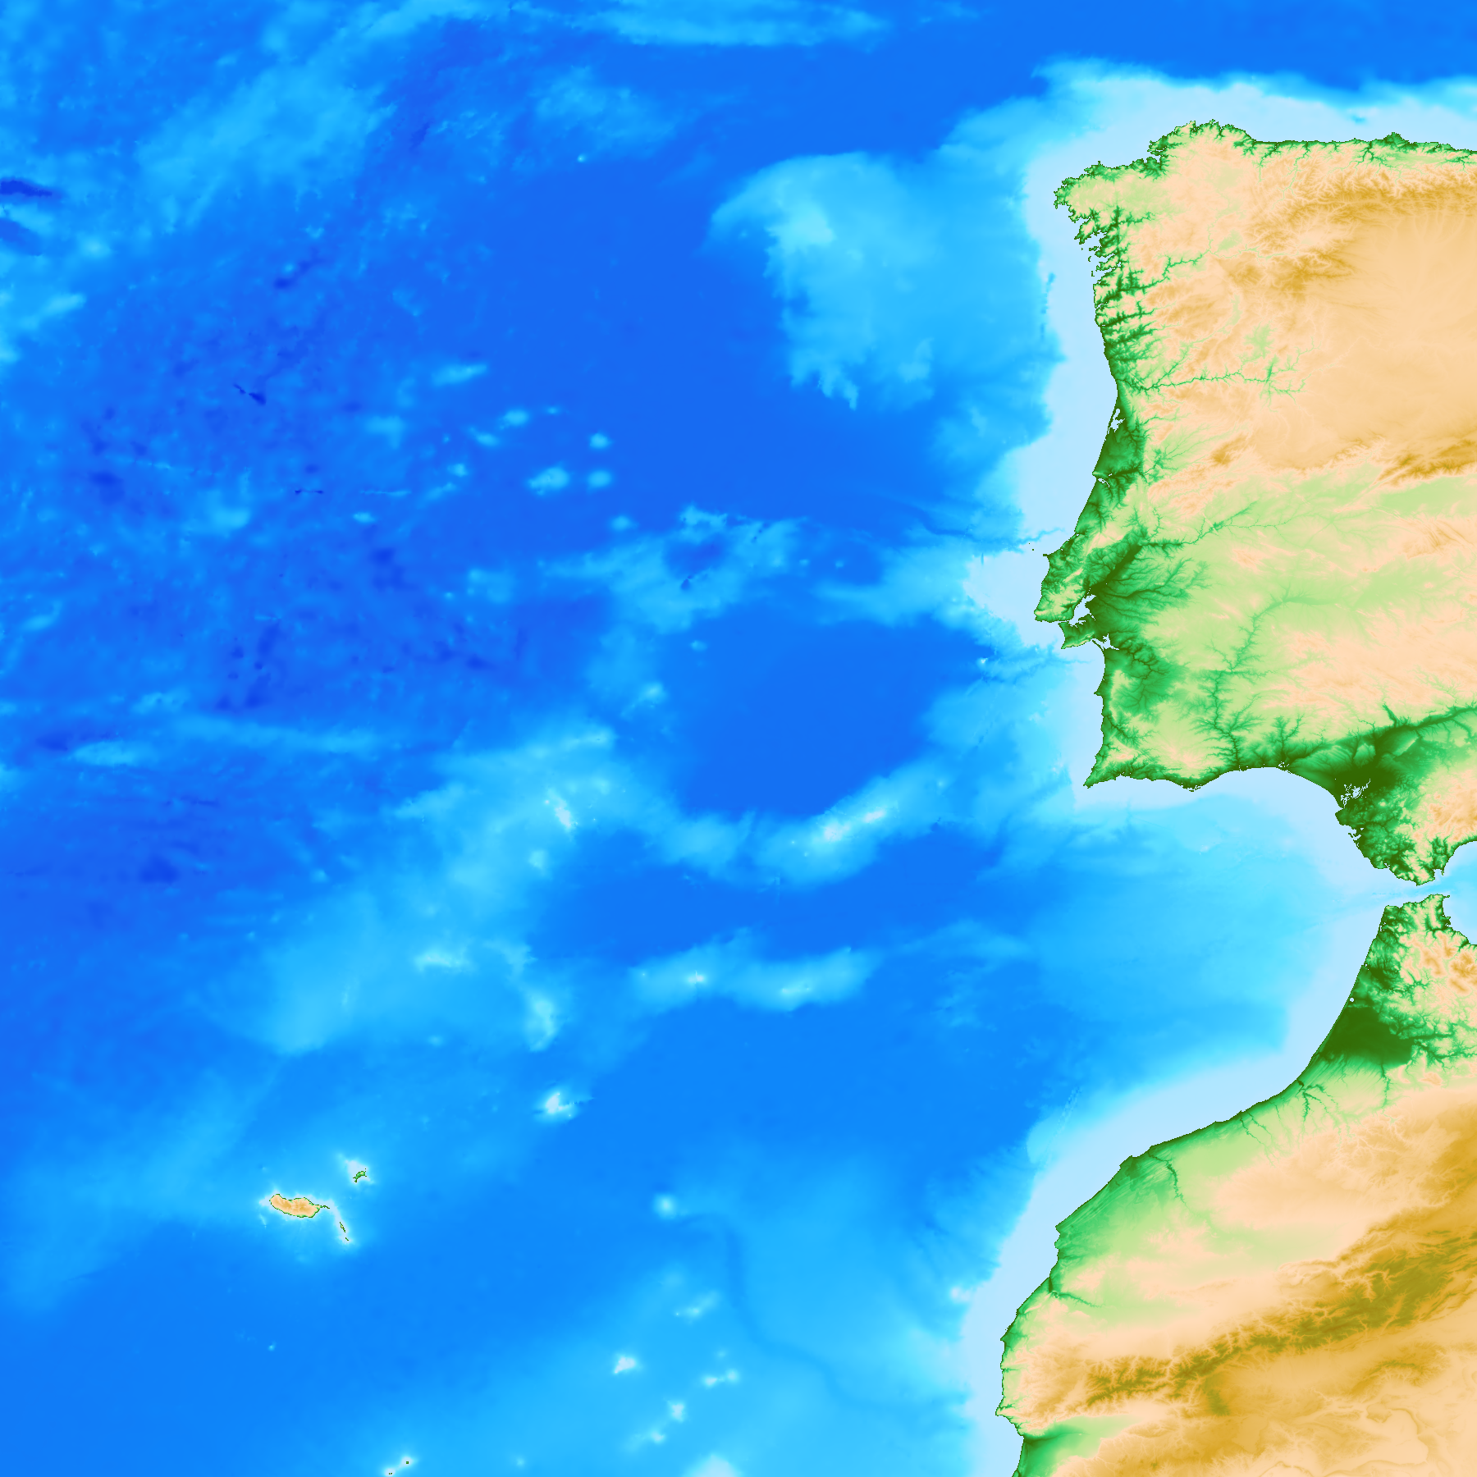
Earthquake source model
Each input .flt file contains the earthquake fault(s) parametres:
There is no fixed set of input fault parameters in easywave
General rule - a fault should be sufficiently defined
For example, one can literally specify the whole set of Okada's parameters:
location, depth, length, width, slip, strike-, dip- and rake-angle
or fault location, orientation and earthquake moment magnitude
8

Slide 9
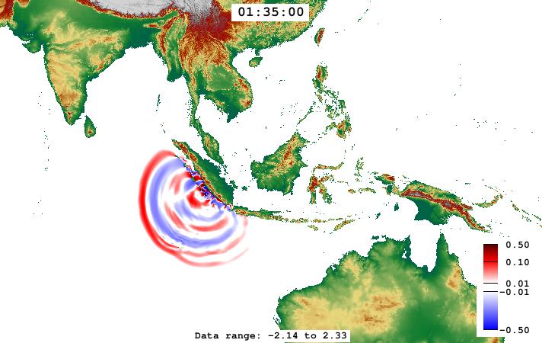
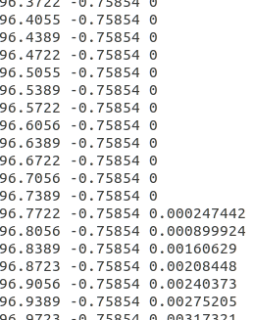
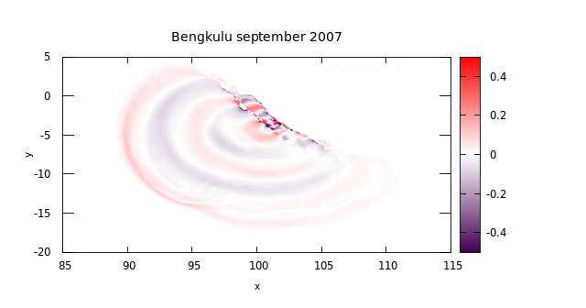
The xyz file is a snapshot of height wave at fixed time
x y z
x -> longitude
y -> latitude
z -> wave height
[m]
unperturbed ocean surface
wave height
[m]
9

Slide 10
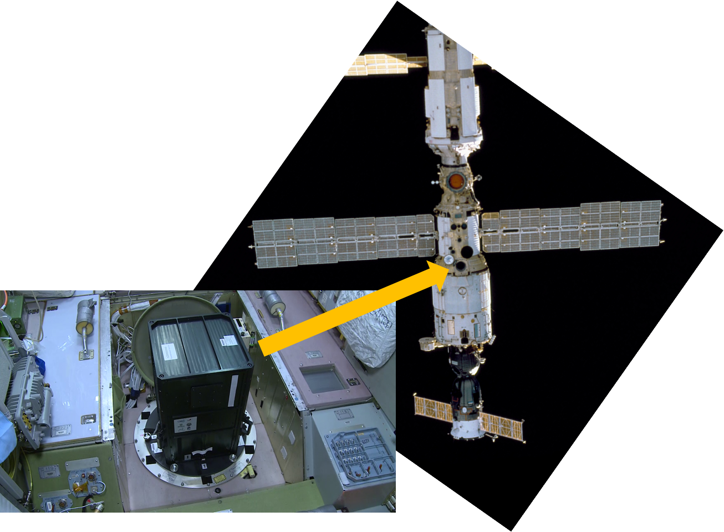
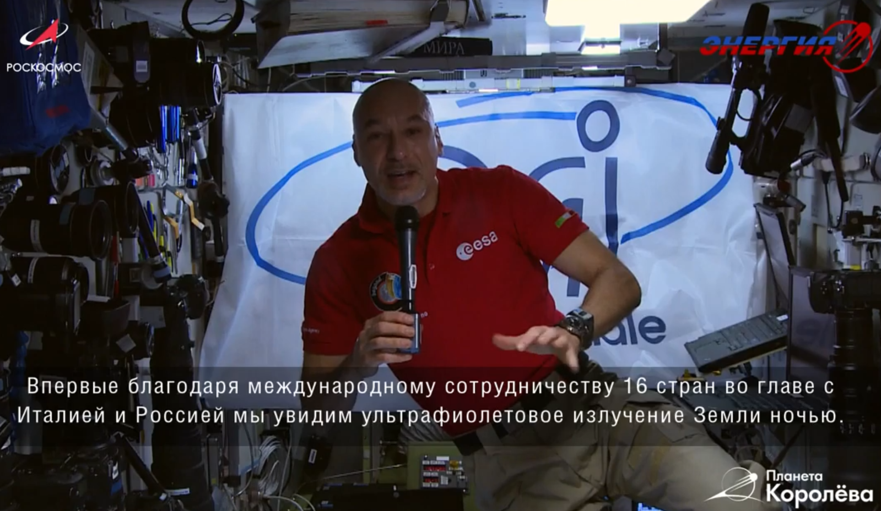
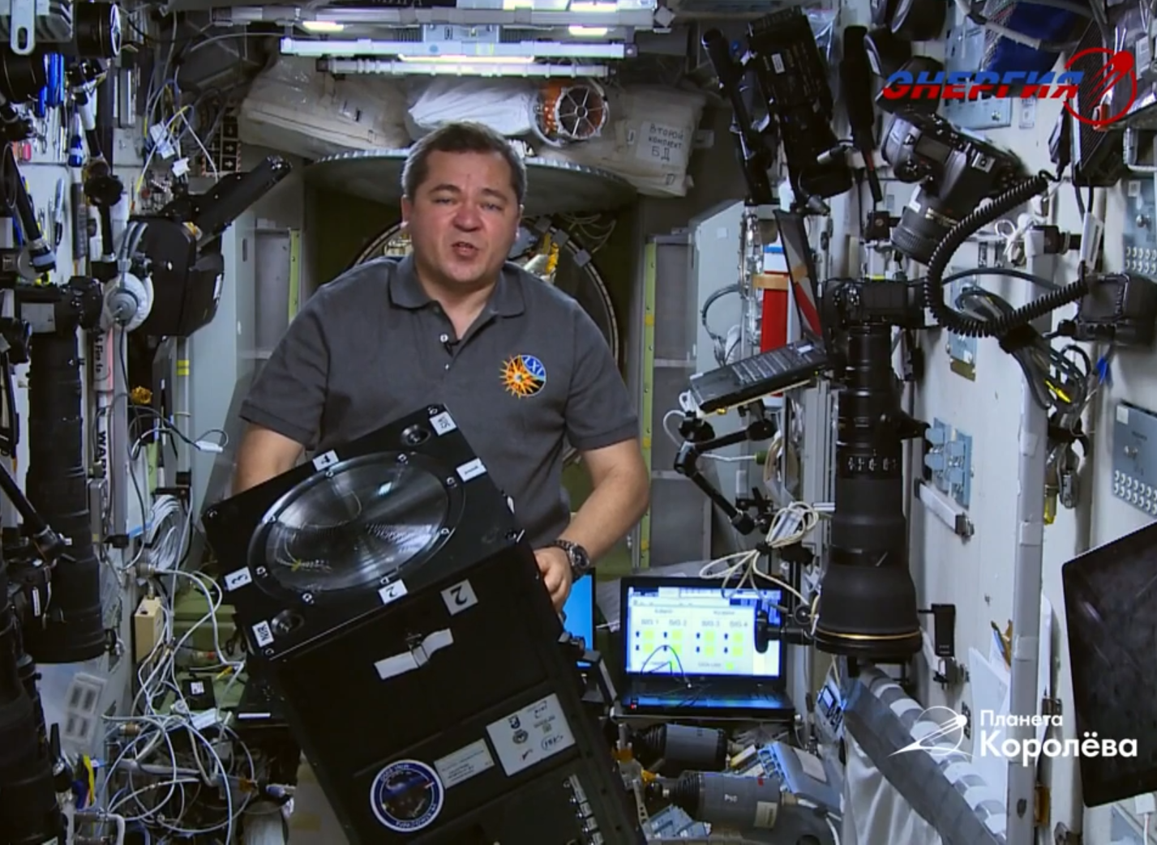
Mini-EUSO
The mission started as a co-operation between Italian Space Agency and Russian Space Agency
It is located in front of the UV transparent window in the Zvezda Russian module in the ISS, looking at Earth in nadir position.
https://www.youtube.com/watch?v=lXedBGVHc4o&t=62s
10

Slide 11
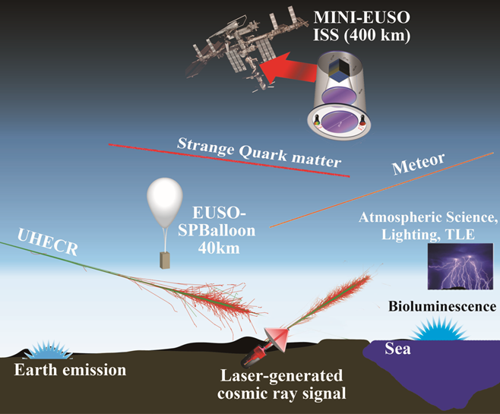
Mini-EUSO
Atmospheric phenomena
UV light emission from Earth during nighttime
Transient phenomena
Cosmic rays
Meteor
Lightning
TLE
UHECR
Diffuse phenomena
Earth emission
Bioluminescence
Chemiluminescence
Clouds
airglow
cities
11

Slide 12
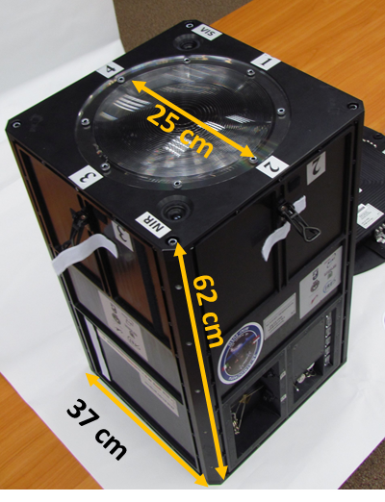
Mini-EUSO
JEM-EUSO program: Joint Experiment Missions for the
Extreme Universe Space Observatory
The UV light (300-400 nm) is focused onto a Photo-Detector-Module (PDM) (2304 MAPMT pixels).
Fresnel lens
The Mini-EUSO instrument comprises a compact telescope with a large field of view (44°) based on an optical system employing two Fresnel lenses for increasing light collection.
NIR camera
12

Slide 13
Can Mini-EUSO see tsunamis which propagate through internal gravity waves in the atmosphere and reach the airglow layers?
13

Slide 14
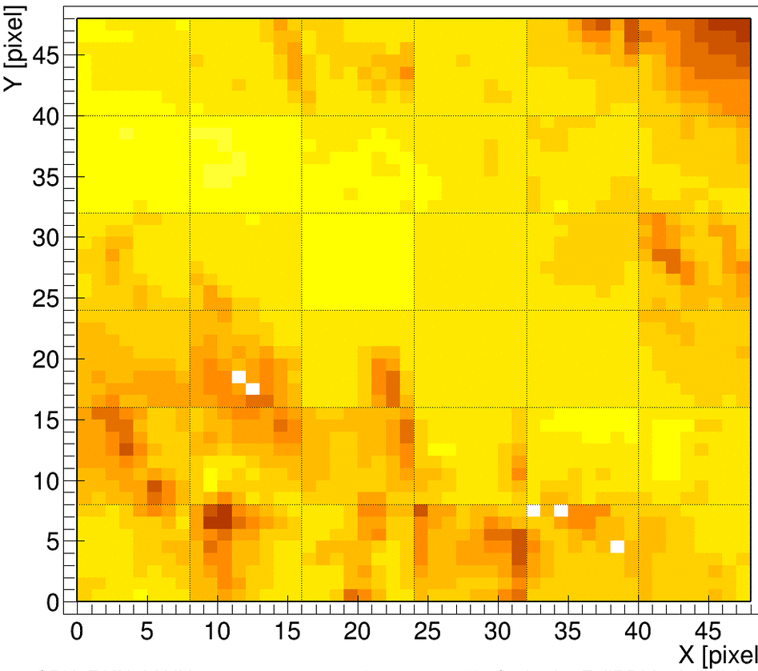
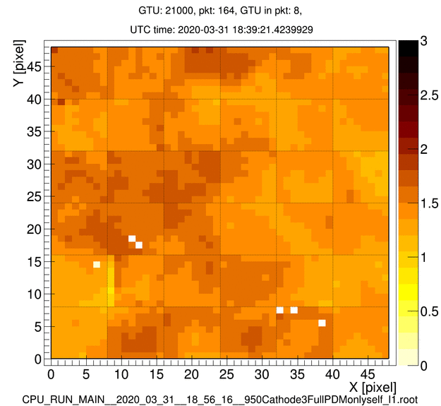
Clouds and sea emission
Date and time: 2019_12_05 from 18:30 UTC (gtu_time+fix)
Counts/pixel/GTU
Location: Indian Ocean
1 frame = signal integrated in 40.96 ms
~14 min video (1 frame every 128 frames)
Pixel size 6.1km ISS speed 7,66 km/s
1 frame = signal integrated in 40.96 ms
~14 min video (1 frame every 128 frames)
10 % fluctuation in signal clearly visible by naked eye (high resolution)
Tsunamis behave like waves, with a wave structure made of troughs and crests, thus clearly different from cloud geometry
Tsunami speed (800 km/h) and cloud speed (80 km/h) have different order of magnitude
14

Slide 15
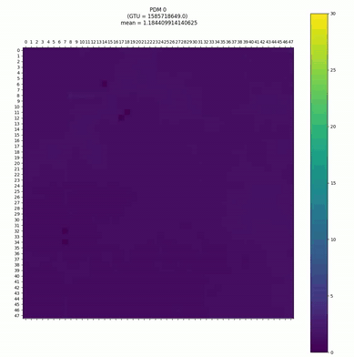
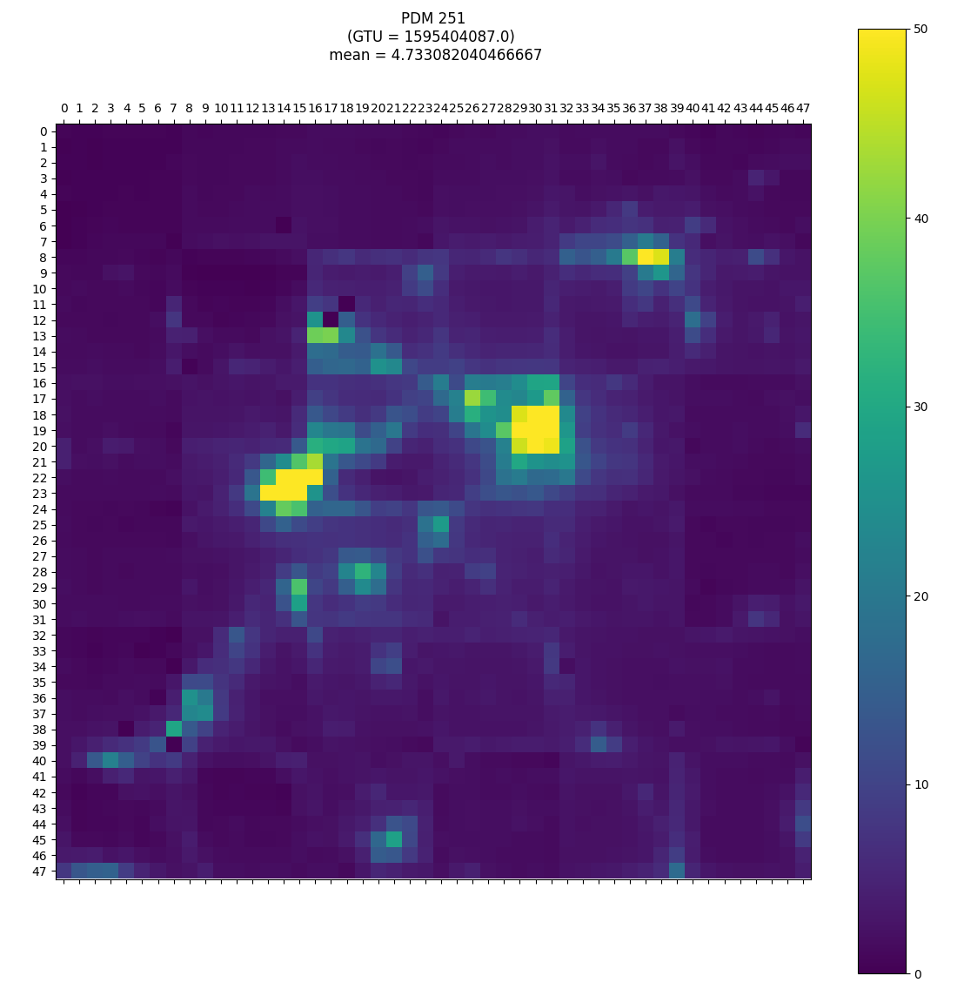
Mini-EUSO data analysis tool
To analyze Mini-EUSO data we used a tool which is still in development
This tool was developed by Kristian Pal’uch, as a thesis work at Technical University of Kosice
One of my tasks was implementing this tool:
c++ script
python script
15

Slide 16
Mini-EUSO data analysis tool
the c++ script
converts Mini-EUSO data root files into text files
implementation: unix timestamp to UTC date and time and addition of ISS location
16

Slide 17
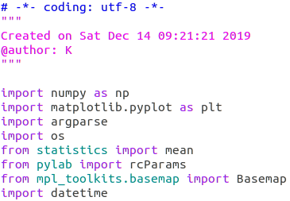
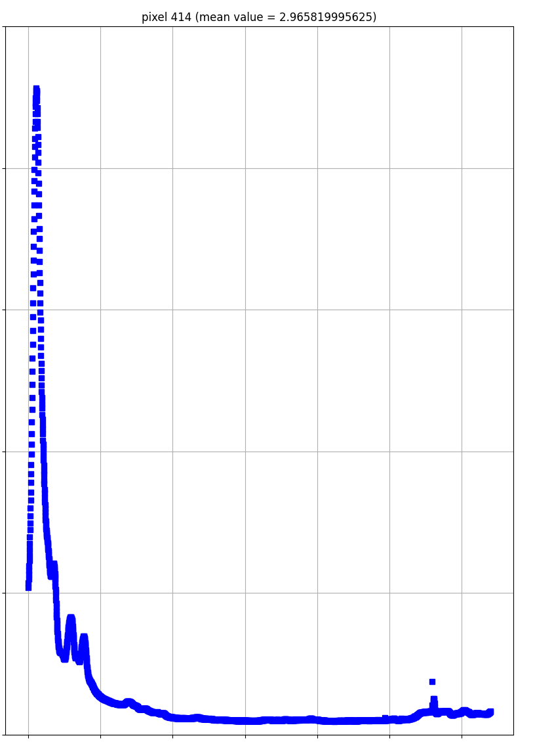
Mini-EUSO data analysis tool
the python script
processes data to create:
PDM images
single pixel in time plot
1000
50
histograms of intensity in single pixels throughout the measurement session
histograms of PDM
PDM location images
ISS trajectory plot
latitude/longitude in time plot
nearest cities images
40
800
600
30
400
20
200
10
counts/pixel/GTU
0
5
10
15
20
0
17
0
1000
2000
3000

Slide 18
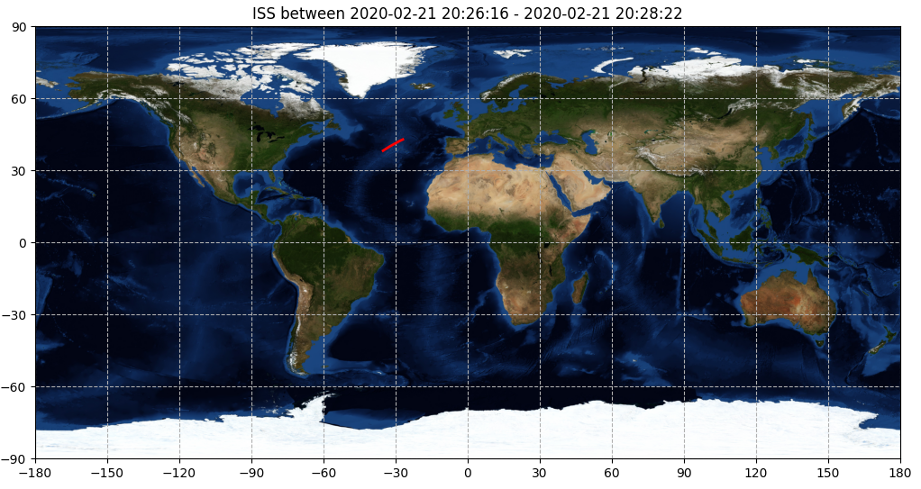
Mini-EUSO data analysis tool
the python script
implementation:
graphs description fixed
histogram dynamic scaling fixed
ISS trajectory plot and time fixed
quick run option added to visualize only pixel in time histograms
18

Slide 19
Mini-EUSO data analysis tool
the python script
A set of optional parameters is also included
-q (optional): quickrun, skips visualization of PDMs, histograms
-rmin (optional): range minimum - skips PDMs before the indicated number
-rmax (optional): range maximum - skips PDMs after the indicated number
-fps (optional): frames per second for video visualization of the overflight
-p (optional): print pixels values
and so forth...
19

Slide 20
tsunami event while Mini-EUSO operating (Mini-EUSO session and data taking on)?
tsunami overflight?
if yes, can we observe airglow fluctuations?
20

Slide 21
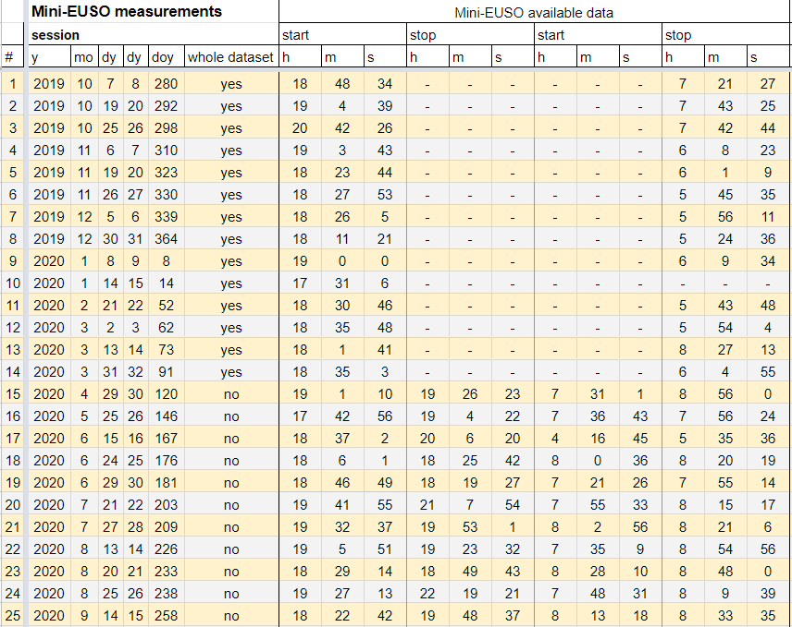
~ when is mini-EUSO operative?
nearly one measurements session every two weeks
Mini-EUSO is operative during the nighttime (evening-night-morning)
evening and morning data transmitted by telemetry
every six month whole night data brought to Earth by astronauts
21

Slide 22
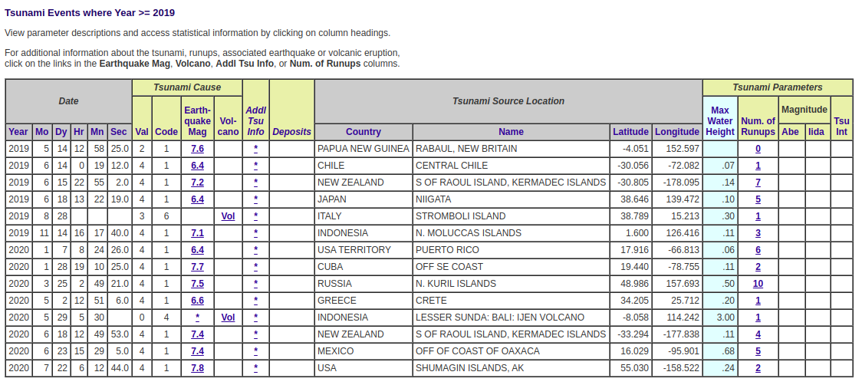
~ during any measurement session did any tsunami event occur?
https://www.ngdc.noaa.gov/nndc/struts/form?t=101650&s=7&d=7, updated 8/10/20
22

Slide 23
~ one event observable in space and time: Shumagin Island tsunami, Alaska
[Max Water Height] = m
23

Slide 24
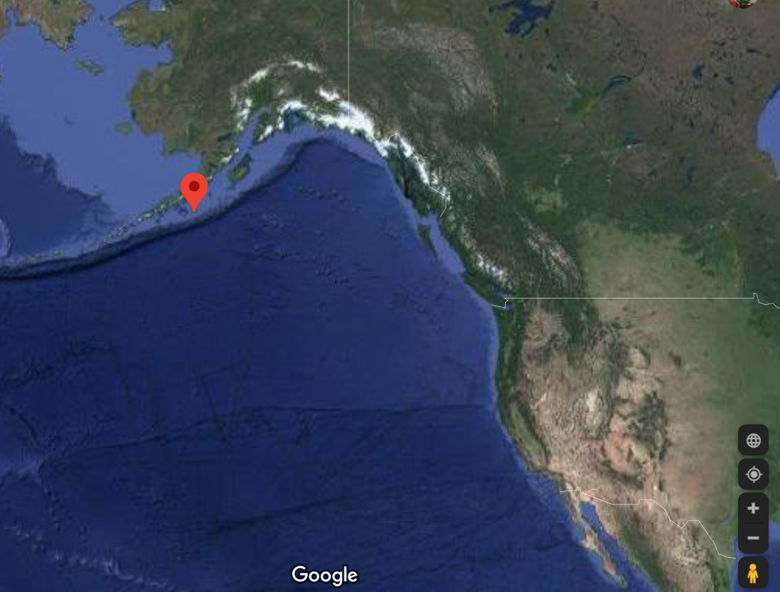
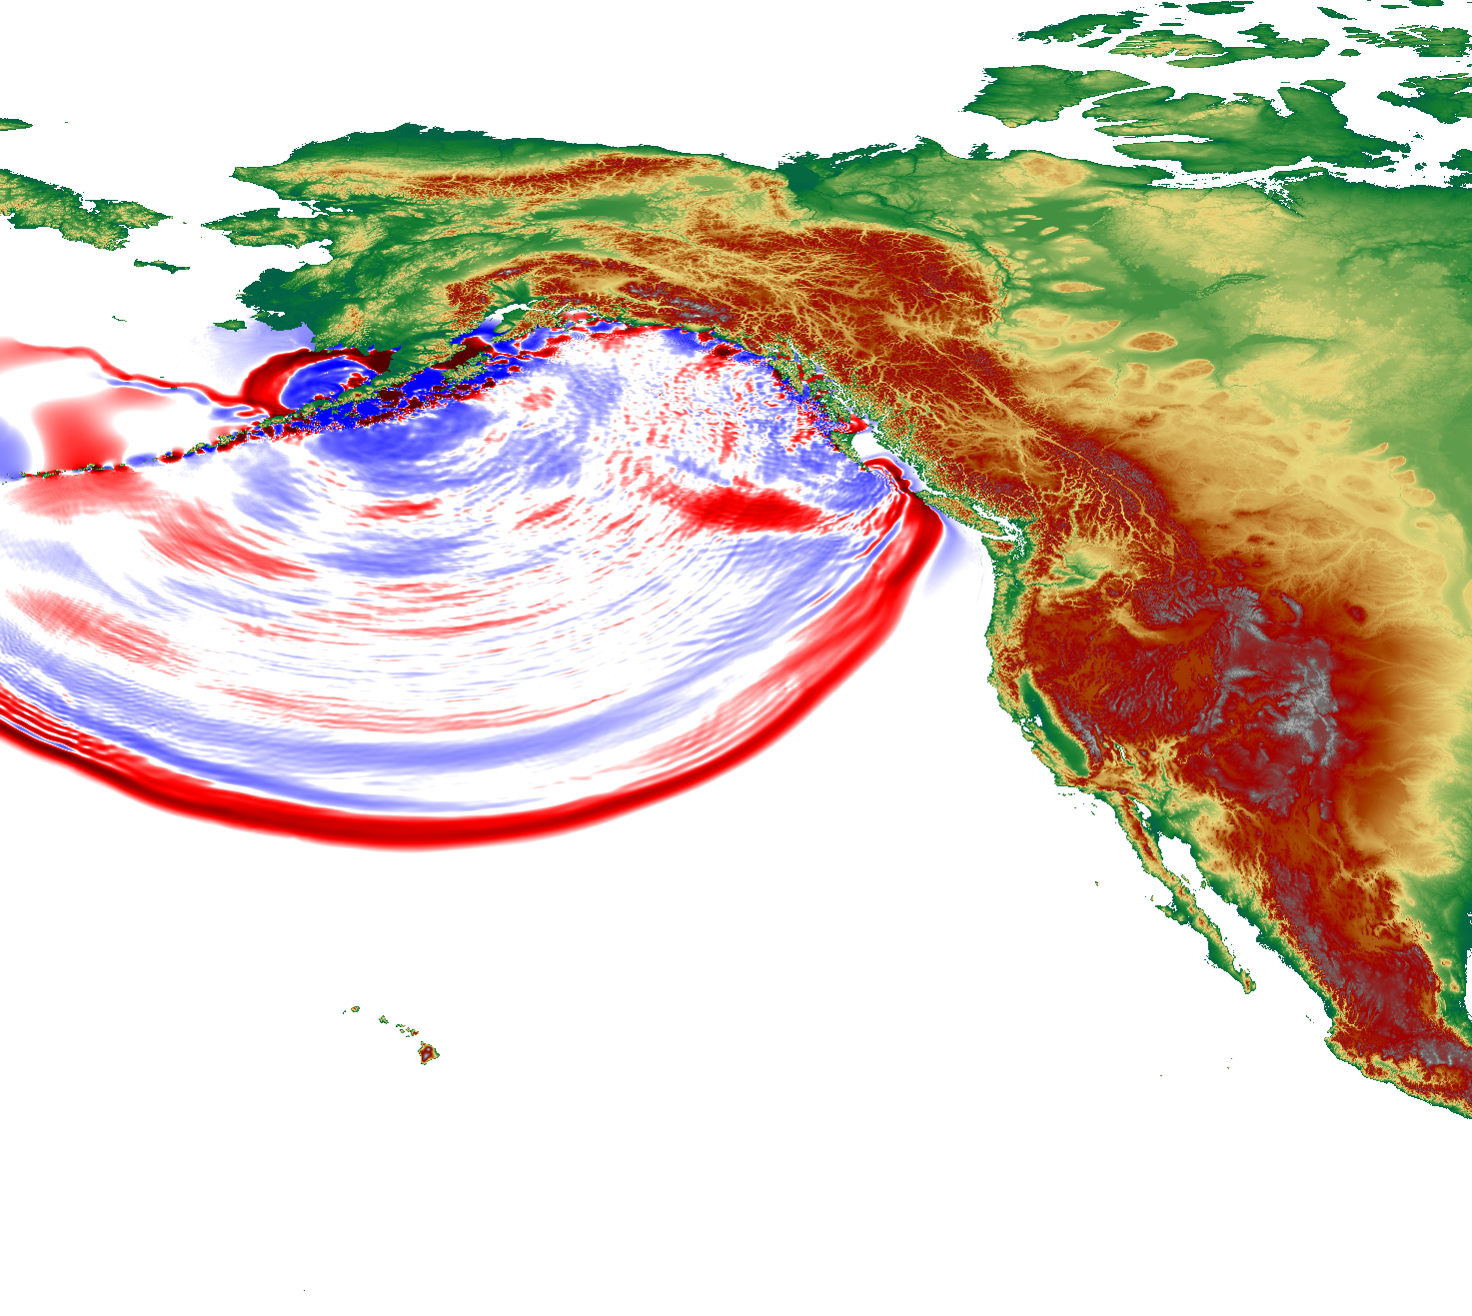
55.030 N 158.522 W t0: 6:12:44
24

Slide 25
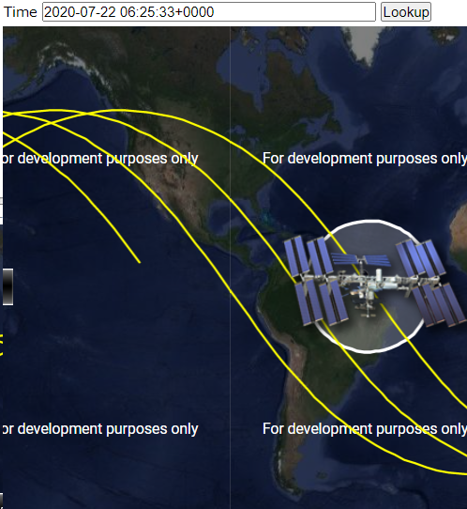
25

Slide 26
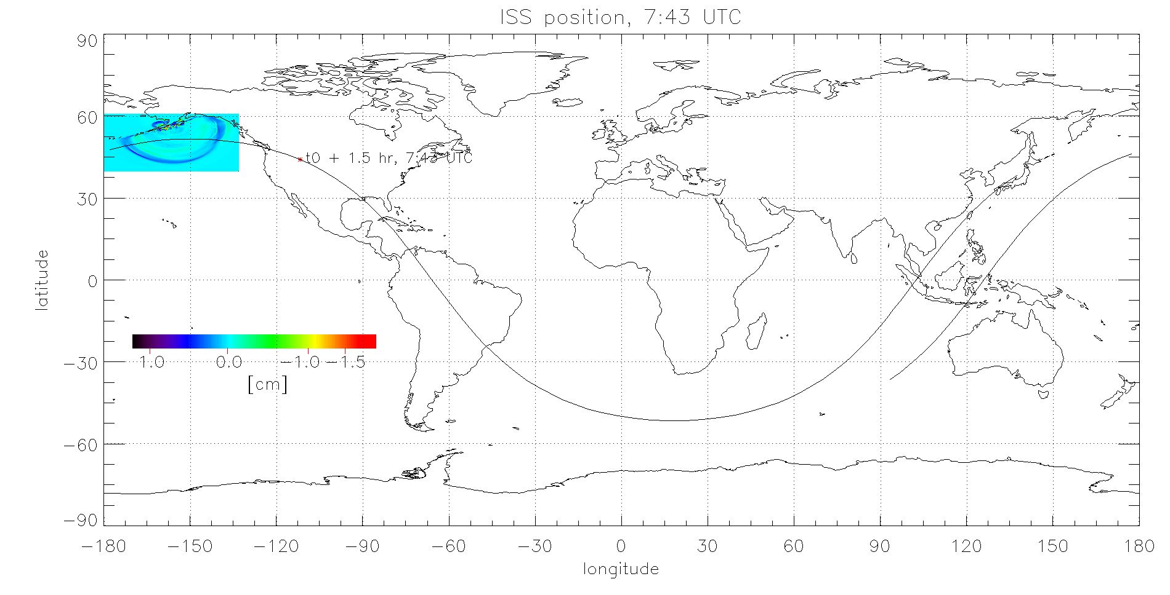
~ one specific event: Shumagin Island tsunami, Alaska
26

Slide 27
Overflight time ~ min
wave progress is almost negligible with respect to ISS progress
27

Slide 28
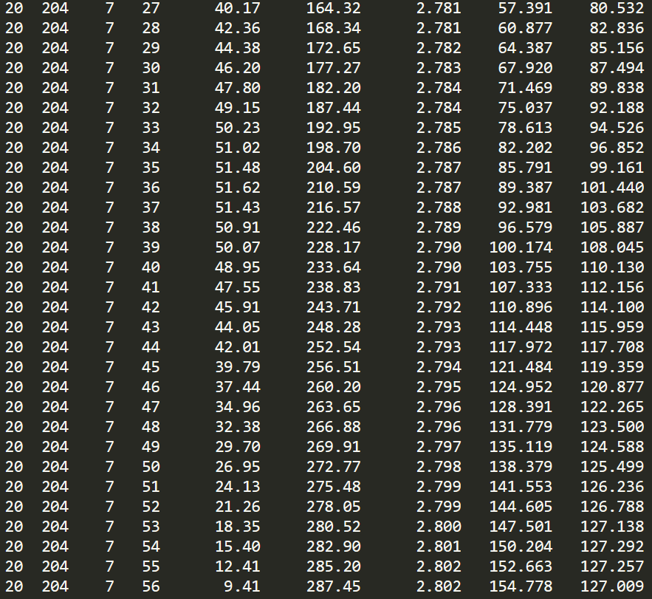
sun zenith angle ≅ 120° at least for minimizing sunlight noise in Mini-EUSO
y
doy
lat
long
Mph
Mza
Sza
h
m
day
Unfortunately, this event can’t be detected in measurements because during the overflight darkness conditions were not met (Mini-EUSO was in stand-by)
Thus, even if data from 7:28-7:44 were available we would not be able to analyze airglow fluctuations
day
night
night
28

Slide 29
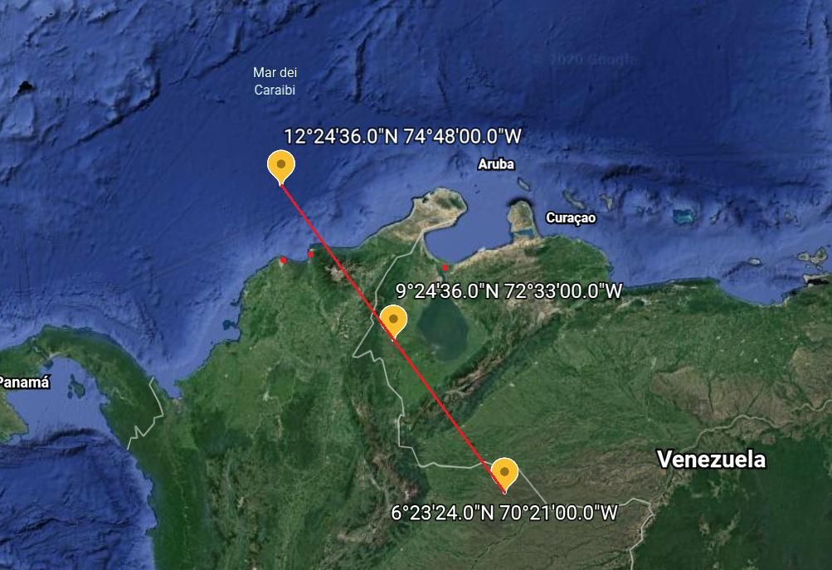
Pixel 100 randomly chosen, Venezuela overflight. Naked eye visible peaks, probably owing to cities
Tsunami induced signal increase at least 2% not to be negligible with respect to noise (red baseline)
Naked eye visible peak signal increase by 5% (red circle peak)
29

Slide 30
Assumption: 1 cm high tsunami will create 1% change in airglow production
based on the following article
M.P. Hickey et al.: Atmospheric airglow fluctuations due to a tsunami driven gravity wave disturbance, ‐ JGR, 115, A06308, doi:10.1029/2009JA014977, 2010
From ISS this detectable change is little smaller because it depends on how much airglow light is produced, reflected star light and zodiacal light.
In order to have a 5% signal increase minimum wave height
30

Slide 31
black line: Mini-Euso signal as measured
red line: Mini-Euso signal with Shumagin tsunami added. Tsunami size is 10 times higher than the real one (~10 cm in the open ocean). The tsunami should be visible
Shumagin tsunami: open ocean h=0,5cm, maximum water height at shore H=25 cm
Therefore open ocean h=7cm, maximum water height at shore H=3,5 m
Mini-EUSO could be able to detect tsunamis which produce some meters high waves
31

Slide 32
Conclusions
Readjustment of EasyWave software
Systematic control of the Mini-EUSO data analysis tool
Analysis of one event. Observation conditions were not met
The method shows that sufficiently high tsunamis will be detectable by Mini-EUSO when they occur
An increase of signal around 5% inducted by tsunami generated pressure wave is needed in order to distinguish peaks from noise
This leads to consider some meters high tsunami waves at shore
The method was elaborated, is consistent and is now ready to be used at occurrence of big tsunami events

Slide 33
Thanks for your attention!
Many thanks to
Professor Mario Edoardo Bertaina
Professor Pavol Bobik
Colleague Kristián Pal’uch

