Slide 1








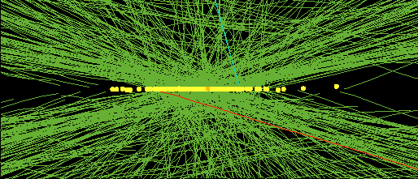
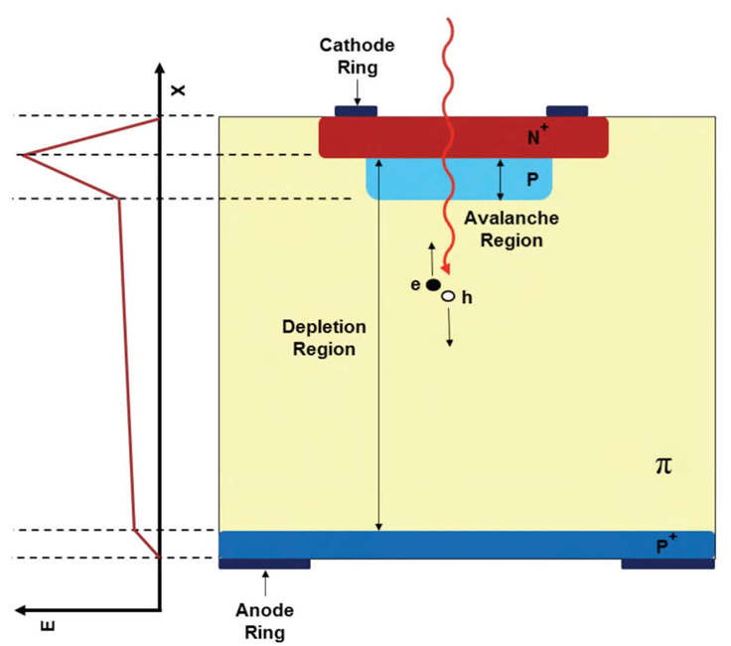
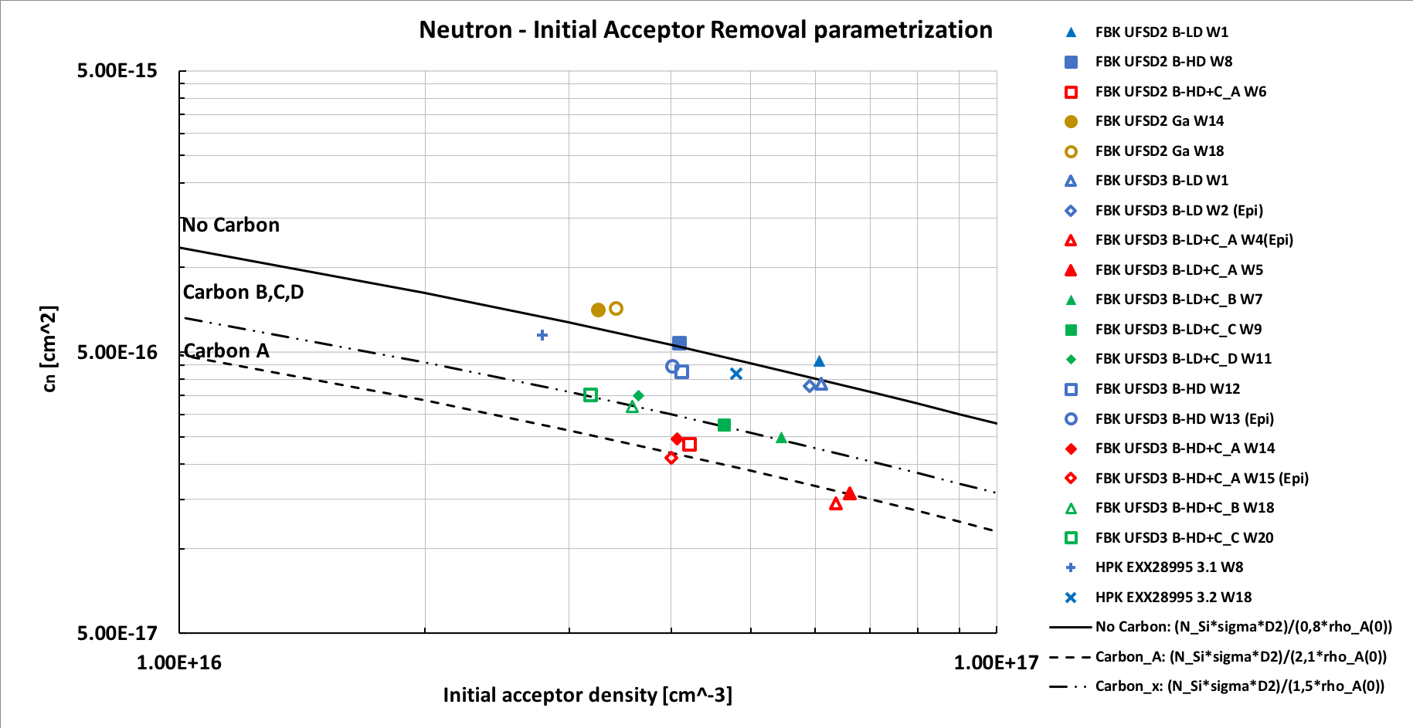
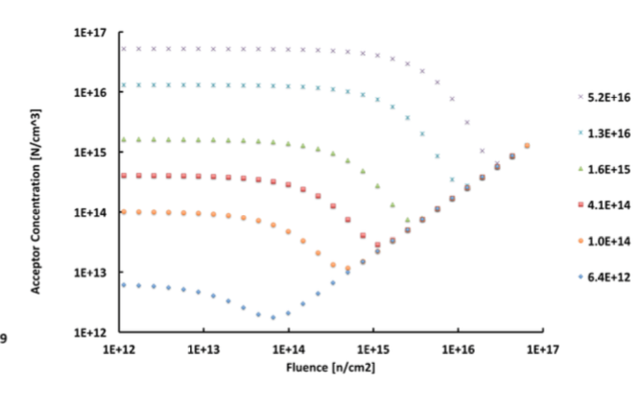
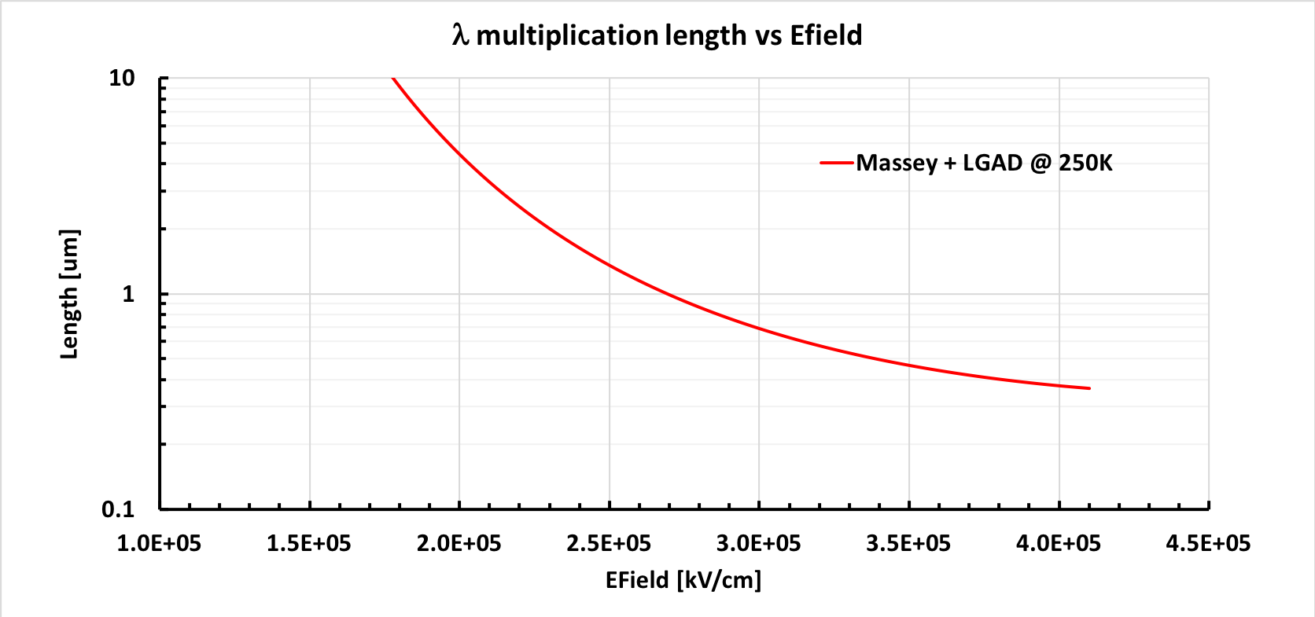
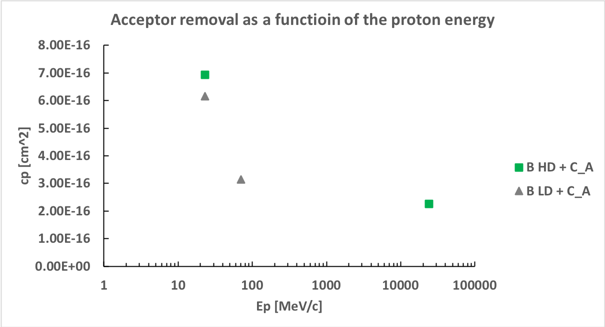
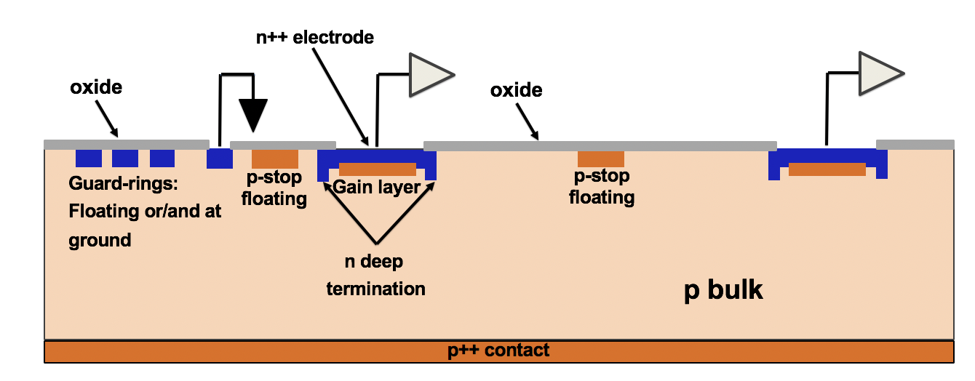
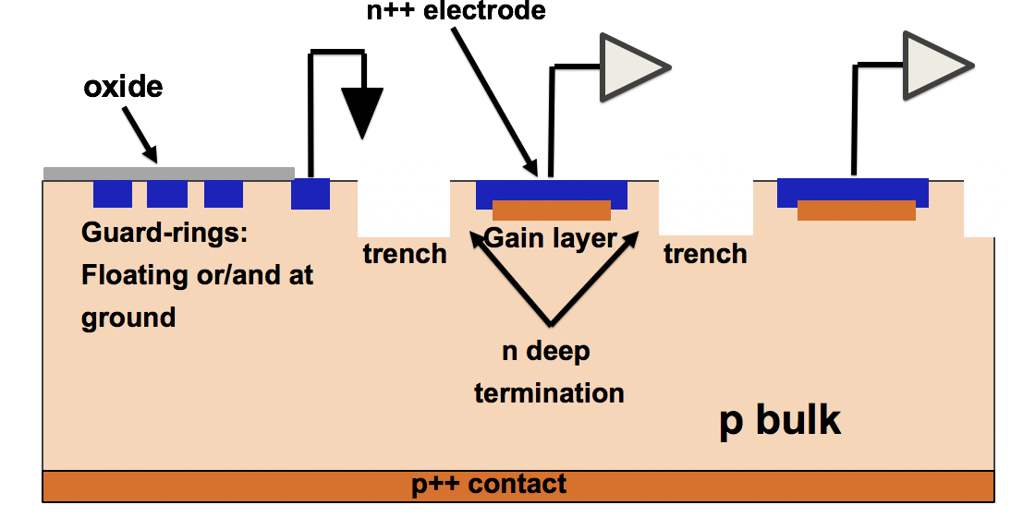
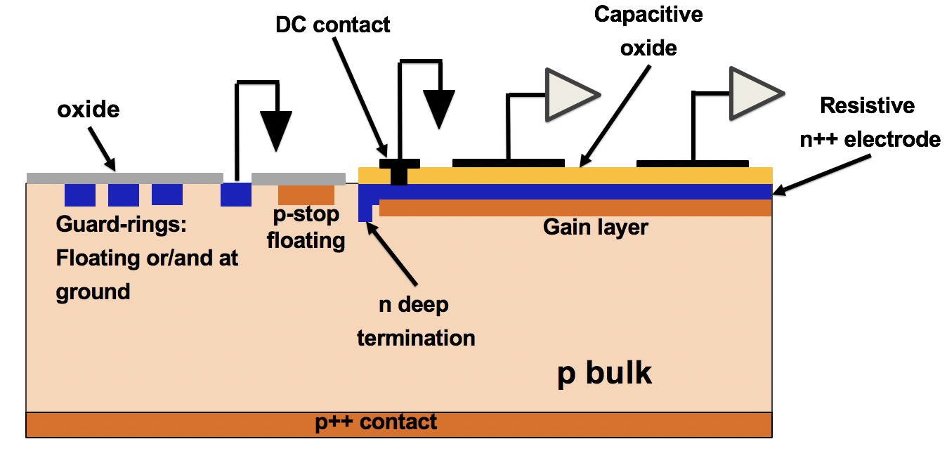
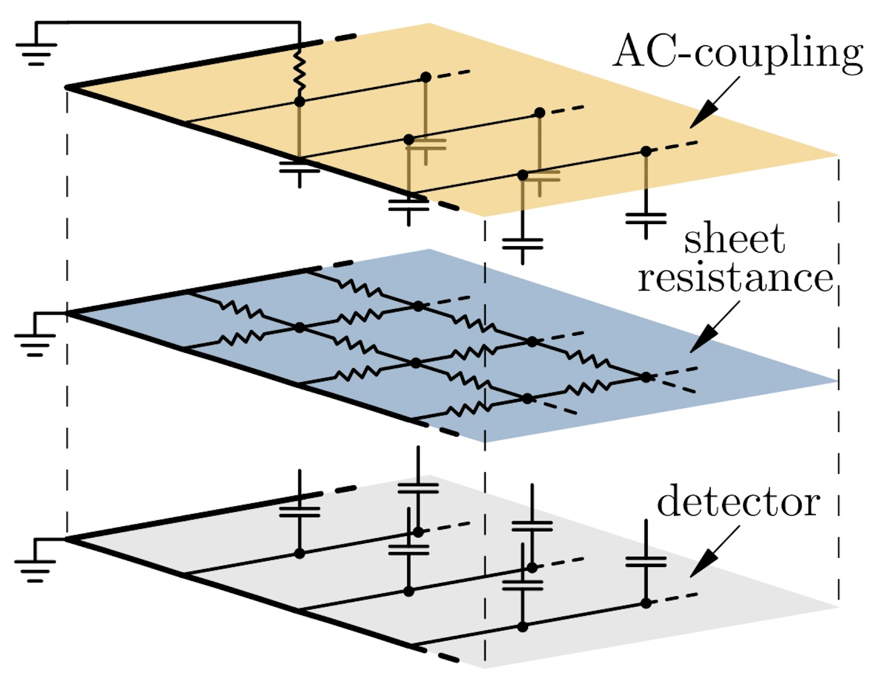
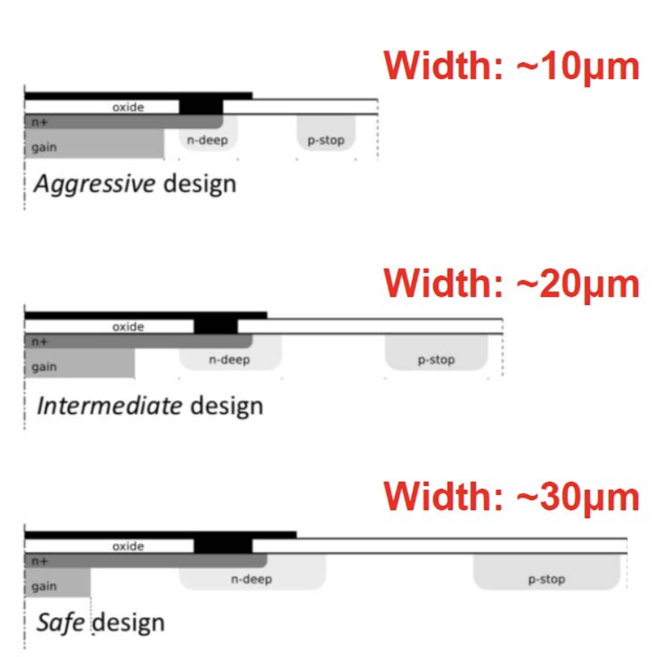
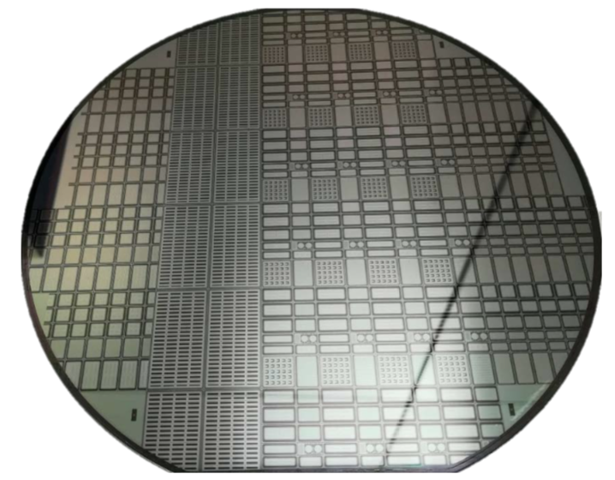
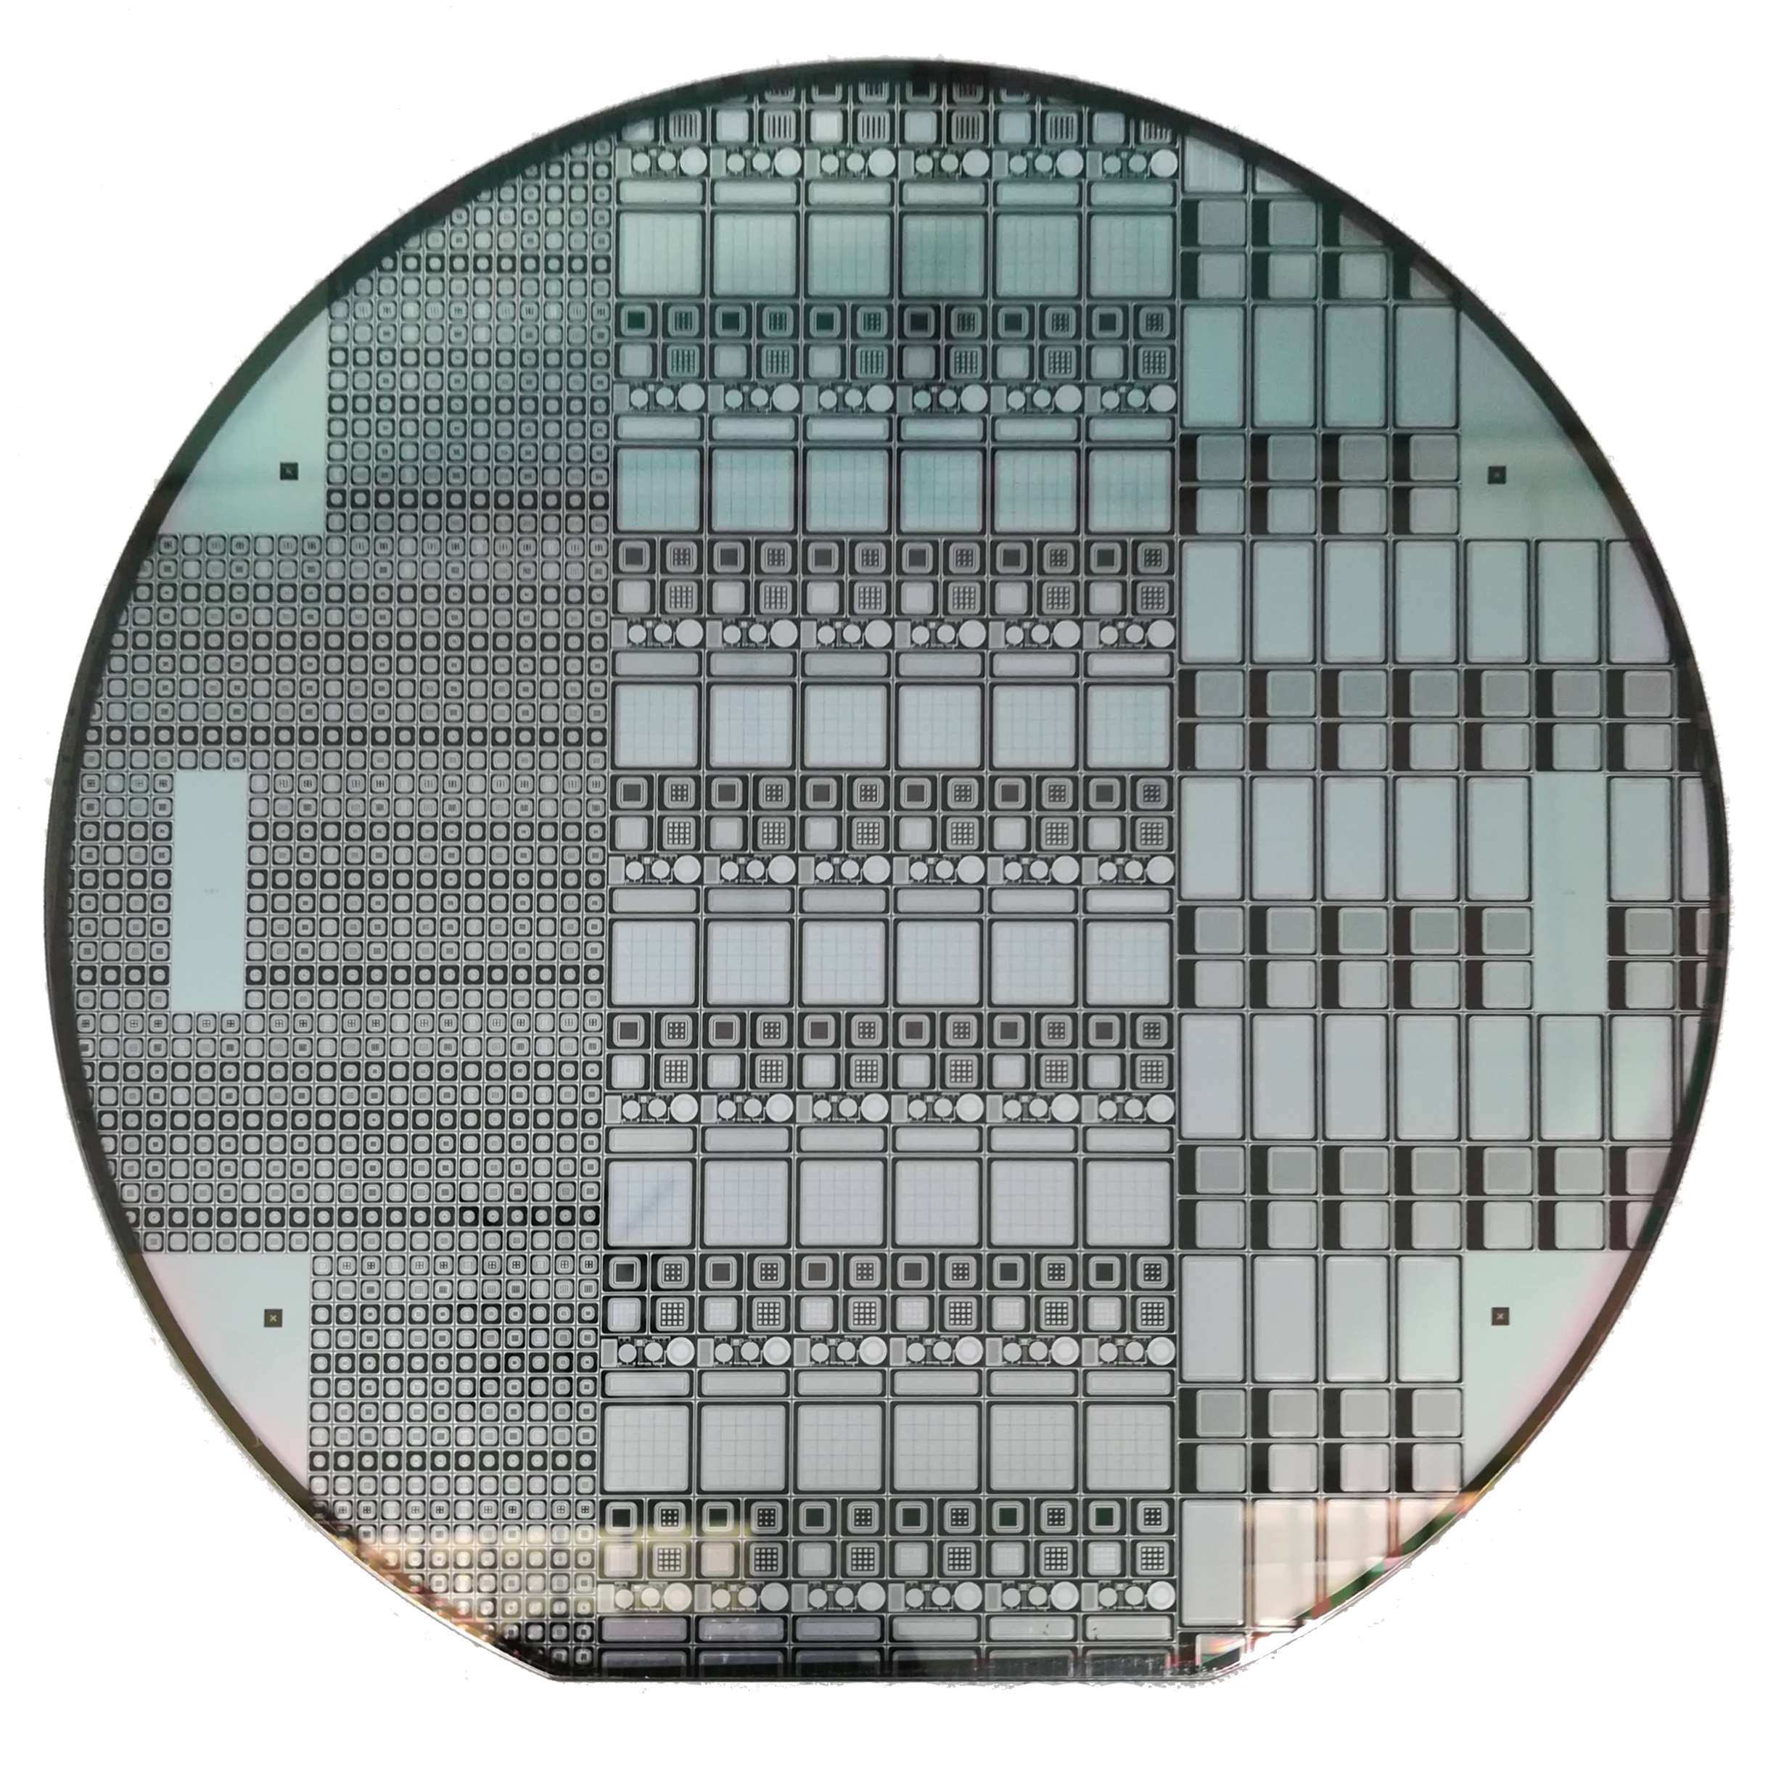
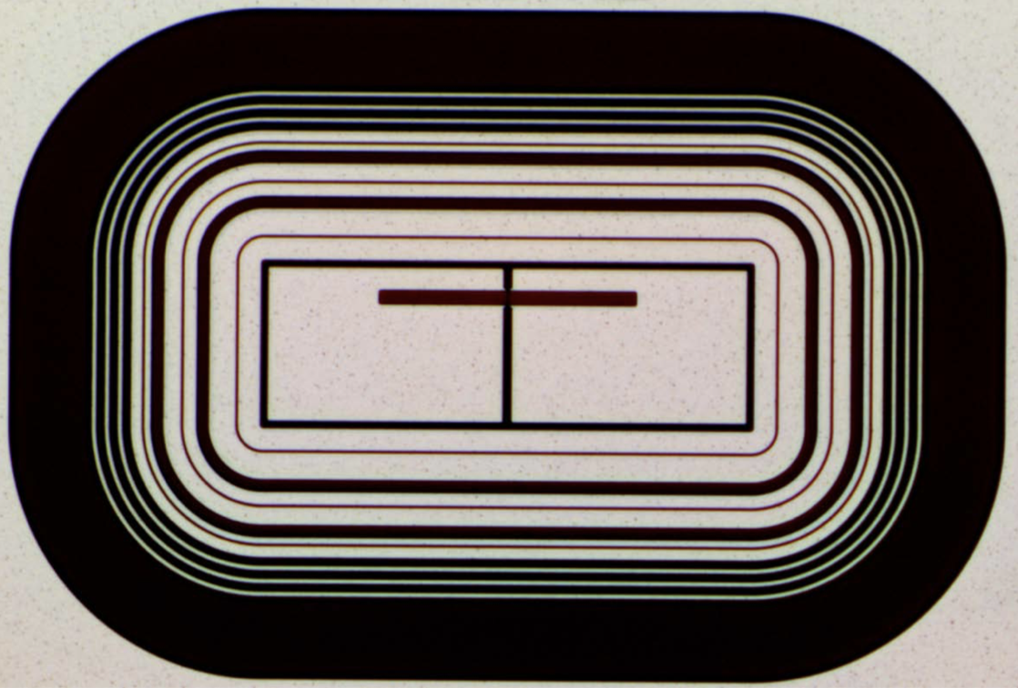
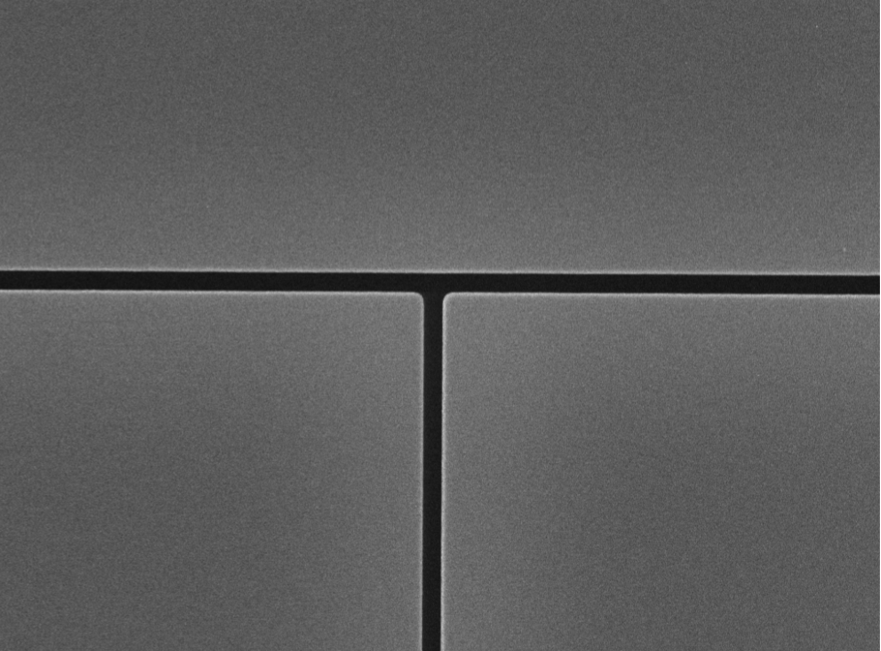
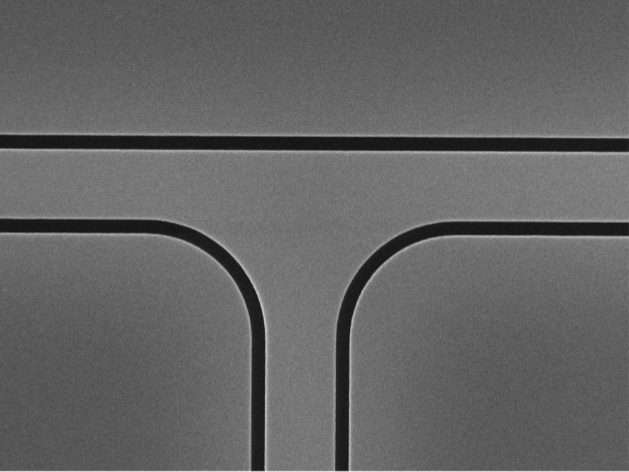
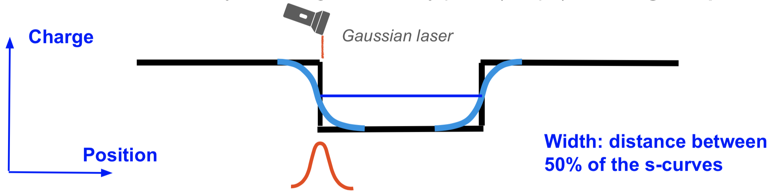
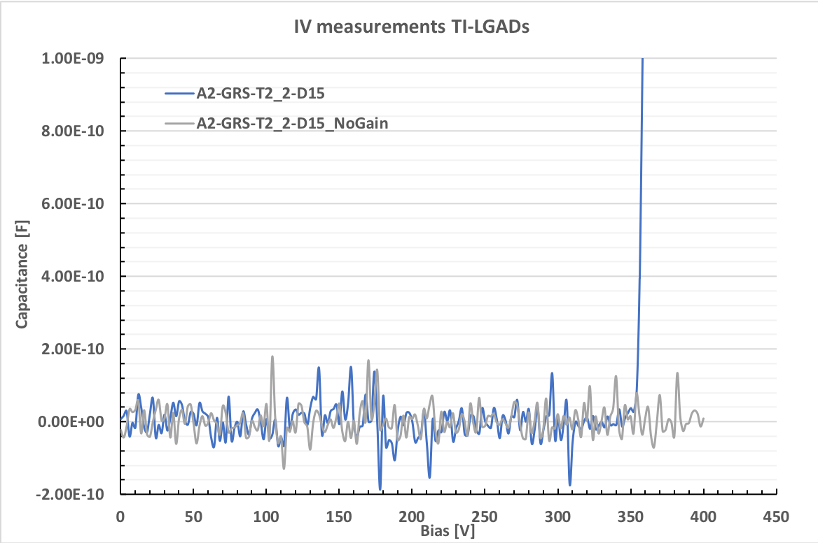
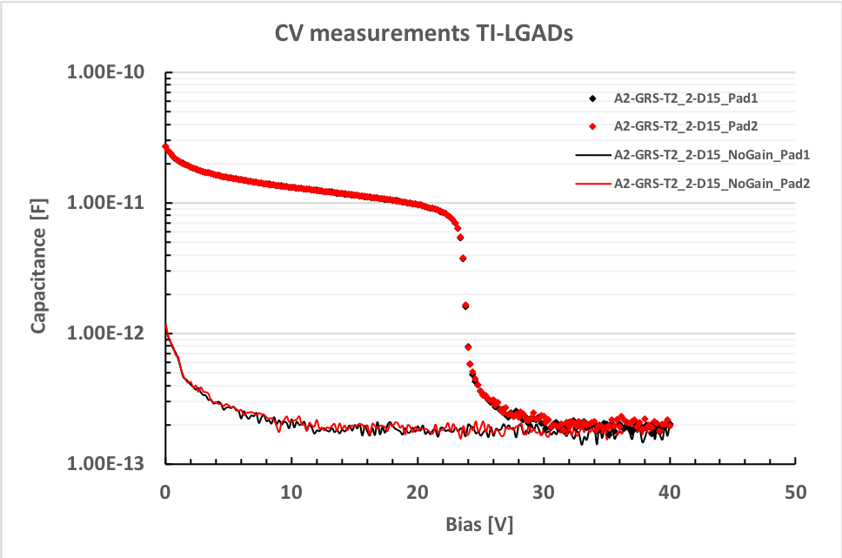
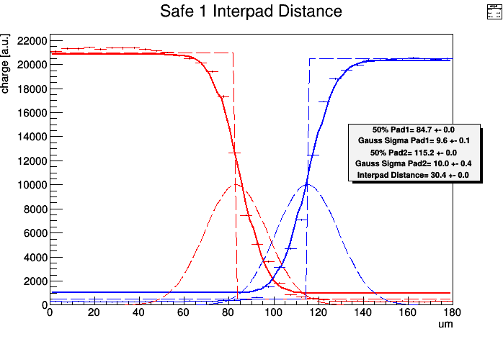
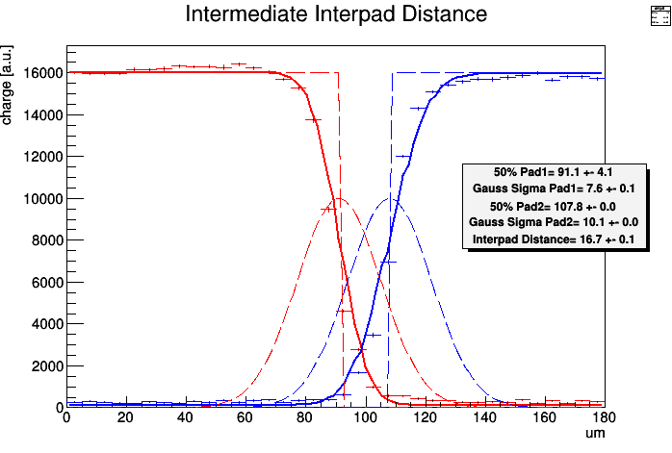
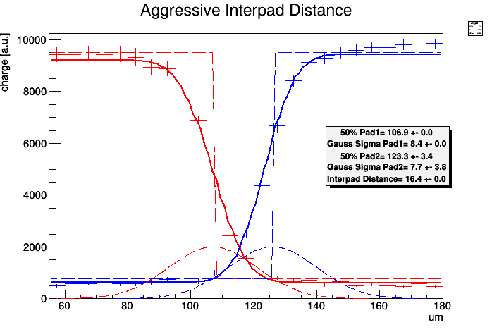


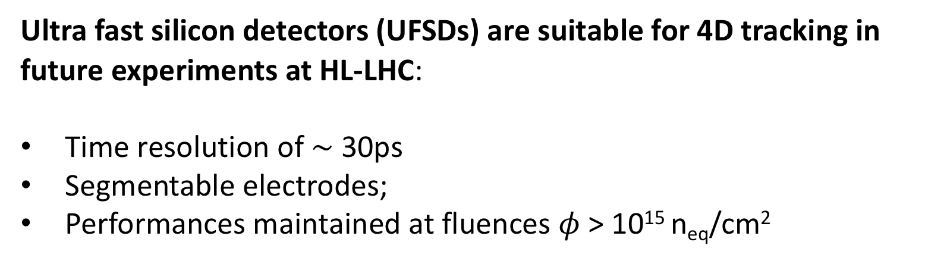
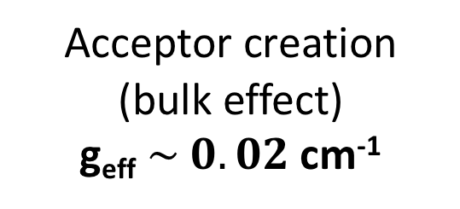

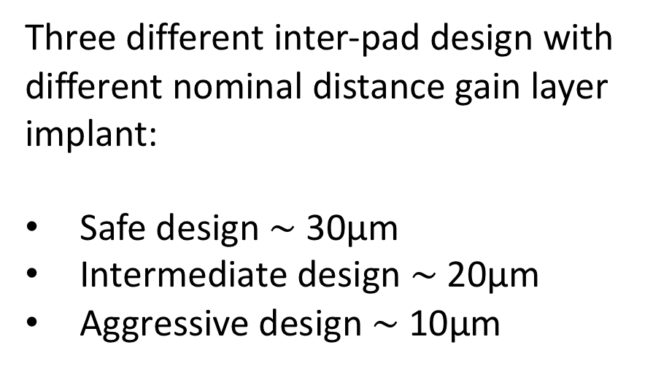

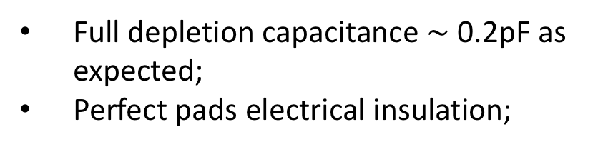
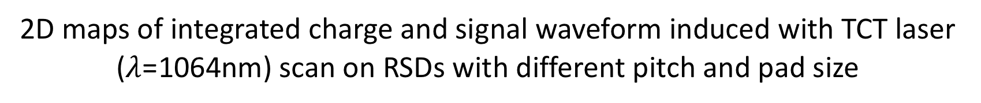
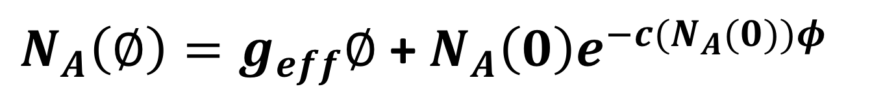
15th Topical Seminar on Innovative Particle and Radiation Detectors (IPRD19) 14-17 October 2019, Siena, Italy
Evolution of the design of Ultra Fast Silicon detector to cope with high irradiation fluences and fine segmentation
M. Ferrero^{1*}, R. Arcidiacono⁴, G. Borghi⁵, M. Boscardin⁵, N. Cartiglia¹, M.Costa², G.F. Dalla Betta³, F.Ficorella⁵, M. Mandurrino¹, M.M. Obertino², L. Pancheri³, G. Paternoster⁵, F. Siviero², V. Sola^{1,2}, A. Staiano¹, M.Tornago², M. Vignali⁵
¹INFN, Torino, Italy
²Università di Torino, Torino, Italy
³Università di Trento and INFN, Dipartimento di ingegneria industriale, Trento, Italy
⁴Università del Piemonte Orientale, Novara, Italy
⁵Fondazione Bruno Kessler (FBK), Trento, Italy
4D tracking motivation
Low Gain avalanche Diode (LGAD)
Timing-Tracking capability is strongly motivated by high dense environments in future hadron collider
Sensors requirements:
Radiation resistance
High fill factor (fraction of active area)
Principle:
Add to n-on-p Silicon sensor an extra thin p-layer ($\sim$10¹⁶ atoms/cm³) below the junction which increases the E-field so that charge multiplication with moderate gain of 10-50 occurs without breakdown.
High Doping Concentration equal High Field
Ultra Fast Silicon Detector (UFSD) is a thin LGAD ($\sim$50µm thick) optimized to achieve a time resolution of $\sim 3$0ps
Bunch crossing simulation HL-LHC
Ultra fast silicon detectors (UFSDs) are suitable for 4D tracking in future experiments at HL-LHC:
Time resolution of $\sim$30ps
Segmentable electrodes;
Performances maintained at fluences $φ$ > 10¹⁵ n_{eq}/cm²
UFSD design based on Low Gain Avalanche diode technology
Radiation effects
Acceptor removal
LGAD gain mechanism
Investigation of acceptor removal mechanism on different gain layer flavors
Gain: exp(field * distance)
$$G {∝e}^{α∗d}$$
$N_{A}\left(∅\right)=g_{eff}∅$ + $N_{A}\left(0\right)e^{−c(N_{A}(0))φ}$
n++ implant
Shallow gain layers work at higher E field.
Neutron
irradiation
Thinner and Higher gain layer profiles are more radiation resistance
Acceptor removal mechanism is mitigated by co-implantation of carbon into gain layer
Shallow GL
n implant
Deep GL
Acceptor creation
(bulk effect)
g_{eff} $\sim 0.02$cm⁻¹
Acceptor removal
(gain layer effect)
c(N_{A}(0)) acceptor removal coefficient
High Electric field drift space
E₁
Q₁
Gain layer
p implant
E₂
Q₂
Depth
Gain layer
p+ implant
d₁
d₂
The position of the GL determines the field working point: the deeper it is, the lower the field is
$$E_{1}> E_{2}$$
Acceptor removal
Dependence of acceptor removal upon the proton energy
Bulk
Proton
irradiation
Proton irradiation induces more or equal acceptor removal than Neutron
Effect of Proton energy: acceptor removal is faster for lower Proton energy
Different manufacturers have different gain layer strategies:
FBK: shallow implant
HPK: deep implant
Deep Gain Layer (DGL)
Shallow Gain Layer (SGL)
Acceptor creation
c_{n (B HD + C_A)}
Multiplication in the Bulk: ~ 170-200 kV/cm
Deep Gain Layer: ~ 290 – 300 kV/cm
Shallow Gain Layer: ~ 380 – 400 kV/cm
c_{n (B LD + C_A)}
At high field the mean free path is saturated, so the “recovering power” of bias is much reduced. At lower field, bias is more effective
UFSD standard design
Trench Isolated LGADs
Resistive AC-Coupled Silicon Detectors (RSD)
Trench isolation technology successfully used in FBK UHD SiPMs
Silicon particle detector with 100% fill factor
Transversal cut of a standard multi pad UFSD sensor
Full
gain
region
No gain region
Full
gain
region
Transversal cut of a UFSD trench isolated sensor
Transversal cut of a RSD sensor
Simplified model
FBK UFSD3 production (2018)- reducing the border dimensions in terminations structure
Full
gain
region
No gain region
Full
gain
region
Full gain region
UFSD3 Wafer layout
Trench isolation could reduces inter-pad border region down few µm:
Typical trench width < 1µm
Trench filling with SiO_{2,} Si₃N₄, Polysilicon
RSD1 production:
Si-Si Float Zone (FZ) and epitaxial (Epi) substrate;
three n++ doses;
two capacitive oxide thickness;
pads matrix with 50x50 to 500x500 µm² pitch and different pads size;
Three different inter-pad design with different nominal distance gain layer implant:
Safe design $\sim$ 30µm
Intermediate design $\sim$ 20µm
Aggressive design $\sim$ 10µm
FBK started a first development run of TI-LGADs in 2019 to demonstrate feasibility of technological process
FBK-UFSD3 inter-pad layout (in scale)
250µm
375µm
SEM imagine of a sensor with single trench isolation
Layout splits:
n of trenches (1-2 trenches)
Guard ring isolation (trench Vs p-stop)
2D maps of integrated charge and signal waveform induced with TCT laser ($λ$=1064nm) scan on RSDs with different pitch and pad size
Inter-pad measured with TCT setup, using a 1064nm focused laser
Design | Nominal distance (µm) | Measured distance (µm)
Safe | 31 | 30.4
Intermediate | 20.5 | 16.7
Aggressive | 11 | 16.4
Front view of a two pads device
SEM imagine of a sensor with double trench isolation
3x3 pad matrix;
200µm x 200µm pitch;
150µm x 150µm pad size;
Integration time of 5ns;
Very low current <100pA;
Breakdown due to internal gain at $\sim$ 350V;
No Breakdown up to 400V in sensors without gain;
3x3 pad matrix;
50µm x 50µm pitch;
25µm x 25µm pad size;
Integration time of 2.7ns;
Safe
Intermediate
Aggressive
Full depletion capacitance $\sim$ 0.2pF as expected;
Perfect pads electrical insulation;
Conclusion
Ultra-Fast Silicon Detectors are being realized in form of thin Low-gain Avalanche Detectors
Radiation hardness improved by co-implantation of carbon into the gain layer
The interplay of acceptor removal and the capability to recover the effect of fluence with Bias will determine the more radiation resistance designs.
16-17µm is the minimum inter-pads distance measured in multi-pad sensors
Trench isolation and and Resistive AC-coupling detectors are the two technological solution to improve the inactive inter-pad region in multi-pad sensors
* Corresponding author: Marco Ferrero, INFN Torino, marco.ferrero@to.infn.it
Acknowledgments
NFN - Gruppo V
Horizon 2020, grant UFSD669529
Horizon 2020, grant no. 654168 (AIDA-2020)
U.S. Department of Energy grant number DE-SC0010107
Dipartimenti di Eccellenza, Univ. of Torino (ex L. 232/2016, art. 1, cc. 314, 337)

