Slide 1
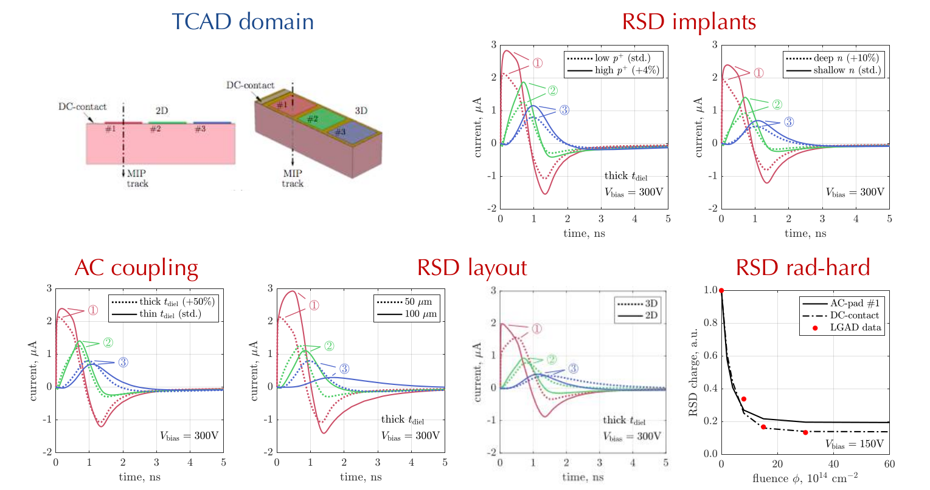
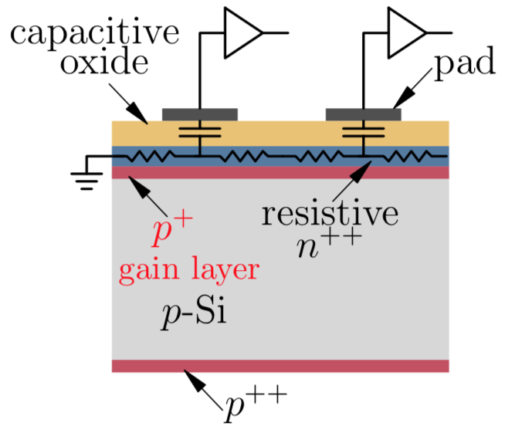
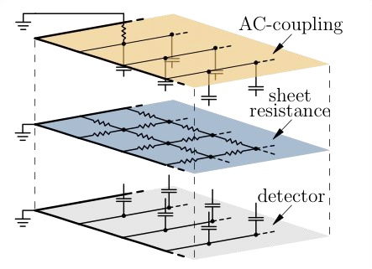
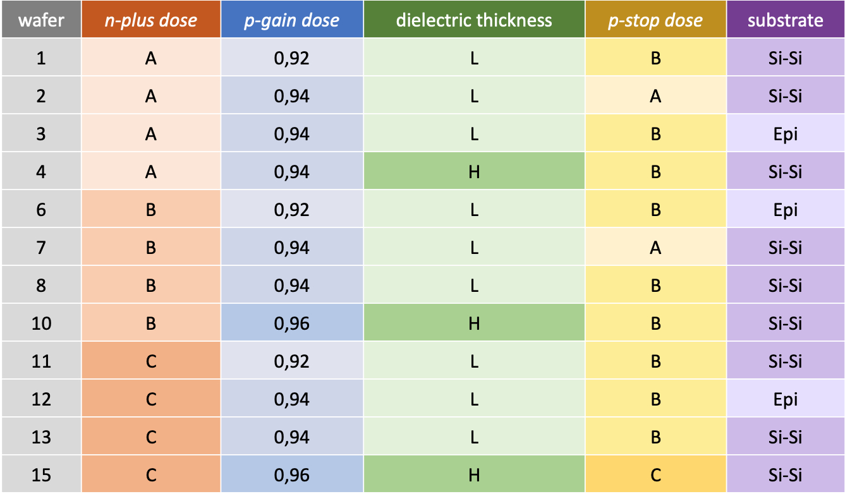
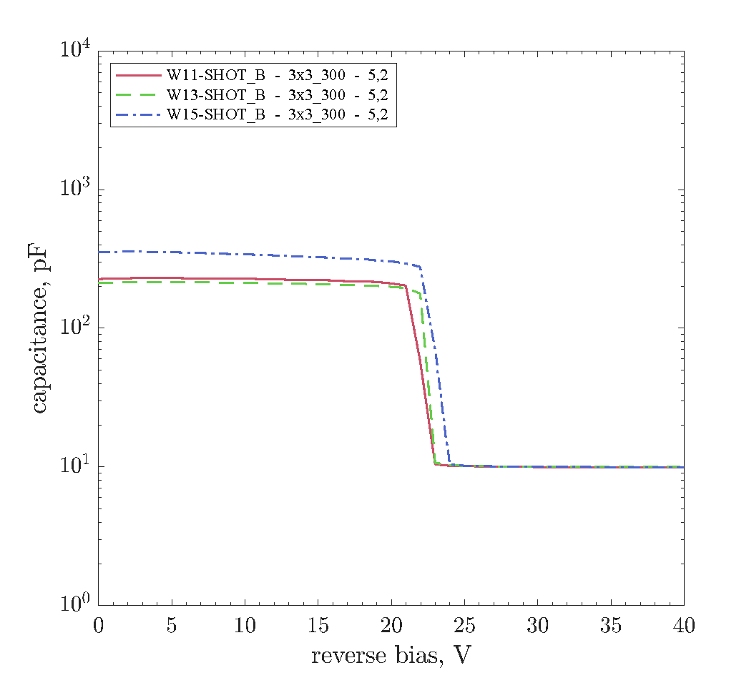
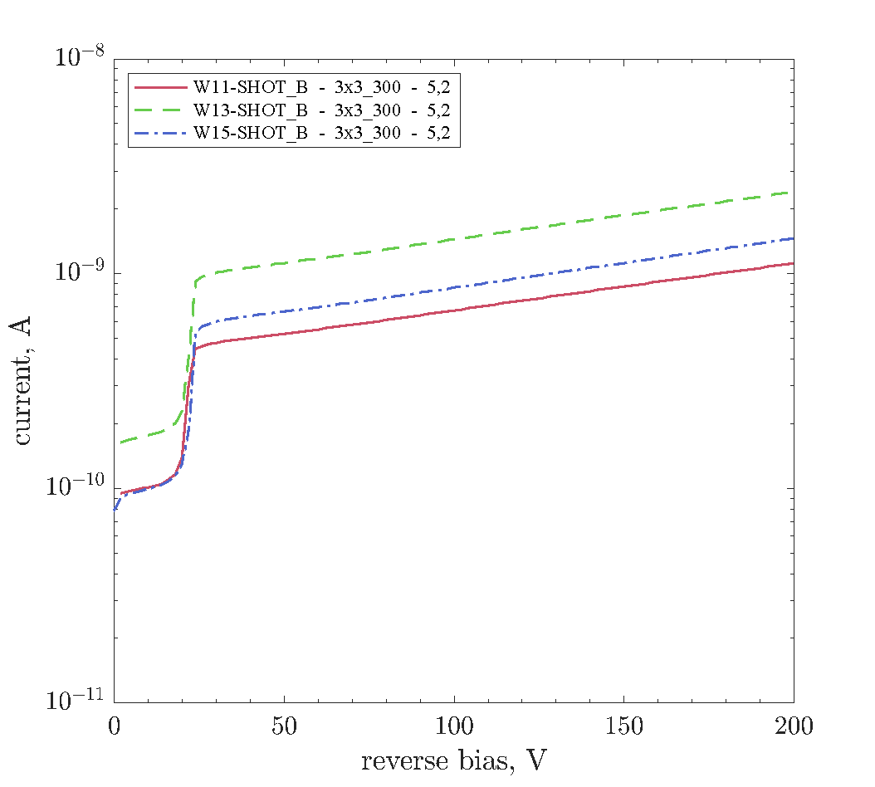
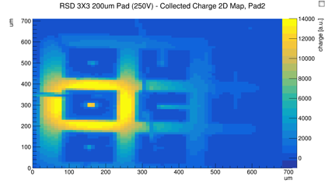
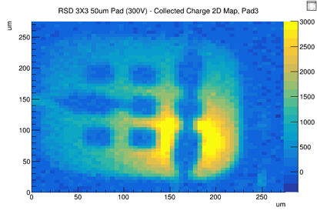
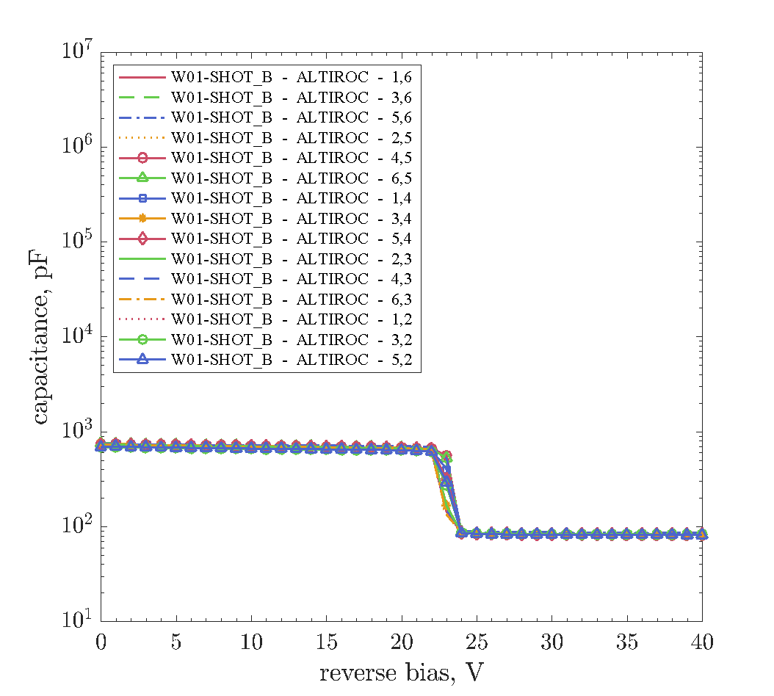
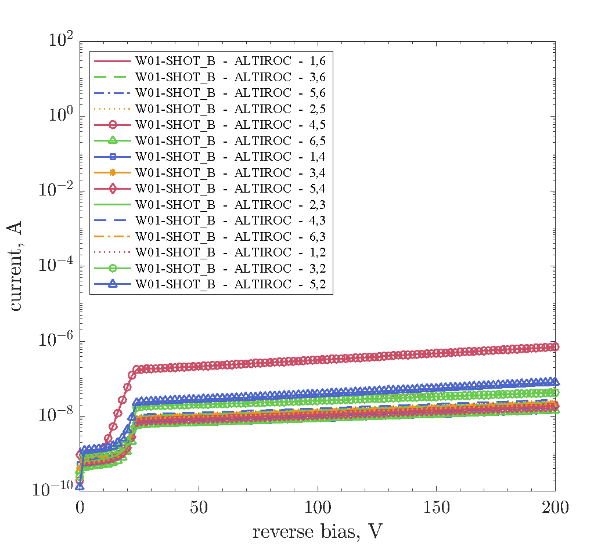
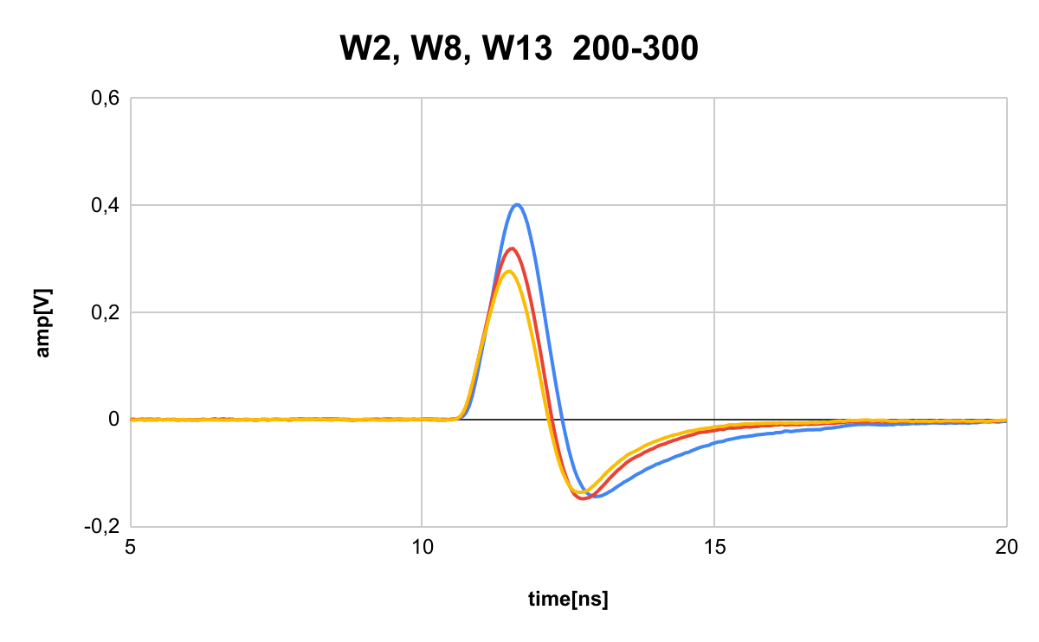
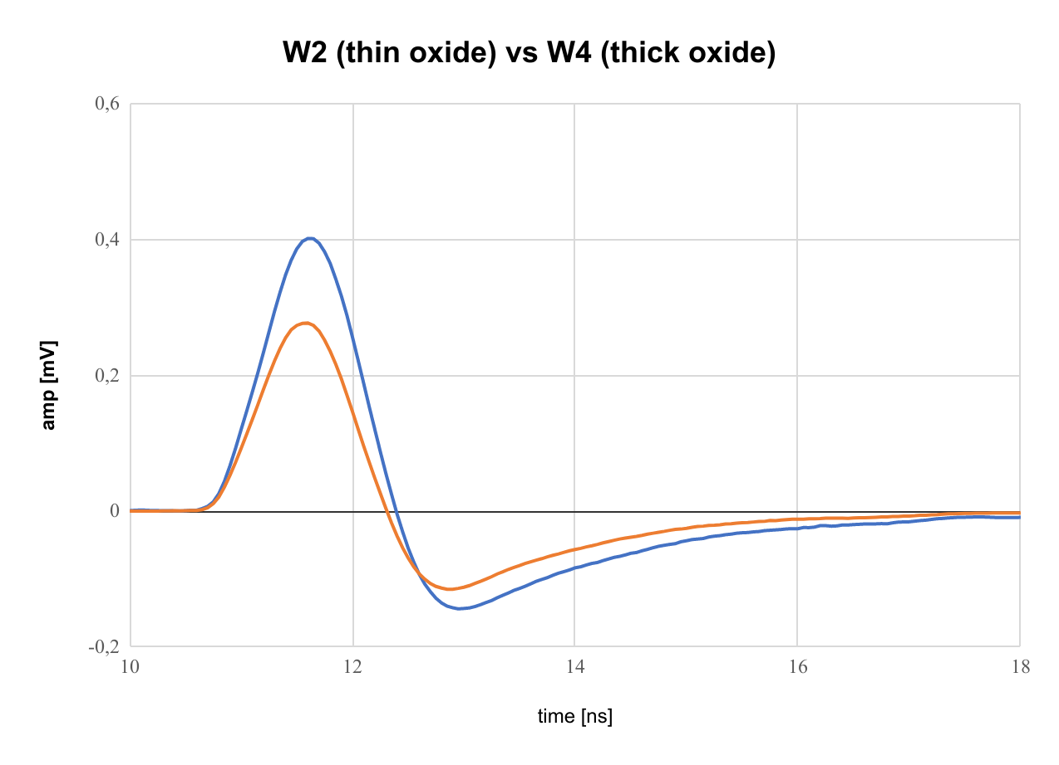
High performance 4D tracking with 100% fill-factor and very fine pitch Silicon detectors
F.Siviero ^{1,2}, M. Mandurrino ^{1,*}, R. Arcidiacono ^{1,3} , M. Boscardin ⁴ , N. Cartiglia ¹ , G. F. Dalla Betta ⁵ , M.Ferrero ^{1,2} , F. Ficorella ⁴ , L. Pancheri ⁴, G. Paternoster ⁴ , M.Tornago ^{1,2}
¹INFN Sezione di Torino (Torino, Italy), ² Università di Torino (Torino, Italy), ³ Università del Piemonte Orientale (Novara, Italy), ⁴ Fondazione Bruno Kessler (Trento, Italy), ⁵ Università di Trento (Trento, Italy)
*Corresponding author: marco.mandurrino@to.infn.it
4D tracking: measurement of spatial position and timing of particles’ tracks with high precision
A new generation of Silicon detectors based on the Low-Gain Avalanche Diode (LGAD) technology is particularly suited for 4D tracking:
Si detectors can be easily segmented → good spatial resolution
LGAD technology provide an internal, low-gain → large output signals, low noise → precise timing
Ultra-Fast Silicon Detectors (UFSD) are an example of LGAD sensors optimized for precise timing
→ UFSD will be employed in the timing layers of the ATLAS & CMS experiments at HL-LHC
To achieve precise timing UFSD adopt a segmented geometry, with each sensitive region being isolated from the others by an inactive area
The extension of the active area is quantified by the fill factor → fill factor = active area / total area
The higher the fill factor, the more efficient the detector is
Device Sketch
We present the 1st production of Resistive AC-coupled Silicon detectors (RSD) @ FBK
An LGAD detector designed for 4D tracking which uses the principle of resistive AC-coupled read-out to achieve 100% fill factor
RSD Principle of Operation
The detector bulk is connected to a resistive n⁺⁺ layer with a characteristic sheet resistance (R_{sheet})
The AC-coupling is realized by an oxide layer placed between the n⁺⁺ layer and the metal pads
The characteristic time τ= C_{AC}R_{sheet} must be long enough to ensure complete charge collection by the read-out pads before being discharged by the resistance.
Simulation
Characteristic values:
R_{sheet} ~ kΩ
C_{AC} ~ 100 pF
Device cross-section
Circuital model
Figure of merit of RSD with respect to standard LGAD devices:
100% fill factor
Continuous and uniform gain → less critical fabrication processes
Production of detectors with very small pitch
The 1st RSD production produced by Fondazione Bruno Kessler (FBK, Italy)
It features 12 wafers with different gain layer and n⁺⁺ doses and 2 different dielectric thicknesses
2D/3D TCAD simulations of laser-stimulated signals in different pitch RSD detectors
Capacitance-Voltage & Current-Voltage Characterization
Laboratory Measurements
TCT Characterization
2D maps of the induced charge
Particulars TCT setup
IR pulsed laser with 10 μm spot
xy-stage with sub-μm precision
The “knee” is proportional to the gain layer doping
W10 100-200
Laser reflected by metal pads
W8 35-50
W8 35-50
Doping increasing
The IVs are exponential due to the internal gain, as in a standard LGAD
Very good uniformity across the wafer
Laser signals - DUTs with same pitch from different wafers
Different n⁺⁺ dose:
W2 (low), W8 (medium), W13 (high)
W2 has the largest RC → longest induced signal
W2
W8
W13
Summary
RSD are Silicon detectors, based on the LGAD technology, designed to perform high-performance 4D tracking
RSD achieve 100% fill factor by means of a resistive AC-coupled read-out, avoiding in this way the drawbacks of the segmented geometry of standard LGAD detectors
The 1st RSD production by FBK feature 12 wafers with different gain doses and AC-couplings
IV & CV curves have the expected shape and show that internal gain occurs
Good wafer uniformity has been measured
TCT signals gave the expected results: signals are dipolar and signal shapes depend on R_{sheet}C_{AC}
Time resolution measurements with a Sr90 source ongoing… stay tuned!
W2
Thin oxide → larger RC → longer induced signal
W4
Characteristic negative lobe of the AC-signal
We kindly acknowledge the following funding agencies, collaborations:
INFN, Gruppo V - RSD project
Horizon 2020, Grants no. UFSD669529 and no. 654168 (AIDA-2020)
U.S. Department of Energy Grant no. DE-SC0010107
Dipartimenti di Eccellenza, Univ. of Torino (ex L. 232/2016, art. 1, cc. 314, 337)
http://personalpages.to.infn.it/~mandurri/rsdproject.html
M. Mandurrino et al., "Demonstration of 200, 100, and 50 μm pitch Resistive AC-Coupled Silicon Detectors (RSD) with 100% fill-factor for 4D particle tracking", preprint on IEEE Electron Device Lett. (2019), DOI: 10.1109/LED.2019.2943242
M. Mandurrino, "4D particle tracking with Resistive AC-Coupled Silicon Detectors", European Physical Society Conference on High Energy Physics (EPS-HEP), Ghent (Belgium) 10-17 Jul 2019
The 28th International Workshop on Vertex Detectors, Lopud Island (Croatia), 13-18 October 2019

