Slide 1

THE TIMING
Turin VFE-UFSD Bulletin Last update 30 April 2020
FAST 2 TDR
T32
VLSI
ASIC designers: Jonhatan Olave olave@to.infn.it Federico Fausti fausti@to.infn.it

Slide 2
Steps to implement the bugs correction
Status
To be done
Identify the best solution
Implement the schematic with ideal devices
Implementation with real devices by keeping into account the space in silicon
Test the solution found with schematic simulations
Implementation of the schematic solution in the channel → sector → multichannel chip
Layout of single block used to fix the bug
Post-layout simulations to test the single block
Implementation of the layout in channel → sector → multichannel chip
Done

Slide 3
Where we are with FAST2?
X
TIA bias is missing
Status 9
Status 10
Post-layout simulation need
Status 9
Post-layout simulation needed
Status 3
Status 1
Status 1
Status 1
Status 10
Status 1
Status 1
Status 1
Status 8

Slide 4
Excessive IR drop in current bias
Problem description

Slide 5
Excessive IR drop in current bias
Problem description
Three currents are provided from the PCB to FAST to enable preamp and discriminator. Each of these currents is physically provided through two PADs placed on the right and left chip edge and reaches the 20 channels of the chip. The metal line used to provide this currents has a geometry of 0.8 x 5000 um2 with a not negligible resistance of about 750 Ω which generates undesired IR drop.
Simplified model
Ibias /2
Ibias /2
DISC1 Ibias
DISC2 Ibias
TIA Ibias
Rp = 37 Ω Rbias = 9 kΩ
According to this model, channels placed
in the chip center have an higher IR drop

Slide 6
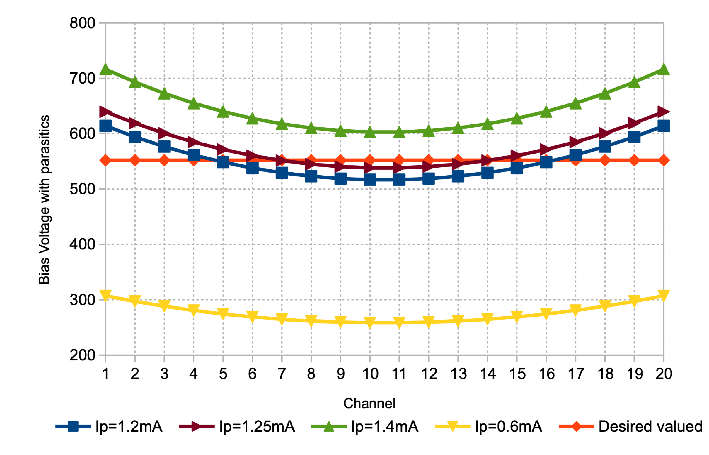
Excessive IR drop in current bias
Effects observed during measurements
The current generated in the 20 channels is different from the desired and depends on the channel position
The IR drop depends on the nominal current which flows through the metal line:
- TIA_Ibias = DISC2 Ibias = 1.2 mA → IR drop = 100 mV
- DISC1 Ibias = 0.6 mA → IR drop = 50 mV
This variation has been observed in measurements as a baseline variation (250 mV p-p) greater than what expected from process mismatch in CMOS technologies (40 mV rms)
Baseline for 20 chs in EVO1
Simulated voltage drop along channels
100 mV
DISC1
DISC2
TIA
Geometrical effect due to undesired IR drops
50 mV
Simulation obtained with the simplified model

Slide 7
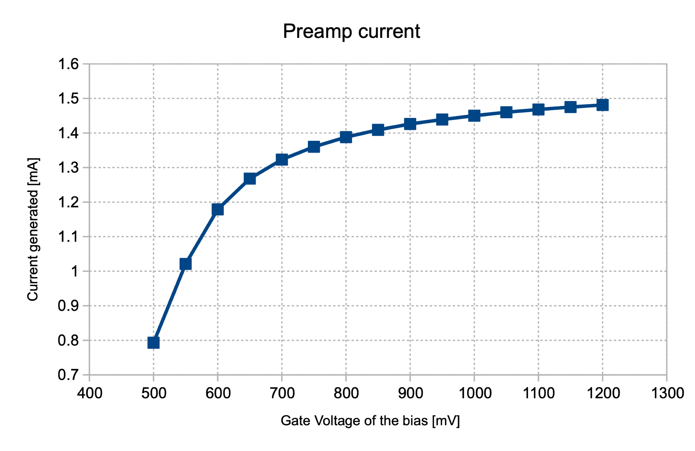
Excessive IR drop in current bias
Effects due to TIA bias
The nominal current of TIA bias is 1mA and it is generated when the bias cell provides to the channel a «gate voltage» equal to 550 mV. If this voltage changes, the current changes as well. The regulation process is based on this effect.
Due to IR drop, the «gate voltage» changes by 100 mV and this results in a current variation of about 400uA! This means that between the channel 11 and 1 the TIAs will work with currents which differ by 400 uA
The effect of having a smaller current in the TIA turns in an signal amplitude reduction of the analog output
The band represents the voltage variation observed by the 20 channels. The lower voltage is the one observed by channels in the center (10 and 11).
Current generated vs gate voltage
Analog output vs gate voltage
NOMINAL
This effect affects the slew rate and thus also jitte!
NOMINAL
→ CRITICAL

Slide 8
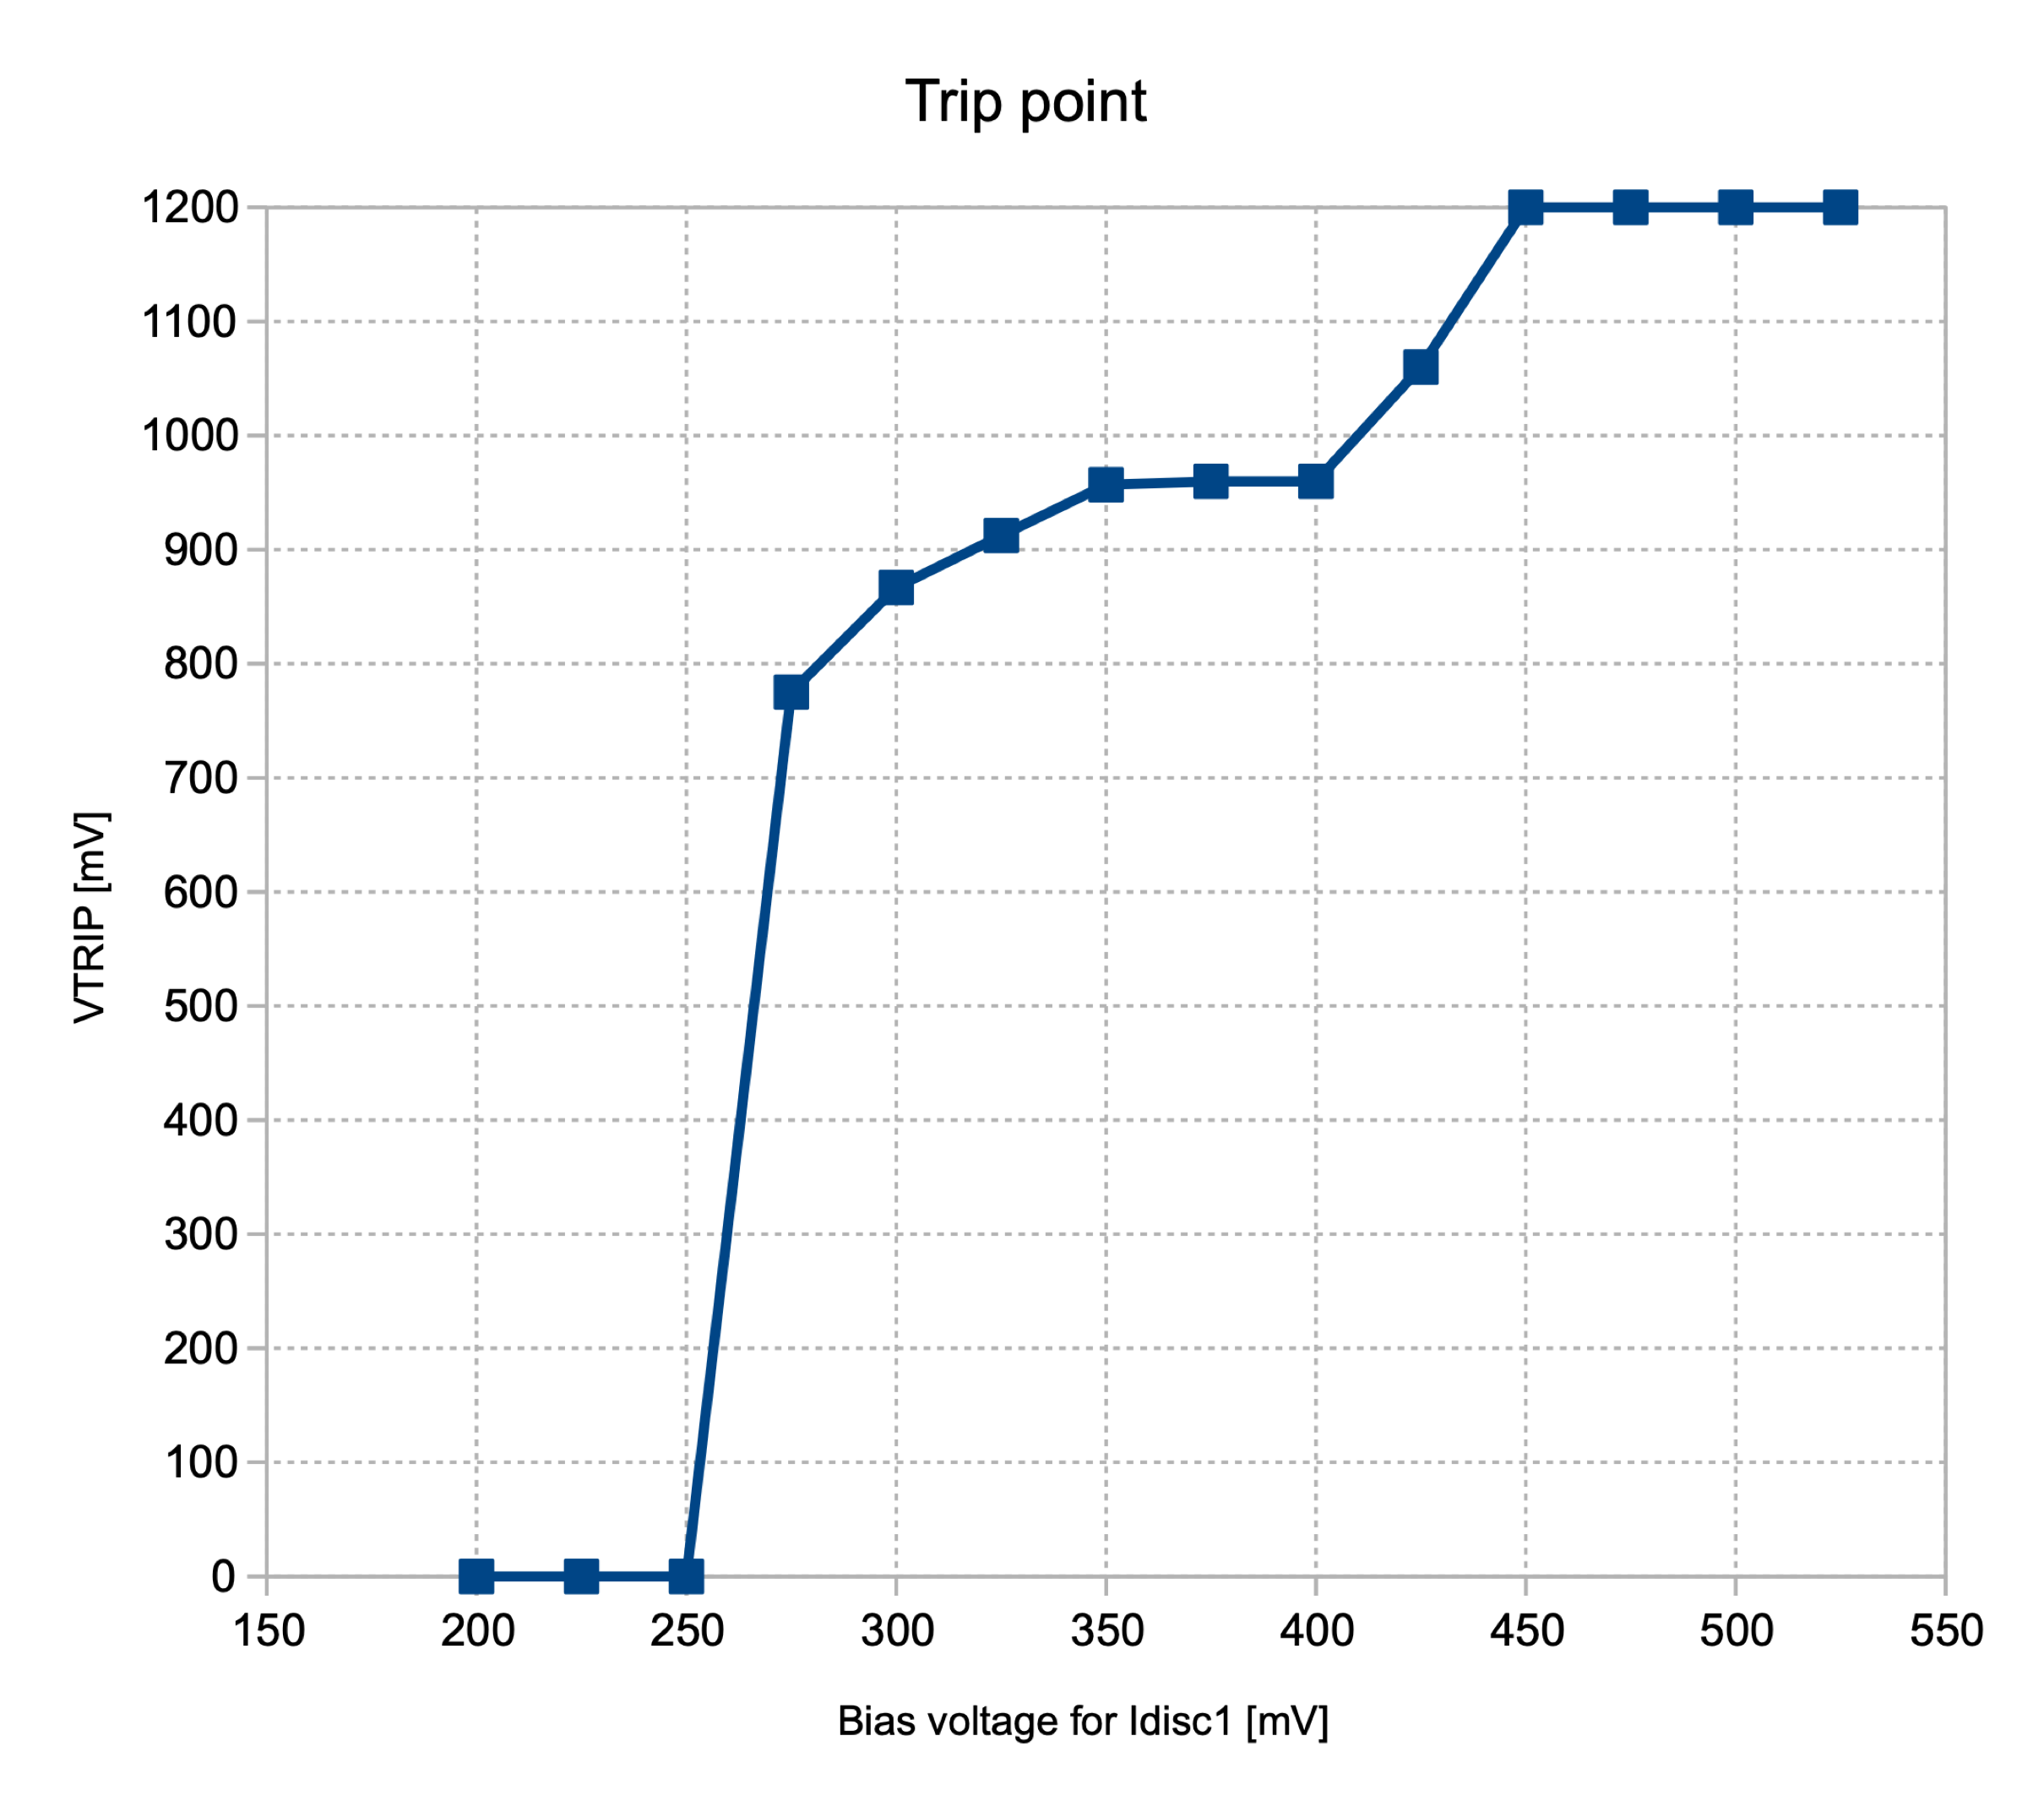
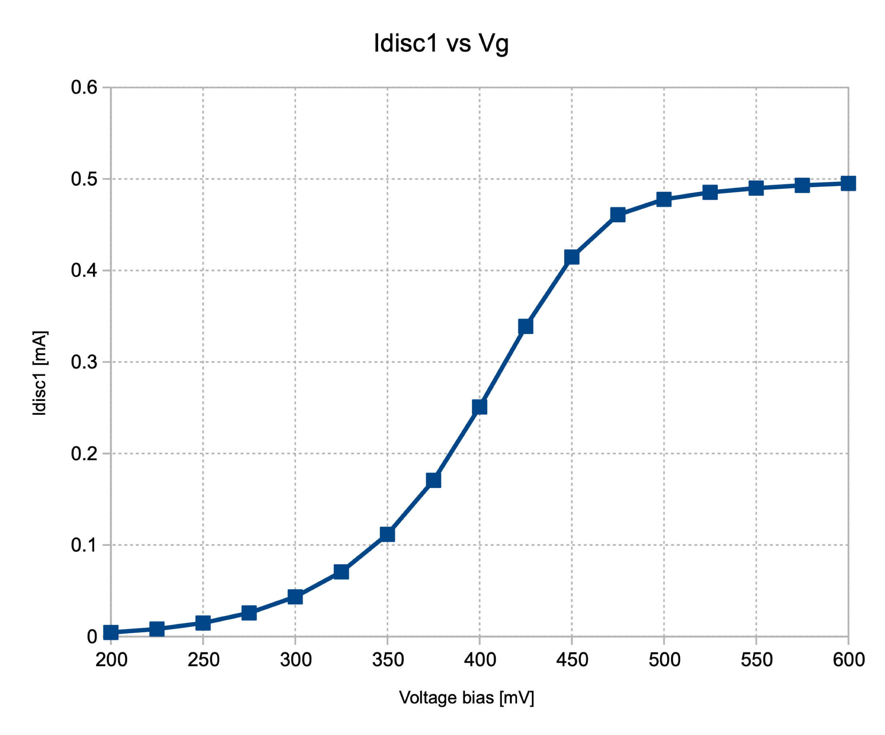
Excessive IR drop in current bias
Effects due to DISC1 bias
The IR drop of 50 mV changes the measured baseline by 100 mV and may turn OFF the discrimintor of some channels. Channels placed in the center (10 & 11) are those which can suffer from this problem → CRITICAL
One can move up the voltage bias so that recover the channels in the middle (10 & 11) however, this have an upper limitation of 450 mV because for higher values the discriminators of channels 1 and 20 turn off.
For working channels (region ON), IR drop affects the measured baseline. Generally, the lower is the local current, the lower is the measured baseline (the real baseline does not depend on this, so «the problem is in the way we use to measure it»)
Baseline variation vs Idisc1
Baseline variation vs voltage
Current generated vs voltage
OFF
ON
OFF
Expected
Analog baseline
Desired
baseline
NOMINAL
Disc out
∆V_{baseline} = 100 mV
100 uA
160 uA
420 uA
Baseline [mV]
NOMINAL
Vth
* This current reffers to the whole ASIC. The current of the single channel can be
obtained dividing by 4 (4 is the number of sectors)

Slide 9
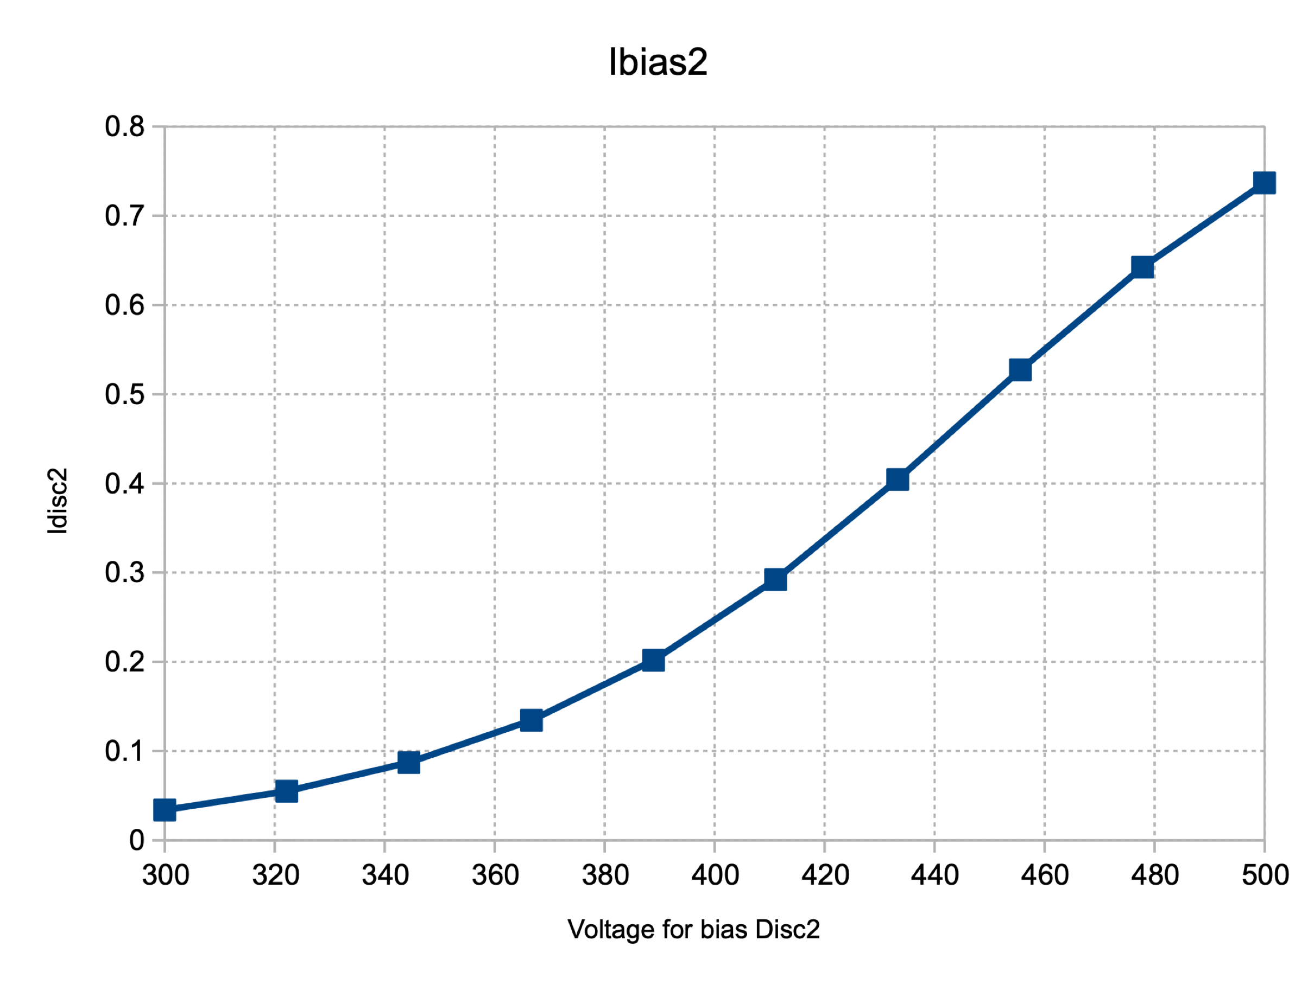
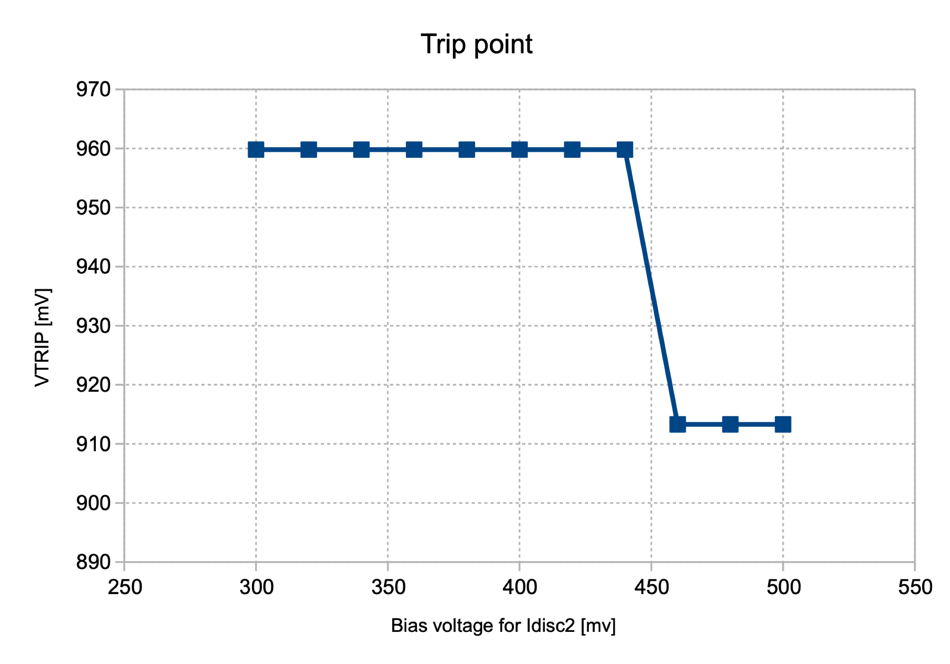
Excessive IR drop in current bias
Effects due to DISC2 bias
The «gate voltage» for this bias is 100 mV which turns in a current variation of about 250 uA
The effect is visible in the digital output which is modulated in ToA and ToT
IR drop in this case is not that critical as it is for Idisc1and does not switch off the discriminators
Current generated vs voltage
Disc OUT vs current variation
Baseline vs current variation
1
3
2
3
Analog output
Disc OUT
NOMINAL
2
NOMINAL
1
The effect of this bias in the baseline is almost negligible
The band represents the voltage variation observed by the 20 channels. The lower voltage is the one observed by channels in the center (10 and 11).

Slide 10
Excessive IR drop in current bias
Solutions implemented in FAST2
Shortcut for readers:
    Solution for DiscIbias1 → click here
    Solution for DiscIbias2 → click here
    Solution for TIAIbias → work in progress

Slide 11
Possible solutions to avoid IR drop
1- Can we use a wider metal line to remove the problem ?
The simplest solution is the design a wider metal line (by using more metal layers if necessary) to reduce the metal resistance. Howevere, this is not sufficient to remove the problem.
Simulations done for the most critical bias (DISC Ibias1) show that even by using two wide (3 um) metal lines in parallel (the maximum allowed with the current layout) the expected current variation would be 5% of the nominal. 5% in simulations may be 10 % in silicon so this number is considered too high.
2- Can we generate the current locally to avoid IR drop along the lines ?
Yes and it would solve the problem. The drawback is that in this way we can not regulate the bias.
Since the discriminator can affect operation of some channel and also the time resolution performance (we know this from the experience of other groups), it would be nice to have the regulation of at least Disc_Ibias1 and TIAIbias
3- In FAST1 the metal line is used to send a current whose value defines the IR drop.
Can we send a voltage instead of a current?
Yes, this solution allows to remove the IR drop by using the same metal line already designed in FAST1.
More circuitry is needed to implement this solution
Some effort is done to make the solution 100 % compatible with the existing test board

Slide 12
Solution to avoid IR drop in DISC Ibias1
Solution for
DiscIbias1

Slide 13



Solution to avoid IR drop in DISC Ibias1
Solution for
DiscIbias1
On the test board
$$I_{Disc,Ibias1}= \frac{3}{4}\frac{V_{ref}}{R_{2}}$$
$$V_{ref,nominal}=460 mV$$
$$R_{2}=11.77 kΩ$$
Voltage sent along the ASIC
In theory we can sent only this voltage along the 20 channels. The solution would be simpler but it does not take into account vdd variations between sectors. For this reason it is better to maintain the sector division even if power consumption increases a little bit

Slide 14
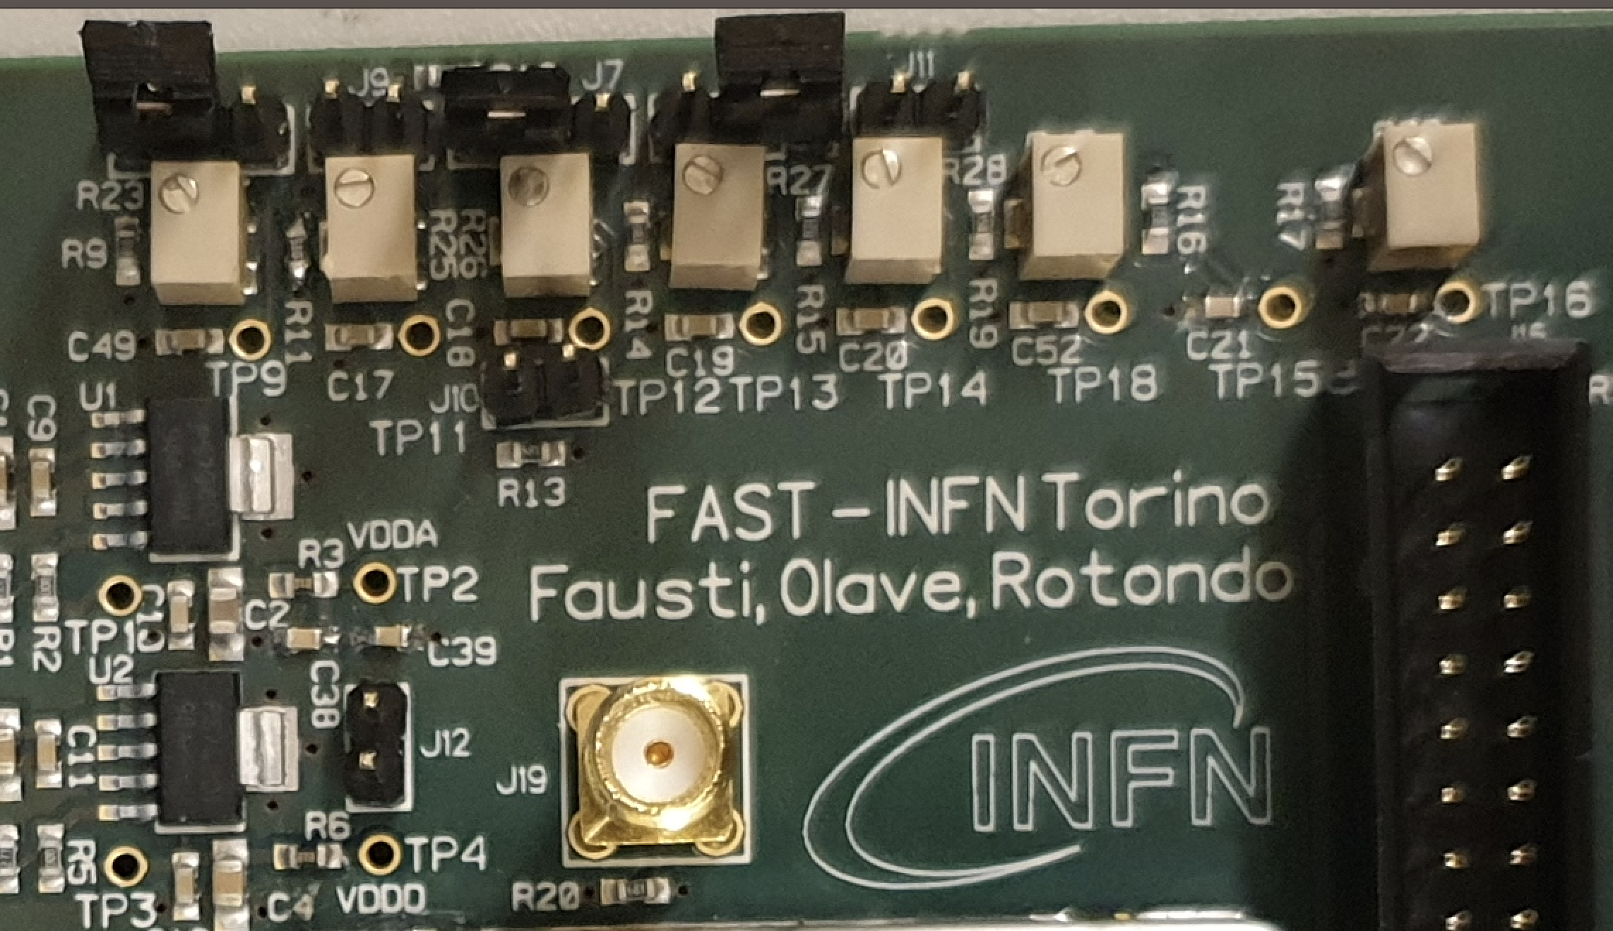
Compatibility with FAST-PCB
R1 is needed to convert the bias from current to voltage. This resistor can be mounted directly on the board. This solution allows to change the device in case a different value is needed.
R1 (1.8k) must be mounted in parallel to C20 . The capacitor is big enough (code 0603 – 1.5 mm) and is placed close to the trimmers of the PCB

Slide 15
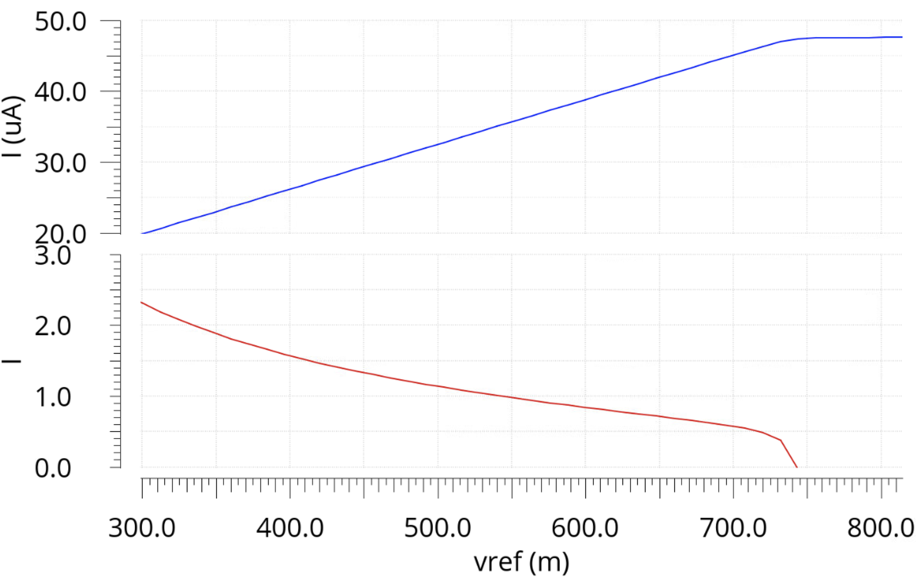
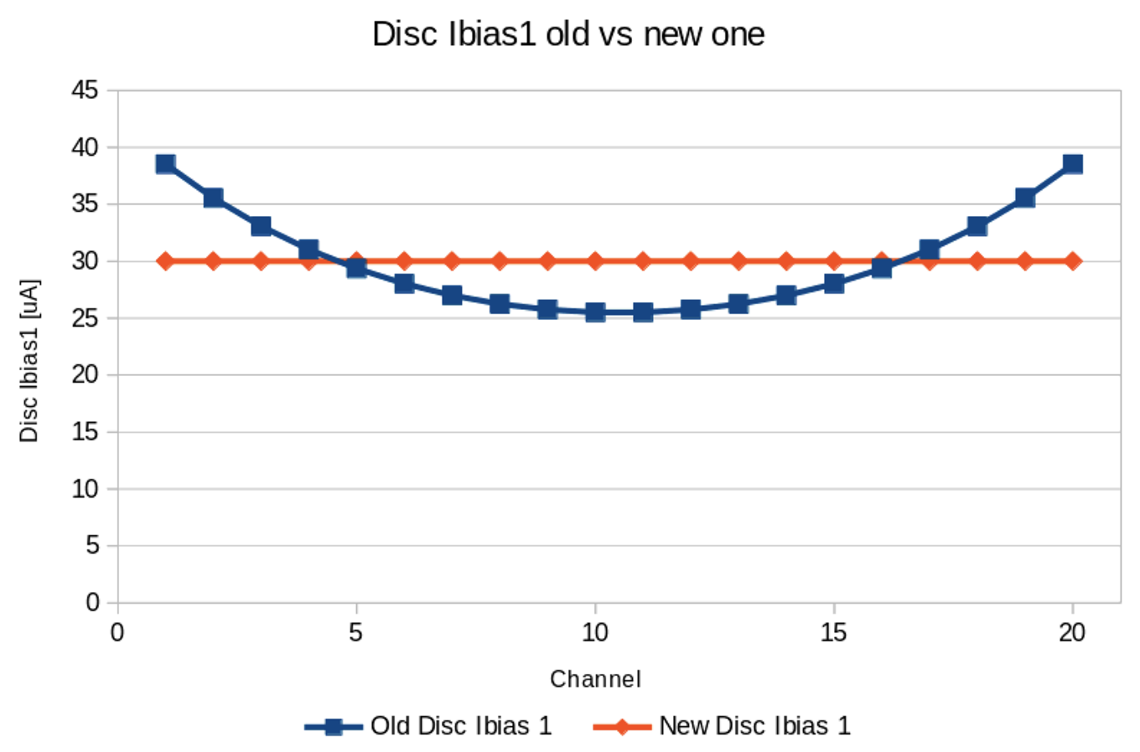
Current regulation with the new bias
Current Disc Ibias1 vs Vref
Current Disc Ibias1 vs channel
Disc_Ibias1 = 1.53 + 61.9 x Vref
FAST1
Idisc1 [uA]
Nominal OP: 30 uA with Vref = 460 mV
Idisc1 [uA]
FAST2
% err
Vref [mV]
The new solution allows a linear regulation (<2%) from 20 uA to 50 uA. The nominal value is 30 uA
Compared with the bias implemented in FAST1, the solution adopted in FAST2 removes completely the IR drop problem. According to simulations, this should remove the geometrical effect observed in the baseline measurements reported here

Slide 16
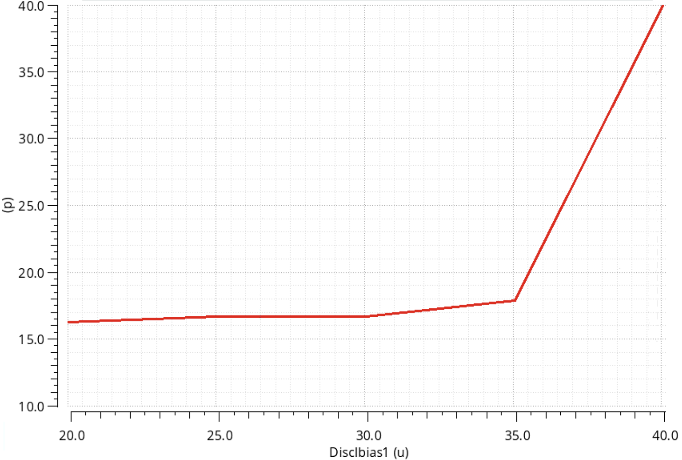
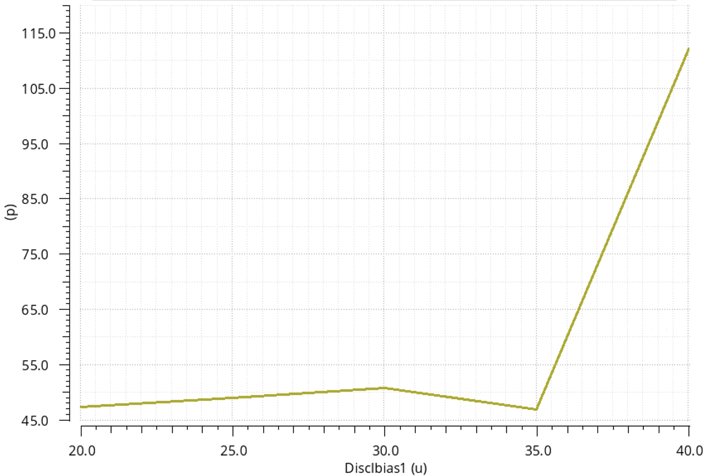
Jitter performance of FAST2-EVO1 with the new Disc bias1
Simulation details
Full channel simulation - schematic
Input: 8 fC trapezoidal
Simu: transient noise x 30 runs
Jitter simulated as sigma ToA
Vth is 3 fC
Other settings are the nominal of FAST1
Jitter
Sigma ToT
Jitter [ps]
Sigma ToT [ps]
Nominal OP: 30 uA with Vref = 460 mV
Nominal OP: 30 uA with Vref = 460 mV
Disc IBias1 [uA]
Disc IBias1 [uA]

Slide 17
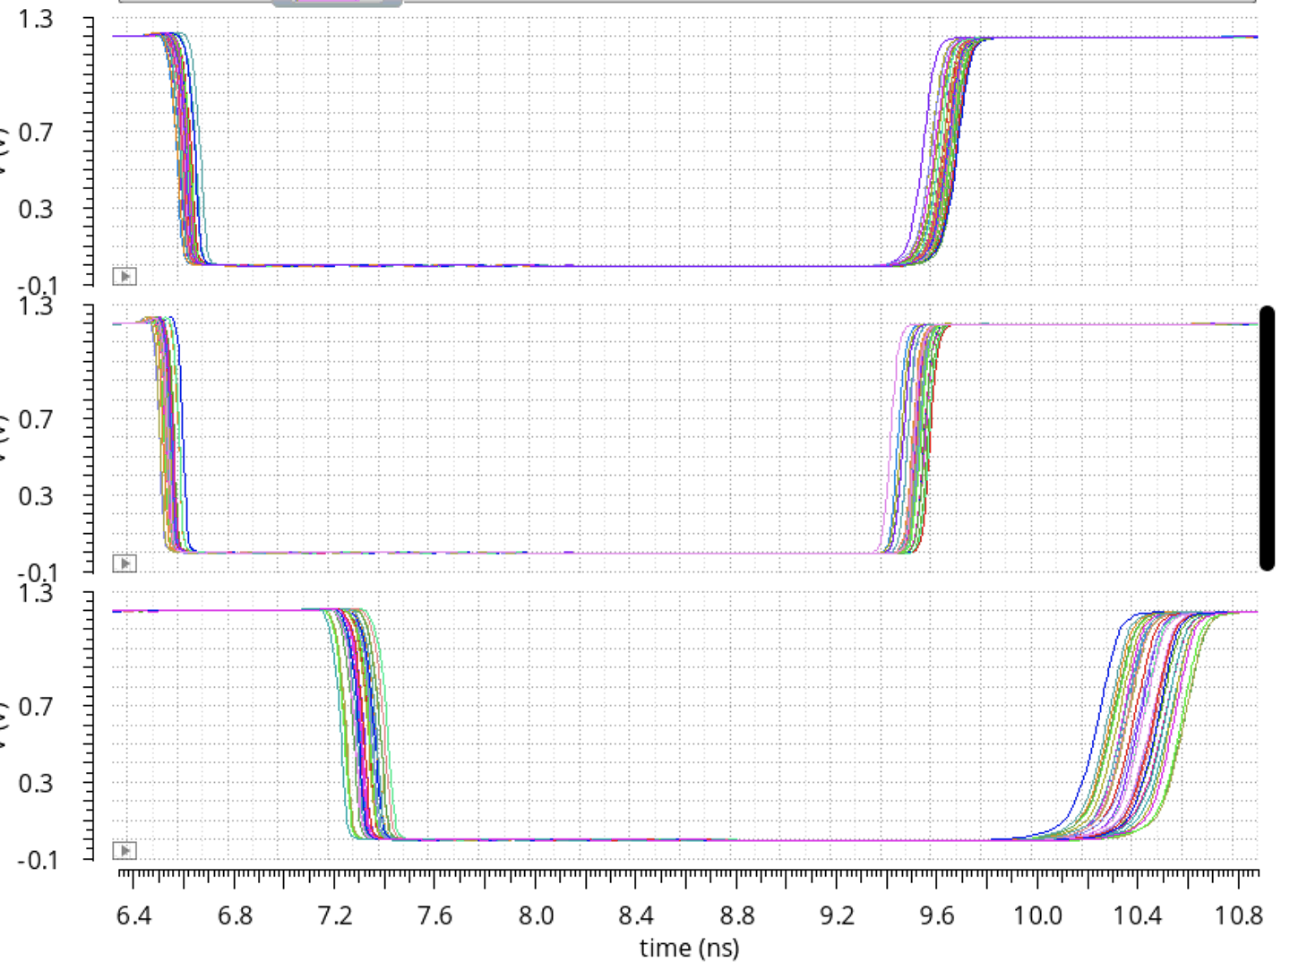
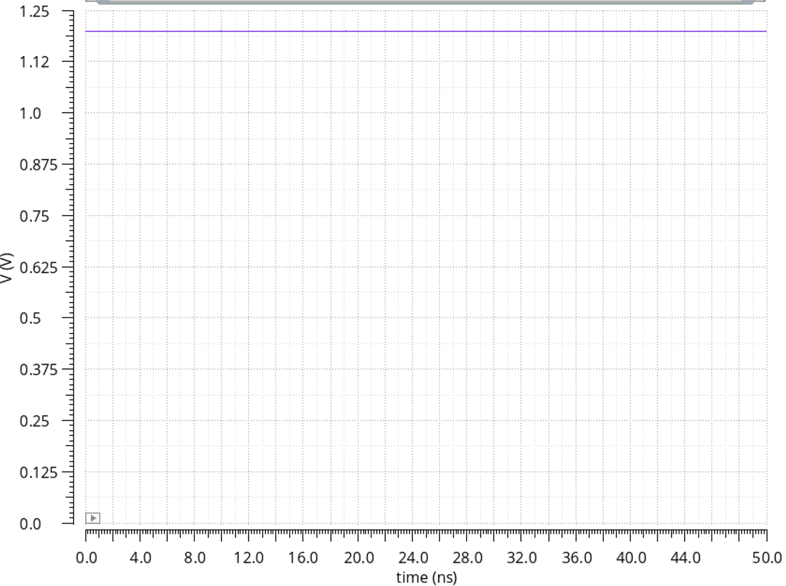
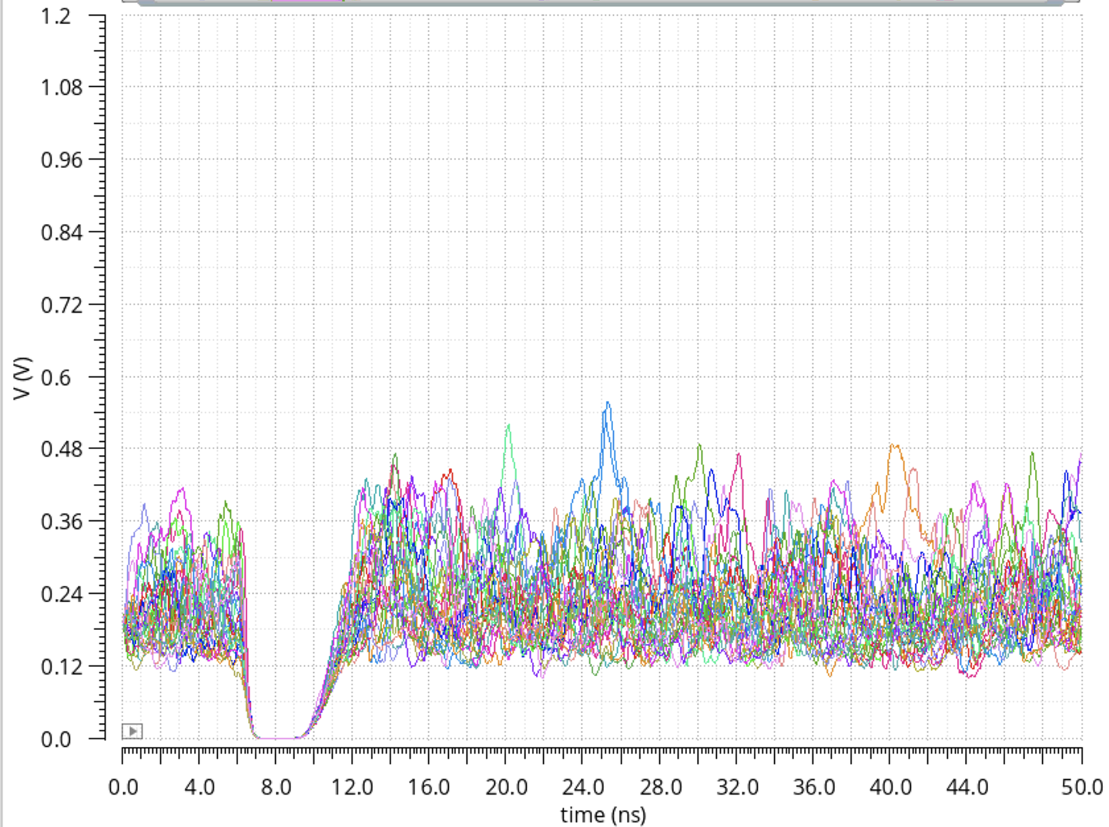
Disc out for different Disc bias1
Disc Ibias1 = 20 uA
Disc Ibias1 = 50 uA
Ibias1 = 10 uA
Disc Ibias1 = 30 uA
NOMINAL
Disc Ibias1 = 40 uA
In these two conditions the discriminators do not work propertly so be careful with the settings you use for the trimmer because the regulation can lead you in undesired working regions

Slide 18
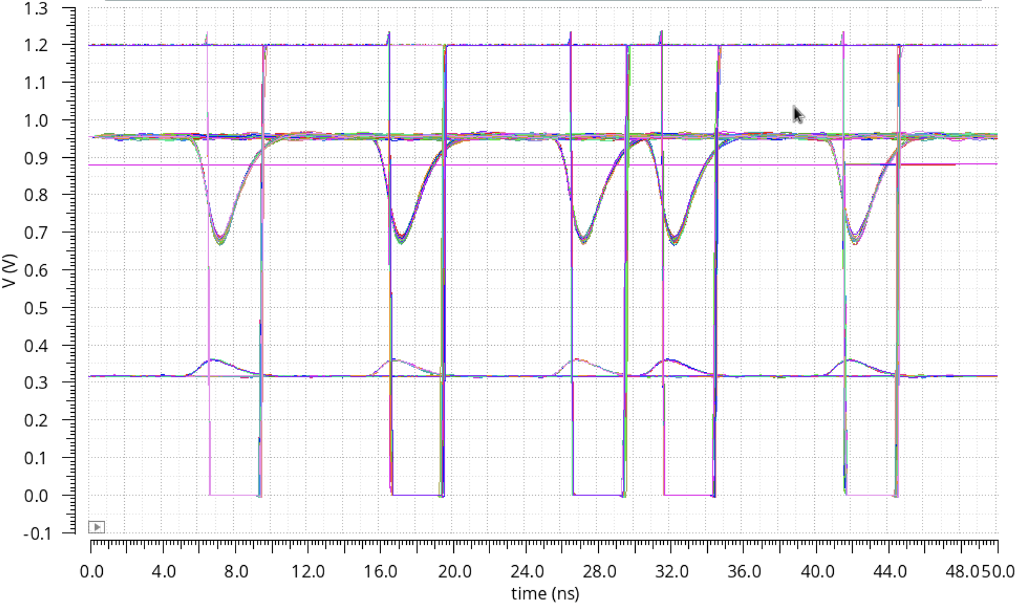
Sector simulation FAST2 - EVO1
Simulation details
Full sector simulation - schematic
Inputs: 8 fC trapezoidal @ different time
Simu: transient noise x 30 runs
Jitter simulated as sigma ToA
Vth is 3 fC
Other settings are the nominal of FAST1
Jitter CH0 = 14 ps
Jitter CH1 = 12.3 ps
Jitter CH2 = 17.2 ps
Jitter CH3 = 16.7 ps
Jitter CH4 = 15.8 ps

Slide 19
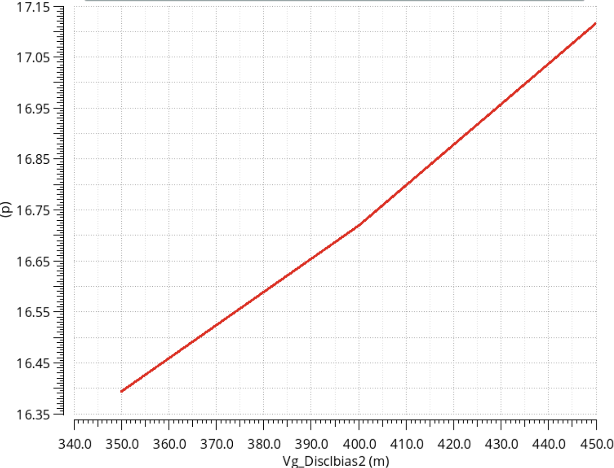
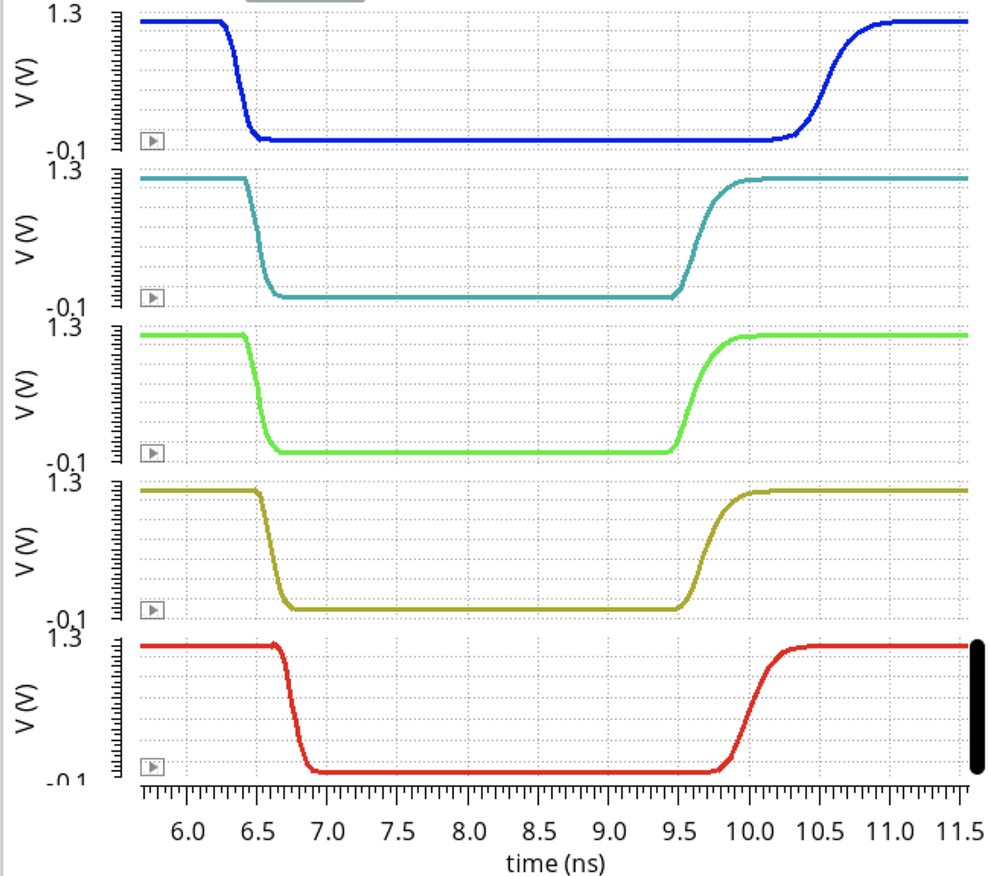
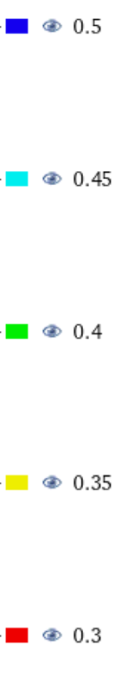
Solutions to avoid IR drop in DISC Ibias2
1- If necessary we can adopt the same solution used for DISC Ibias1 but do we really
need the regulation of this bias?
DISC OUT vs time vs DISC Ibias 2 (in voltage)
Jitter vs DISC Ibias 2 (in voltage)
Vg,DISC Ibias2
Wrong OP
nominal
Jitter is always 16-17 ps
V_{g,DISC Ibias 2} (mV)
If a regulation of Vg,DISC Ibias2 is needed, it should be done between 450 mV and 350 mV
However Jitter does not depend on this regulation so we can fix this bias

Slide 20
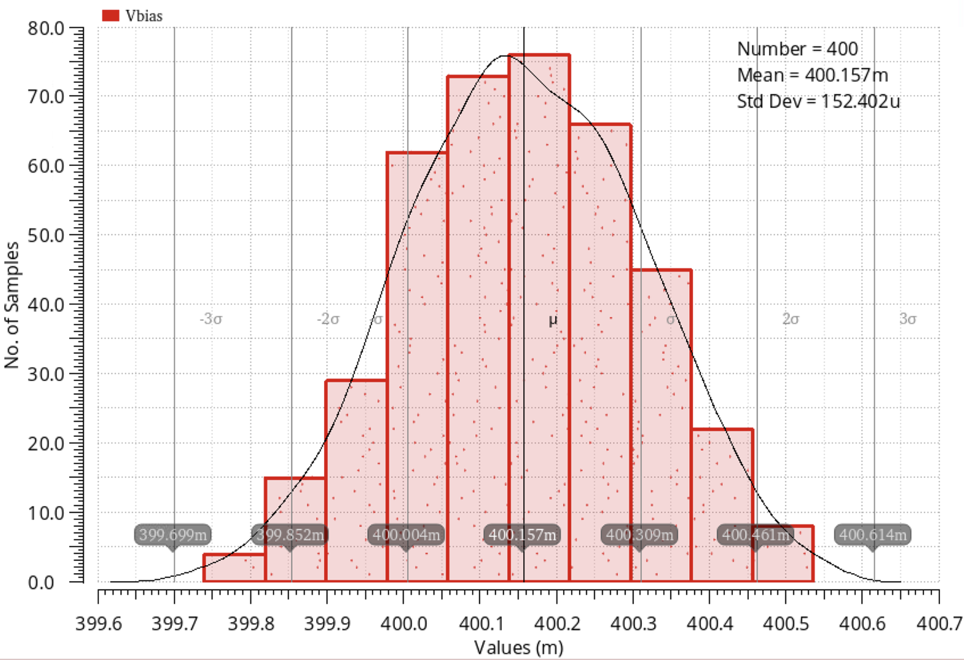
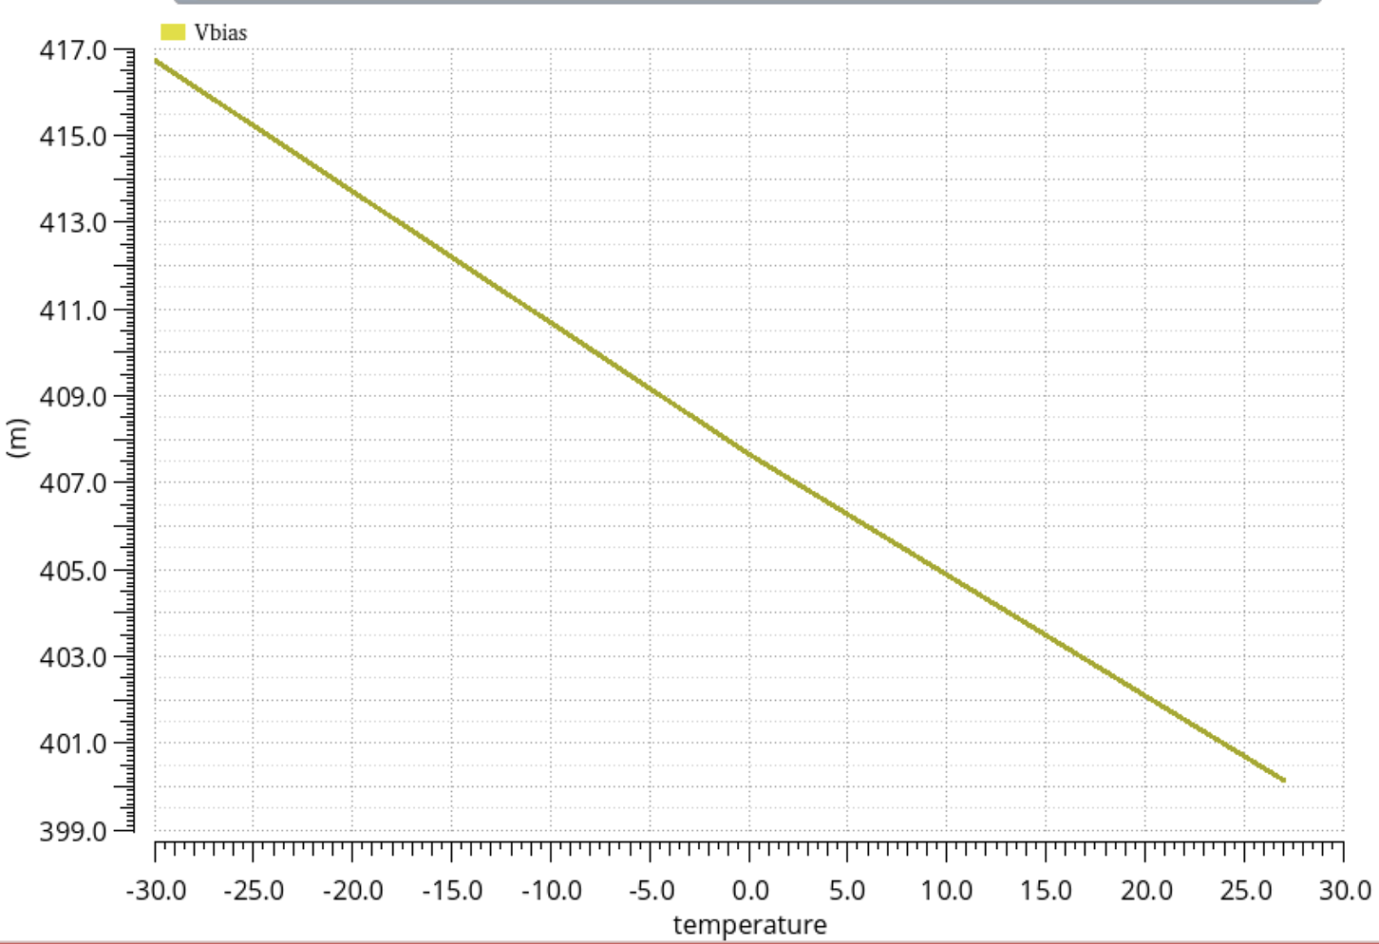
Solution to avoid IR drop in DISC Ibias2
Simple bias scheme for Disc Ibias2:
  Drop voltage is removed because the current is generated locally. Differences may be present but they depend on the IR drop in power lines (they are negligible)
  This simple solution does not allow to tune this bias but we can fix it because jitter does not depend on it
  We save two PADS
Montecarlo variation of V_{g,DiscIbias2}
V_{g,DiscIbias2} vs temperature
x8
Process
+
mismatch
Solution for
DiscIbias2
Low mismatch variation of 150 uV
in 400 runs
Variation of 17 mV when T=-30°C. However at 417 mV, jitter increses by 0.2 ps → negligible

Slide 21
Improvements in the TIA Ibias of FAST1
The power consumption of the TIA bias can be reduced so that reduce the total power consumption of the channel
In FAST1 the nominal currents flowing in the circuitry are the following:
PCB
TIA BIAS
80 uA
98 uA
952 uA
60 uA
885 uA
72 uA
This current can be reduced without degrading the FE performante

Slide 22
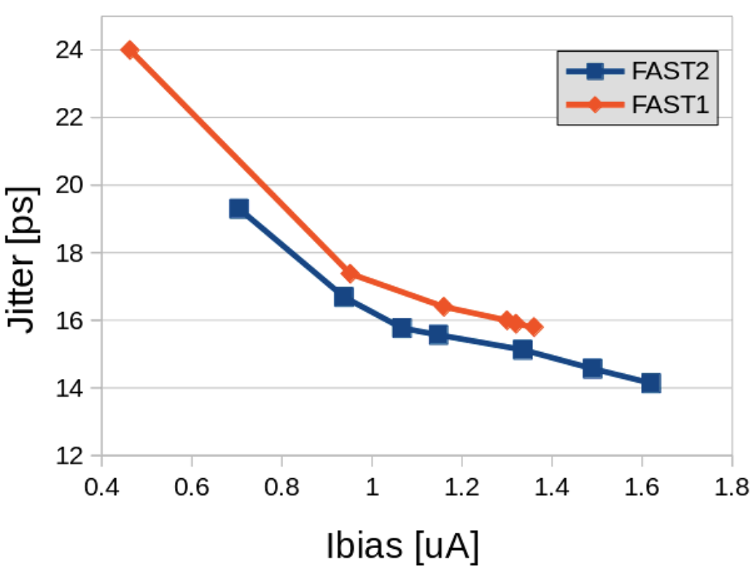
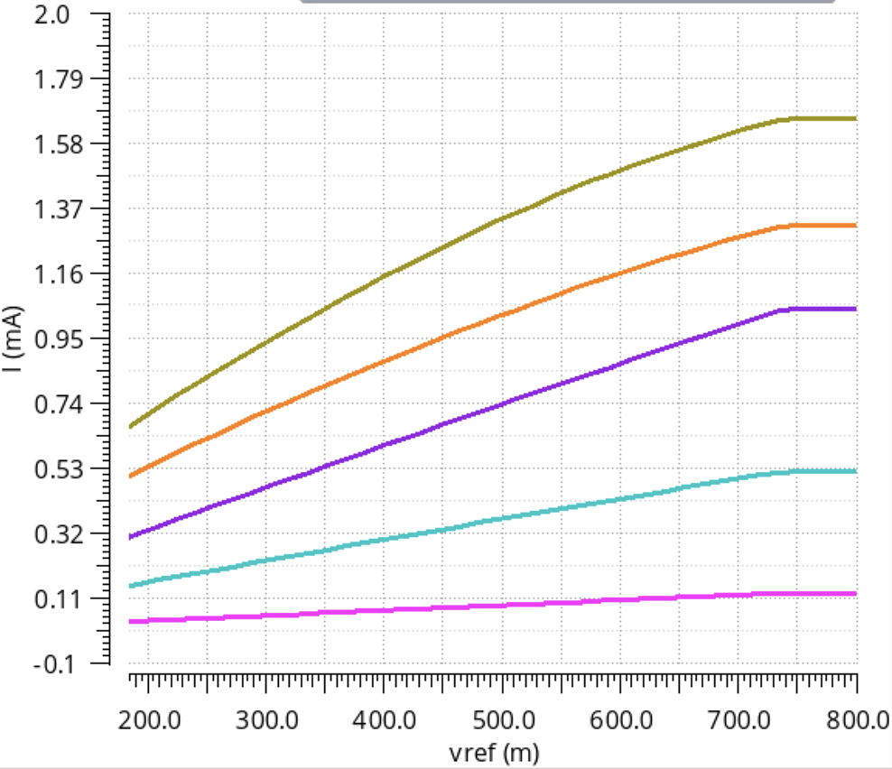
Regulation of TIA Ibias of FAST1
Jitter vs Vref
Ibias vs Vref
VERY PRELIMINARY
TIA current
Bias 3
50 runs
Bias 2
Bias 1
Bias 0
Maximum current regulation in FAST1 is 1.3 mA. This current reaches 1.6 mA in FAST2 with the new bias network
Bias 0 to 3 are currents used to generate the TIA current

Slide 23
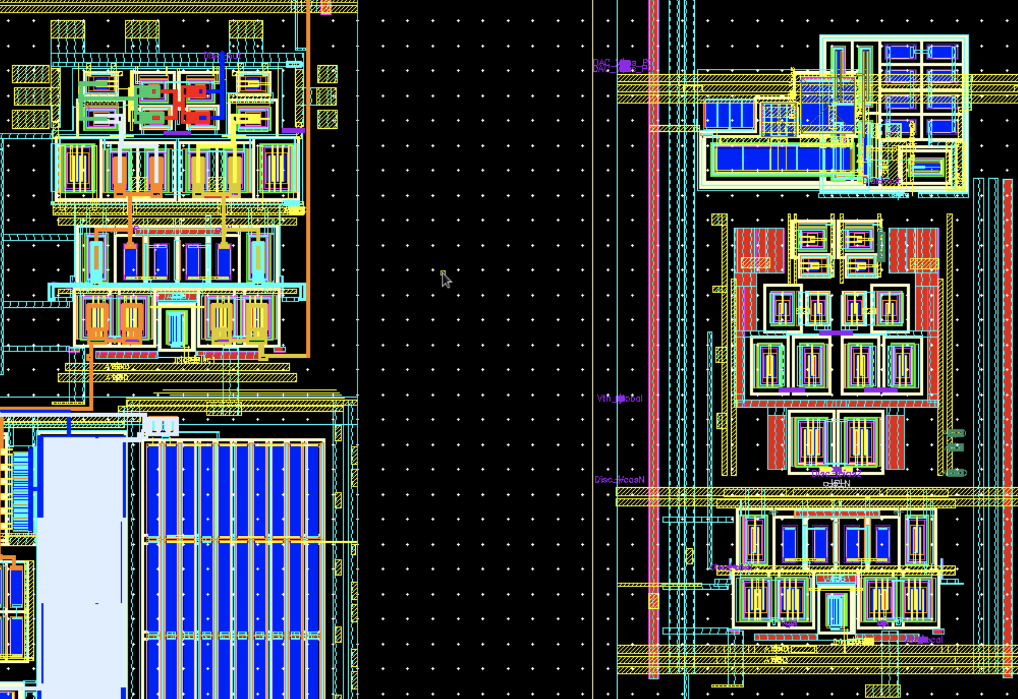
New layouts
DISC of FAST1
DISC of FAST2
80 um
80 um

Slide 24
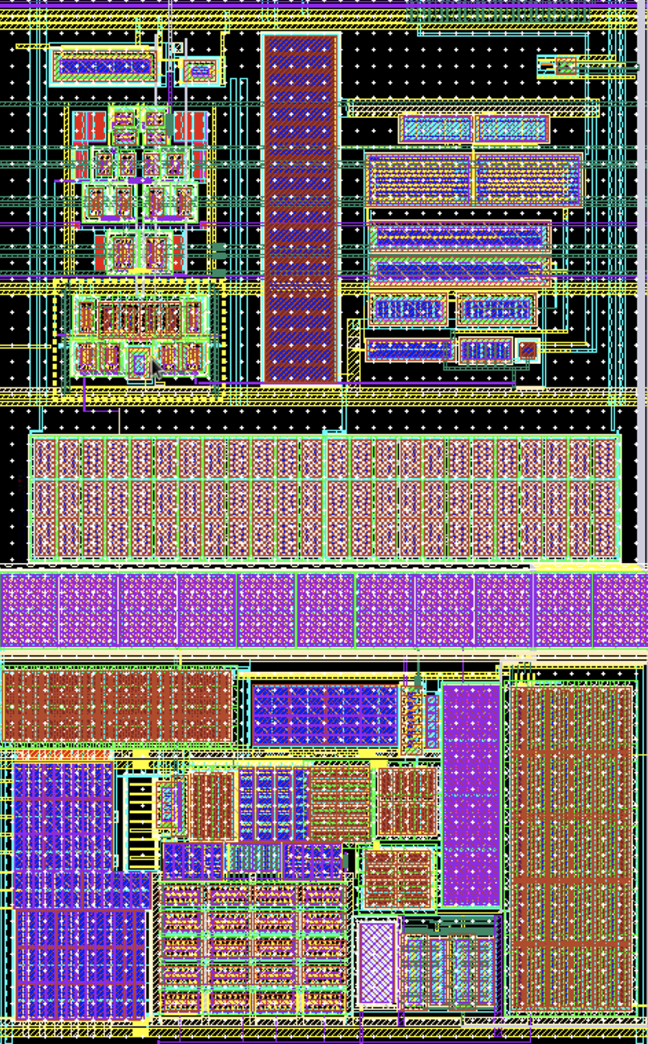
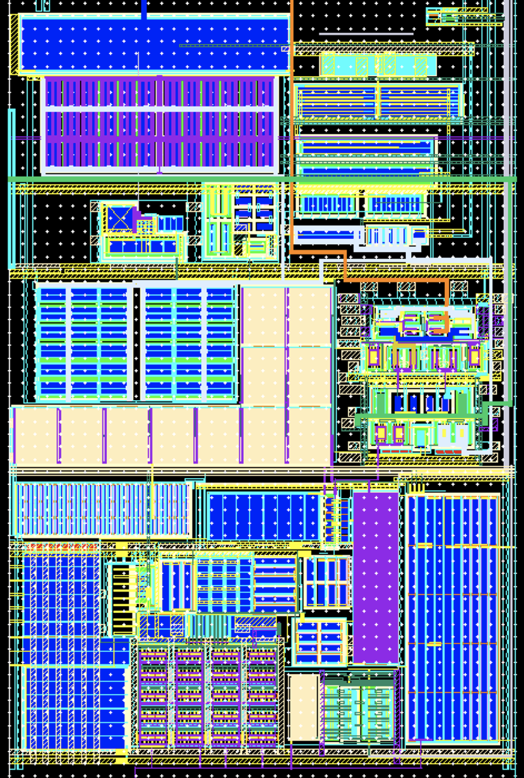
New layouts
Channel of FAST1
Channel of FAST2
UPDATED
Disc
Vth local
Vth local
Bias Disc
caps
caps
Disc
Front End
Front End
DRC
LVS
clean
170 um
170 um

Slide 25
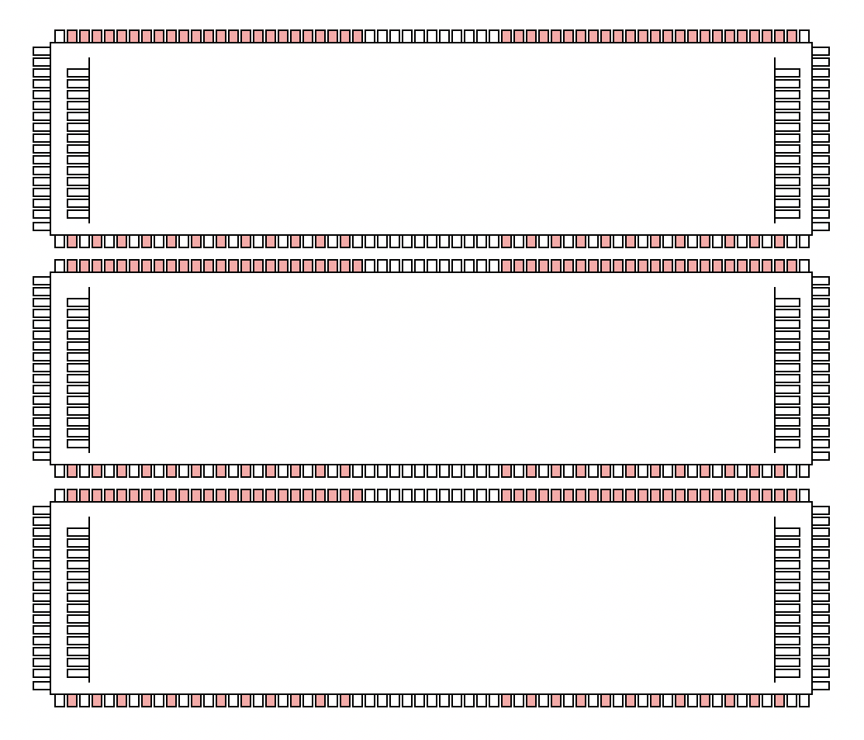
Ideas for the MPW
FAST1 Family
FAST2 Family
FAST_REG
FAST_EVO1_Full_analog
5 mm
5 mm
FAST_EVO1
FAST_EVO1_Hybrid
FAST_EVO2
FAST_EVO1_Full_digital
5 mm
5 mm

Slide 26
Ideas for the MPW
FAST2 Family
Number of channels: 16
Chain: FE + Analog buffer
FAST_EVO1_Full_analog
5 mm
Number of channels: 8 + 8 or 16 digital + 4 analog
Chain analog: FE + Analog buffer
Chain digital: FE + Disc + LVDS driver
FAST_EVO1_Hybrid
Number of channels: 16
Chain: FE + Disc + LVDS driver
FAST_EVO1_Full_digital
5 mm
We need a fast analog buffer to make this possible

Slide 27
New analog buffer
Ideas
Shortcut for readers:

Slide 28
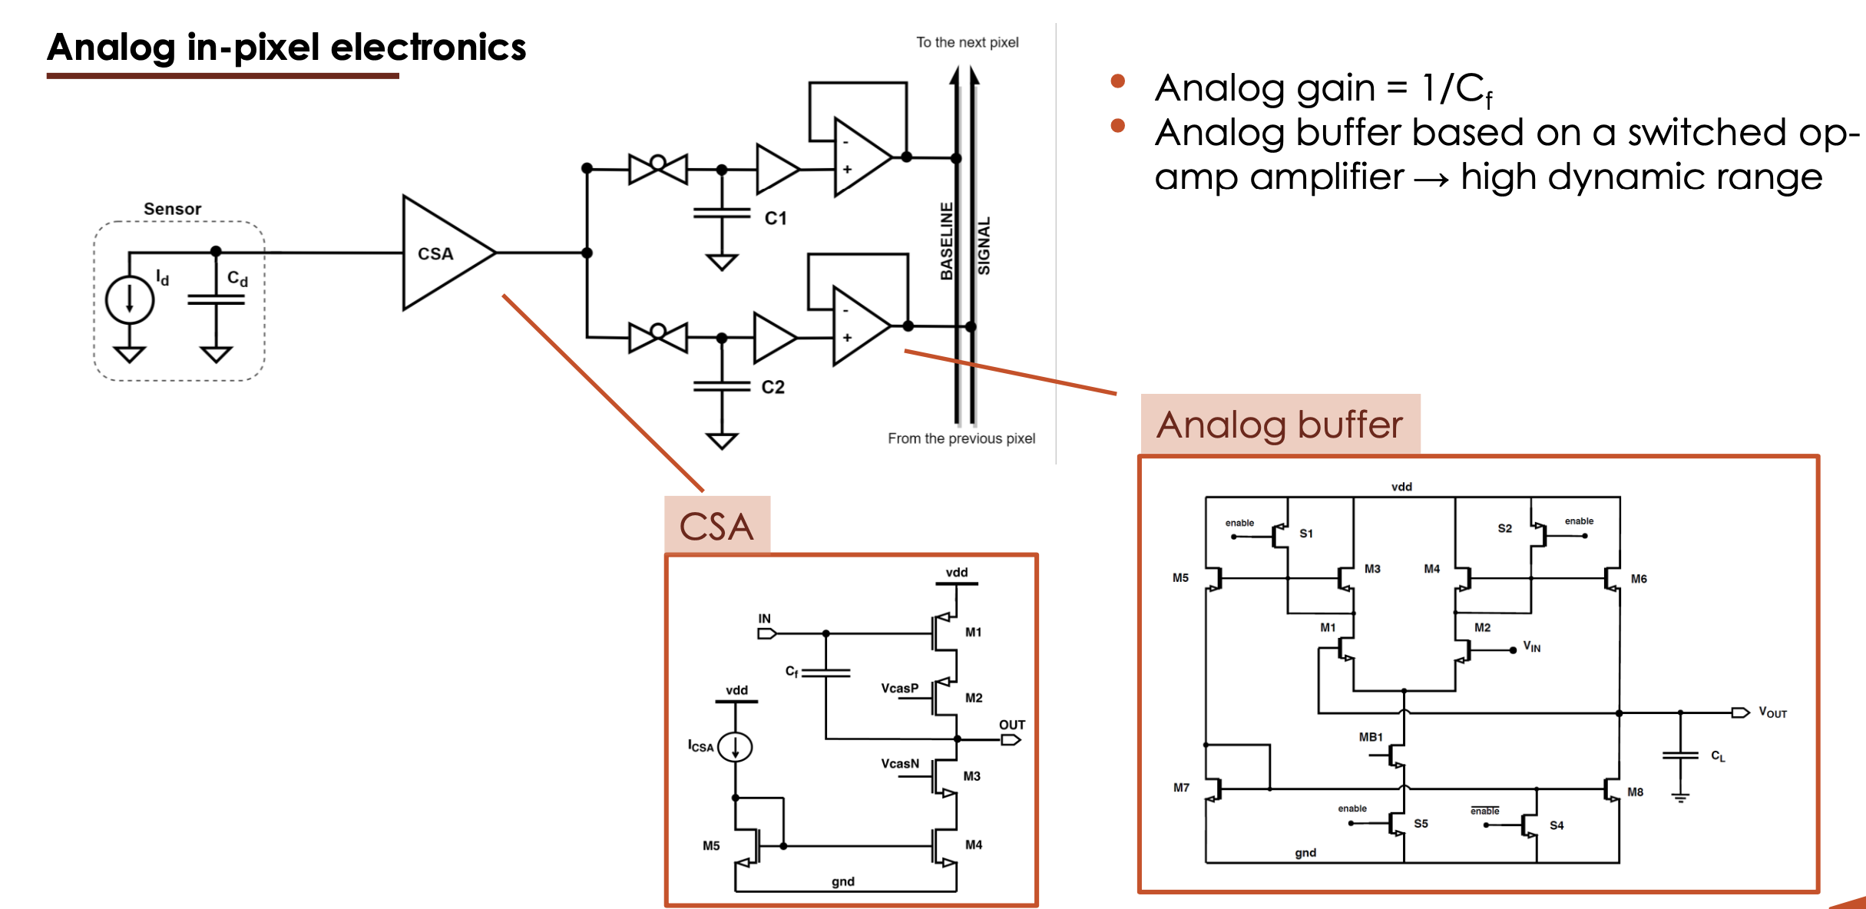
Ideas for the analog buffer
Analog buffer used in MATISSE
Designed for slow applications
Low power (~150 mW)
From MATISSE (2016)
Analog buffer for FAST2
More power must be used to be fast. We can use also the 2.5 V domain
Large bandwidth (800-900 MHz)

Slide 29
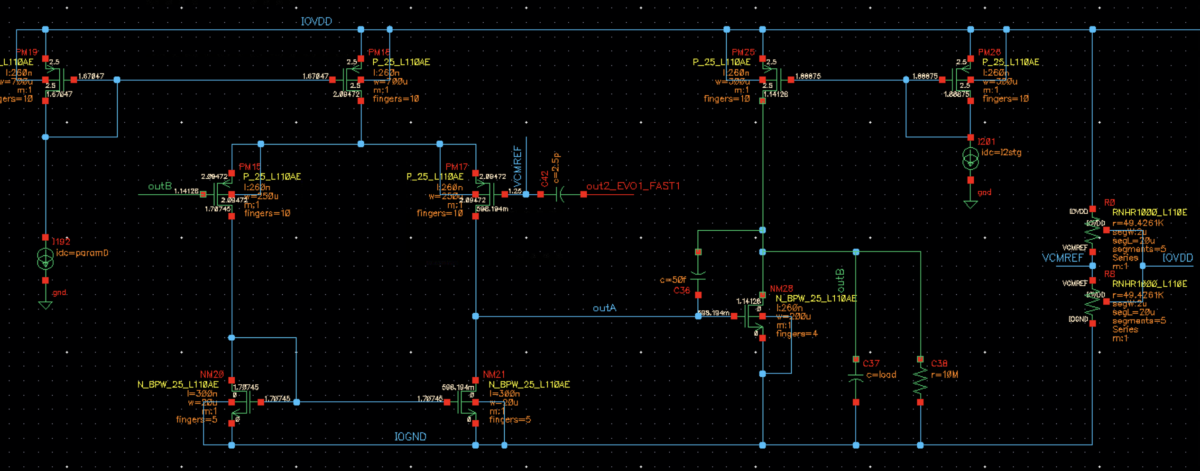
the analog buffer
Analog buffer of FAST2
Two stages to increase OL gain → this makes the input impedance low
Current is ~10 mA
Voltage supply is 2.5 V
Load
R = 10 Mohm
C=2-5 pF
Stage 1
Stage 2
IN
OUT
LOAD

Slide 30
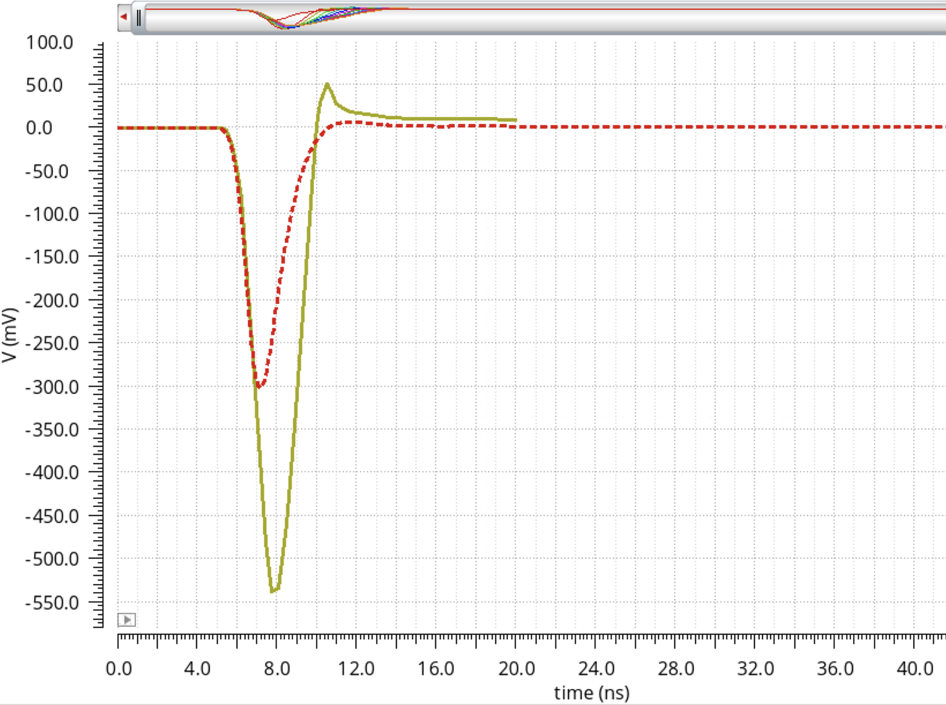
the analog output
FE output
Good stability
Current is ~10 mA
Voltage supply is 2.5 V
DC output voltage is 1.25 V
Output is single ended
The SR is the same from the input
Amp _{OUT} = Amp _{IN} X 1.8
BW=1.9 GHz
Buffer OUT
C_{L}=2pF

Slide 31
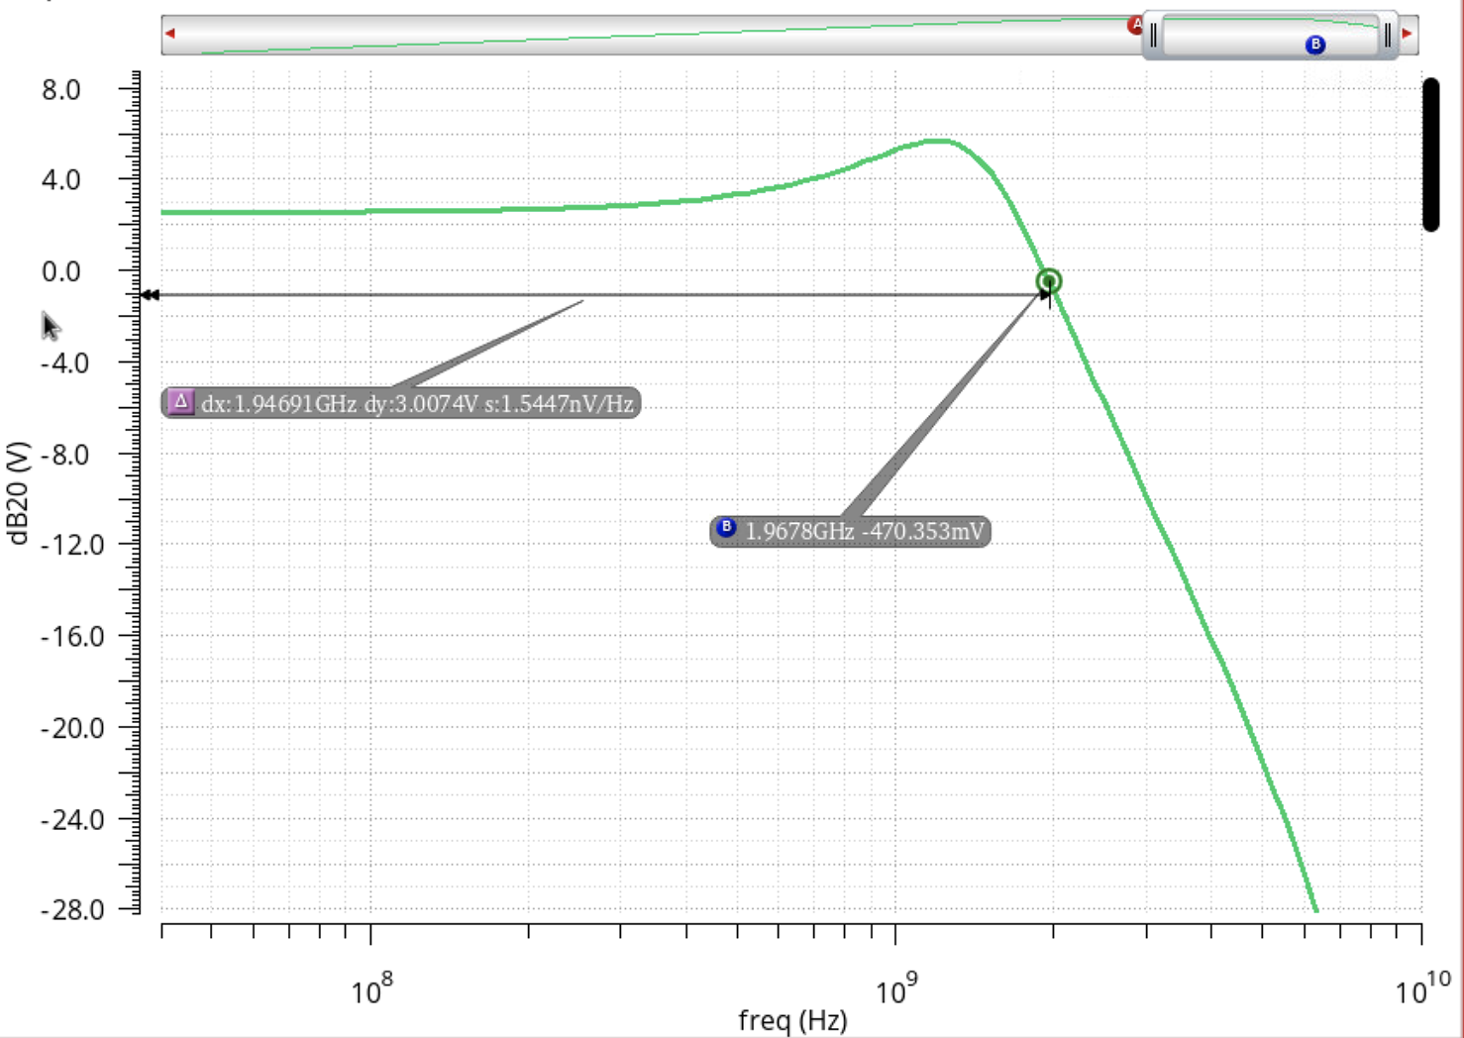
the analog output
Good stability
Current is ~10 mA
Voltage supply is 2.5 V
DC output voltage is 1.25 V
Output is single ended
The SR is the same from the input
Amp _{OUT} = Amp _{IN} X 1.8
BW=1.9 GHz

Slide 32
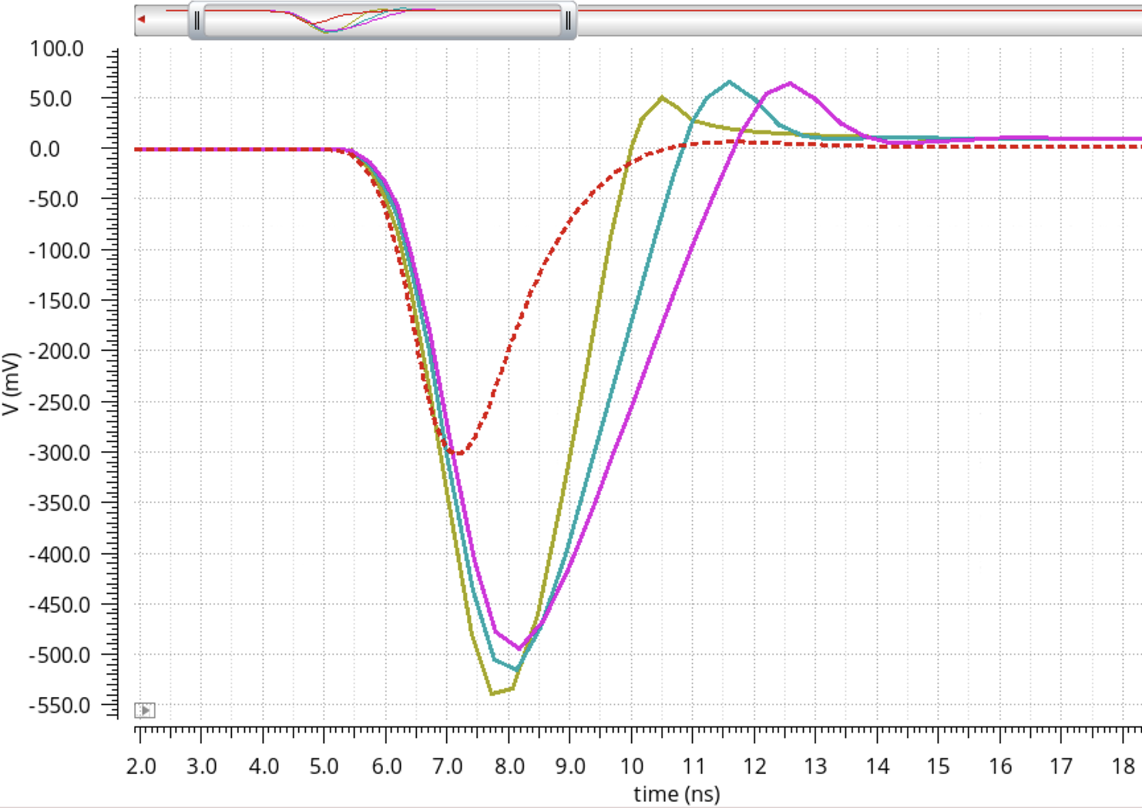
the analog output vs C_{L}
FE output
ToT increases with C_{L}
C_{L} = 2 pF
C_{L} = 4 pF
C_{L} = 6 pF

Slide 33
Updates from FAST2

Slide 34
Where we are with FAST2?
X
TIA bias is missing
Status 9
Status 10
Post-layout simulation need
Status 9
Post-layout simulation needed
Status 3
Status 1
Status 1
Status 1
Status 10
Status 1
Status 1
Status 1
Status 8

Slide 35
List of new blocks and status
NAME | Improvements | LVS check | DRC check | Status
Disc Ibias1 | Schematic and layout | PASS | PASS | 10
Disc Ibias1 - sector | Schematic and layout | PASS | PASS | 10
Disc Ibias2 | Schematic and layout | PASS | PASS | 10
TIA bias | Schematic and layout | TO DO | TO DO | 6
DISC1 | Layout | PASS | PASS | 10
DISC2 | Layout | PASS | PASS | 10
TP Circuitry | Schematic and layout | PASS | PASS | 10
NAME | LVS check | DRC check | Status
Channel | PASS | PASS | 10
Sector | PASS | PASS | 10
Full chip | PASS | PASS | 10
new
new

Slide 36
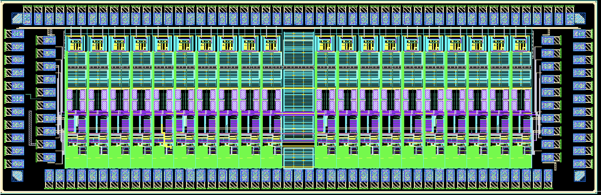
MPW run
FAST2 Family
WORK IN PROGRESS
FAST_EVO1_Fully_analog
5 mm
WORK IN PROGRESS
FAST_EVO1_Hybrid
READY
FAST_EVO1_Fully_digital
5 mm

Slide 37
Bug in the internal TP system
Solutions implemented in FAST2
Shortcut for readers:

Slide 38
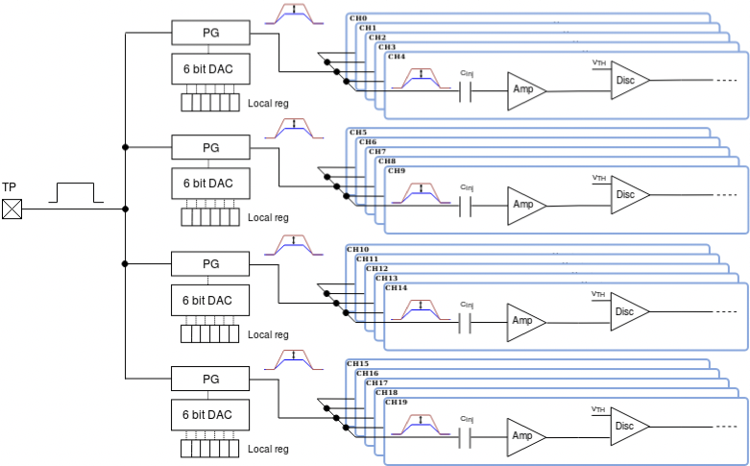
Circuitry for the TP inj
EN1
The pulse is generateb by an external trigger pulse sent from a dedicated pulse and called TP in the diagram.
The trigger controls the generation of an internal pulse, whose amplitude depends on a 6-bit local register. This register is shared between 5 channels of FAST2.
The system is enable by means of two registers (EN1 and EN). EN1 controls the entire sector and in FAST2 is fixed ALWAYS ACTIVE. Every channel has a EN1 register which can be used to activate the TP mode.
Bug in FAST1: EN1 was always disable
EN
EN1
EN
EN1
EN
EN1
EN

Slide 39
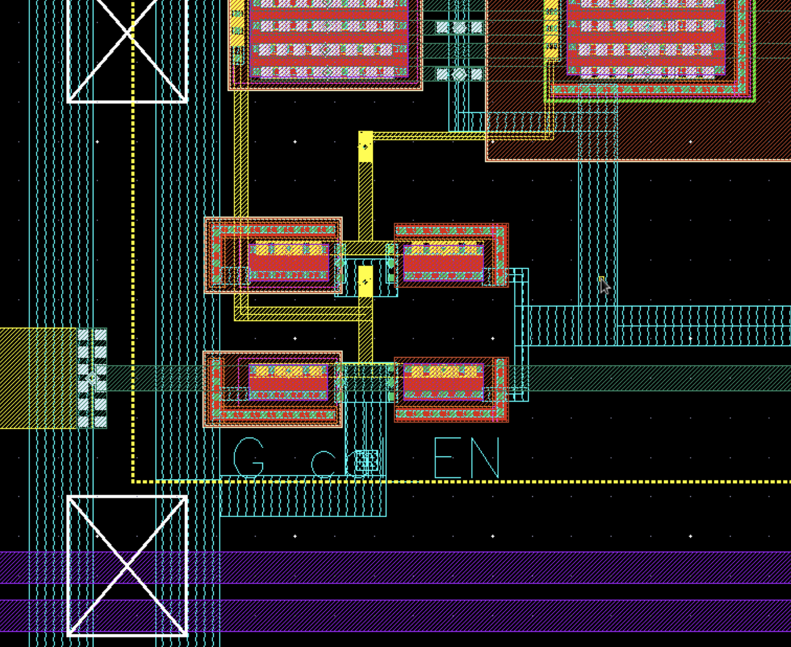
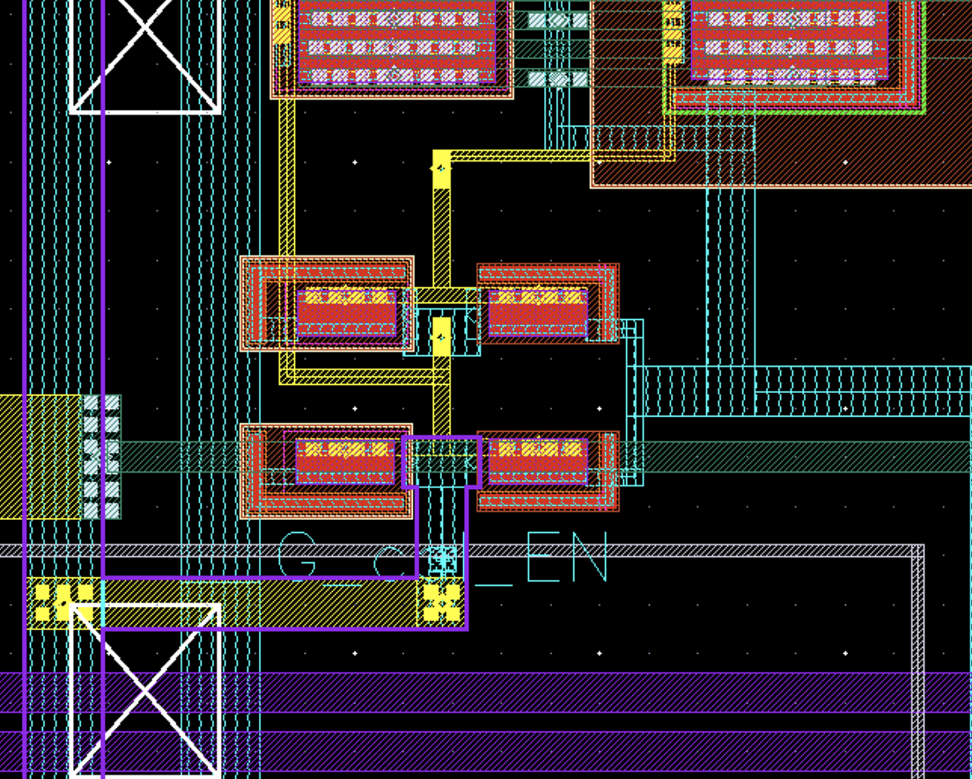
Layout solution
FAST1
FAST2
GND
VDD
GND
VDD
EN1
EN1
EN1 connected to VDD
EN1 connected to GND

Slide 40
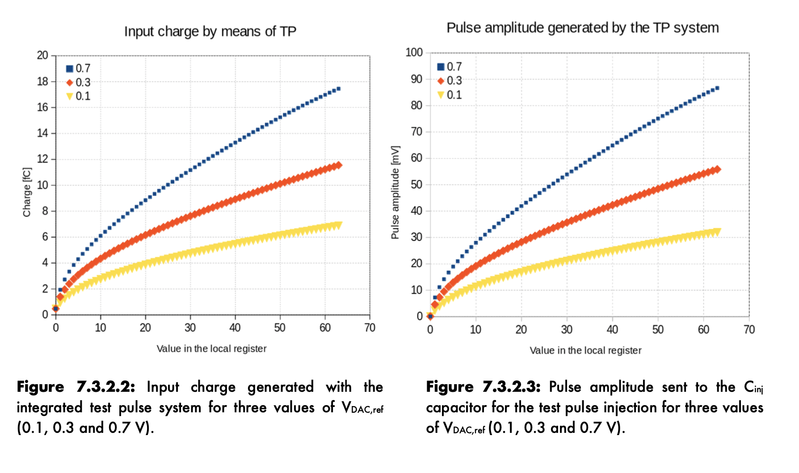
Internal Test Pulse

Slide 41
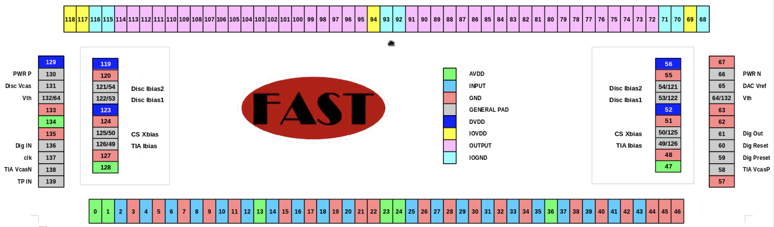
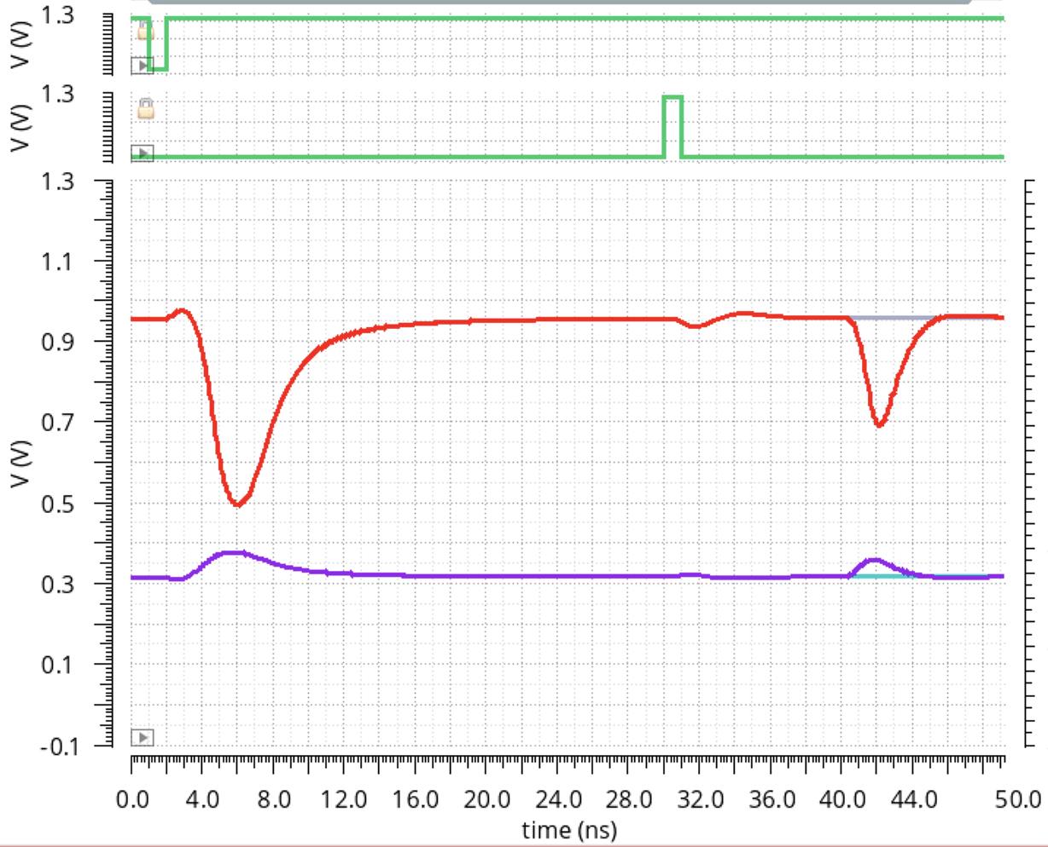
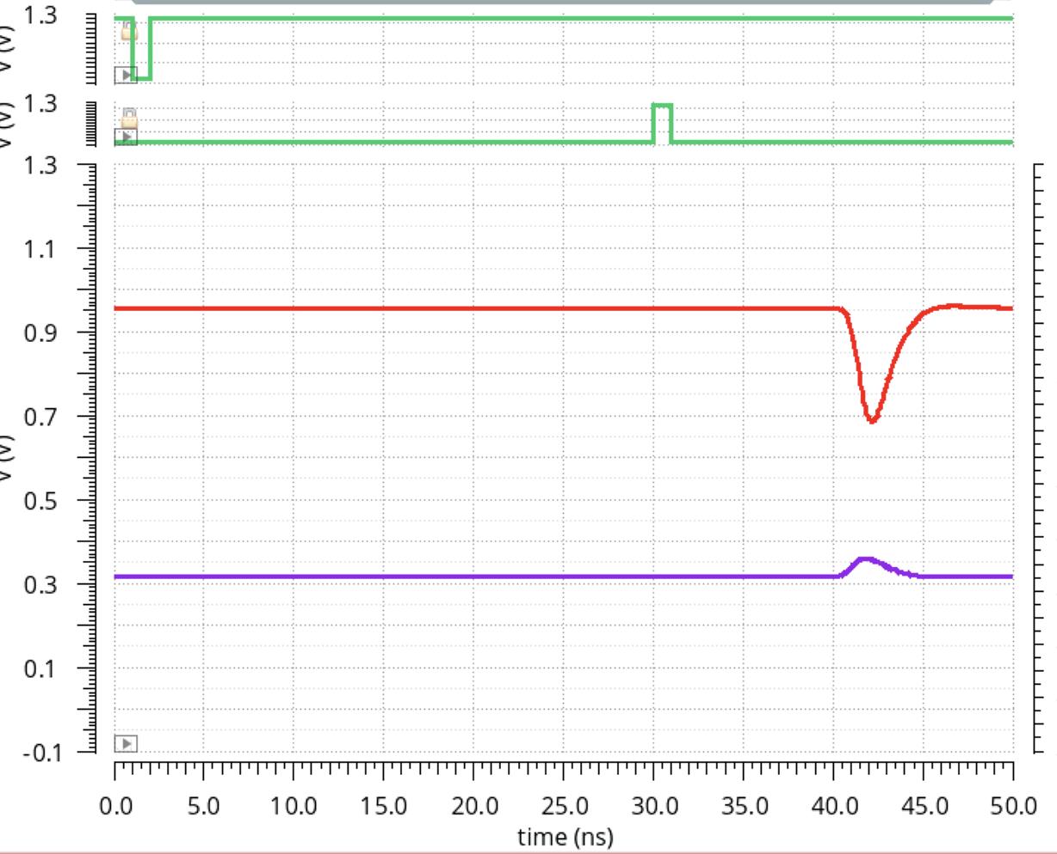
Internal Test Pulse
Keep into account that the register which sets the pulse amplitude can be reset by using the «reset signal» (PAD 60) which controls all the register chain of FAST2.
Be careful during this opereation becase the reset inject charge in the channels which looks like a signal. To avoid this one can used the EN register which mask the undesired pulse injection
Drive link
EN=0 (TP active)
EN=1.2 (TP disable)
reset
reset
Trigger TP
Trigger TP
CS out
CS out
TIA out
TIA out
Ghost signal
Valid signal

Slide 42
Things to do to use FAST2
Mount a resistor of 1.8k ohm in parallel to C20. This resistor is required to convert the bias from «current» to «voltage».

Slide 45
Solution for the TIA Ibias
The new bias allows a linear regulation up to 1.5 mA but at the moment, simulations do not prove that it behaves better than FAST1. More in general, we have to simulate jitter in a different way because at the moment, it depends in several factors like Fmax, stoptime, number of transistors, probes in the schematic.
Would be nice to identify the best way to simulate jitter with EDA tools.
Here a reference that we can use to proceed in this direction

Slide 46
Possible layout improvements
FE and Disc can be placed closed. I should estimate the parasitic capacitance and evalute what we can get with this improvement
Mismatch in the disc stage 2. Input trans are really small

